Slide 1
Using Fault Kinematics To Evaluate The Relationship Between Cenozoic Fault Activity, Sedimentation Rates and Salt Movement In The Gulf of Mexico: A Comparison Between Southwest and Southeast Louisiana
Abah P. Omale¹
Juan M. Lorenzo¹
¹ Department of Geology& Geophysics
Louisiana State University, Baton Rouge, LA 70803
12/13/2015

Slide 2
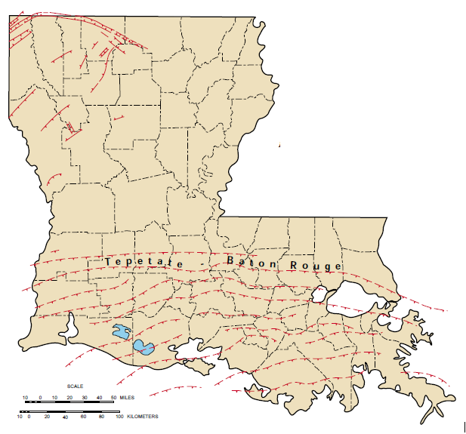
Gulf of Mexico fault systems across south Louisiana
Introduction
2
3
McCulloh, 2001

Slide 3
Models for fault reactivation
Introduction
‘Salt displacement model’ (Vendeville, 2005)
  Differential loading
  Gravity spreading
‘Lithospheric flexure model’ (Nunn, 1985)

Slide 4
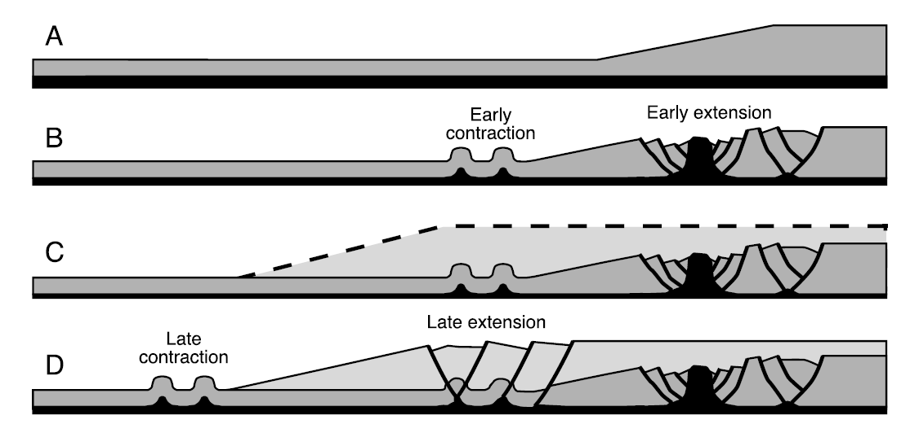
Salt displacement model
Introduction
Vendeville, 2005

Slide 5
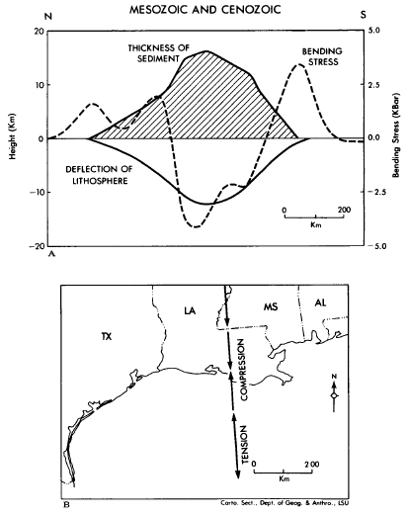
Lithospheric flexure model
Introduction
Nunn, 1985

Slide 6
Summary of fault reactivation models
Introduction
Sediment loading induces fault initiation and reactivation via salt displacement or lithospheric flexure

Slide 7
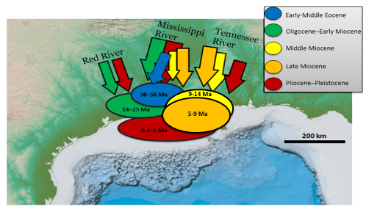
Cenozoic locations of sediment depositional centers
Introduction
Modified from AlDhamen 2014; Galloway et al., 2011; Combellas-Biggot & Galloway, 2006; Galloway, 2000; Woodbury 1973

Slide 8
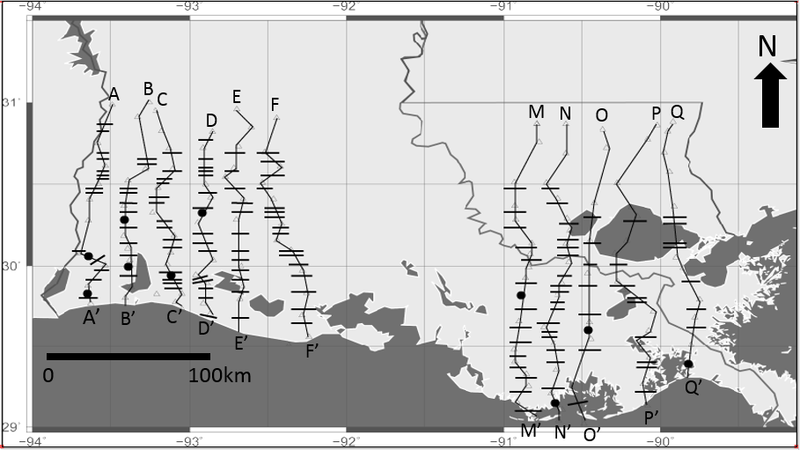
Data and Methods
Methods
Modified from Bebout and Gutierrez, 1982; 1983

Slide 9
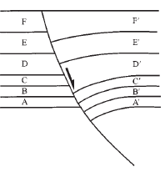
Fault data from kinematic analysis
Methods
D’
C’
B’
A’
T
F’
E’
Z
Cumulative throw (T)
Depth (Z)
Cartwright et al., 1998

Slide 10
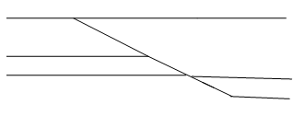
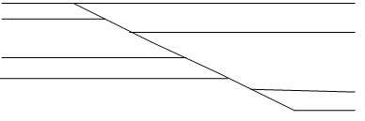
Fault data from kinematic analysis
Methods
1
B
B’
A
T_{B}
A’
2
C
C’
T_{C}
B
A
B’
T_{B}
A’
Incremental throw (∆T)= T_{B} (2) - T_{c}
Slip rates

Slide 11
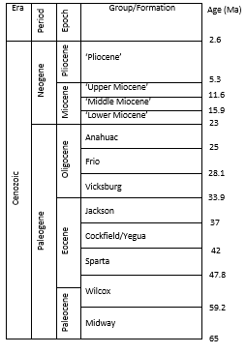
Correlated units
Methods
Bebout and Gutierrez, 1983; Hackley, 2012

Slide 13
Fault 2;cross section Q-Q’
Results & Discussion

Slide 14
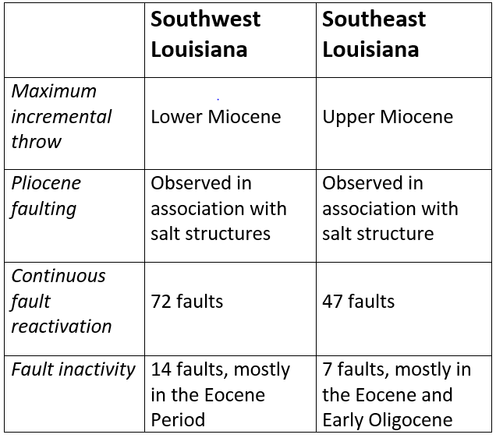
Summary of Results
Results & Discussion

Slide 15
Cenozoic locations of sediment depositional centers
Results & Discussion
Modified from AlDhamen 2014; Galloway et al., 2011; Combellas-Biggot & Galloway, 2006; Galloway, 2000; Woodbury 1973

Slide 16
Regional cross sections
Results & Discussion
Modified from Bebout and Gutierrez, 1982; 1983

Slide 17
Incremental throw vs. time for cross section A-A’ (southwest Louisiana)
Results & Discussion

Slide 18
Regional cross sections
Results & Discussion
Modified from Bebout and Gutierrez, 1982; 1983

Slide 19
Incremental throw vs. time for cross section C-C’ (southwest Louisiana)
Results & Discussion

Slide 20
Regional cross sections
Results & Discussion
Modified from Bebout and Gutierrez, 1982; 1983

Slide 21
Incremental throw vs. time for cross section F-F’ (southwest Louisiana)
Results & Discussion

Slide 22
Cenozoic locations of sediment depositional centers
Results & Discussion
Modified from AlDhamen 2014; Galloway et al., 2011; Combellas-Biggot & Galloway, 2006; Galloway, 2000; Woodbury 1973

Slide 23
Regional cross sections
Results & Discussion
Modified from Bebout and Gutierrez, 1982; 1983

Slide 24
Incremental throw vs. time for cross section N-N’ (southeast Louisiana)
Results & Discussion
500m
0

Slide 25
Regional cross sections
Results & Discussion
Modified from Bebout and Gutierrez, 1982; 1983

Slide 26
Incremental throw vs. time for cross section P-P’ (southeast Louisiana)
Results & Discussion

Slide 27
Average slip rates
Results & Discussion

Slide 28
Average slip rates
Results & Discussion

Slide 29
Average slip rates
Results & Discussion

Slide 30
Average slip rates
Results & Discussion
Southwest Louisiana

Slide 31
Average slip rates
Results & Discussion

Slide 32
Average slip rates
Results & Discussion

Slide 33
Average slip rates
Results & Discussion

Slide 34
Average slip rates
Results & Discussion

Slide 35
Salt tectonics model
Results & Discussion
Penetrating salt structures

Slide 36
Salt tectonics model
Results & Discussion

Slide 37
Lithospheric flexure model
Results & Discussion
Faulting on the periphery of the depositional center

Slide 38
Cenozoic locations of sediment depositional centers
Results & Discussion
Modified from AlDhamen 2014; Galloway et al., 2011; Combellas-Biggot & Galloway, 2006; Galloway, 2000; Woodbury 1973

Slide 39
Conclusions
Conclusions
Faults have been reactivated throughout the Cenozoic in south Louisiana
The timing and location of major fault reactivation correlates with the sediment depositional center by showing a similar shift from west to east in the Cenozoic
The timing of fault activity correlates with the timing of salt movement suggesting salt displacement via differential loading or gravity spreading

Slide 40

Acknowledgements
Drilling Info Inc.
Geographix

Slide 41
THANK YOU

Slide 42
Using Fault Kinematics To Evaluate The Relationship Between Cenozoic Fault Activity, Sedimentation Rates and Salt Movement In The Gulf of Mexico: A Comparison Between Southwest and Southeast Louisiana
Abah P. Omale¹
Juan M. Lorenzo¹
¹ Department of Geology& Geophysics
Louisiana State University, Baton Rouge, LA 70803

