Slide 1
Association of
Levee
Boards of
Louisiana
COL Michael Clancy
New Orleans District
U.S. Army Corps of Engineers
Dec. 8, 2016

Slide 2
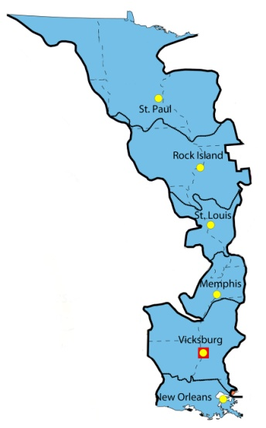
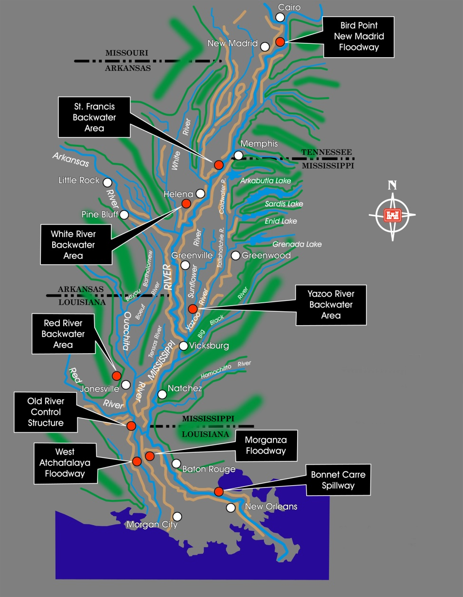
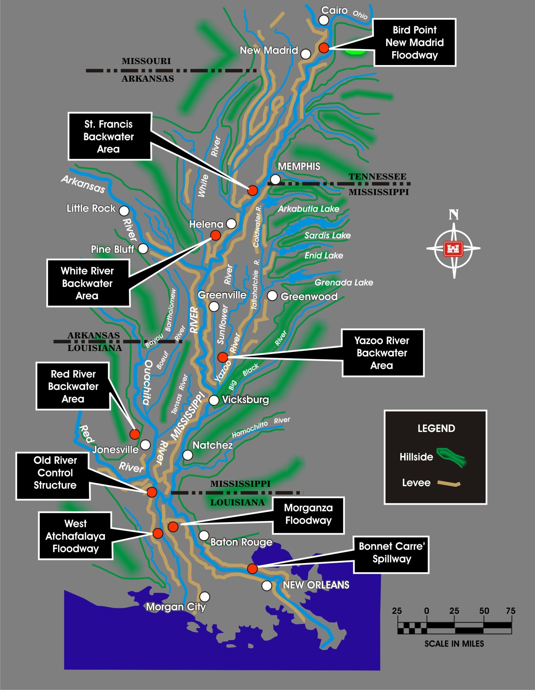
Mississippi River & Tributaries
New Orleans District Overview
Notes:
$14 B invested in the entire MR&T since 1928 preventing $612 B in damages (44:1 return on investment)
Provides risk reduction for:
2.3 million Louisiana residents that reside within the floodplain.
Industry and urban centers in Louisiana that include New Orleans, Baton Rouge and Morgan City.
The greatest concentration of oil refineries, natural gas processing plants, and petrochemical production facilities in the western hemisphere.
There are a total of 3,787 miles of authorized MR&T levee and floodwall;
~2,216 miles of levee are along the main stem MS & Atch Rivers; the remaining levees are backwater, tributary, and floodway levees.
During 2011 Flood, MR&T project passed largest MS River flood in recorded history and prevented over $230 B in damages
3/4ths, approx. $173 B, of these prevented damages were in Louisiana alone
Uncompleted features located in both the Atchafalaya and Mississippi River require extensive flood fighting to safely pass the project flood.
Based on latest cost estimates, several billion dollars of work remains; extended completion schedule further increases costs and risk.
Funding levels continue to decline and available funds must address both construction and O&M.

Slide 3
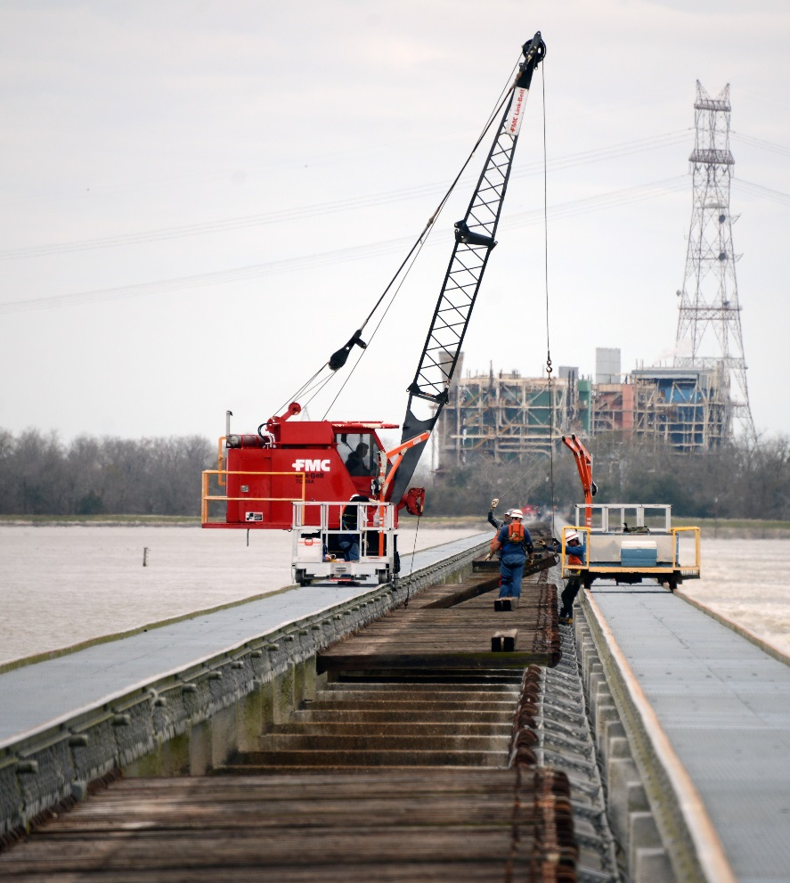
2016 Winter Flood
Post-2011 Reset and Restore Work that paid off in this flood
Approx. $24 billion in damages avoided in 2016, keeping pace with the 45 to 1 cost benefit ratio
Earliest operation of Bonnet Carré Spillway, 11th operation
Notes:
MR&T
600 hotspots in 2011 only 287 hotspots in 2016
Resources are required for this project to continue to perform as designed
Highlights
Earliest operation of Bonnet Carré Spillway, 11th operation
210 bays open at Bonnet Carré passing a max flow of 203,000 cfs
Ready to operate Morganza but conditions were not met
Partnership
Worked closely with federal, state and local partners before, during and after the flood
Could not have passed the flood without support from local levee boards heling with daily inspections and enforcement

Slide 4
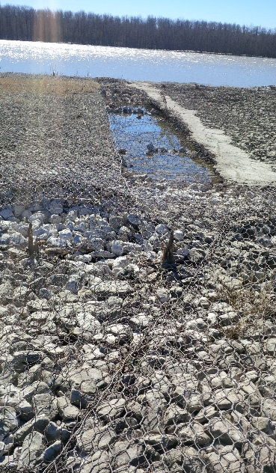
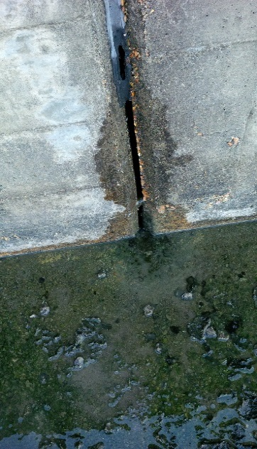
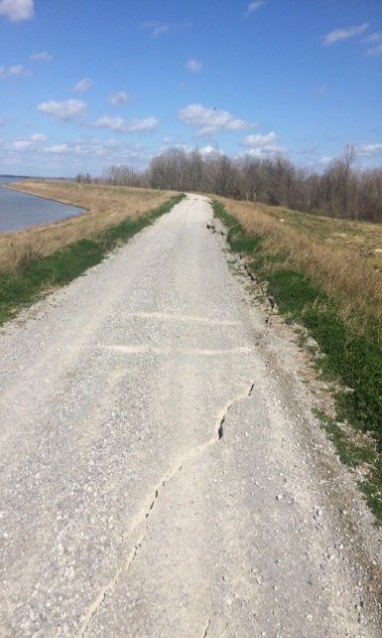
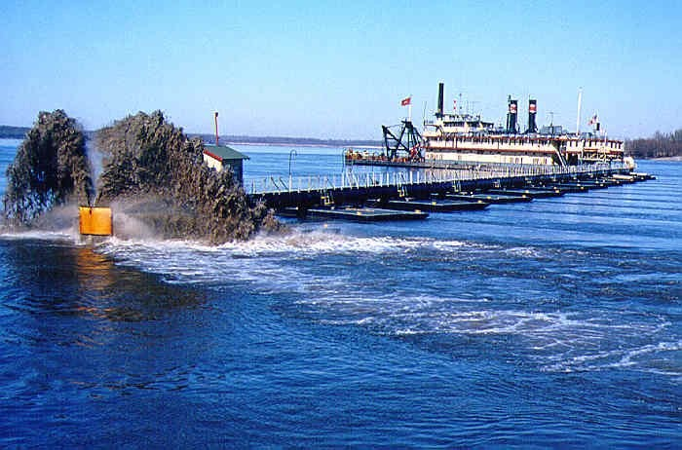
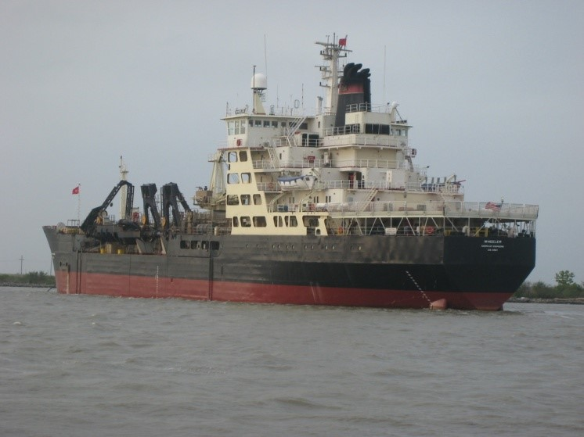
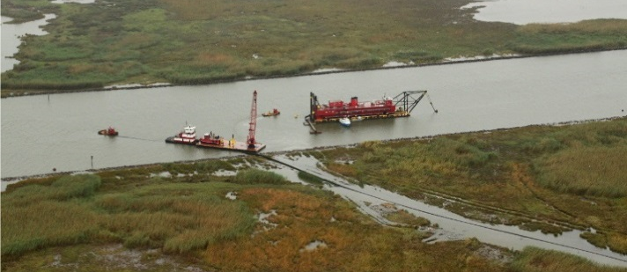
2016 Winter Flood
Levees
Channel Improvements
Seepage in PLD
Sand Boil in Batchelor, LA
Levee Slide in Atch Basin
Erosion at Carr Point
Bank Failure along MS River
Structures
Dredging
Crossings at Baton Rouge
Old River Gabion Field Damage
Morganza Control Structure Seepage
Morganza Guide Levee Slide
Southwest Pass Dredging
Venice Dredging
Notes:
Levees: Sandboil in Batchelor, LA. Seepage in Pontchartrain Levee District, Levee Slide in Atch Basin
CI: Erosion at Carr Point. Bank Failure along the banks of the MS river

Slide 5
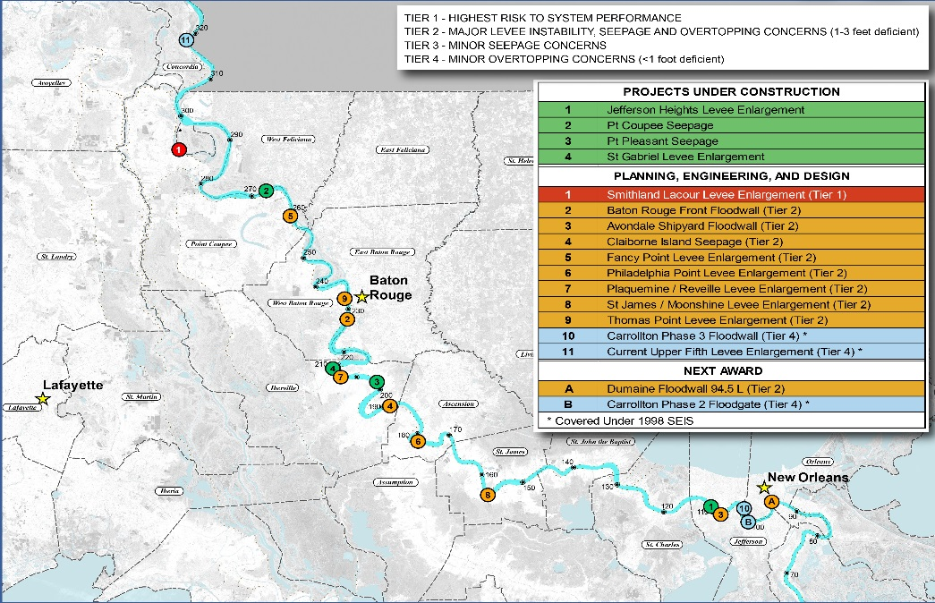
Mississippi River Levees
A total of 83 items require work with an estimated cost of $1,046M
Construction Contract Awards: Carrollton Phase II Floodgate and Carr Point
Significant challenge to complete the project with the current funding stream
Notes:
79 levee enlargement items spanning 194 miles; System 63% complete within MVN: 1 – Tier I item – Smithland to Lacour and 9 – Tier II items reaches (1-3 foot deficiency)
Per MVD guidance memo dated 02 Jul 15, reaches not covered under the 1998 EIS are not eligible for budget consideration
Exceptions can be made through a waiver request if a reach is declared an imminent threat to life and safety or for items identified as a categorical exclusion

Slide 6
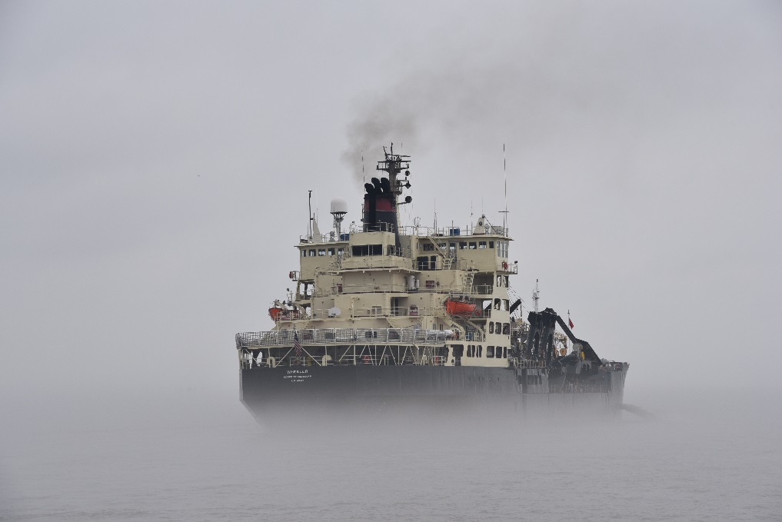
Flowline
A multi-year Flowline Study is underway to determine a range of options for the MR&T system to pass the Project Design Flood
Several MRC briefs are scheduled throughout the remainder of the study which is expected to be completed in December 2017
Notes:
The Mississippi River Project Design Flood was last updated following the 1973 Revised Flowline Study.
The study team is comprised of members from all Districts within the Mississippi Valley Division as well as members from the National Weather Service.
Updated parameters and hydrologic analyses for current and future conditions will be used to develop an updated flowline.
Change in the flowline may mean changes to water control manual for Morganza, Old River and the Bonnet Carre Spillway.

Slide 7
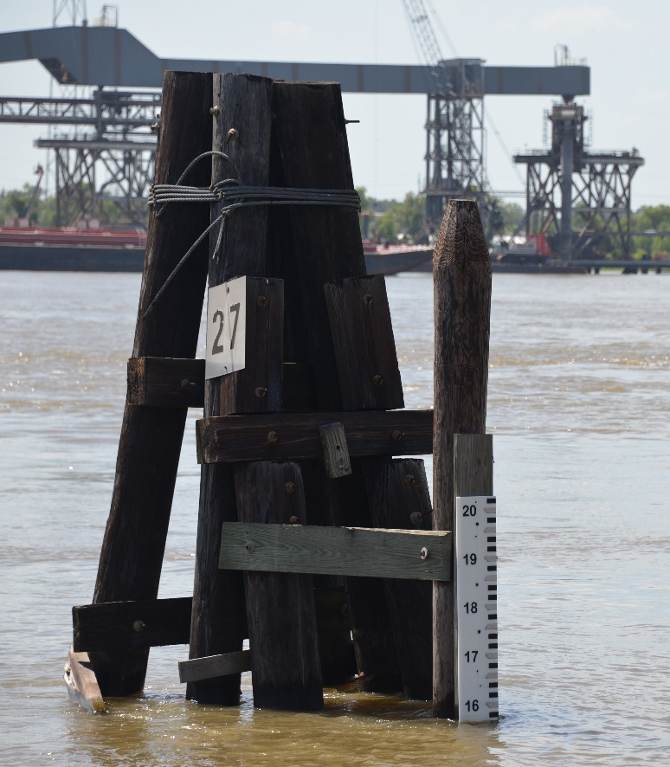
Levee Safety
Work together with state and local levee districts to communicate risk
Focus on the communication of risks, benefits and the importance of flood risk management actions, not LSAC
The Levee Safety Action Classification is neither a grade or rating. It is a measure for categorizing, comparing and monitoring our Nation’s levee systems
Notes:
No levee system eliminates all risk. Even the best levees can be overtopped by extreme events.
Reducing risk is a shared responsibility between the federal, state, and local governments as well as the general public. Structural measures should be considered as only one feature in the multiple lines approach to reducing risk. Other measures include elevation of structures, flood proofing, flood insurance and evacuation.
Through risk communication USACE seeks to provide needed flood risk information, understand the needs and values of impacted communities, and work with all stakeholders to develop levee system specific management actions to reduce flood risk.

Slide 8
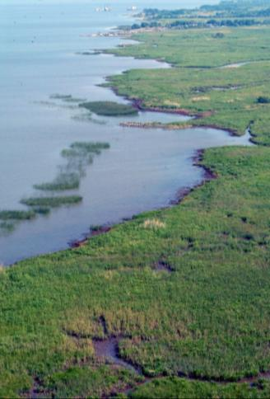
408 Permission
Procedural Review Plan in place to reduce processing time
Interim Guidance Update – approval authority delegated from HQUSACE to MVD
MVN preparing Categorical Permission
Simplified EA process
Notes:
Procedural Review Plan covers majority of routine permission requests. Result: reduced processing time → skips step of preparing individual review plan, including obtaining required approvals
Interim Guidance Update was issued by HQUSACE effective 10 Nov 16. Now only requests that go to HQUSACE: (1) involve hydropower, (2) change how authorized purpose is met, (3) negatively impact ongoing USACE study, or (4) involve navigation alterations where USACE would assume O&M responsibility; all others approved at MVN or MVD unless District Commander has reason to elevate the decision level
Categorical Permission is being prepared. The result is expected to be streamlining of review process for individual requests that fit within the definition of the Categorical Permission.
Simplified EA process has been developed to help reduce overall processing time
Information on 408 permits and feedback available on our website mvn.usace.army.mil

Slide 9
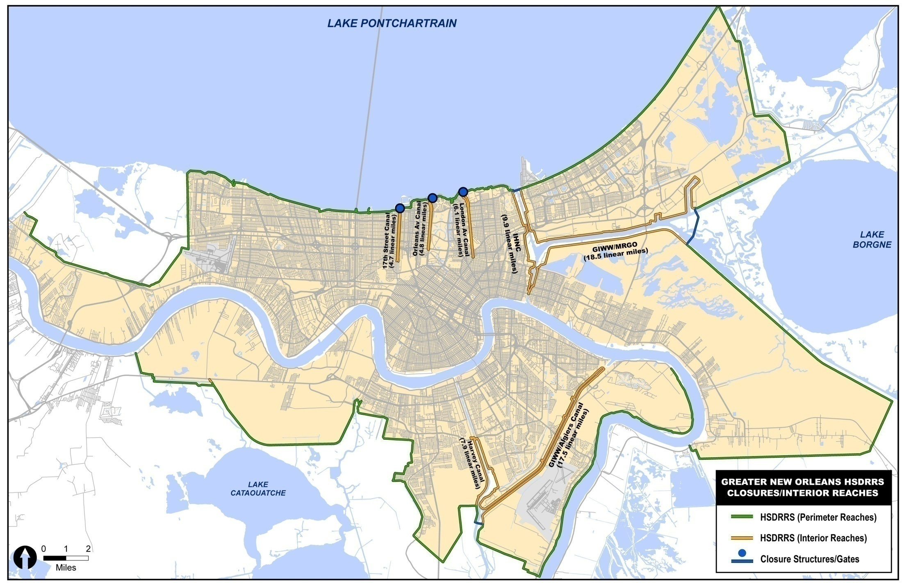
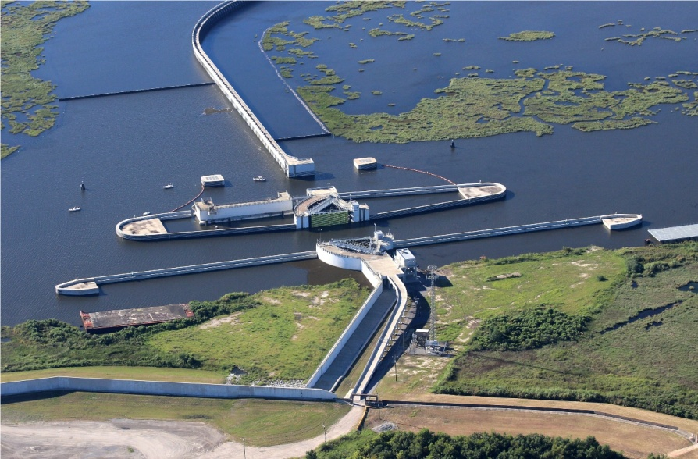
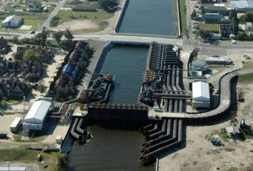
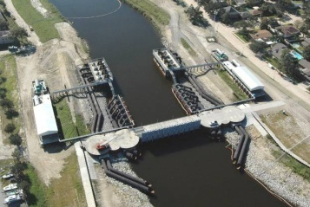
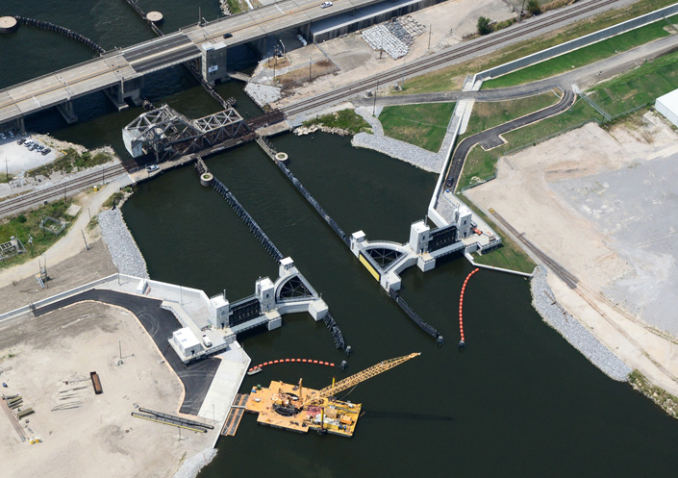
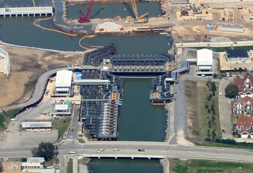
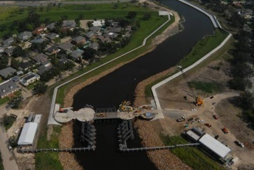
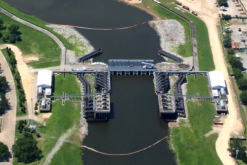
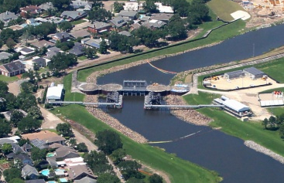

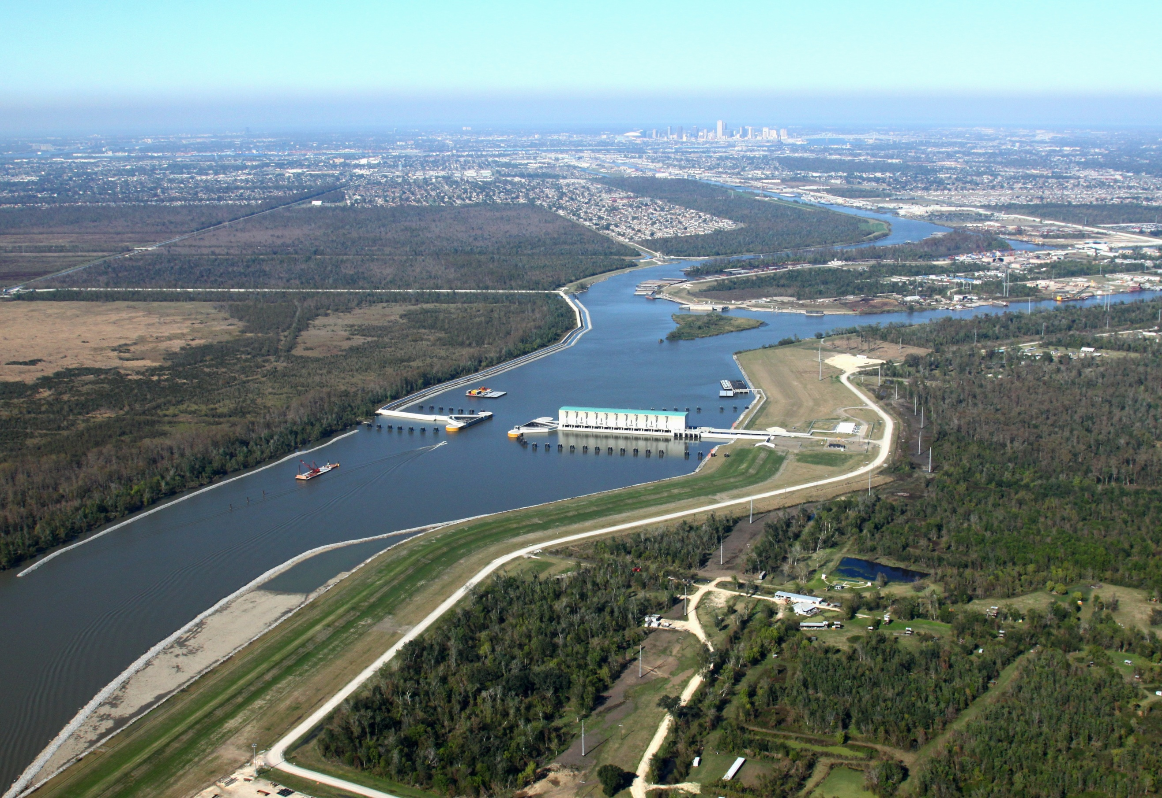
A Stronger System Than Ever Before
17th St.
Orleans
London
Seabrook
IHNC Surge Barrier
Developed new HSDRRS hydraulic, geotechnical and structural design criteria.
Floodwalls and hardened structures built for 2057 hydraulic conditions
Pre-Katrina system: 200 miles
Post-Katrina 100-yr system: 130 miles
→35% shorter perimeter exposed to surge
West Closure Complex
Notes:
The $14.6 billion HSDRRS provides a stronger level of protection than the system that was previously in place. It is capable of defending against a 100–year level of storm surge.
Under HSDRRS, the Corps has strengthened the levees, floodwalls, gated structures and pump stations that form the 133–mile Greater New Orleans perimeter system, as well as improved approximately 70 miles of interior risk reduction structures.
Among its technically-advanced engineering solutions, the HSDRRS now includes the world’s largest surge barrier of its kind, the IHNC-Lake Borgne Surge Barrier, and the largest drainage pump station in the world, the GIWW-West Closure Complex.

Slide 10
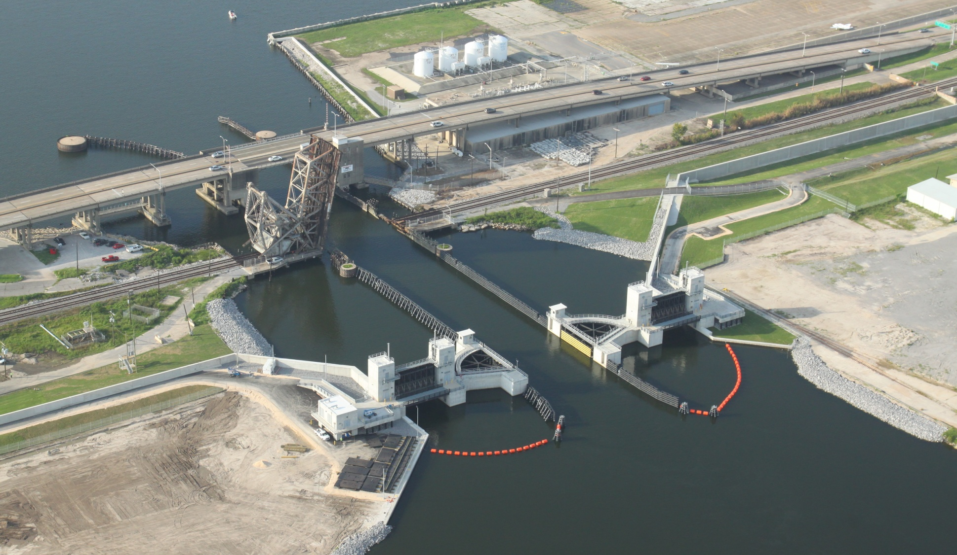
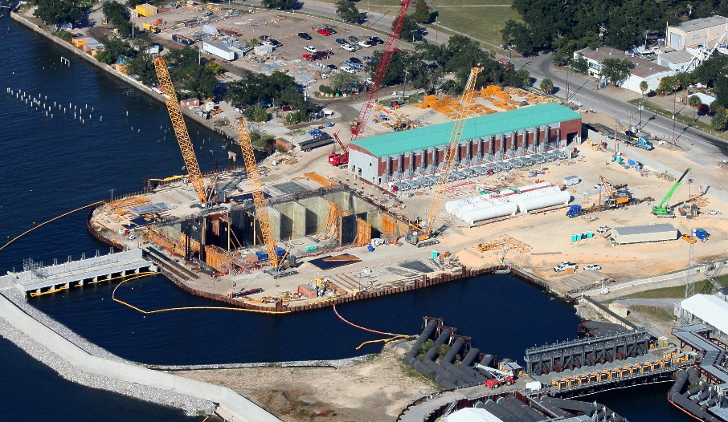
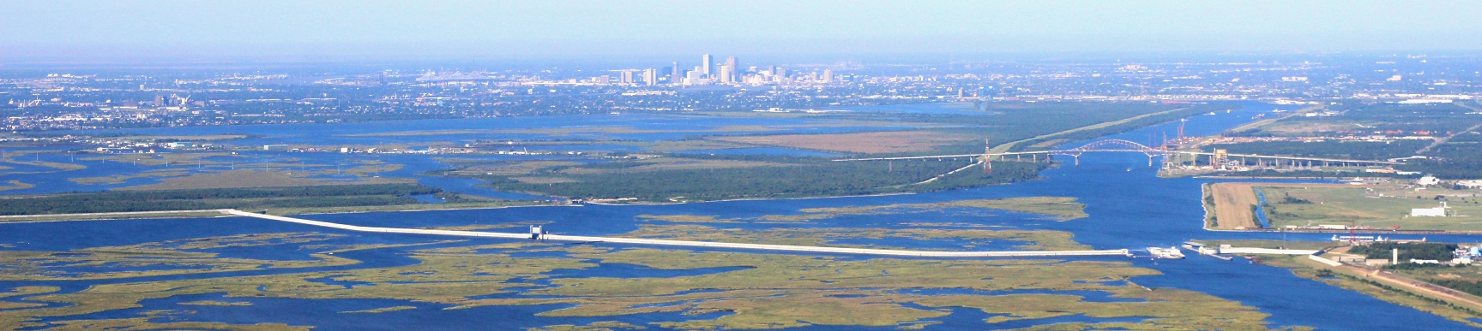
HSDRRS Major Structures
~$200 M
Completed June 2012
Seabrook Gate Complex
West Closure Complex
Completed Dec 2012
~$1 B
17th St. Canal PCCP
Est. Complete 2017
~$850 M
Lake Borgne Surge Barrier
Completed Dec 2012
~$1.3 B
Notes:
Achieving 100-year level of defense at the Inner Harbor Navigation Canal Surge Barrier Project, USACE’s largest-ever design-build civil works construction contract and one of the largest surge barriers in the world (nearly two miles).

Slide 11
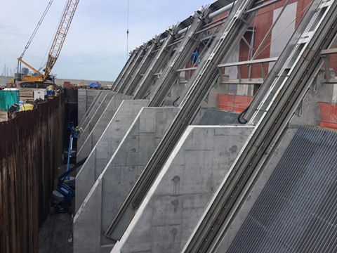
PCCP
Design is 97% complete and construction is 90% complete
The contract completion date for all three PCCP projects is late November 2017
When fully operational, the three pump stations combined will be able to pump 24,300 cfs
Notes:
Last large project of the HSDRRS
The PCCP will be composed of permanent gated storm surge barriers and brick façade pump stations at or near the lakefront. The pumps will move rainwater out of the canals,
around the gates and into Lake Pontchartrain during a tropical weather event, and be equipped with a stand-alone emergency power supply capacity so that it can operate independently of any publically provided utility.
When complete, the PCCP at 17th Street will consist of six 1,800 cubic feet per second (cfs) pumps and two 900 cfs pumps and have a total pumping capacity of 12,600 cfs; the PCCP at Orleans Avenue will consist of three 900 cfs pumps and have a total pumping capacity of 2,700 cfs; the PCCP at London Avenue will consist of four 1,800 cfs pumps and two 900 cfs pumps and have a total pumping capacity of 9,000 cfs.

Slide 12
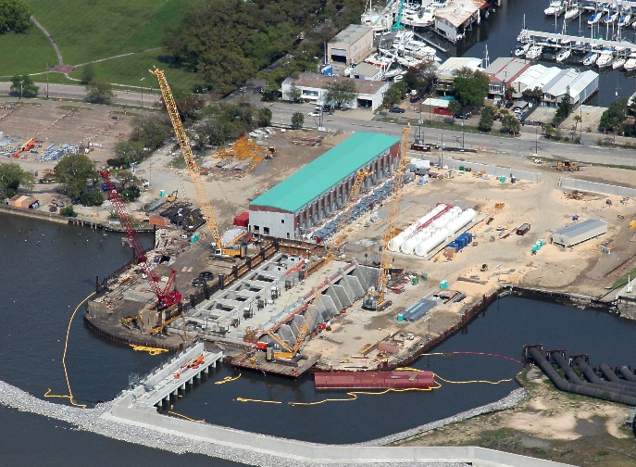
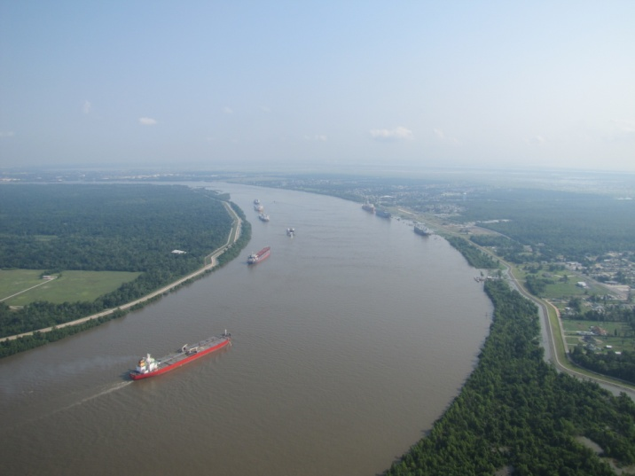
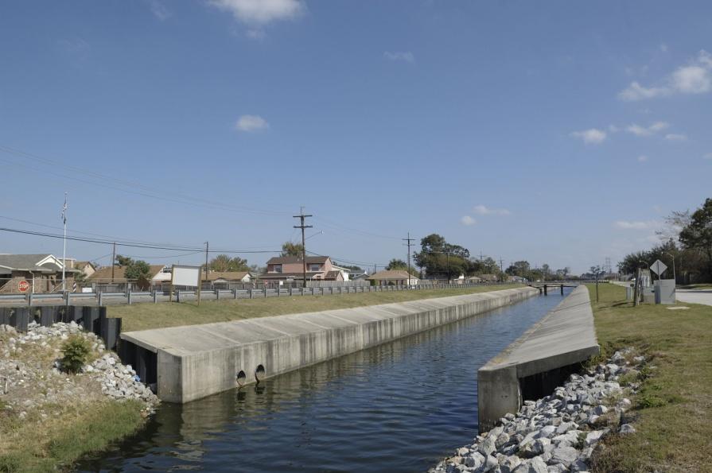
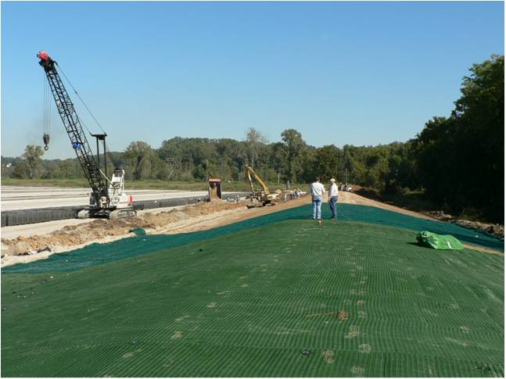
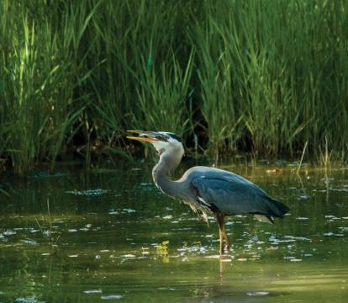
HSDRRS Remaining Work
$1.38 B
$850 M
$313 M
~$1.4 B
~$552 M unobligated
Permanent
Pump Stations
Mississippi River / HSDRRS Co-located Levees
SELA Interior Drainage
$414 M
$325 M
Armoring
Environmental Mitigation
Notes:
We were fully funded at the start of HSDRRS. Which allowed us to build great things like the West Closure Complex and the Surge Barrier. This slide shows the remaining aspects of HSDRRS that is not yet finished.
We also have projects in the works, like Southwest Coastal and Westshore Lake Pontchartrain, which are authorized but not funded.
Like to recognize our local partners for taking initiative and not waiting on federal funding

Slide 13
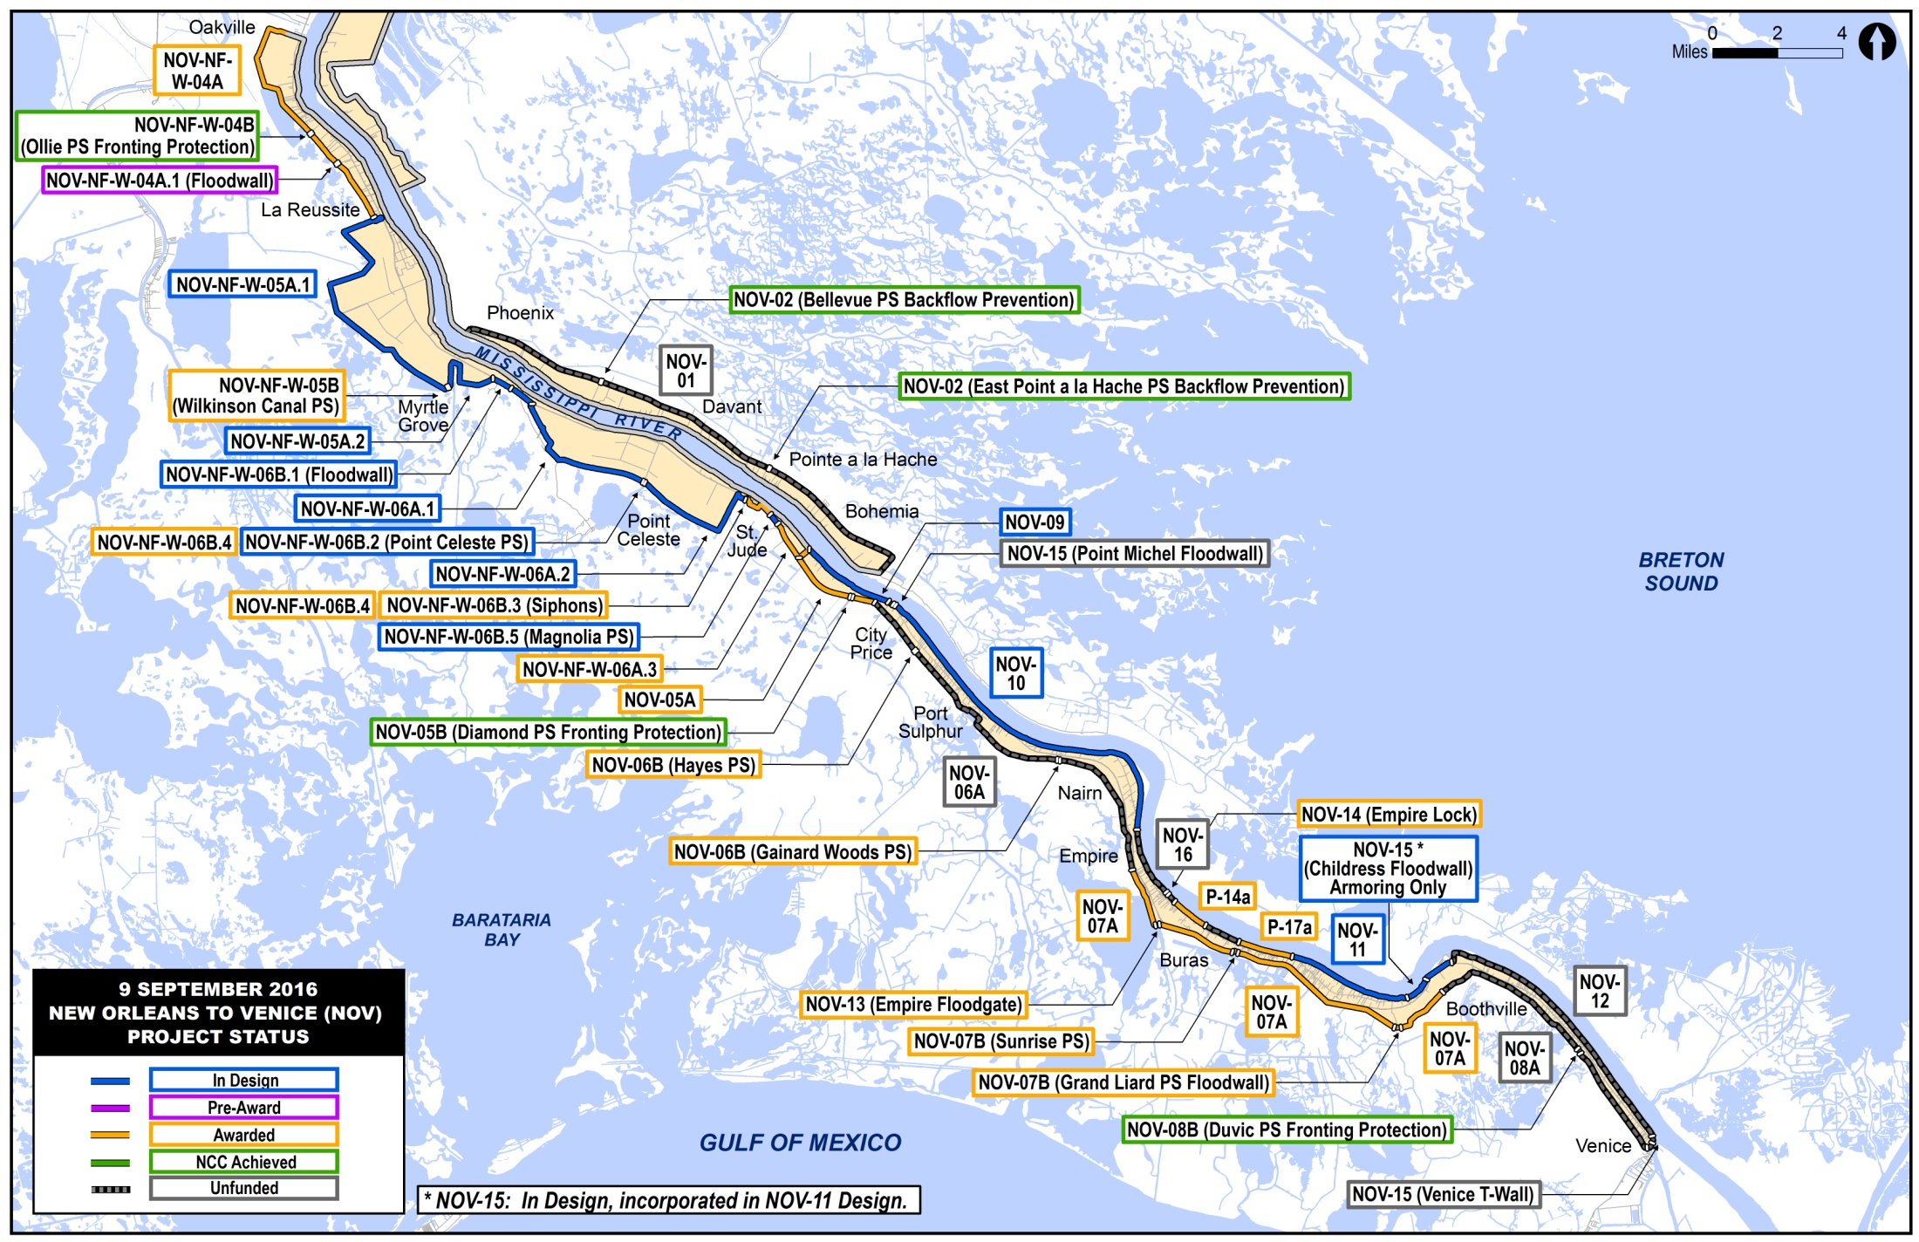
NOV/NFL
Notes:
Limited funding to complete the NOV/NFL project features.
ROW acquisition of approximately 800 properties.
Mitigation planning and implementation of mitigation measures.
Co-Located Challenges
Sustaining risk reduction during high river events and hurricane season while constructing floodwalls and levees along the MRL.
Providing access for the contractor and to flood side businesses during construction.
Utility relocations - Relocations of key Plaquemines Parish utilities.

Slide 14
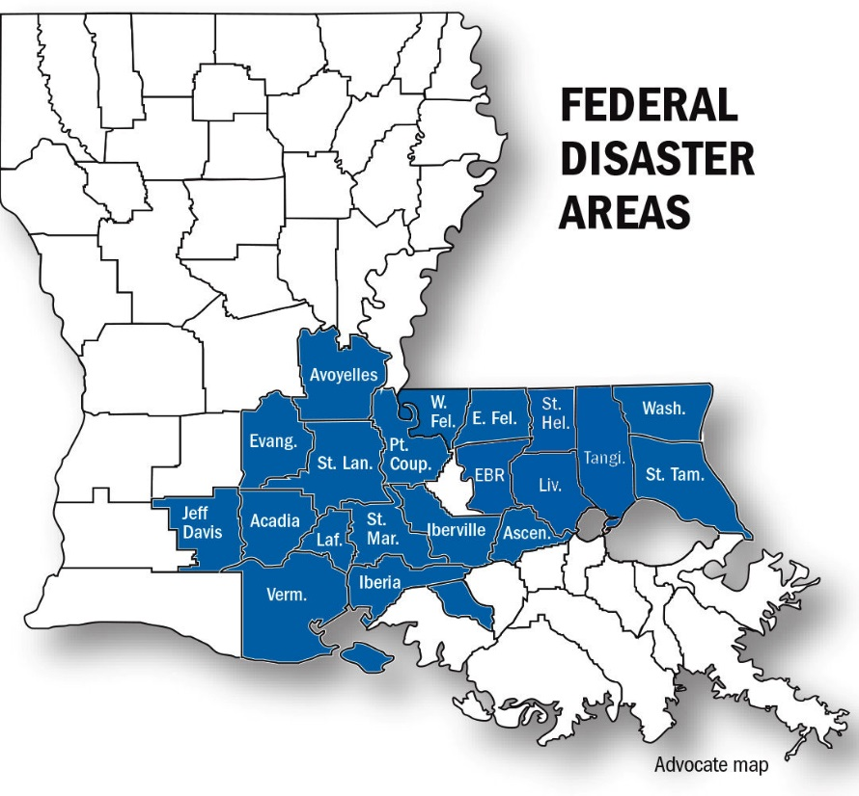
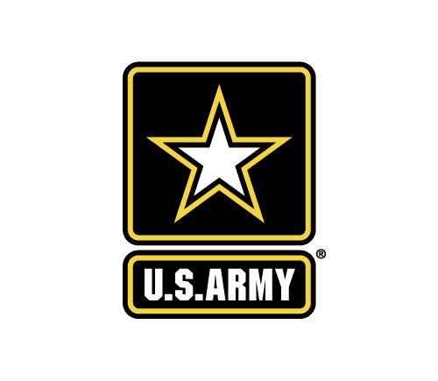

2016 Louisiana Summer Flood
Continue to support MVM as necessary for recovery efforts from August severe Weather Event
MVN Employees currently onsite Total: 16
QA inspectors for Housing Mission
Project Managers
Notes:
This event impacted over 1,700,000 residents and 950,000 structures throughout the state.
Worked closely with state and local parishes to provide assistance
FEMA took the lead at the federal level with support from the Corps of Engineers
New Orleans District provided:
1 LA P.E. to review and stamp permitting actions
Mission Specialist
Technical Monitors
Project Managers
Administrative Support
2 personnel supporting IS-RSF FEMA recovery mission
The Great Flood of 2016, highlighted the importance and need to initiate a comprehensive evaluation of the watershed west & east of the Mississippi River.

Slide 15
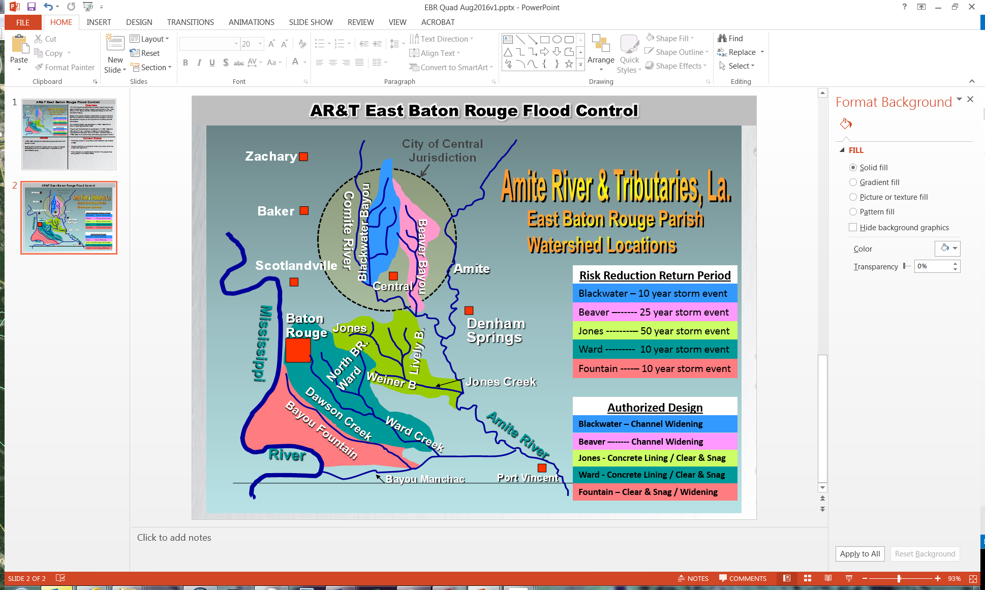
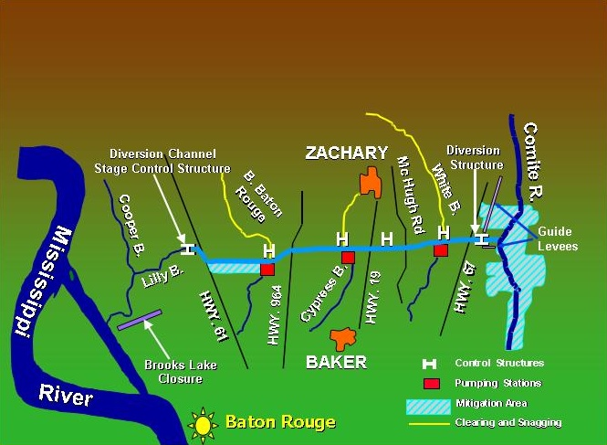
Future Operations
East Baton Rouge Flood Control
Comprehensive studies East & West of Mississippi River
Southwest Costal
Westshore Lake Pontchartrain
Comite River Diversion
Notes:
The FRM project was authorized to reduce flooding along 5 sub-basins throughout the parish including Jones Creek & Trib., Ward Creek & Trib., Bayou Fountain, Blackwater Bayou & main Trib., and Beaver Bayou. Scope of the project includes a combination of improvements to 66 miles of channels in 5 sub-basins in East Baton Rouge Parish, including clearing and snagging, widening, and concrete lining as well as improvements to existing culverts and bridges to reduce headwater flooding and backwater overflow in the Amite River Basin.
The Great Flood of 2016, highlighted the importance and need to initiate a comprehensive evaluation of the watershed west of the Mississippi River. Watershed study will identify feasible flood risk reduction alternatives that may be implement at the local, state, or federal level. Analysis of the causes and impacts of the flood will assist local governments in managing flood risk to residents, property, commercial industries, major evacuation routes, railroad corridors & several assets critical to the region and nation’s energy production
The Southwest Coastal Louisiana project proposed by the U.S. Army Corps of Engineers will provide non-structural hurricane and storm surge damage risk reduction measures, as well as ecosystem restoration features, in the 4,700 square mile study area located in Calcasieu, Cameron, and Vermilion Parishes in southwest Louisiana.
Westshore Lake Pontchartrain project would provide hurricane and storm surge risk reduction on the east-bank of the Mississippi River in St. Charles, St. John the Baptist, and St. James Parishes to nearly 18,000 residential, commercial and industrial structures as well as the I-10 hurricane evacuation corridor through both structural and non-structural measures.
Comite
$125M is needed to fully fund federal portion of the project; if fully funded all construction contracts can be awarded within 2 years.
If Comite was in place during the 2016 floods it would have provided some minor relief to portions of the impacted area. 2016 event was well excess of a 100 year event
Continue to work closely with DOTD, ARBC, East Baton Rouge Parish to advance this effort.

Slide 16
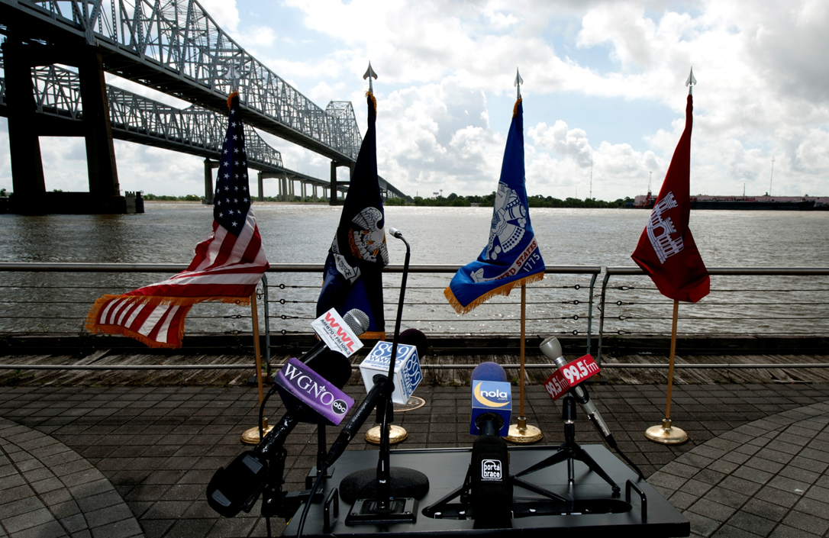
Discussion

Slide 17
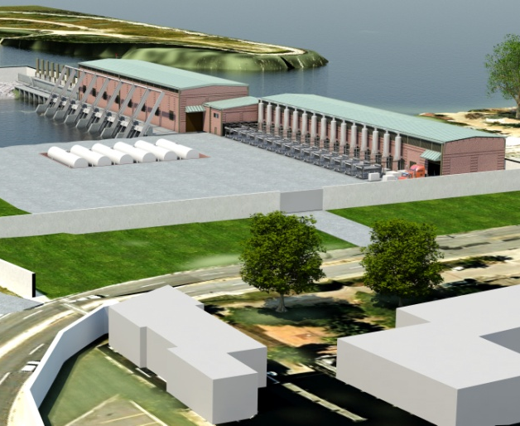
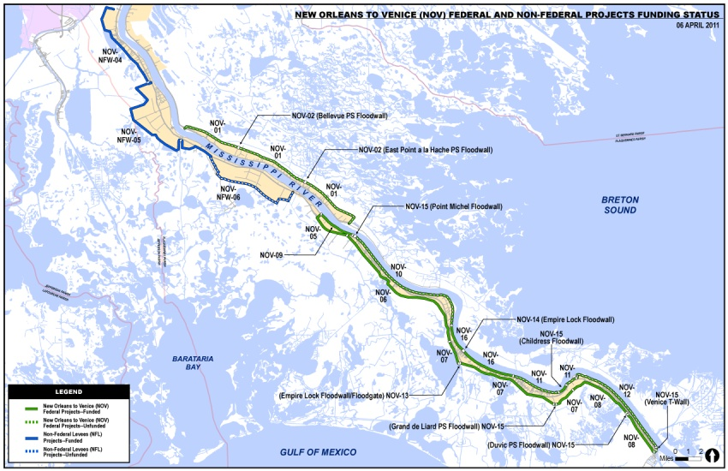
HSDRRS remaining work
SELA Interior Drainage
Permanent
Pump Stations
~$1.4 B
~$552 M unobligated
$380 M
~$140 M unobligated
Mississippi River / HSDRRS Co-located Levees
$157 Million
$74 Million
$21 Million
Armoring
Environmental Mitigation
New Orleans to Venice / Non-Federal Levees
$264 Million
$245 Million
$605 Million
Notes:
NOV/NFL Challenges
1. Limited funding to complete the NOV/NFL project features.
2. ROW acquisition of approximately 800 properties.
Mitigation planning and implementation of mitigation measures.
Co-Located Challenges
1. Sustaining risk reduction during high river events and hurricane season while constructing floodwalls and levees along the MRL.
2. Providing access for the contractor and to flood side businesses during construction.
3. Utility relocations - Relocations of key Plaquemines Parish utilities.

Slide 18
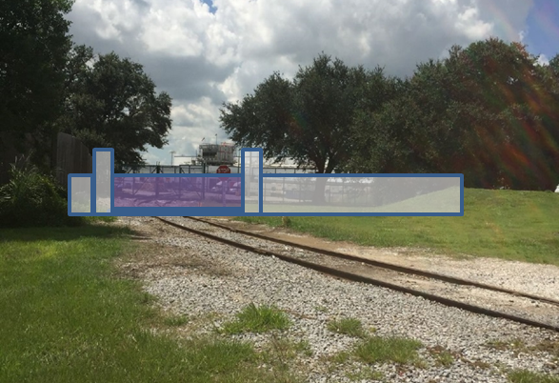
Audubon Floodgate
Construction of the MRL-C project is 89% complete with 83 items remaining
The Carrollton Phase I Levee Enlargement was completed in September 2015
The Carrollton Phase II Flood Gate was awarded in September 2016 and is scheduled for completion in September 2017
Notes:
The Mississippi River Levees Construction Project (MRL-C) is a subset of the overarching Mississippi River and Tributaries (MR&T) Project, authorized by the Flood Control Act of May 15, 1928. The goal of the MRL-C project is to manage flood risk along the Mississippi River by conveying the Project Design Flood flows through the Mississippi Valley to the Gulf of Mexico.
Project Summary
The portion of the MRL-C project in the New Orleans Districts area of responsibility is located in southeast Louisiana along the Mississippi River and includes the Old River, Morganza, and Bonnet Carre Control Structures. The Mississippi River Levee system in the New Orleans District extends along the River’s west bank from the vicinity of Black Hawk, LA, generally southward to the vicinity of Venice, LA and on the east bank from Baton Rouge, LA to Bohemia, LA.
The project features reduce the risk associated with riverine flooding by raising and strengthening existing levees to provide protection against a project flood having a flow of 3,030,000 cubic feet per second passing the Old River Complex. Without corrective actions to address the identified deficient levee reaches the system will not operate in accordance with the project design, introducing significant risk to the 1.9M residences behind the existing levees.
Project Features
The MRL-C Project consists of construction of levee enlargements, floodwalls, seepage berms, relief wells, slope paving, and other features as necessary.
Examples of these features include the Carrollton Phase I Levee Enlargement consisting of a 1-3 foot lift of approximately 2 miles of existing levee and the Carrollton Phase II Flood Gate consisting of a 65 foot flood wall and 20 foot swing gate.
Project Status
Construction of the MRL-C project is 89% complete with 83 items remaining. The Carrollton Phase I Levee Enlargement was completed in September 2015. The Carrollton Phase II Flood Gate was awarded in September 2016 and is scheduled for completion in September 2017.

Slide 19
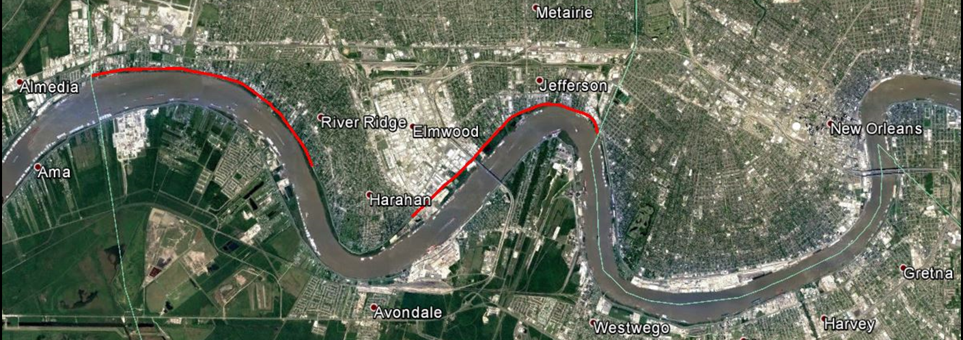
Jefferson Heights
The project is substantially complete and the final inspection will occur in early 2017
Work consisted of raising 9 miles of the levee, on the east bank of Jefferson Parish, to the congressionally authorized elevation
Notes:
This project is part of the Mississippi River and Tributaries project designed to provide flood damage risk
The Army Corps has worked closely with its partners at the East Jefferson Levee District throughout construction.

Slide 20
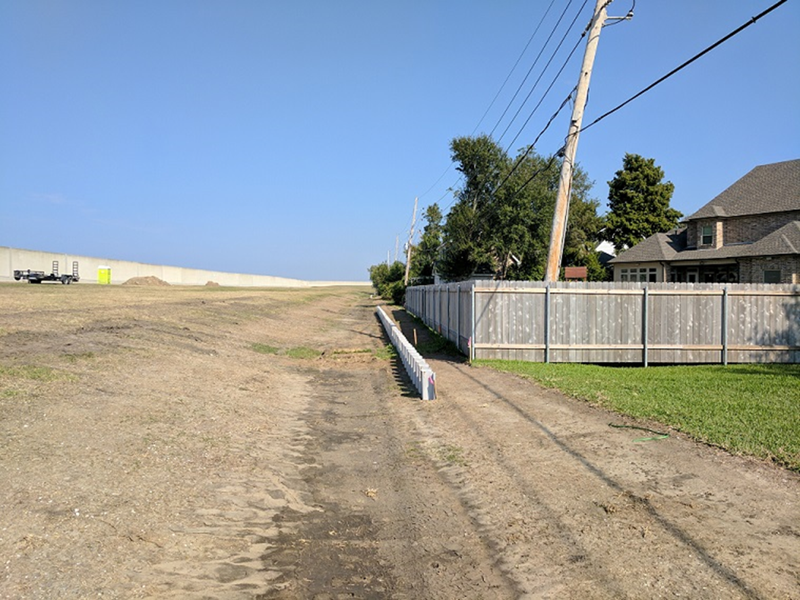
West Return Floodwall
Approximately 40% more area drains east after construction of the new floodwall in May of 2012
Additional storage capacity was required to safely contain runoff from short but intense rain events
Notes:
Performance of the system during high intensity short duration rainfall events over the past 2-3 years that approximated or exceeded the 10 year design event was not acceptable. The work being undertaken now is intended to further reduce risk to nearby residences from these types of storms.
An existing landside runoff system along the lakefront levees in East Jefferson Parish has been successfully collecting rainfall from the levee for many years.
The West Return Floodwall landside runoff system is of a similar design and initial work was completed 8/25/2014
Additional storage capacity was required to safely contain runoff from short but intense rain events.
Scheduled for completion in January 2017.

Slide 21
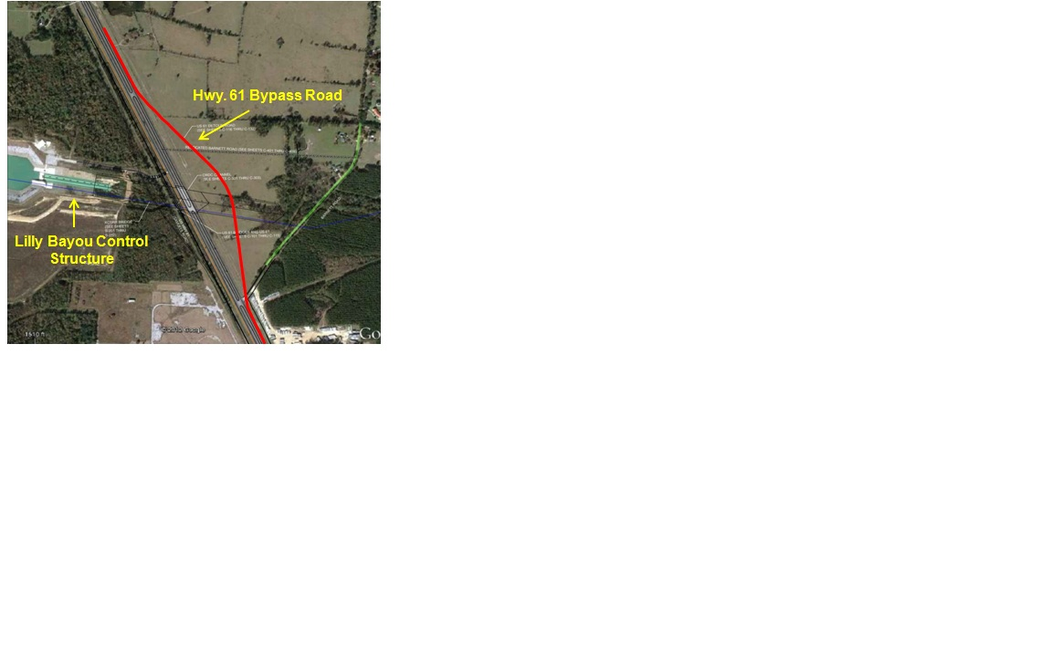
Comite River Diversion
Received $12M in FY15 Work Plan.
  Awarded $8.2M Mitigation contract in May 2015
  Awarded $1.9M Hwy. 61 Bypass Road construction
Awarded $1.9M Hwy. 61 Bypass Road construction.
  Substantially Completed in July 2016
Notes:
Completed all “backlog” mitigation. Current on mitigation requirements
Positioned to advance future construction
Challenges:
Consistent funding stream required to advance project construction efforts.
Federal allocations over last 2 years have allowed CRITICAL mitigation acquisition but not allowed any substantial construction
Complex, costly and time consuming relocation efforts (Estimated at $40) must be completed by DOTD as NFS. DOTD non-comital on this action.
Current BCR is 1.37 which is less than the 2.5 threshold for current administration budgeting
Project was authorized at 75/25 which is often pointed to by NFS/stakeholders as another reason the project’s lack of inclusion in the President’s Budget.

