Slide 1
Conservation servitudes December 2, 2015

Slide 3
Acreage Summary
Marsh Type
 | Brackish | Intermediate | Open Water | Total
Inside Existing Wildlife Management Area | 30.90 | 0.00 | 10.20 | 41.10
Outside Existing Wildlife Management Area | 9.90 | 15.90 | 1.70 | 27.50
Total | 40.80 | 15.90 | 11.90 | 68.60

Slide 5
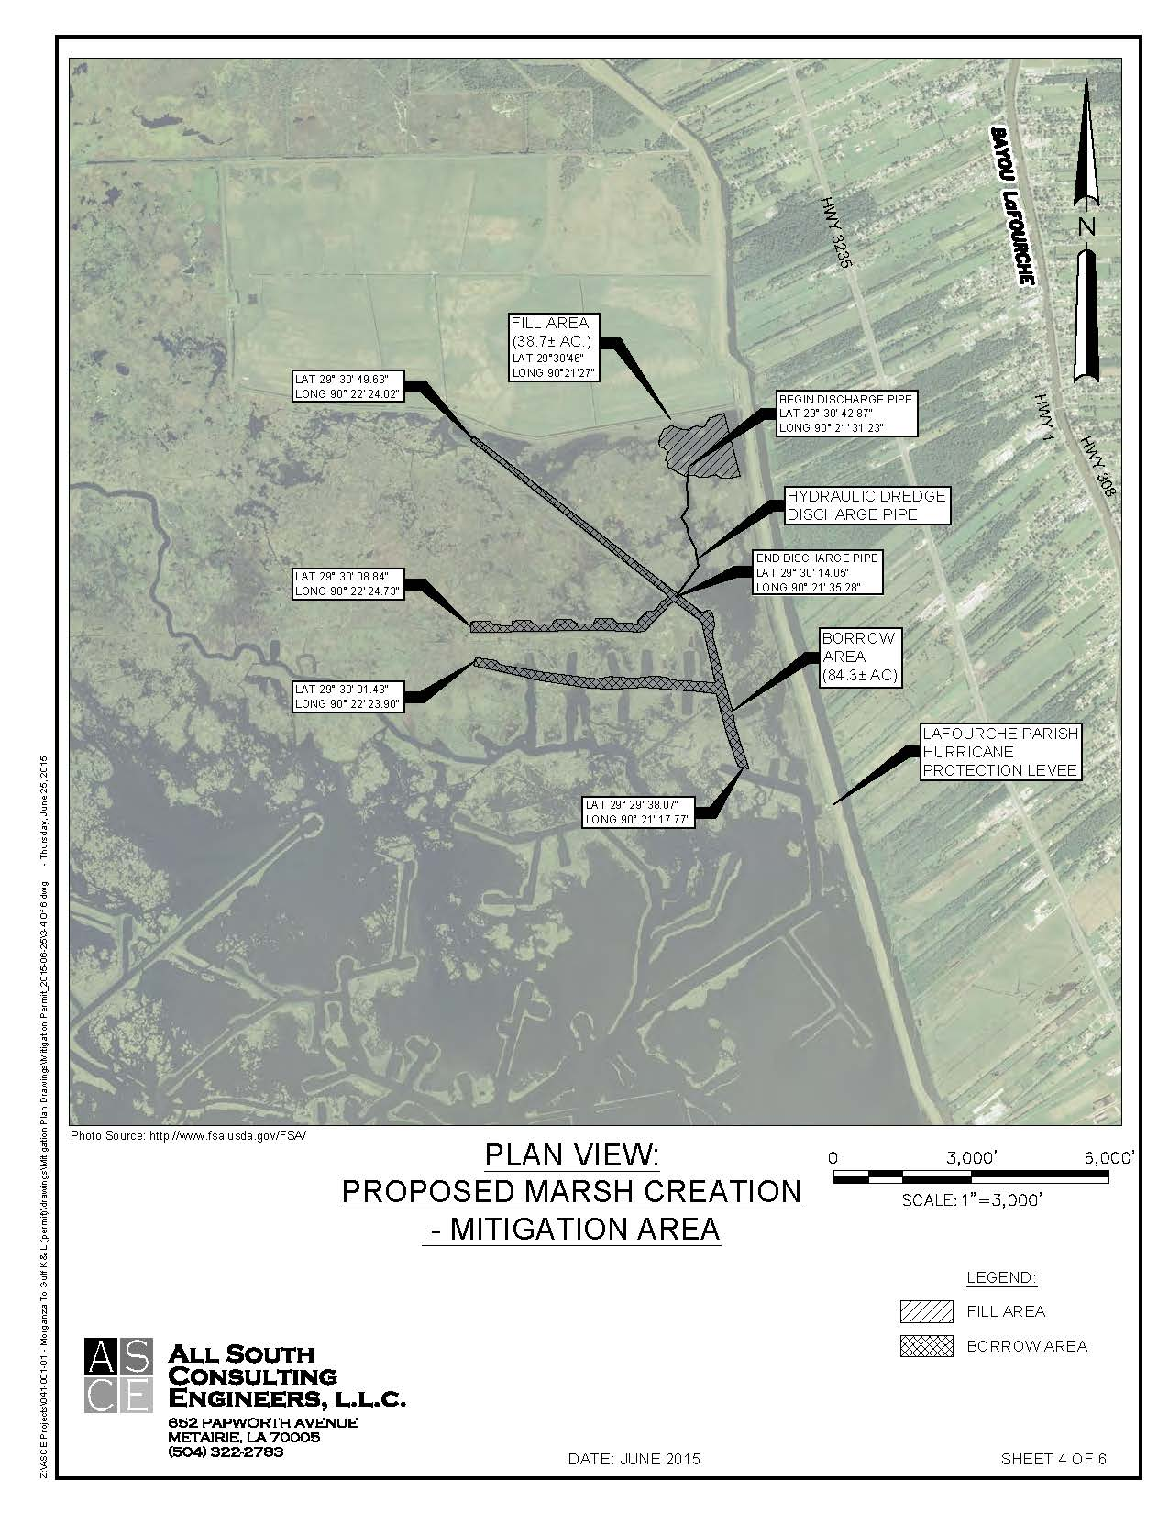

Slide 6
Landowners

Slide 7
Mitigation Terms
The Permittee shall conduct and submit elevation surveys (at points along the 200 foot grid) covering that respective area one (1) year following completion of placement of fill to the Louisiana Department of Natural Resources, Office of Coastal Management, PO Box 44487, Baton Rouge, LA 70804-4487.
The Permittee is made aware that if the mitigation plan does not result in the projected level of marsh creation, the permittee shall implement remedial measures necessary to ensure full compensation, or may be required to provide additional or alternative mitigation to compensate for any deficiency.
Permittee shall maintain the mitigation project for a minimum of 20 years.

Slide 8
Mitigation Servitude
This Agreement shall become effective when executed by GRANTOR and PERMITTEE, and shall remain in effect for a term of twenty (20) years from completion of the Mitigation Project if the project is constructed.

Slide 9
Relationships
Permit
Levee and
Mitigation ROW
Conservation Servitude

Slide 10
Conservation Servitude
This CONSERVATION SERVITUDE is binding in perpetuity on GRANTOR, its heirs and assigns, and all subsequent owners, purchasers, lessees, grantees, and licensees.

Slide 11
Landowner Perspective
Timeline
0 -20 years
20 – 100 Years
100 years and Beyond

Slide 12
What to do

Slide 14
Revised Conservation
Servitude Language
This Agreement shall remain in effect until such time as the mitigation project no longer provides the wetland values and functions as anticipated and called for in the mitigation plan, for a term of twenty (20) years from completion of the mitigation project if the project is constructed, or unless sooner released by HOLDER; upon such release, all rights of HOLDER hereunder shall automatically terminate. Should PERMITTEE fail to construct the mitigation project within a three (3) year period from the effective date, this Servitude shall extinguish and no further rights will be conveyed. Neither termination of this Agreement, nor any release by HOLDER of its rights hereunder, nor any reduction of the PROPERTY shall diminish or affect any of PERMITTEE’s obligations assumed to GRANTOR hereunder in the MITIGATION PERMIT.

Slide 15
Conservation servitudes December 2, 2015

