Slide 1
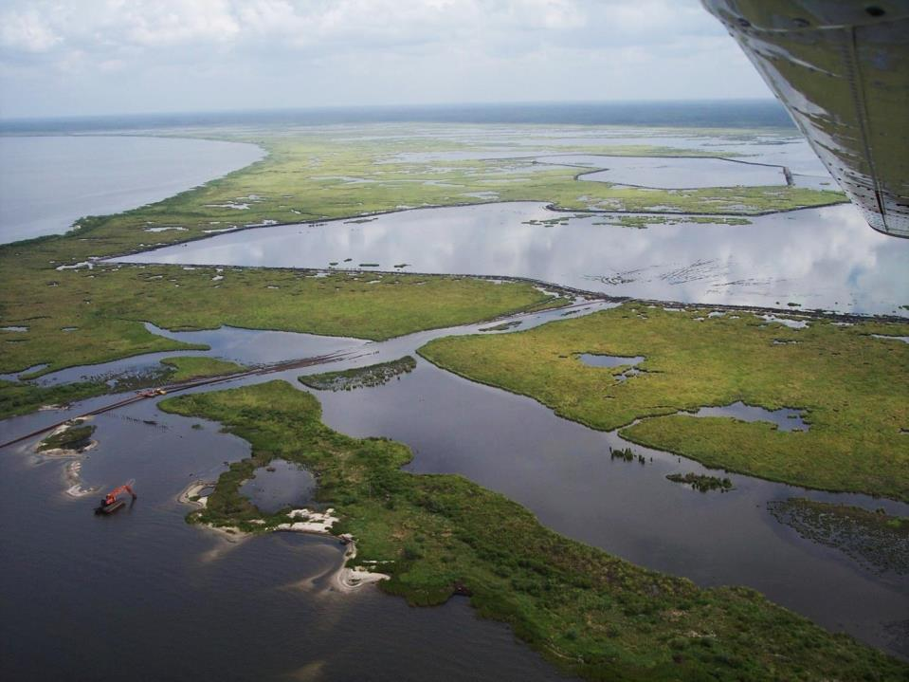
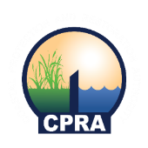

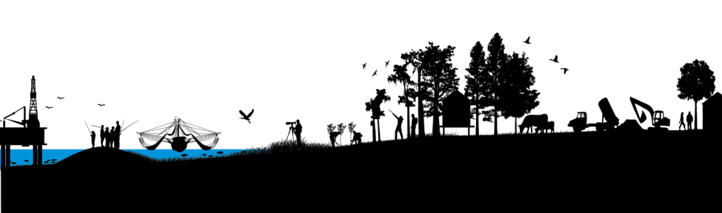
COASTAL PROTECTION
AND RESTORATION AUTHORITY
ALBL Annual Meeting
Johnny Bradberry
December 7, 2017
committed to our coast

Slide 2
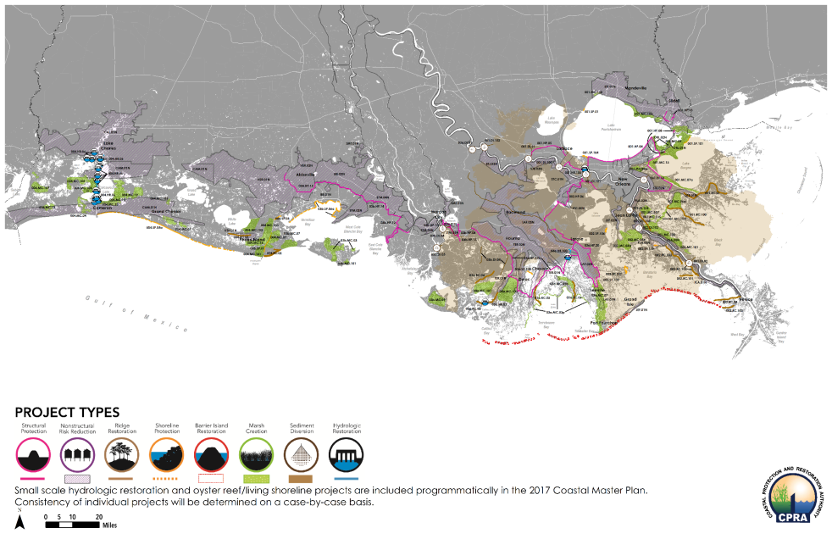
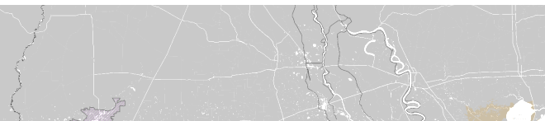
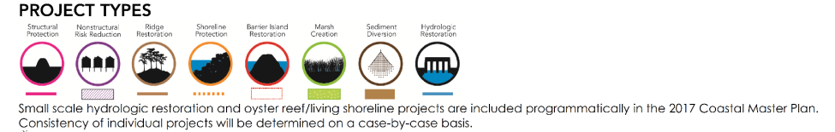

Our Plan
Project Types
124
PROJECTS
FLOOD DAMAGES REDUCED BY $150B
802
LAND CREATED
SQUARE
MILES OF

Slide 3
Annual Plan FY19
Timeline
  December 13 –Draft Annual Plan FY19 presented to Board
  Public Hearings - Open house at 5:30 pm; Meetings at 6:30 pm
    January 8 – Belle Chasse Auditorium
    January 9 – Houma Terrebonne Civic Center
    January 10 – Lake Charles Civic Center
    December 13-February 12 – Receive public comments
    February 21 – Final Annual Plan FY19 presented to Board
    March 14 – Final Annual Plan FY19 presented to Legislature

Slide 4


Our Projects
committed to our coast

Slide 5
Our Projects
Unprecedented Scope and Scale
Cornerstone Project | E&D | Construction | Total
Calcasieu Salinity Control Measures | $36.4 million | $263 million | $299 million
Increase Atchafalaya Flow to Terrebonne | $37 million | $431 million | $468 million
East Timbalier Island Restoration | $5.6 million | $160 million | $166 million
Houma Navigation Lock Complex | $34 million | $323 million | $357 million
Mid-Barataria Sediment Diversion | $127 million | $1.3 billion | $1.4 billion
Mid-Breton Sediment Diversion | $99 million | $660 million | $759 million
River Reintroduction into Maurepas Swamp | $14.2 million | $186 million | $200 million
Life of project TOTALS:
$353 Million
$3.3 Billion
$3.7 Billion

Slide 6
Our Projects
Notable Protection Projects - Federal and State Focus
Jean Lafitte Tidal Protection – $29.4M; Phase 1 is complete; Phase 2 is headed to bid as soon as January ’18. Construction will take about 18 months.
Rosethorne Tidal Protection – $22.9M; Work continues on land rights and E & D. Phase 1 is scheduled for advertisement in August ‘18.
Kraemer Bayou Boeuf Levee Lift – $1M; Approximately 15% complete; estimated completion in Feb. ‘18.
Falgout Canal Road Levee- $24.8M; Scheduled to complete by Jan’18.
St. Tammany Coastal Reconnaissance Study – $2M; Contract to be awarded in December, this month.
St. Mary Backwater Flooding - $10.4M; Phase 1, LA 70 improvements, construction began Oct. ‘17. and scheduled to complete July ‘18; Phase 2, pump station, RFQ has been issued.
Morgan City/St. Mary Parish Flood Protection - $11.1M; Construction of 2.5 miles of levee improvements scheduled to complete in January ‘18.
Violet Canal North Levee Alignment – $4M; Advertised for construction Nov. ‘17.
South Central Coastal Plan - $970 thousand; Draft report will be finalized in January ‘18.
Houma Navigation Canal - $366M; At 30% design; Final design by Spring ’19; to advertise for construction Summer ‘19.

Slide 7
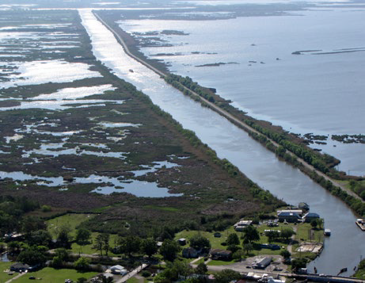
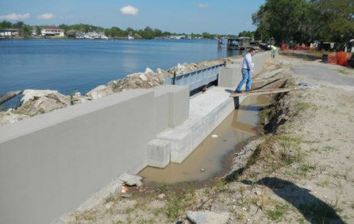
Our Projects
Falgout Canal Road Levee
Jean Lafitte Tidal Protection

Slide 8
Our Issues and Initiatives
committed to our coast

Slide 9
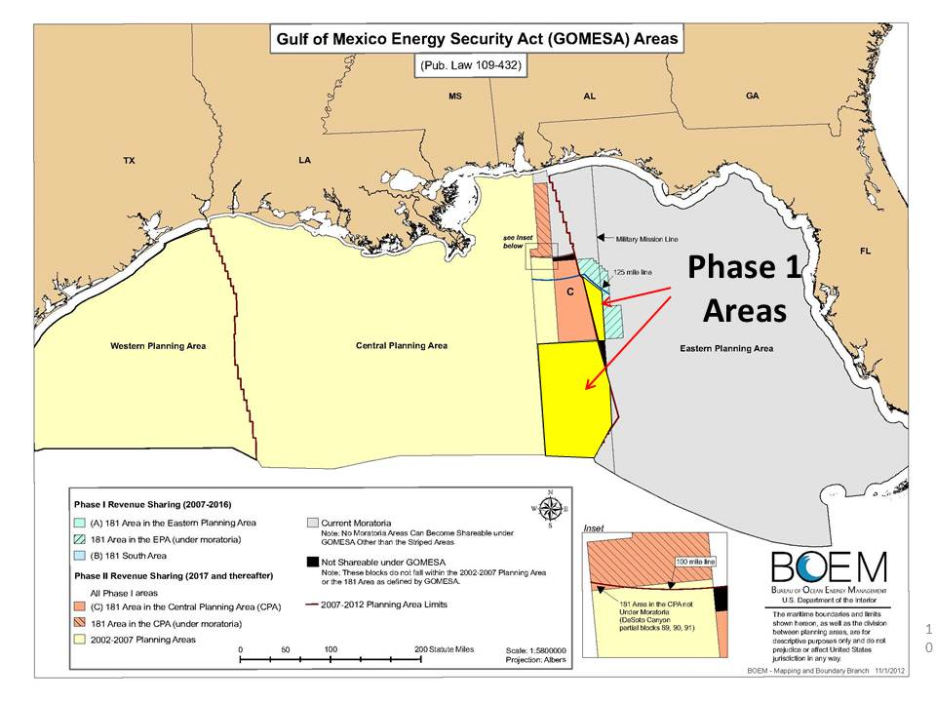
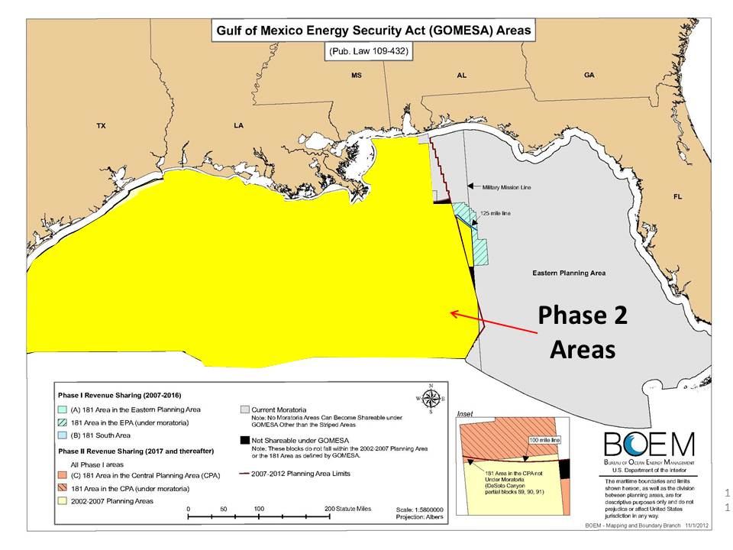
Our Issues and Initiatives
Gulf of Mexico Energy Security Act of 2006 (GOMESA)
  Revenue sharing with Gulf producing states and their eligible political subdivisions (TX, LA, MS, AL)
    Phase I (2006-2016) Phase II (2017-2055)

Slide 10
Our Issues and Initiatives
GOMESA Revenue Sharing
The four states share 37.5% of the 50% of qualified revenues (capped at $500 million until 2055)
First Phase 2 disbursement expected in 2018
(March-September)
$500 Million cap not met
-$60-$70 million ~ next five years

Slide 11
GOMESA and LA’s Coastal Program
Our Issues and Initiatives
Cash Flow:
  Crucial revenue stream for LA coastal program
  Flexible revenue stream
    cash flow large projects, ability to operate an integrated coastal program (restoration/protection/resilience)
  Potential to leverage these revenues to accomplish priority projects
Hurricane Protection:
  Can fund necessary protection projects (levees, flood gates, etc.), that are ineligible for Deepwater Horizon funding
Resilience:
  Can fund proactive flood risk and resilience activities such as home elevation, flood proofing businesses, or voluntary acquisitions, actions that currently have no dedicated funding

Slide 12
Path Forward
Our Issues and Initiatives
CPRA has been working with levee districts for several years prior to receiving the GOMESA revenues
CPRA plan for GOMESA revenues has been to support levee districts and provide much needed funding for flood protection
CPRA has projects planned for the GOMESA revenues; but these revenues may fluctuate from year to year. Therefore, adjustments may have to be on a year to year basis.
CPRA will continue to work with the levee districts to ensure that we identify and invest in projects that are priorities and that are in line with CPRA’s mission

Slide 13
