Slide 1
Association of Levee Boards of Louisiana
May 3, 2018

Slide 2
SEASONALOVERVIEW
GOVERNOR’S OFFICE OF HOMELAND SECURITY & EMERGENCY PREPAREDNESS

Slide 3
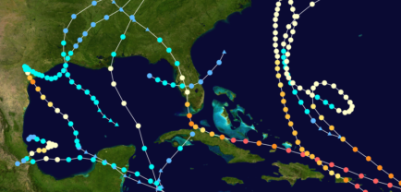
2017 Hurricane Season
Storm Type | 2017
Named Storms | 17
Hurricanes (CAT 1, 2) | 4
Major Hurricanes (CAT 3, 4, 5) | 6
3 direct threats to Louisiana
Pre-seasonal start - April 19th (TS Arlene)
Overall: Well above seasonal average
Peak Intensity Category
Tropical Depressions 1
Tropical Storms 7
Category 1 2
Category 2 2
Category 3 2
Category 4 2
Category 5 2
(Average season 1981-2010 = 12 named storms)
2016 Gulf of Mexico/Local Storm Activity
LA
TX
LA
Tropical Systems 18

Slide 4
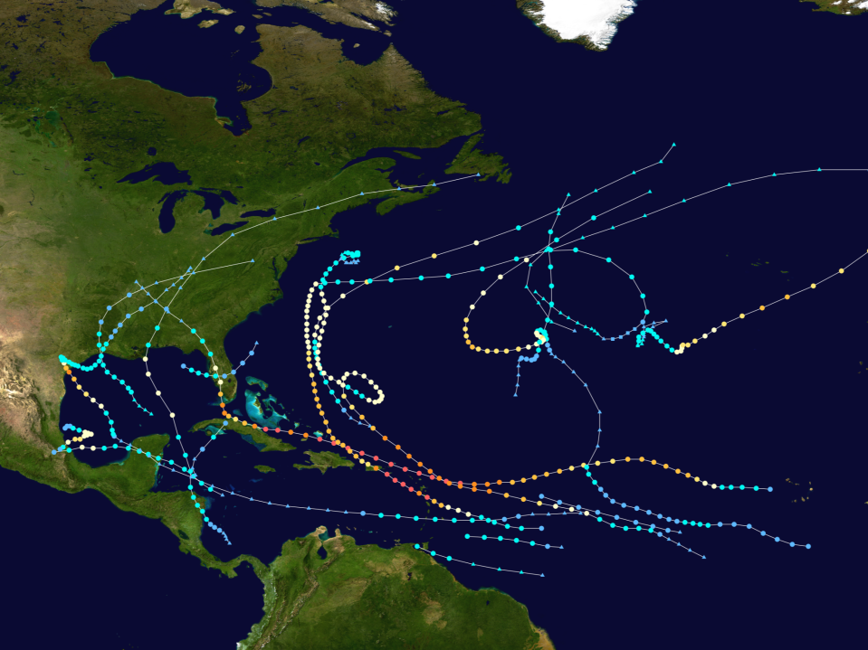
2017 Hurricane Season
* NOAA Pre-Season Outlook
Named Storms: | 11 - 17
Anticipated Hurricanes: | 5 - 9
Major Hurricanes: | 2 - 4
Actual Storms
Depressions: | 1
Total Named Storms: | 17
Hurricanes (Cat 1 & 2): | 10
Major Hurricanes (Cat. 3+): | 6
* Pre-Season outlook only & does not reflect subsequent forecast changes
Hurricane Cindy - TS
LA
Hurricane Nate - CAT 1
Storm Name | Dates Active | Peak Storm Category
Arlene | April 19 - 21 | Tropical Storm
Bret | June 19 - 20 | Tropical Storm
Cindy | June 20 - 23 | Tropical Storm
Don | July 17 - 18 | Tropical Storm
Emily | July 30 - August 1 | Tropical Storm
Four | July 5 – 7 | Tropical Depression
Franklin | August 7 - 10 | Cat 1 Hurricane
Gert | August 12 - 17 | Cat 2 Hurricane
Harvey | Aug 17 - Sep 1 | Cat 4 Hurricane
Irma | Aug 30 - Sep12 | Cat 5 Hurricane
Jose | Sep 5 - 22 | Cat 4 Hurricane
Katia | Sep 5 - 9 | Cat 2 Hurricane
Lee | Sep 15 - 30 | Cat 3 Hurricane
Maria | Sep 16 -30 | Cat 5 Hurricane
Nate | Oct 4 - 9 | Cat 1 Hurricane
Ophelia | Oct 9 - 16 | Cat 3 Hurricane
Philippe | Oct 28 - 29 | Tropical Storm
Rina | Nov 5 - 9 | Tropical Storm
Hurricane Harvey - CAT 4
Notes:
Pre-Season outlook only & does not reflect subsequent forecast changes
3 Storms that directly affected Louisiana – Hurricane Harvey, TS Cindy & Hurricane Nate

Slide 5
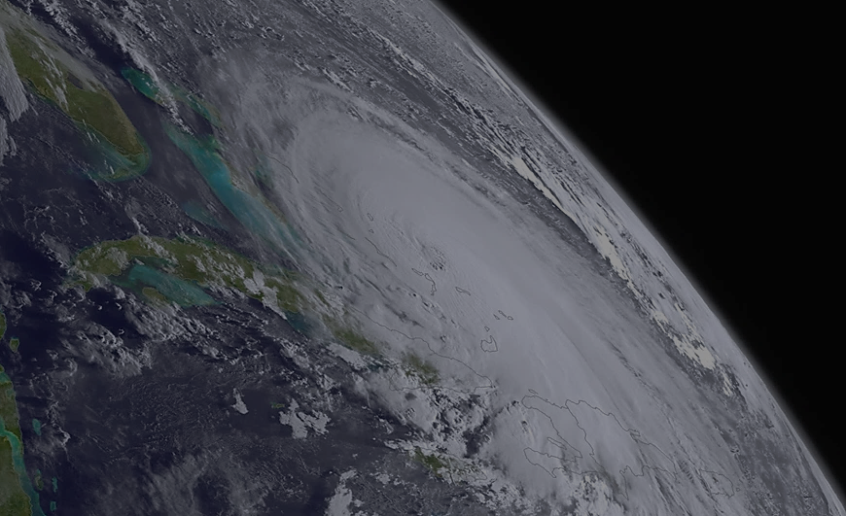
2018 Atlantic Tropical Cyclone Names
Hurricane season runs from June 1st to November 30th annually
Alberto
Beryl
Chris
Debby
Ernesto
Florence
Gordon
Helen
Isaac
Joyce
Kirk
Leslie
Michael
Nadine
Oscar
Patty
Rafael
Sara
Tony
Valerie
William

Slide 6
2018 Pre-Seasonal Colorado State Outlook
Forecasters predict a slightly above-average season & are anticipating a slightly above-average probability for major hurricanes making landfall along the continental United States coastline
Predictions:
14 Named Storms
7 Hurricanes
Forecast Basics:
Outlook reflects the current weak El Nino & forecasters do not anticipate a significant El Niño event this summer/fall
The western tropical Atlantic is anomalously warm right now, while portions of the eastern tropical Atlantic & far North Atlantic are anomalously cool
3 Major Hurricane (Category 3 or greater)
* Saffir/Simpson category 3 - 5 are considered major hurricanes
Notes:
Atlantic hurricane forecasts from Colorado State - forecast released April 5, 2018
PROBABILITIES
1) Entire continental U.S. coastline - 63% (average for last century is 52%)
2) U.S. East Coast Including Peninsula Florida - 39% (average for last century is 31%)
3) Gulf Coast from the Florida Panhandle westward to Brownsville - 38% (average for last century is 30%

Slide 7
ARE YOU READY
?
GOVERNOR’S OFFICE OF HOMELAND SECURITY & EMERGENCY PREPAREDNESS

Slide 8
Hurricane Preparedness Individual Responsibility
Plan ahead
Prepare a Family Disaster Plan
Maintain a Disaster Supply Kit
Stock essentials for at least 72 hours
Stay aware - watch/listen to your local news
Listen to your public officials

Slide 9
Get A Game Plan Campaign
www.getagameplan.org

Slide 10
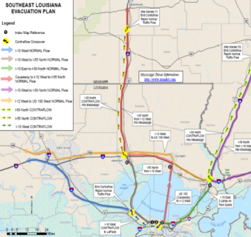
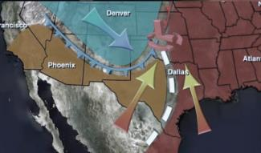
Emergency Public Information
Louisiana Preparedness Guides
The State’s Joint Information Center (JIC) “Press Staff”
The Louisiana Emergency Alert System (EAS) & NOAA Weather Radio
EMERGENCY
Tornado
Warning
ALERT
SYSTEM
Baton
Rouge
NOAA
Weather
A BROADCAST BY THE EMERGENCY ALERT SYSTEM
Radio

Slide 11
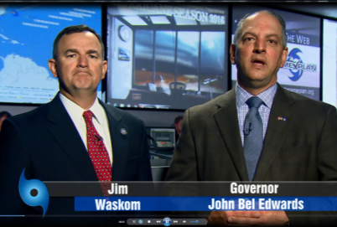
Emergency Public Information
Public service announcements via television, radio, print, web & social media platforms
Former
Saints

Slide 12
LA GET A GAME PLAN APP
The new Louisiana Get A Game Plan App upgrade is now publically available
Under Construction

Slide 13
Emergency Public Information
emergency.la.gov

Slide 14
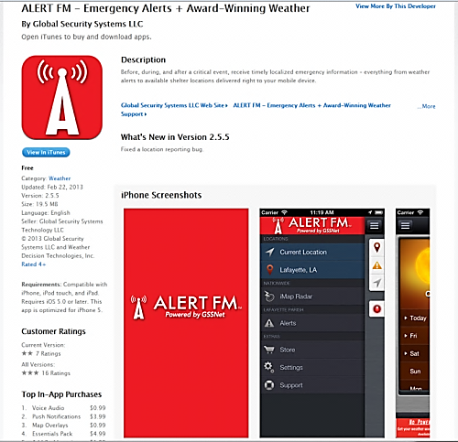
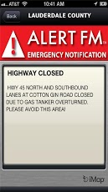
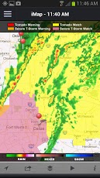
Louisiana Alert FM
Transmit digital messages based on geographic or organizational groupings
Messages delivered via data subcarrier of existing FM transmitters to multiple receiving FM devices & to a downloadable Apple or Google smartphone App
No recurring usage fees paid by government customers after initial license fee
App based emergency notifications for a user’s current geo-specific location & a single bookmarked location are free

Slide 15
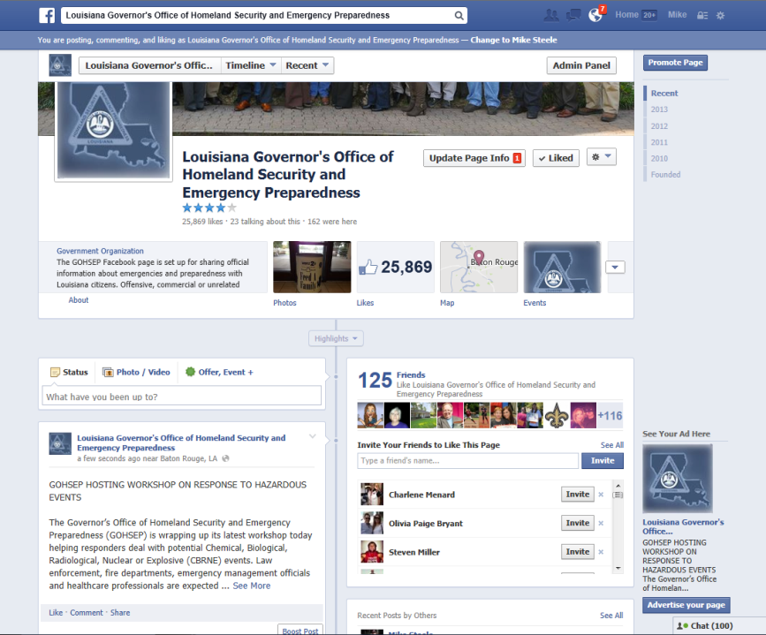
Social Media-Facebook

Slide 16
Social Media - Twitter
@GOHSEP

Slide 17
RESOURCES
GOVERNOR’S OFFICE OF HOMELAND SECURITY & EMERGENCY PREPAREDNESS

Slide 18
An annex of the State’s Emergency Operations Center:
Facilitates communication with Louisiana's major economic driver industries, operators of critical infrastructures & key resources to enhance Louisiana's emergency management efforts
The Louisiana BEOC is housed at the University of Louisiana at Lafayette & is under the leadership of Louisiana Economic Development & the Governor’s Office of Homeland Security & Emergency Preparedness

Slide 19
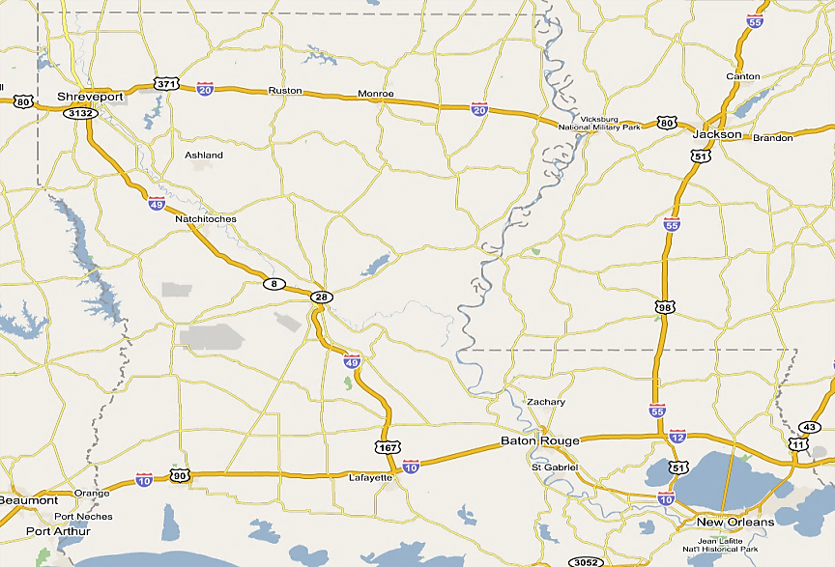
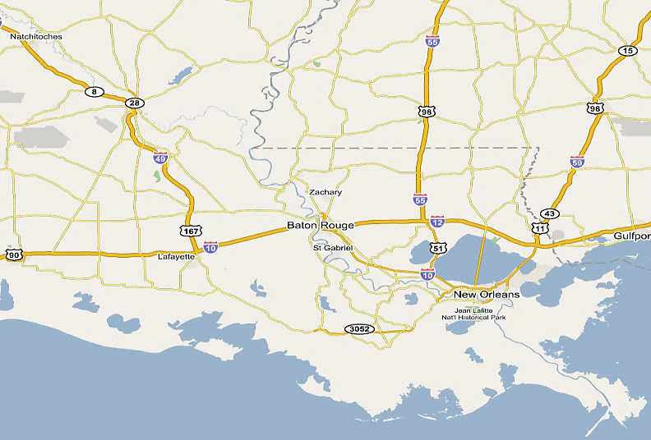
0 MRE’s
96,330 Water
33,622 Tarps 249,500 Sandbags 876 Blankets 2,970 Cots
Minden
GOHSEP Totals:
MRE’s: 46,080
Blankets: 876
Water: 551,742
Tarps: 39,170
Lg. Tarps/Rolls 51
Cots 3,633
Sandbags 935,500
Sand bag chutes 8
Camp Beauregard
16,128 MRE’s
75,600 Water
70 Tarps
51 Lg.Tarps/Rolls
643,000 Sandbags
195 Cots
29,952 MRE’s
359,672 Water 714 Tarps
143,000 Sandbags
Camp Villere
RSA
RSA
BTR Terminal Transfer
- State of Louisiana
New Orleans
468 Cots
4,604 Tarps
LOGISTICS
State Warehouse/RSA Resources

Slide 20
PEPAREDNESS EFFORTS
GOVERNOR’S OFFICE OF HOMELAND SECURITY & EMERGENCY PREPAREDNESS

Slide 21
2018 Preparedness Efforts
February 27 - March 2, 2018: Interagency Coordinating Committee on Hurricanes (ICCOH) Annual Meeting -
March 14, 2018: Rehearsal of Concept (ROC) Drill - Hurricane related exercise in conjunction with state & federal partners
April 3 - 5, 2018: National Sheltering & Housing Workshop: Sponsored by the State of Louisiana with select state & federal agencies in attendance
April 11 - 12, 2018: Annual State Hurricane Exercise
April 25, 2018: Region 3 Tropical Coordination Meeting with select state & parish agencies in Thibodaux to review current plans & discuss outstanding issues

Slide 22
2018 Preparedness Efforts
May 9, 2018: Baton Rouge Annual Hurricane Awareness Day at the Baton Rouge Metropolitan Airport Multiplex Building
May 22 - 23, 2018: The 2018 MSY CTN Air Evacuation Workshop in New Orleans will review the Louisiana MSY General Population Air Evacuation mission, concept of operations, H-Hour Timeline, stakeholder roles & exercise the related manifesting & screening process
June 5, 2018: Regions 6, 7 & 8 Parishes will participate in a Hurricane Season 2018 Preparation Meeting with select state agencies in Alexandria to review current plans & discuss outstanding issues

Slide 23
2018 Preparedness Efforts
June 14, 2018: Mississippi Valley Division Hurricane Table-Top Exercise: GOHSEP will participate in an interagency hurricane exercise in Vicksburg, MS in conjunction with the U.S. Army Corps of Engineers & other select agencies
June 26 - 28, 2018: Flood Fight 101 Workshops - In conjunction with GOHSEP & the U.S. Army Corps of Engineers & other select agencies
June 26, 2018: Ouachita River Parishes - West Monroe
June 27, 2018: Red River Parishes - Natchitoches
June 28, 2018: Mississippi River Parishes - Vidalia

Slide 24
CLOSING COMMENTS
GOVERNOR’S OFFICE OF HOMELAND SECURITY & EMERGENCY PREPAREDNESS

Slide 25
FIND US ON THE WEB
+
gohsep.la.gov
getagameplan.org

