Slide 1
“Effective Communication”
ALBL Conference
Baton Rouge
3 May 2018
Jay Grymes
WAFB Chief Meteorologist
LSU AgCenter Climatologist

Slide 2
“Does My Wife Understand Me?”
ALBL Conference
Baton Rouge
3 May 2018
Jay Grymes
WAFB Chief Meteorologist
LSU AgCenter Climatologist

Slide 3
Who are we talking to:
. . . dialog with your professional peers . . .
. . . dialog with the public . . .
. . . interacting with the media . . .
. . . my role at GOHSEP

Slide 4
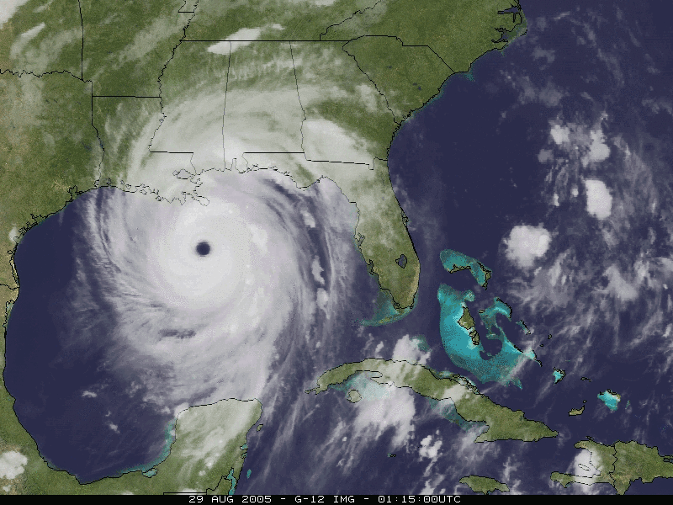
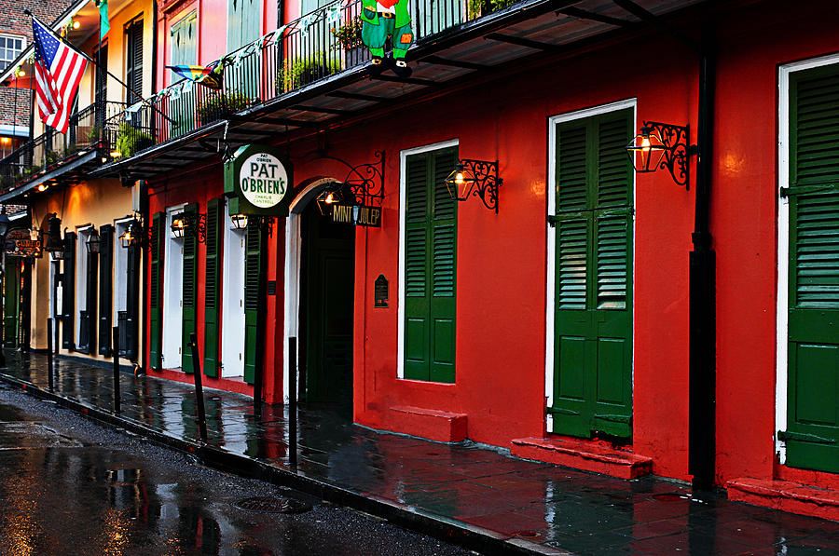
Understanding Hurricanes 101
What is a
hurricane?
Where do they
come from?

Slide 5
Forecast Group | ‘Named’ Storms | Total Hurricanes | ‘Major’ Hurricanes
 | -- | -- | --
 | 14 | 7 | 3
 | 12 | 6 | 2
 | 14 - 18 | 7 - 11 | 3 - 5
 | 12 - 15 | 6 - 8 | 3 - 5
 | 13 | 7 | 2
 | -- | -- | --
 | 11 - 15 | 5 - 7 | 1 - 3
1995 - 2010 1981 - 2010 | 15 12 | 8 6 | 4 2
NOAA
NCSU

Slide 6
HURRICANE READY!

Slide 7
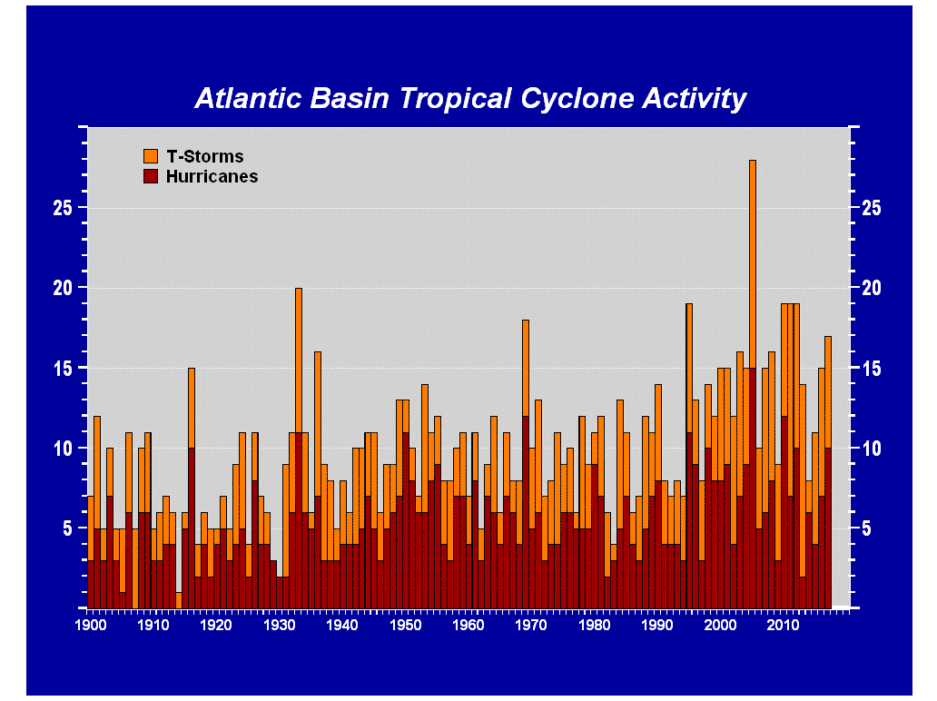

Slide 8
“Hyper-Active”
since 1995

Slide 9
Aircraft ReCon
The long-term upward trend
is a result, at least in part,
of improved observations
Satellite Tech

Slide 10
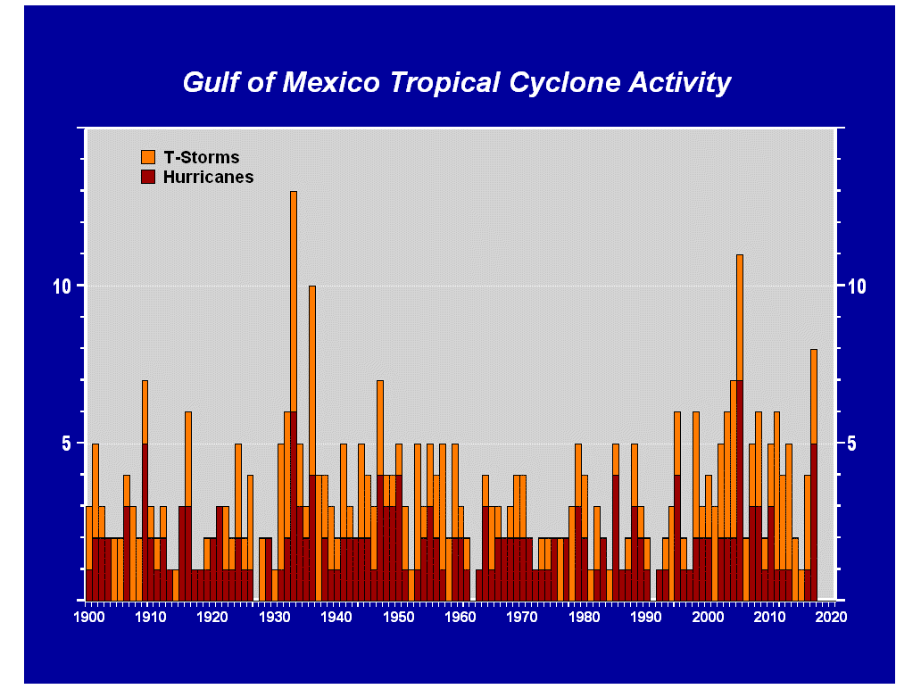

Slide 11
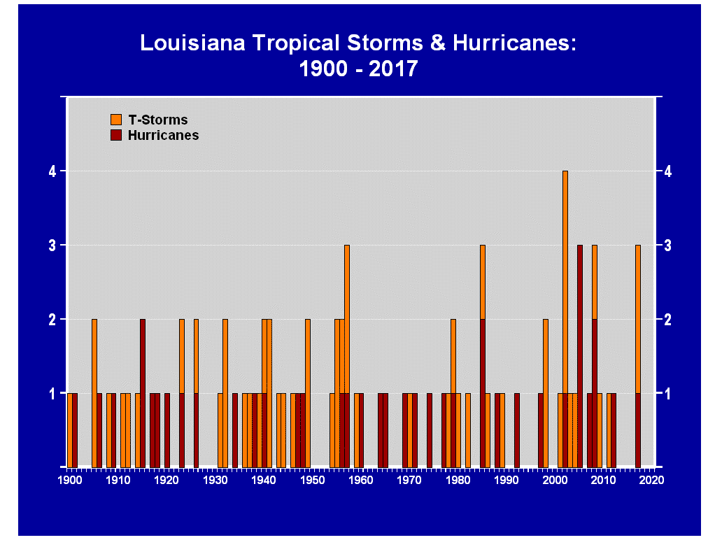
multiple ‘hits’ occur in 1-in-6
seasons, on average
runs of 3 to 4 years without a
Louisiana ‘hit’ are uncommon
4 Years
3
4
4
3
3
4

Slide 12
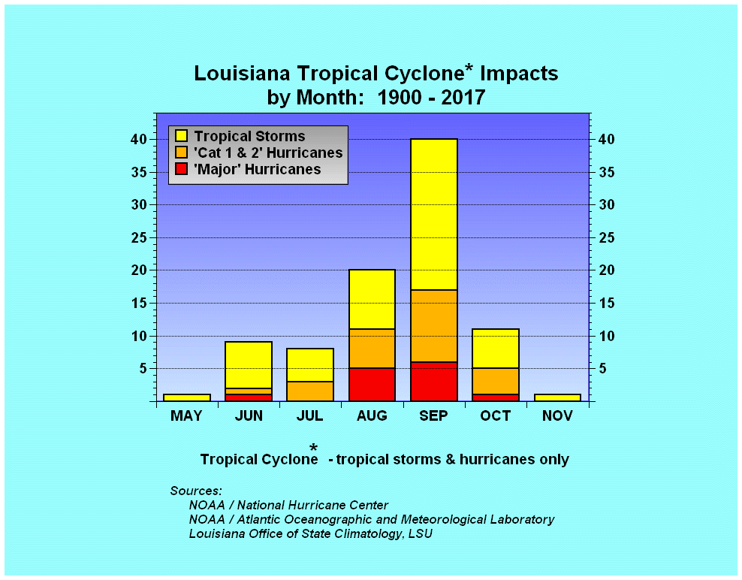
44%
90 Total Storms:
51 Tropical Storms
39 Hurricanes
13 ‘Majors’
22%

Slide 13
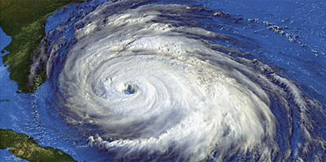
Louisiana Tropical Cyclone Take-Home Numbers*
. . . better than a 50-50 chance of at least one
‘Named Storm’ impacting Louisiana
in any given year . . .
. . . Louisiana averages 7 ‘named storm’
landfalls per decade . . .
. . . 3 hurricanes / 4 tropical storms
*Based on a review of storms since 1900

Slide 14
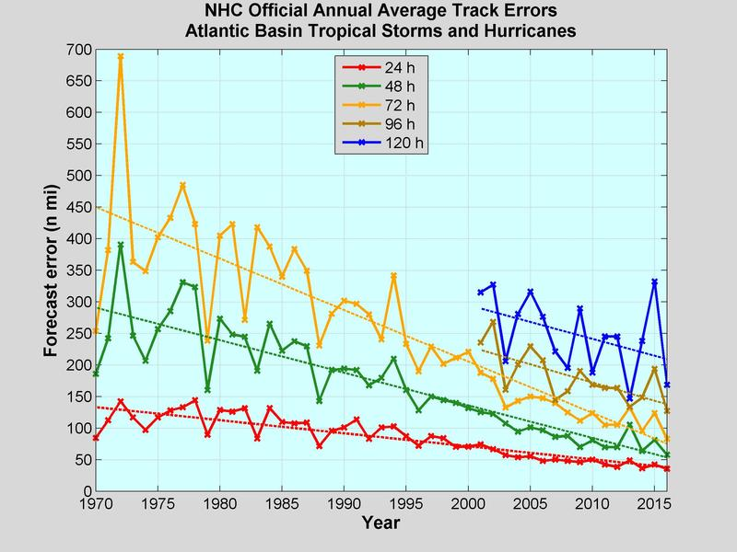

Slide 15
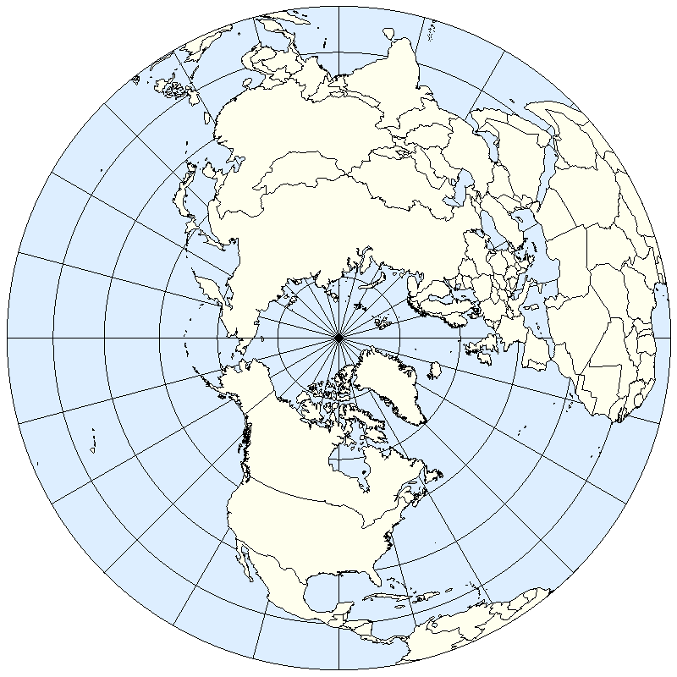
Forecasting “where will it go?” for tropical systems
requires a broad, regional modeling effort . . .
tropical cyclones are “corks in the stream.”

Slide 16
What is Risk?
Does the public
understand?
Risk =
the chance “it” will occur
* what “it” will cost

Slide 17
What is Risk?
Does the public
understand?
Defining the 100-year,
500-year, or 1000-year event?
“Easy-to-Use” terms that mislead the public …

Slide 18
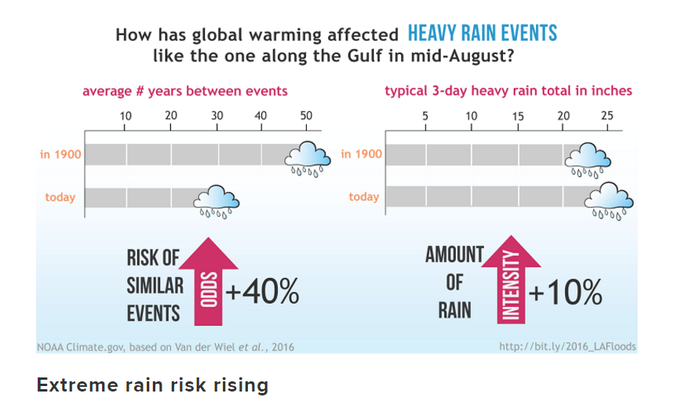
climate change
Rain Events with One or More Sites
Recording ≥ 20” in Two Days in Louisiana:
1930 – 2016 (87 years)
Aug 1940, Aug 1962, Sep 1998, May 1995,
Mar 2016, Aug 2016

Slide 19
Elizabeth Crisp
The Advocate
August 2016 – Greater Baton Rouge area
188,818
90,389
“inside”
Flood Zone
98,429
“outside”
Flood Zone
Many defined this as the
1000-year flood

Slide 20
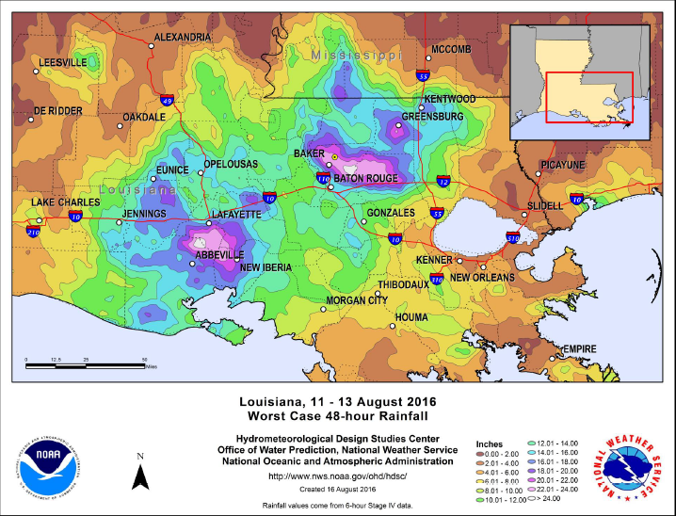
> 24”
in 48 hrs

Slide 21
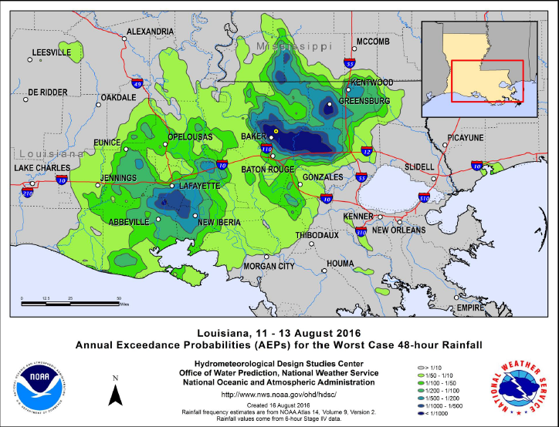
< 1-in-1000
“chance”

Slide 22
Elizabeth Crisp
The Advocate
August 2016 – Greater Baton Rouge area
188,818
90,389
“inside”
Flood Zone
98,429
“outside”
Flood Zone
Jay’s Take-Home Quiz:
“Should I seriously consider Flood Insurance?”
(1) Do you live in Louisiana?
(2) Has it ever rained in your backyard?

Slide 23
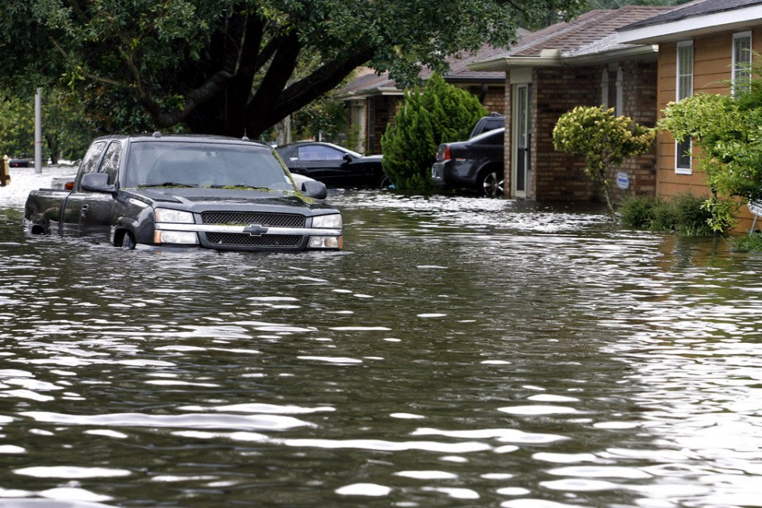
Do you understand the “hurricane/named-storm” deductibles attached to your policy?
Have you given Flood Insurance (NFIP) a really
good ‘think’?
- for many homes outside of the ‘High Risk’ zones,
NFIP annual policies are under $500/year
- on average, 20% - 25% of all NFIP claims each year
are for properties OUTSIDE of the ‘High Risk’ zones
- nearly one-third of the annual NFIP dollars paid-out
each year are for properties OUTSIDE of the
‘High Risk’ zones

Slide 24
Jay –
When we first moved here (in 2011) you began hurricane season readiness with,
“No matter where you live in LA, get flood insurance."
Well, my wife heard that and made me get it, even though we live in Zone X.
Thank-you! You saved us.
Tom & Jackie Braumuller

Slide 25
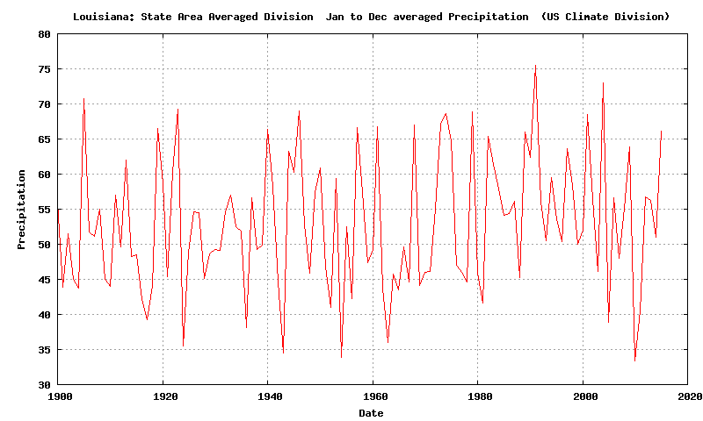
LOUISIANA STATEWIDE AVERAGE RAINFALL:
1900-2015

Slide 26
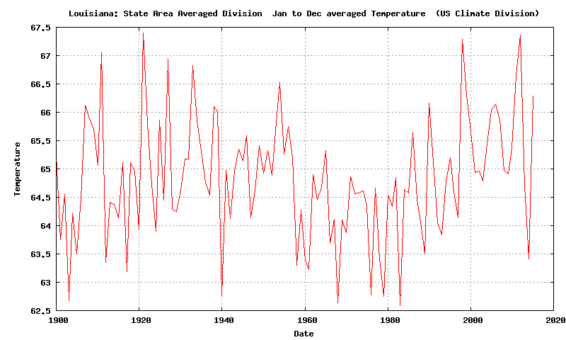
LOUISIANA STATEWIDE AVERAGE TEMPERATURES:
1900-2015

Slide 27
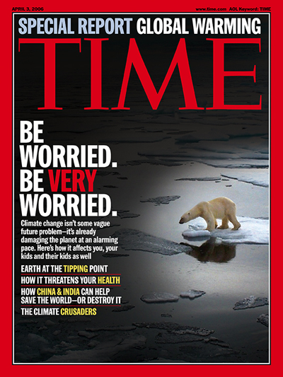
Is human-induced
‘Climate Change’
a scientific reality?
As a climate scientist,
I say,
“A virtual certainly . . .
. . . but?”

Slide 28
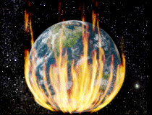
Climate Forcings / Climate ‘Controls’:
”natural” vs. ”human”
“greenhouse gases”
“landscape change”
“solar variability”
“clouds & aerosols”
… we have a (very) limited understanding
of these factors.

Slide 29
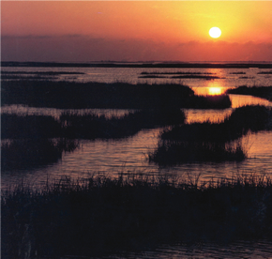
Do I believe that the climate has changed?
Is the planet “warmer” than it was
100-150 years ago?
Yes.
Let’s also stop calling it “global warming” and call it “climate change.”
2. Are human activities contributing to
this “change?”
A human influence is a certainly!

Slide 30
Do I believe that the climate has changed?
3. Are human activities the primary
drivers behind this “change?”
Humans responsible for “how much?”
. . . I doubt we can quantify . . .

Slide 31
Do I believe that the climate has changed?
Should we take actions to reduce the
human impact on the environment?
Of course!
This should not be a point of debate!
6. Can “climate change” be stopped?
Impacts can be mitigated but “change” cannot be controlled …

Slide 32
Do I believe that the climate has changed?
In my opinion, the ‘science’ is not settled ...
… but the politics of climate change in recent years have been so contentious that it doesn’t matter.

Slide 33
Do I believe that the climate has changed?
There is clearly an on-going shift in the context and content of climate change discussions due to the change in the D.C. political “climate.”
The discussions should get back to examining the “knowns” and “unknowns.”
Unfortunately, these discussions will likely remain driven by political perspectives rather than the state of the science.

Slide 34
Do I believe that the climate has changed?
Even if the threats of climate change
are being overstated, just modest impacts could have dire effects on Louisiana ...
In the decades to come, Louisiana
may become the most adversely impacted
of any of the lower 48 states.

Slide 35
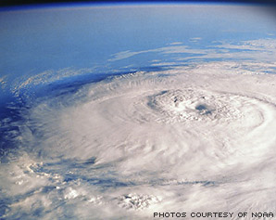
“Thank You!”
Jay Grymes
WAFB Chief Meteorologist
LSU AgCenter Climatologist (Ret.)
jgrymes@wafb.com
225 / 505-6916
Jay Grymes WAFB
@Jay_WAFB

Slide 36
GLOBAL WARMING
Think: CLIMATE CHANGE

