Slide 1
Louisiana Flood Risk Coalition
Association of Levee Boards of Louisiana
May 2018 Workshop
Baton Rouge, LA

Slide 2
Louisiana Flood Risk Coalition
National Flood Insurance Program
Reauthorization & Reform

Slide 3
Who We Are
Louisiana Flood Risk Coalition (LFRC) was established in 2016 to advocate for reform of the National Flood Insurance Program (NFIP) in order to develop responsible floodplain management within coastal and riverine communities.
The Coalition is comprised of levee districts spread across Louisiana, but welcomes input and engagement from others working to ensure Americans have a NFIP that is both sustainable and fiscally responsible in working to mitigate flood loss.

Slide 4
LFRC Critical Issues
Participation
Grandfathering/Affordability
Cost Reduction
Mitigation/Risk Reduction

Slide 5
Participation
The NFIP has had a mandatory participation requirement since 1973.
A 2006 study by the Rand Corporation identified that only 49% of the homeowners that were required to have insurance, were actually participating in the program.
FEMA’s Roy Wright has testified that he has seen participation estimates between 35-55%.
GAO Report (GAO-17-425) - Increasing consumer participation could help ensure more consumers would be better protected from the financial risk of flooding.

Slide 6
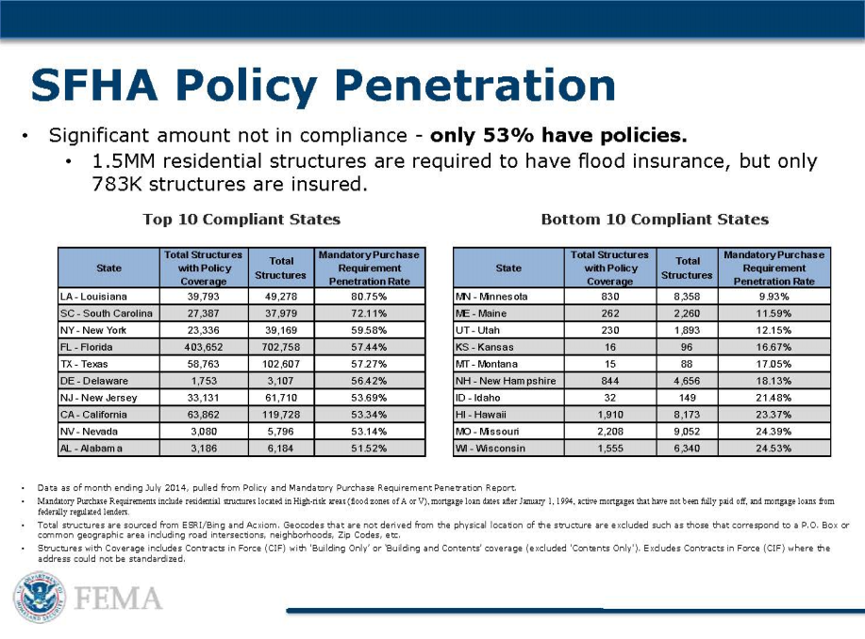
Notes:
In LA, we have better than 85% compliance with this requirement.
But, nationally, a study done in 2006 showed that only 49% of those required to have flood insurance actually had it.
Further, it is estimated that when “Super-storm Sandy” was heading up the eastern seaboard of the US, only 15-25% of the at risk population had flood insurance.
increased the penalties to lending institutions for non-compliance. But, this law must be enforced.

Slide 7
Affordability/Grandfathering
The federal government invited all of today’s policyholders to become policyholders at some point in the past – pre and post firm.
These homeowners should not be penalized for the past poor performance of our government.
future and continued participation should be the program’s focus.
Why are we saddling those who are following the rules with burden of maintaining the program’s solvency?

Slide 8
Cost Reduction
Increasing revenues/solvency of the NFIP is the critical element of this reauthorization.
Policymakers must seek to reduce the cost of government operations (e.g., administration reforms, WYO, etc.)
Raising rates to carry a bloated operational budget is not sustainable
The program is strapped with cost for events >100yr return.
Future claims cost can be reduced with the establishment of other initiatives, improved mapping, the fairness of 2.4% of the program’s budget being spent on state sales taxes, etc.

Slide 9
NFIP Premiums vs. Loss Dollars Paid

Slide 10
Mitigation\Risk Reduction
FEMA should recognize the difference between riverine and coastal levees within the LAMP process and allow for a new zone designation such as a new, AL. As compared to the LAMP proposed Zone D:
This AL zone would recognize reduced residual risk on the basis of the LAMP study.
The AL zone would carry mandatory purchase of flood insurance as is required in all SFHAs.
The AL zone would include an elevation evaluation that can be used by communities for flood plain management.
Reauthorization should recognize the fiscal responsibility of investments in mitigation, including structural flood protection.
Is it desirable to simply elevate individual homes and tolerate flooding in the area?
Is it practical to elevate individual homes as compared to structural flood protection for a community?

Slide 11
Mitigation
“Investment before the disaster is imperative. The GAO report in 2016 stressed a national mitigation strategy – to harmonize federal investments and incentivize private investments in that budget space.”, Roy Wright, FEMA
It was said at a recent Congressional hearing that mitigation investments cannot be overstated or under-looked.
GAO report indicated that for every one dollar in mitigating, a community realizes four in savings during disaster relief.

Slide 12
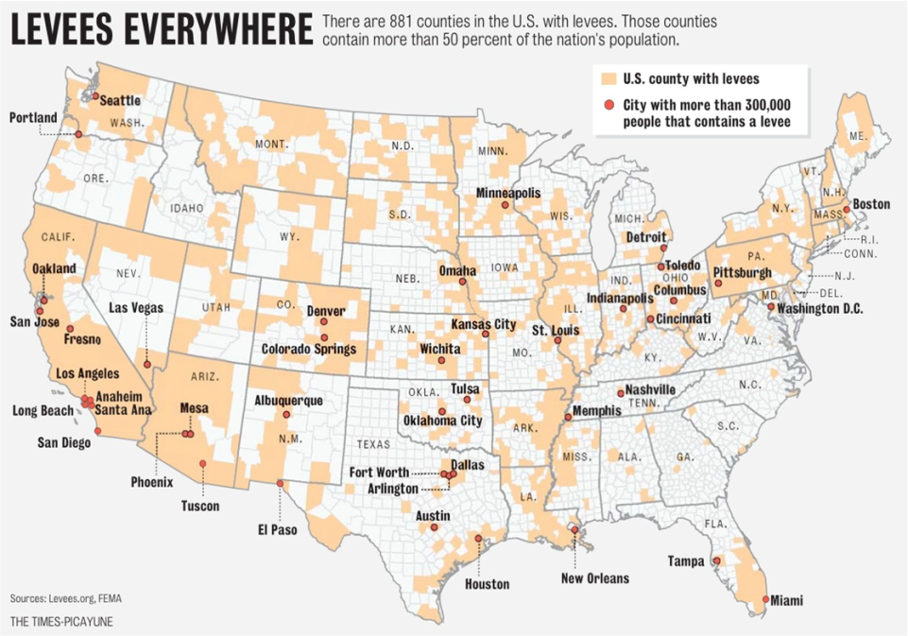
LAMP

Slide 13
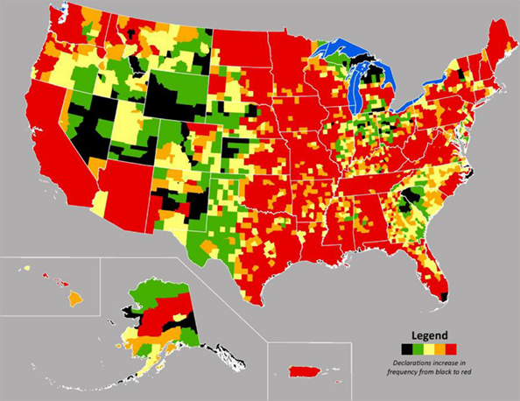
Presidential Flood Disasters since 1965 – black to red

Slide 14
NFIP Legislation
H.R.2246 Luetkemeyer – Repeal mandatory Flood Insurance coverage req. for commercial Property, increase private capital and reinsurance
H.R.2874 Duffy - 21st Century Flood Reform Act
S.1368 Menendez - Sustainable, Affordable, Fair, and Efficient (SAFE) National Flood Insurance Program Reauthorization Act of 2017
S.1571 Crapo - A bill to reauthorize the National Flood Insurance Program, and for other purposes

Slide 15
NFIP Legislation
H.R.2246 Luetkemeyer – Repeal mandatory Flood Insurance coverage req. for commercial Property, increase private capital and reinsurance
Repeal mandatory flood insurance coverage requirement for commercial properties located in flood hazard areas
Provide for greater transfer of risk under the National Flood Insurance Program to private capital and reinsurance markets, and for other purposes.

Slide 16
NFIP Legislation
H.R.2874 Duffy - 21st Century Flood Reform Act
Removal of the prohibition on offering new coverage for new construction in the Special Flood Hazard Area
Preservation of grandfathering for properties in communities who have adopted updated maps
Decreasing the proposed floor of annual premium increases for pre-FIRM properties from 8% to 6.5% (current law is 5%)

Slide 17
NFIP Legislation
H.R.2874 Duffy - 21st Century Flood Reform Act
Section 504 any property will lose grandfathered status or pre-FIRM subsidies upon the filing of its second claim, no matter the amount of the claim.
Increases surcharges for most policy holders
primary homeowners from $25 to $40
for all second homes and businesses that are not Preferred Risk Policies from $250 to $275
Section 505 prohibits any new or renewal of coverage for any multiple loss property where the aggregate amount in claims exceeds twice the replacement cost of the structure.
The bill puts in place a $10,000 annual premium cap
should be lowered and aligned with the value of the policy

Slide 18
NFIP Legislation
S.1368 Menendez - Sustainable, Affordable, Fair, and Efficient (SAFE) National Flood Insurance Program Reauthorization Act of 2017
6 Year Reauthorization
Cap All Premium Rate Hikes to 10%
• Prohibit FEMA from increasing premium rates above 10% per year on any policy holder for 6 years.
Increase the maximum Increased Cost of Compliance payment from $30,000 to $100,000
Authorize $1 billion to be appropriated to fund the FMA
Cap all WYO compensation at 22.46% of written premiums while maintaining agent commission at 15% of written premiums

Slide 19
NFIP Legislation
S.1571 Crapo - A bill to reauthorize the National Flood Insurance Program, and for other purposes
Short Term Authorization ~ 3years
Increase the maximum Increased Cost of Compliance payment from $30,000 to $100,000
For each first 6 full fiscal year authorized appropriation $200,000,000 to carry out the predisaster hazard mitigation program under section 203 of the Robert T. Stafford Disaster Assistance and Emergency Relief Act
major disaster for wildfire on Federal land President may transfer funds conduct wildfire suppression

Slide 20
LFRC-Proposed NFIP Legislation
Proposed Amendment:
GAO STUDY - reconcile all properties in SFHA and existing policies for flood insurance to determine the extent of current compliance with such mandatory purchase requirements.
EVALUATE EFFECTIVENESS OF:
Current oversight by FEMA, Federal agency lenders, Director of the Federal Housing Finance Agency
Penalties for violation mandatory purchase requirements
Providing for routine third party oversight of compliance with such mandatory purchase requirements;
Whether framework for compliance and enforcement under existing laws and regulations is sufficient regarding:
FEMA, lending institutions, private insurance providers and other institutions.

Slide 21
LFRC URGES CONGRESS TO CONSIDER:
Utilizing mitigation to protect taxpayer liabilities and reduce NFIP costs;
Focusing upon increasing participation;
Expanding NFIP policyholders.
Grandfathering – Pre-BW

Slide 22
Questions?

Slide 23
