Slide 2
SEASONALOVERVIEW
GOVERNOR’S OFFICE OF HOMELAND SECURITY & EMERGENCY PREPAREDNESS

Slide 3
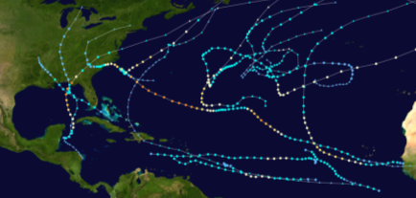
2018 Hurricane Season
Named Storm Summary | 2018
Named Storms | 15
Hurricanes (CAT 1, 2) | 6
Major Hurricanes (CAT 3, 4, 5) | 2
3 direct/indirect threats to Louisiana
Pre-seasonal start - May 25th (TS Alberto)
Overall: Above seasonal average
Peak Intensity Category
Tropical Depressions 16
Tropical Storms 7
Category 1 3
Category 2 3
Category 3 0
Category 4 1
Category 5 *1
(Average season 1981-2010 = 12 named storms)
2016 Gulf of Mexico/Local Storm Activity
LA
TX
LA
Tropical Systems 31
*Hurricane Michael was re categorized from a CAT 4 to a CAT 5 in April of 2019
Notes:
*Hurricane Michael was re categorized from a CAT 4 to a CAT 5 in April of 2019

Slide 4
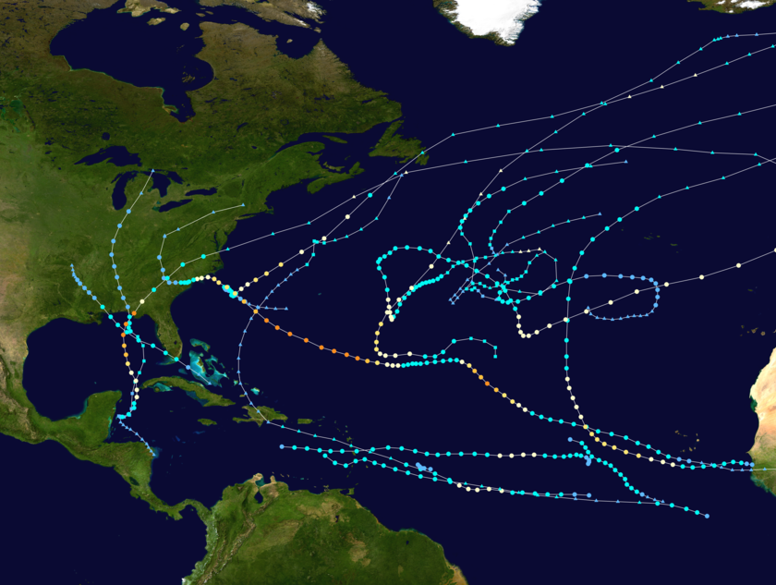
2018 Hurricane Season
* NOAA Pre-Season Outlook
Named Storms: | 10-16
Anticipated Hurricanes: | 5-9
Major Hurricanes: | 1-4
Actual Storms/Systems
Total Named Storms: | 15
Hurricanes (Cat 1 & 2): | 6
Major Hurricanes (Cat. 3+): | 2
Depressions: | 16
* Pre-Season outlook only & does not reflect subsequent forecast changes
TS Alberto
LA
Storm Name | Dates Active | Peak Storm Category
Hurricane Michael – CAT 5
TS Gordon
Alberto | May 25 – 31 | Tropical Storm
Beryl | July 4 – 16 | Cat 1 Hurricane
Chris | July 6 – 12 | Cat 2 Hurricane
Debby | Aug 7 – 9 | Tropical Storm
Ernesto | Aug 15 – 17 | Tropical Storm
Florence | Aug 31 – Sep 17 | Cat 4 Hurricane
Gordon | Sep 3 – 6 | Tropical Storm
Helene | Sep 7 – 16 | Cat 2 Hurricane
Isaac | Sep 7 – 15 | Cat 1 Hurricane
Joyce | Sep 12 – 18 | Tropical Storm
Eleven | Sep 21 – 22 | Tropical Depression
Kirk | Sep 22 – 29 | Tropical Storm
Leslie | Sep 23 – Oct 13 | Cat 1 Hurricane
Michael | Oct 7 – 12 | *Cat 5 Hurricane
Nadine | Oct 9 – 12 | Tropical Storm
Oscar | Oct 26 – 31 | Cat 2 Hurricane
*Hurricane Michael was re categorized from a CAT 4 to a CAT 5 in April of 2019
Notes:
Pre-Season outlook only & does not reflect subsequent forecast changes
3 Storms that directly or indirectly affected Louisiana – TS Gordon, TS Alberto & Hurricane Michael

Slide 5
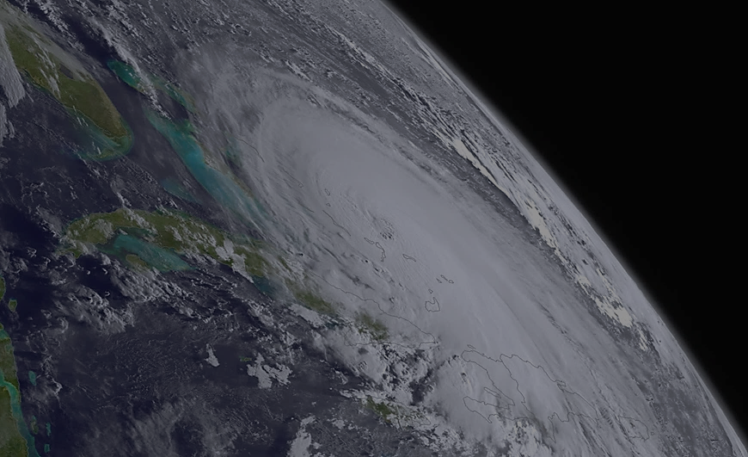
2019 Atlantic Tropical Cyclone Names
Hurricane season runs from June 1st to November 30th annually
Andrea
Barry
Chantal
Dorian
Erin
Fernand
Gabrielle
Humberto
Imelda
Jerry
Karen
Lorenzo
Melissa
Nestor
Olga
Pablo
Rebekah
Sebastien
Tanya
Van
Wendy

Slide 6
2019 Pre-Seasonal Colorado State Outlook
Forecasters predict a slightly below-average Predictions:
13 Named Storms
5 Hurricanes
Forecast Basics:
Outlook reflects relatively high likelihood of a weak El Niño as a primary factor
The tropical Atlantic is slightly cooler than normal
Colder-than-normal sea surface temperatures in the tropical Atlantic provide less fuel for tropical cyclone formation & intensification
Associated with a more stable atmosphere as well as drier air, both of which suppress organized thunderstorm activity necessary for hurricane development
2 Major Hurricane (Category 3 or greater)
* Saffir-Simpson category 3 - 5 are considered major hurricanes
Notes:
Atlantic hurricane forecasts from Colorado State - forecast released April 4, 2019
PROBABILITIES
48 percent for the entire U.S. coastline (average for the last century is 52 percent)
2) 28 percent for the U.S. East Coast including the Florida peninsula (average for the last century is 31 percent)
3) 28 percent for the Gulf Coast from the Florida panhandle westward to Brownsville (average for the last century is 30 percent) 4) 39 percent for the Caribbean (average for the last century is 42 percent)

Slide 7
ARE YOU READY
?
GOVERNOR’S OFFICE OF HOMELAND SECURITY & EMERGENCY PREPAREDNESS

Slide 8
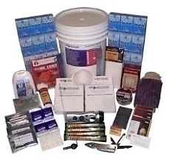
Hurricane Preparedness Individual Responsibility
Plan ahead
Prepare a Family Disaster Plan
Maintain a Disaster Supply Kit
Stock essentials for at least 72 hours
Stay aware - watch/listen to your local news
Listen to your public officials

Slide 9
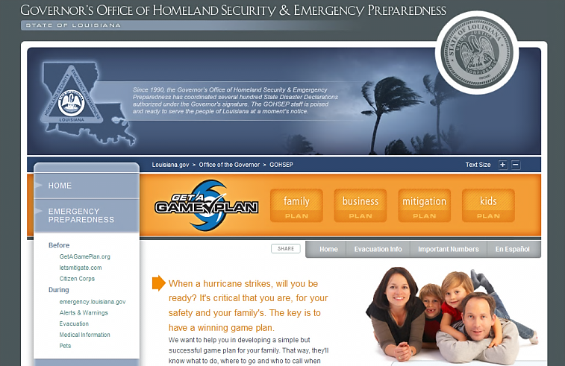
Get A Game Plan
www.getagameplan.org

Slide 10
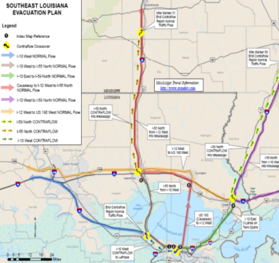
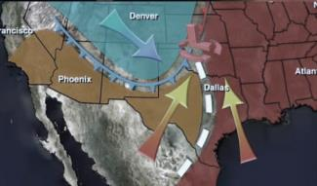
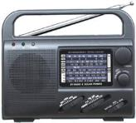
Emergency Public Information
Louisiana Preparedness Guides
The State’s Joint Information Center (JIC) “Press Staff”
The Louisiana Emergency Alert System (EAS) & NOAA Weather Radio
EMERGENCY
Tornado
Warning
ALERT
SYSTEM
Baton
Rouge
NOAA
Weather
A BROADCAST BY THE EMERGENCY ALERT SYSTEM
Radio

Slide 11
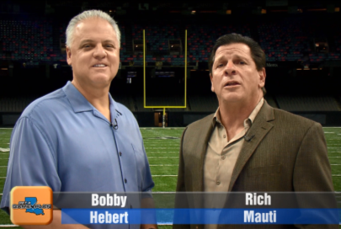
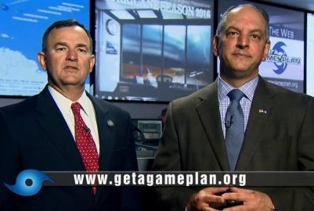
Emergency Public Information
Public service announcements via television, radio, print, web & social media platforms
Former
Saints
Jim Waskom
John Bel Edwards

Slide 12
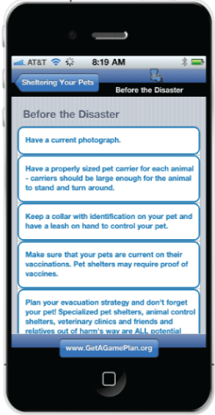
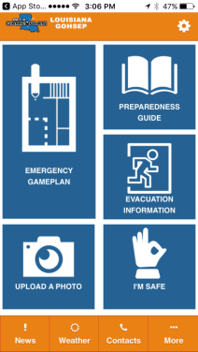
LA GET A GAME PLAN APP
The Louisiana Get A Game Plan App upgrade is now publically available
Under Construction

Slide 13
Emergency Public Information
emergency.la.gov

Slide 14
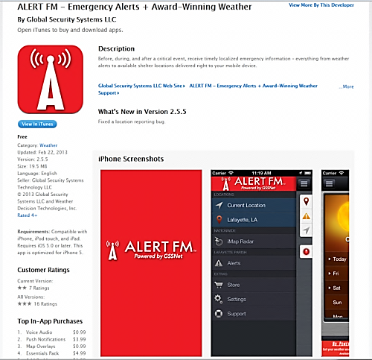
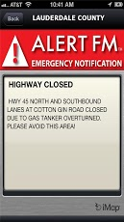
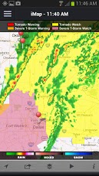
Louisiana Alert FM
Transmit digital messages based on geographic or organizational groupings
Messages delivered via data subcarrier of existing FM transmitters to multiple receiving FM devices & to a downloadable Apple or Google smartphone App
No recurring usage fees paid by government customers after initial license fee
App based emergency notifications for a user’s current geo-specific location & a single bookmarked location are free

Slide 15
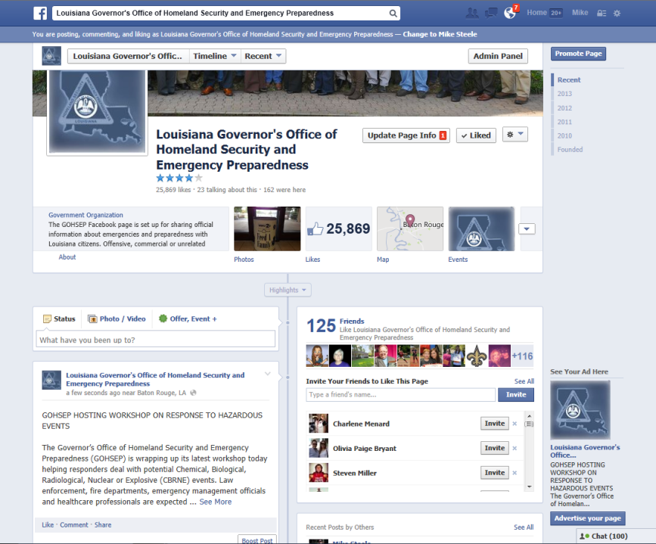
Social Media-Facebook

Slide 16
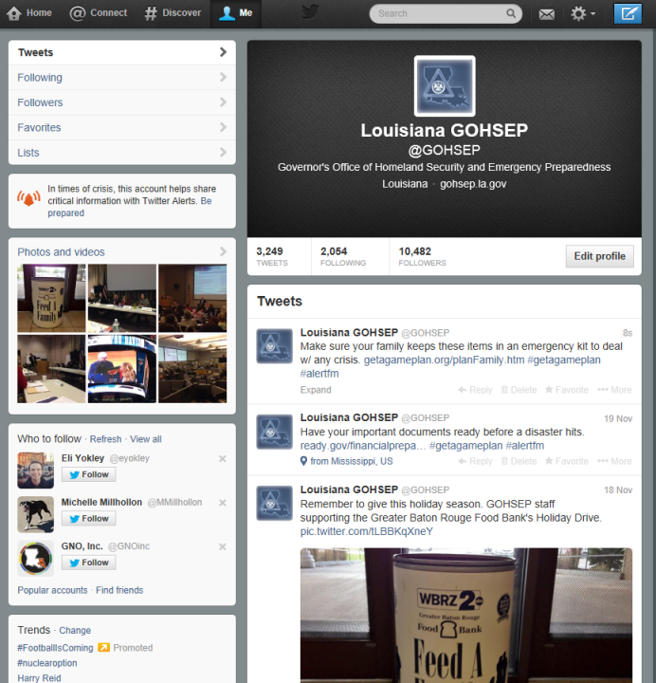
Social Media - Twitter
@GOHSEP

Slide 17
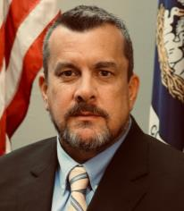
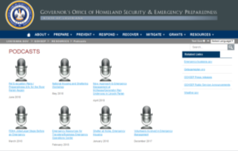
Mike Steele
gohsep.la.gov/resources/podcast

Slide 19
An annex of the State’s Emergency Operations Center:
Facilitates communication with Louisiana's major economic driver industries, operators of critical infrastructures & key resources to enhance Louisiana's emergency management efforts
The Louisiana BEOC is housed at the University of Louisiana at Lafayette & is under the leadership of Louisiana Economic Development & the Governor’s Office of Homeland Security & Emergency Preparedness

Slide 20
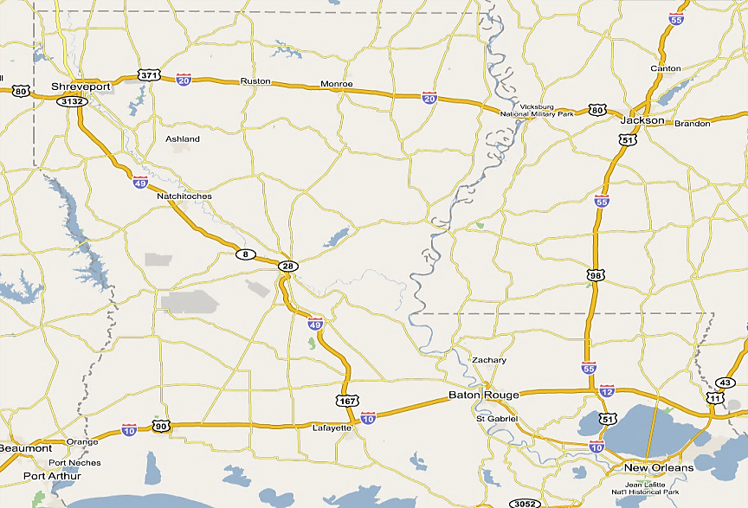
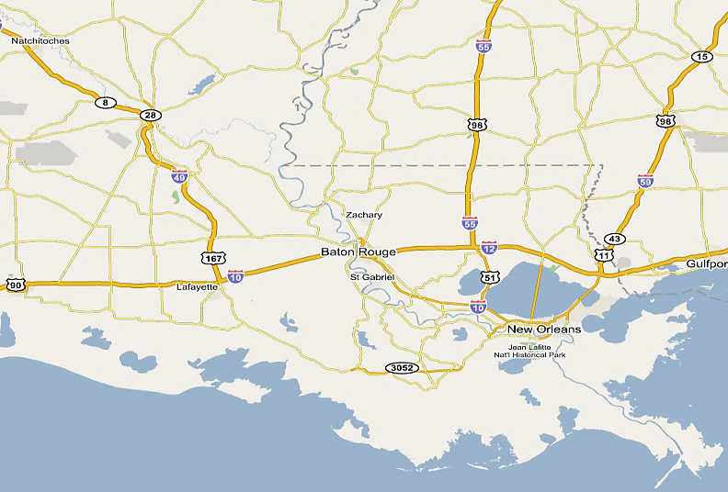
0 MRE’s
96,330 Water
33,622 Tarps 249,500 Sandbags 876 Blankets 2,970 Cots
Minden
GOHSEP Totals:
MRE’s: 46,080
Blankets: 876
Water: 551,742
Tarps: 39,170
Lg. Tarps/Rolls 51
Cots 3,633
Sandbags 935,500
Sand bag chutes 8
Camp Beauregard
16,128 MRE’s
75,600 Water
70 Tarps
51 Lg.Tarps/Rolls
643,000 Sandbags
195 Cots
29,952 MRE’s
359,672 Water 714 Tarps
143,000 Sandbags
Camp Villere
RSA
RSA
BTR Terminal Transfer
- State of Louisiana
New Orleans
468 Cots
4,604 Tarps
LOGISTICS
State Warehouse/RSA Resources

Slide 21
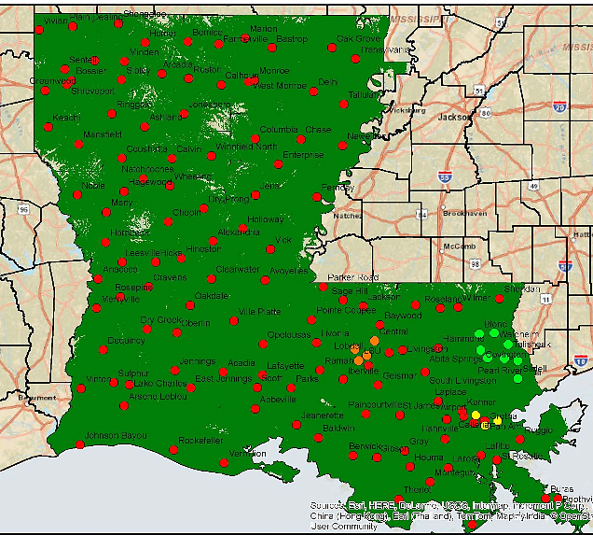
Statewide Interoperability
Louisiana Wireless Information Network
Mobile Sites 6
Users 97,000
Active Sites 135
Coverage 95%
Tower Sites
http://gohsep.la.gov/interop/coveragemap.htm
http://gohsep.la.gov/interop/coveragemap.htm
Notes:
Maintenance budget has not seen an increase in the last 3 years.
July 2008 – LWIN consisted of 55 Operational Sites and approximately 32,000 users.
July 2011 – LWIN consists of 108 Operational Sites and approximately 62,000 users.
No users fees is a key component to LWIN’s success – encourages local participation.
Federal grant money cannot be used for system maintenance.
Without additional monies, LWIN’s predominance as a national example will be in jeopardy.
LWIN is the largest statewide, interoperable communication system and a model of success.
During the past 3 years, the system provided interoperable communications to multi-layers of responders during emergencies and events (Gustav, BP Oil Spill, 2011 Spring Floods, numerous Mardi Gras, safety fairs, emergency operations exercises, etc).
Federal (FEMA, US Coast Guard, Army Corp of Engineers, FBI, US Marshals, US Border Patrol, etc)
State (State Legislative offices, GOHSEP, DPS / LSP, LDWF, Dept of Ag, DSS, DOTD, etc)
Local (Levee Boards, Parish Sheriffs, Parish EOCs, City Fire and EMS, Public Works, etc)
Provided communication to all these agencies and alleviated the need for each agency to expend resources establishing separate communication infrastructure and interoperable patches. (Reduced duplication of effort.)
Several articles in national news and industry publications.
Numerous speaking engagement requests, both nationally and internationally, for LWIN personnel to showcase LWIN’s success.
Monthly average of over 9 million “Push-to-talk” transmissions for past 12 months.
Over 380 separate local/state/federal agencies use LWIN.
In order to stay at the forefront of interoperable communications, more funding is needed.
Maintenance costs are increasing – fuel, T1 lines, rent of tower space, electricity, etc.
Increases in capacity will be needed as more users come on LWIN (more users mean more repeaters needed to carry the increased load in traffic).
New technologies will have to be integrated – Mobile Broadband networks needed for First Responders (laptops in vehicles for LE / Fire / EMS; surveillance systems (video camera feeds) on highways, ports, airports, etc; mobile devices (smart phones, ipads, etc) and associated applications that are being developed for First Responders.

Slide 22
HOST STATE AGREEMENTS
Current Out Of State Sheltering Commitments
Method | Host State | Population
 | Georgia | 3,000
 | Arkansas | 4,000
 | Texas | 10,000
 | Tennessee | 3,500
 | Kentucky | 2,000
Total 22,500
Kentucky
Annual validation in progress
Tennessee
Arkansas
Georgia
Texas
Louisiana
LA DOTD maintains coach buses contingency contracts
Federal contingency plans for air transport

Slide 23
PEPAREDNESS EFFORTS
GOVERNOR’S OFFICE OF HOMELAND SECURITY & EMERGENCY PREPAREDNESS

Slide 24
2019 Preparedness Efforts
March 18, 2019: Spring Flood Outlook with National Weather Service & US Army Corps of Engineers at the State EOC to provide overall outlook for this season
March 19, 2019: Region 1 Tropical Coordination Meeting with select state & parish agencies in New Orleans to review current plans & discuss outstanding issues
March 20, 2019: Rehearsal of Concept (ROC) Drill - Hurricane related exercise in conjunction with state & federal partners
March 26, 2019: GOHSEP UMR Training - State EOC activation personnel training
April 2 - 7, 2019: LANG Disaster Response Exercise (DRX) - Statewide

Slide 25
2019 Preparedness Efforts
April 3 - 5, 2019: Annual State Hurricane Exercise - State EOC
April 10, 2019: Region 3 Hurricane Coordination Meeting - Thibodaux Wellness Center
April 22 - 25, 2019: 2019 National Hurricane Conference - New Orleans
May 2, 2019: Regions 4 & 5 Tropical Coordination Meeting with select state & parish agencies in Crowley to review current plans & discuss outstanding issues
June (TBD), 2019: Regions 6/7/8 Hurricane Preparedness Coordination Meeting - Alexandria

Slide 26
CLOSING COMMENTS
GOVERNOR’S OFFICE OF HOMELAND SECURITY & EMERGENCY PREPAREDNESS

Slide 27
FIND US ON THE WEB
+
gohsep.la.gov
getagameplan.org

