Slide 1
Water How we use it, Where we get it, What it is worth to us. David Johnson USACE, Vicksburg District Presented to the Association of Levee Boards of Louisiana 5 May 2016
Notes:
This presentation covers how the world uses water, what sources of water are used, what is happening to those sources, and the economic impact that water use has to our economy.

Slide 2
On average we drink 4 liters of water a day, but the food we eat each day requires 2000 liters of water to produce. We are currently mining both ancient and alluvial water to produce the food needed to feed the world, where will the water come from in the future?

Slide 3
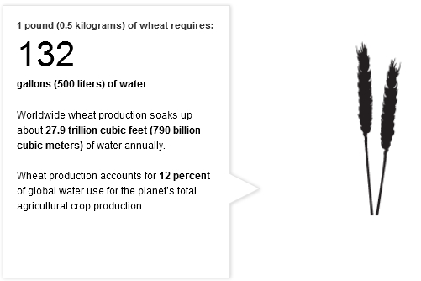
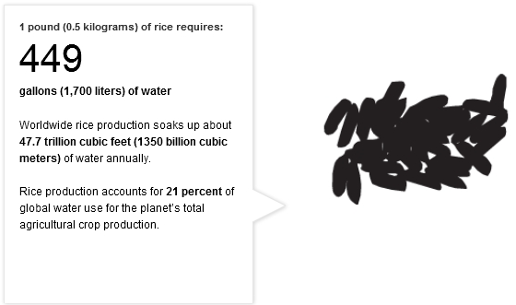
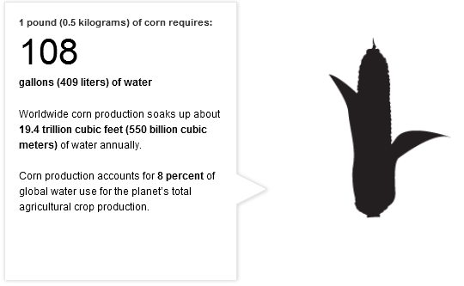
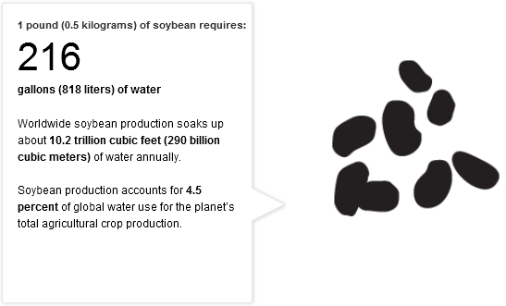
How Much Water is Embedded in Everyday Life?
Wheat 500 l/lb
Rice 1700 l/lb
MAV 142 gal/lb
Corn 409 l/lb
Soybeans 818 l/lb
MAV 50 gal/lb
These four crops account for 45.5%
of water consumption
MAV 150 gal/lb
Website: The Hidden Water We Use

Slide 4
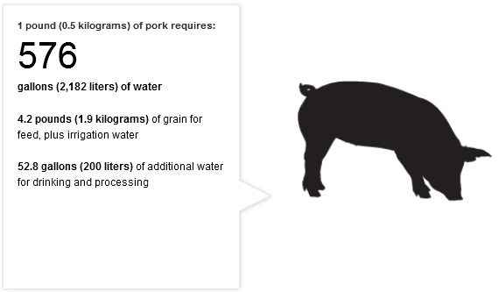
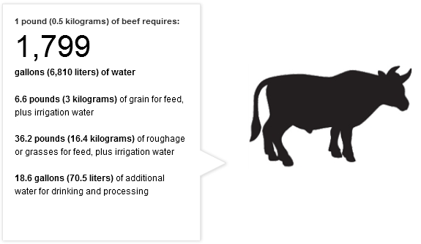
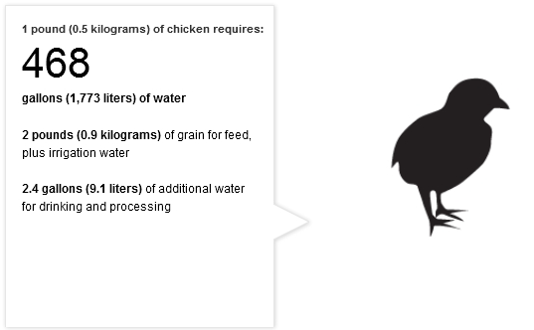
Water Use by crop and meat product
Pork 2182 l/lb
Beef 6810 l/lb
Chicken 1773 l/lb
National Geographic

Slide 5
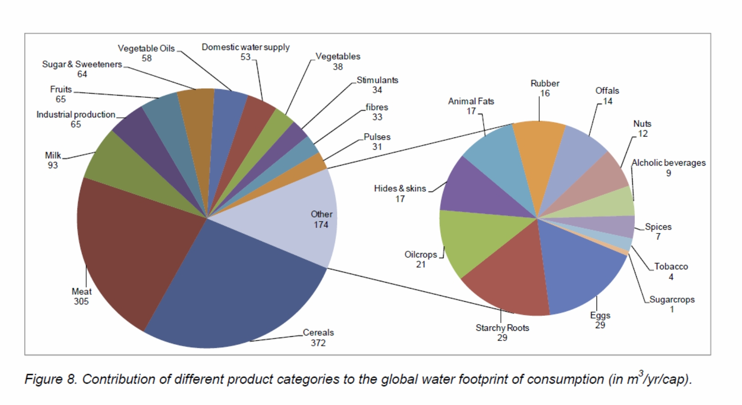
World Water Consumption by Product Categories
92% Agriculture – 4.5% Industrial Production – 3.5% Domestic Water Supply
1385 m³/cap/yr
Mekonnen, M.M. and Hoekstra, A.Y., 2011. National Water Footprint Accounts: The Green, Blue, and Grey Water Footprint of Production and Consumption, Value of Water Research Report Series No. 50., United Nations Educational, Scientific and Cultural Organization – Institute of Water Education (UNESCO-IHE).

Slide 6
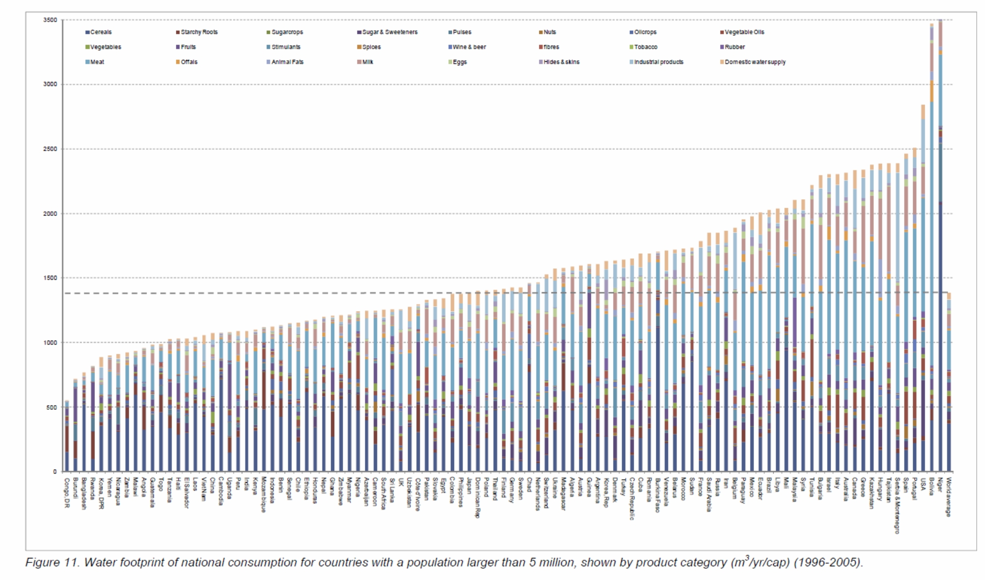
Water Footprint of National Consumption for Countries > 5 Million
USA
Japan
World average (1385 m³/yr/cap)
China
Mekonnen, M.M. and Hoekstra, A.Y., 2011. National Water Footprint Accounts: The Green, Blue, and Grey Water Footprint of Production and Consumption, Value of Water Research Report Series No. 50., UNESCO-IHE.

Slide 7
Categories of Global Water Sources
Green Water – Precipitation
Blue Water – Surface water and renewable groundwater
Dark Blue Water – Non-renewable groundwater
White -- Interbasin transfers

Slide 8
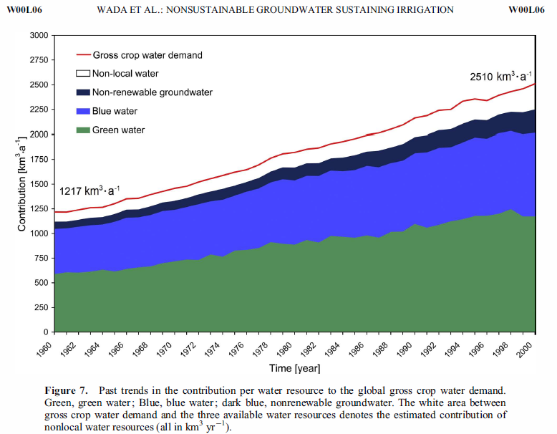
World Water Use
Renewable groundwater
Precipitation

Slide 9
Future World Water Use
2015
Renewable groundwater
Precipitation and surface water
Assumes that there is sufficient additional land available for crops
Wikipedia: World population based on U.N. estimates. (Units are km³/year)

Slide 10
World Water Footprint by Country
World Population (2008) | Millions
China | 1,333.00
India | 1,140.00
United States | 304.00
Indonesia | 228.00
Brazil | 192.00
Pakistan | 166.00
Bangladesh | 160.00
Nigeria | 151.00
Russia | 142.00
Japan | 128.00
World Total | 6,688.00
Units are Gm³/yr or Km³/yr
Mekonnen, M.M. and Hoekstra, A.Y., 2010. The green, blue, and grey water footprint of crops and derived crop products, Value of Water Research Report Series No. 47., UNESCO-IHE.

Slide 11
World Water Footprint by Basin
Mekonnen, M.M. and Hoekstra, A.Y., 2010. The green, blue, and grey water footprint of crops and derived crop products, Value of Water Research Report Series No. 47., UNESCO-IHE.

Slide 12
World Water Use by Crop
Km³/yr
Mekonnen, M.M. and Hoekstra, A.Y., 2010. The green, blue, and grey water footprint of crops and derived crop products, Value of Water Research Report Series No. 47., UNESCO-IHE.

Slide 13
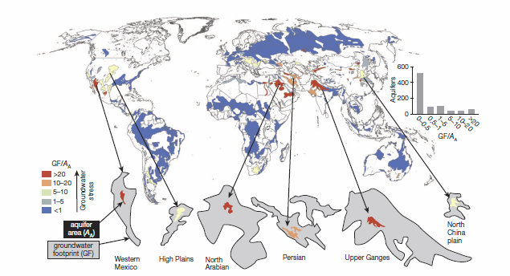
Aquifer Foot Prints
Aquifer Foot Print = the area needed to recharge the aquifer at the current rate of use and current rate of recharge.
Gleeson, T. et al., 2012. ‘Water balance of global aquifers revealed by groundwater footprint,’ Nature, Vol. 488

Slide 14
Where we get our water, and how much we use from aquifers in the U.S.

Slide 15
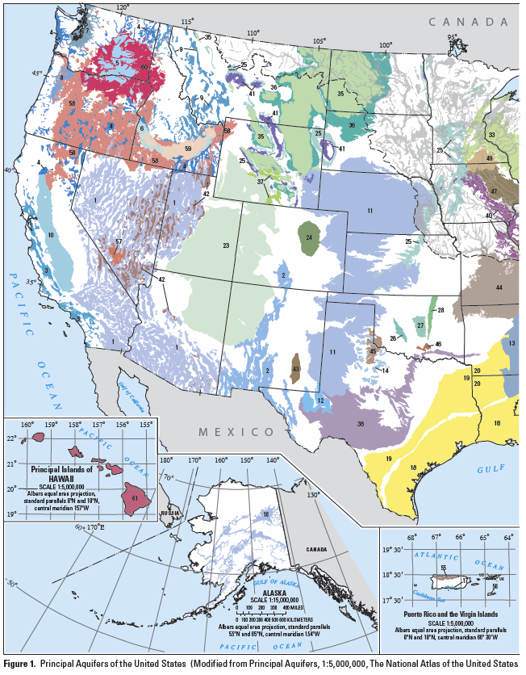
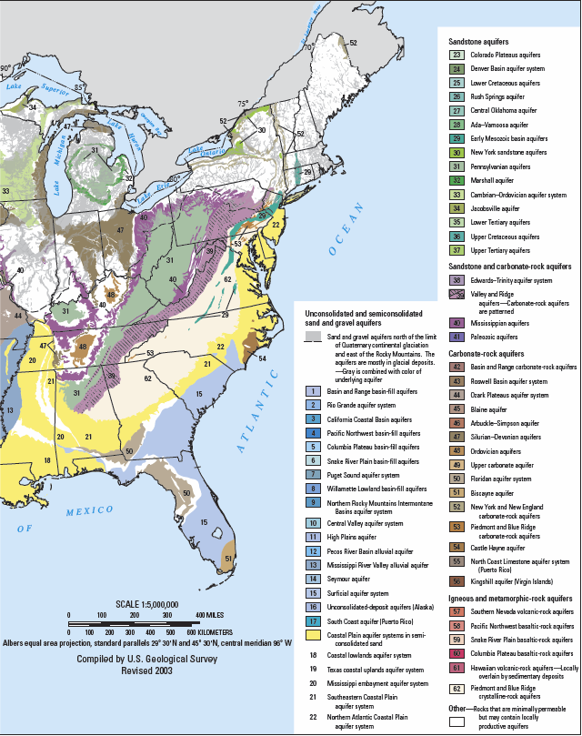
Principal Aquifers in the U.S.
USGS Circular 1279, Estimated Withdrawals from Principal Aquifers in the United States, 2000.
Notes:
Blue is alluvial sand and gravel, yellow are semi-consolidated sand, brown are karst (limestone), green are sandstone, purple are limestone and sandstone, red are igneous (volcanic and basaltic.

Slide 16
Groundwater use in the U.S.
4.7%
20.9%
74.4%
MGD
USGS Circular 1279, Estimated Withdrawals from Principal Aquifers in the United States, 2000.

Slide 17
Groundwater use in the U.S. by aquifer
MGD
USGS Circular 1279, Estimated Withdrawals from Principal Aquifers in the United States, 2000.

Slide 18
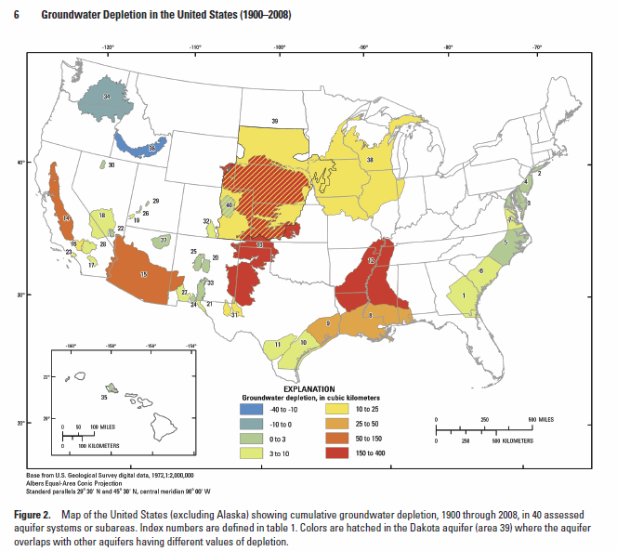
Cumulative groundwater depletion in 40 aquifers, 1900-2008
Km³
USGS Scientific Investigations Report 5079, 2013, Groundwater Depletion in the United States (1900-2008).

Slide 19
Mississippi Alluvial Aquifer

Slide 20
Groundwater use in the Mississippi Alluvial Aquifer
MGD
USGS Circular 1279, Estimated Withdrawals from Principal Aquifers in the United States, 2000.

Slide 21
Percent of Crops Irrigated in the Mississippi Alluvial Aquifer
Arkansas | Percent Irrigated
Year | Corn | Cotton | Rice | Soybeans | Total
2012 | 78.5 | 72.1 | 100.0 | 74.6 | 81.3
2007 | 84.3 | 80.4 | 100.0 | 66.9 | 82.9
2002 | 70.6 | 77.1 | 100.0 | 59.8 | 76.9
1997 | 70.3 | 61.0 | 100.0 | 45.8 | 69.3
Louisiana | Percent Irrigated
Year | Corn | Cotton | Rice | Soybeans | Total
2012 | 67.2 | 40.1 | 100.0 | 50.4 | 73.9
2007 | 51.6 | 37.6 | 100.0 | 40.6 | 55.5
2002 | 36.8 | 40.3 | 100.0 | 29.8 | 49.3
1997 | 36.2 | 32.2 | 100.0 | 16.5 | 45.2
Mississippi | Percent Irrigated
Year | Corn | Cotton | Rice | Soybeans | Total
2012 | 68.1 | 63.2 | 100.0 | 57.9 | 63.1
2007 | 54.2 | 63.4 | 100.0 | 42.8 | 53.5
2002 | 39.6 | 51.0 | 100.0 | 37.9 | 48.7
1997 | 43.8 | 45.6 | 100.0 | 28.4 | 40.1
Missouri | Percent Irrigated
Year | Corn | Cotton | Rice | Soybeans | Total
2012 | 59.1 | 61.8 | 100.0 | 38.3 | 53.5
2007 | 56.1 | 52.4 | 100.0 | 33.7 | 48.9
2002 | 54.0 | 52.0 | 100.0 | 30.2 | 45.5
1997 | 59.3 | 35.6 | 100.0 | 24.5 | 38.8
Based on reports from the USDA, National Agricultural Statistics Service (NASS)

Slide 22
Conjunctive Water Use Issues in the Mississippi Alluvial Valley
How much can we save through conservation?
Regardless of the above answer- the current rate of aquifer utilization is not sustainable.
New water supplies must be developed to meet the future demand for water.
No single state or federal agency is in charge of the aquifer.
The water use laws vary significantly by state.
The states are reluctant to pass laws which might be interpreted as restricting landowner water rights.
The states are reluctant to measure or monitor water use.

Slide 23
Groundwater depletion occurs when groundwater abstraction exceeds the groundwater recharge over extensive areas for prolonged periods. When persistent groundwater depletion occurs, this leads to falling groundwater levels.

Slide 24
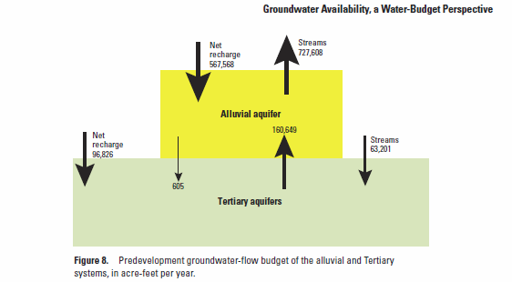
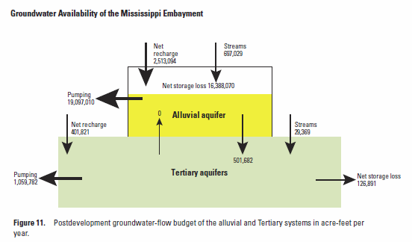
Groundwater Availability of the Mississippi Embayment, USGS Professional Paper 1785, 2011.
Net loss in storage
> 16,000,000 acre-feet/year
Net change to streams
> 1,400,000 acre-feet/year

Slide 25
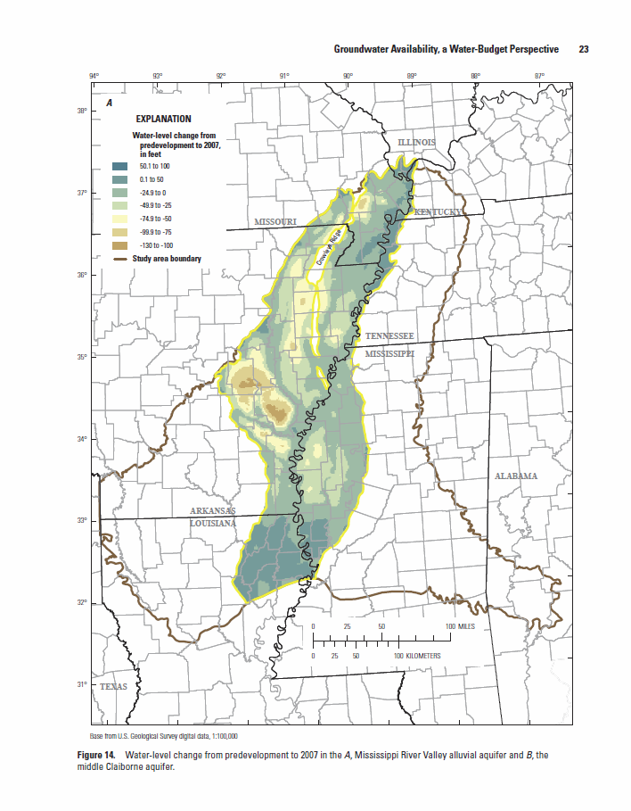
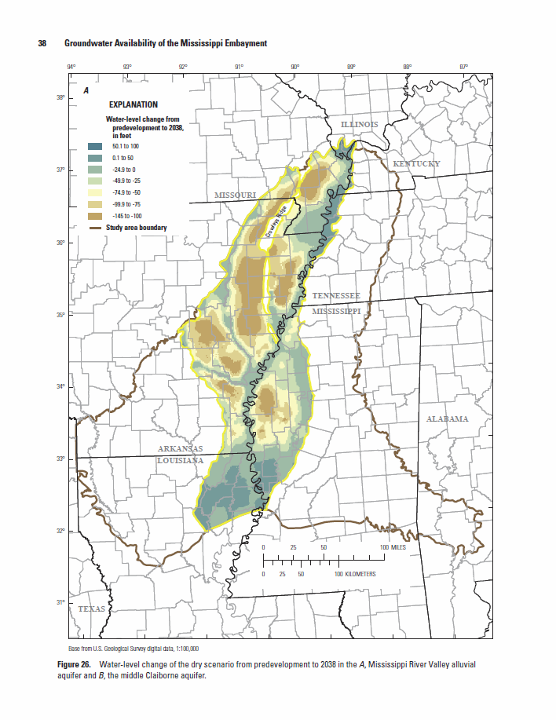
Water level change from predevelopment to 2007 in the Mississippi River alluvial aquifer
Predicted water level change of the dry scenario in the Mississippi River alluvial aquifer to 2038
Change in elevation
50.1 to 100
0.1 to 50
-24.9 to 0
-49.9 to -25
-74.9 to -50
-99.9 to -75
-130 to -100
Groundwater Availability of the Mississippi Embayment, USGS Professional Paper 1785, 2011

Slide 26
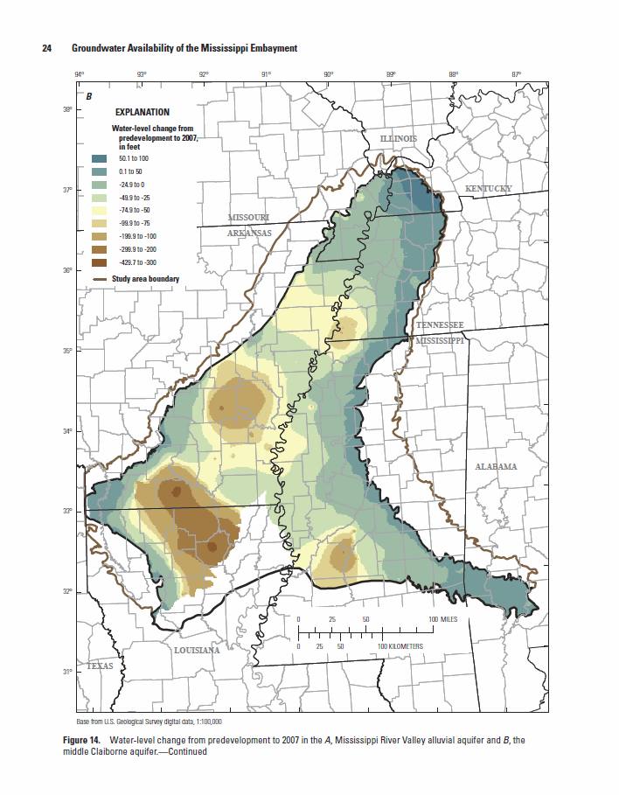
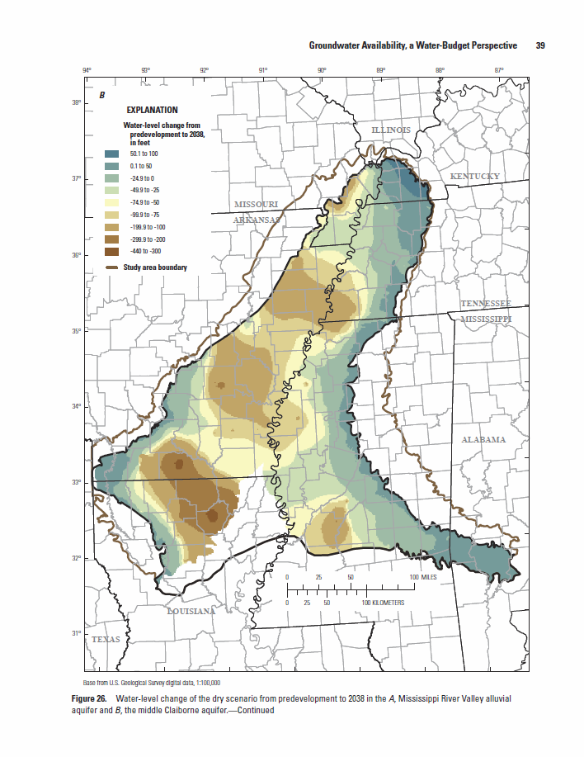
Water level change from predevelopment to 2007 in the middle Claiborne aquifer
Predicted water level change of the dry scenario in the middle Claiborne aquifer to 2038
Groundwater Availability of the Mississippi Embayment, USGS Professional Paper 1785, 2011

Slide 27
Consequences of declining aquifer levels
Additional pumping costs for crop irrigation
Wells begin to draw air and yield decreases
Availability of water may restrict crop choice
Salt water intrusion can spoil well
Surface streams lose base flow
Aquatic life adversely impacted
Waste load assimilation reduced
Reduced water quality

Slide 28
How does today’s weather and the predicted changes in weather patterns affect water demands?

Slide 29
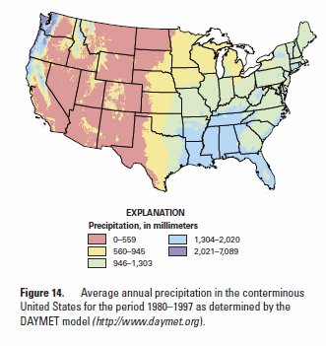
Average Annual Precipitation in the conterminous U.S. for 1980-1997 as determined by the DAYMET model
Inches
0-22
22.1-37.2
37.3-51.3
51.4-79.6
79.7-279.1
Healy, R.W., Winter, T.C., LaBaugh, J.W., and Franke, O.L., 2007, Water Budgets: Foundations for Effective Water-Resources and Environmental Management, USGS Circular 1308

Slide 30
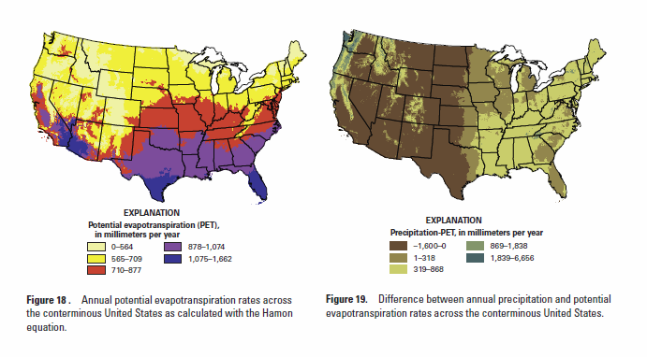
Potential Evapotranspiration rates and the difference between annual precipitation and evapotranspiration
0-22.1 inches
22.2-27.9
28.0-34.5
34.6-42.2
42.3-65.4
-63-0
0-12.5
12.6-34.1
34.2-72.3
72.4-262
Healy, R.W., Winter, T.C., LaBaugh, J.W., and Franke, O.L., 2007, Water Budgets: Foundations for Effective Water-Resources and Environmental Management, USGS Circular 1308

Slide 31
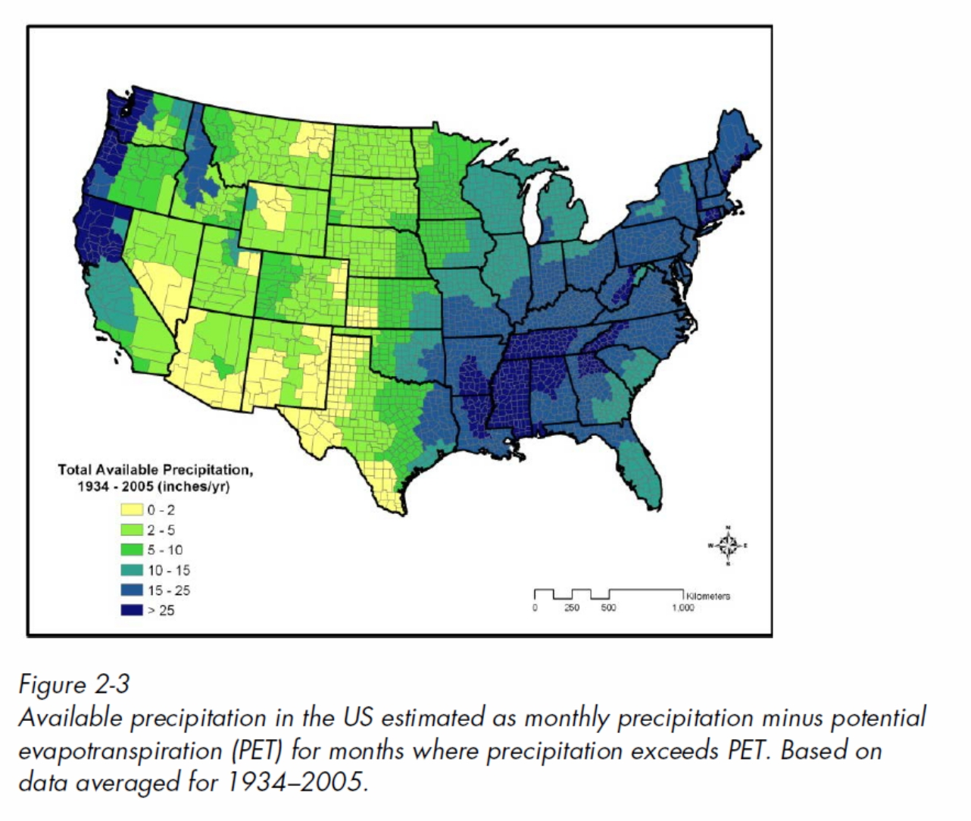
Available Precipitation by County
Effective precipitation is the available precipitation that occurs during the crop growing season. The Mississippi Alluvial Valley receives on average 14 inches of precipitation during the crop season, which is less than the ET demand for those months.
Electric Power Research Institute,”Water Use for Electricity Generation and Other Sectors: Recent Changes (1985-2005) and Future Projections (2005-2030), 2011 Technical Report

Slide 32
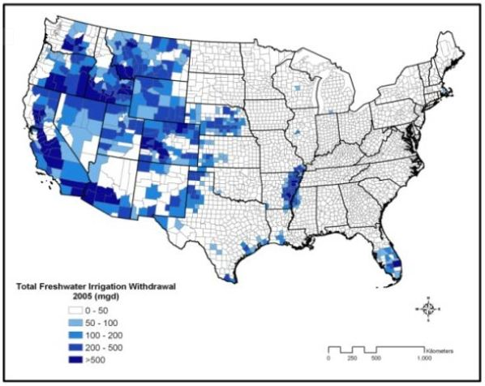
Freshwater Irrigation Withdrawal 2005
Electric Power Research Institute,”Water Use for Electricity Generation and Other Sectors: Recent Changes (1985-2005) and Future Projections (2005-2030), 2011 Technical Report

Slide 33
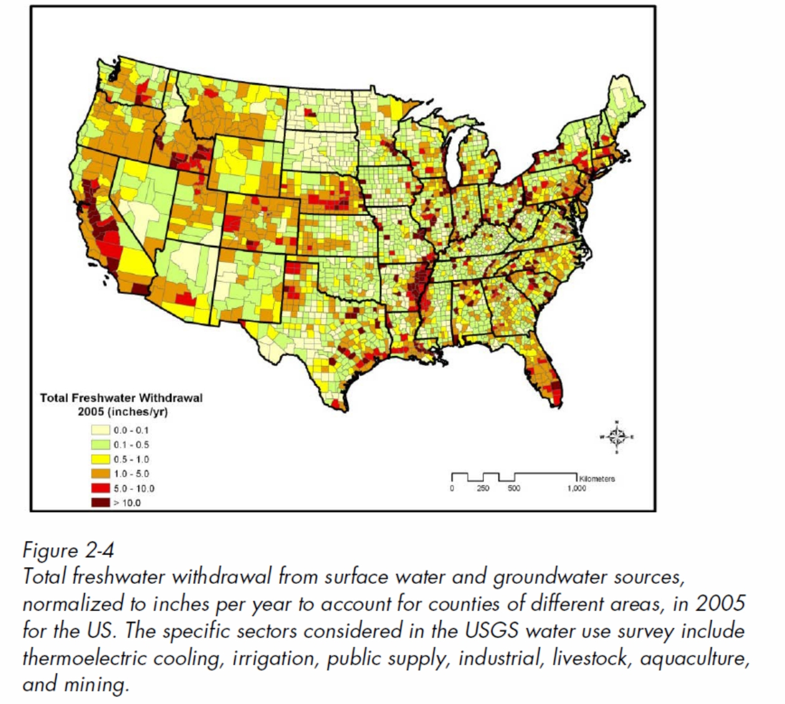
Total freshwater Withdrawal by County
Electric Power Research Institute,”Water Use for Electricity Generation and Other Sectors: Recent Changes (1985-2005) and Future Projections (2005-2030), 2011 Technical Report

Slide 34
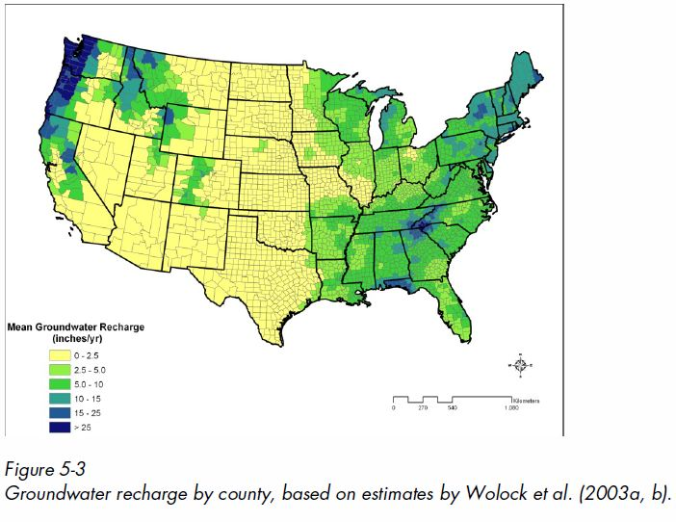
Mean Groundwater Recharge (inches/yr)
Electric Power Research Institute,”Water Use for Electricity Generation and Other Sectors: Recent Changes (1985-2005) and Future Projections (2005-2030), 2011 Technical Report

Slide 35
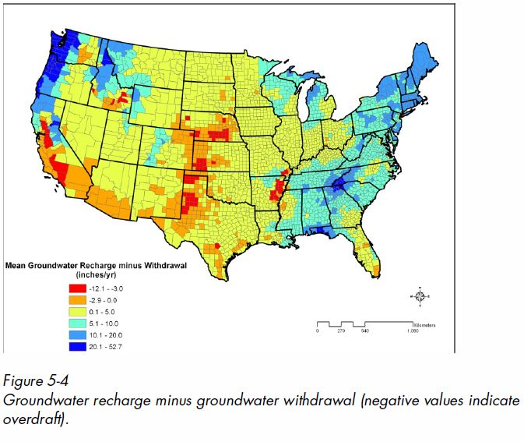
Freshwater Irrigation Withdrawal 2005
Electric Power Research Institute,”Water Use for Electricity Generation and Other Sectors: Recent Changes (1985-2005) and Future Projections (2005-2030), 2011 Technical Report

Slide 36
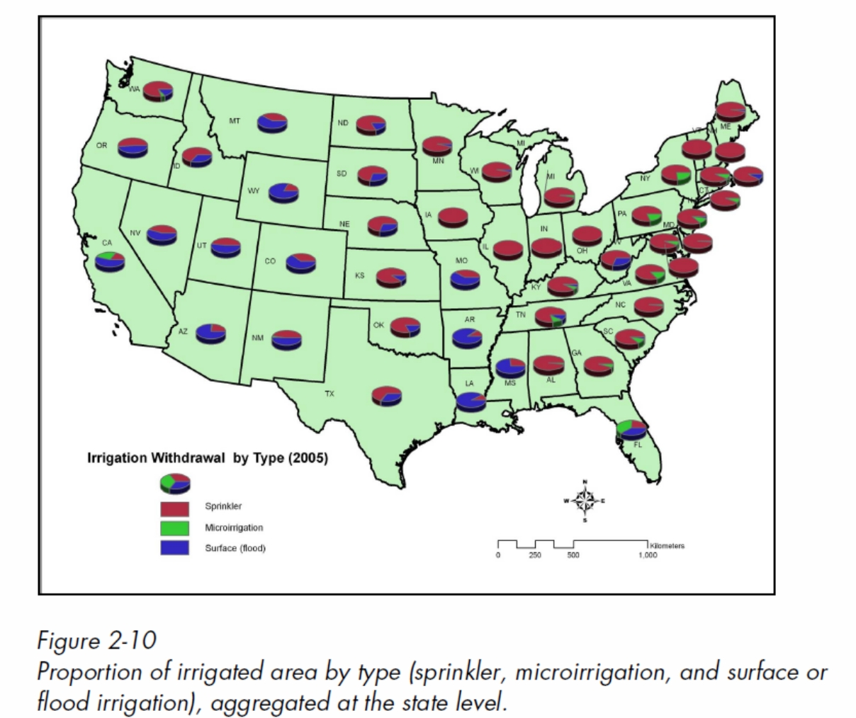
Irrigation Methods by State
Electric Power Research Institute,”Water Use for Electricity Generation and Other Sectors: Recent Changes (1985-2005) and Future Projections (2005-2030), 2011 Technical Report

Slide 37
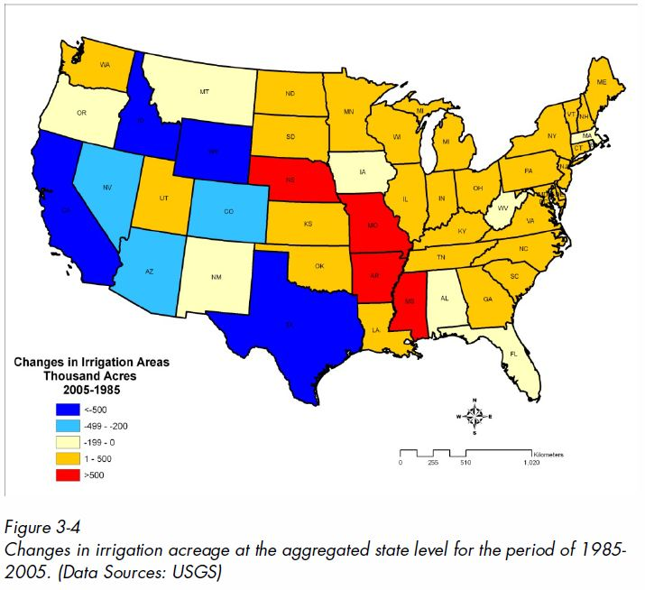
Changes in irrigated acreage 1985-2005
Electric Power Research Institute,”Water Use for Electricity Generation and Other Sectors: Recent Changes (1985-2005) and Future Projections (2005-2030), 2011 Technical Report

Slide 38
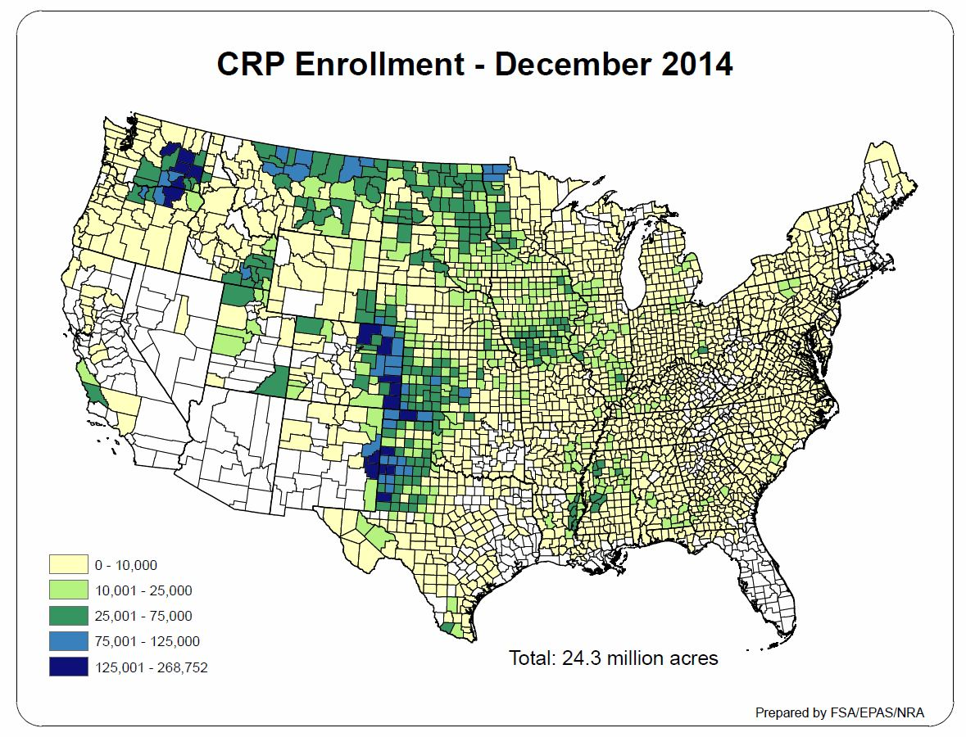
USDA-Farm Services Agency

Slide 39
Third National Climate Assessment Predictions on future precipitation patterns in the U.S.

Slide 40
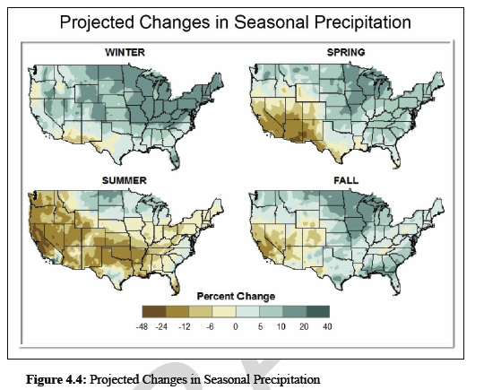
National Climate Assessment 2012 Report
Reduced precipitation over most of the agricultural areas of the U.S. during the crop season

Slide 41
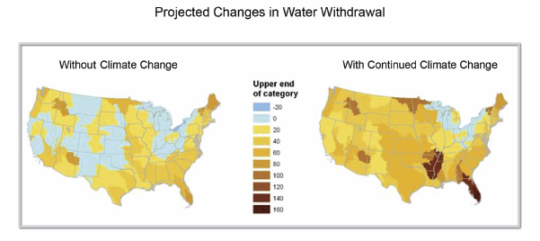
National Climate Assessment 2012 Report
Percent Change
Climate change will increase irrigation demand in the Mississippi Alluvial Valley by 180%

Slide 42
What are the impacts of groundwater abstraction in excess of the rate of recharge?

Slide 43
Historically the Big Sunflower River at Sunflower, MS was both a gaining and losing stream
Notes:
Total phosphorus shows a significant downward trend. 2008 was a very wet year. It had 78 inches of rain. Third and forth quarters of 2009 were also very wet. So wet there was little fall field preparations.

Slide 44
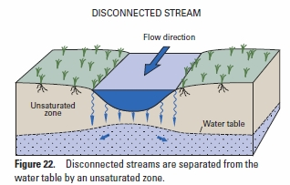
Currently Big Sunflower River at Sunflower, MS
is a Disconnected Stream
Notes:
Total phosphorus shows a significant downward trend. 2008 was a very wet year. It had 78 inches of rain. Third and forth quarters of 2009 were also very wet. So wet there was little fall field preparations.

Slide 45
Big Sunflower River at Sunflower, MS
Cumulative Frequency by Decade
215
Notes:
Total phosphorus shows a significant downward trend. 2008 was a very wet year. It had 78 inches of rain. Third and forth quarters of 2009 were also very wet. So wet there was little fall field preparations.

Slide 46
Big Sunflower River at Sunflower, MS
Annual Minimum Flow
YMD starts fall flow augmentation
~ 50 cfs
cfs
Year
Notes:
Total phosphorus shows a significant downward trend. 2008 was a very wet year. It had 78 inches of rain. Third and forth quarters of 2009 were also very wet. So wet there was little fall field preparations.

Slide 47
Groundwater Level, Mississippi Delta, Leflore County
Notes:
Total phosphorus shows a significant downward trend. 2008 was a very wet year. It had 78 inches of rain. Third and forth quarters of 2009 were also very wet. So wet there was little fall field preparations.

Slide 48
Big Sunflower at Sunflower
5-Year Moving Average Flows
cfs
Year
Notes:
Total phosphorus shows a significant downward trend. 2008 was a very wet year. It had 78 inches of rain. Third and forth quarters of 2009 were also very wet. So wet there was little fall field preparations.

Slide 49
Groundwater depletion leads to increased capture of exogenous surface water and groundwater through a reduction in groundwater discharge to streams

Slide 50
How have water-level declines changed the condition of the alluvial aquifer?
Confined Conditions in 1870
(Predevelopment)
Water-Table Conditions in 2007
Recharge
0.307/248,889
Discharge to wells
-2.19/-1,775,462
Recharge
0.066/53,507
Mississippi
River
-0.002/ -1,621
Mississippi River
0.011/ 8,918
Bluff Hills
0.052/ 42,157
Bluff Hills
0.035/ 28,375
Stream Leakage
-0.192/ -155,657
Stream Leakage
0.120/ 97,286
Underlying Units
0.095/77,018
Underlying Units
-0.022/-17,836
This information was provided by the USGS
Notes:
Units white text in km3, orange in acre feet

Slide 51
USGS

Slide 52
Summer Flow Duration by Decade for Bayou Meto at Lonoke, AR
Based on stage data of the USGS

Slide 53
Annual Flow Duration for Boeuf River at Girard, LA
Based on discharge data of the USGS

Slide 54
Fall Flow Duration for the Boeuf River at Girard, LA by Decade
Based on stage data of the USGS

Slide 55
Flow Duration for Bayou Bartholomew at Jones, AR
1335
Based on discharge data of the USGS

Slide 56
Flow Duration for Bayou Macon at Delhi, LA
500 cfs
230 cfs
Based on discharge data of the USGS

Slide 57
Spring Flow Duration for Tensas River at Tendal, LA
Based on discharge data of the USGS

Slide 58
Economic Impact of Groundwater

Slide 59
Farm Income from counties within the MAV
 | Louisiana Farm Income
Year | Corn | Cotton | Rice | Soybeans | SugarCane | Total
2012 | 575,784,445 | 137,150,000 | 129,821,933 | 640,366,016 | 203,556,944 | 1,686,679,338
2007 | 392,498,911 | 150,523,000 | 106,667,071 | 166,990,064 | 140,827,132 | 957,506,178
2002 | 119,131,975 | 126,453,000 | 41,774,388 | 92,589,345 | 142,104,383 | 522,053,091
1997 | 115,059,782 | 289,015,000 | 109,746,842 | 194,248,172 | 127,470,053 | 835,539,849
 | Mississippi Production-Sales
Year | Corn | Cotton | Rice | Soybeans |  | Total
2,012 | 658,091,080 | 212,143,000 | 127,360,998 | 945,898,220 |  | 1,943,493,297
2,007 | 332,980,932 | 241,688,000 | 156,646,867 | 371,210,710 |  | 1,102,526,509
2,002 | 75,162,282 | 325,305,000 | 69,361,226 | 176,792,253 |  | 646,620,760
1,997 | 59,639,874 | 383,782,000 | 129,912,110 | 328,147,399 |  | 901,481,383
 | Arkansas Production Sales
Year | Corn | Cotton | Rice | Soybeans |  | Total
2,012 | 801,872,202 | 413,616,000 | 1,364,597,792 | 1,891,888,341 |  | 4,471,974,335
2,007 | 346,134,408 | 456,246,000 | 1,151,787,723 | 864,507,901 |  | 2,818,676,031
2,002 | 64,666,477 | 364,098,000 | 398,362,952 | 520,482,119 |  | 1,347,609,548
1,997 | 49,534,175 | 527,736,000 | 805,055,869 | 681,952,370 |  | 2,064,278,414
 | Missouri Production Sales
Year | Corn | Cotton | Rice | Soybeans |  | Total
2,012 | 394,108,668 | 187,246,000 | 167,776,718 | 464,103,545 |  | 1,213,234,930
2,007 | 353,562,203 | 163,619,000 | 142,694,756 | 285,205,052 |  | 945,081,012
2,002 | 110,089,366 | 137,123,000 | 38,184,783 | 170,838,160 |  | 456,235,309
1,997 | 130,360,886 | 176,870,000 | 64,511,226 | 215,264,167 |  | 587,006,279

Slide 60
Farm Income from counties within the MAV
Millions of $
Year | Corn | Cotton | Rice | Soybeans | SugarCane | Total Value
2,012 | 2,429.9 | 950.2 | 1,789.6 | 3,942.3 | 203.6 | 9,315.4
2,007 | 1,425.2 | 1,012.1 | 1,557.8 | 1,687.9 | 140.8 | 5,823.8
2,002 | 369.1 | 953.0 | 547.7 | 960.7 | 142.1 | 2,972.5
1,997 | 354.6 | 1,377.4 | 1,109.2 | 1,419.6 | 127.5 | 4,388.3

Slide 61
Conclusion The challenge of the last century was to provide economic security to the MAV, through the reduction in flood risk. That challenge was met. The challenge of this century will be to provide continued economic security by ensuring adequate water supply for crop production. Of the major U.S. aquifers used for irrigation, only the MAV has the potential for recovery (excess precipitation).

Slide 62
Conclusion – continued Groundwater depletion is a problem not just in the U.S., but in the whole world. The world’s population will continue to grow for the next 50 years or more. The population explosion will increase the demand for food, while increasing the demand on the over stressed aquifers of the world. You met the challenge of the last century, but are you willing to accept the challenge of this century?

