Slide 1
Hurricanes, Science and Service For Decision Makers
Frank Revitte
National Weather Service
Weather Forecast Office
New Orleans/Baton Rouge

Slide 2
Communicating Risk
“This is just a CAT 1 hurricane”
“It has never flooded here before”
“I’ve been through Katrina and Gustav, this is nothing”
“I saw the news break into programming, that GFS thing says it won’t come here, phew!”
“This is the same surge forecast as Gustav and I didn’t flood then”
“My app has most of those lines way east of here. I like the one that says CLIPER”
“We are going to evacuate for all CAT1 hurricanes from now on”
“Ah great, I have a GIS map. Finally something accurate”
“We just had our 100 year storm last year”

Slide 3
Saffir-Simpson Wind Scale
Categories based on wind speed
Ignores other threats such as wind duration, storm surge, heavy rainfall, river flooding, etc
No such thing as “just a category 1” or “only a tropical storm”
Can give people a dangerous and false sense of safety/security

Slide 4
2016 Seasonal Forecast
Weakening El Nino or possibly La Nina could be a major player
 | 2015 | Average | Colo. State | NOAA
Named Storms | 11 | 12 | 12 | 10-16
Hurricanes | 4 | 6 | 5 | 4-8
Major Hurricanes | 2 | 3 | 2 | 1-4
Accumulated Cyclone Energy (ACE) | 62 | 92 | 90 | 60-129
*CAUTION* It only takes one storm to make a “bad” season

Slide 5
2016 Atlantic Hurricane Season

Slide 6
2016 Seasonal Forecast
 | 2015 | Average | Colo. State | NOAA | Actual
Named Storms | 11 | 12 | 12 | 10-16 | 16
Hurricanes | 4 | 6 | 5 | 4-8 | 6
Major Hurricanes | 2 | 3 | 2 | 1-4 | 3
Accumulated Cyclone Energy (ACE) | 62 | 92 | 90 | 60-129 | 138

Slide 8
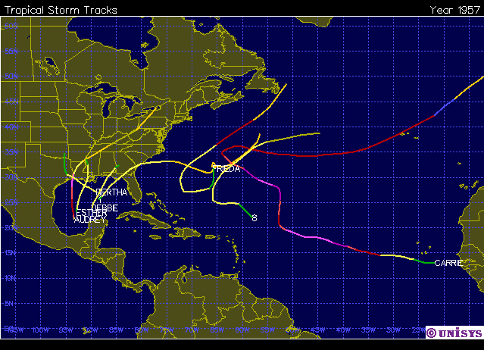
1957: Inactive Season, but High Impact for FL and LS
Moderate El Niño
Below normal activity
8 Named Storms
2 Hurricanes
1 Major Hurricane
Audrey – Cat 4

Slide 9
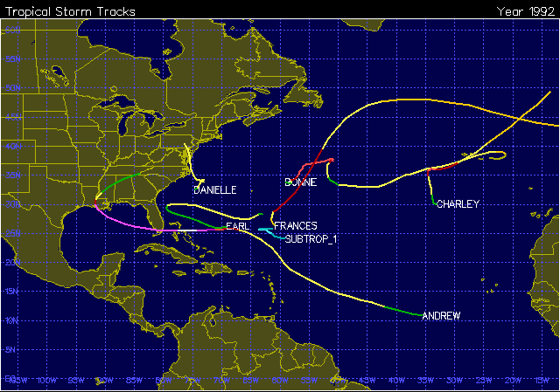
1992: Inactive Season, but High Impact for FL and LS
Neutral El Niño
Well below normal activity
7 Named Storms
3 Tropical Storms
4 Hurricanes
Andrew caused significant impacts across FL and LA

Slide 10
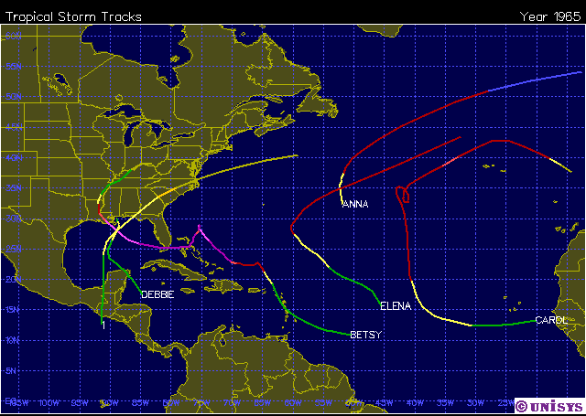
1965: Inactive Season, but High Impact for FL and LS
Strong El Niño
Well below normal activity
6 Named Storms
1 Tropical Storm
5 Hurricanes
Betsy caused significant impacts across FL and LA

Slide 11
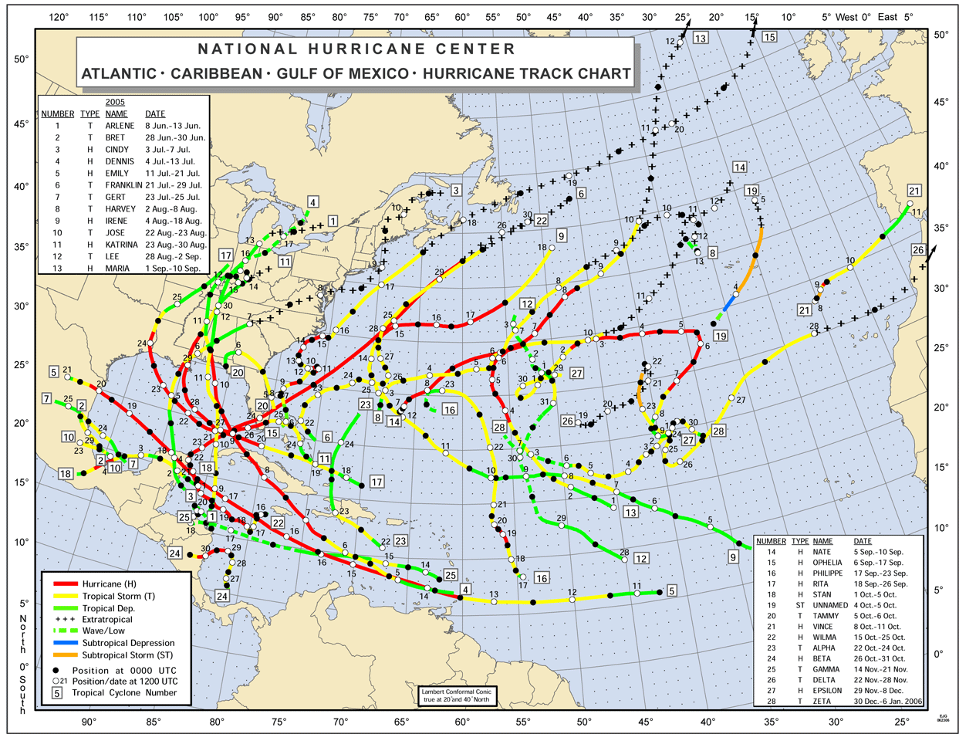
2005: Active Season with High Impact for FL and LS

Slide 12
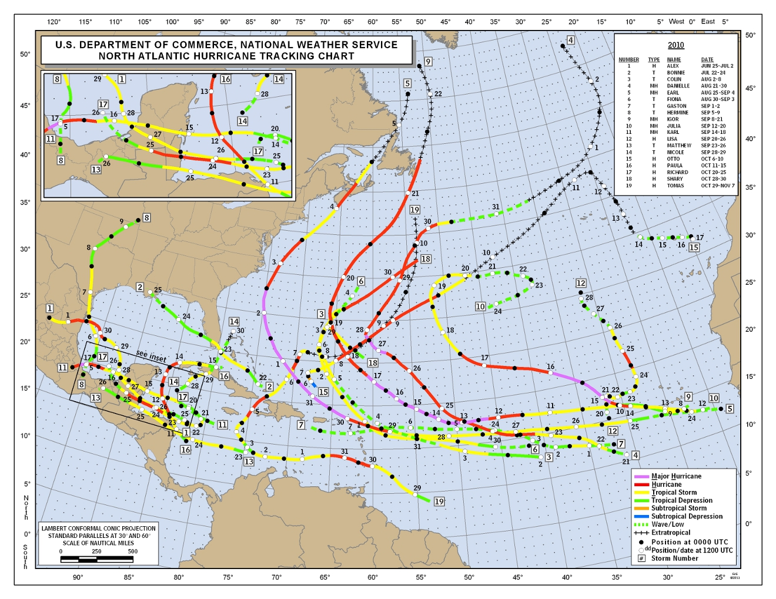
2010: Active Season, but Low Impact for FL and LS

Slide 13
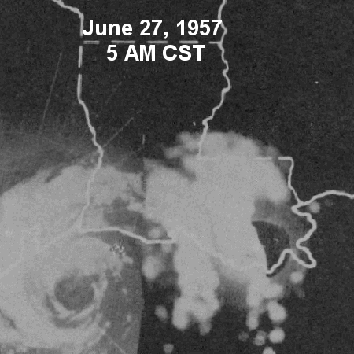
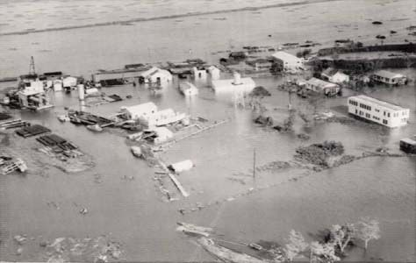
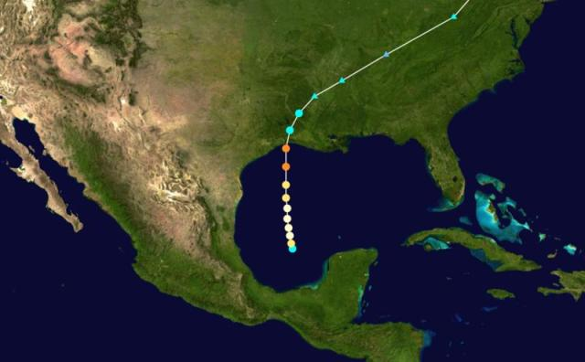
Lead Time is Great, but…
Hurricane Audrey (1957)
Landfall 9AM June 27 in SW LA as a cat 4 with winds of 105 mph and gusts up to 140 mph
Was not classified as TD until late June 24; less than 72 hrs prior to landfall
Was not classified as TS until early June 25; about 48 hrs prior to landfall

Slide 14
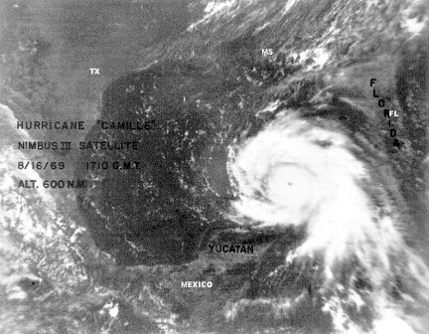
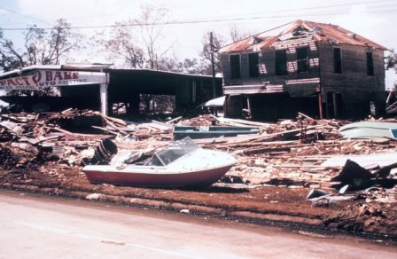
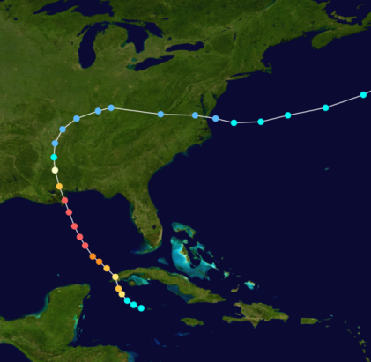
Lead Time is Great, but…
Hurricane Camille (1969)
Landfall 9PM Aug 17 in SE LA/MS as cat 5 with estimated gusts of 150-170 mph
Classified as a TS near Grand Cayman at 2PM Aug 14th; about 80 hrs prior to landfall

Slide 15
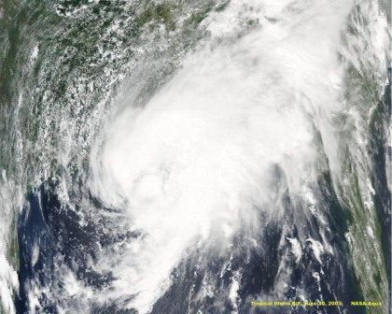
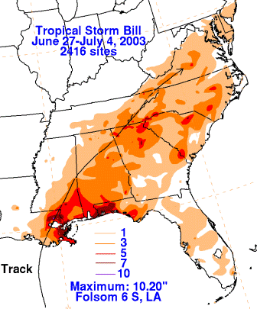
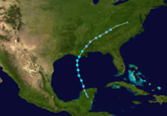
Lead Time is Great, but…
Tropical Storm Bill (2003)
Landfall 4PM June 30 in SE LA as a TS with winds of 60 mph
Classified as a TD at 10AM June 29; only 30 hrs prior to landfall

Slide 16
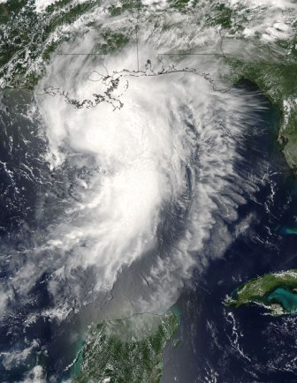
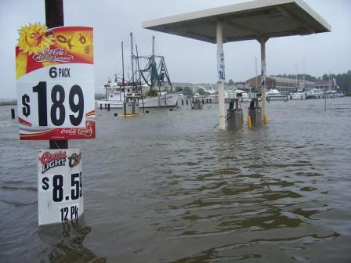
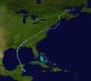
Lead Time is Great, but…
Hurricane Cindy (2005)
Landfall 10PM July 5 in SE LA as a cat 1 with winds of 75 mph. Most areas experienced TS winds around 60 mph.
Classified as a TD at 4PM July 3; about 48 hrs prior to landfall

Slide 17
Lead Time is Great, but…
Verified Position 1PM Mon
Along track errors can
reduce lead time.
TS winds started about 12 hours earlier than forecast 72 hrs prior
Forecast
Position
1PM Mon
Notes:
Though the track was very accurate from left to right, there were significant along track errors, resulting in reduced lead time

Slide 18
Local Hurricane Statistics
Average Tropical Storm Return Period = 2 years
Average Hurricane Return Period = 6.3 years
Most Recent Landfall: Hurricane Isaac (2012)
Large, slow moving category 1 hurricane
12-14 ft of storm surge on the coast (8.5 ft in Lake Pontchartrain)
Heavy rain, river flooding
Over $1 Billion in damage (Approx. $612 million in LA)

Slide 19
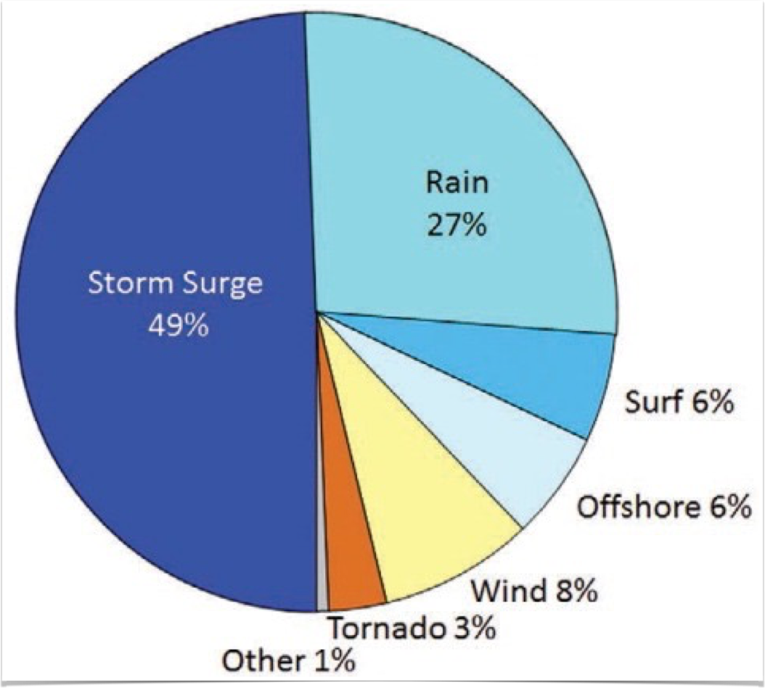
Causes of deaths directly attributable to Atlantic tropical cyclones
1963-2012

Slide 20
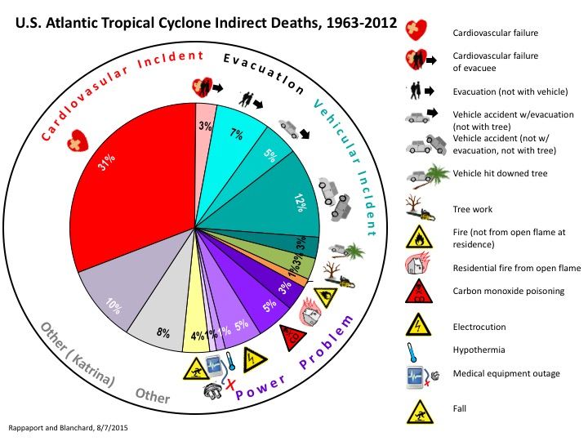

Slide 21
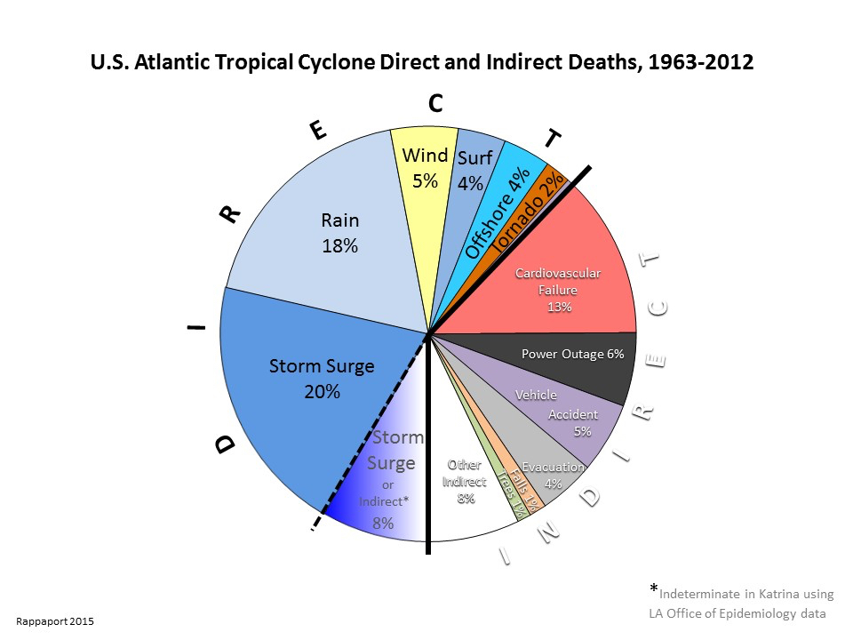

Slide 22
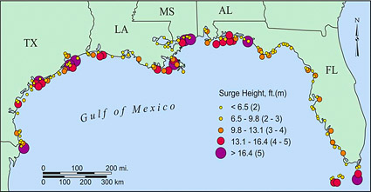
Storm Surge Events 1880-2011

Slide 23
Factors Influencing Storm Surge
Where the circulation center crosses the coast
Direction of storm motion relative to the coast
Wind strength (storm intensity)
Radius of maximum winds
Overall size of storm (outer wind radii)
Slope of the continental shelf
Shape of the coastline and other coastal features (barrier islands, bays, rivers, levees, etc)

Slide 24
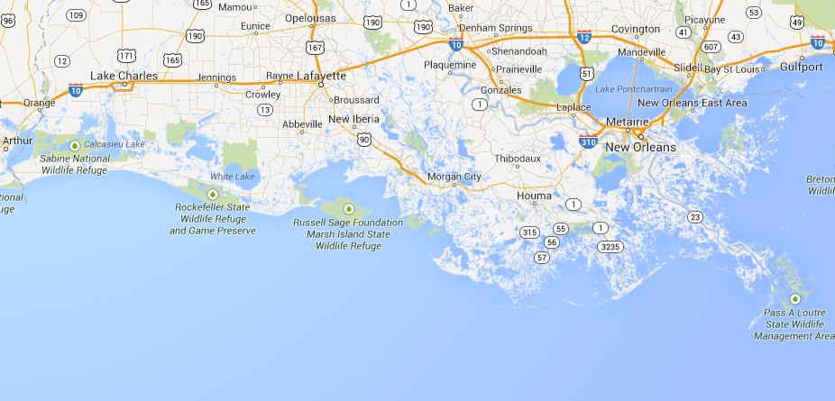
Storm Surge Influences: Shape of the Coastline
Is there anywhere water can be “funneled”?
Any inlets/rivers for water to travel inland?
How quickly does land elevation increase?

Slide 25
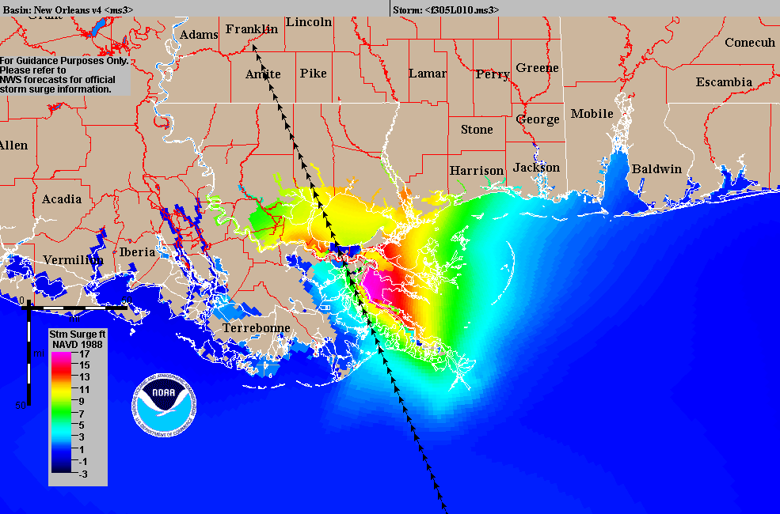
Single Track Storm Surge Plot

Slide 26
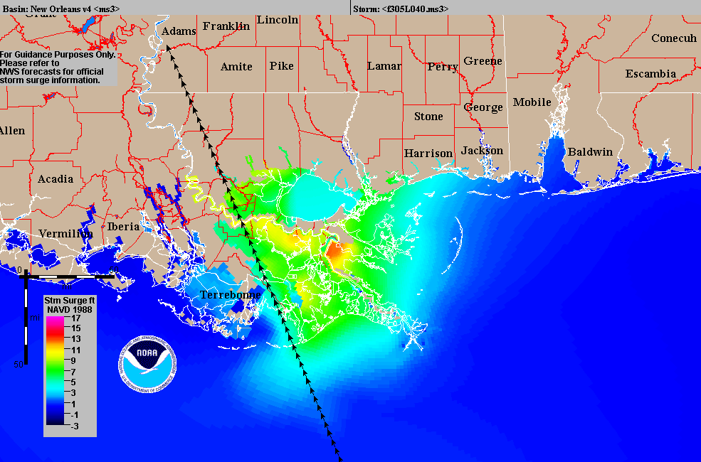
Single Track Storm Surge Plot (moved track west)

Slide 27
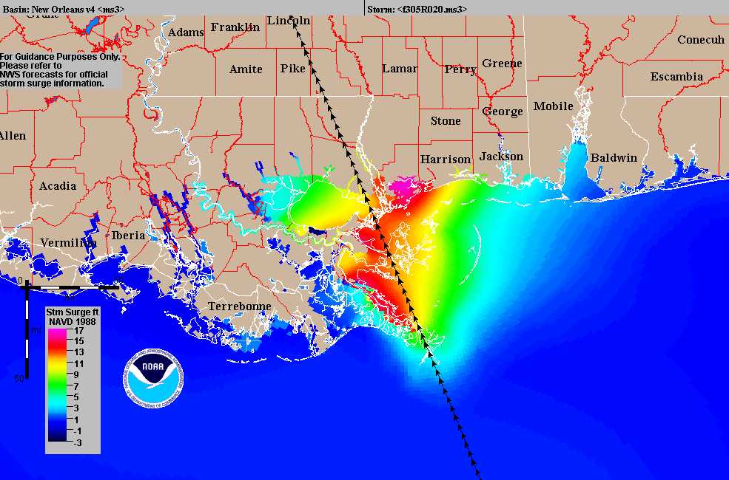
Single Track Storm Surge Plot (moved track east)

Slide 28
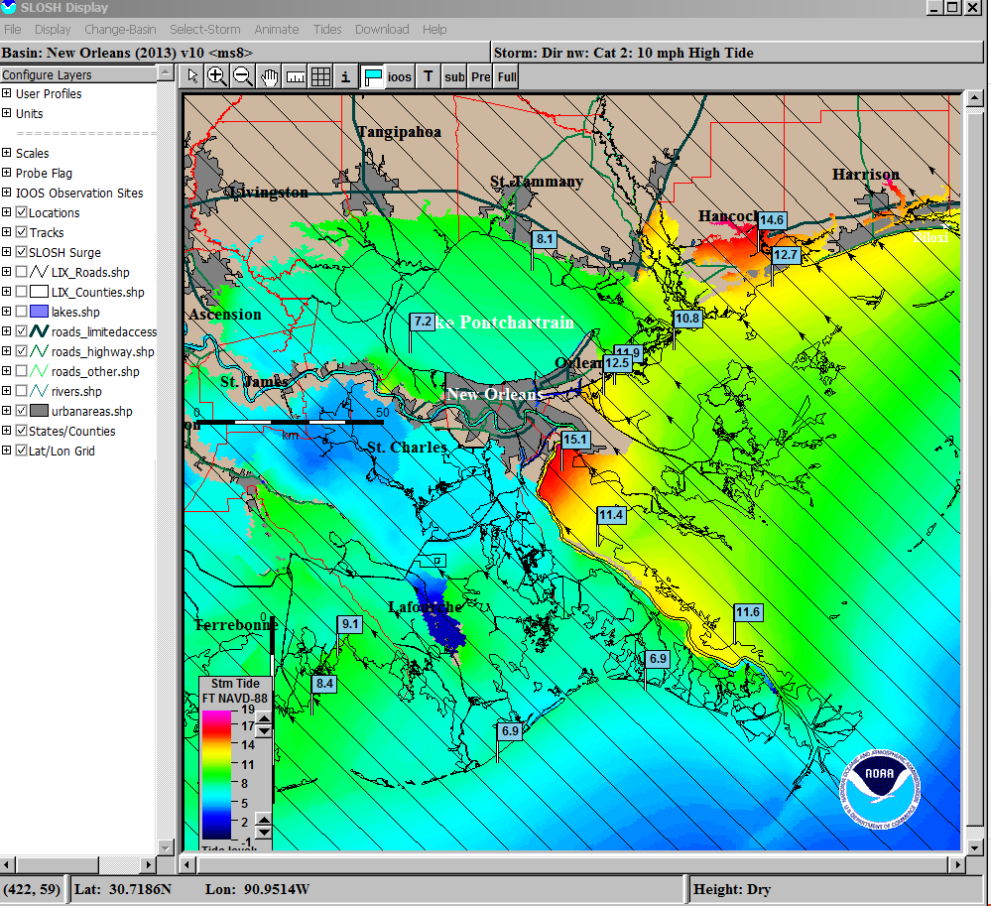

Slide 29
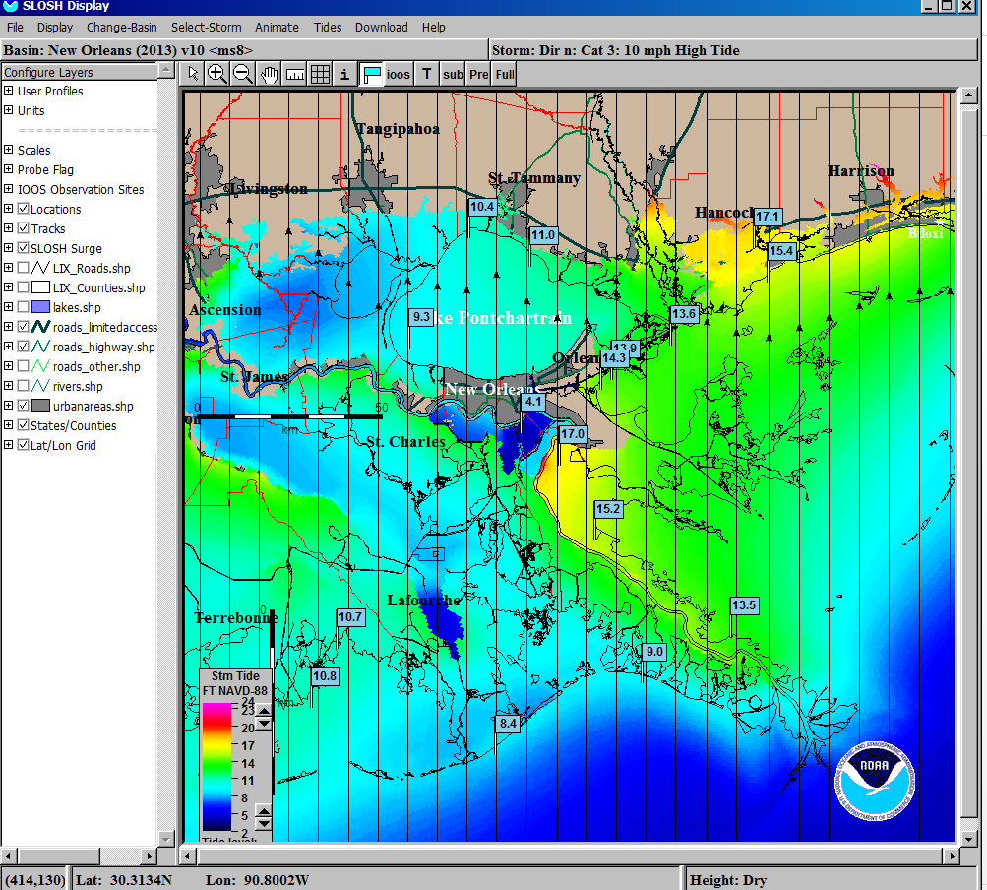

Slide 30
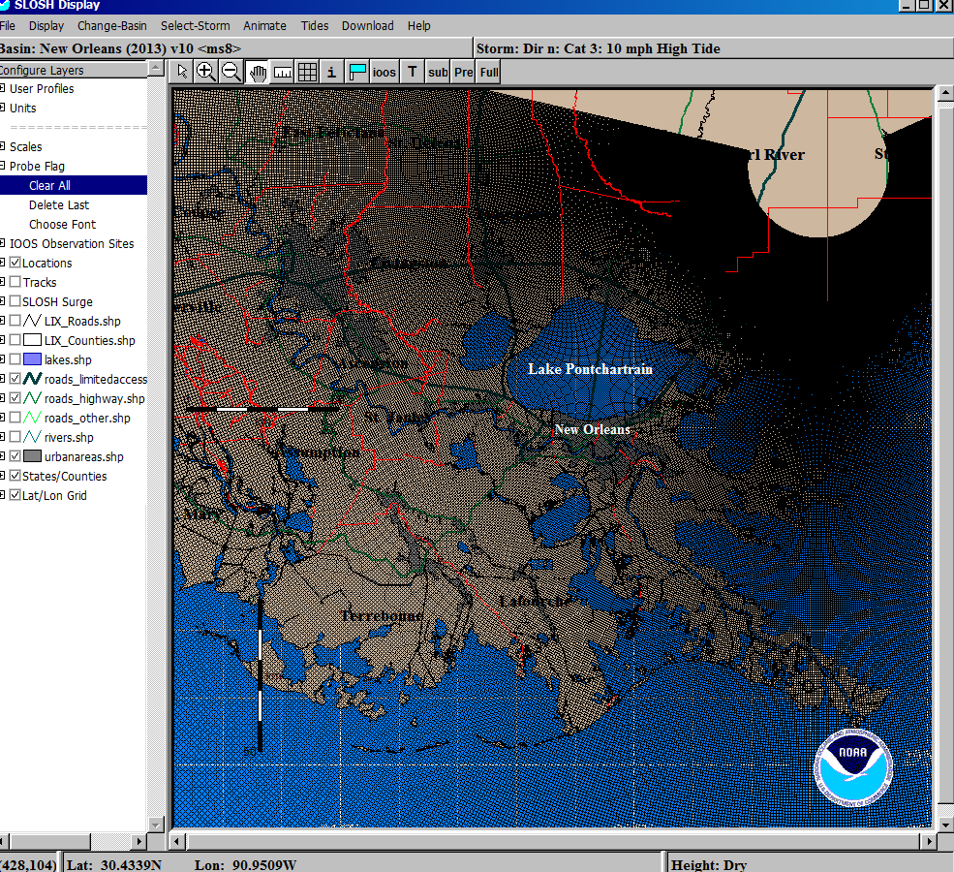
SLOSH Grid Resolution Greatly Increased in 2013

Slide 31
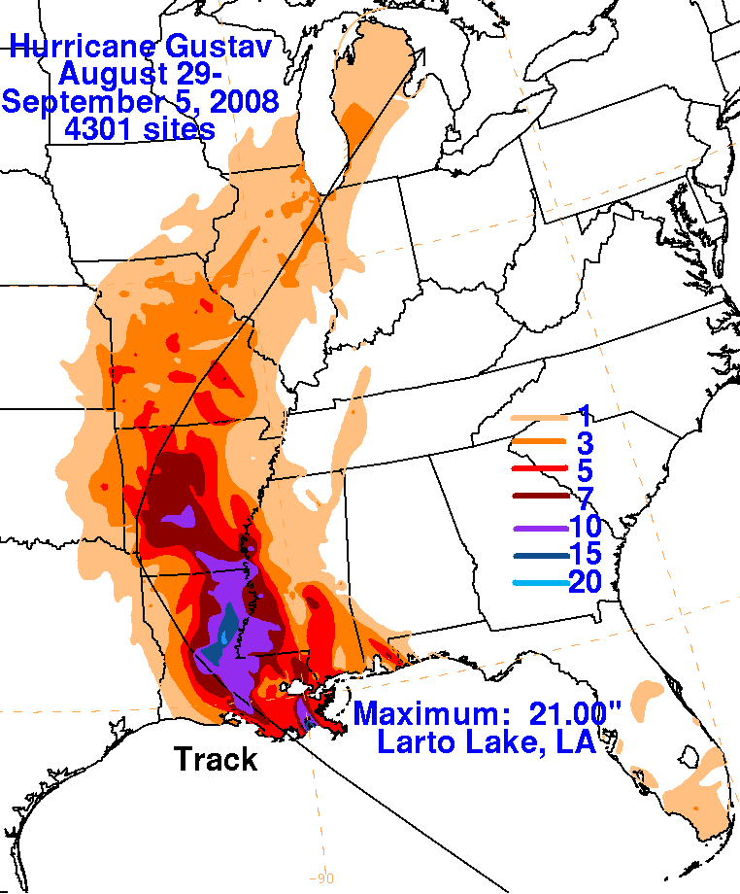
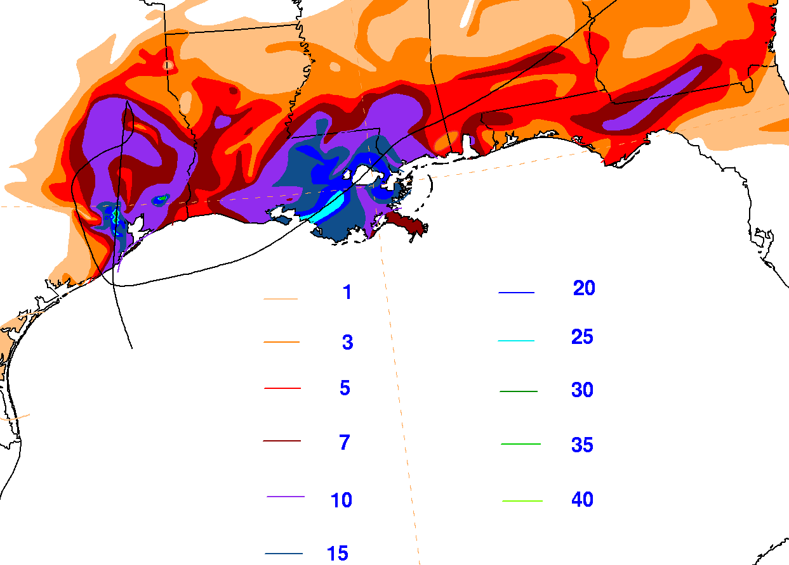
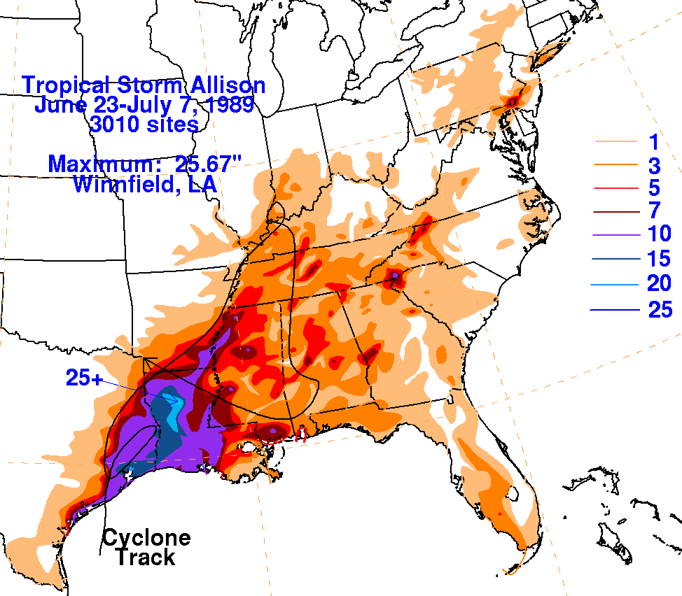
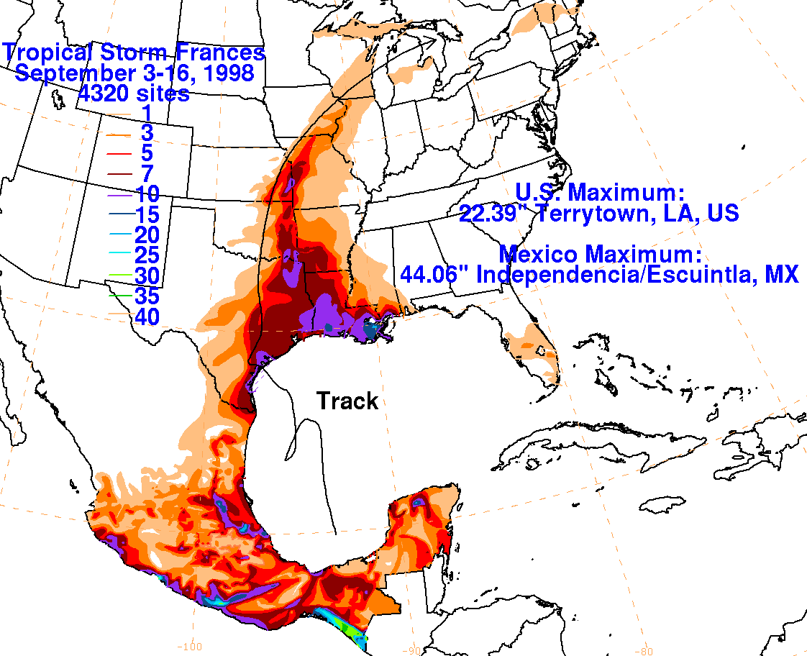
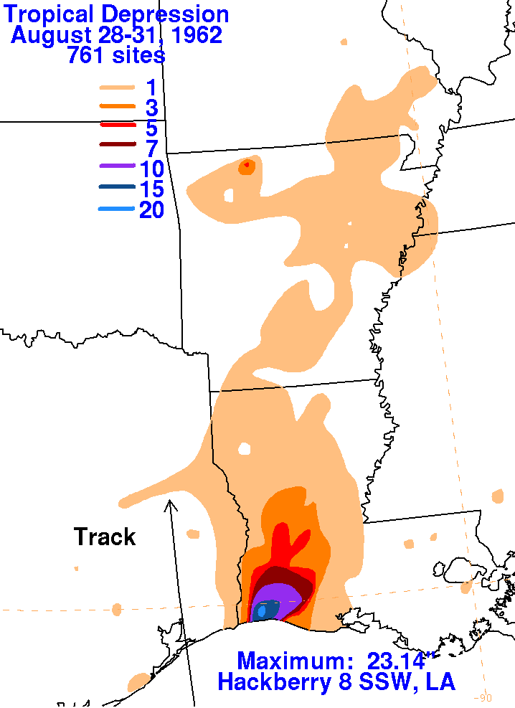
Historic Heavy Rain Events
1962 TD- 23.14”
2. 1989 TS Allison- 25.67”
3. 1998 TS Frances- 22.39”
4. 2001 TS Allison- 25” with >40+” in Texas
5. 2008 Hurricane Gustav- 21.00”
* Recent studies indicate that the probability of high intensity/excessive rain events will increase

Slide 32
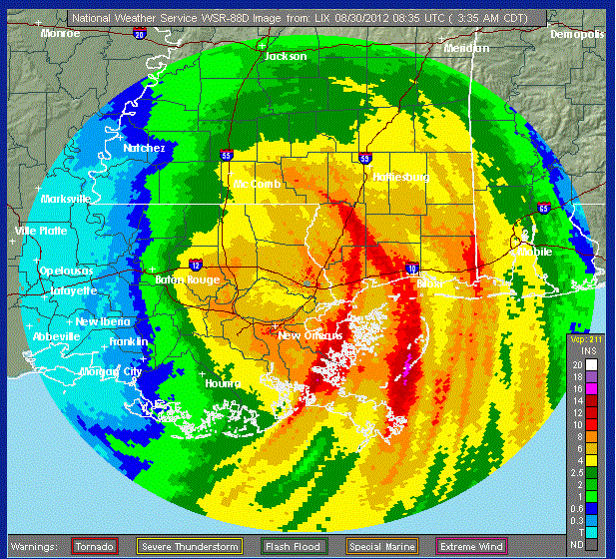
Hurricane Isaac Rainfall Impacts

Slide 33
Hurricane Isaac Rainfall Impacts
Location | Crest (feet)
Wolf near Landon | 31.36 (record)
Wolf near Gulfport | 16.50 (record)
Hobolochitto near Caesar | 21.48 (record)
Tangipahoa near Kentwood | 16.86 (major)
Tangipahoa near Robert | 24.02 (major)
Amite near Maurepas | 7.48 (major)
Pearl near Pearl River | 18.54 (major)
Bogue Chitto near Tylertown | 29.81 (major)
Bogue Chitto near Franklinton | 22.13 (major)
Bogue Chitto near Bush | 19.82 (major)
Biloxi near Wortham | 26.38 (major)

Slide 34
Information Timeline Scenario from pre-formation to landfall

Slide 35
There’s a Tropical Wave Moving Toward The Caribbean…

Slide 36
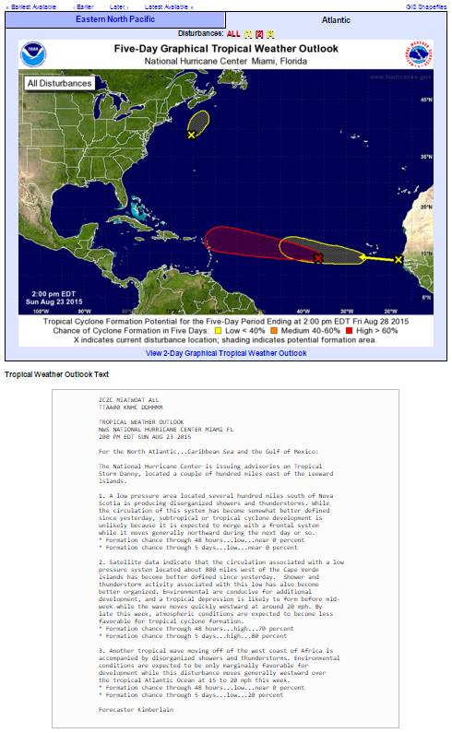
Tropical Weather Outlook
Available on the NHC website for easy access
Issued for both a 2-day and 5-day period
Issued in both graphical and text format

Slide 37
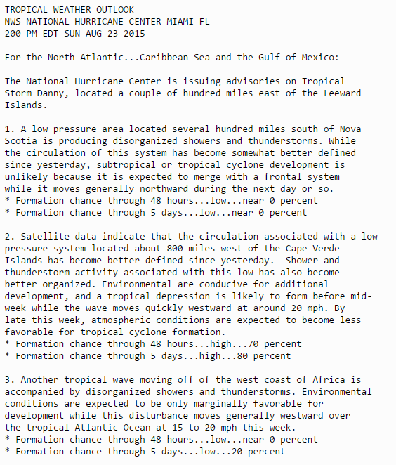
Tropical Weather Outlook
Any systems for which advisories are being issued will be listed first
Potential development areas are numbered and each is assigned a probability of development over the next 2 days and 5 days

Slide 38
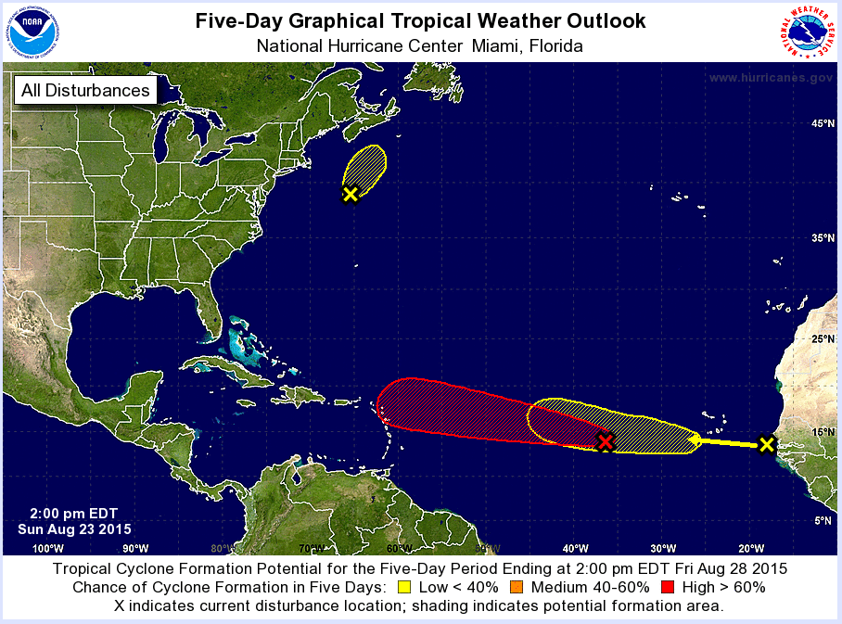
Tropical Weather Outlook
5-day graphic does NOT include current systems
All potential development areas included
For more detail, click on one of the disturbances

Slide 39
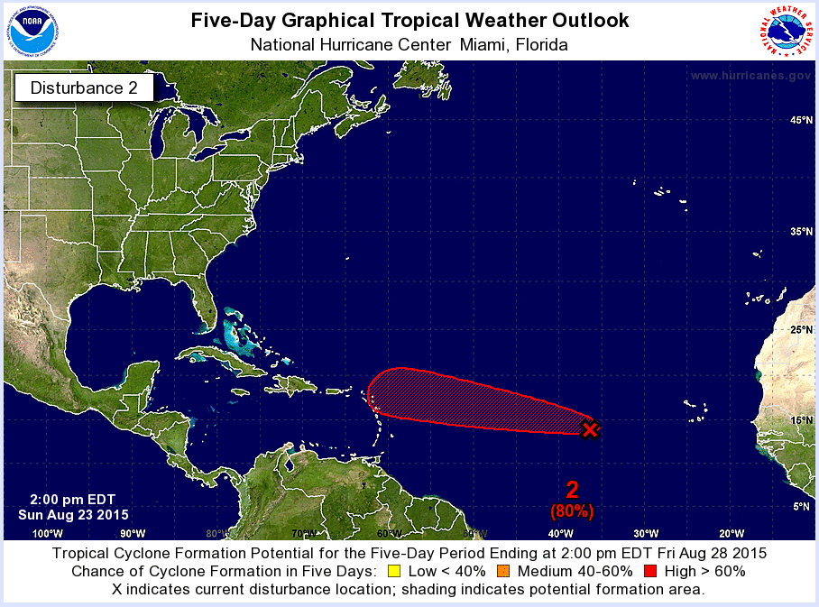
Tropical Weather Outlook
Indicates this is a graphic for a single disturbance
Possible “track”
Of Disturbance
Current Location of Disturbance
Probability of Development
Disturbance number

Slide 40
Tropical Weather Outlook
How To Use:
Highlights areas where development might occur over the next 2-5 days
Gain an overall sense of the likelihood a given disturbance will develop
Can infer a VERY GENERAL idea of how a disturbance might move
Things To Be Aware Of:
Shaded areas are NOT actual forecast tracks, but a broad area over which development may occur
For development probabilities of 50% or higher, there has been a slight low bias in the forecast the last few years (in other words more than 50% of the disturbances with a 50% probability of development actually developed)

Slide 41
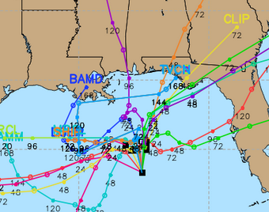
A Note About Spaghetti Plots…
Models notoriously struggle before an actual low pressure center has formed (i.e. for “invests”), so take any guidance with a grain of salt
These plots can sometimes be used as a gauge of forecast confidence, but be careful, even a confident forecast can be wrong
NWS meteorologists have years of experience and know the strengths and weaknesses of the different models
Model tracks for Debby on Jun 24, 2012
Model tracks for Isaac on Aug 22, 2012

Slide 42
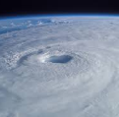
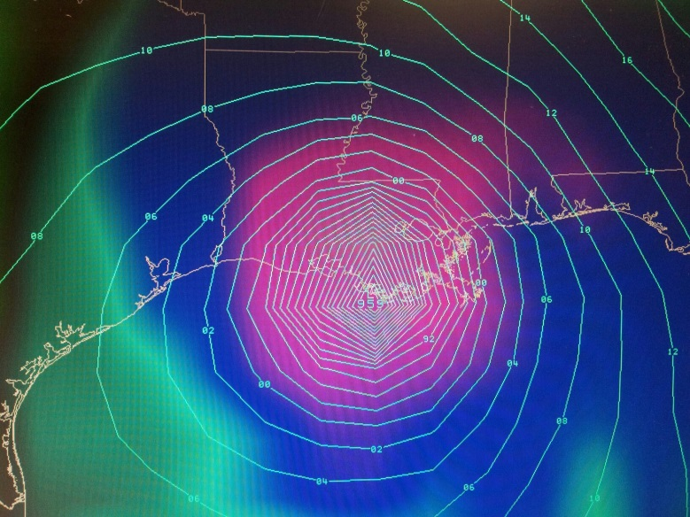
Social Media Alarmism
THE Armchair Weatherologist
Just because something goes “viral” doesn’t mean it’s true
Unfortunately, alarmism tends to spread much faster than level-headed reason
Never take a 10 day model forecast as gospel
If you have questions, just call us!
4 hrs · My Mom’s Basement
Look out Louisiana, latest GFS says you’ll be dealing with a category 3 hurricane in 10 days. Better start getting ready!!!
7K
476 Comments 23,582 Shares

Slide 43
A Tropical Storm Has Been Named in the Caribbean…

Slide 44
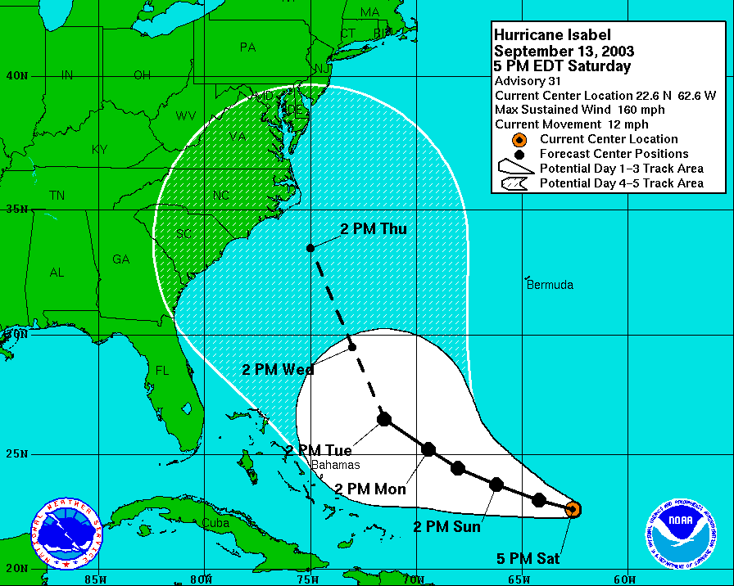

Slide 45
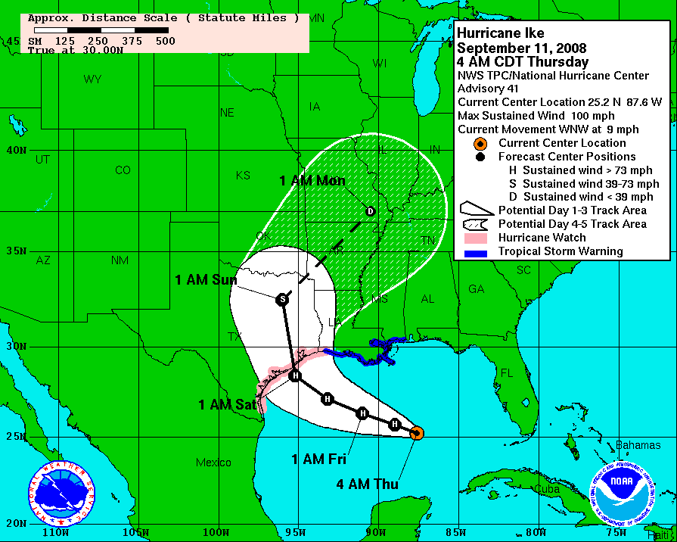
What The Forecast Cone Isn’t…
The cone is NOT a forecast of the impact area.
Impacts can extend well beyond the cone, especially for large storms.
At left, Hurricane Ike remained well south of the LA coast, and southeast LA was never in the cone, but storm surge from Ike exceeded that of Gustav in some places.

Slide 46
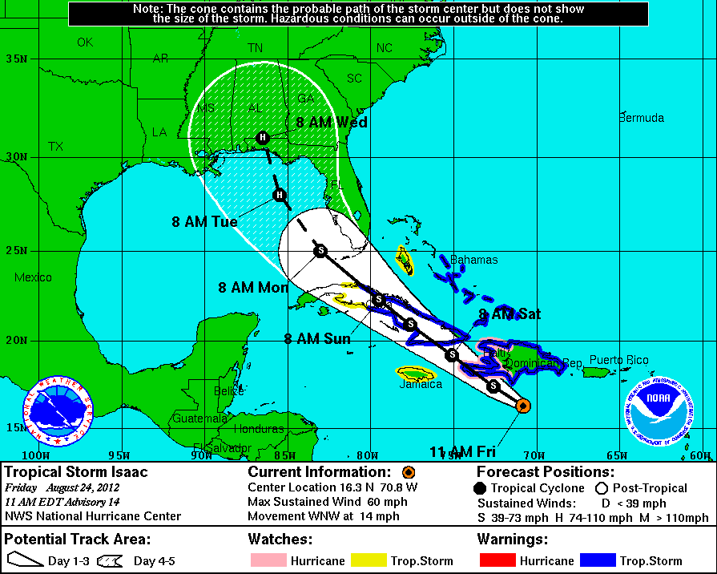
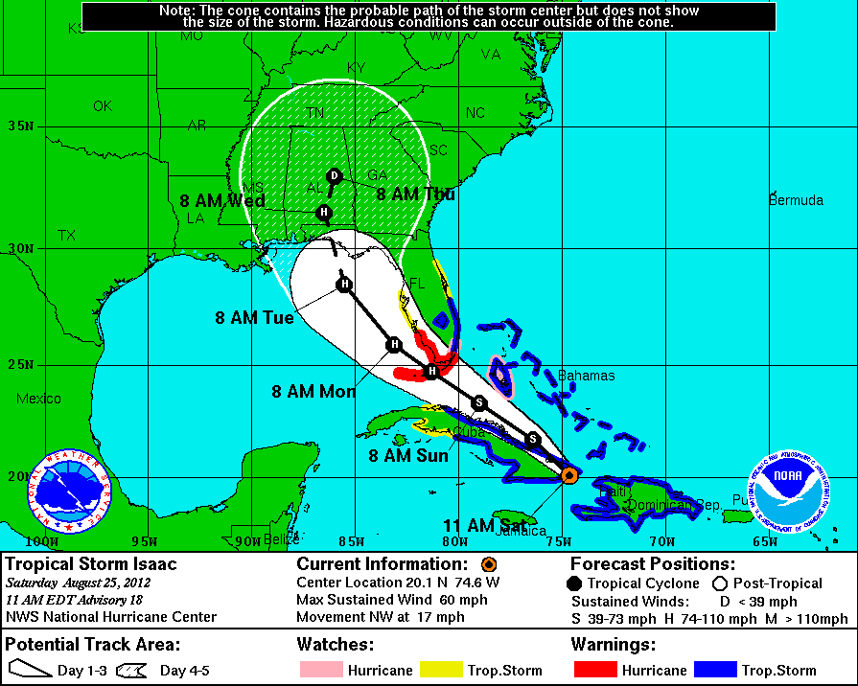
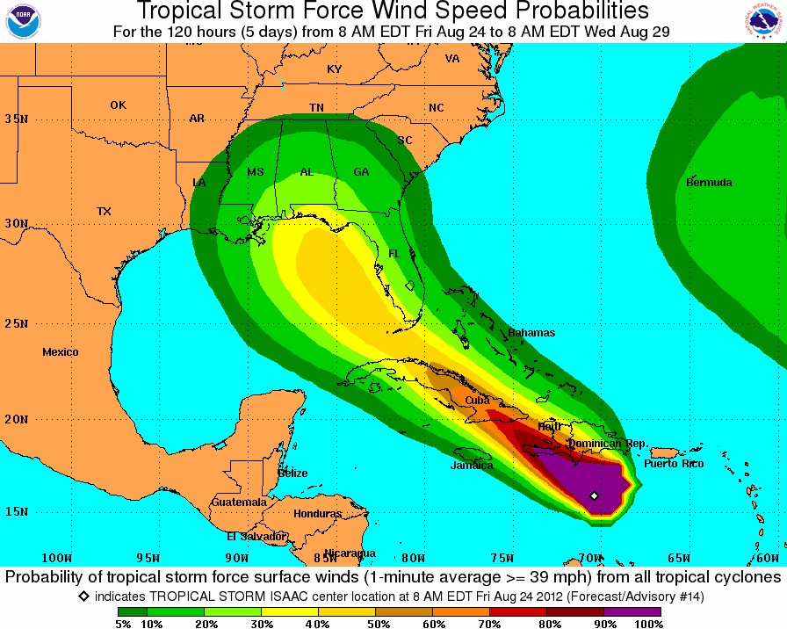
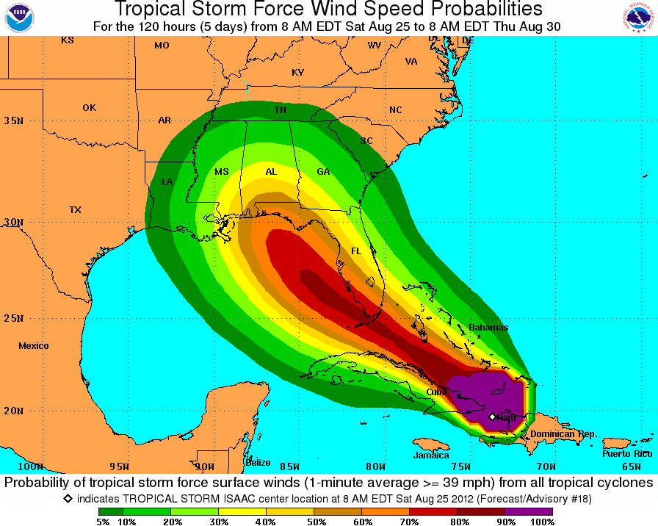
Wind Speed Probabilities
Hurricane Isaac Forecast at 11am 8/24/12
Hurricane Isaac Forecast at 11am 8/25/12
Don’t focus on exact numbers since probabilities will almost always be low several days from landfall
Focus on trends
For example, despite little change in the forecast track, probability of tropical storm force winds INCREASED across SE LA and S MS between the two forecasts depicted
Maximum probability: 20-30%
Maximum probability: 40-50%

Slide 47
Storm Surge Products – MEOWs
Uses multiple tracks and sizes, then keeps the highest value for each grid square
Can be displayed reference to NAVD88 or above ground level
Evacuation Decisions made with the MEOW
MEOW – Category 2, NW 10mph, High Tide
Water levels noted feet above terrain (AGL)

Slide 48
Storm Surge Products – MEOWs
How To Use:
Use in the pre-watch phase
Should preference at least 2 categories and/or speeds (depending on forecast confidence)
If our office is sending briefing updates (typical for any potential threat to SE LA or S MS), reference the briefing for the most likely scenarios
If there are any questions, contact us
Things To Be Aware Of:
Levees are included, and overtopping of levees is displayed
The MEOW will likely be overdone in some areas since it is based on multiple tracks and sizes
Color bars in the SLOSH display program change based on the actual values displayed unless manually edited. This could lead to misleading representation when comparing multiple MEOWs

Slide 49
A Tropical Storm or Hurricane Watch Has Been Issued (Major trigger for many additional products)

Slide 50
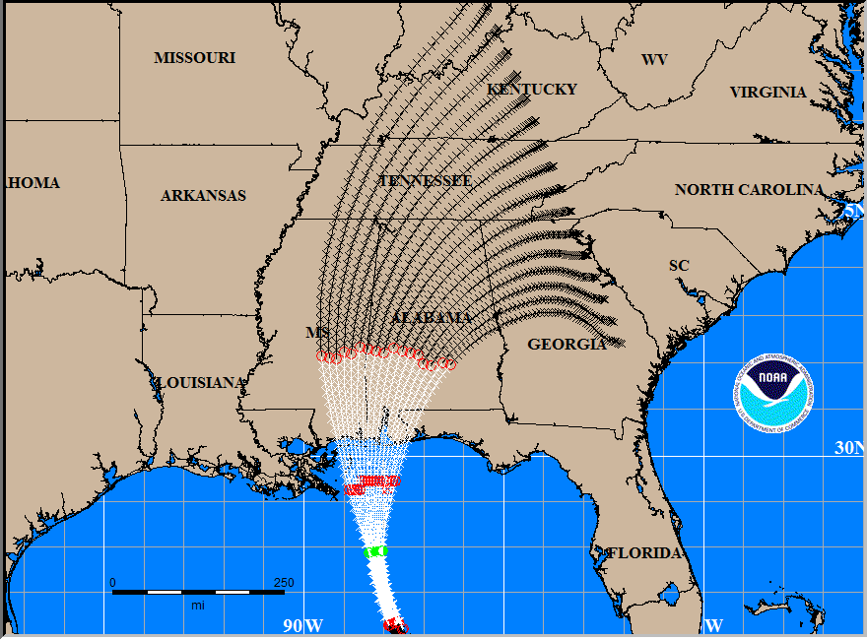
Probabilistic Surge (P-Surge) 2.0
Initiated when Watches and Warnings are in effect (48 hrs prior to onset of TS winds)
Based on the current storm
Accounts for errors in speed, direction, intensity, and size
Accounts for tide
Available approximately 60 minutes after each advisory is issued

Slide 51
NHC TRACK ERROR 12 hr. OUT
133 mph, 933 mb.
Hurricane Advisory – Approximately 12 hr. before landfall

Slide 52
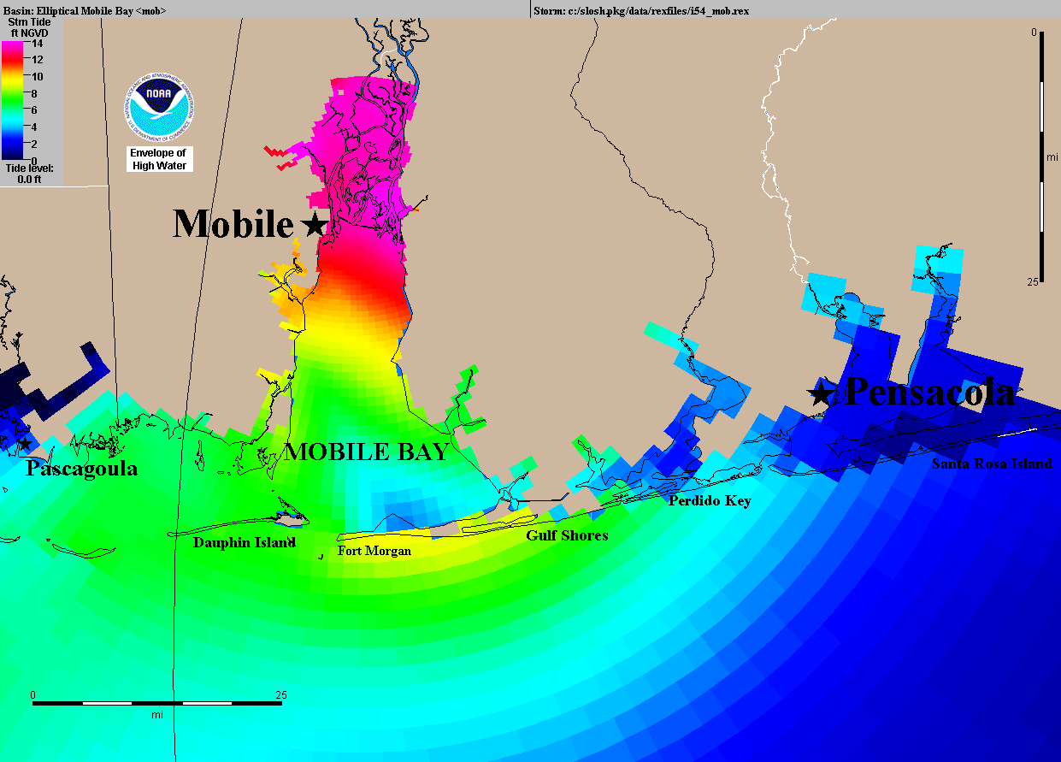
Rmax=25 mi
(forecast)
Surge Based on NHC -12 hr. Advisory

Slide 53
ACTUAL TRACK
TRACK FORECAST
133 mph, 933 mb.
Actual Hurricane Track 30 mi. E of -12 hr. Advisory Forecast Track

Slide 54
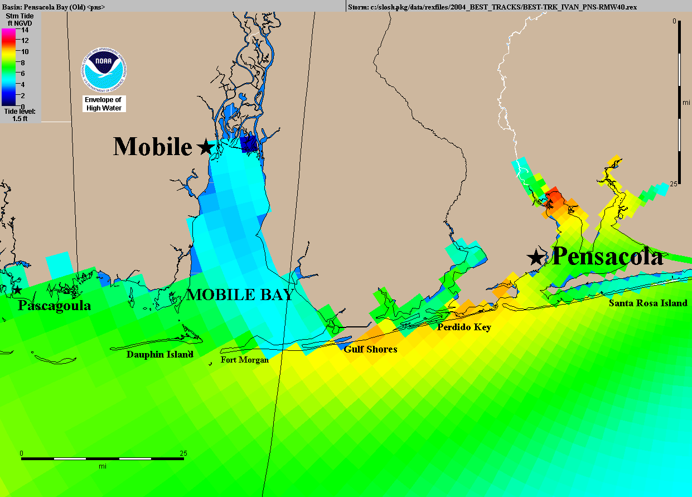
Rmax=40 mi
Surge Based on NHC Storm Best Track

Slide 55
Probabilistic product shows considerable surge threat to Pensacola area

Slide 56
Actual storm caused highest surge in Pensacola area

Slide 57
P-Surge 2.0
How To Use:
The 10% exceedance provides a “reasonable” worst case storm surge forecast based on the current track and intensity forecast
Experienced users can gain better understanding of storm surge timing by using the “incremental” option
Things To Be Aware Of:
Potential for BIG changes to storm surge representation from MEOWs to P-Surge – especially on fringes
Will be available to everyone at the same time
Small changes can occur from one advisory to the next
Can be displayed above NAVD88 datum or above ground level. Be sure you know which one you’re looking at

Slide 58
Potential Storm Surge Flooding Map (Inundation)
IMPORTANT: This is ONLY surge flooding
Based on P-Surge 2.0 10% exceedance (90% of solution this value or lower)
“Reasonable” worst case scenario
Available when watches/warnings are in effect (48 hrs prior to onset of TS winds, same as p-surge)
Will be available approximately 80 minutes after each advisory
New map generated for each advisory – some subtle changes possible
Risk Reduction System included
Outside of system: values will match p-surge
Inside of system: hatched area with no overtopping shown

Slide 59
Potential Storm Surge Flooding Map (Inundation)
How To Use:
Graphical depiction of “reasonable” worst case scenario with easy to understand color scale
Things To Be Aware Of:
Only accounts for storm surge flooding
Does NOT include fresh water (rain) flooding
Does NOT include any drainage flooding (water flowing downstream)
Will be available to everyone at the same time
Subtle changes can occur with each advisory, so do not focus on hard boundaries

Slide 60
Storm Surge Watch/Warning
“Experimental” for 2016
Graphic only, no text watch/warning product
Issued for areas where inundation greater than 3 feet is possible
exceedance, but with some “buffer”
CAN be issued for areas inside the risk reduction system

Slide 61
Storm Surge Watch/Warning
How To Use:
Determine areas where “life threatening” storm surge flooding will be possible (greater than 3 ft)
Can help support evacuation decisions – especially inside levee systems
Things To Be Aware Of:
Only accounts for storm surge flooding
Does NOT include fresh water (rain) flooding
Does NOT include any drainage flooding (water flowing downstream)
Will be available to everyone at the same time

Slide 62
Storm Surge Watch/Warning
How To Use:
Graphical representation of hurricane local statement which is issued by local NWS offices and discusses individual threats and threat areas
Determine risk of each individual threat
Storm Surge
Wind
Inland flooding (fresh water)
Tornado
Things To Be Aware Of:
Based on current advisory, so there could be subtle changes with each update
Only issued by coastal offices, so there will be discontinuities for inland threats

Slide 63
Some Final Thoughts…
Issuance of a tropical storm or hurricane watch/warning triggers the production of several other products and represents the biggest change in product usage
Every storm is different, please attend our webinars and read the emails to determine the greatest threats and impacts – if there are questions, just ask!
In a social media world, those you serve will get information at the same time as you do
Briefing schedules may not align well with forecast/advisory timing
Be careful where you get your information

Slide 64
National Weather Service New Orleans/Baton Rouge
www.weather.gov/neworleans
Facebook: NWSNewOrleans
Twitter: @NWSNewOrleans
985-649-0429x4 504-522-7330x4
Email:
Ken Graham – Meteorologist-in-Charge
Kenneth.Graham@noaa.gov
Frank Revitte – Warning Coordination Meteorologist
Frank.Revitte@noaa.gov

