Slide 1
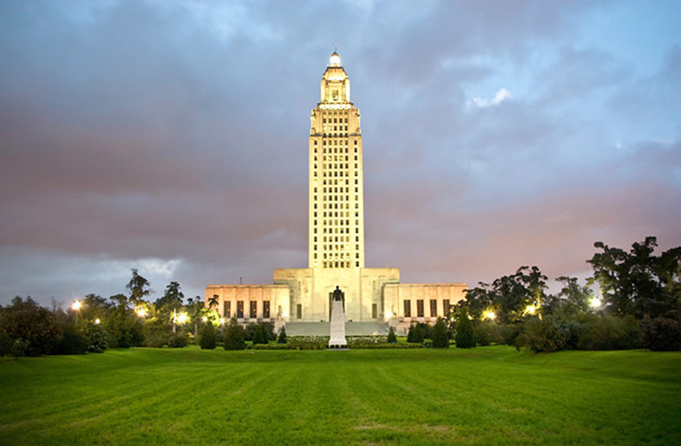
Weathering the Storm – 2016 Legislative Update
Representative
Jerome “Zee” Zeringue
Louisiana House of Representatives

Slide 2
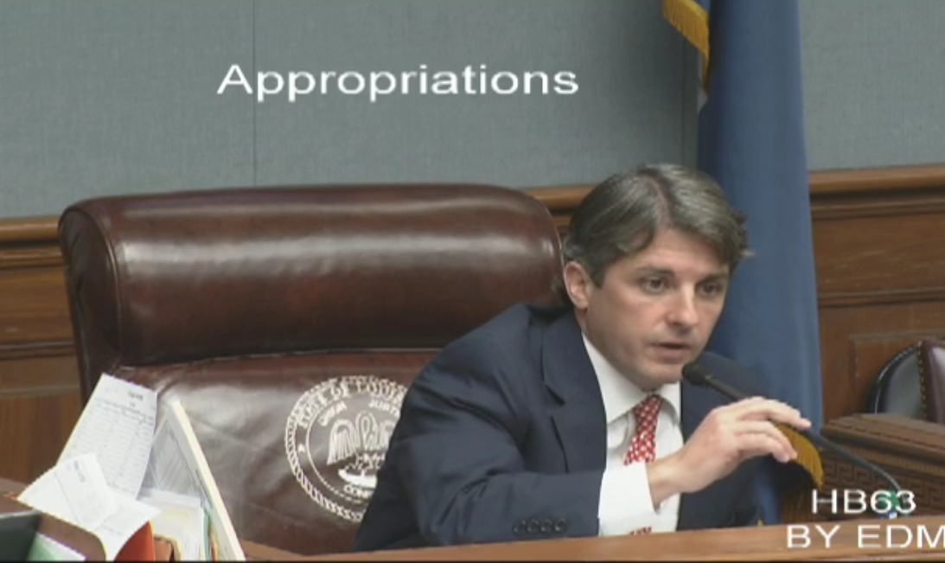
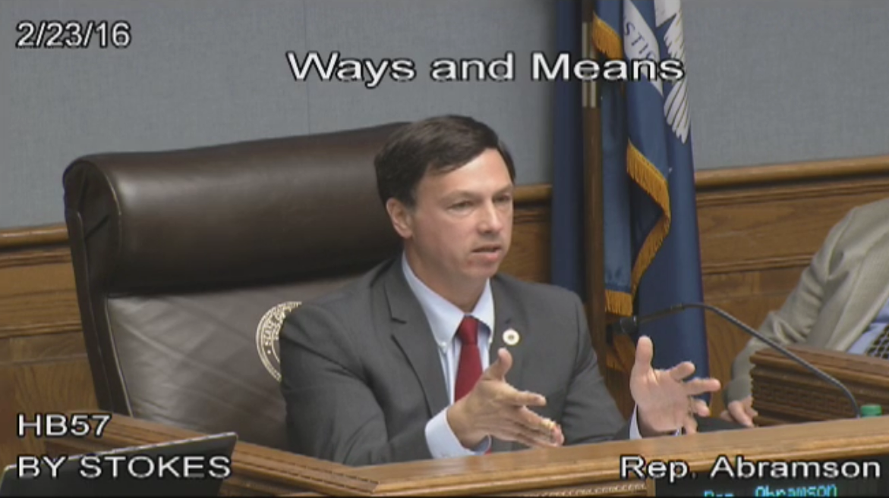
Sessions at a Glance
Budget
Remaining Shortfalls
Fiscal Action
Going Forward
Additional Studies
Spending Cuts
Revenue Raising
Beginning Year Shortfalls
What Caused Mid-Year Shortfall?
Revenue Adjustments

Slide 3
2016 1st Extraordinary Session
The Numbers
25 day session, convening on Sunday, February 14, 2016, and adjourning Wednesday, March 9, 2016
Legislators limited to filing and debating bills that fall within the subjects set out by the Governor’s “call”
“Special Session”
1 will be submitted to the voters
14 constitutional amendments filed
Constitutional amendments:
27 Senate Bills
127 House Bills
Total Instruments Filed:
“Called” by the Governor’s Proclamation No. 10 JBE 2016 to address certain fiscal matters, including raising of revenue, which cannot be considered in the 2016 Regular Session

Slide 4
Beginning Year Shortfalls
$600M
$1.6B
$2.1B
FY17
FY16
FY15

Slide 5
What Caused Mid-Year Shortfall?
Revenue loss due to drops in oil & gas prices & decline in income & sales tax collections: $570,100,000
Anticipated FEMA reimbursement not realized: $17,401,603
$954,139,310FY 2015-2016 Shortfall
Anticipated executive “preamble” cuts not implemented: $18,840,452
Budget short to cover unanticipated expenditure needs: $281,246,413
Unanticipated expenditure needs to be absorbed: $66,550,842

Slide 6
Spending Cuts
HB 122 – Executive appropriation
HB 118 – Judicial appropriation
HB 119 – Legislative appropriation
$39,852,588 cut from total budget of $25 billion (after vetoes)
$3,991,120 cut from total budget of $180 million
$2,033,243 cut from total budget of $73 million

Slide 7
Spending Cuts: State Contracts
HCR 2 directs state officials to review state contracts and:
Identify contracts that can be terminated
Determine potential savings from termination
Identify contracts that have already been terminated
Initial findings are to be reported to the
Joint Legislative Committee on the Budget by March 17th.

Slide 8
Immediate Revenue Raising
HB 62
HB 14
HB 27
“Clean” penny added to state sales & use tax
Increases cigarette tax by 22 cents per pack
Beer, wine, & spirits taxes increased
HB 61
“Cleans” existing state sales & use tax
HB 39
Automobile rental tax
HB 72
Renews tax on telecommunications services
HB 18
Discount for reporting & remitting tobacco taxes reduced
HB 28
Discount for reporting & remitting alcohol taxes reduced
$214,200,000
$65,300,000
$11,000,000
$4,700,000
$800,000
$600,000
$275,000
$94,000
Caps annual vendor compensation
$3,700,000
HB 43

Slide 9
Future Revenue Raising
HB 87
HB 55
HB 59
Reduces insurance premium tax credits by 5% for 2 years
Add-back for certain corporate income tax deductions
Extends hotel-motel tax to include online bookings (Airbnb)
HB 71
Expands the companies subject to the corporate franchise tax
HB 19
Reduces Enterprise Zone tax credit
HB 95
Repeals state deduction of federal income taxes for corporations
HB 29
Flat 6.5% tax rate for corporate income tax
HB 30
Collects sales tax from internet sales
HB 20
Prohibits amount of net operating loss (NOL) deductions
HB 116
Provides for order of loss years for NOL

Slide 10
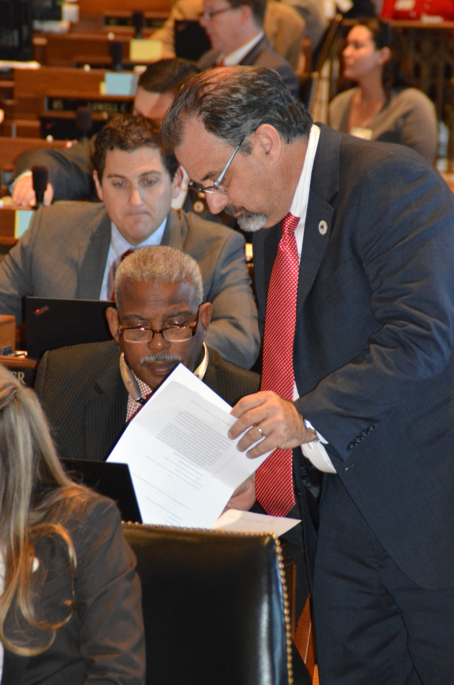
Additional Revenue Adjustments
SCR 2 tapped the “Rainy Day” fund for $128,459,664
SB 4 tapped BP oil spill settlement funds for $200,000,000
General Obligation (GO) Municipal Bond restructuring of $81,641,065
Executive Order JBE 16-4 reduced agency spending by $21,734,240
Executive cuts approved by the Joint Legislative Committee on the Budget totaled $38,490,799

Slide 11
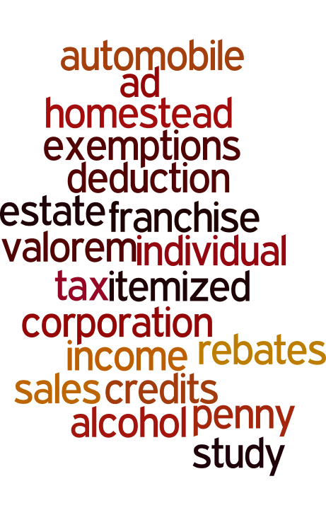
Additional Studies
HCR 11
SCR 6
Creates the Task Force on Structural Change in Budget & Tax Policy
Establishes a task force to study ad valorem taxes that are offset by state tax credits

Slide 12


Constitutional Amendment on the November 8, 2016 ballot
HB 31
If approved by the voters, HB 31 would remove a deduction allowing corporations to reduce their state tax liability by the amount of federal income taxes they pay.

Slide 13
2016 Regular Session
The Numbers
474 Senate Bills
1,154 House Bills
Total Instruments Filed:
110 House Concurrent Resolutions
92 Senate Concurrent Resolutions
122 House Resolutions
105 Senate Resolutions

Slide 14
Remaining Shortfalls
$70 million*
Current Fiscal Year (FY16), ending June 30, 2016
Cuts and revenue measures taken this session reduced the $954 million shortfall by $884 million*
Next Fiscal Year (FY17),
beginning July 1, 2016
$750 million*
Cuts and revenue measures taken this session will reduce the $2 billion shortfall by $1.25 billion*

Slide 15
Remaining Shortfalls
30,000 Students are ineligible only high ACT scores are eligible
TOPS
Scholarship Program
Governor cut TOPS by 60%
DHH Cuts
Occurring at a time we’re expanding Medicad to serve thousands more residents
Safety net Hospitals will close in Alexandria, Bogalusa, Houma, and Lake Charles

Slide 16
Levee Legislation
HB241 by Representative Jerome Zeringue
  COASTAL COMMISSION: Relative to administrative and budgetary services for the Coastal Protection and Restoration Authority
HB313 by Representative Ray Garofalo
  PROPERTY/EXPROPRIATION: Provides for disclosure of information to property owners whose property is subject to expropriation
HB629 by Representative Walt Leger, III
  LEVEES: (Constitutional Amendment) Provides relative to the taxing authority of regional flood protection authorities

Slide 17
Levee Legislation
HB895 by Representative Jerome Zeringue
  PUBLIC CONTRACT/BIDS: Grants preferences to Louisiana resident contractors for integrated coastal protection projects
HB1044 by Representative Jerome Zeringue
  Public Contracts: Provides an exception to the prohibition on closed specification of products for construction of certain integrated coastal protection projects
HB1087 by Representative Gregory A. Miller
  LEVEES: Provides relative to the Lafourche Basin Levee District
HB1149 by Representative Walt Leger, III
  LEVEES: Provides relative to the Southeast Louisiana Flood Protection Authority-East and Southeast Louisiana Flood Protection Authority-West Bank

Slide 18

Levee Legislation
SB391 by Senator Dale Erdey
  LEVEES: Adds Livingston Parish to the Coastal Louisiana Levee Consortium.
Several Bills that can/will impact Levee and Coastal Funding
  HB 477, HB 504, HB 508, HB 512, HB 577, HB 603,
  HB 646, HB 696, HB 716, HB 829,
  SB 182, SB 214,

Slide 19
Capital Outlay
Governor Edwards announced “radically different approach” to funding state construction projects this year
DOTD has a $12 billion backlog in projects for road repairs, highway upgrades and bridge fixes
Governor said more than $80 million would be put toward projects that build and fix roads in Louisiana this year.

Slide 20
Capital Outlay
Capital Outlay Bill HB 2 - Governor and the Commissioner of Administration are recommending
  $1 billion less in projects for reauthorization in Priority 5 funding.
For New Projects the Governor is recommending
  Priority 1 (cash lines of credit) and Priority 2 funding limit to what can be supported by bond sales.

Slide 21
Capital Outlay
The state will issue (or sell) bonds in the fall of 2016 and then again in the spring of 2017.
Estimated annual bond sales are greatly limited
  recent negative revenue forecasts
  credit rating reductions
This impacts the number of projects the state can realistically afford to fund.

Slide 22
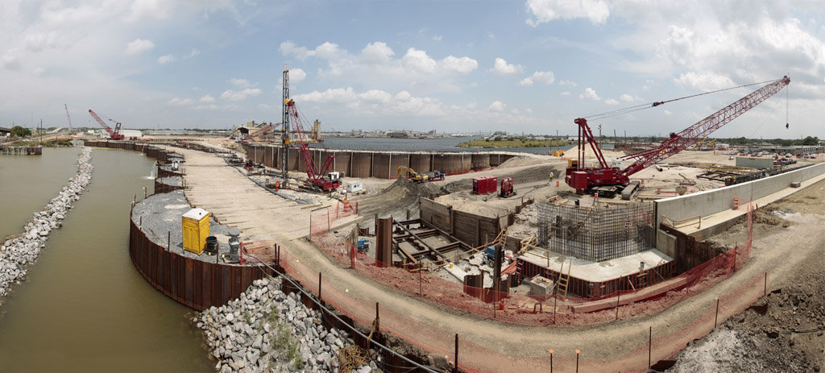
Capital Outlay
State can only legally issue up to $395 million worth of debt for construction projects.

Slide 23
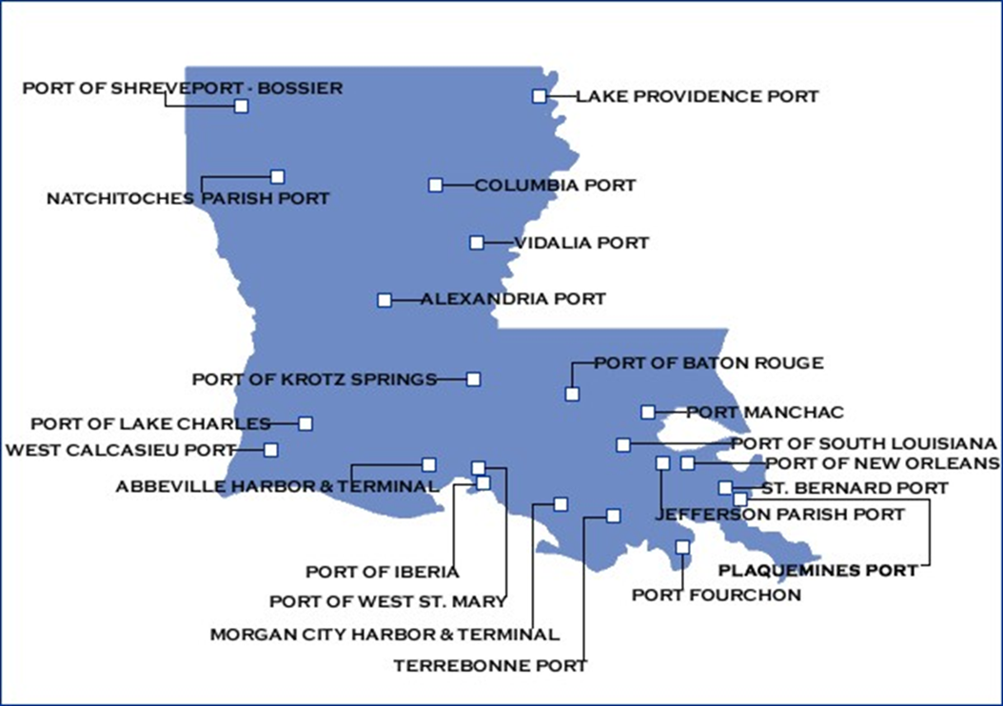
Ports of Louisiana

Slide 24

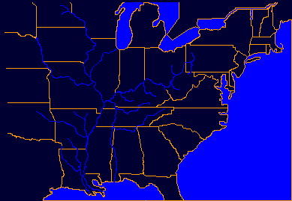
Louisiana Ports Deliver…
To National and Global Markets
LA is the crossroad for MS River and Intracoastal Waterway carrying 97% of US tonnage
Exports from Canada and 28 states move down the Mississippi
Imports of steel, coffee, rubber, timber & containerized cargo come from Latin America, Europe, Asia and Africa
Shallow draft ports function as industrial parks attracting business and jobs to local areas
56% of US grain exports travel through LA ports
Each year 1.2 M trucks call on LA ports
Notes:
What do we deliver?
La. as we said is the crossroad for the Mississippi River and Intracoastal waterway—which carries 97% of waterway tonnage in the US
We move exports from Canada and 28 states down the Mississippi
We import steel, coffee, rubber, timber and containerized cargo from foreign ports.
56% of all of the grain exported in the US comes through La ports.
1.2 Million trucks call on La ports each year.
Shallow draft ports function as industrial parks and business generators for their regions.

Slide 25
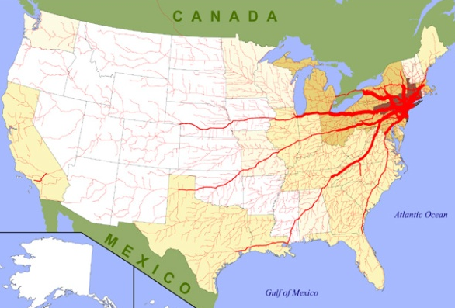
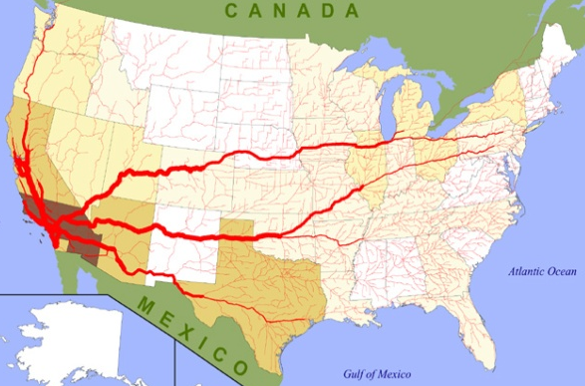
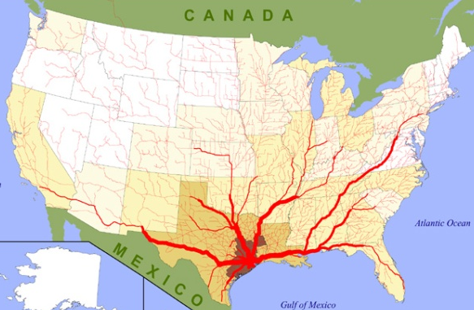
Ports, Waterways, and Commerce
New York
Los Angeles
Houston
Notes:
#1, #7, #8, #11, and #12 ports in the nation
Truck cargo flows out of Louisiana compared to other large port cities
LA coast exports over $120 billion of goods and services annually inside the US; additional $36.2 billion internationally
We import $160 billion of goods and services each year as well.

Slide 26
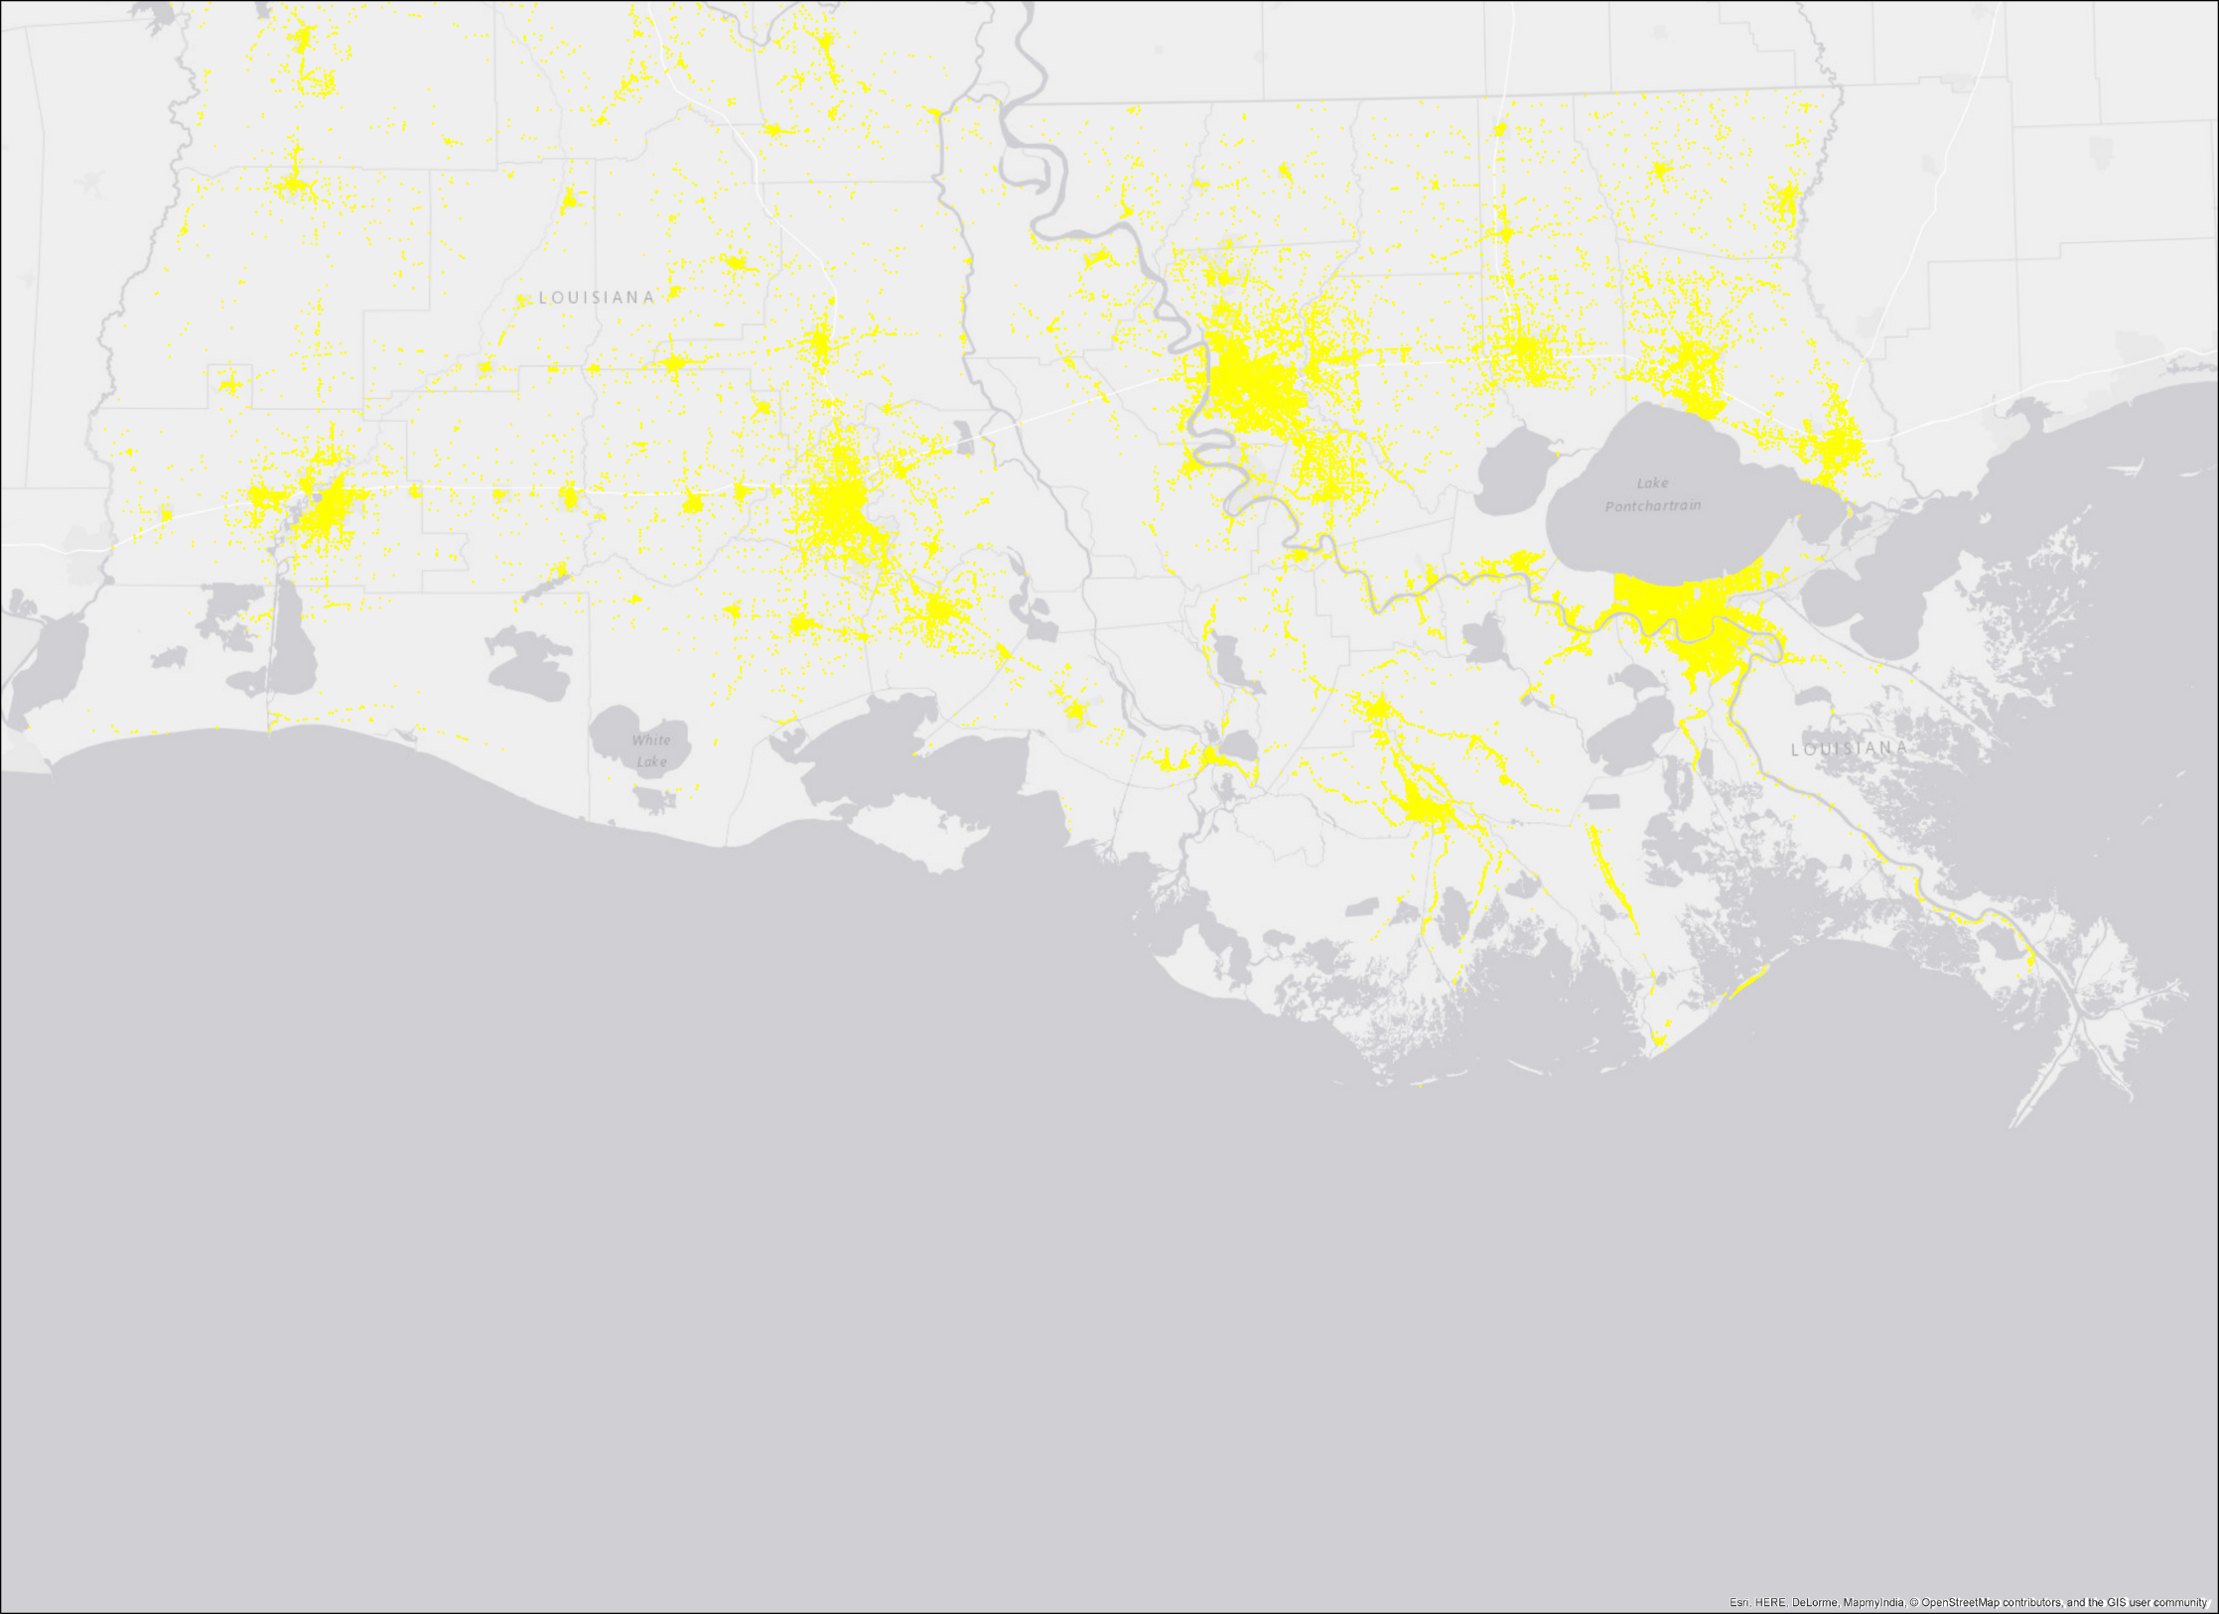
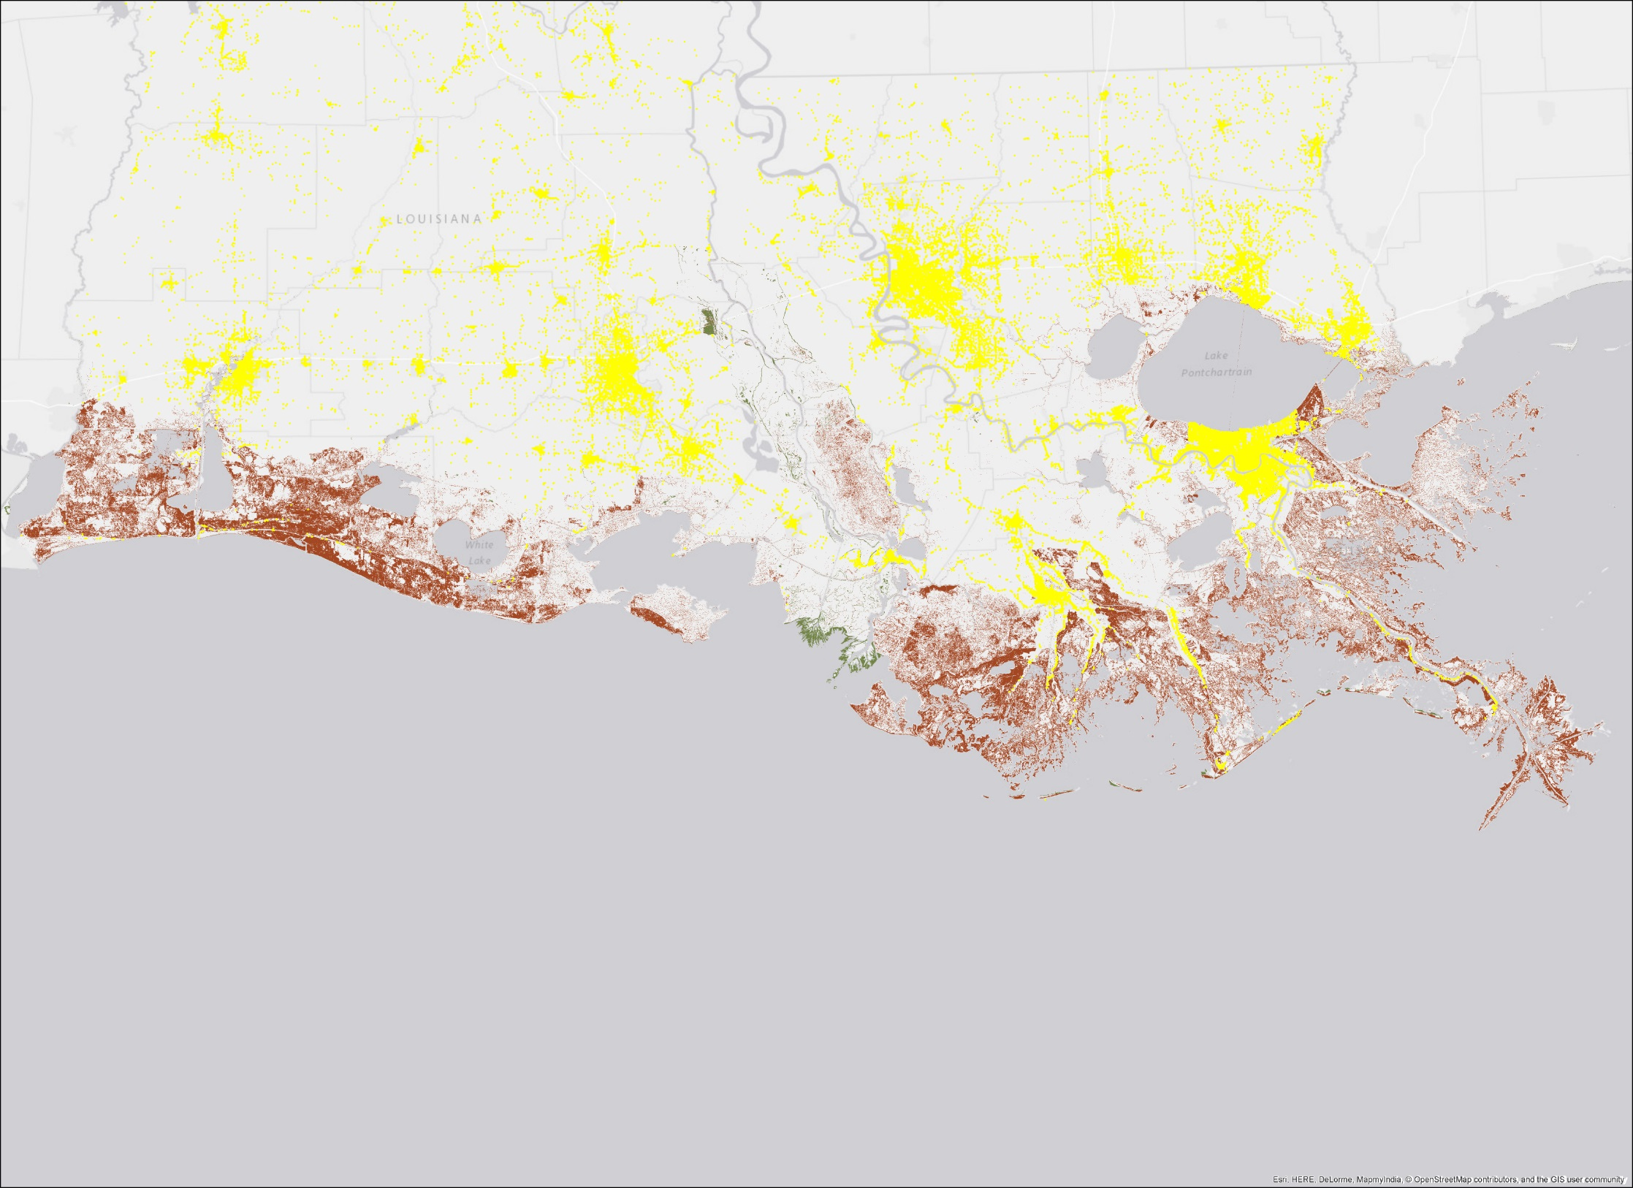
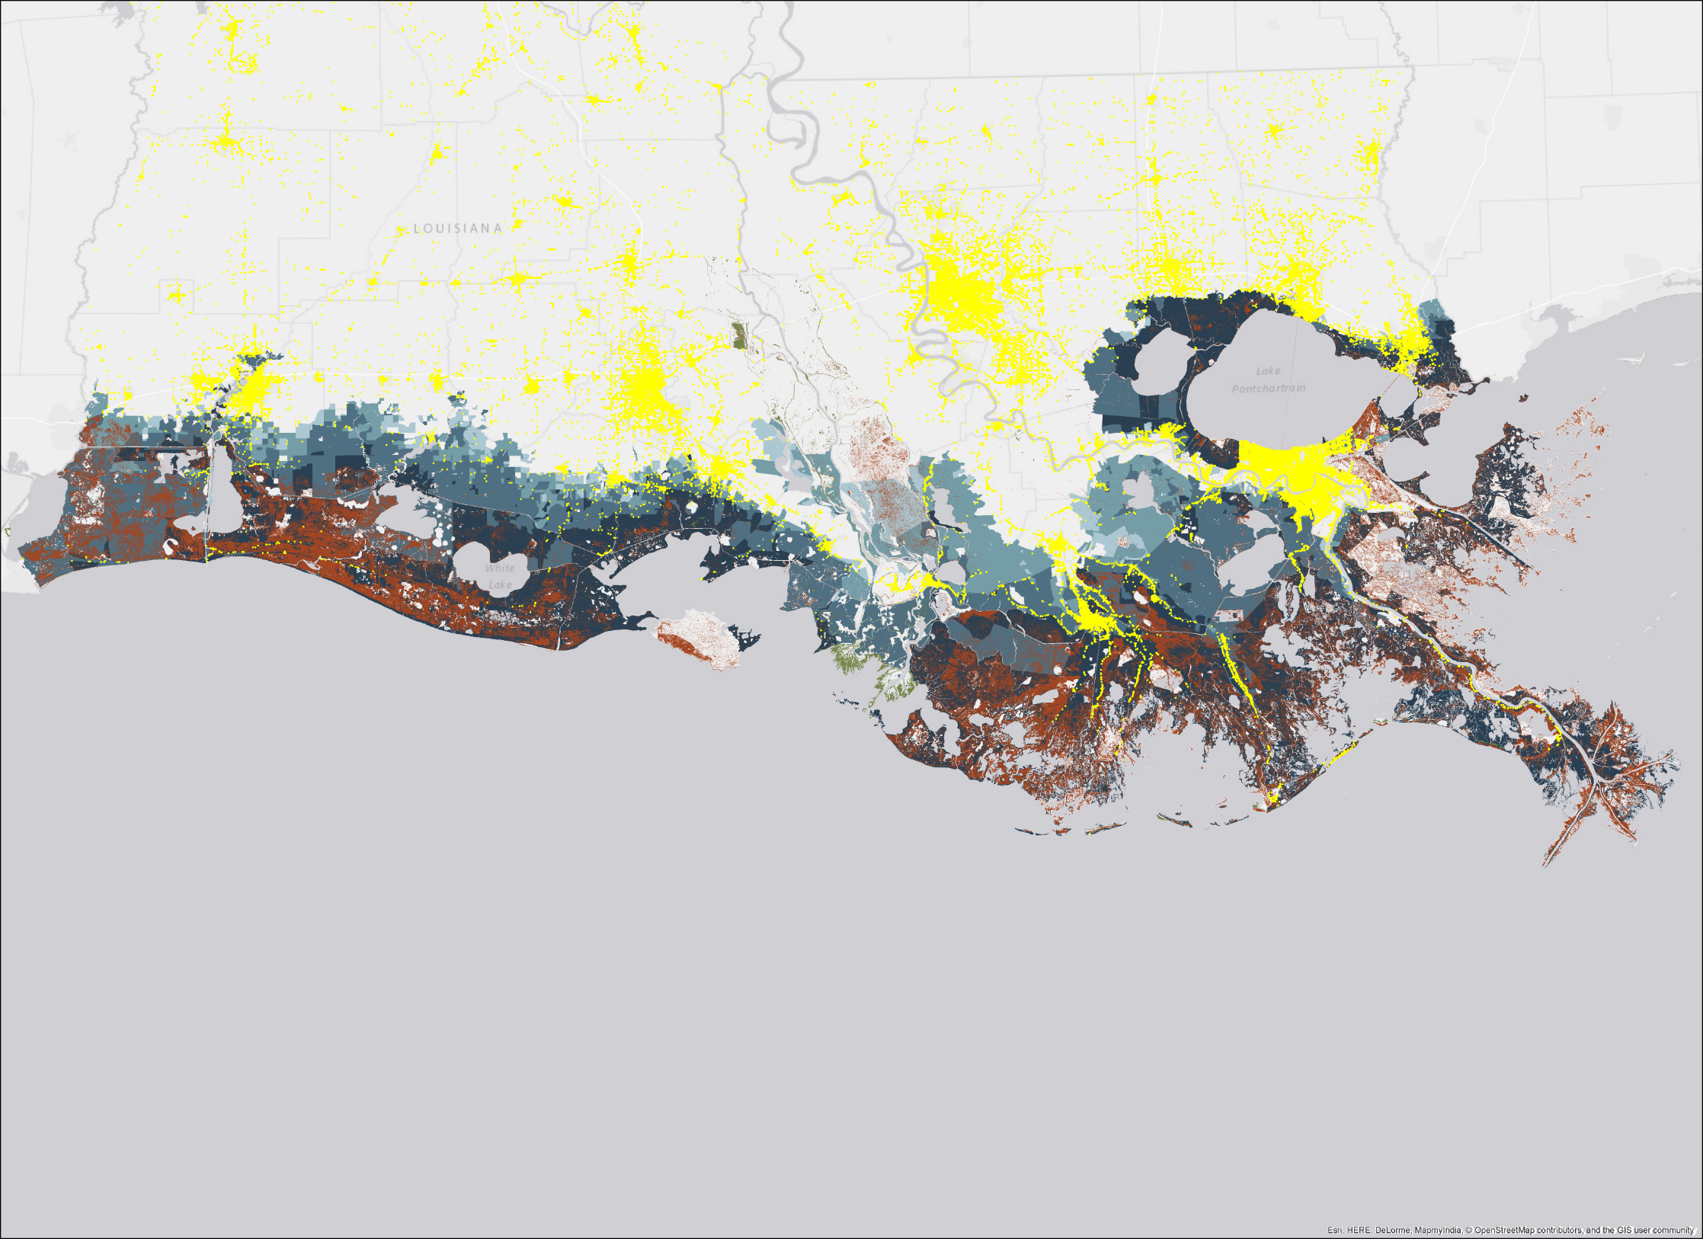
Land Loss, Storm Vulnerability, and Economy
Location of businesses in yellow: clustered in urban areas and along highways
Land loss in red
Flooding in blue
Small amounts of land gain in green
Notes:
Showing Louisiana’s businesses in yellow
Red shows where we are predicting that solid ground will become open water
Blue is showing the increased flooding expected by storms on this degraded landscape
Even with the protection of high ground or inland locations, direct land loss is putting homes and businesses and economic activity at risk
This land loss process will continue. It can be managed but it cannot be stopped.

Slide 27
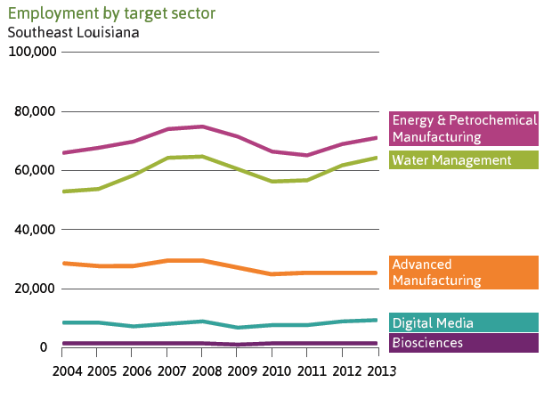
Water Management Industry*
In Southeastern Louisiana this segment grew by 7,832 jobs from 2010 to 2013
Outperformed the overall national economic trends
Outperformed national trends specific to this industry
*Refers to work happening off the coast on barrier islands and marshes, levee construction, and work managing subsidence and stormwater runoff

Slide 28
Weathering the Storm – A Sign?
Session Has to End:
  6 pm
  6th Day of the Month
  6th Month of the Year

Slide 29

Weathering the Storm – A Sign?
666

