Slide 1
ASSOCIATION OF LEVEE BOARDS OF LOUISIANA
Major General Michael C. Wehr
Commander, Mississippi Valley Division
President, Mississippi River Commission
8 December 2016
Notes:
Good morning ladies and gentlemen, and thank you for the invitation to attend your annual meeting.
It is a great pleasure to meet with our Louisiana partners and customers.
I plan to keep my remarks rather brief today, as most of you will have the opportunity to hear my full discourse tomorrow.
Today my presentation will center on:
Conditions that exist (four revolutions)
Events that have occurred (Winter flood, dredging SW Pass, Louisiana flood)
Opportunities that exist (2017 MRC high- & low-water inspection trips)
The future….

Slide 2
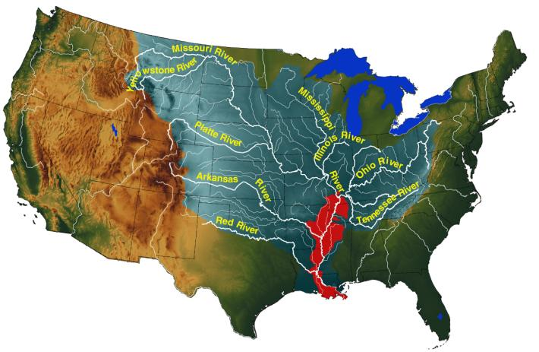
WORLD’S LARGEST “NATURALLY” NAVIGABLE WATERSHED
3rd largest watershed
in the world
41% of United States drainage flows through
the heartland of the nation
Notes:
Mississippi River basin is 1.25 million-square-miles in size.
It gathers water from 41% of the continental United States … which includes 31 states and 2 Canadian provinces.
It encompasses 3 Corps Divisions and the 3 largest rivers in the United States.
3rd largest watershed in the world behind the Amazon and Congo respectively.
Average flow = 640,000 cfs
2011 peak flow = 2.4 million cfs
Lower Mississippi River Basin = 35,000 sq. miles

Slide 3
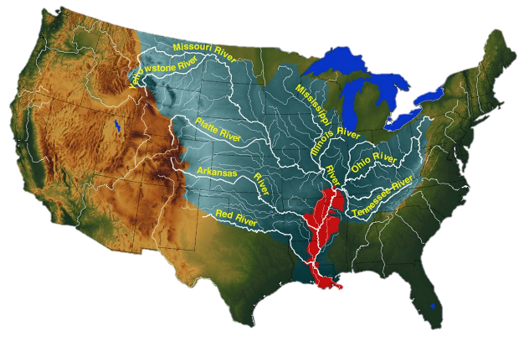
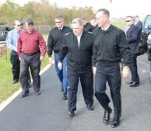
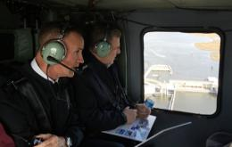
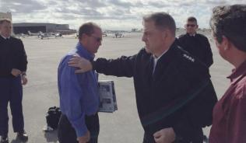
Worth Defending
World’s Largest Naturally Navigable Watershed
Dec. 11, 2015 visit by U.S. Army Chief of Staff General Mark A. Milley.
We must remain vigilant.
We must be ready for a threat from any direction.
We cannot secure the world alone.
Joint Forces are required.
Boots are required on the Ground
National commitment is required.
Notes:
I met with the U.S. Army Chief of Staff General Mark A. Milley on December 11, 2015 where we toured some of the nation’s significant infrastructure. During the meeting we discussed how we must be vigilant to outside threats with a broad coalition of partners who are willing to stand side by side to resolve the nations challenges. We must remain resolute in out commitment to meeting these challenges head-on leveraging many national as well as local resources.
One of our challenges brings us here today…the Southwest Coastal Louisiana study. This study is part of a broader national effort to provide risk reduction to the Gulf Coast from Florida to the Mexican border.

Slide 4
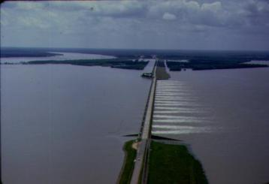
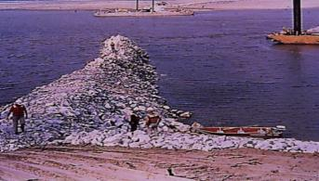
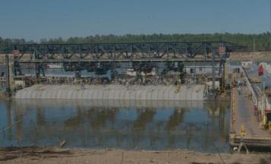
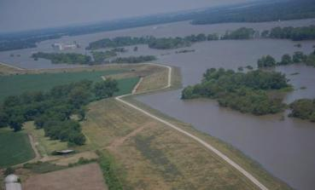
Mississippi River & Tributaries Project Status
MR&T system is not complete.
Flowline Study is ongoing and will reassess effects of the project design flood.
Dikes
383 miles authorized
340.5 miles completed
88.9% complete
Revetment
1,091 miles authorized
1,063.7 miles completed
97.5% complete
Levees
3,727 miles authorized
Approximately 370 miles of remaining work on the Mainstem levee system.
Notes:
The MR&T System is not complete, however previous events have proven system capability by providing 45 to 1 return on investment and preventing $666 billion in flood damages since 1928.
Ongoing flowline study will evaluate the flowline for the MR&T System using state of the art engineering and science. Current flowline done in 1976 following the 1973 flood.
The MR&T system is a comprehensive system of levees, floodways, tributaries basin improvements (reservoirs, pump stations, etc.) and Channel Improvements (revetments and dikes).
Levees are the backbone of flood protection and this project. The status of the mainstem levee system will be reevaluated at the completion of the MR&T Flowline Study.
Channel Improvements including dikes and revetments help to support waterborne commerce by providing a safe navigation channel through an environmentally sensitive manner and provide bank protection along the toe of the levee system.

Slide 5
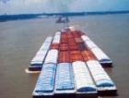
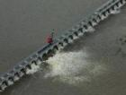
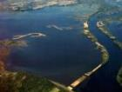
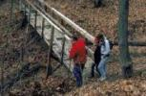
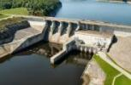
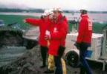
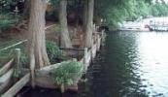
FY17 PRESIDENT’S BUDGET
Navigation - $ 451 million ($4 million more)
Flood Risk Reduction - $ 212 million ($3 million more)
Environmental - $ 74 million ($ 6 million less)
Emergency Operations - $ 5 million ($1 million more)
Hydropower - $ 11 million ($6 million less)
Recreation - $ 47 million ($2 million more)
Regulatory - $ 26 million (same)
$826 million total
Notes:
Thank you for your voice in Congress.

Slide 6
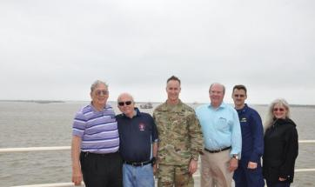
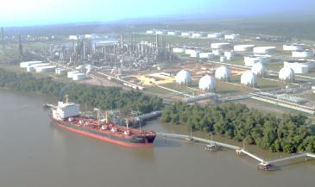
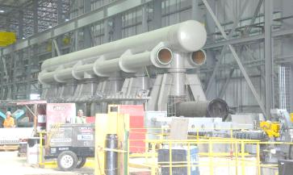
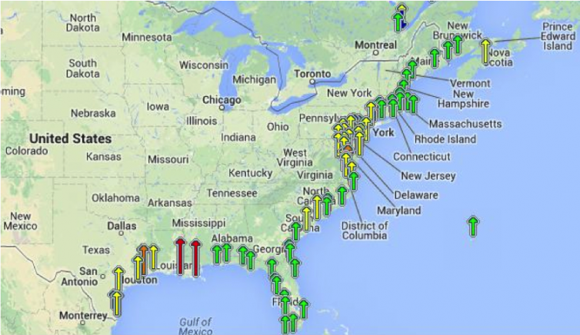
Four Revolutions
Explosive growth in U.S. agricultural productivity
Hydrocarbon production revolution
Return of manufacturing to the U.S. & the Mississippi Valley
Accelerating impacts of climate change
Notes:
During August low-water trip, we took the opportunity to go witness these and how they pertain to the Mississippi River & Tributaries system.
Explosive growth in agricultural productivity – starting in St. Paul, Minnesota, we saw lots of traffic. Looking for a continued high number of barges due to the perfect storm of a good crop, tax advantages to moving product, and weather challenges to farmers in other countries.
2. Hydrocarbon production revolution – For the past 3 years, the United States has been the world’s fastest-growing hydrocarbon producer, and the trend is not likely to stop anytime soon. MR&T levees protect more than 100 petroleum and related industries; over 1,000 chemical related industries, and more than 2,500 critical infrastructure.
3. Return of manufacturing in the Mississippi valley – We visited a steel mill along the river – again, possible because of the MR&T levees which protect it. This steel will be shipped out of a local port onto the Mississippi River for export. This is why we keep the navigation channels open.
Impacts of climate change** – Studies agree on an increase in mean annual air temperature of approximately 3.6 to 10.8 degrees Fahrenheit by the latter half of the 21st century in the Upper Mississippi Region.
Studies also project an increase in annual precipitation and in the frequency of large storm events. Yet despite projected precipitation increases, droughts are also projected to increase in the Upper Mississippi basin.
** Recent US Climate Change and Hydrology Literature Applicable to US Army Corps of Engineers Missions; UPPER MISSISSIPPI REGION 07

Slide 7
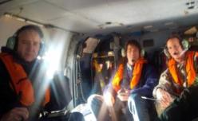
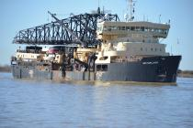
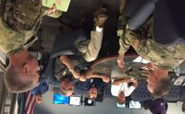
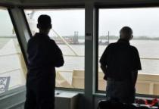
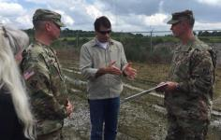
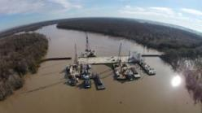
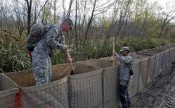
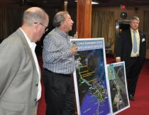
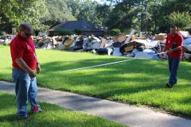
2015-2016
Winter flood
Dredging
Southwest Pass
2016 Louisiana flood
Dredge McFarland
Gov. John Bel Edwards
Rep. Garrett Graves
Comite River Diversion project
Bayou Chene
MRC high-water trip
MHU inspection in Baton Rouge
LA National Guard
Wingate, Lorino, Duffy
Notes:
WINTER FLOOD
Winter flood flyover of Bonnet Carré with Rep. Garrett Graves.
Me and the MRC staff visited Bayou Chene and Morgan City to view conditions during winter flood event.
Louisiana National Guard helped fill HESCO baskets near Morgan City.
DREDGING SOUTHWEST PASS
Winter flooding caused record dredging requirements in January, which is typically the slow season.
During our spring high-water trip, the Mississippi River Commission and New Orleans District staff visited Bayou Chene, and also decided to continue downstream to conduct an inspection in the ship channel to the Gulf and observe dredging operations at Head of Passes.
Capt. Mike Lorino, Mark Wingate and Sean Duffy giving a presentation during a portion of the MRC’s low-water inspection trip.
LOUISIANA FLOODING
I joined Governor John Bel Edwards at the state EOC in Baton Rouge.
During our low-water inspection, I -- along with Dr. Norma Jean Mattei and RADM Gerd Glang -- toured the Comite River Diversion project with Col. Clancy, Rep. Graves & others from the state of Louisiana.
These 2 Corps employees were conducting a site survey in Baton Rouge for a Mobile Housing Unit.

Slide 8
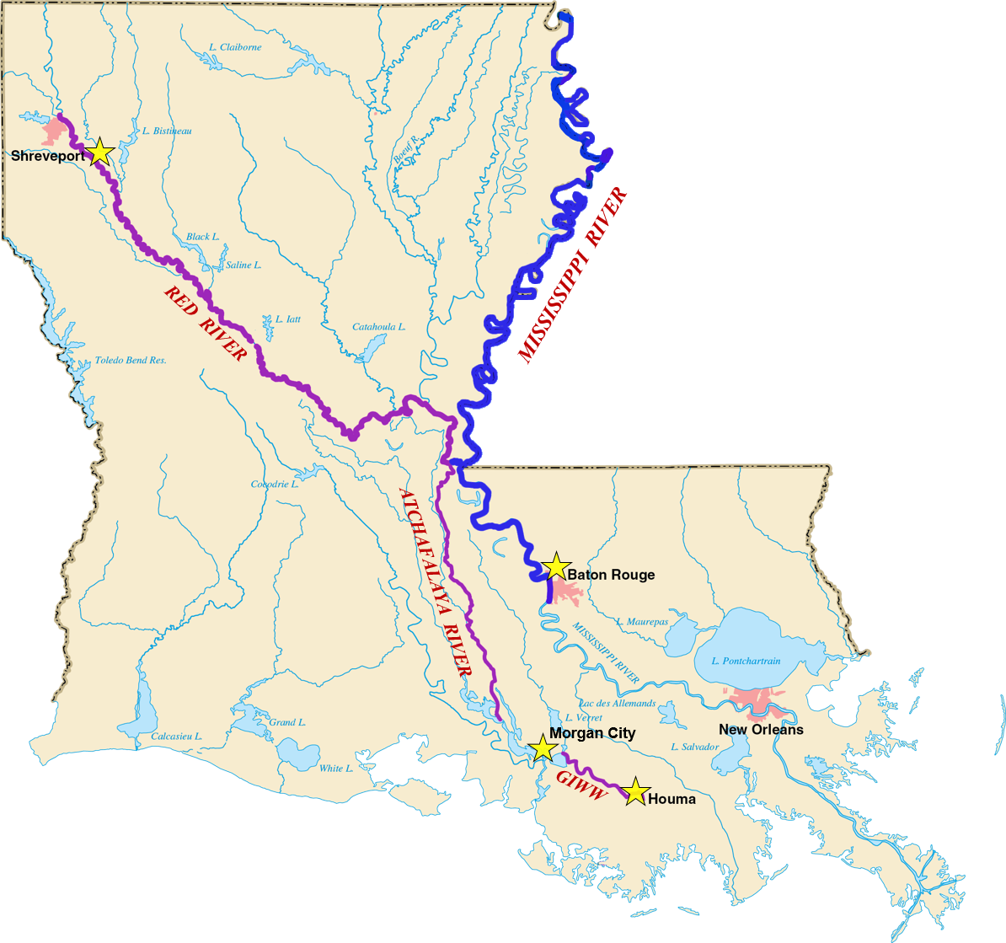
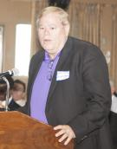
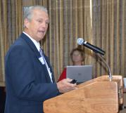
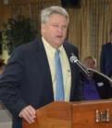
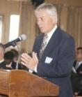
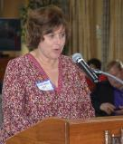
Partnering opportunities
High-water trip
2017 MRC high-water inspection trip
April 7 public meeting in Baton Rouge
2017 MRC low-water inspection trip
Traveling down Red River from Shreveport-Bossier City then down the Atchafalaya River
Notes:
Opportunities to continue the dialogue….
We have received excellent feedback from our roundtable discussions held onboard the MV Mississippi during the commission’s high- and low-water inspection trips.
We look to further that dialogue with you during these partnering opportunities in 2017:
April 6-7, as part of our high-water trip we will be traveling down the Mississippi River to Baton Rouge. We hope to engage in another roundtable discussion on the motor vessel.
While in Baton Rouge, the commission intends to try to arrange a visit to the state house and perhaps meet with the Joint Transportation Committee to discuss ongoing water resources challenges in Louisiana.
In August the commission will spending a full week in the state of Louisiana traveling form the Red River down to the vicinity of Old River, then head down the Atchafalaya to Morgan City, and finally down the GIWW to Houma.
Lastly, mention BG Hill and Southwestern Division – Red River flooding 2015 & 2016.

Slide 9
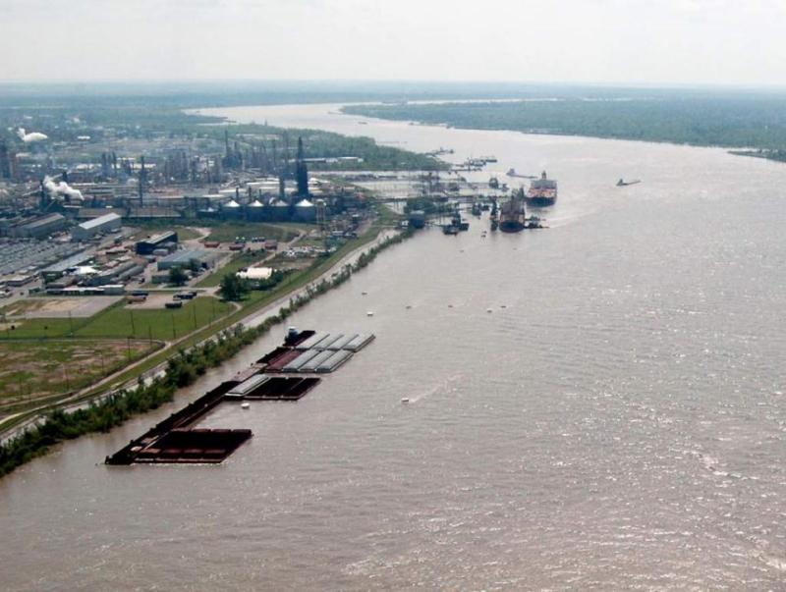
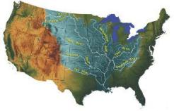
America’s Watershed: A 200-year working vision
An Intergenerational Commitment
Our people enjoy a quality of life unmatched in the world. We ...
Lead secure lives along the river or tributary.
Enjoy fresh air and the surrounding fauna, flora and forests while hunting, fishing and recreating.
Travel easily, safely and affordably.
Drink from and use the abundant waters of any river, stream or aquifer.
Choose from an abundance of affordable basic goods and essential supplies that are grown, manufactured and transported efficiently and reliably along and by the river to local and world markets.
The Mississippi watershed is 41% of the US, 31 states, 1.25 million square miles, over 250 tributaries
Balancing needs for …
National security, flood control and flood damage reduction
Environmental sustainability & recreation
Infrastructure & energy
Water supply & water quality
Movement of goods; agriculture & manufacturing
Leveraging local citizens’ input, international dialogue, science, engineering, technology and public policy
join the dialogue, visit:
www.mvd.usace.army.mil/mrc
cemvd-ex@usace.army.mil
Notes:
Our vision for the nation’s future is comprehensive, multiple basin water resource engineering solutions that are developed with broad based, regularly scheduled interest and stakeholder participation.
The Mississippi River Commission, through the continuation of its tested and proven process of listening, inspecting, and partnering, and engineering will help lead and influence the nation’s engineering solutions for river transportation infrastructure, flood damage reduction, and the environment.
CPRA should see themselves in this vision.
The Corps shares the state’s commitment to build upon recent accomplishments to further develop a mutually respective partnership and is positioned to continue to collaborate with the Coastal Protection and Restoration Authority Board of Louisiana to address Louisiana’s water resource issues.
USACE is committed to continually meet to ensure good communication and coordination exists to address the most important and relevant issues to the state.

Slide 10
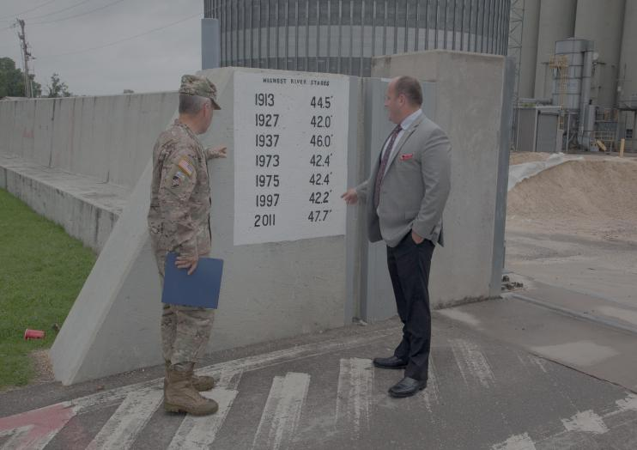
THE FUTURE
Engage the future
200-year vision
Long-term relationships
Invest in the future
Armor 1
Coastal protection (Morganza to Gulf / Southwest Coastal)
Hurricane & Storm Damage Risk Reduction System
Inner Harbor Navigation Canal
P3 (Fargo-Moorhead, ASCE)
Upper miss hydraulic model
Water supply
Deliver one watershed for the future
Comprehensive system approach
Flowline study
Watershed planning
Action for the future
Aquifer restoration/water security
Champion nav. infrastructure
MR&T strategic investment plan
Prioritize dredging requirements
Socialize discussion on flowline study
Notes:
ENGAGE THE FUTURE
Continue to foster longtime cooperative bonds among local partners, the Corps of Engineers, and Congress that has delivered on quality investments.
Bend to a more deliberate and sustained external strategic focus across the watershed.
Use 200-year working vision campaign and framework to shape partnerships, strategic engagement, stronger collaboration, and clear goals on a national scale.
Engage Washington interests and key strategic partners in a consistent fashion from multiple levels to strengthen relationships and collaboration toward a common future.

Slide 11
Notes:
SLIDE: THE FUTURE
INVEST IN THE FUTURE
Shape and contribute to the national dialogue re: balanced & sustainable water resources infrastructure system that delivers reliable outcomes.
Reinforce value of flood control projects and protection they provide.
Translate our status as a maritime nation and critical global exporter into water resource infrastructure investment decisions that sustain and enhance the nation’s global economic status.
DELIVER ONE WATERSHED FOR THE FUTURE
Drive the commitment to treat the entire Mississippi drainage basin as one system to provide comprehensive flood protection for people, property, infrastructure and energy.
The watershed impacts 41% of the United States.
Water resource management in the 6 major sub-basins directly impact not only the operations, practices, and decisions of the commission, but also the actions and practices of the Corps of Engineers and sister agencies.
ACTION FOR THE FUTURE
Our 200-year vision provides a great end result, but what actions can we take over the next 10 years that will move us closer to achieving that vision.
The commission is dedicated to prioritizing actionable items over the next 10 years that will bring us closer to realizing the 200-year vision. We will use your input and dialogue to shape this 10-year plan.

