Slide 1
MVN Levee Safety Program
Risk Communication Efforts of Levee Safety Risk Assessments
Mark L. Woodward, PE
Levee Safety Program Manager
USACE – New Orleans
6 December, 2017

Slide 2
Agenda and Objectives
Agenda:
Program Overview
Understanding Risk
Risk Communication
Objectives:
Understand the evolution of levee safety within USACE and nationally
Know the USACE Levee Safety Program mission and guiding principles
Recognize the components of risk
Understand Risk Communication Process
Notes:
Notes:__________________________________________________________________________________________________________________________________________________________________________________________________________________________________________________________________________________________________________________________________________________________________________________________________________________________________________________________________________________________________________________________________________________________________________________________________________________________________________________________________________________________________________________________________________________________________________________________________________________________________________________________________________________________________________________________________________________________________________________________________________________________________________________________________________
Notes:___________________________________________________________________________________________________________________________________________________________________________________________________________________________________________________________________________________________________________________________________________________________________________________________________________________________________________________________________________________________________________________________________________________________________________________________________________________________________________________________________________________________________________________________________________________________________________________________________________________________________________________________________________________________________________________________________________________________________________________________________________________________________________________________________________

Slide 3

PROGRAM Overview
Update on USACE Levee Safety Program

Slide 4
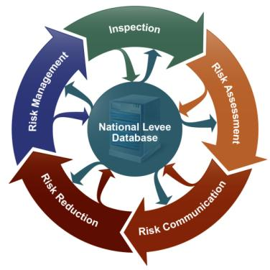
USACE Levee Safety Program Mission
Ensure levee systems provide benefit to the Nation by working with stakeholders to assess, communicate, and manage the risks to people, the economy, and the environment
Notes:
USACE Levee Activities
March 2008
USACE Activities-4

Slide 5
Guiding Principles
Hold life safety paramount, and reduce economic and environmental risk
Decisions will be risk informed
Open and transparent communication
Shared responsibility for risk management
Systems approach
Periodic and continuous activities

Slide 6
Levee System
Levee Segment: A separable section of levee with a single sponsor.
Levee System: All components and features which collectively provides risk reduction (reduces the probability of flooding) to a defined area up to a specific event.
Riversburg
t
Greentown
Metroville
This diagram shows one levee “project” and three levee systems
Segments → Systems → Project
Notes:
Orleans, Jefferson, St. Charles Levee District → East Bank System → MRL / HSDDRS
USACE Levee Activities
March 2008
USACE Activities-6

Slide 7
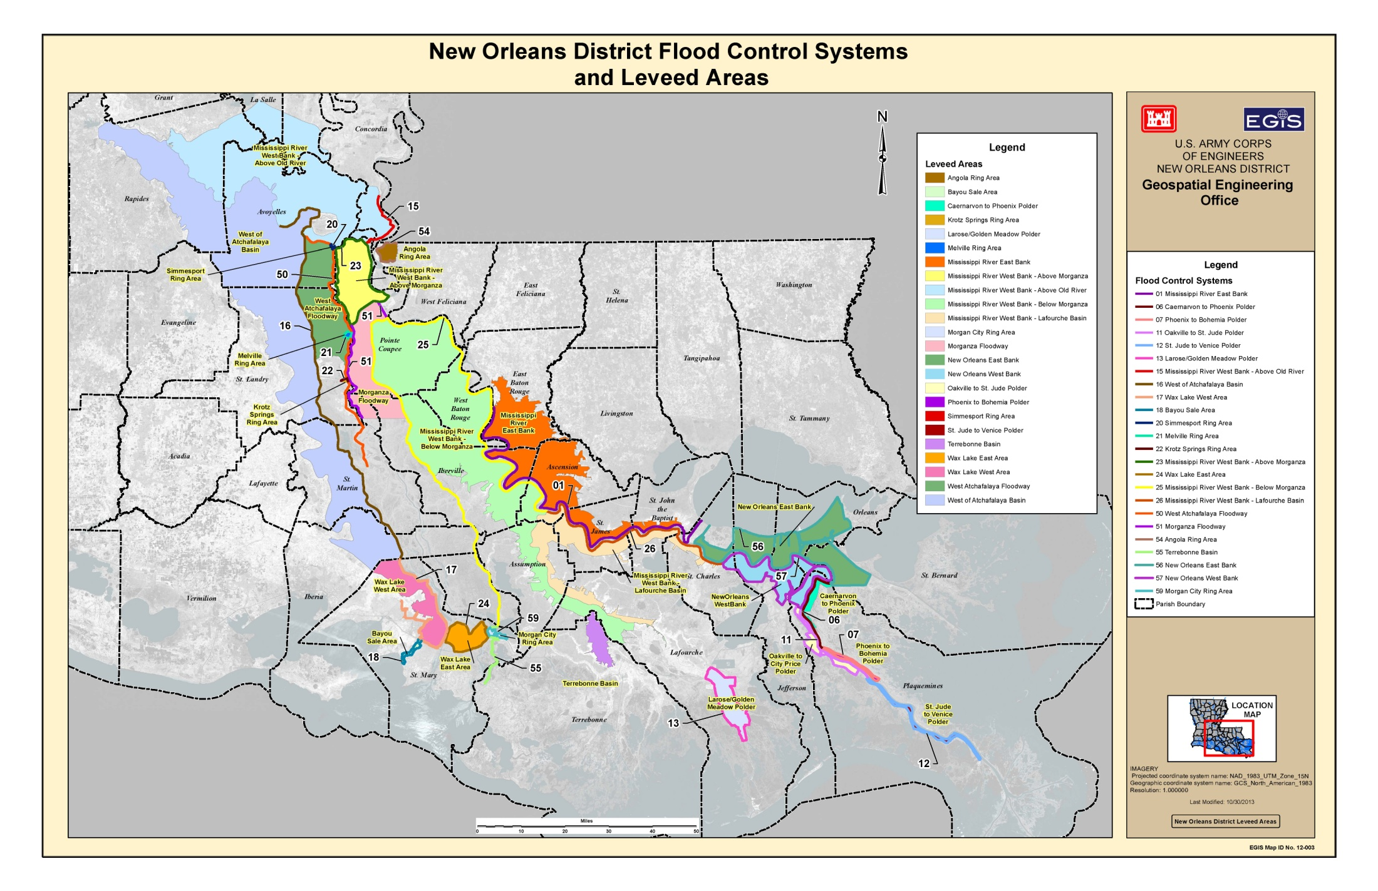
MVN Systems Overview
24 Systems
52 Segments
49 Structures

Slide 8
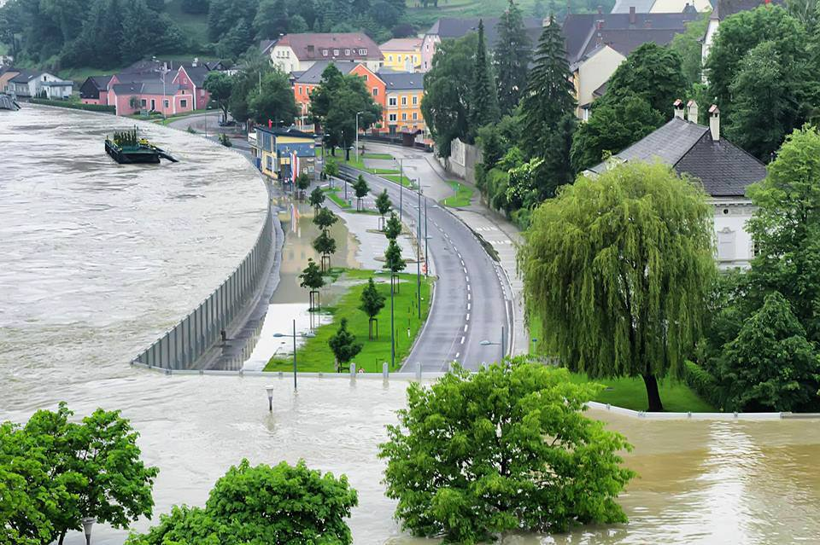
Levee Safety
--because flood risk and levee conditions change
Sound technical practices to levee design, construction, operation, maintenance, and assessment --applied consistently and continuously
Effective public awareness of flood risks involving the entire levee system
Risk-informed decision-making with life safety as paramount
Shared responsibility and solutions for risk management

Slide 9
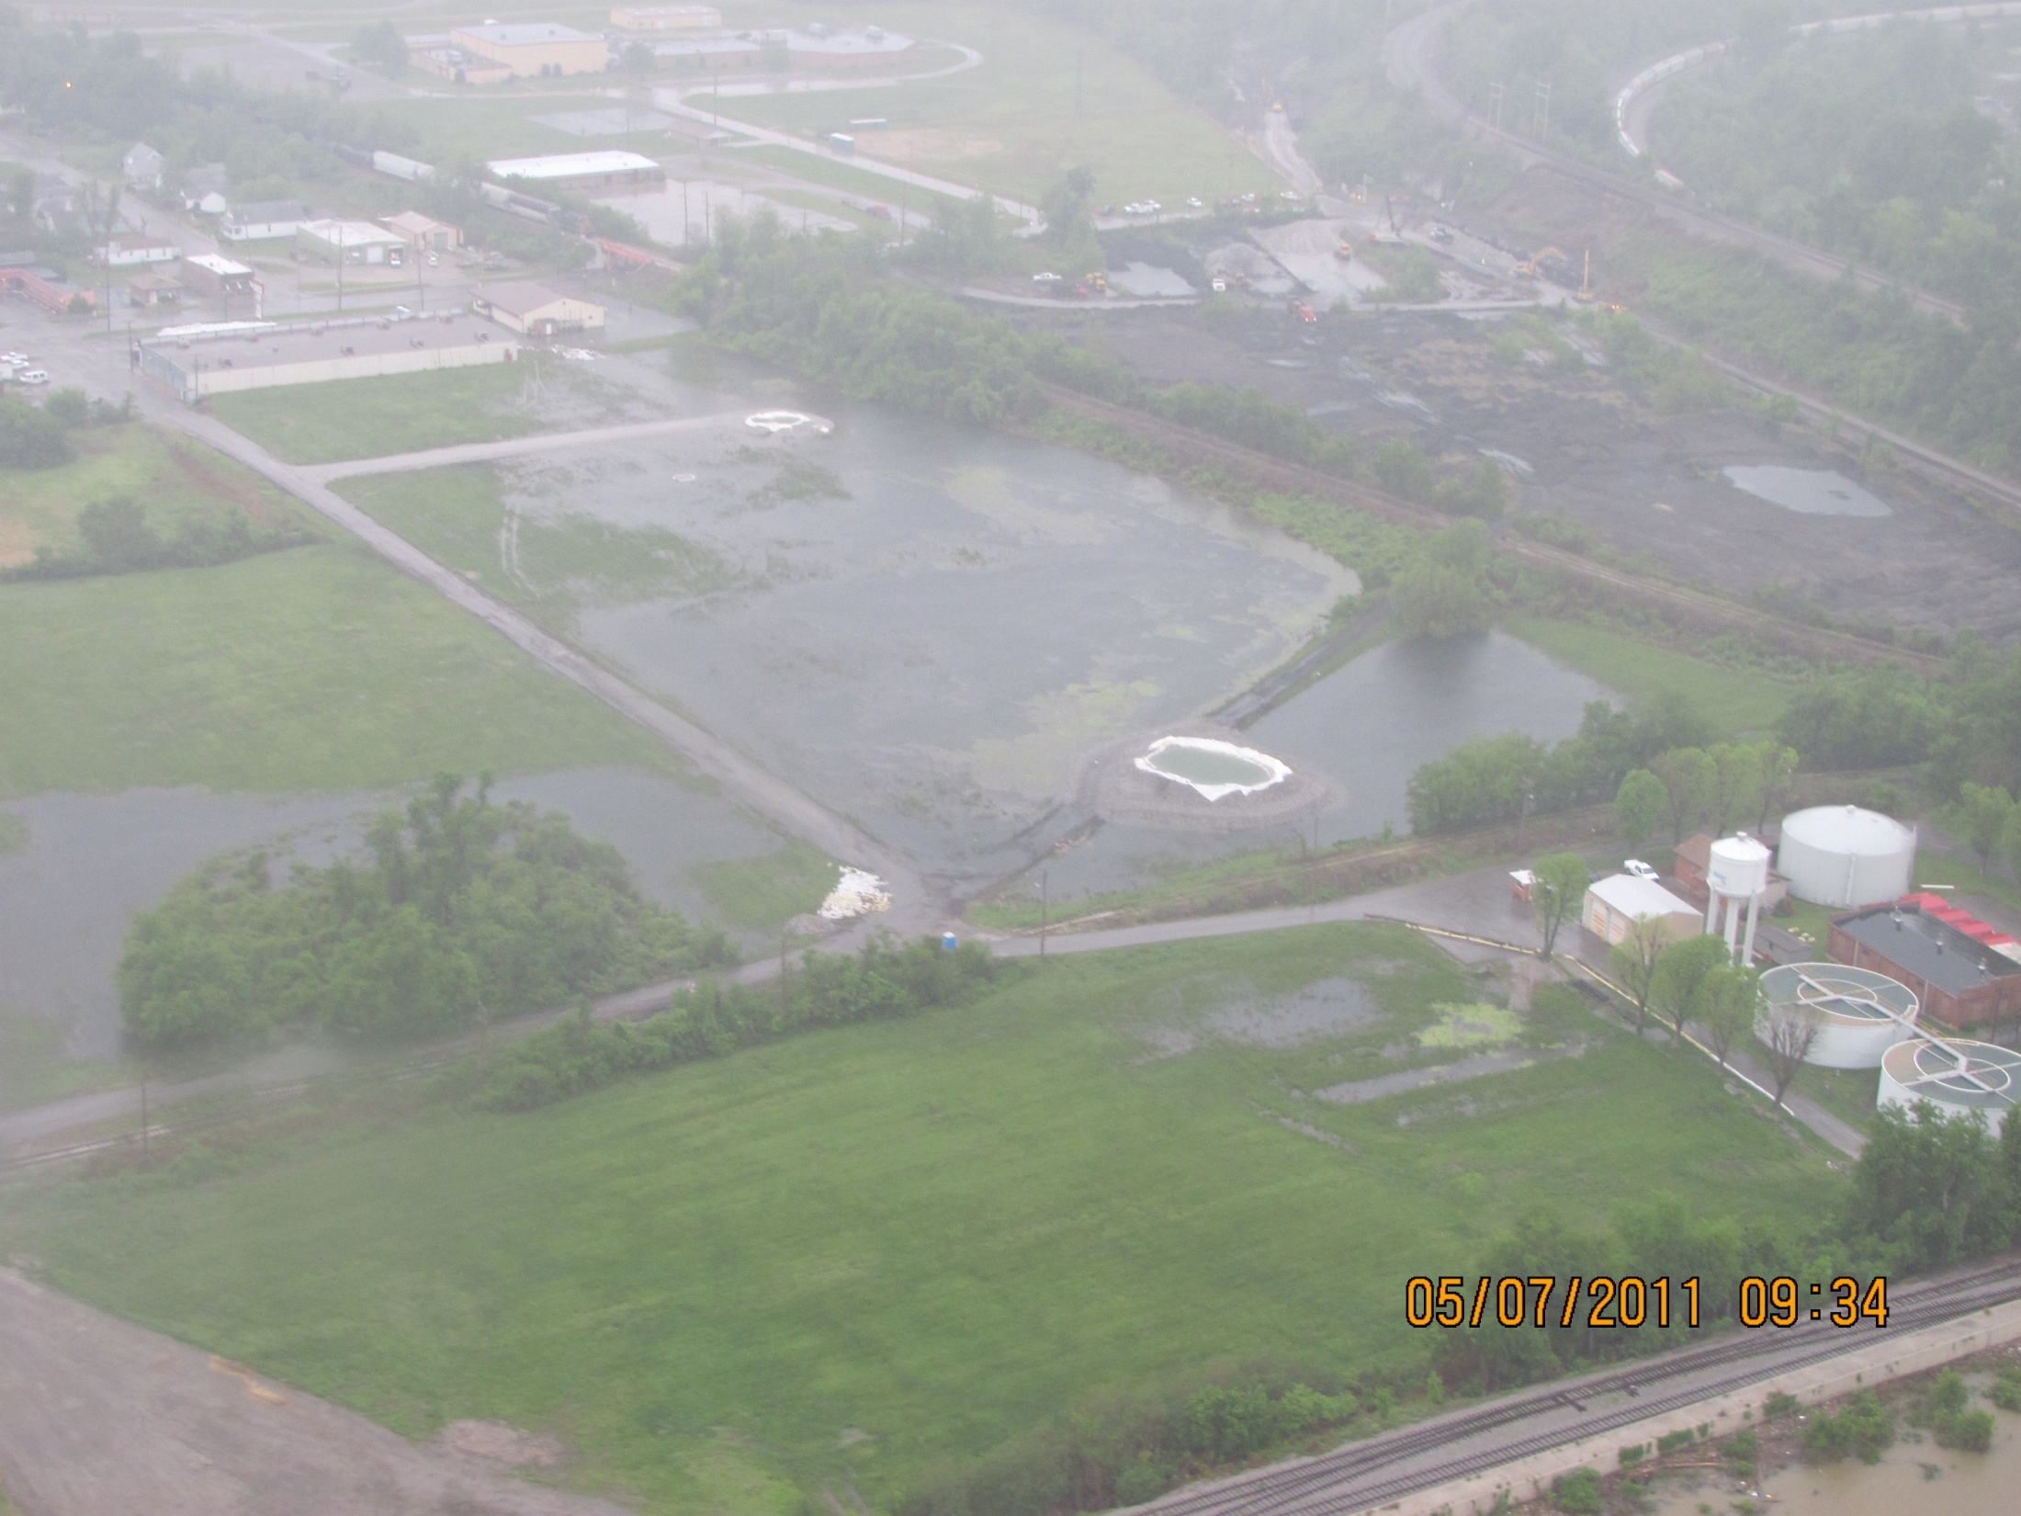
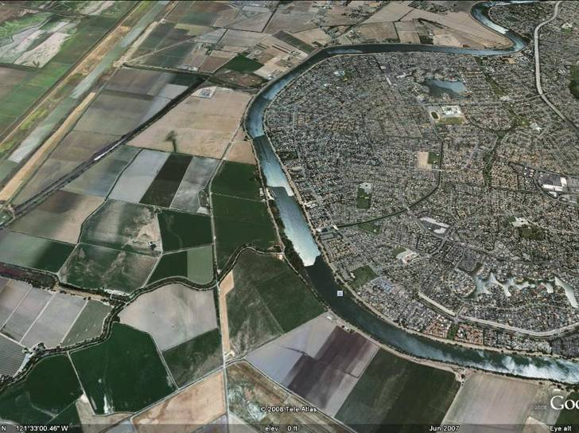
Differences in Consequences
  Improved Understanding
  Improved
  Decisions
  Improved Communications
Notes:
Full Explanation of taking into account uncertainty about infrastructure and preparedness of evacuation –
Improved Understanding = knowing where issues have occurred in the past so LS and EM know where to focus their attention during future events

Slide 10
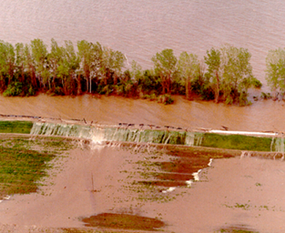
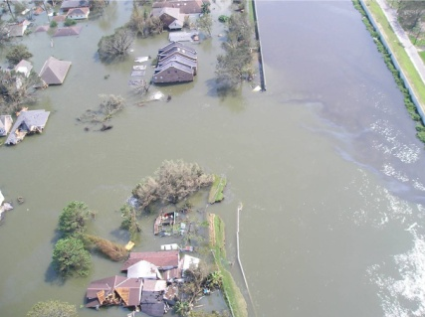
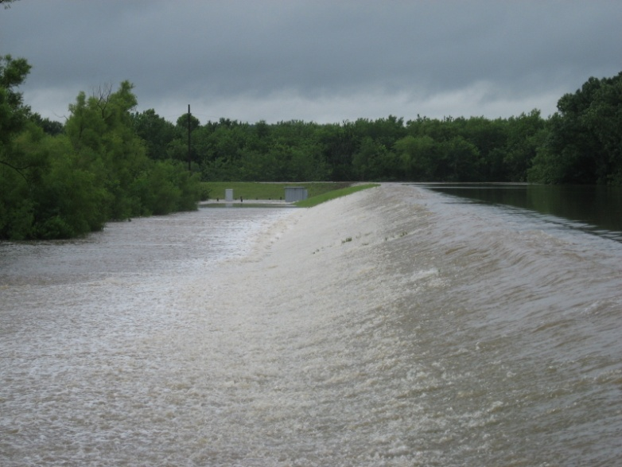
Goals for the Risk Framework
Improve public sponsor engagement in and knowledge of USACE levee safety activities
Develop increased understanding of benefits and risks of levee systems
Promote actions to manage risks
Build foundation for shared responsibilities of solutions

Slide 11
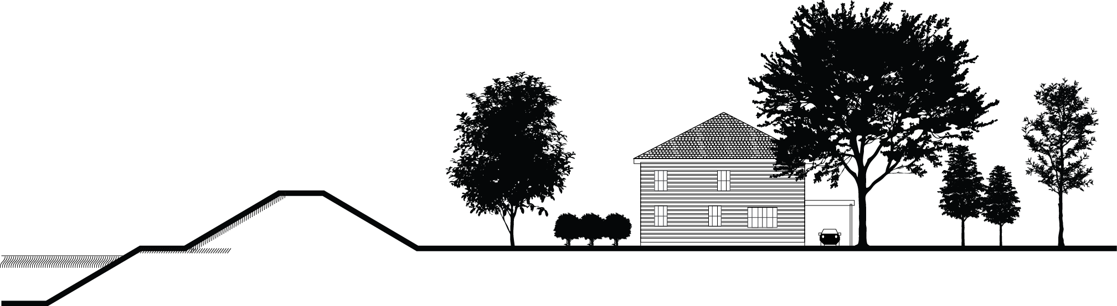
Definition of Risk
Risk = f(Hazard, Performance, Consequences)
What are the hazards and how likely are they to occur?
How will the infrastructure perform in the face of these hazards?
Who and what are in harms way?
How susceptible to harm are they? How much harm is caused?
Levee Safety Program: Focused on People, Performance, and Risks
11
Notes:
This is how we define risk and these are the benefits of why we’ve changed from the previous focus to risk. Consider photos depicting singular focus on infrastructure failure vs. holistic approach.
Include slide w/ table depicting decisions that are risk informed vs. singular focus.

Slide 12
USACE Levee Safety Program
Implementing the Risk Framework
Condition
Inventory
Periodic Inspections
Context
Risk Assessments
Communication
Action
Advise
Plan Path Forward
Answer the
Basic Questions:
~95% completed
Build Shared
Solutions:
Tell the Story:
~60% completed
Initiated 2006
Initiated in 2010
2016 and Beyond

Slide 13
Levee Risk Framework
Risk Assessment
Risk Management
Risk Communication
Stakeholder Engagement Communication of:
Risk Identification
Risk Estimation
Characterization of Uncertainty
Risk Evaluation
Risk Management Options Assessment
Prioritization of Recommendations
Risk Management Option Selection
Monitoring and Review
Implementation
Nature of Risk
Uncertainties in Risk Assessments
Risk Management Options
Notes:
Discussion of risk terminology variances – focus is on the process for implementation

Slide 14
Purpose of USACE Levee Inspections
Assess Levee Integrity & Likely Performance
Evaluate Operations and Maintenance Programs
Ensure Ability to Flood Fight
Make Recommendations for Monitoring and Action
Assist in Communicating Risk

Slide 15


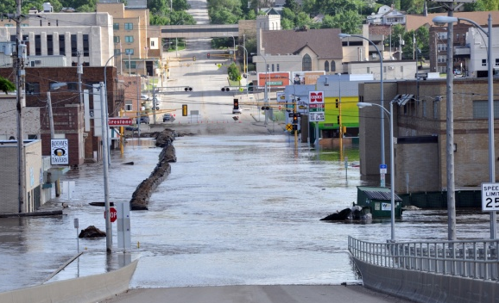

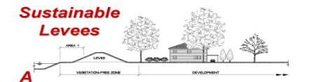
Risk Characterization
Scalable Risk Assessments
  Commensurate with Decision to be Made
  Screening Level for Entire Portfolio
  Higher Level Risk Assessment for Non-Routine Decisions
Risk = f(Hazard, Performance, Consequences)
Breach Prior to Overtopping
Overtopping with Breach
LEVEE RISK
Malfunction of Levee System Components
Overtopping Without Breach
FLOOD RISK

Slide 16
Screening Assessment Ratings
The screening assessment rating is made in the context of whether the observation for a specific item is an indication of distress and/or failure initiation considering actual and/or expected performance under hydraulic loading (riverine or hurricane).
Within the various inspection ratings there are primary factors, which are weighted more than other factors based on possible failure during an event. Primary factors evaluated for levee embankment are seepage, erosion, and slope stability.
Levee System Action Classifications (LSACs) are given from the range of 1 (high risk) to 4 (Low risk) based on performance, historical events, loading circumstances, and consequences.
Slide 16

Slide 17
Levee Screening Process
District Screening
LSPM/LSO Approval
MSC Approval
Cadre Review - LSAC recommended
Levee Senior Oversight Group – LSAC Assigned
HQ Review – LSAC Official

Slide 18
Risk Characterization
Levee Safety Action Classification
Urgency of Action |  | Actions | Characteristics
Very High (1) |  | Actions recommended for each class are commensurate with risks. | Likelihood of inundation with associated consequences characterizes each class.
High (2)
Moderate (3)
Low (4)
Normal (5)
THE FOCUS IS MAKING RISK INFORMED DECISIONS!
THE FOCUS IS NOT THE LSAC NUMBER!
18

Slide 19
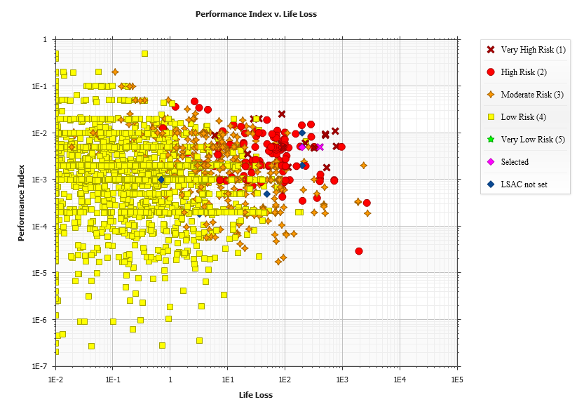
Why are both LSAC 3?
What does the data indicate for each segment?

Slide 20
Policy Guidance Letter – Placing Levee Systems in a Risk Context, Emphasis on Communication and Sponsor Engagement Dated Nov 06 2015
The Overall Objectives of this guidance are to:
  Improve Sponsor Engagement and understanding of the levee safety activities
  Improve sponsor and community understanding of the benefits and flood risks associated with levee systems
  Promote actions to reduce and manage the associated flood risks
  Build a foundation for shared responsibility in developing and implementing flood risk management solutions for levee systems
Notes:
Length 11 miles
Features 3 miles of earthen levee
8 miles of floodwall
67 gates

Slide 21
Policy Guidance Letter – Placing Levee Systems in a Risk Context, Emphasis on Communication and Sponsor Engagement Dated Nov 06 2015
All Districts must develop and maintain a District-Level:
  Programmatic Communication and Sponsor Engagement Strategy
  Levee System Summary Sheets
  Levee System Specific Risk Communication Plan
Notes:
Length 11 miles
Features 3 miles of earthen levee
8 miles of floodwall
67 gates

Slide 22
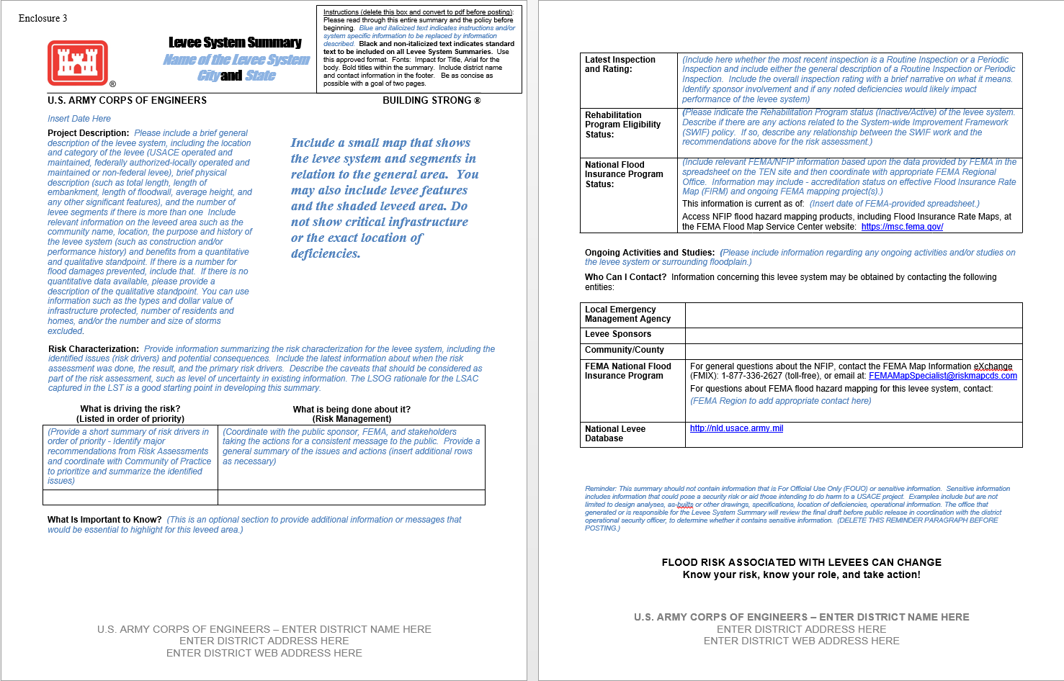
Levee System Summary

Slide 23
Project Stakeholders
Internal
  USACE – New Orleans (MVN)
    Public Affairs Office (PAO), Inspection of Completed Works (ICW), Emergency Management (EM), Engineering Division (ED), Project Management (PM), Office of Council (OC), Operations Management (OM), Flood Risk Management (FRM), Levee Safety Committee, Silver Jackets
  USACE – Mississippi Valley Division (MVD)
  USACE – Headquarters (HQ)
  USACE – Risk Management Center (RMC)
External
  Local and Louisiana State Government
  Levee District Sponsors and Levee Owners
  Federal Emergency Management (FEMA)
  Parish Emergency Management Agencies (EMA)
  Populations Living in the Leveed Areas
  US Senators and Legislators

Slide 24

Value of Risk Dialogue for Sponsors?
Understand how USACE
Views and Prioritizes
their Project for Federal
Action
  Technical Assistance
  Flood Fighting
  Study Priorities
  Construction Priority
  Improve Communication
  of the Benefits and Risks
  to All Stakeholders
Inform Sponsor of Risk
Reduction Actions
  Structural
    Interim Repairs
    Long Term Repairs
  Non-Structural
    Land Development
    Building Codes
    Emergency Action Plans

Slide 25
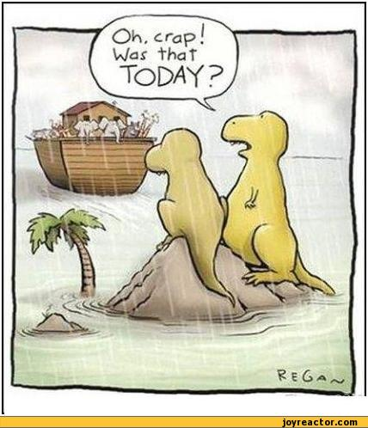
Questions
Oh No!
Was that
TODAY?
USACE Levee Safety Program:
Life Safety is Paramount!!!

