Slide 1
$350 Million for Coastal

Slide 2
Bayou Chene 2019 Flood Fight
1-2 feet held back prior to Hurricane Barry
4.3 feet water held back at peak

Slide 3
Hurricane Barry
HSDRRS fully operational; all 320 gates closed
Landfall at Marsh Island/Intracoastal City
71mph sustained winds
9-11 foot surge in Terrebonne: only 12 homes flooded vs. 11,000 in Rita with similar surge

Slide 4
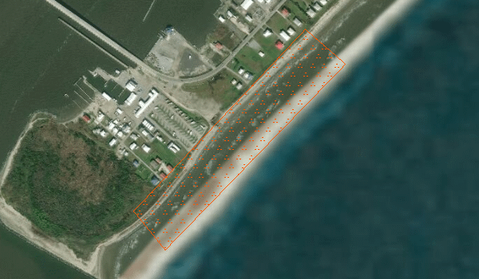
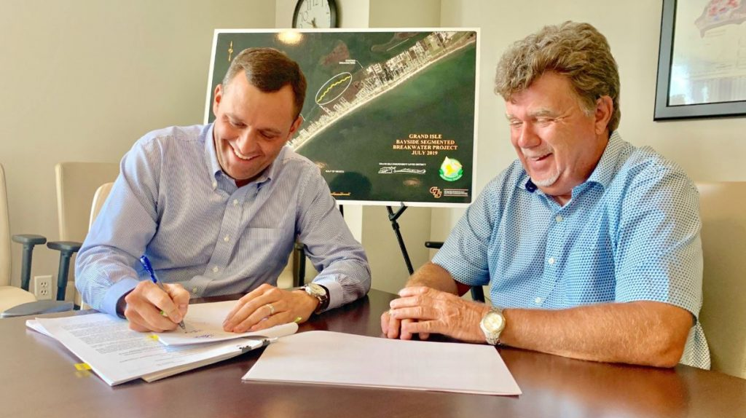
Grand Isle
Grand Isle & Vicinity Breakwater $15M (construction)
Protective Breakwater Gap Closure on Bayside $6.5M (announced in July)

Slide 5
$41.7 Million N. Lafourche & S. Lafourche
N. Lafourche
Gheens levee improvements from 5 to 7 feet
Improved Des Allemands pump station
Hollywood Canal deployable structure to protect 1,800 homes
40 Arpent Canal Levee enhancement. Additional protection for 3,500 structures
1,500 feet of levee from Bayou Folse that ties back to Hwy. 90 embankment
S. Lafourche
Grand Bayou Floodgate—protection to 15 feet
Golden Meadow Pump Station from 13 to 17 feet
Larose Floodgate Steel A-frame Improvement raising protection from 8 to 13 feet

Slide 6
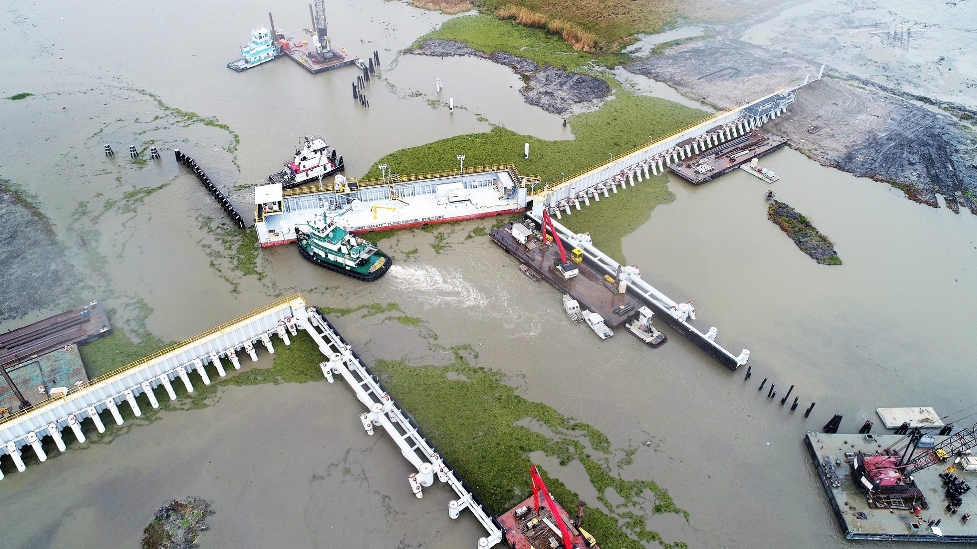
Jimmy Dagate Floodgate Falgout Canal
$36.5 Million
189 feet x 40 feet
Protects against 18 ft of storm surge

Slide 7
St. Charles Parish
$6 million for Magnolia Ridge improvements and gate on Paradis Canal
2 miles + levee improvements ($3.5M)
Vertical lift and sluice gates ($2.54M)
Improved protection for 27,000 residents
GOMESA, RESTORE Parish Matching, RESTORE Parish Funds, and Local Millage

Slide 8
Looking Ahead
Jean Lafitte and Rosethorne Tidal Protection under construction
Bayou Chene permanent closure under construction
MOUs with TLCD and St. Tammany
West Shore moving forward

Slide 9
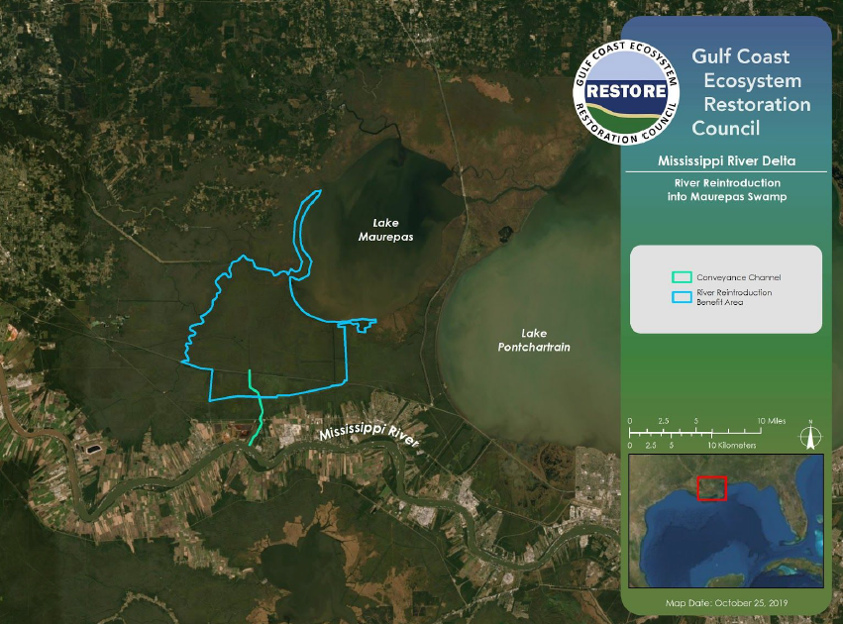
Notes:
$130 Million from the RESTORE Council; proposed vote in February
Overlaps with the West Shore Lake Pontchartrain Project and provides the opportunity to save money by consolidating the engineering, design, and construction of overlapping portions of the two projects and improve the overall resilience of the region by fully integrating restoration and protection projects and objectives.
Overall project cost is $190 M with the additional $60 coming from Bucket 3 RESTORE or another source. USACE and CPRA are considering whether a portion of the environmental beneftits derived from the Maurepas project could be used to mitigate for swamp habitat impacts that will occur from the implementation of the West Shore project.

Slide 10
Upper Barataria
$514-$653.4 Million (with armoring)
18.3 mile system
Portions of seven parishes
35/65 State/Federal
50 year protection

Slide 11
GOMESA Update
Fed FY17 $82.8M ($66.2M CPRA/$16.6M Parish)
Fed FY18 $94.7M ($75.8M CPRA/$18.9M Parish)
14% increase for LA overall
Fed FY20 and 21 cap at $650 not $500 ($214.8 M max payment for LA)
COASTAL Act by Murkowski and Cassidy passed by Senate Committee on Energy and Natural Resources
Senate floor as early as January

