Slide 1
Association of Levee Boards of Louisiana
Shawn D. Wilson, Ph.D.
Secretary
@onevisionary
Dec 4, 2019

Slide 2
Today’s Discussion
Statewide Flood Control Program update
DOTD Watershed update
Comite River Basin status

Slide 3
Louisiana Statewide Flood Control

Slide 4
Statewide Flood Control Program Review
$20M in total program funding
Rural Grant Opportunity Act 384
Does away with 10% match requirement for parishes with less than 50,00 residents and municipalities less than 5,000 residents
Project requirements
Must reduce existing flood damages of structures
Does not encourage additional development in flood prone areas
Does not adversely affect upstream or downstream flooding
Must have a construction cost of $100,000 or more
Must be a stand-alone project

Slide 5
Statewide Flood Control Program
Competitive & Cost-Shared
Projects are evaluated based on potential damage reduction versus State investment
Provides up to 90% of the construction cost for non-federal projects
Provides up to 70% of non-federal participants’ share of federal projects
Uniquely structured to ensure:
Equitable distribution of funds statewide
All levels of local government can compete successfully

Slide 6
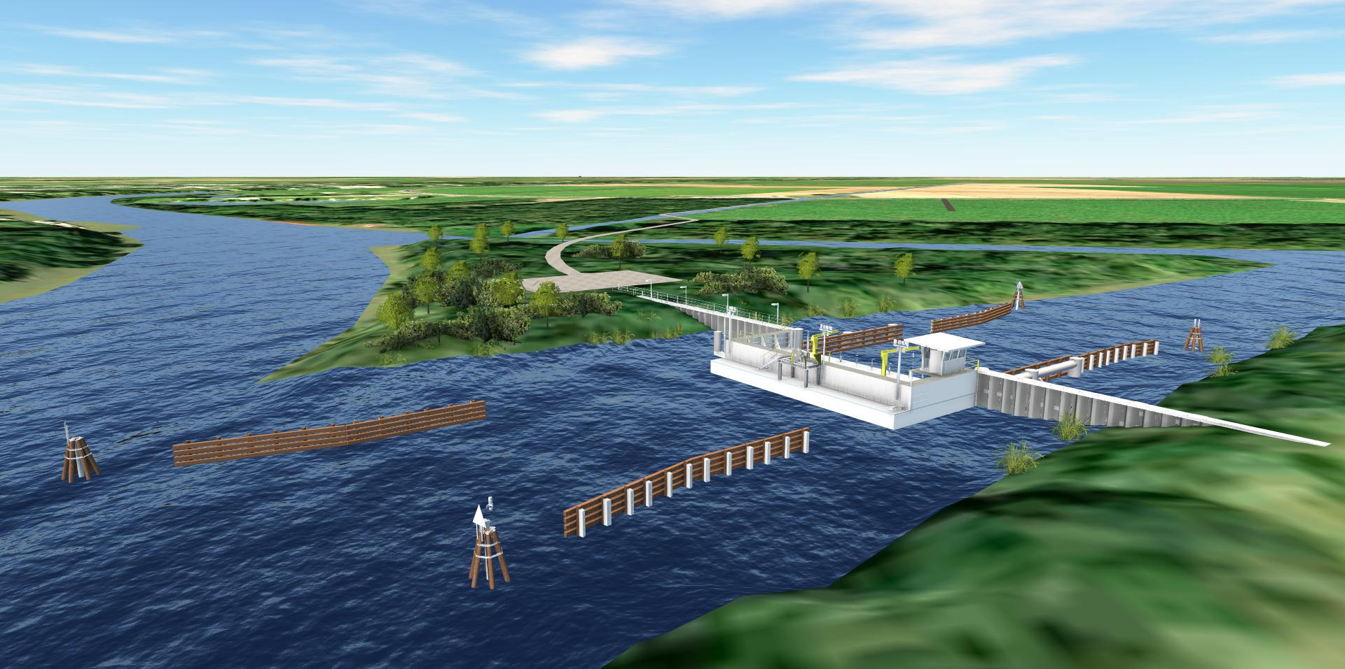
Statewide Flood Control Program
Bayou Teche Flood Protection in St. Mary Parish
State share: $11 M
Project went to bid Fall 2019

Slide 7
Statewide Flood Control Program 2019 Numbers
10 pre-applications received
6 deemed ineligible
Projects must fit the mission of the program
4 final applications received
2 municipalities
2 parishes
Max amount requested of roughly $13M

Slide 8
Statewide Flood Control Program Accomplishments since Inception
Approved projects in 43 of 64 parishes
121 projects completed
40 additional phases completed
13 projects/phases under construction or awaiting closeout
$269M Expended
$2.680M in Flood Reduction Benefits
10.71 Benefits/Cost Ratio

Slide 9
Watershed

Slide 10
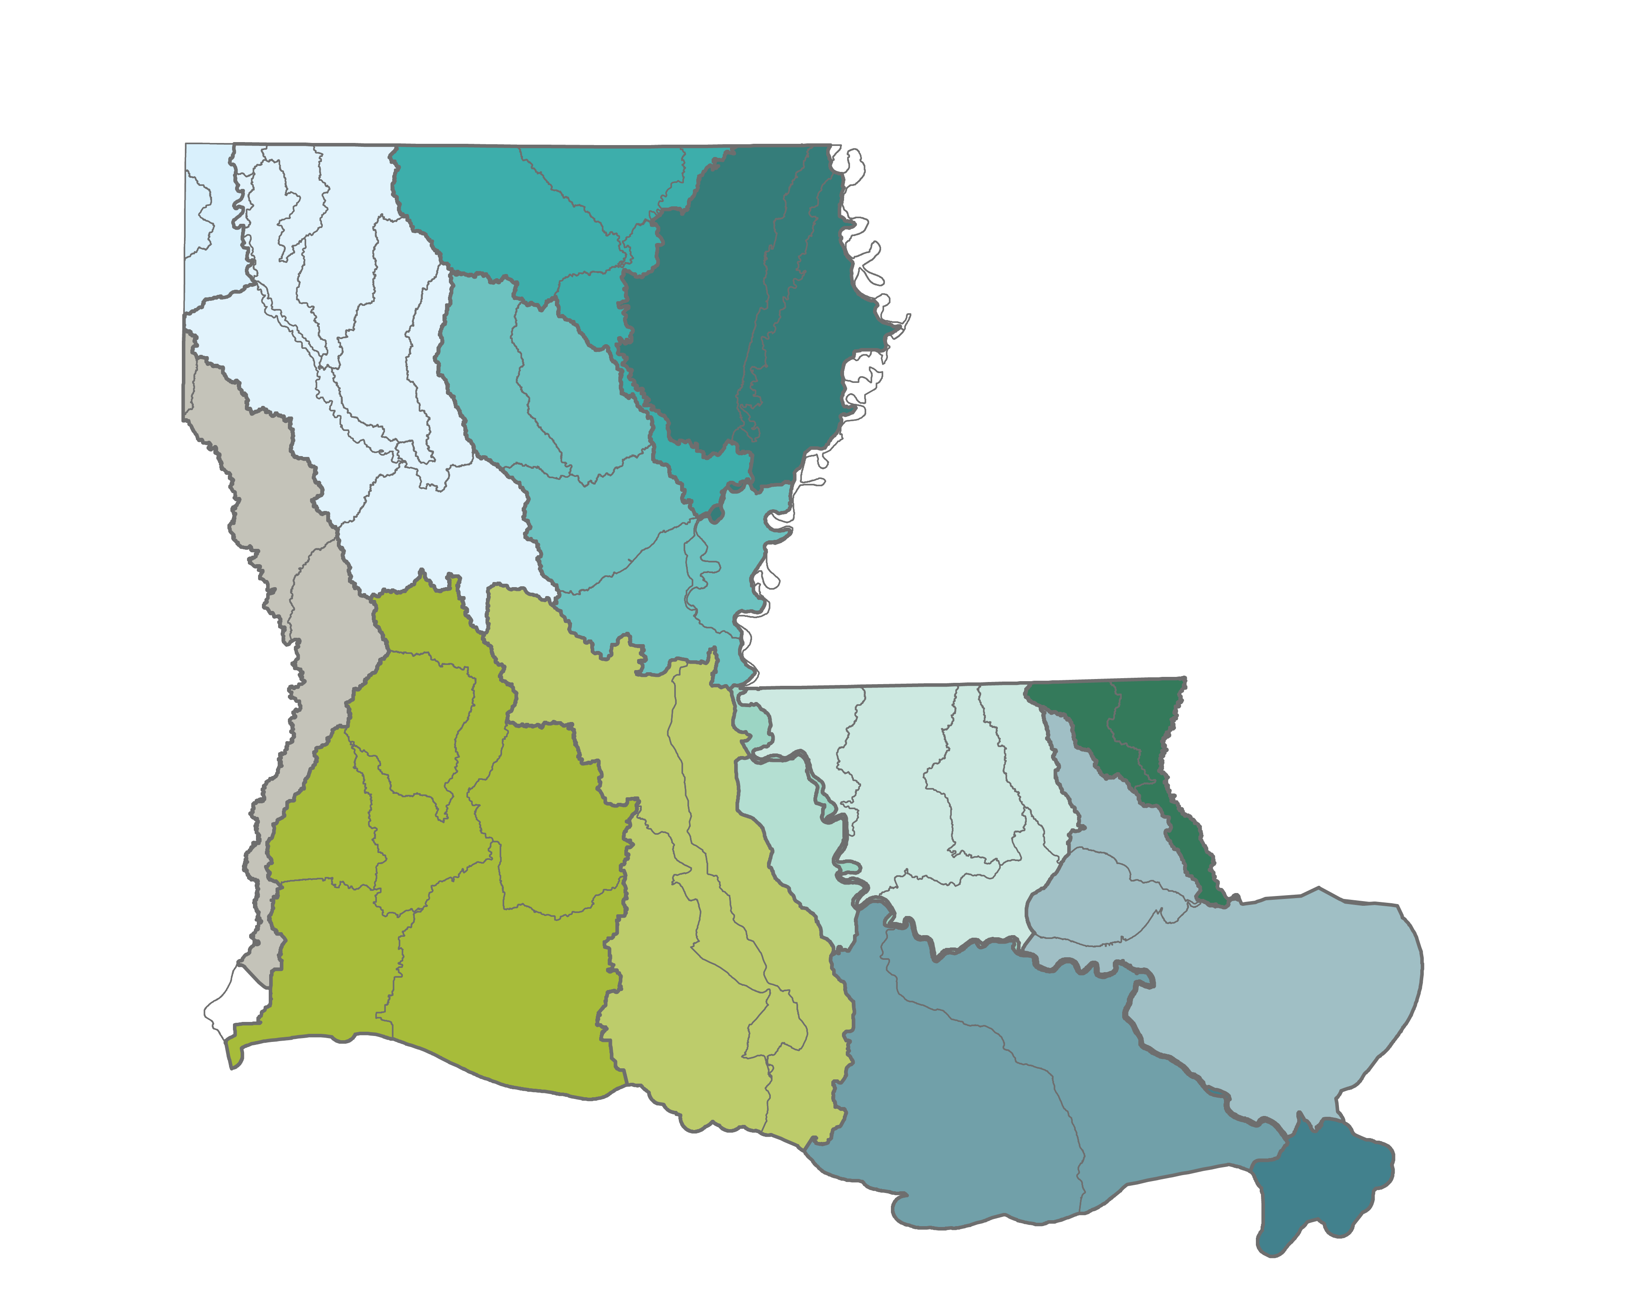
Louisiana Watershed Initiative
Mission
Reduce flood risk and improve floodplain management across the state
LOUISIANA WATERSHED INITIATIVE

Slide 11
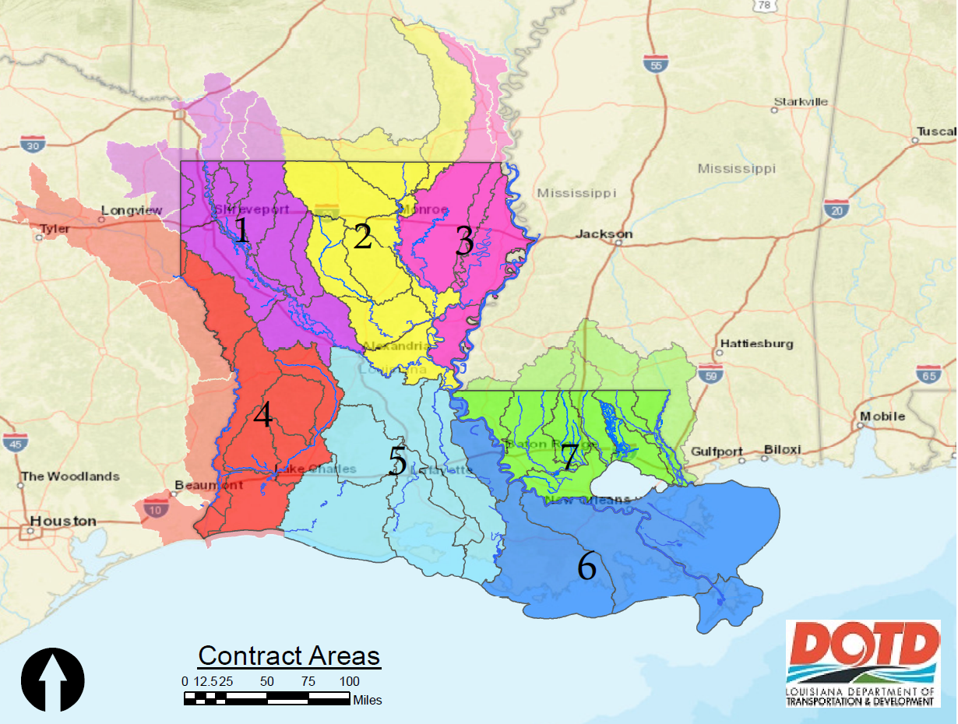
Seven Modeling Regions
Two Rounds of Procurement:
Round 1: Regions 2, 3, 5 & 7
Round 2: Regions 1, 4 & 6

Slide 12
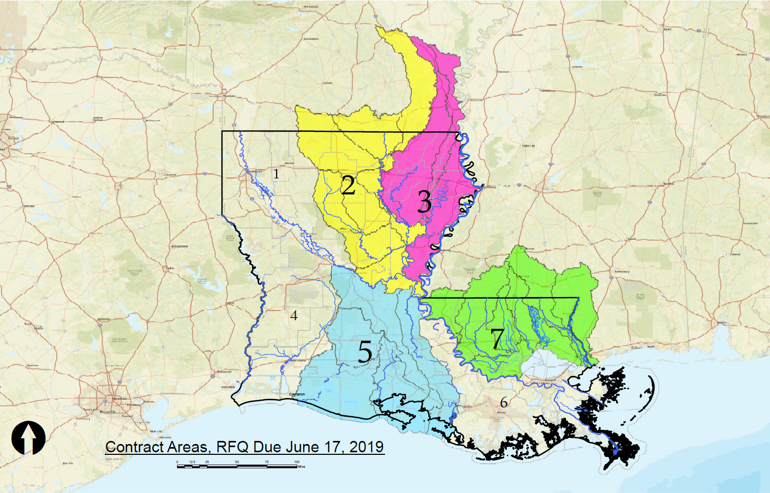
Round 1 Modeling Procurement
Firms selected
Wood Environment & Infrastructurennn
Freese & Nicholsnn
Dewberry Engineersnnn
HDR Engineeringnnn

Slide 13
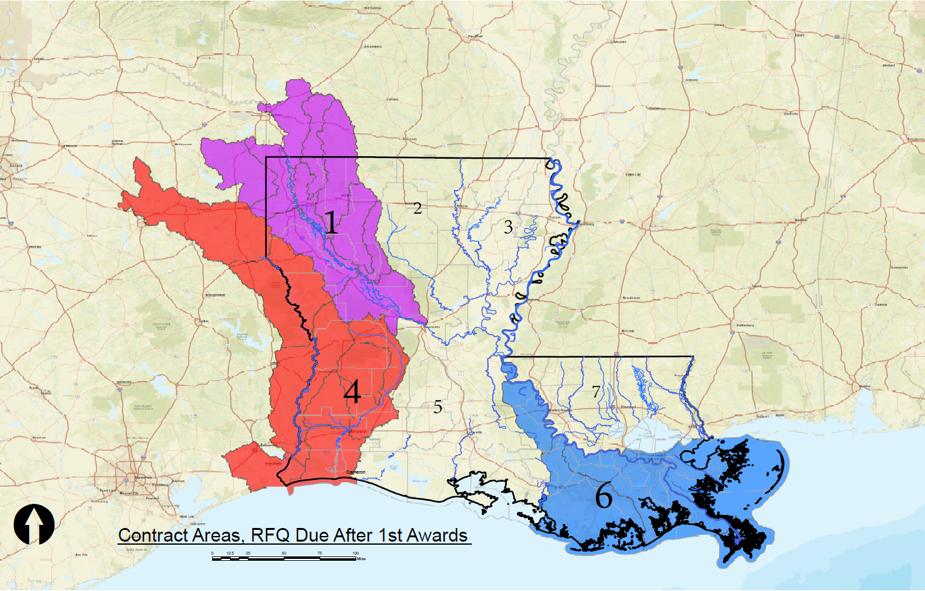
Round 2 Modeling Procurement
Modeling proposals for Regions 1, 4 & 6 are currently being evaluated
Oral Presentations will be held January 7th-9th once a shortlist of firms has been selected

Slide 14
Comite Diversion Project Status

Slide 15
Non-Federal Partner Roles
DOTD is responsible for the project LERRDs and taking the lead on LA 964, LA 19 and LA 67 bridge design and construction.
ARBC is contributing funding towards the completion of the project.
EBR is responsible for operations and maintenance of the functionally complete project.
In FY 18, MVN received funding to fully construct the Comite River Diversion through the FY18 Workplan and the Bi-partisan Budget Act of 2018

Slide 16
Simultaneous Construction tasks along the Comite Channel
Tasks in progress:
Real Estate
All project activities along the channel will be initiated along with the current construction activities at US 61
58 Parcels needed
1 in closing
14 under negotiations
LA 964 | LA 19 & 67
Design: 70% | CMAR Project Delivery Design Consultant Awarded
Anticipated bid date: 1st quarter of 2020 | Preparing for General Contractor advertisement

Slide 18
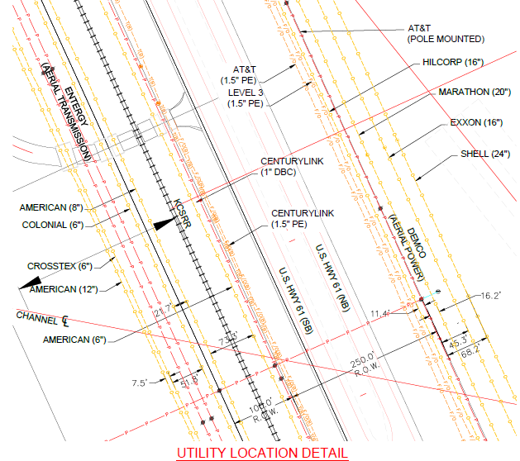
US Highway 61 Utility Relocation Status
West-Side Relocations
Entergy 69kV to be relocated this December
East-side Relocations
East Side Completion Date March 2020
ORX to begin December 2019

Slide 19
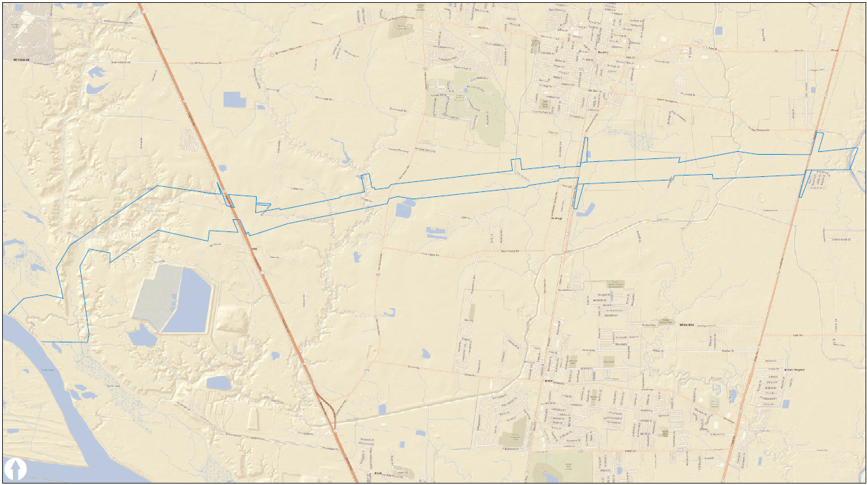
Bridge design and construction will continue simultaneously throughout the project life
LA 19-
Bridge and R/R Bridge
Construction Start:
2020
LA 67-
Bridge
Construction Start:
2020
LA 964-
Bridge
Construction Start:
2020
US 61-
Bridge and R/R Bridge
Construction Start:
2019

Slide 20
Questions

