Slide 1
New Orleans District update to the
Association of Levee Boards of Louisiana
COL Stephen Murphy
Commander, MVN
5 MAY 2022

Slide 2
Association of levee boards of Louisiana USACE New Orleans District Update
Disaster Relief Supplemental Appropriations Act Infrastructure Investment and Jobs Act
$1.95B in South Louisiana
Projects include:
New Orleans to Venice ($783M)
Southeast Louisiana Urban Flood Control ($94M)
Upper Barataria Basin ($8M)
Tangipahoa Parish Flood Risk Mgt Study ($3.2M)
$727M in South Louisiana
Projects include:
Environmental Infrastructure projects ($4.25M)
Ascension Parish (3)
East Baton Rouge Parish
Southwest Coastal LA ($240M)
Morganza to the Gulf ($378.5M)
$2.6B of additional federal investment in South Louisiana

Slide 3
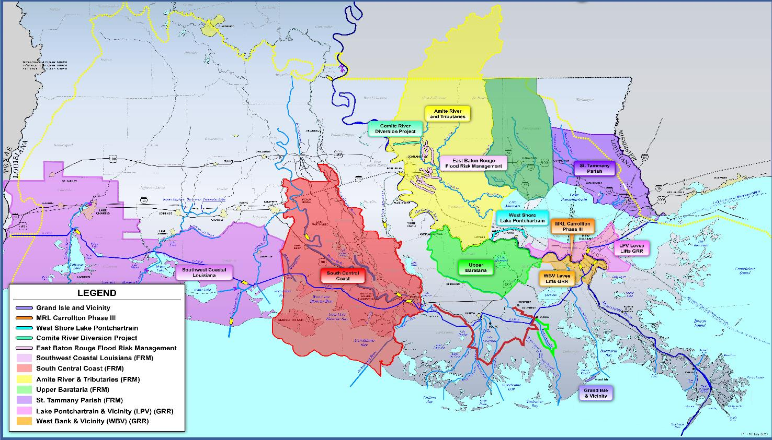
Association of levee boards of Louisiana USACE New Orleans District Update
National Commitment to South Louisiana with Regional Delivery
Upper Barataria
ST. PAUL
SW Coastal
ROCK ISLAND
Flood Risk Management
Tangipahoa
ST. LOUIS
NO to Venice
MEMPHIS
Miss R. Levees
VICKSBURG
NEW ORLEANS

Slide 4
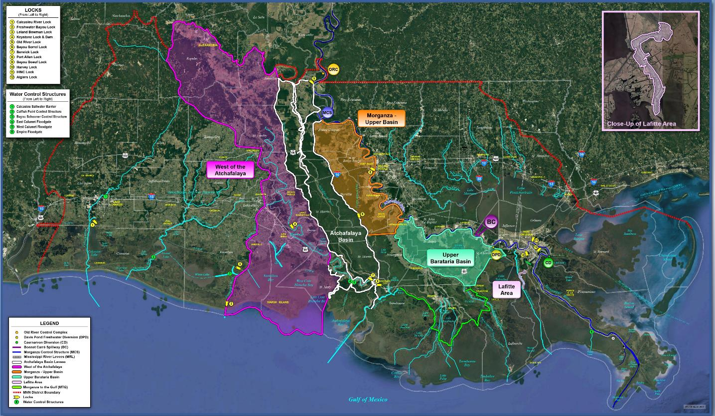
Association of levee boards of Louisiana USACE New Orleans District Update
Mississippi River and Tributaries Investigations
New Start Studies
Lafitte
Upper Morganza Basin
West Atchafalaya
Flood Risk Management
Requires Funding

Slide 5
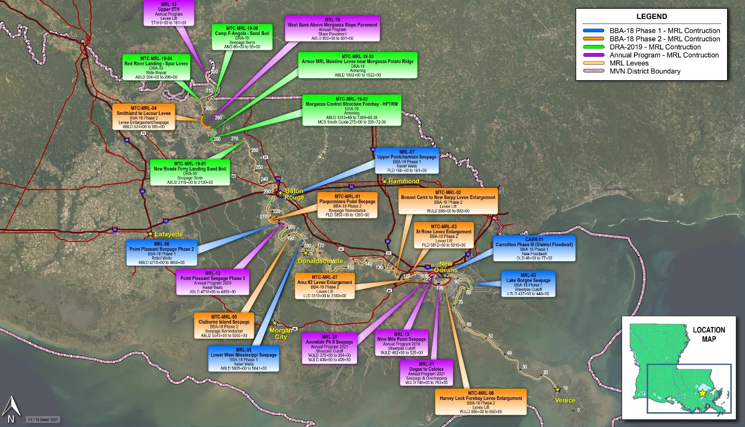
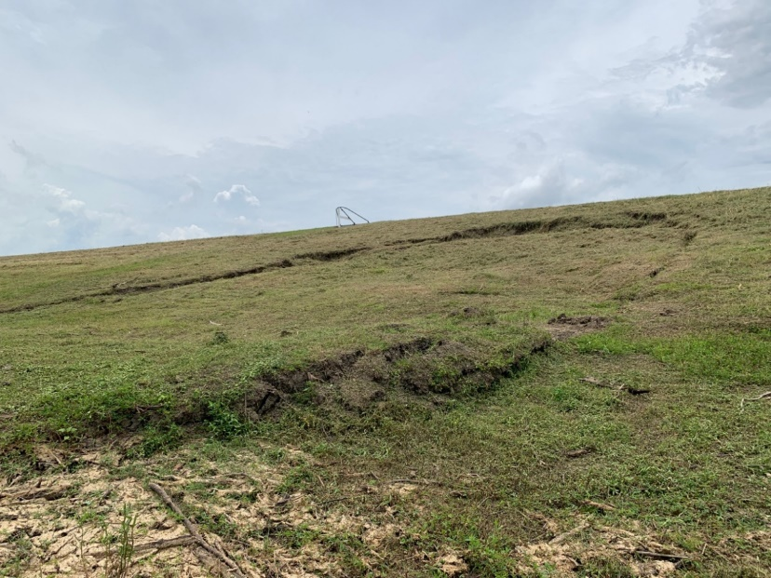
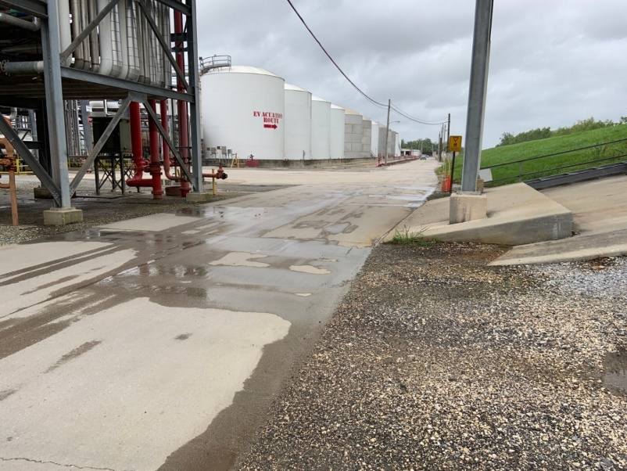
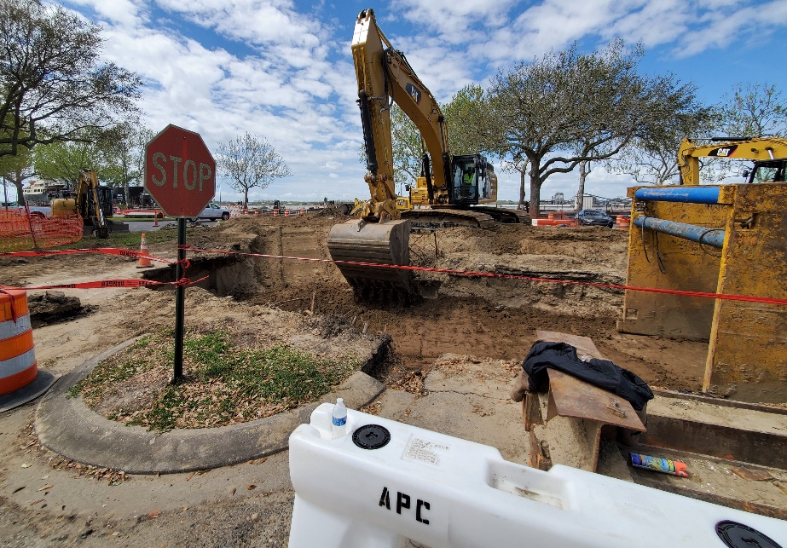
Association of levee boards of Louisiana USACE New Orleans District Update
Mississippi River Levee System
Slides
Flood Risk Management
Seepage
Enlargement

Slide 6
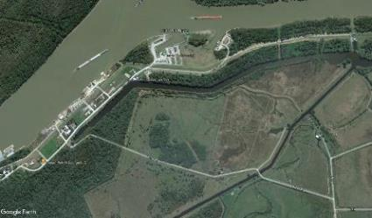
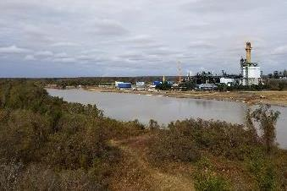
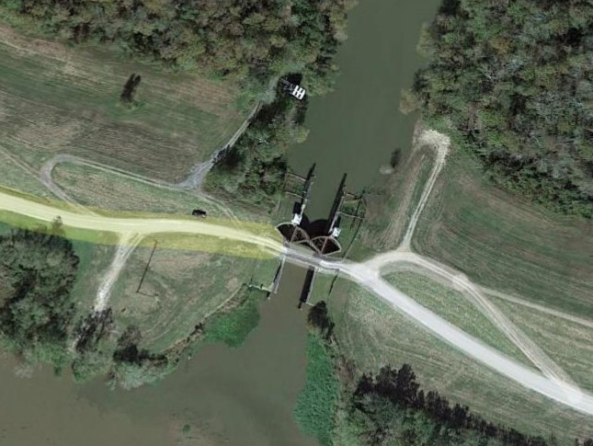
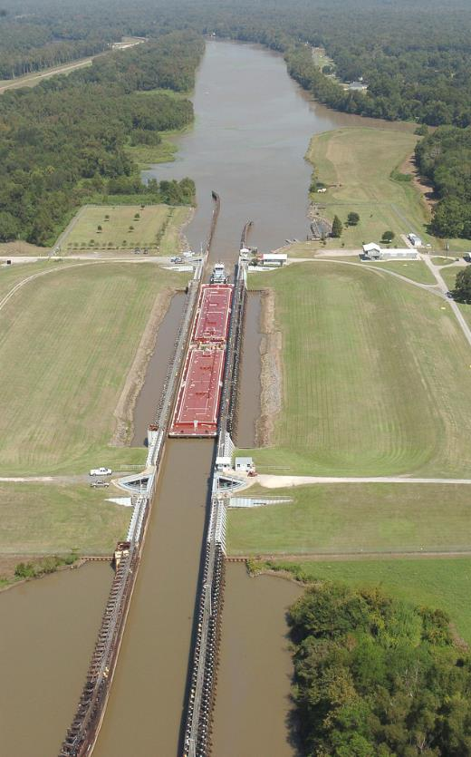
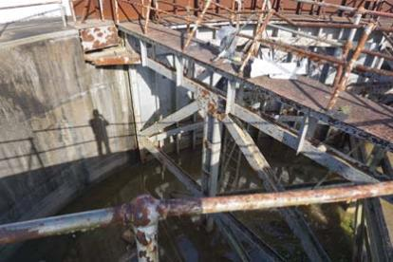
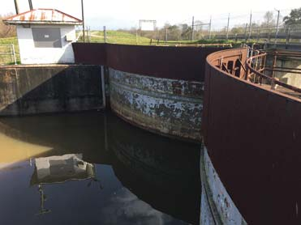
Association of levee boards of Louisiana USACE New Orleans District Update
Atchafalaya Basin Risk Reduction
Bayou Sorrel Lock
Flood Risk Management
Charenton Floodgate

Slide 7
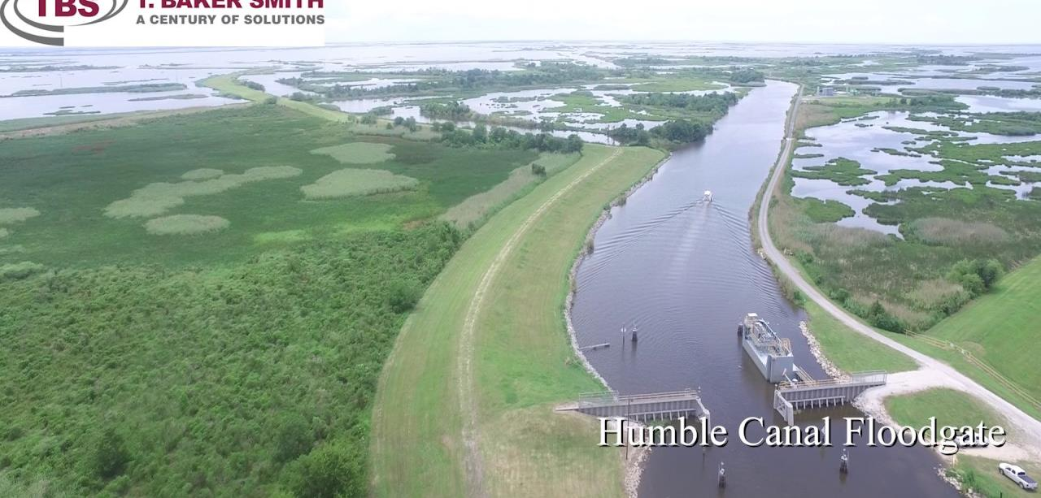
Association of levee boards of Louisiana USACE New Orleans District Update
Morganza to the Gulf of Mexico
$397.3M in federal construction funding
Design and construction includes:
Minors Canal floodgate
GIWW East & West floodgates
Humble Canal floodgate
Flood Risk Management

Slide 8
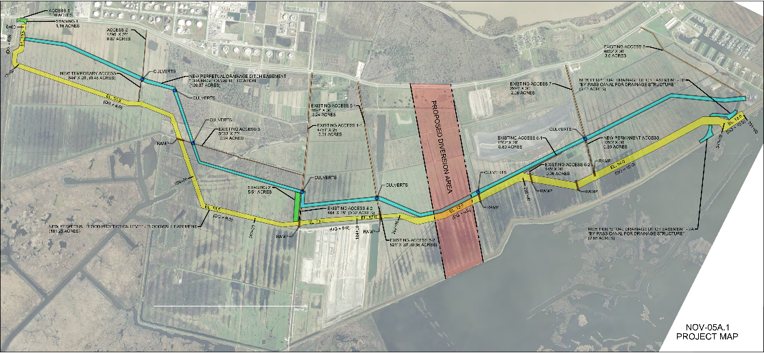
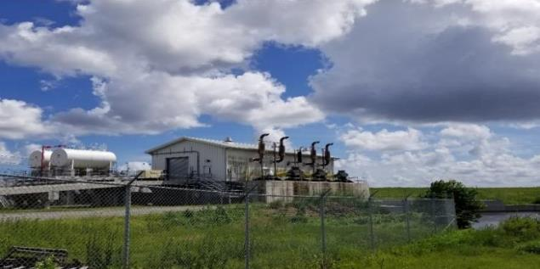
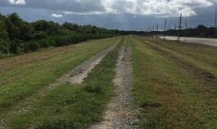
Association of levee boards of Louisiana USACE New Orleans District Update
New Orleans To Venice Hurricane Damage Risk Reduction
All levee reaches under construction
Provided additional $783M under DRSAA
Improve to 50-yr LORR
10 planned contracts
Levee enlargements
Fronting protection
More robust floodwalls
Flood Risk Management

Slide 9
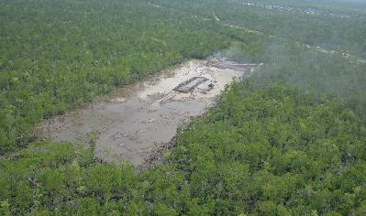
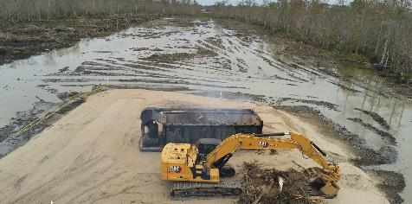
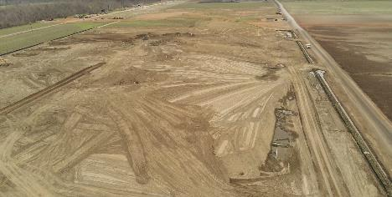
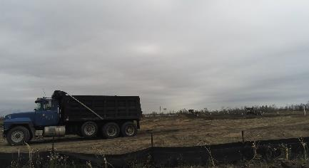
Association of levee boards of Louisiana USACE New Orleans District Update
West Shore Lake Pontchartrain
Flood Risk Management
$760M in full federal funding to reduce risk for more than 60,000 residents

Slide 10
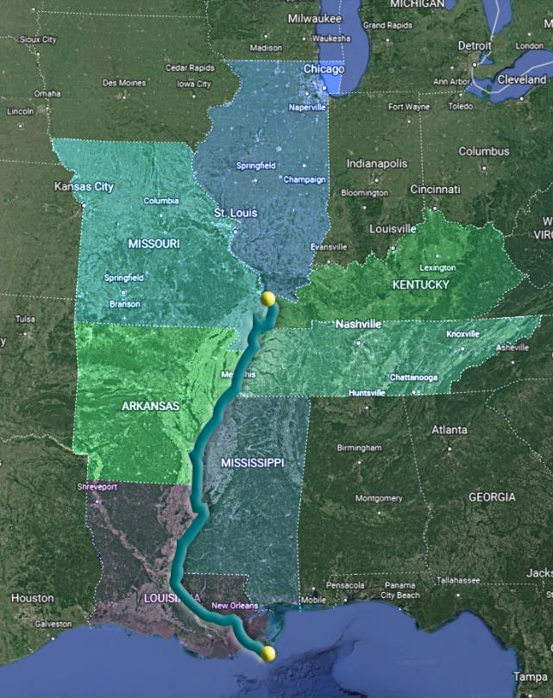
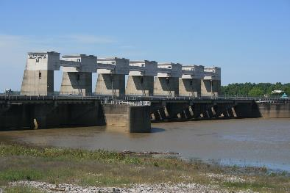
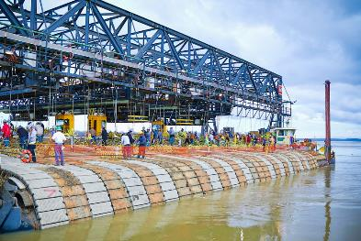
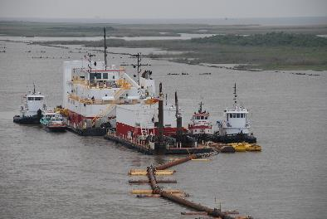
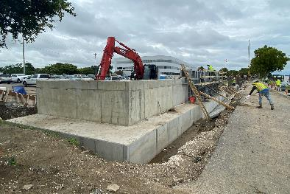
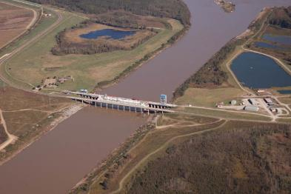
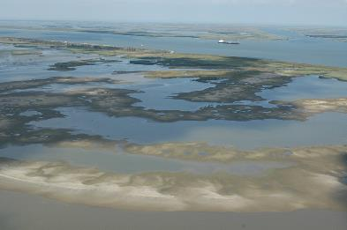
Association of levee boards of louisiana USACE New Orleans District Update
Lower Mississippi River Comprehensive Study
$25M five-year study
Cape Girardeau, IL to Gulf of Mexico
Study Area: Illinois, Missouri, Kentucky, Tennessee, Arkansas, Mississippi & Louisiana
Sect. 213, WRDA ‘20

Slide 11
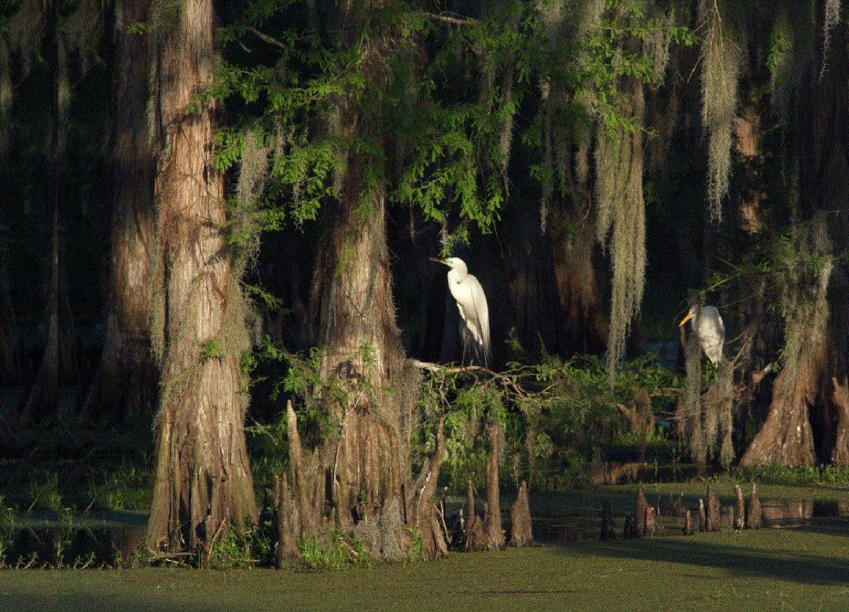
Association of levee boards of louisiana USACE New Orleans District Update
Regulatory Activities
MVN Division-Level Office
Annual Funding Constraints
Early and Frequent Communication
Sect. 10, 404 and 408

Slide 12
USACE New Orleans Social media
Follow, join, comment, and share messaging along with us
Visit our website
www.mvn.usace.army.mil
Like us on Facebook
@usacenola
@westshorelakepontchartrain
@comiteriverdiversion
Follow on Twitter
@USACENOLA
Find on Instagram
@corps_of_engineers_nola
Notes:
Thank you for sharing your time with me this morning. Of course, good partnership starts with communication so please never hesitate to reach out to us if you have questions, ideas or need additional information.
I look forward to working with each of you in the coming weeks and months. Until then, I hope you enjoy a safe weekend. Thank you again.

