Slide 1
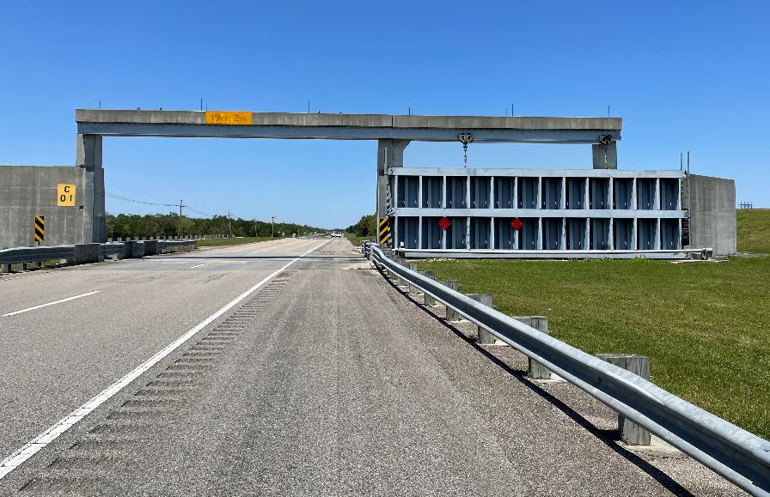
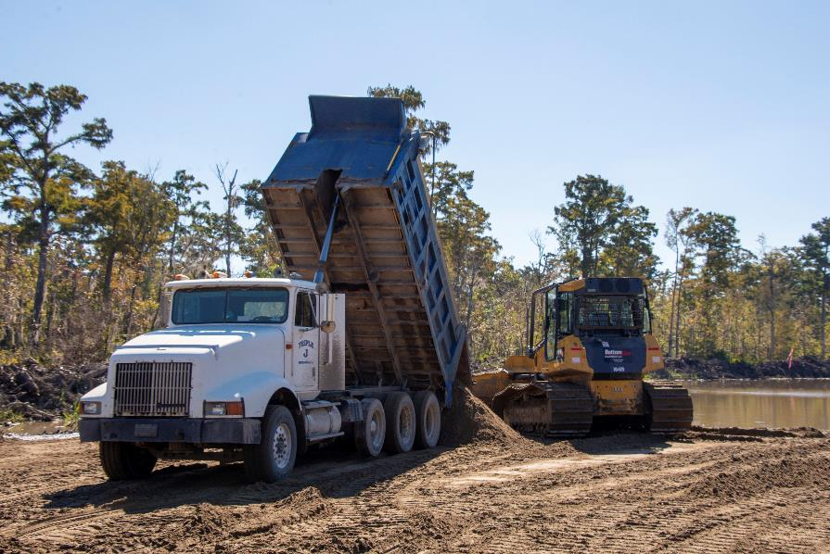
NEW ORLEANS DISTRICT ANNUAL UPDATE TO Association OF LEVEE Boards of Louisiana
COL Cullen Jones
District Commander
USACE New Orleans District
30 November 2022

Slide 2
New Orleans District Update
FY22 Obligations: $941M (FY21: $933M)
Regular Program: $438M
HSDRRS: $157M
Supplemental Funding: $364M
Contracting Processes
975 contract actions
$693M in contract obligations
$327M awarded to Small Businesses
Upper Barataria
ST. PAUL
SW Coastal
ROCK ISLAND
Disaster Relief Supplemental Approp. Act (DRSAA) of 2022: $1.95B
Projects include:
New Orleans to Venice ($783M)
Southeast Louisiana Urban Flood Control ($94M)
Upper Barataria Basin ($8M)
Tangipahoa Parish Flood Risk Mgt Study ($3.2M)
Bipartisan Infrastructure Law (BIL): $727M
Projects include:
Environmental Infrastructure projects ($4.25M)
Ascension Parish (3)
East Baton Rouge Parish
Southwest Coastal LA ($240M)
Morganza to the Gulf ($378.5M)
Tangipahoa
ST. LOUIS
NO to Venice
MEMPHIS
Miss R. Levees
VICKSBURG
NEW ORLEANS

Slide 3
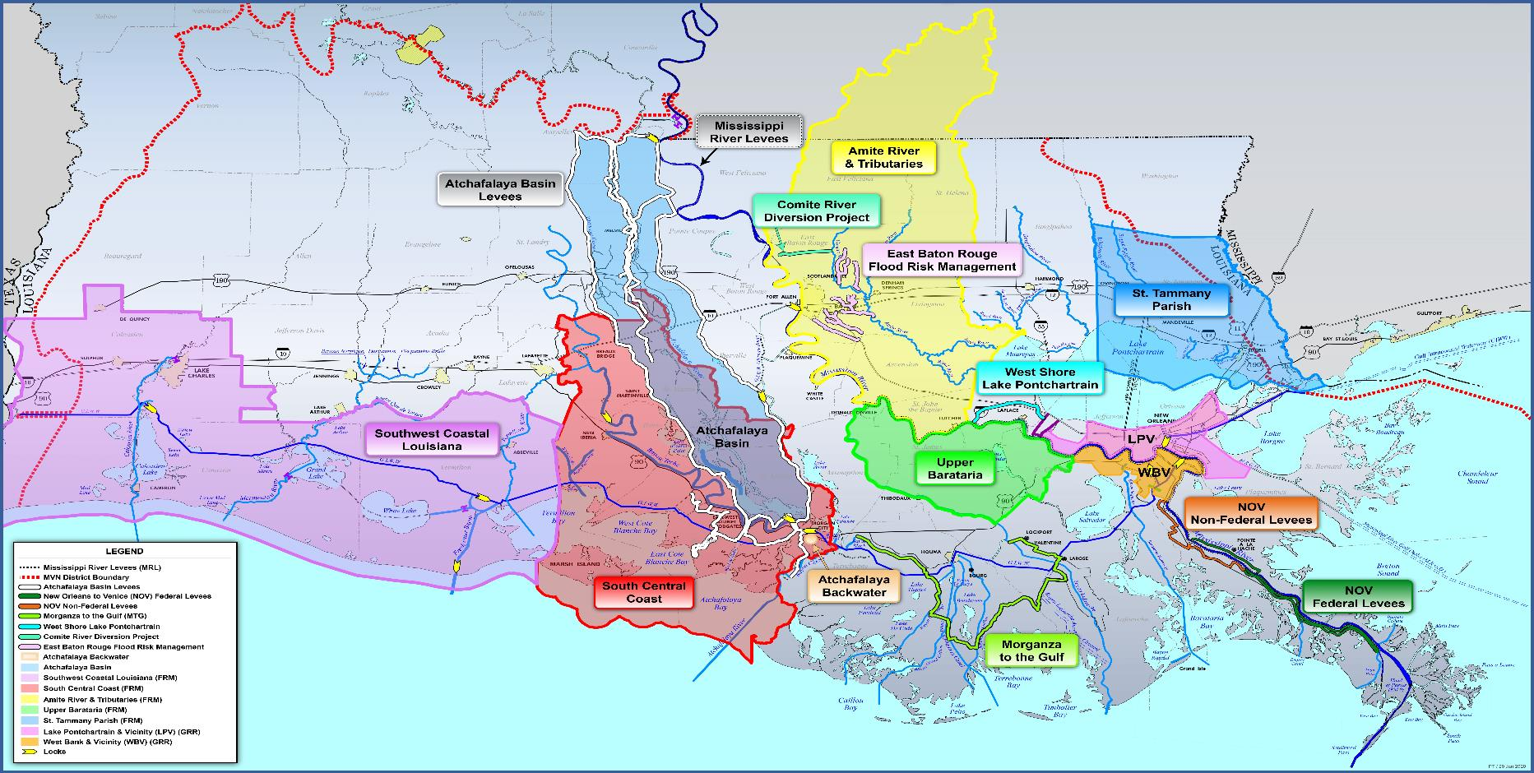
FlooD Risk Management in South Louisiana

Slide 4
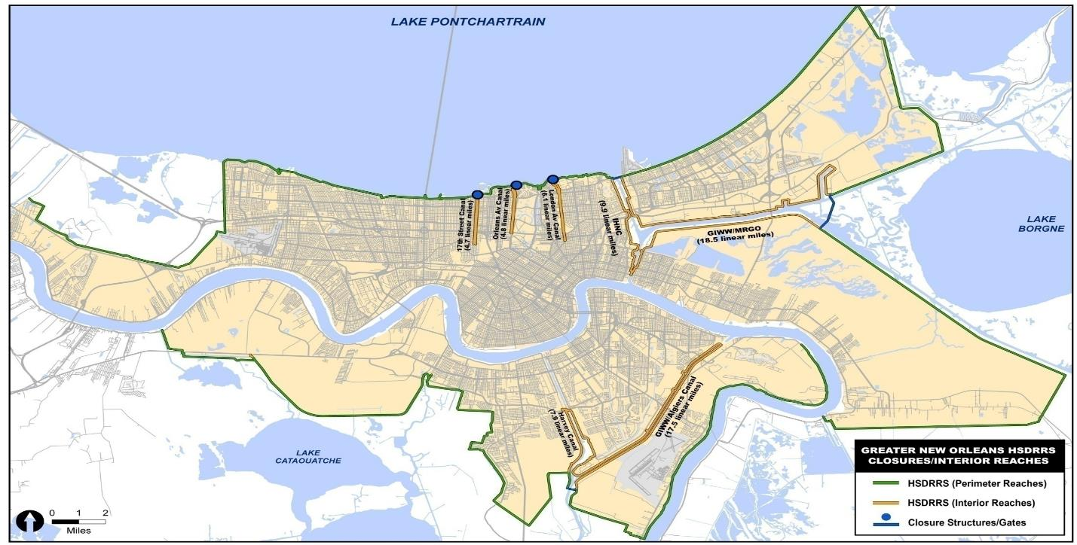
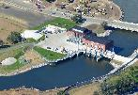
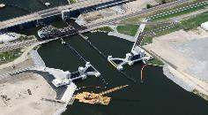
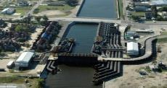
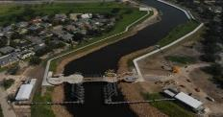
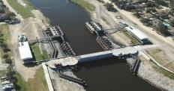
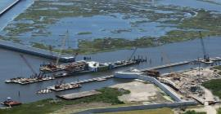
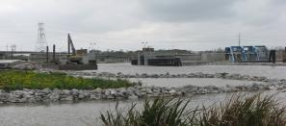
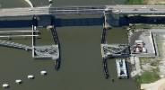
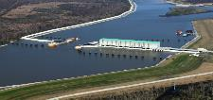
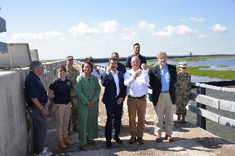
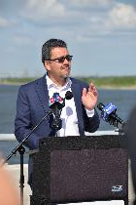
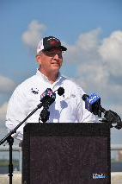
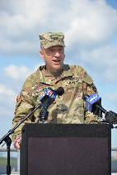
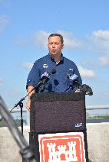
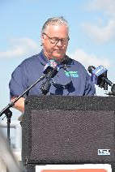
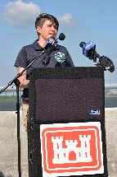
Hurricane and storm damage risk reduction System
Partners: Southeast La. Flood Protection Authorities- East & West and CPRA
SYSTEM COMPLETE
$14.45 billion
15 years of active construction (2007-2022)
Transferred to the state of Louisiana in May 2022
LPV & WBV General Reevaluation Reports signed in December 2021
17th St.
Orleans
London
Seabrook
IHNC Surge Barrier
Bayou Verret
Caernarvon
Harvey Floodgate
West Closure Complex
Bayou Segnette
Hero Canal

Slide 5
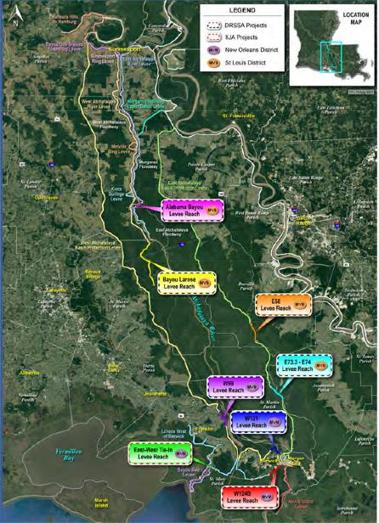
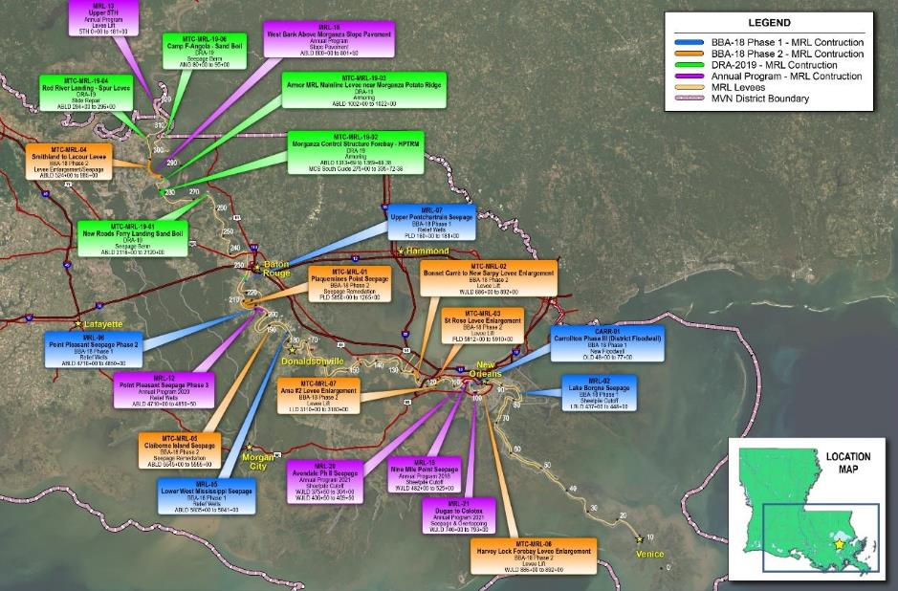
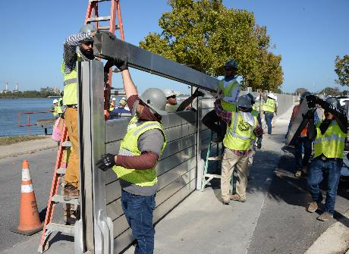
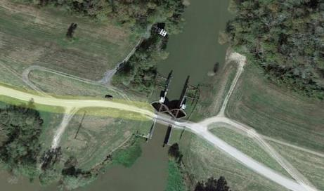
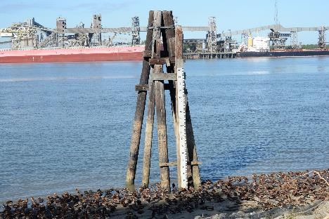
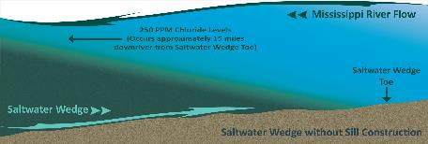
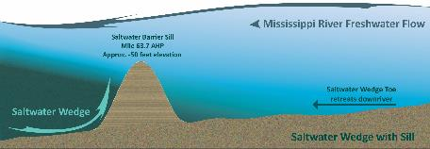
Mississippi River & Tributaries in South Louisiana
Partners: SLFPA-E & W, PLD, SMLD, ABLD, LBLD
Carrollton Floodwall substantially complete in December
Charenton Floodgate replacement will address critical deficiency in Atchafalaya Basin
Will support Vicksburg District’s lead in delivering MRL work under BIL/DRSSA

Slide 6
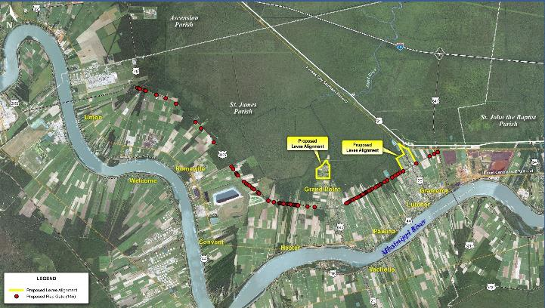
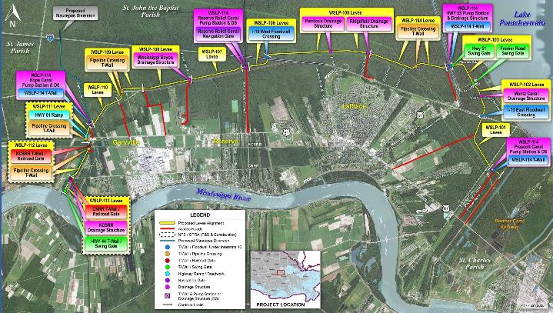
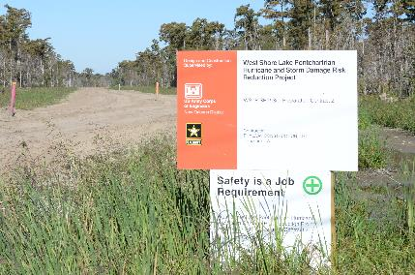
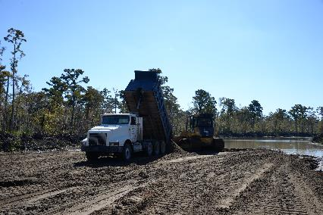
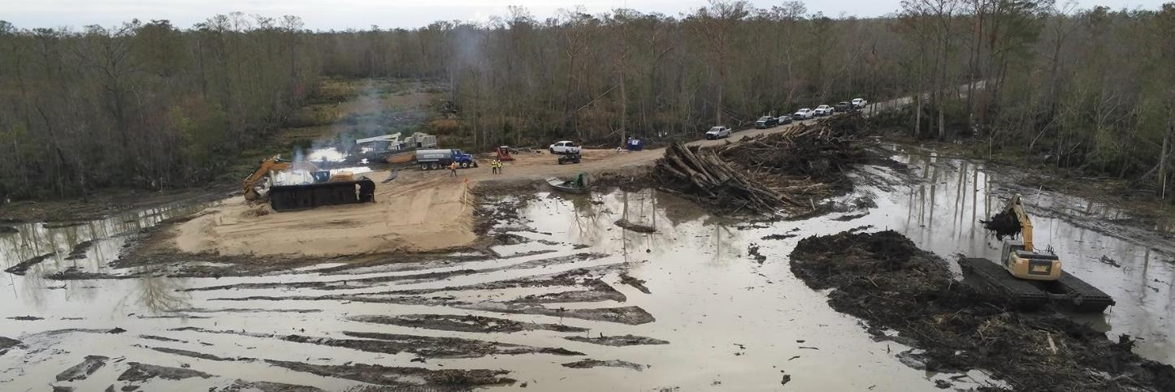
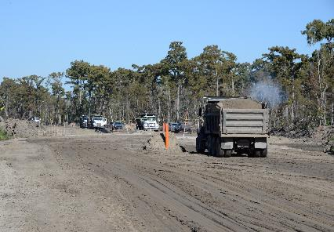
West Shore lake Pontchartrain
Partners: Pontchartrain Levee District and CPRA
Notes:
.

Slide 7
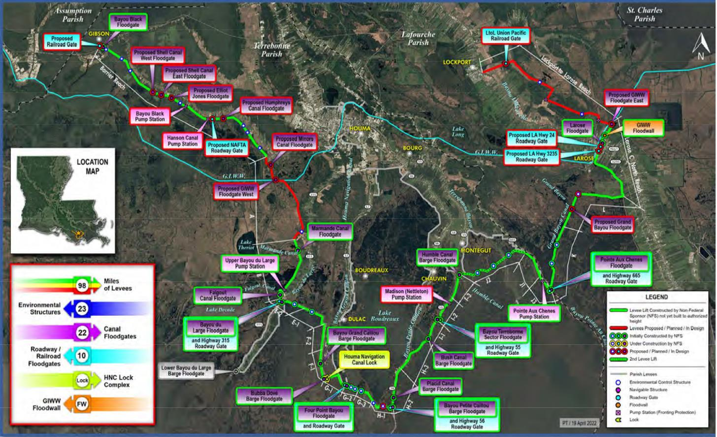
Morganza to the Gulf
Partners: Terrebonne Conservation and Levee District and CPRA
Dec. 9: Humble Canal Preload Groundbreaking
Bipartisan Infrastructure Law (BIL) included an additional $378.5 M for further federal investment.
Future work to include:
Humble Canal Floodgate
Minor Canal Floodgate
GIWW East and West floodgates

Slide 8
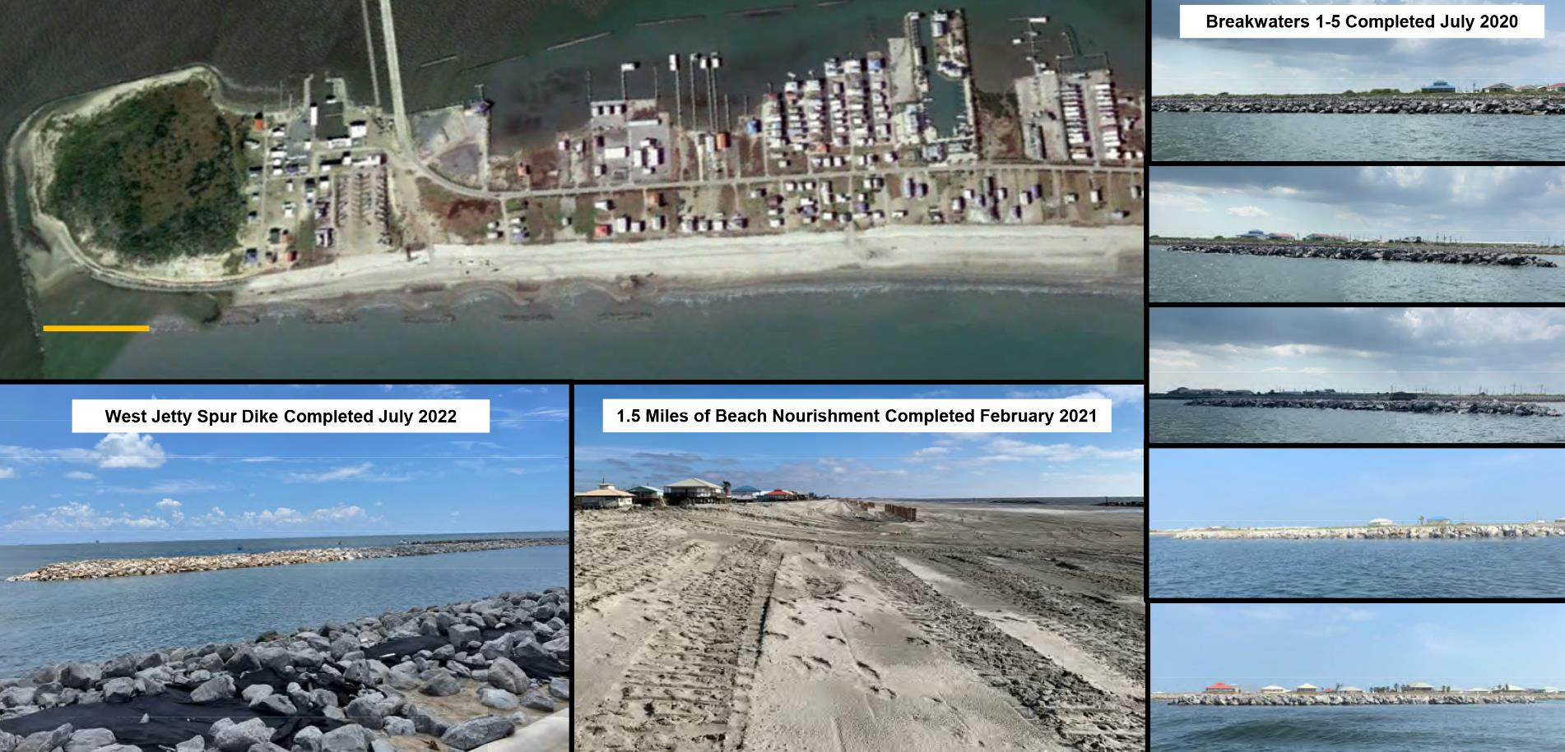
Grand Isle Storm risk Management
Partners: Coastal Protection and Restoration Authority
$120 Million received under the Disaster Relief Supplemental Appropriations Act to address damages experienced during recent storms

Slide 9
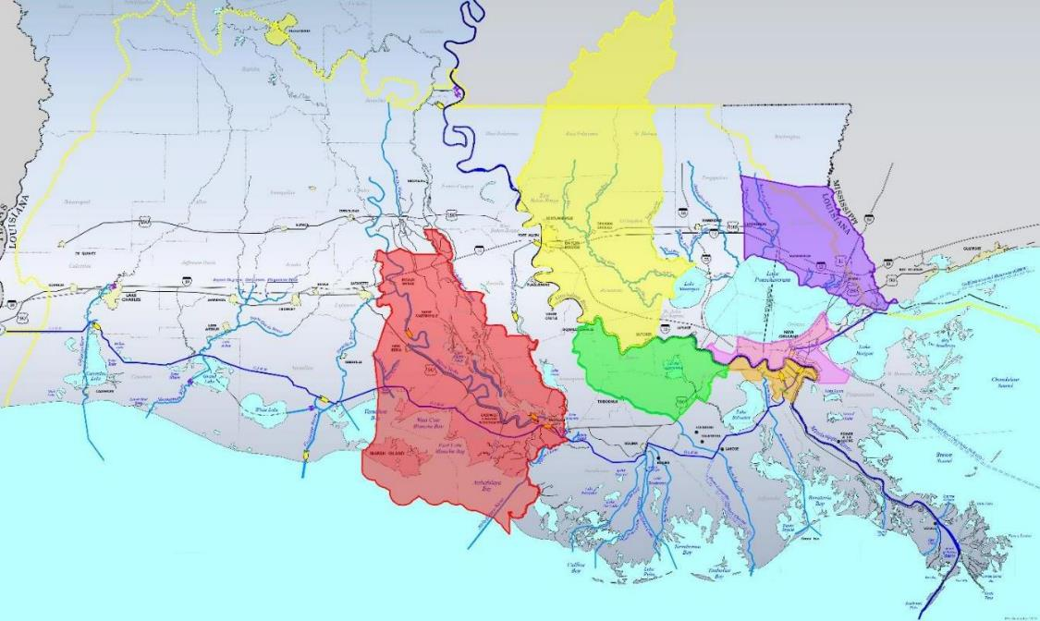
Flood risk management studies
Partners: Coastal Protection and Restoration Authority
Positive Chief’s Reports for the Upper Barataria Basin LA and South Central Coastal Louisiana feasibility studies.
Continue to make progress on the Amite River and Tributaries and St. Tammany feasibility studies.
A new study for Tangipahoa soon underway (St. Louis District to lead)

Slide 10
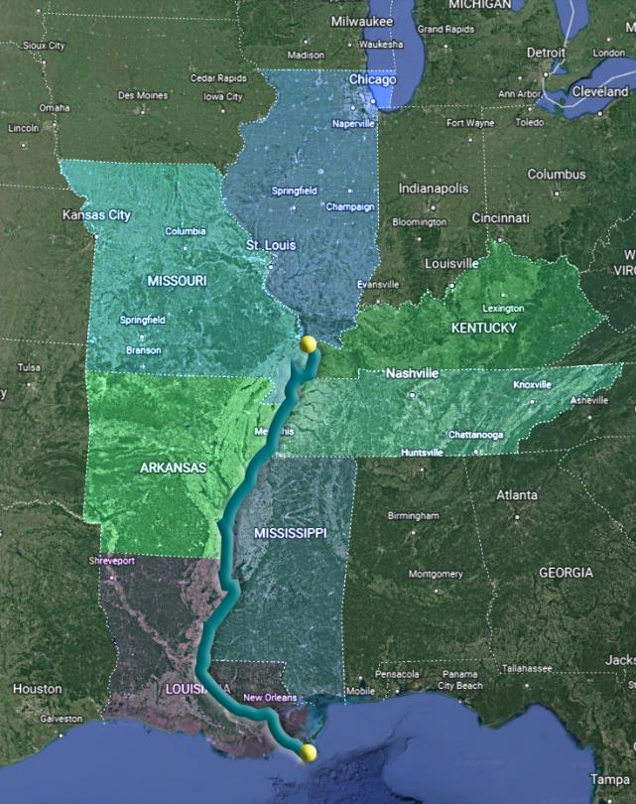
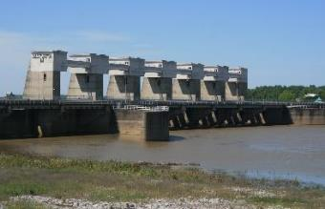
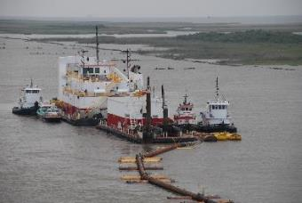
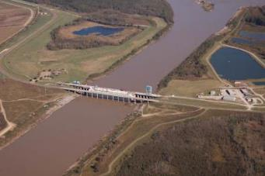
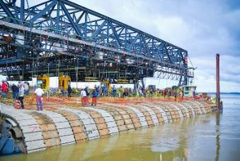
Lower Mississippi River Comprehensive
Partners: Coastal Protection and Restoration Authority
Authorized in WRDA 2020
$25M five-year study
Cape Girardeau, IL to Gulf of Mexico
Study Area: Illinois, Missouri, Kentucky, Tennessee, Arkansas, Mississippi & Louisiana
Considers all facets of the river, to include flood risk management, coastal restoration, navigation
Will deliver recommendations for future river management

Slide 11
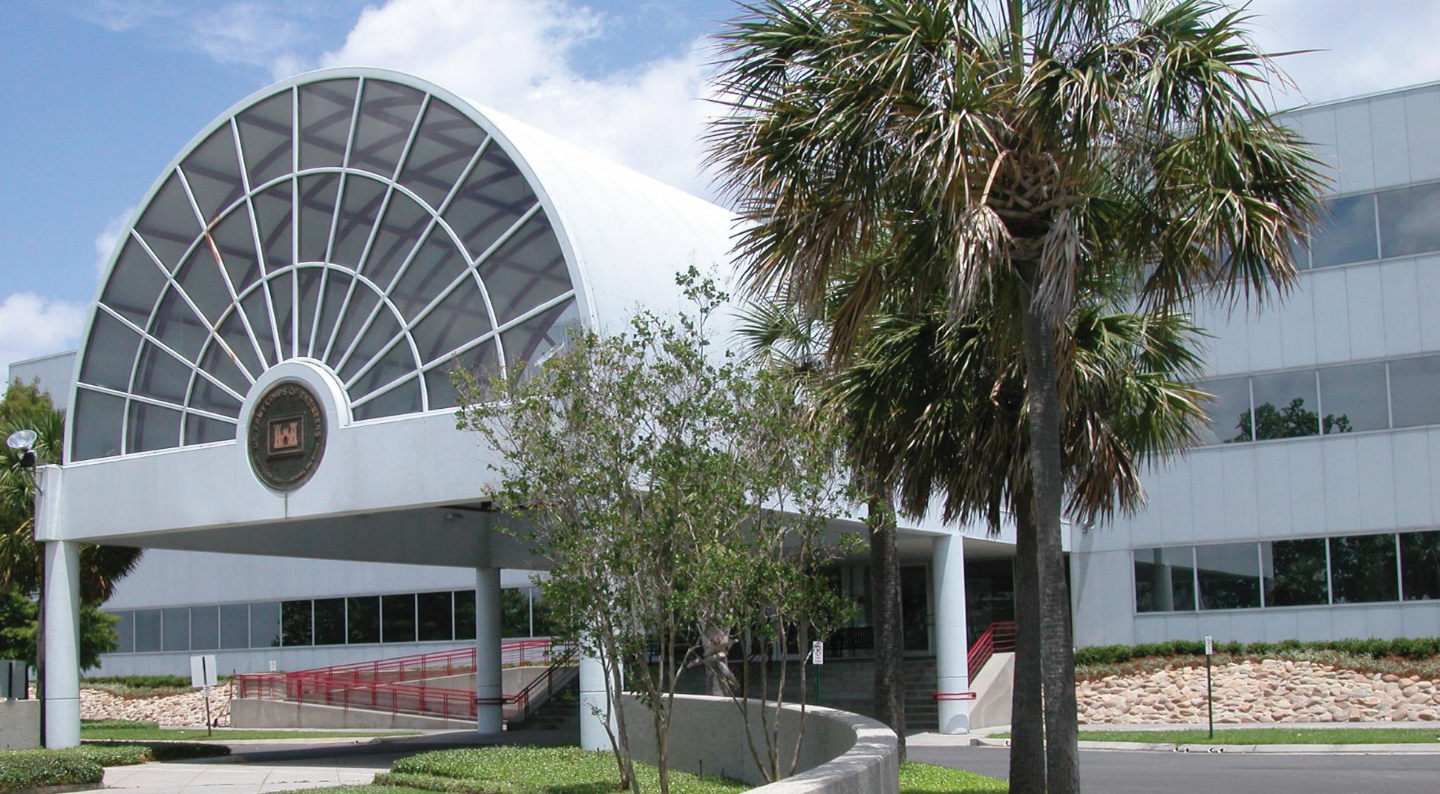
Contact us
COL Cullen A. Jones, Commander
Phone: 504-862.2077
Email: Cullen.A.Jones@usace.army.mil
Mark Wingate, Deputy District Engineer
Phone: 504-862.2204
Email: Mark.R.Wingate@usace.army.mil
Regulatory Questions
Steve Roberts, Executive Assistant
Phone: 504-862.2517
Regulatory: 504-862-2207
Email: Steve.W.Roberts@usace.army.mil

Slide 12
USACE New Orleans Social media
Follow, join, comment, and share messaging along with us
Visit our website
www.mvn.usace.army.mil
Like us on Facebook
@usacenola
@westshorelakepontchartrain
@comiteriverdiversion
Follow on Twitter
@USACENOLA
Find on Instagram
@corps_of_engineers_nola

