Slide 1
ASSOCIATION OF
LEVEE BOARDS
ANNUAL MEETING
November 30, 2022
Genea Lathers, Resilience and Mitigation Manager
Louisiana Office of Community Development

Slide 2
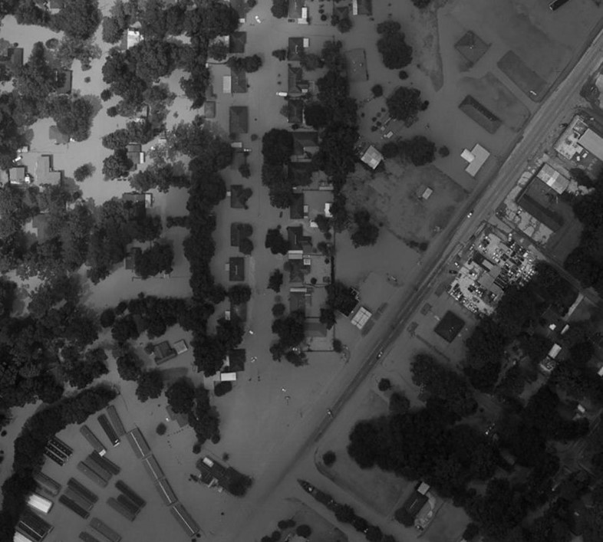
The challenge
Flooding does not follow political boundaries, as major watersheds cross parish and state lines
Actions in one community impact other communities and entire ecosystems
2016 FLOOD, DENHAM SPRINGS

Slide 3
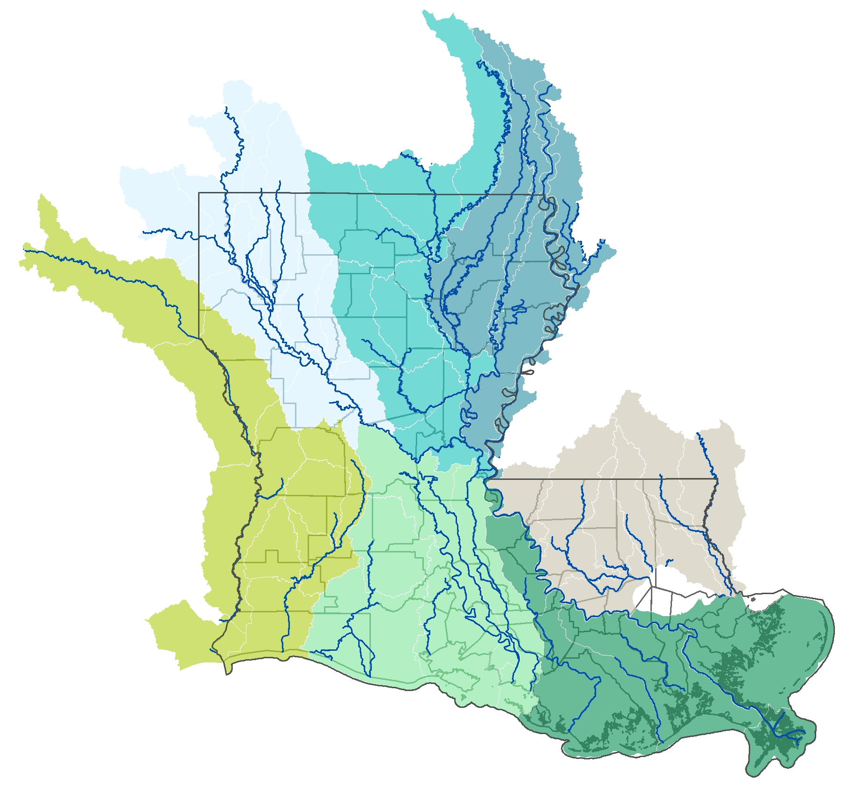
The opportunity
Fundamentally change the state’s approach to flood risk reduction
Proactively address flood risk and improve floodplain management through a watershed-based approach

Slide 4
Louisiana Watershed Initiative
Mission: reduce flood risk, improve floodplain management throughout the state and maximize the natural and beneficial functions of floodplains
Key focus areas of LWI:
Provide data and tools necessary for good decision making
Provide structure and funding to build capacity and facilitate decision making at the watershed level
Provide funding for implementation of projects that are:
selected by coalitions built around watersheds
informed by improved data and tools
2016 FLOOD, DENHAM SPRINGS

Slide 5
Funding focus areas
Flood risk reduction projects
Modeling and data
Regional water management
Enhanced retention, drainage and protection
Moving people and property out of harm’s way
High-quality gauge network
Watershed models and maps
User-friendly data portal
Regional watershed management
Improved building and land use practices to reduce flood risk

Slide 6
$1.2 BILLION IN CDBG-MIT FUNDING

Slide 7
Funding progress
$1.2 billion CDBG-MIT FUNDING
$450 million awarded to flood risk reduction projects throughout the state
Funding drainage, infrastructure, flood storage, floodplain preservation and buyout projects
$145 million dedicated to the statewide watershed modeling effort
Developing models of all watersheds to simulate flood scenarios and analyze solutions
$15 million dedicated to enhancing the statewide river and rain gauge network
Installing new gauges at 100 sites throughout the state
$10 million dedicated to regional watershed management efforts
Building staff capacity and providing technical assistance in watershed regions

Slide 8
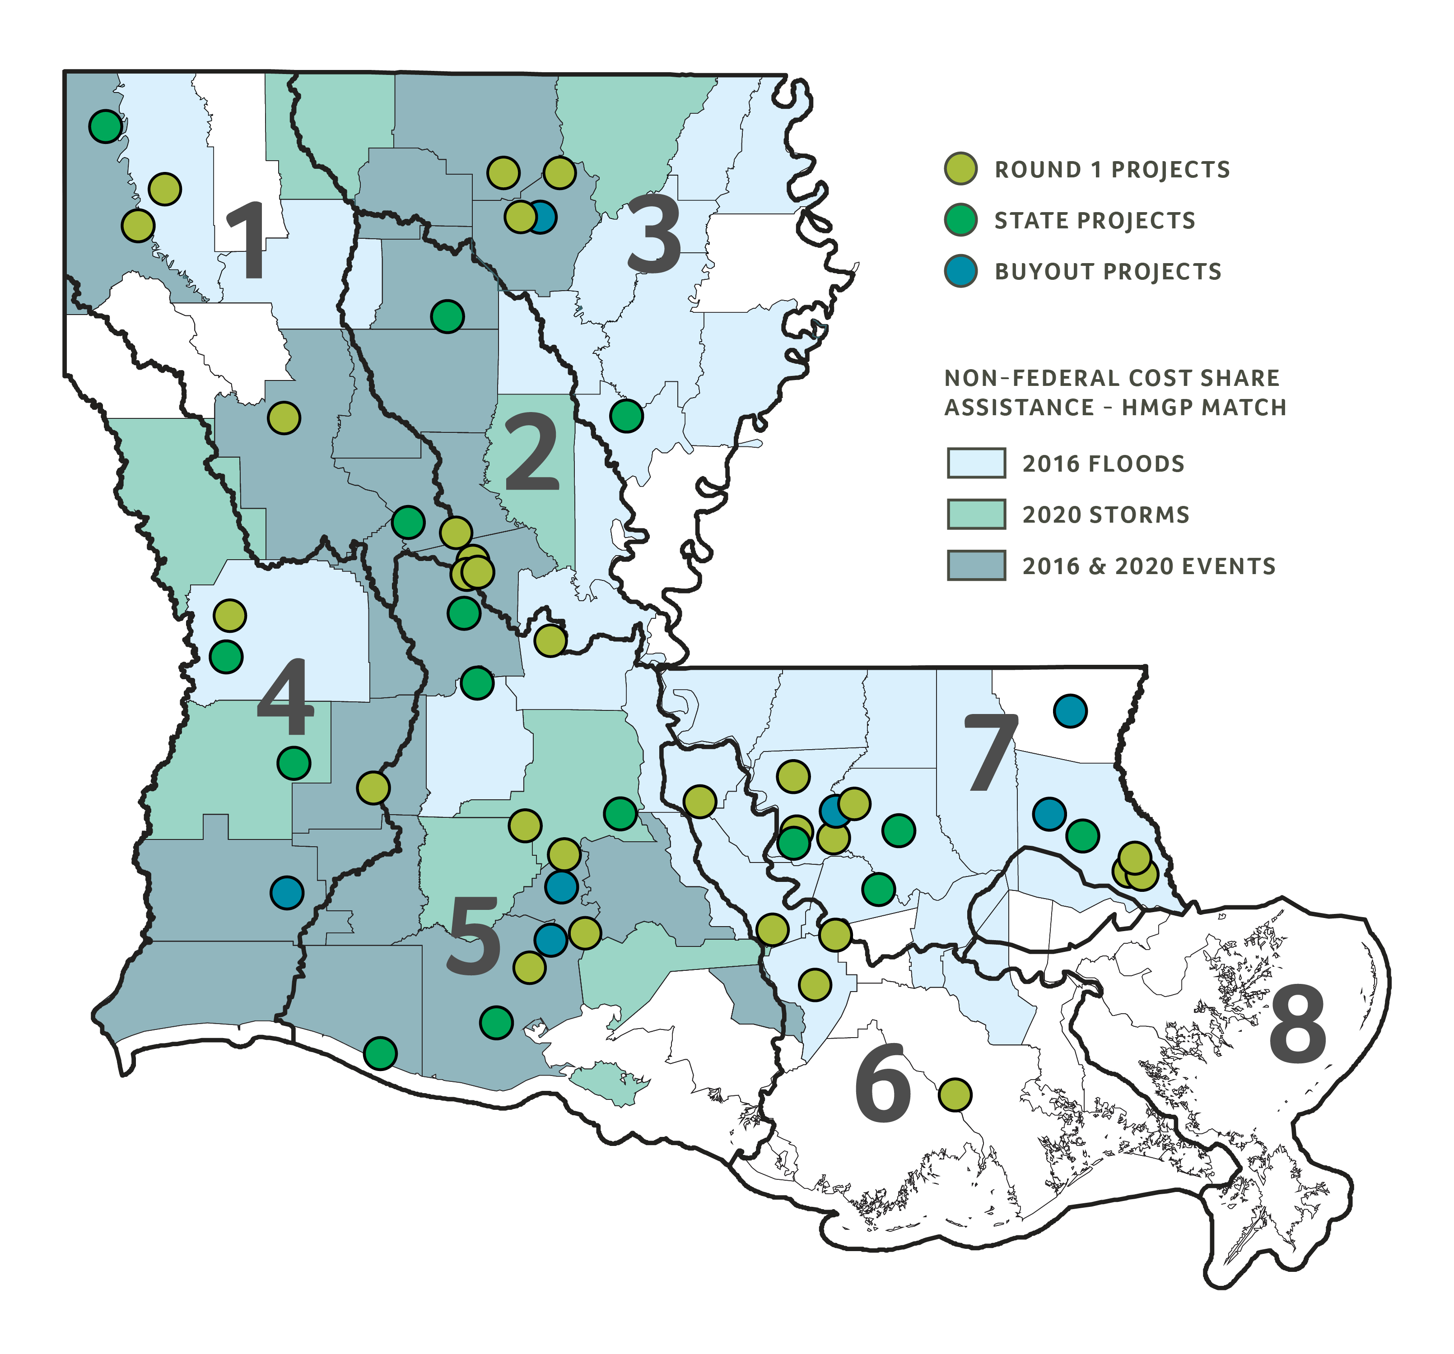
Funded projects

Slide 9
Design Support Program
Overview
$100 million for project applications submitted in Round 1 that did not receive funding, including providing technical assistance to applicants
Project Focus
benefit low- to moderate-income populations
HUD-identified most impacted and distressed areas
incorporate nature-based solutions
Selected from unfunded Round 1 projects based on the projects’ upstream and downstream impacts, design needs to address gaps in the original applications and modeling methodologies and outcomes

Slide 10
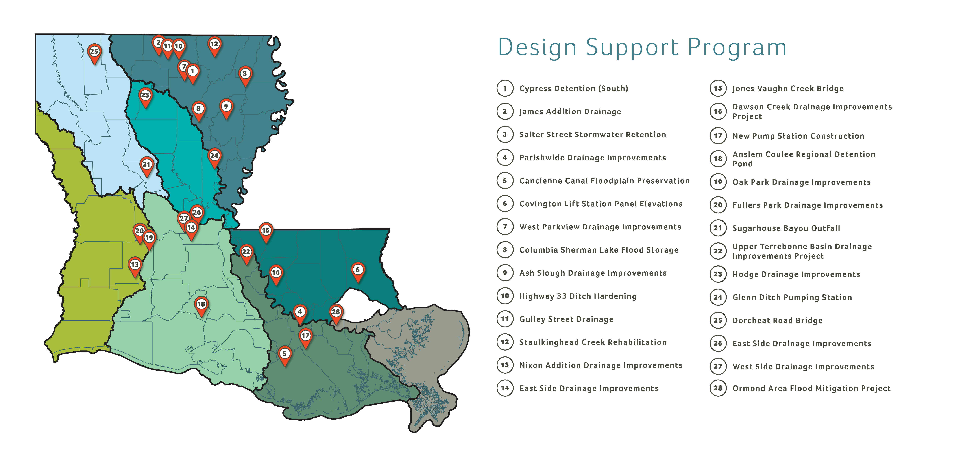

Slide 11
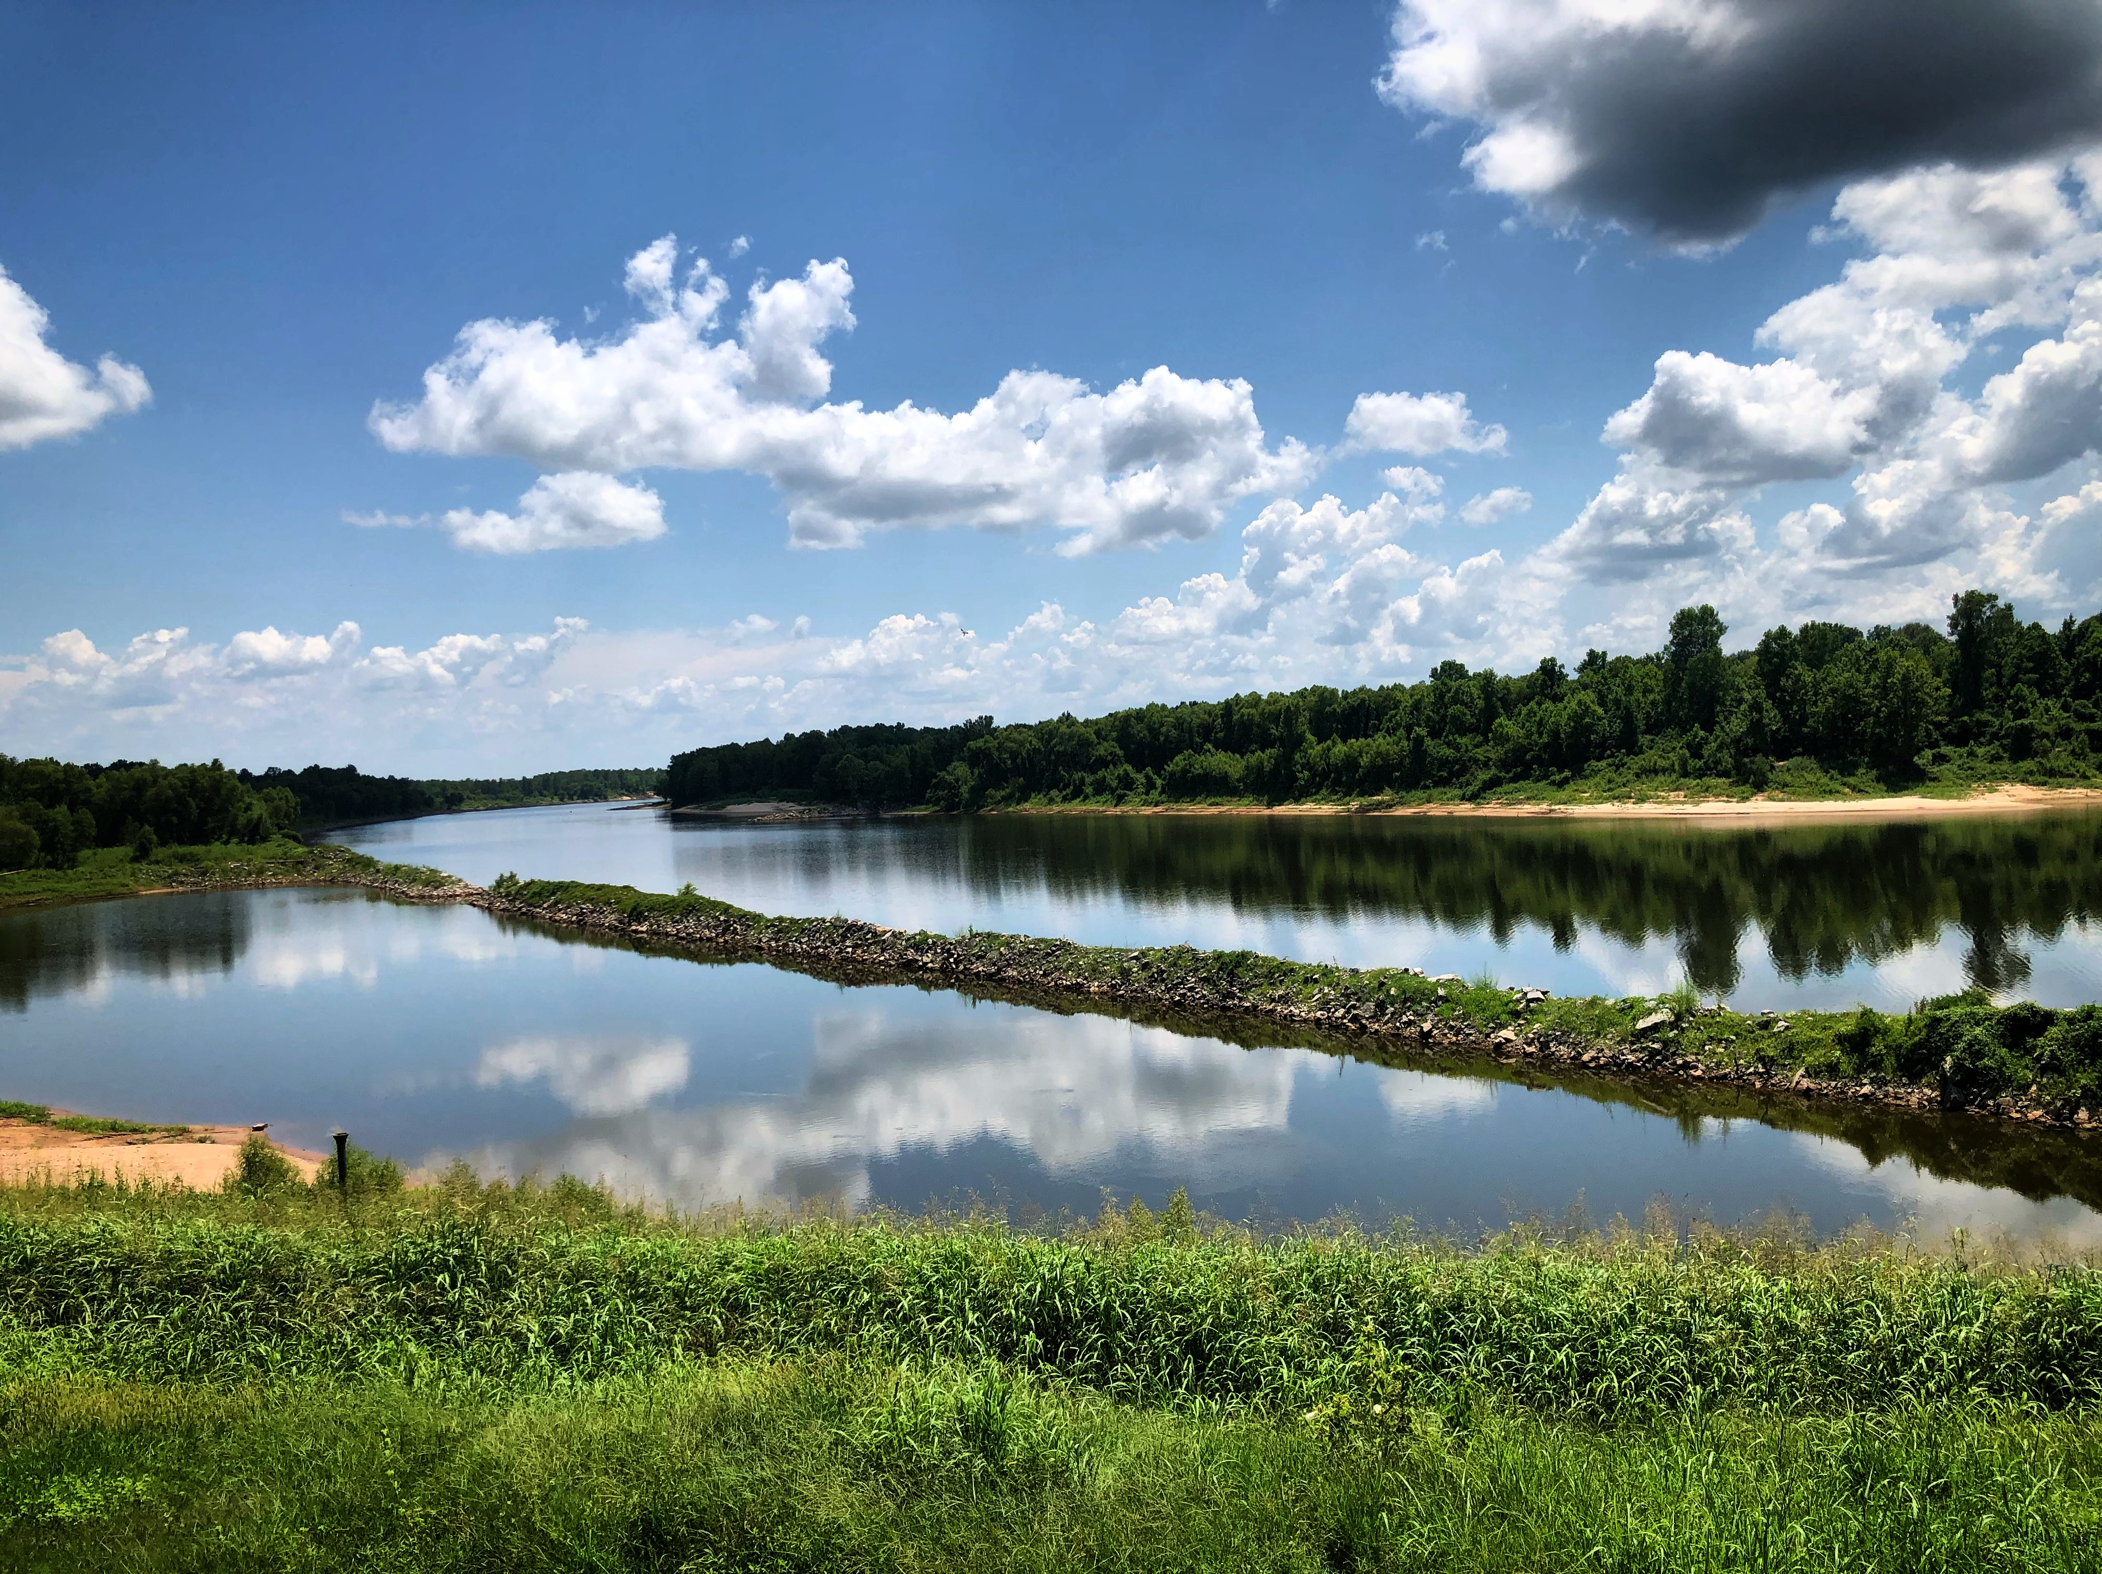
Round 2
LOCAL AND REGIONAL PROJECTS
Phase 1: $100 million project funding opportunity for low-risk, high-impact flood mitigation projects
Projects must benefit low- to moderate-income populations (per HUD national objective).
HUD-identified most impacted and distressed areas will be a priority of Round 2.
RED RIVER, COLFAX

Slide 12
Round 2 timeline
LOCAL AND REGIONAL PROJECTS
EVENT | DATE
Project application period begins | January 2023
Project application deadline | Two months after application period begins
Funding awards announced | Late spring 2023

Slide 13
Statewide modeling effort
Overview
The state and its partners are developing models of Louisiana’s major watersheds, which will simulate flood scenarios and analyze potential mitigation solutions
DOTD consultants are in the process of developing 48 HUC8 hydrologic and hydraulic regional models
Models are expected to be available by late 2023

Slide 14
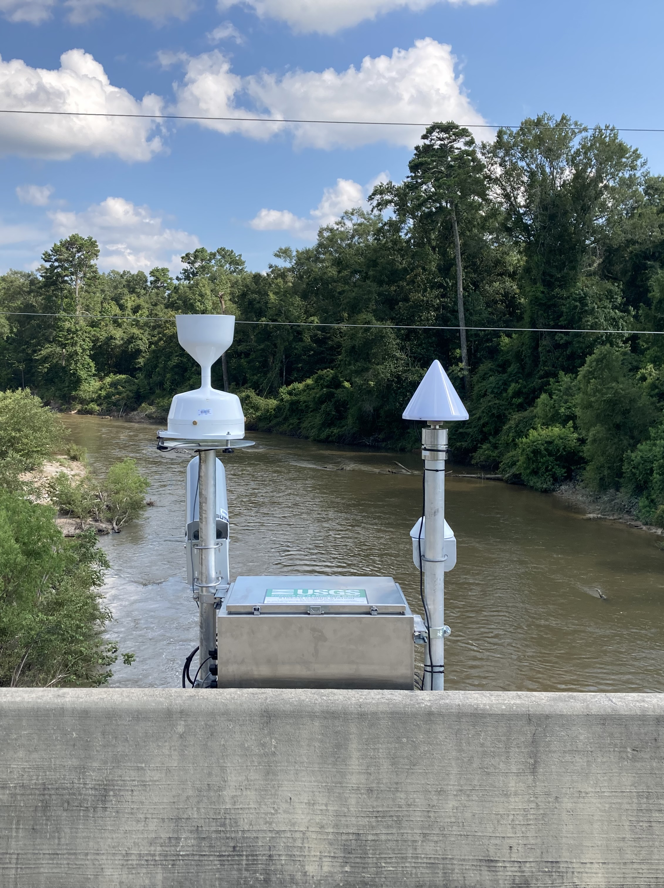
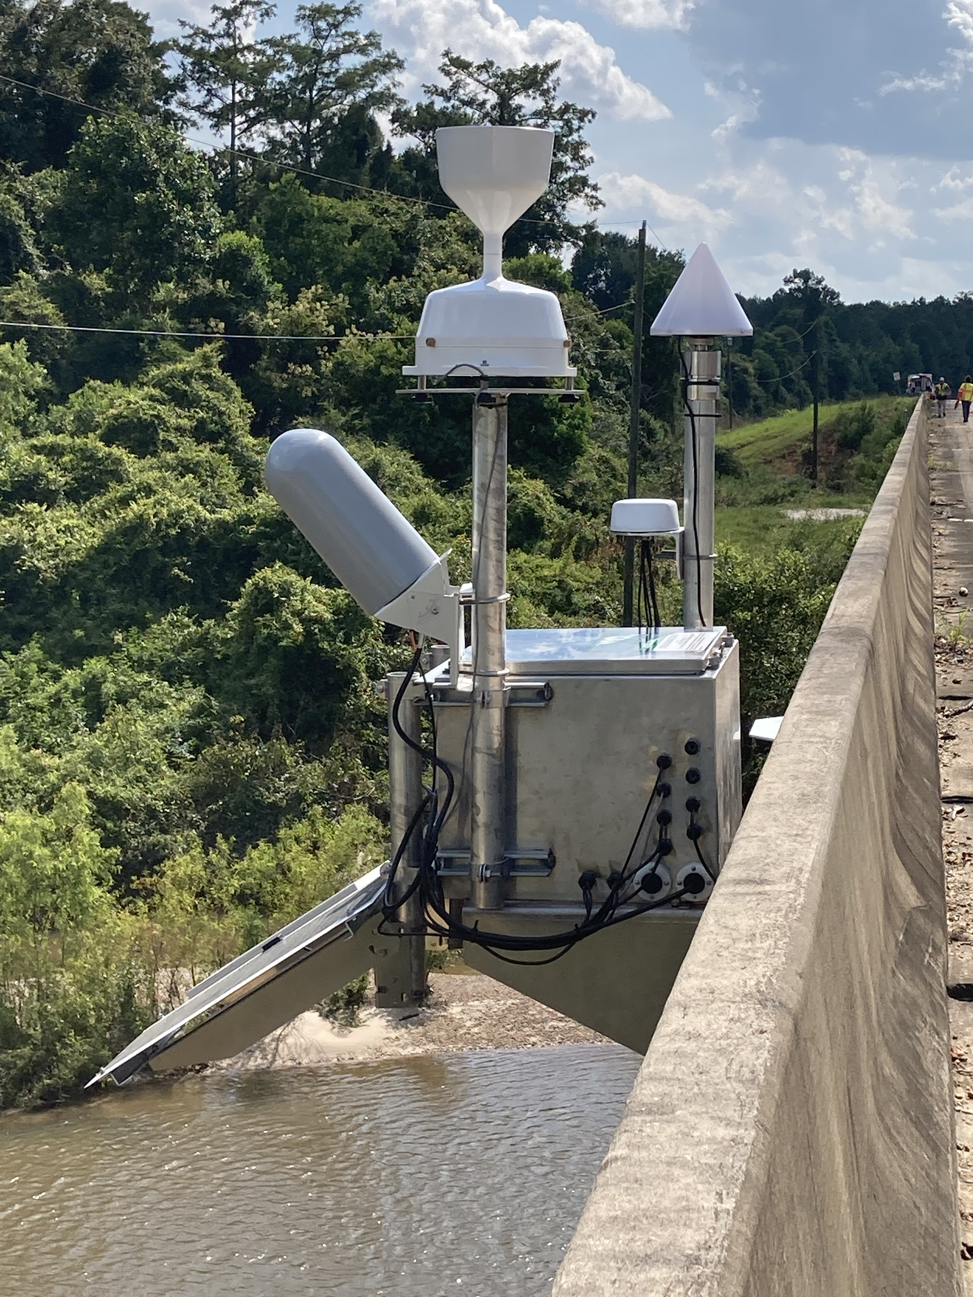
River and rain gauge network
$15 million to install river and rain gauges at 100 sites throughout Louisiana to enhance the statewide gauge network
USGS has installed gauges at 37 sites so far
For more details, visit watershed.la.gov/modeling-program
Gauge installed at Tangipahoa river

Slide 15
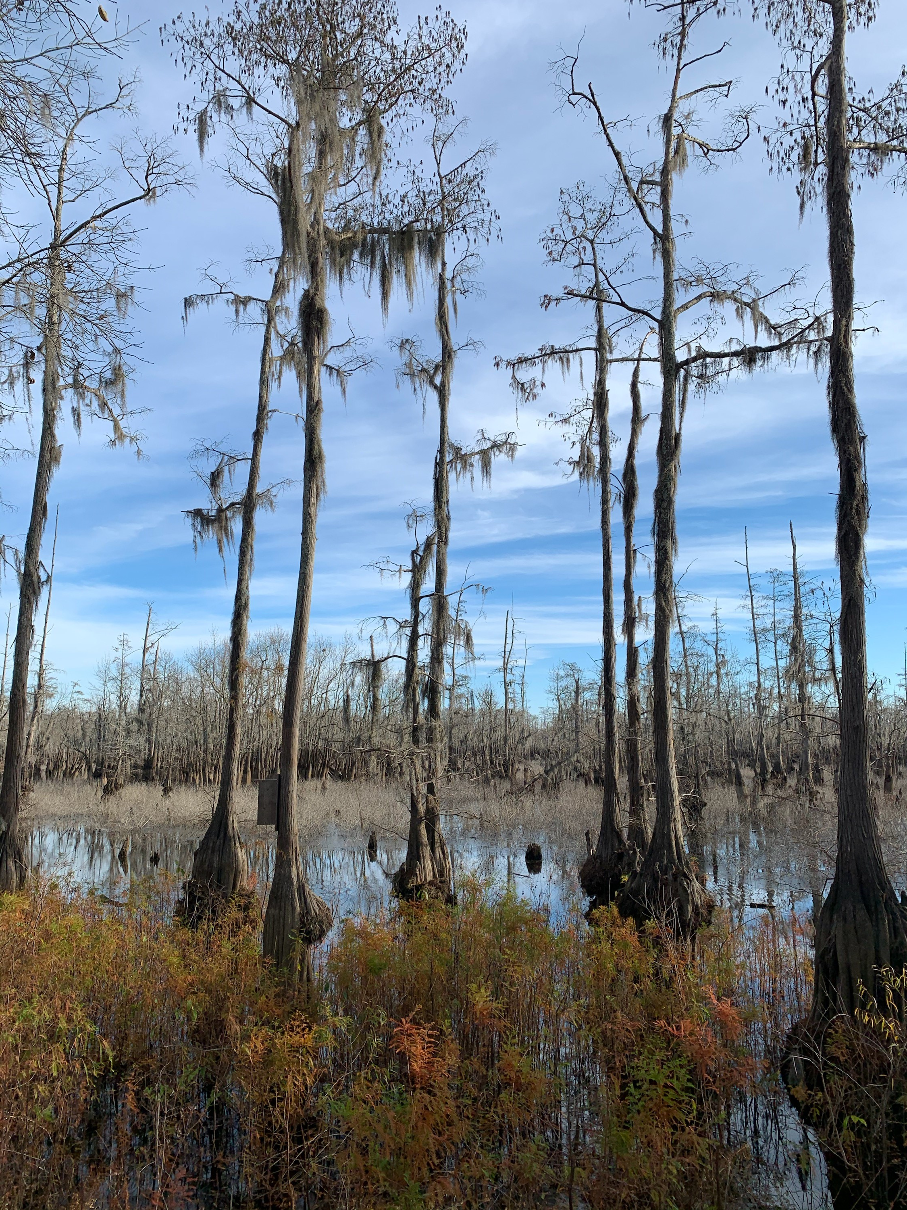
Model Use, Storage and Maintenance Plan
Provides the framework for long-term management of watershed models, with recommendations on use, storage and maintenance
The plan, including public comments, is available at watershed.la.gov/modeling-program
Phase II is underway now - involves continuing regional outreach and developing formal MUSM recommendations to present to the council
Cheniere lake

Slide 16
Training and workforce development
NATURE-BASED SOLUTIONS
PRO LOUISIANA
Nine-part webinar training series on the design and development of nature-based flood mitigation projects
Nature-Based Solutions for Flood Risk Management Information Guide
Training series and guide available at watershed.la.gov/nature-based-solutions
A workforce development program for occupations critical to flood recovery and resilience efforts
Initial courses for heavy equipment operators
30 students completed courses
47 students enrolled
255 students on waiting list
More details: watershed.la.gov/pro-louisiana

Slide 17
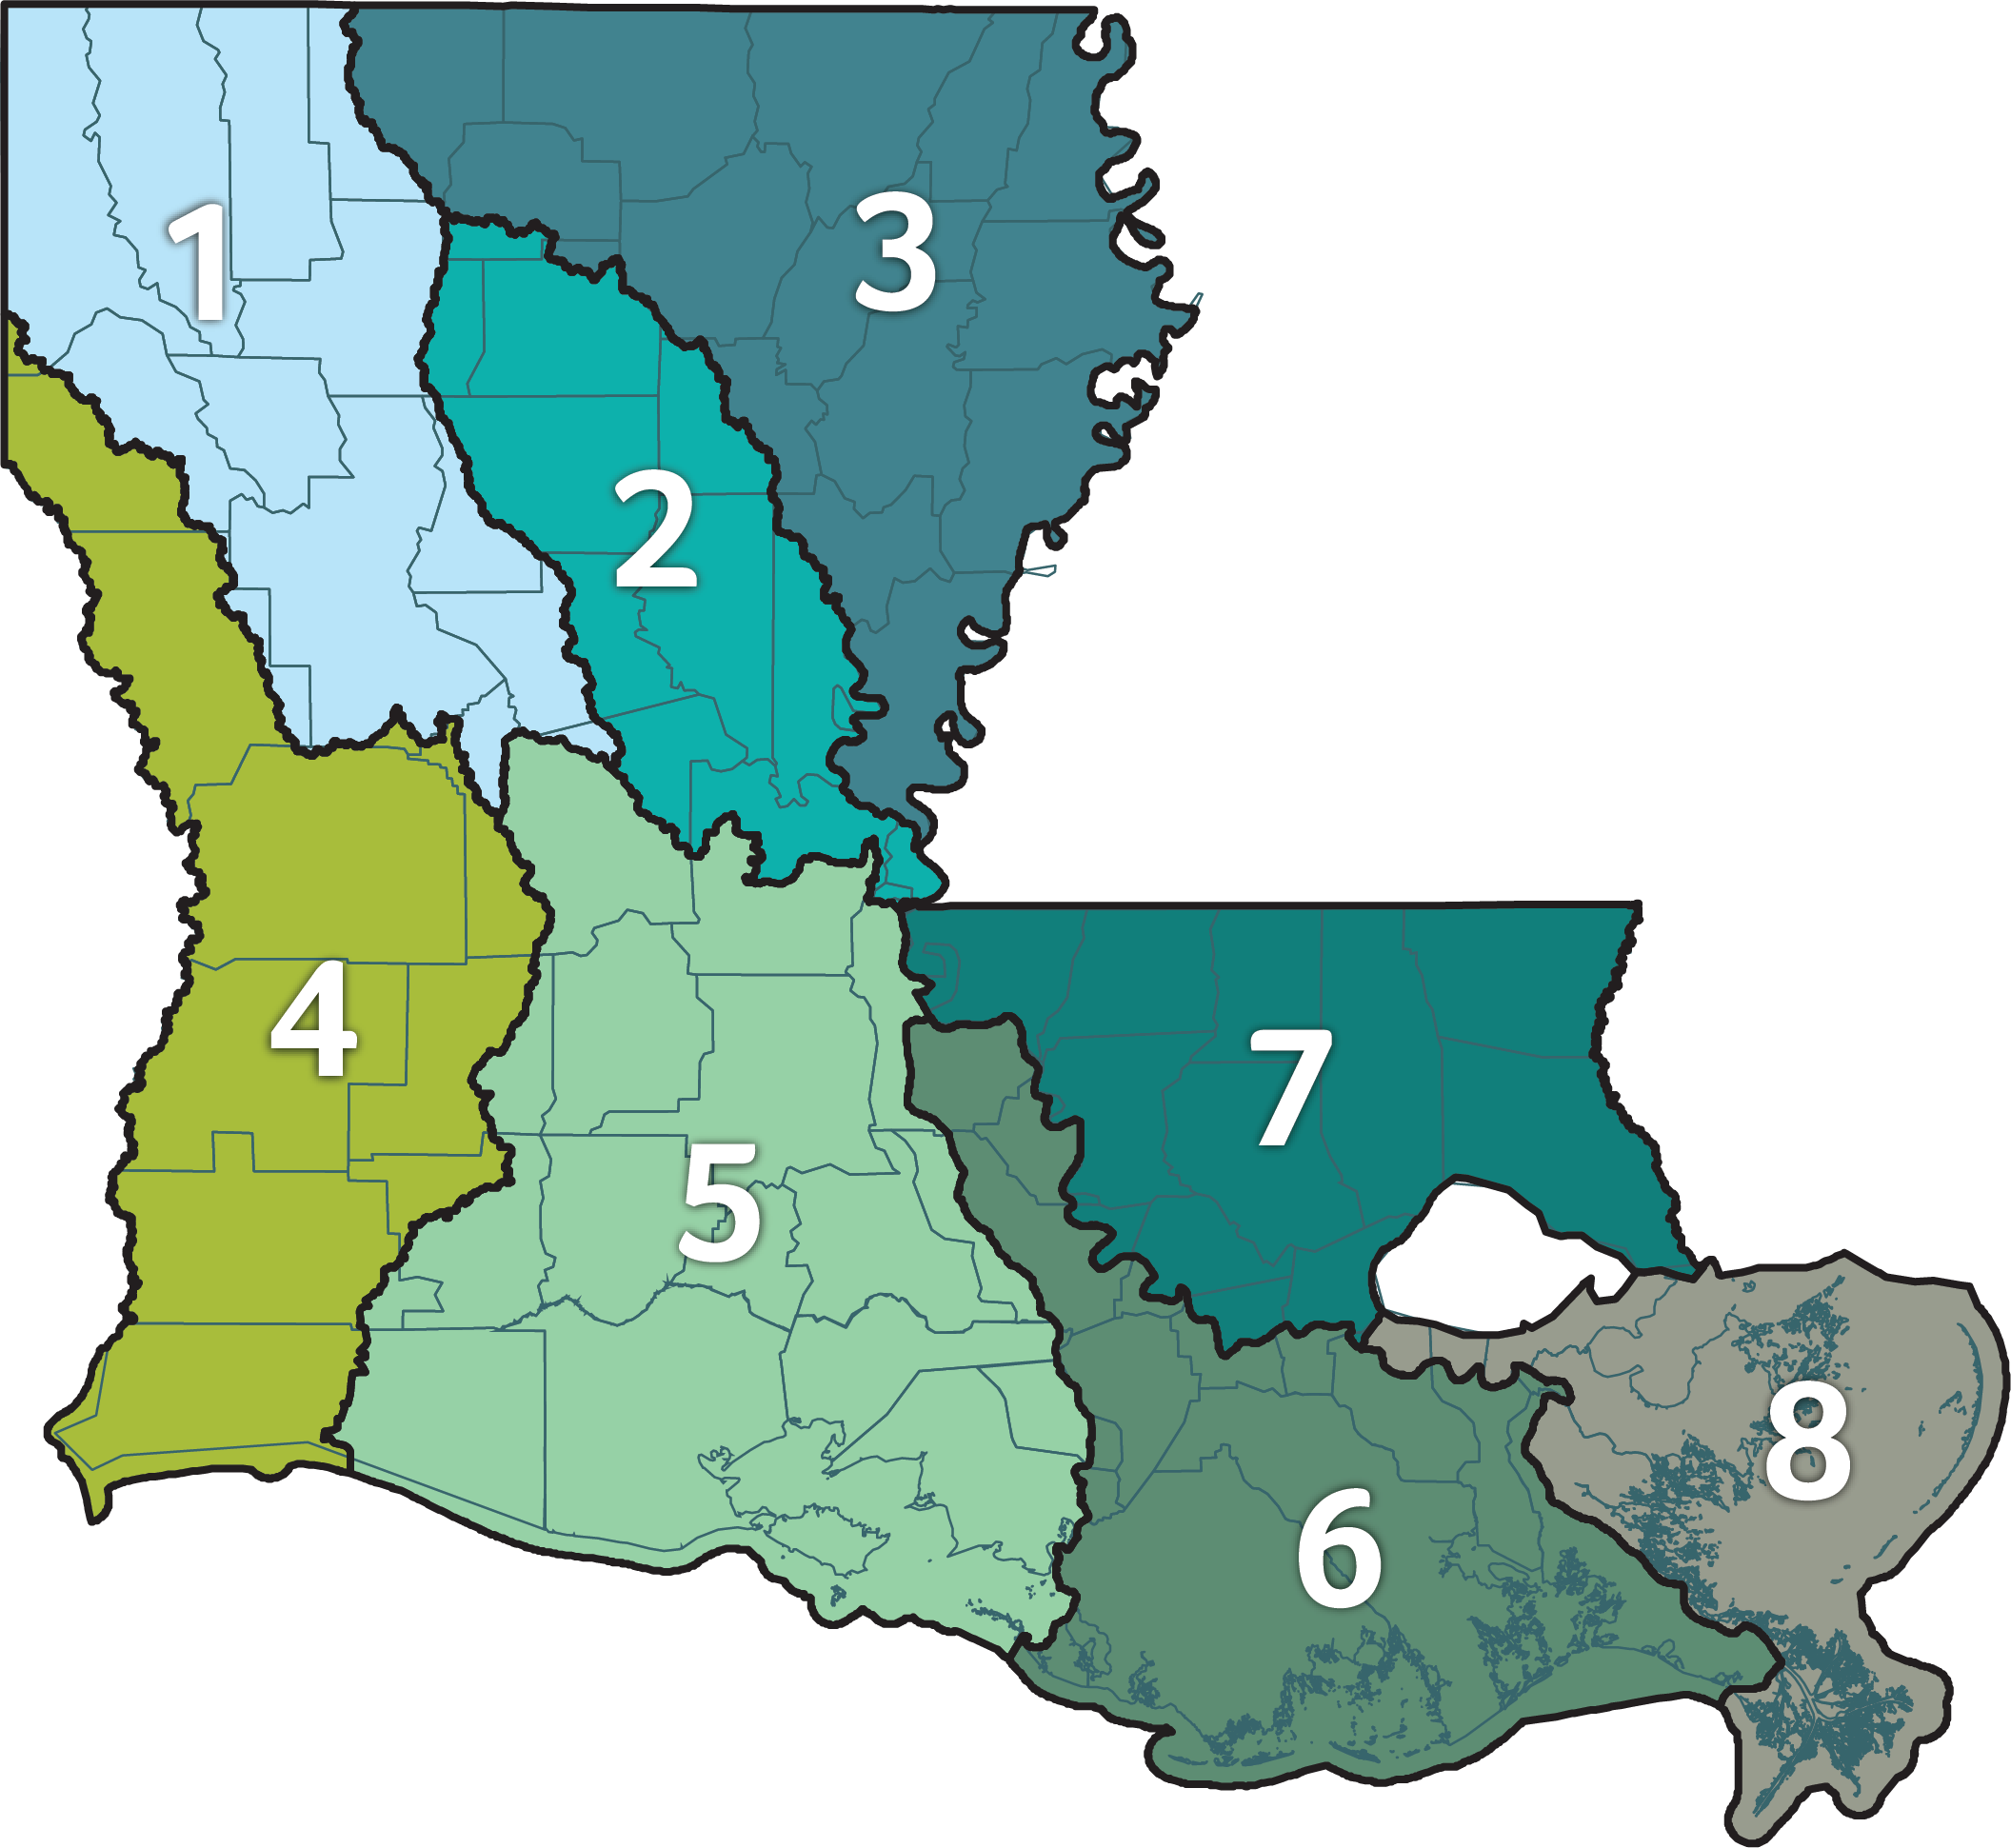
RCBG Program
Three-year grant program to help the state’s eight provisional watershed regions build staff capacity for regional watershed management
Primary goal: Establish a long-term entity—or watershed coalition—in each region, responsible for regional watershed management

Slide 18
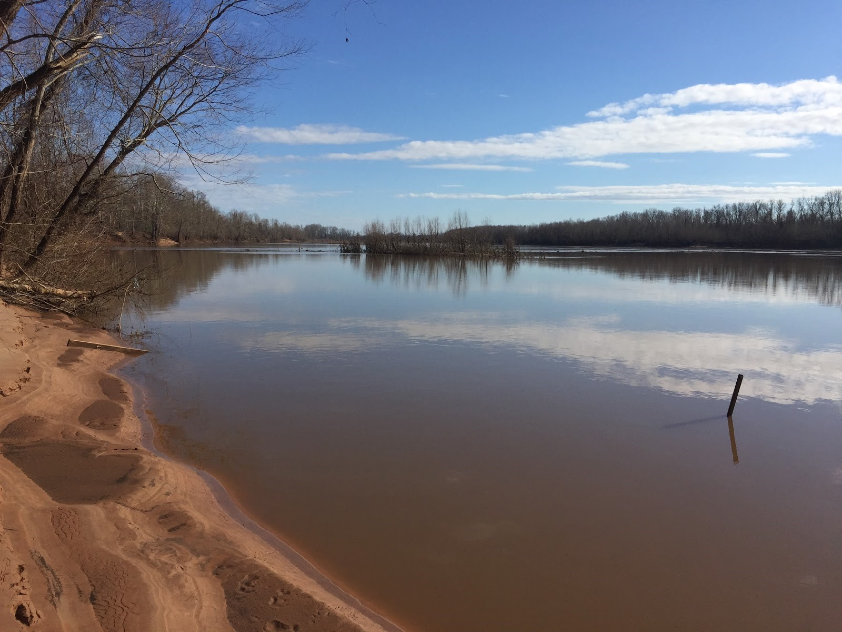
Regional workshops
Rcbg program
The state is hosting a series of regional workshops on the development of regional plans, tools and data, as well as project prioritization, as regions move into Phase 2
Four workshops have been held focusing on available funding opportunities (CDBG-MIT, IIJA, BRIC, etc.) and specifically the modeling and the MUSM approach
Phase 2 of the program will begin in the fall
RED RIVER

Slide 19
Non-Federal Share Match Program
Currently provides funding for the required state share of the Hazard Mitigation Grant Program
State allocation is calculated at 15% of the total FEMA Individual Assistance and Public Assistance allocations resulting from the 2016 Floods Events (DR-4263 and DR-4277)
Current grantees with projects in CDBG-MIT program: Ascension Parish, East Baton Rouge Parish and Ouachita Parish
Commitment of $13.3 million in CDBG-MIT funding for Laura/Delta HMGP Non-federal cost share assistance program
Federally Declared Disaster | Hazard Mitigation Grant Allocation | Non-Federal Cost Share
DR-4263 (March 2016) | $28,992,576 | $9,664,192
DR-4277 (August 2016) | $261,971,744 | $87,323,915
Total | $290,964,320 | $96,988,107

Slide 20
IIJA - Summary of LWI Opportunities
37 Infrastructure Investment and Job Act (IIJA) fund provisions are identified that may support directly or indirectly the Louisiana Watershed Initiative (LWI).
These opportunities will flow through 6 principal departments, totaling $24.52 billion.
The Department of the Army has the largest number of relevant opportunities with 19; followed by DHS (6) and Commerce (5).
A majority of the opportunities (53.6%) will remain with and be spent by federal programs through direct and contracted services.
Important to note, 46.4% will be available for states and other entities through grants and cooperative agreements.
The Department of Homeland Security has the largest possible grant funding at $5.61 billion

