Slide 1
Association of Levee Boards of Louisiana
Mr. Jim Bodron, SES
Director of Programs
Mississippi Valley Division
April 27, 2023

Slide 2
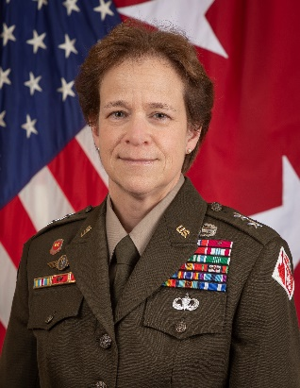
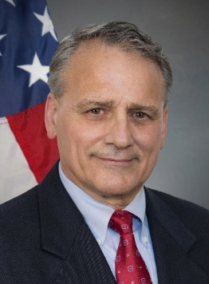
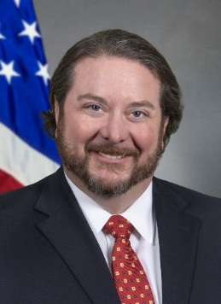
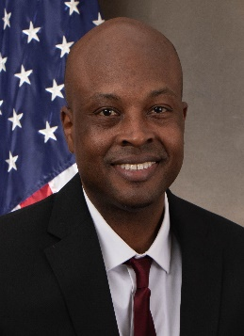
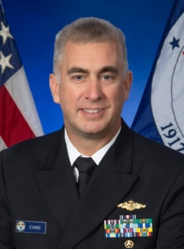
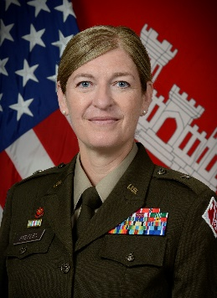
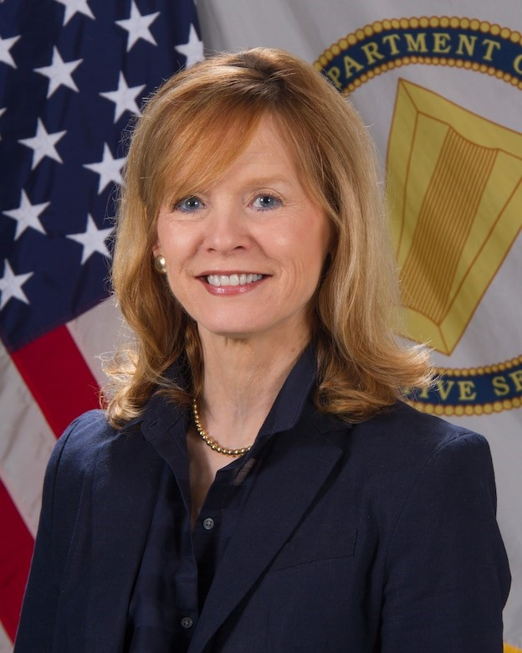
MG Diana Holland
Commanding General, MVD
President, MRC
The Mississippi River Commission
District Commanders
ST. PAUL
COL Eric
Swenson
ROCK ISLAND
COL Jesse Curry
Hon. James Reeder
Civilian
2018
Hon. Riley James
Civilian
2020
Hon. Robert Miller, Ph.D.
Civilian
2022
Rear Adm.
Ben Evans
NOAA
ST. LOUIS
COL Kevin
Golinghorst
MEMPHIS
COL Brian
Sawser
COL Andy Pannier
Deputy Commander, MVD
Secretary, MRC
Brig Gen. Kimberly Peeples
Great Lakes &
Ohio River Division
Brig Gen. Geoff
Van Epps
Northwestern
Division
VICKSBURG
COL Christopher
Klein
NEW ORLEANS
COL Cullen
Jones
Mr. Jim Bodron
Director of Programs
Dr. Beth Fleming Director, Regional Business

Slide 3
CIVIL WORKS National INVESTMENT TRENDS (Includes Supplemental Funding)
AS OF 24 MAR 23
Notes:
HQ USACE CIVIL WORK INVESTMENT TRENDS Events:
Hurricane Katrina (Cat. 5 – Cat. 3 landfall) – 29 Aug 2005
High Water 2008
High Water 2011 (record setting flood stages)
Hurricane Sandy (Cat. 3) – 22 Oct 2012: Impacted States (NJ, NY)
Heavy Precipitation Events – 23 Dec 2015
The historic Winter Flood of 2015/2016 was driven by two heavy precipitation events. The first event occurred on 23-25 December, followed by the second event on 26-29 December.
Heavy precipitation fell across the Central U.S. from Texas to Minnesota and eastward into the Illinois/Ohio Valleys. Up to one and a half feet of snow fell over Minnesota and Iowa with rainfall amounts of 5-12 inches and isolated higher amounts falling across the remainder of the watershed.
According to the National Climate Data Center, December was the second wettest December on record over the contiguous U.S., eclipsed only by December 1982.
Hurricanes Harvey, Irma, Maria: 5 eligible States (FL, GA, LA, SC, TX) and 2 Territories (Puerto Rico and US Virgin Islands) + 33 Eligible States and 3 territories (Guam, PR, USVI)
Our next round of natural disasters occurred all within 44-day (a little over a month) timeframe
Starting with Hurricane Harvey impacting the Texas and Louisiana coasts in August 2017; were we sustained most of our damages in MVD
Harvey (Cat. 4) – 17 Aug 2017
Irma (Cat. 3) – 10 Sep 2017
Maria (Cat. 4) – 16 Sep 2017
High Water 2019 (record setting flood duration)
Hurricane Ida (Cat. 4) – 29 Aug 2021: Impacted States (LA, PA, NJ, NY)
Regular Appropriations:
Congressional Ads (Earmarks) ended in 2010. Congress started back supporting Community Project Funding / Congressional Directed Spending (Earmarks 2.0) in 2022.
Continual significant investments since 2014 (increases in appropriations every year)
Supplemental Appropriations:
2006 Start of Katrina Supplementals (2)
PUBLIC LAW 109–148—DEC. 30, 2005: $2,899,549,000 Department of Defense, Emergency Supplemental Appropriations to Address Hurricanes in the Gulf of Mexico, and Pandemic Influenza Act, 2006
PUBLIC LAW 109–234—JUNE 15, 2006: $3,700,924,000 Emergency Supplemental Appropriations Act for Defense, the Global War on Terror, and Hurricane Recovery, 2006
2007: Additional Katrina Supplemental
PUBLIC LAW 110–28—MAY 25, 2007: $1,433,000,000 Supplemental Appropriations Act, 2008
2008: Additional Katrina Supplemental
PUBLIC LAW 110–252—JUNE 30, 2008: $6,366,988,800 U.S. Troop Readiness, Veterans' Care, Katrina Recovery, and Iraq Accountability Appropriations Act, 2007
2009: Received 3 supplementals. Additional Katrina Supplemental, American Recovery and Reinvestment Act (ARRA), and Supplemental Appropriations Act
PUBLIC LAW 110–329—SEPT. 30, 2008: $2,776,800,000 Consolidated Security, Disaster Assistance, and Continuing Appropriations Act, 2009
PUBLIC LAW 111–5—FEB. 17, 2009: $4,600,000,000 American Recovery and Reinvestment Act of 2009
PUBLIC LAW 111–32—JUNE 24, 2009: $797,165,000 Supplemental Appropriations Act, 2009
2010: Supplemental post severe storms and flooding, wildfires, the oil spill in the Gulf of Mexico, and for other purposes
PUBLIC LAW 111–212—JULY 29, 2010: $1,724,000,000 Disaster Relief Appropriations Act, 2010
2012: Supplemental post the Historic MS River Flood of 2011
PUBLIC LAW 112–77—DEC. 23, 2011: $1,724,000,000 Disaster Relief Appropriations Act, 2012
2013: Non-MVD Supplemental following Super Storm Sandy
PUBLIC LAW 113–2—JAN. 29, 2013: $1,353,000,000 Disaster Relief Appropriations Act, 2013
2017: Supplemental following Heavy precipitation
PUBLIC LAW 114–254—DEC. 10, 2016: $1,025,000,000 Further Continuing and Security Assistance Appropriations Act, 2017
2018: Supplemental following Hurricanes Harvey, Irma, and Maria
PUBLIC LAW 115–123—PUBLIC LAW 115–123—FEB. 9, 2018: $17,400,000,000 Bipartisan Budget Act of 2018
2019: Supplemental following MS River High water / storm events
PUBLIC LAW 116–20—PUBLIC LAW 116–20—JUNE 6, 2019: $3,260,000,000 Additional Supplemental Appropriations for Disaster Relief Act, 2019
2022: Received 2 Supplementals. Disaster Relief Supplemental Appropriations Act (DRSAA 2022) following Hurricane Ida and Bipartisan Infrastructure Law (BIL)
PUBLIC LAW 117–43—PUBLIC LAW 117–43—SEPT. 30, 2021: $5,711,000,000 Disaster Relief Supplemental Appropriations Act, 2022
PUBLIC LAW 117–58—PUBLIC LAW 117–58—NOV. 15, 2021: $17,100,000,000 Infrastructure Investment and Jobs Act (IIJA), now known as Bipartisan Infrastructure Law
2023: Supplemental following natural disasters including recent MS low water
PUBLIC LAW 117–328—PUBLIC LAW 117–328—DEC. 29, 2022: $350,000,000 Consolidated Appropriations Act, 2023
2024:

Slide 4
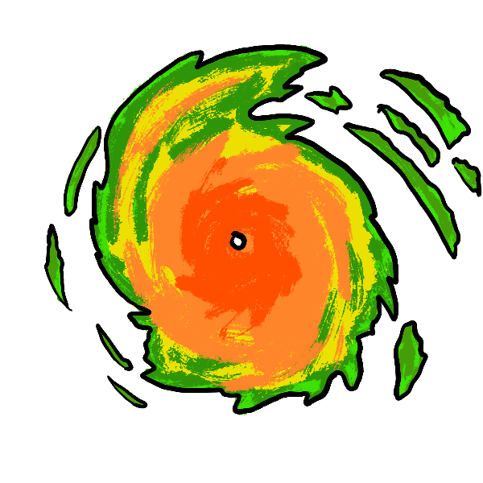
MVD CIVIL WORKS INVESTMENT TRENDS (Includes Supplemental Funding)
Congressional Earmarks Ended
STOP
Community Project Funding (CPF) /
Congressional Directed Spending (CDS)
GO
3
5
4
4
4
HARVEY
IRMA
MARIA
IDA
AS OF 24 MAR 23
Notes:
MVD CIVIL WORK INVESTMENT TRENDS Events:
Hurricane Katrina (Cat. 5 – Cat. 3 landfall) – 29 Aug 2005
High Water 2008
High Water 2011 (record setting flood stages)
Heavy Precipitation Events – 23 Dec 2015
The historic Winter Flood of 2015/2016 was driven by two heavy precipitation events. The first event occurred on 23-25 December, followed by the second event on 26-29 December.
Heavy precipitation fell across the Central U.S. from Texas to Minnesota and eastward into the Illinois/Ohio Valleys. Up to one and a half feet of snow fell over Minnesota and Iowa with rainfall amounts of 5-12 inches and isolated higher amounts falling across the remainder of the watershed.
According to the National Climate Data Center, December was the second wettest December on record over the contiguous U.S., eclipsed only by December 1982.
Hurricanes Harvey, Irma, Maria: 5 eligible States (FL, GA, LA, SC, TX) and 2 Territories (Puerto Rico and US Virgin Islands) + 33 Eligible States and 3 territories (Guam, PR, USVI)
Our next round of natural disasters occurred all within 44-day (a little over a month) timeframe
Starting with Hurricane Harvey impacting the Texas and Louisiana coasts in August 2017; were we sustained most of our damages in MVD
Harvey (Cat. 4) – 17 Aug 2017
Irma (Cat. 3) – 10 Sep 2017
Maria (Cat. 4) – 16 Sep 2017
High Water 2019 (record setting flood duration)
Hurricane Ida (Cat. 4) – 29 Aug 2021: Impacted States (LA, PA, NJ, NY)
Regular Appropriations:
Congressional Ads (Earmarks) ended in 2010. Congress started back supporting Community Project Funding (CPF) / Congressional Directed Spending (CDS) [Earmarks 2.0] in 2022.
Thank you to Congress for significant investments since 2015. FY23 Appropriation is not final, but we anticipate it to be comparable to recent FYs.
$1,296,809,000 known now, to include $1,090,871,000 in FY23 PBud; $139,685,000 in MR&T Funding Pots; and $205,938,000 in CPF/CDS.
Supplemental Appropriations:
2006 Start of Katrina Supplementals (2)
PUBLIC LAW 109–148—DEC. 30, 2005: $360,210,000 Department of Defense, Emergency Supplemental Appropriations to Address Hurricanes in the Gulf of Mexico, and Pandemic Influenza Act, 2006
PUBLIC LAW 109–234—JUNE 15, 2006: $518,800,000.00 Emergency Supplemental Appropriations Act for Defense, the Global War on Terror, and Hurricane Recovery, 2006
2007: Additional Katrina Supplemental
PUBLIC LAW 110–28—MAY 25, 2007: $25,800,000 U.S. Troop Readiness, Veterans' Care, Katrina Recovery, and Iraq Accountability Appropriations Act, 2007
2008: Additional Katrina Supplemental
PUBLIC LAW 110–252—JUNE 30, 2008: $1,991,723,324 Supplemental Appropriations Act, 2008
2009: Received 3 supplementals. Additional Katrina Supplemental, American Recovery and Reinvestment Act (ARRA), and Supplemental Appropriations Act
PUBLIC LAW 110–329—SEPT. 30, 2008: $2,628,426,462 Consolidated Security, Disaster Assistance, and Continuing Appropriations Act, 2009
PUBLIC LAW 111–5—FEB. 17, 2009: $1,116,000,000 American Recovery and Reinvestment Act of 2009
PUBLIC LAW 111–32—JUNE 24, 2009: $70,799,414 Supplemental Appropriations Act, 2009
2010: Supplemental post severe storms and flooding, wildfires, the oil spill in the Gulf of Mexico, and for other purposes
PUBLIC LAW 111–212—JULY 29, 2010: $50,688,500 Disaster Relief Appropriations Act, 2010
2012: Supplemental post the Historic MS River Flood of 2011
PUBLIC LAW 112–77—DEC. 23, 2011: $1,017,279,942 Disaster Relief Appropriations Act, 2012
2017: Supplemental following Heavy precipitation
PUBLIC LAW 114–254—DEC. 10, 2016: $418,000,000 Further Continuing and Security Assistance Appropriations Act, 2017
2018: Supplemental following Hurricanes Harvey, Irma, and Maria
PUBLIC LAW 115–123—PUBLIC LAW 115–123—FEB. 9, 2018: $2,701,000,000 Bipartisan Budget Act of 2018
2019: Supplemental following MS River High water / storm events
PUBLIC LAW 116–20—PUBLIC LAW 116–20—JUNE 6, 2019: $959,000,000 Additional Supplemental Appropriations for Disaster Relief Act, 2019
2022: Received 2 Supplementals. Disaster Relief Supplemental Appropriations Act (DRSAA 2022) following Hurricane Ida and Bipartisan Infrastructure Law (BIL)
PUBLIC LAW 117–43—PUBLIC LAW 117–43—SEPT. 30, 2021: $2,544,000,000 Disaster Relief Supplemental Appropriations Act, 2022
PUBLIC LAW 117–58—PUBLIC LAW 117–58—NOV. 15, 2021: $3,058,000,000 Infrastructure Investment and Jobs Act (IIJA) known as Bipartisan Infrastructure Law
2023: Supplemental following natural disasters including recent MS low water
PUBLIC LAW 117–328—PUBLIC LAW 117–328—DEC. 29, 2022: $15,500,000 Consolidated Appropriations Act, 2023

Slide 5
MR&T CIVIL WORKS INVESTMENT TRENDS (Includes Supplemental Funding)
Community Project Funding (CPF) /
Congressional Directed Spending (CDS)
GO
3
4
4
HARVEY
IRMA
MARIA
4
IDA
AS OF 24 MAR 23
Notes:
MR&T CIVIL WORK INVESTMENT TRENDS Events:
Hurricane Katrina (Cat. 5 – Cat. 3 landfall) – 29 Aug 2005
High Water 2008
High Water 2011 (record setting flood stages)
Heavy Precipitation Events – 23 Dec 2015
The historic Winter Flood of 2015/2016 was driven by two heavy precipitation events. The first event occurred on 23-25 December, followed by the second event on 26-29 December.
Heavy precipitation fell across the Central U.S. from Texas to Minnesota and eastward into the Illinois/Ohio Valleys. Up to one and a half feet of snow fell over Minnesota and Iowa with rainfall amounts of 5-12 inches and isolated higher amounts falling across the remainder of the watershed.
According to the National Climate Data Center, December was the second wettest December on record over the contiguous U.S., eclipsed only by December 1982.
Hurricanes Harvey, Irma, Maria: 5 eligible States (FL, GA, LA, SC, TX) and 2 Territories (Puerto Rico and US Virgin Islands) + 33 Eligible States and 3 territories (Guam, PR, USVI)
Our next round of natural disasters occurred all within 44-day (a little over a month) timeframe
Starting with Hurricane Harvey impacting the Texas and Louisiana coasts in August 2017; were we sustained most of our damages in MVD
Harvey (Cat. 4) – 17 Aug 2017
Irma (Cat. 3) – 10 Sep 2017
Maria (Cat. 4) – 16 Sep 2017
High Water 2019 (record setting flood duration)
Hurricane Ida (Cat. 4) – 29 Aug 2021: Impacted States (LA, PA, NJ, NY)
Regular Appropriations:
Congressional Ads (Earmarks) ended in 2010. Congress started back supporting Community Project Funding (CPF) / Congressional Directed Spending (CDS) [Earmarks 2.0] in 2022.
Thank you to Congress for significant investments in our world class MR&T system.
Consistently over $345,000,000 annual appropriations since 2016.
FY23 Appropriation is not final, but we anticipate it to be comparable to recent FYs.
Final FY23 MR&T total is $370,000,000, to include $230,000,000 in FY23 PBud; $37,375,000 in MR&T Funding Pots; and $104,400,000 in CPF/CDS.
Supplemental Appropriations:
2006 Start of Katrina Supplemental
PUBLIC LAW 109–148—DEC. 30, 2005: $126,750,000 Department of Defense, Emergency Supplemental Appropriations to Address Hurricanes in the Gulf of Mexico, and Pandemic Influenza Act, 2006
2008: Additional Katrina Supplemental
PUBLIC LAW 110–252—JUNE 30, 2008: $17,590,000 U.S. Troop Readiness, Veterans' Care, Katrina Recovery, and Iraq Accountability Appropriations Act, 2007
2009: Received 3 supplementals. Additional Katrina Supplemental, American Recovery and Reinvestment Act (ARRA), and Supplemental Appropriations Act
PUBLIC LAW 110–329—SEPT. 30, 2008: $82,400,000 Consolidated Security, Disaster Assistance, and Continuing Appropriations Act, 2009
PUBLIC LAW 111–5—FEB. 17, 2009: $375,000,000 American Recovery and Reinvestment Act of 2009
2010: Supplemental post severe storms and flooding, wildfires, the oil spill in the Gulf of Mexico, and for other purposes
PUBLIC LAW 111–212—JULY 29, 2010: $18,600,000 Disaster Relief Appropriations Act, 2010
2012: Supplemental post the Historic MS River Flood of 2011
PUBLIC LAW 112–77—DEC. 23, 2011: $802,000,000 Disaster Relief Appropriations Act, 2012
2017: Supplemental following Heavy precipitation
PUBLIC LAW 114–254—DEC. 10, 2016: $290,700,000 Further Continuing and Security Assistance Appropriations Act, 2017
2018: Supplemental following Hurricanes Harvey, Irma, and Maria
PUBLIC LAW 115–123—PUBLIC LAW 115–123—FEB. 9, 2018: $770,000,000 Bipartisan Budget Act of 2018
2019: Supplemental following MS River High water / storm events
PUBLIC LAW 116–20—PUBLIC LAW 116–20—JUNE 6, 2019: $575,000,000 Additional Supplemental Appropriations for Disaster Relief Act, 2019
2022: Received 2 Supplementals. Disaster Relief Supplemental Appropriations Act (DRSAA 2022) following Hurricane Ida and Bipartisan Infrastructure Law (BIL)
PUBLIC LAW 117–43—PUBLIC LAW 117–43—SEPT. 30, 2021: $868,000,000 Disaster Relief Supplemental Appropriations Act, 2022
PUBLIC LAW 117–58—PUBLIC LAW 117–58—NOV. 15, 2021: $808,000,000 Infrastructure Investment and Jobs Act (IIJA) known as Bipartisan Infrastructure Law
2023: Supplemental following natural disasters including recent MS low water
PUBLIC LAW 117–328—PUBLIC LAW 117–328—DEC. 29, 2022: $15,500,000 Consolidated Appropriations Act, 2023

Slide 6
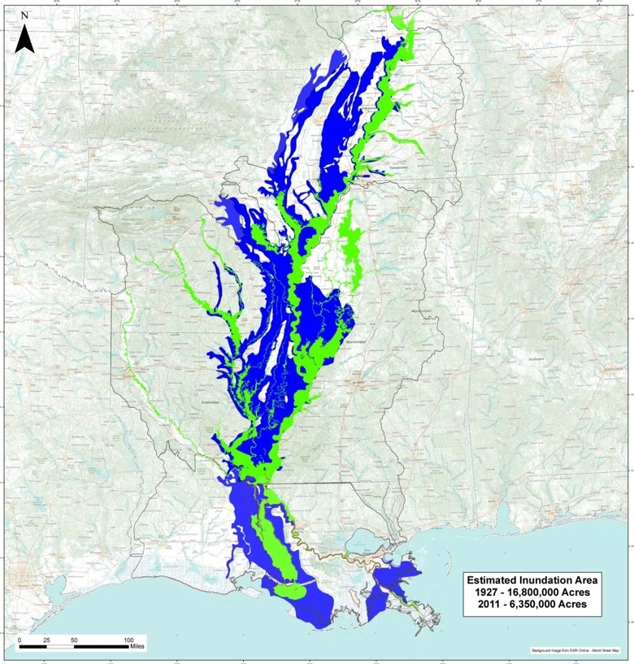
MR&T – Value to the Nation
$20.5B invested in planning, construction,
and O&M since 1928
$2.7T flood damages prevented since 1928
$224.4B flood damages prevented in 2022
4.1 million people protected
$131 return on each dollar invested
Over 650M tons of cargo moved on the
MS River system each year
$12.5B in transportation savings
MR&T Project is Currently Incomplete
- Mainstem project is ~ 87% physically complete

Slide 7
ENABLING LEGISLATION
Appropriation
Appropriation
Appropriation
Bipartisan Budget Act of 2018 (BBA 2018)
$17.4B USACE
$2.9B MVD
$770M MR&T
Bipartisan Infrastructure Law 2022
(BIL 2022)
$17.1B USACE
$3.5B MVD
$808M MR&T
FY 2023 Omnibus +
Disaster Relief Supplemental Appropriation Act of 2023 (DRSAA 2023)
$17.4B USACE
$1.8B MVD
MR&T:
$230M PBud
$370M Appropriation
Authorization
Water Resources Development Act of 2022 (WRDA 2022)
Biennial legislation (since 2014)
Authorizes projects for USACE
Implementation Guidance TBD
Appropriation
Appropriation
Appropriation
Disaster Relief Appropriations Act of 2019
(DRA 2019)
$3.3B USACE
$959M MVD
$575M MR&T
Disaster Relief Supplemental Appropriation Act of 2022
(DRSAA 2022)
$5.7B USACE
$2.5B MVD
$868M MR&T
FY 2024 President’s Budget
$7.4B USACE
$1.1B MVD
MR&T:
$226.5M PBud
$TBD Appropriation
WRDA
2022
Authorization
Water Resources Development Act of 2022 (WRDA 2022)
Biennial legislation (since 2014)
Authorizes projects for USACE
Implementation Guidance TBD
WRDA
2022
Notes:
Every two years since 2014, lawmakers have enacted the Water Resources Development Act (WRDA), which authorizes new construction and rehabilitation projects and directs the Corps to study the feasibility of future projects.

Slide 8
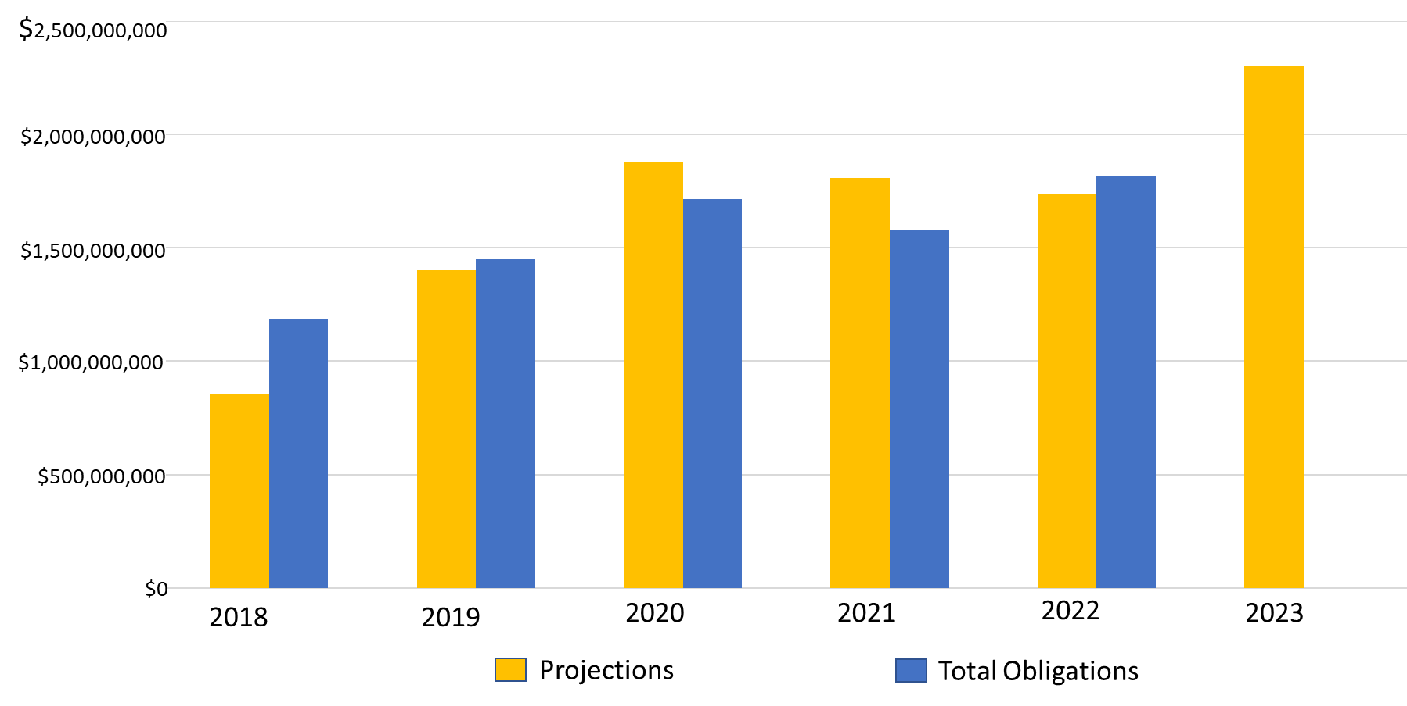
MVD Contract funding
With
Partners
$2.4 Billion
$ Dollars
YEARS
Projections
Total Obligations
Notes:
In FY22, we exceeded previous years in dollars obligated to contractors. And, based on all indications, this year should exceed last year

Slide 9
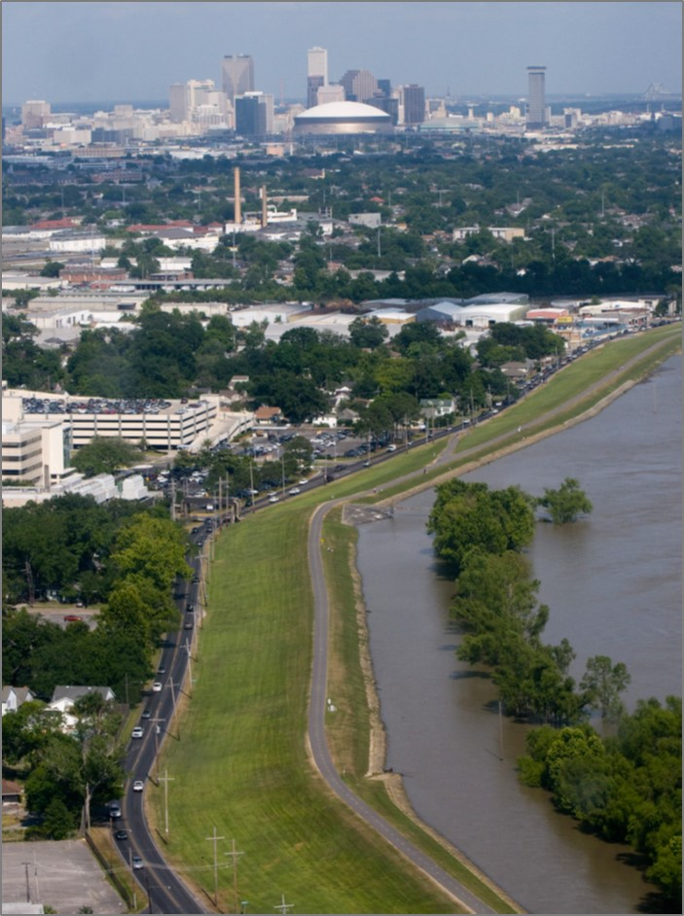
a-e contracting
Current MVD Contract Capacity:
58 active A-E contracts ~ $329M available capacity
Active MVD A-E task orders:
296 task orders totaling $261M
FY23 Projected Awards ~385M
Design - $340M
Surveying - $3M
Photogrammetric - $6M
QA - $16M
Geotechnical - $20M
FY24-25 Forecasted Awards ~$163M
Mississippi River Levee with Caesars Superdome in the background
USACE NO District
Notes:
MVN Capacity – 13 active contracts ~ $51M
MVN Active AE task orders: 43 orders totaling $95M
Projected Awards of new A-E contracts this FY from MVN:
Design $90M
Survey $3M
Photogrammetric Imaging $6M

Slide 10
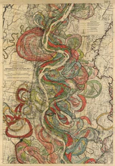
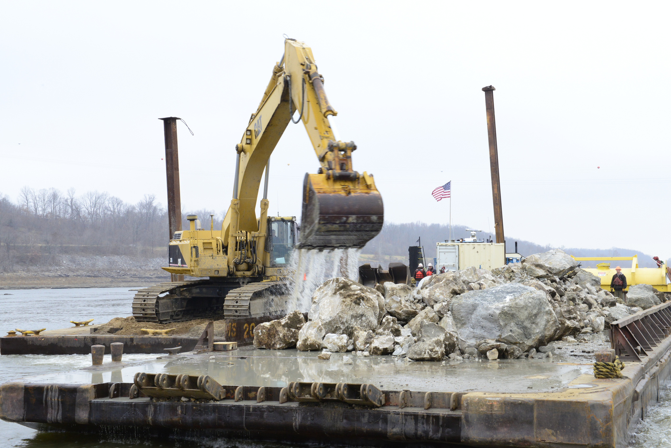
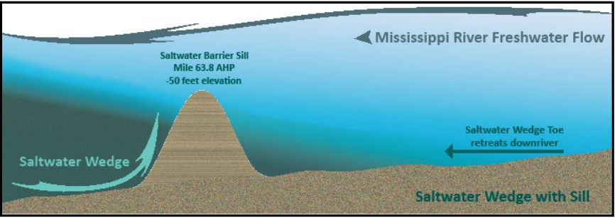
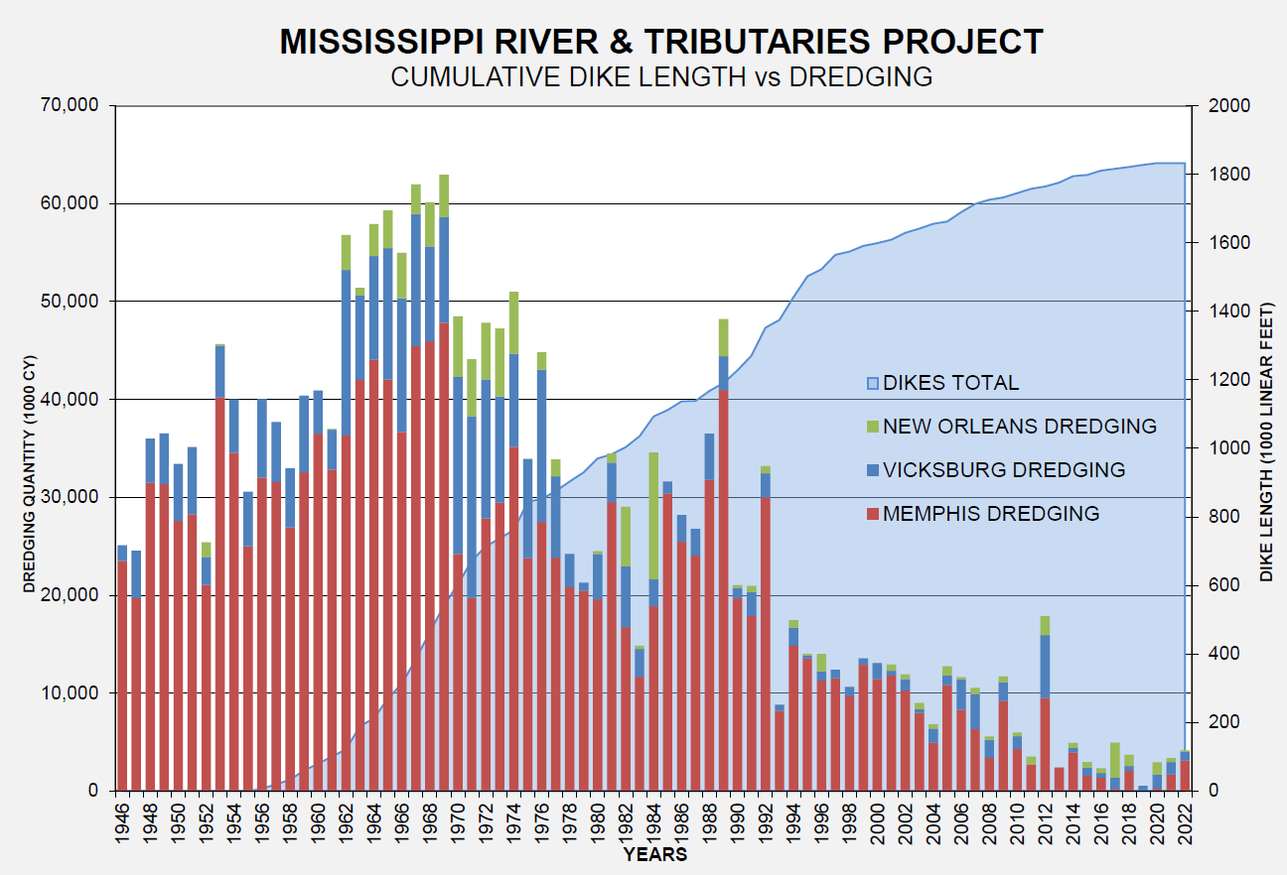
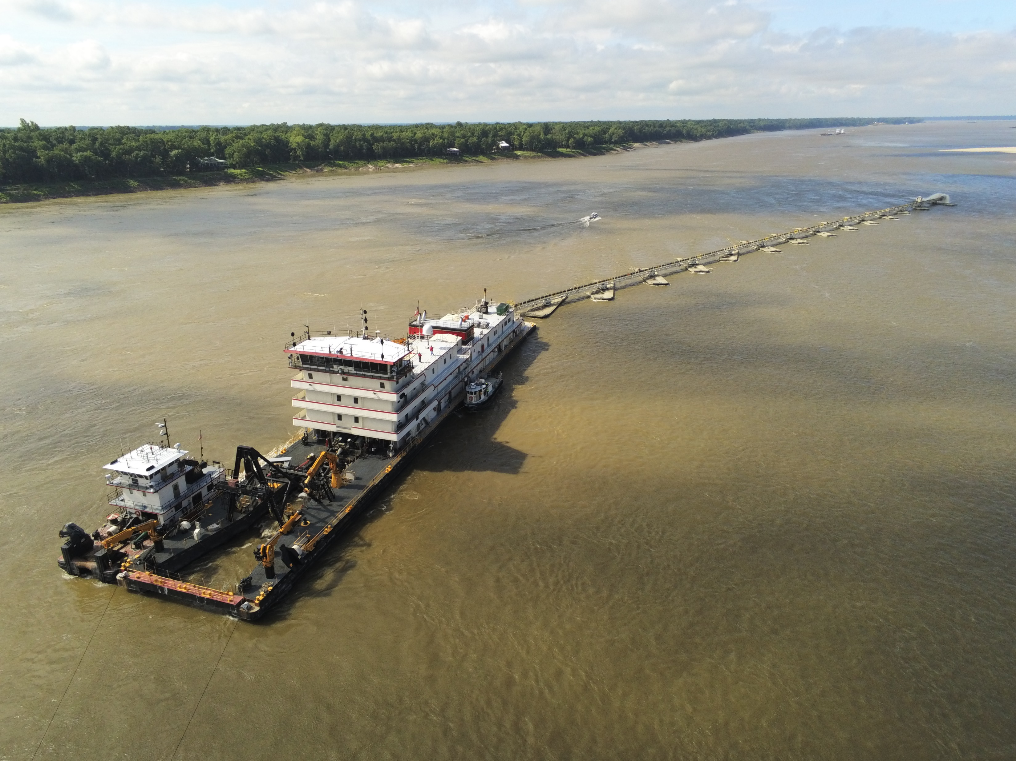
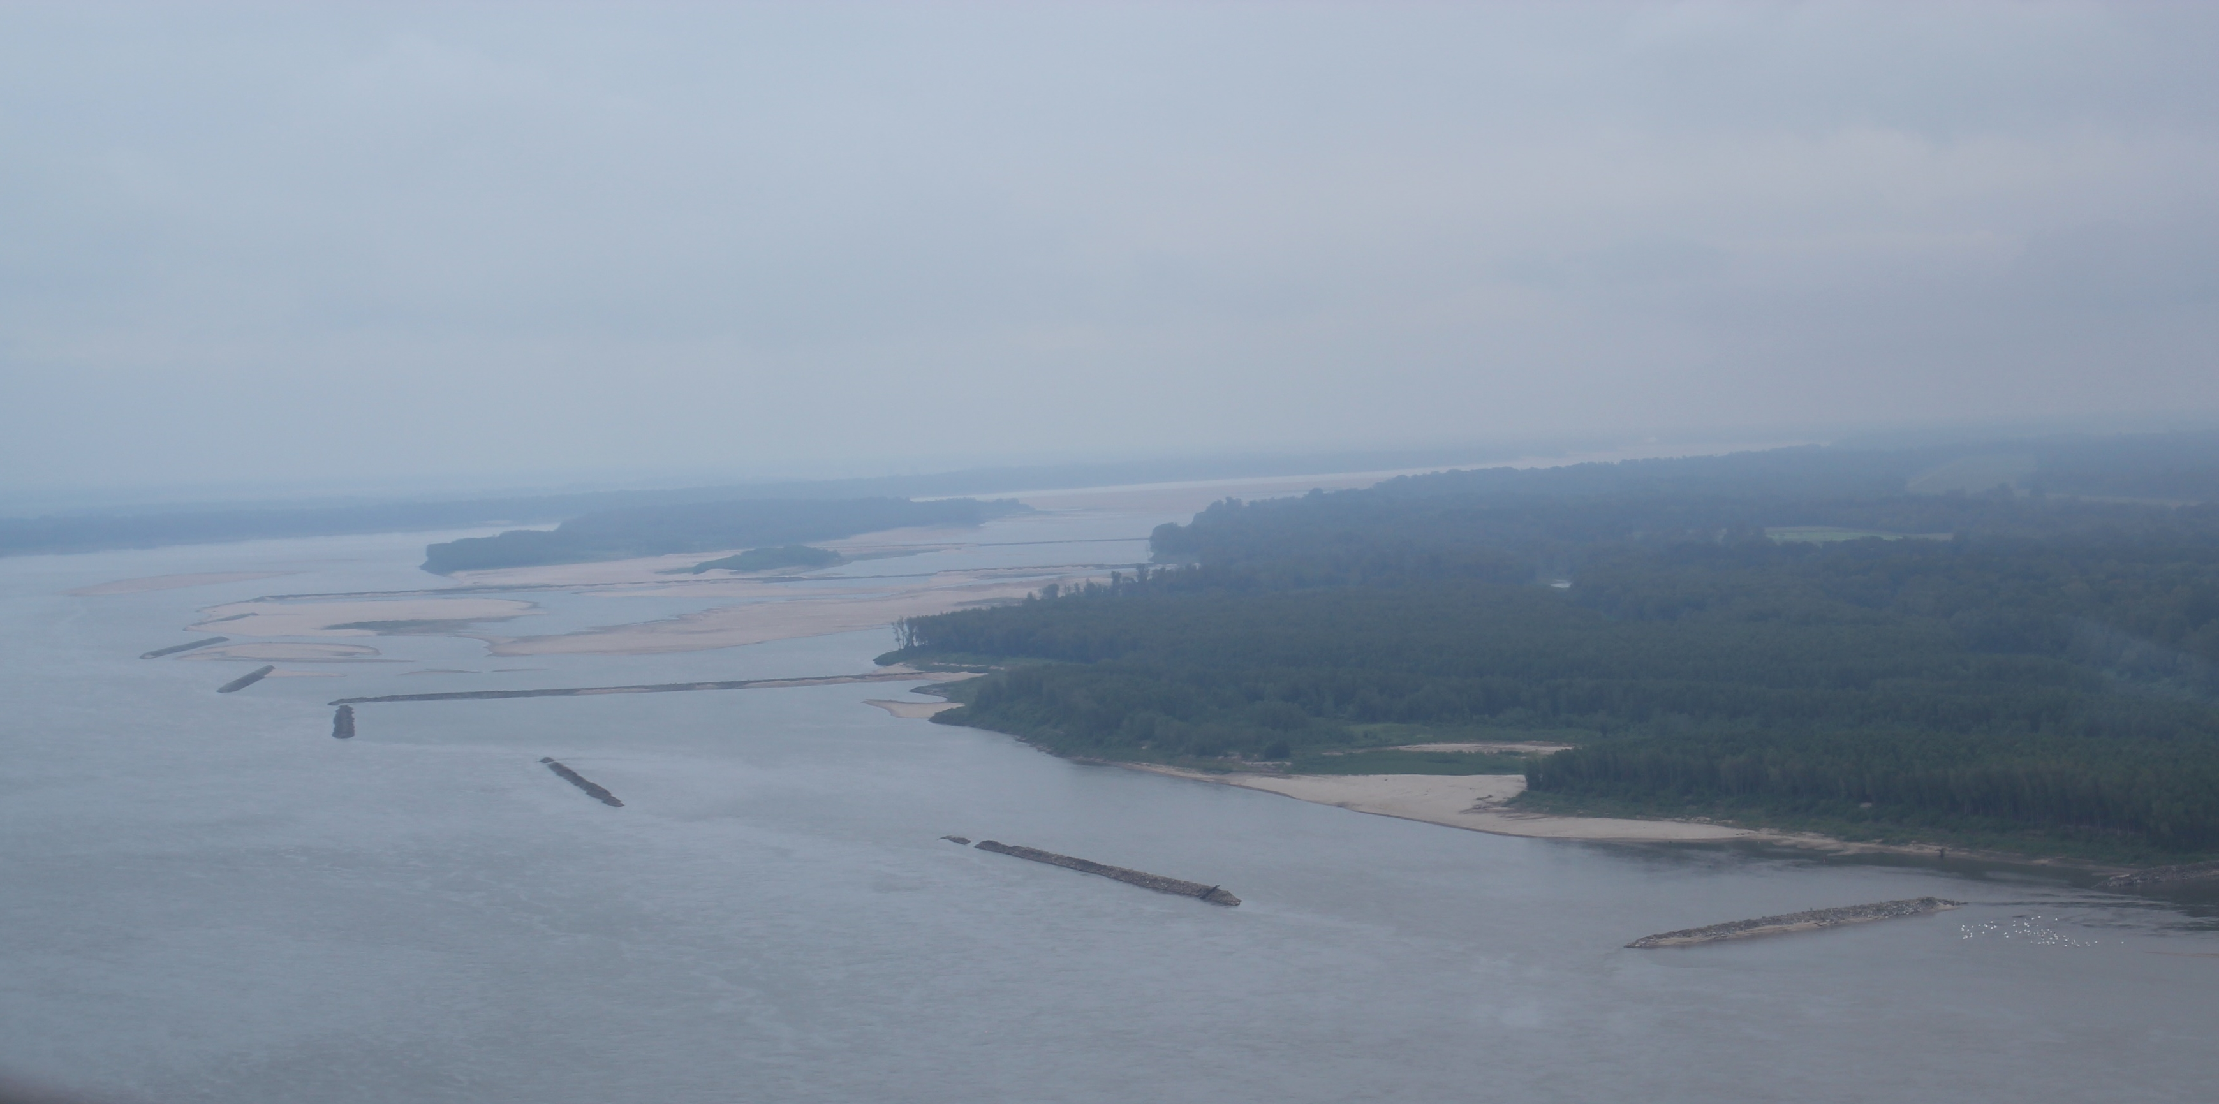
2022 – 2023 Low Water
Stable Channel Nav & FC
Rock Pinnacle removal at Thebes, IL
Dustpan Dredge Hurley
Ben Lomand dikes on the Miss. River
Notes:
Since 1988, over $1.63 Billion has been spent on revetment and dikes on the MS River and Tributaries Project and the Regulated Works project:
As previously mentioned, $1.5B has been invested since 2012 which resulted in:
2.2 Million revetment squares sunk
Over 14 miles of dike construction
Bottom middle image – Graph depicts the dredging totals (bar graphs, peaking in Late 60s and falling vs. cumulative length of dikes (blue shaded area that increases substantially over time) in the MS River. Key takeaway – investing in channel improvement on the river has lowered our dredging costs and made the river more efficient at moving sediment. This further solidifies the need to continue to fund the channel improvement program.
Top left image – Example photo of dikes in the MS River shown during a low water stage
Top right image – Pinnacle removal circa 2012, roughly 1k cubic yards of rock removed which added 2 feet of navigable depth for the Middle MS River
Bottom left image – Dredging operations on the middle MS River facilitates MS River Navigation
Bottom right image – aerial view of the Rock Pinnacles near Thebes, IL during the 2012 low water

Slide 11
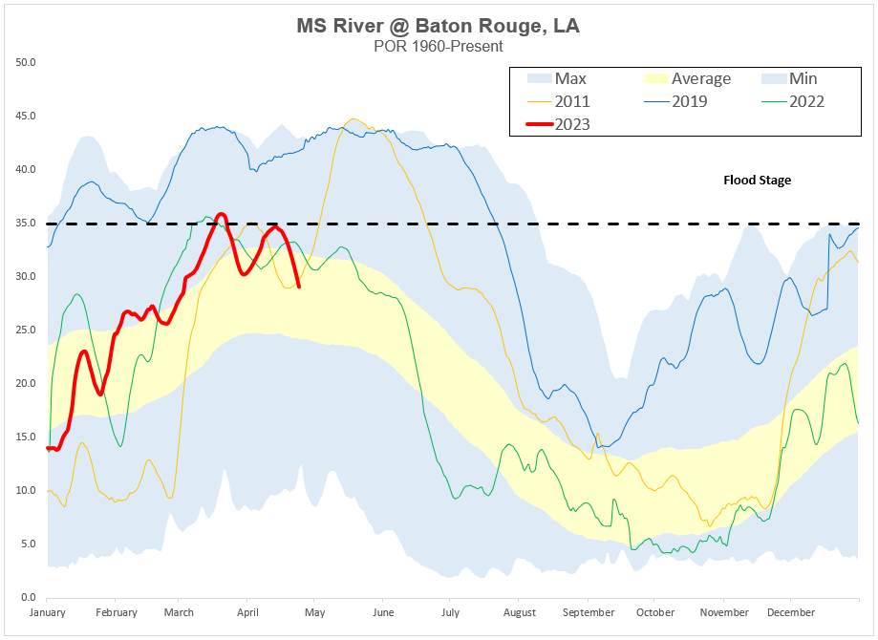
Current conditions

Slide 12
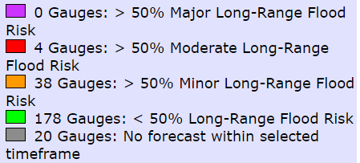
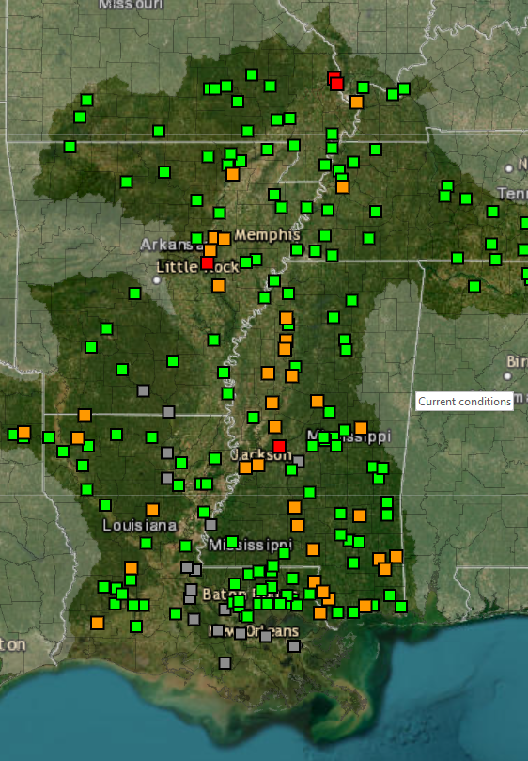
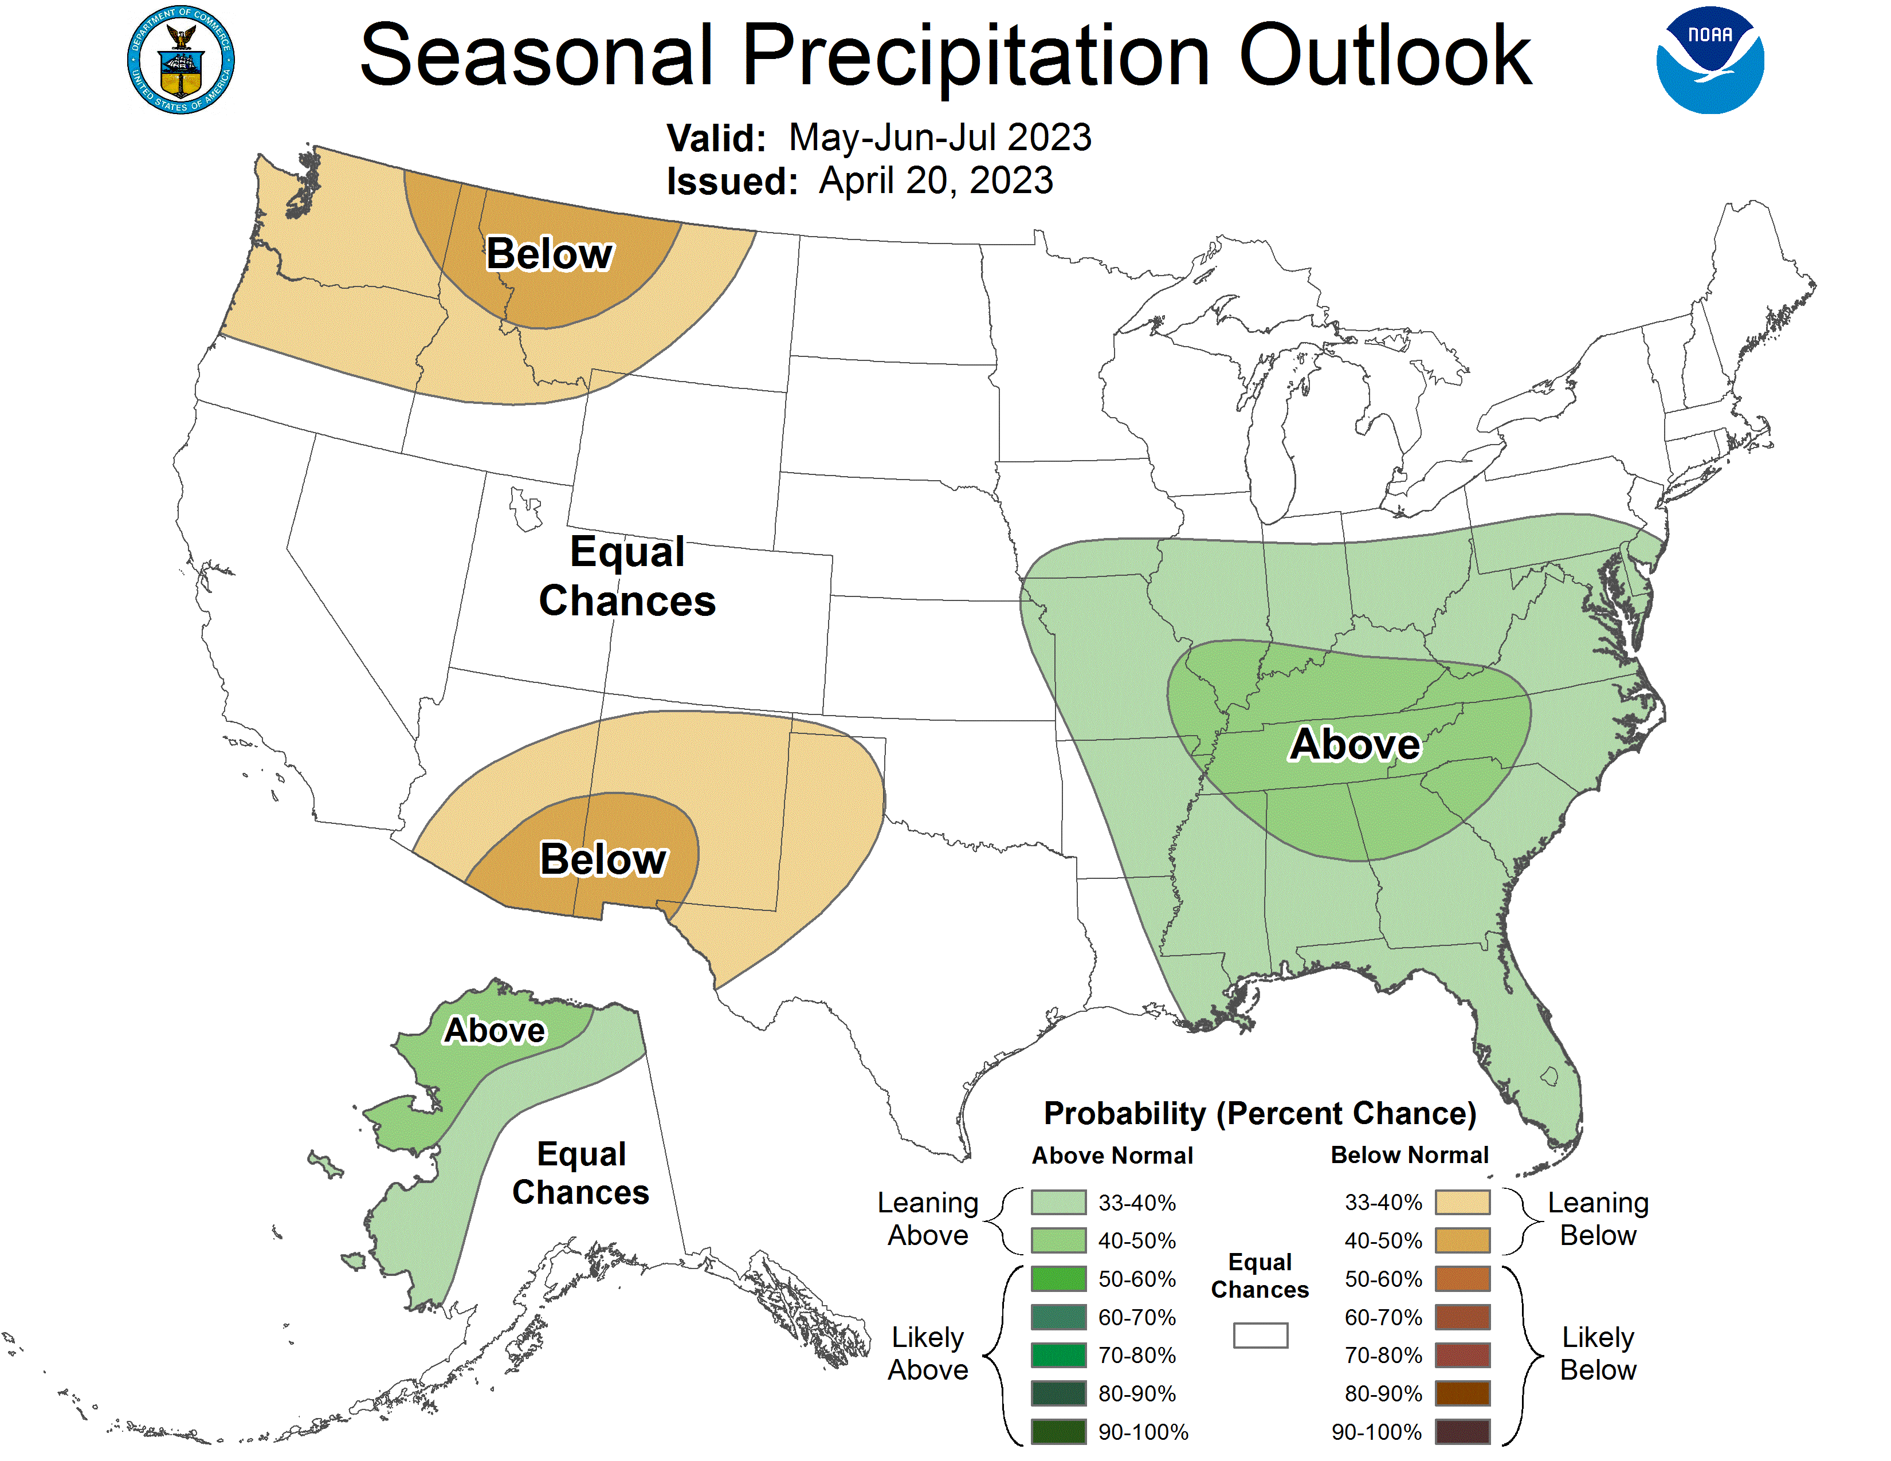
Spring flood outlook

Slide 13
USACE Mission, Vision, Priorities, Command Philosophy AND CAMPAIGN PLAN
PRIORITIES
PEOPLE
READINESS
PARTNERSHIPS
INNOVATE
COMMAND PHILOSOPHY
Promote and maintain a positive command climate
Advance diversity and inclusion in our formations
Deliver the Program
Grow our next generation of leaders
MISSION
Deliver vital engineering solutions,
in collaboration with our partners, to
secure our Nation, energize our economy,
and reduce disaster risk.
VISION
Engineering solutions for the
Nation’s toughest challenges.
Winning = SAFELY Finishing quality projects on time and within budget.

