Slide 1
APRIL 27, 2023
Coastal Update
ALBL Annual Workshop
Chip kline, cpra chairman

Slide 2
100 ACTIVE PROJECTS
40
57
3
PROJECT TYPE
CONSTRUCTION
E & D
PLANNING
HURRICANE PROTECTION (26)
15
9
2
MARSH CREATION (39)
12
27
RIDGE RESTORATION (2)
1
1
SHORELINE PROTECTION (9)
3
6
BARRIER ISLANDS/HEADLANDS (2)
2
DIVERSIONS (4)
1
3
HYDROLOGIC RESTORATION (5)
2
3
OYSTER BARRIER REEF (1)
1
RECREATIONAL USE (5)
4
1
OTHER (7)
1
5
1
Notes:
We have 100 active projects
40 of them are in construction, 57 are in E&D, with 3 more in the planning stage.
Of the projects now being constructed, 26 are hurricane protection projects and 39 are creating marsh. Marsh creation leads the way in E&D with 27 projects moving toward the construction phase.

Slide 3
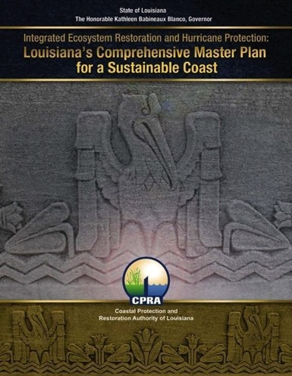
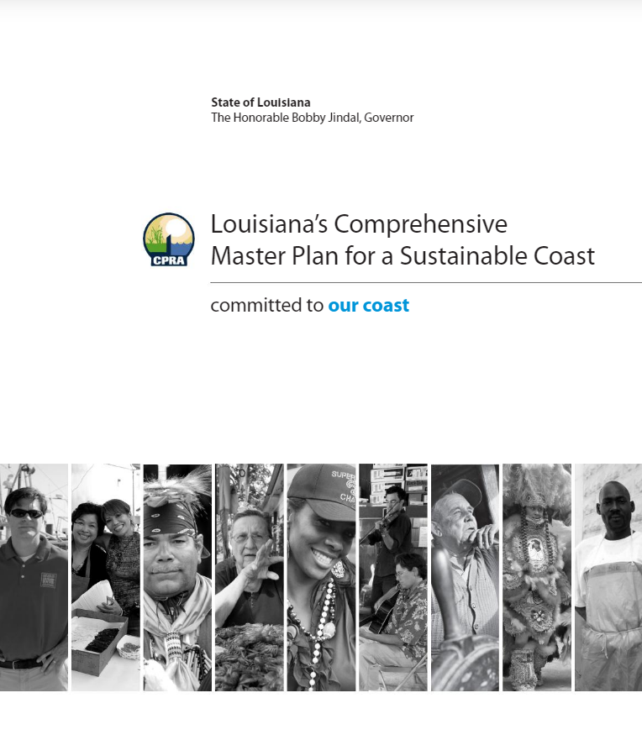
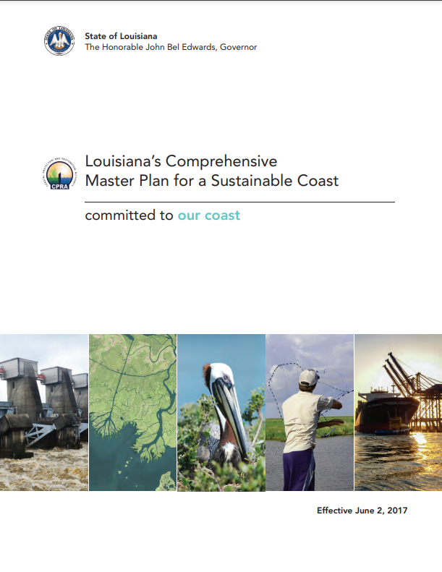
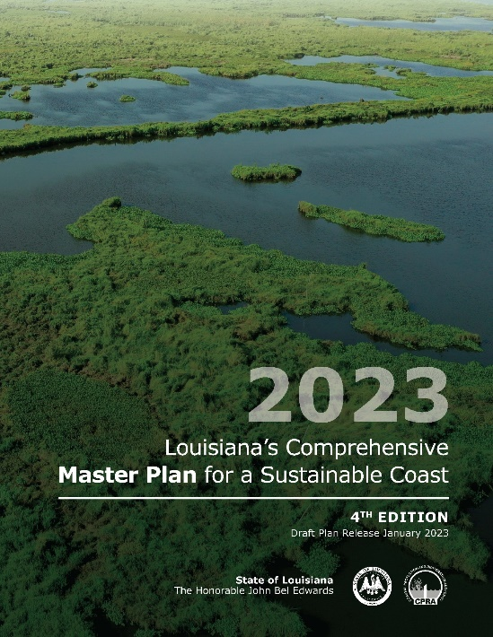
Louisiana’s Comprehensive Master Plan for a Sustainable Coast
Articulates an integrated and comprehensive vision for resilience, restoration, and protection in coastal Louisiana
Defines a list of projects
50-Year, $50 Billion budget
Updated every 6 years
Notes:
Louisiana’s Coastal Master Plan sets an ambitious path to respond to the loss of our coastal land and the threats from storm surge events
The master plan is a list of projects that build or maintain land and reduce risk to our communities. Because the funding for all of those projects is not available now, the master plan identifies a long-term program of construction, operations and maintenance, and adaptive management that is guided by a robust and continuous planning process, to be implemented as funds become available, much like the Federal Highway or the Mississippi River and Tributaries Systems.
Projects within the 2023 DRAFT Coastal Master Plan will restore and maintain over 300 of square miles of Louisiana’s coastal wetlands and reduce expected annual damage by up to $15 billion compared to a future without action. The investments identified in the plan could also reduce the state’s hurricane and tropical storm flood risk in 50 years to below what it experiences today.

Slide 4
Coastal Master Plan
Total Funding: $50B
$25B Restoration
$25B Risk Reduction
Notes:
The plan is split evenly between restoration and protection (risk reduction). The 2023 Coastal Master Plan is based on a $50 billion budget, broken down by project type here.
Important to note that CPRA doesn’t have $50 on-hand or sitting in the bank. During the planning phase of the 2023 Master Plan, CPRA analyzed multiple funding scenarios to examine how changes in the amount of funding and its timing affected the amount of land that could be built or the amount of risk reduction that could be achieved over the 50-year planning period. The $50 billion budget was selected because it yielded the most efficient and effective results regarding land building and risk reduction outcomes within the 50-year period.
Since the state will not possess all $50 billion at once, projects are prioritized to implement the most cost-effective projects first while continually advocating for additional funds to implement additional projects.
The plan is updated every 6 years; CPRA will release a new iteration in 2029.

Slide 5
Total Projected Expenditures FY 2024
By Project Phase
Operation, Maintenance & Monitoring ($83.8 M)
Ongoing Programs & Initiatives ($82.6 M)
5%
5%
Operating Costs ($32.4 M)
82%
Construction
($1.33 B)
2%
1%
Planning ($15.2 M)
5%
Engineering & Design ($74.7 M)
FY 2024 Total Expenditures
$1.62 Billion

Slide 6
Total Projected Expenditures
By Project Phase
$32.4 M
$15.2 M
$82.6 M
$74.7 M
$83.8 M
1%
2%
$33.3 M
$34.2 M
$5.4 M
5%
$10.4 M
5%
5%
$49.4 M
$48.1 M
$27.4 M
$35.6 M
$130.5 M
1%
$52.1 M
1%
3%
2%
3%
8%
2%
4%
2%
4%
82%
$1.33 B
84%
$1.35 B
86%
$1.02 B
FY 2024 Total Expenditures
FY 2025 Total Expenditures
FY 2026 Total Expenditures
$1.62 Billion
$1.61 Billion
$1.19 Billion
● Planning ● Engineering & Design ● Construction ● Operation, Maintenance & Monitoring ● Ongoing Programs & Initiatives ● Operating Costs

Slide 8
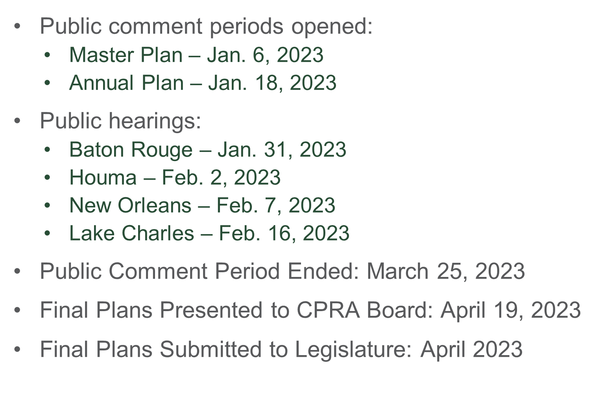
Timeline
8

Slide 9
Coastal Priorities for Legislative Session
SCR 6 by Sen. Hensgens, Approves the annual state integrated coastal protection plan for Fiscal Year 2024
SCR 17 by Sen. Hensgens & Rep. Zeringue, Approves the 2023 Coastal Master Plan for integrated coastal protection
HB 99 by Rep. Orgeron, (Constitutional Amendment) Provides relative to the disposition of funds derived from alternative energy production in the coastal area
HB 116 by Rep. Orgeron, Provides relative to the disposition of funds derived from alternative energy production in the coastal area
HB 526 by Rep. Zeringue, Establishes and provides for the Louisiana Office of Resilience
$157.4 million Coastal Surplus Request
The 2023 Regular Legislative Session ends June 8th at 6:00pm

Slide 10
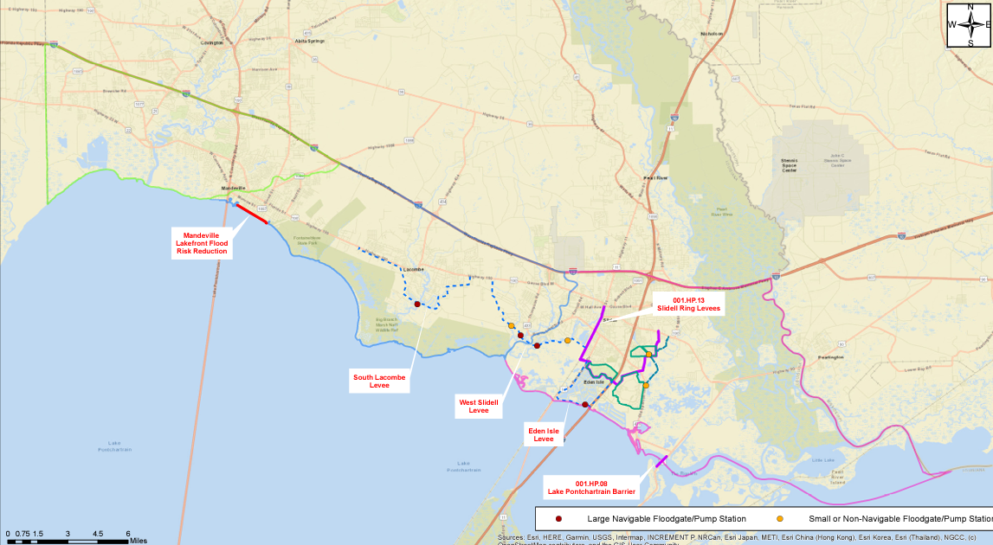
St. Tammany Parish Feasibility Study
Provides protection to 150,000 LouisiANANS and 1,700 miles of farmland
Photo credit: stldcd.com
Notes:
98-mile levee system that protects cities and towns in Lafourche and Terrebonne parish
The system will protect 150k Louisiana residents and 1,700 miles of farmland
The Morganza-to-the-Gulf Hurricane Protection System is a levee, lock, and floodgate system designed to provide 100-year, Category 3 storm surge protection to more than 150,000 Americans living in coastal Terrebonne and Lafourche Parishes (60 miles southwest of New Orleans) as well as over 1,700 square miles of fresh and saltwater marsh.

Slide 11
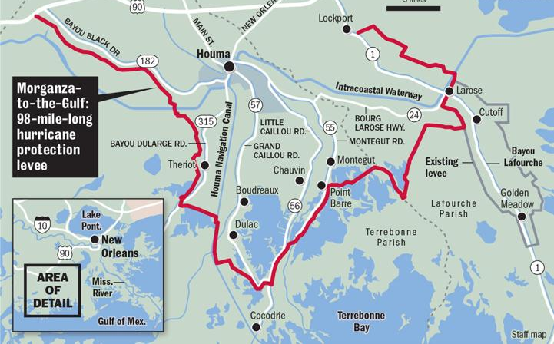
Morganza to the Gulf System
Provides protection to 150,000 LouisiANANS and 1,700 miles of farmland
Photo credit: Nola.com
Notes:
98-mile levee system that protects cities and towns in Lafourche and Terrebonne parish
The system will protect 150k Louisiana residents and 1,700 miles of farmland
The Morganza-to-the-Gulf Hurricane Protection System is a levee, lock, and floodgate system designed to provide 100-year, Category 3 storm surge protection to more than 150,000 Americans living in coastal Terrebonne and Lafourche Parishes (60 miles southwest of New Orleans) as well as over 1,700 square miles of fresh and saltwater marsh.

Slide 12
Upper Barataria Risk Reduction
levee alignment Provides IMPROVEMENTS TO 12.3 miles of existing levees/FLOODWALLS & 18.3 miles of new levee and floodwall construction
Photo credit: mvn.usace.army.mil
Notes:
30.6 mile levee alignment including 12.3 miles of existing levee/floodwall improvements and 18.3 miles of new levee and floodwall construction
16-18.5 foot elevation levee would originate in Luling, connecting to the Mississippi River Levee via the Davis Pond Diversion Structure West Guide Levee
Update and improve deficiencies in the St. Charles Parish Levee, crossing Bayou Des Allemands with a 270 foot barge gate structure
The study area includes communities in seven southeast Louisiana parishes; St. Charles, St. John, St. James, Jefferson, Ascension, Lafourche and Assumption.

Slide 13
West Shore Lake Pontchartrain
Provides HURRICANE protection to 60,000 Louisianans WHO CURRENTLY HAVE LITTLE TO NO HURRICANE RISK REDUCTION IN PLACE
Photo credit: mvn.usace.army.mil
Notes:
The project is located in southeast Louisiana in St. Charles, St. John the Baptist, and St. James parishes.
The project will construct a 100-year level risk reduction system extending from the Bonnet Carre spillway to Garyville
100-year risk reduction will be achieved by a variety of structural and non-structural features to include: levees, floodwalls, and pump stations.

Slide 14
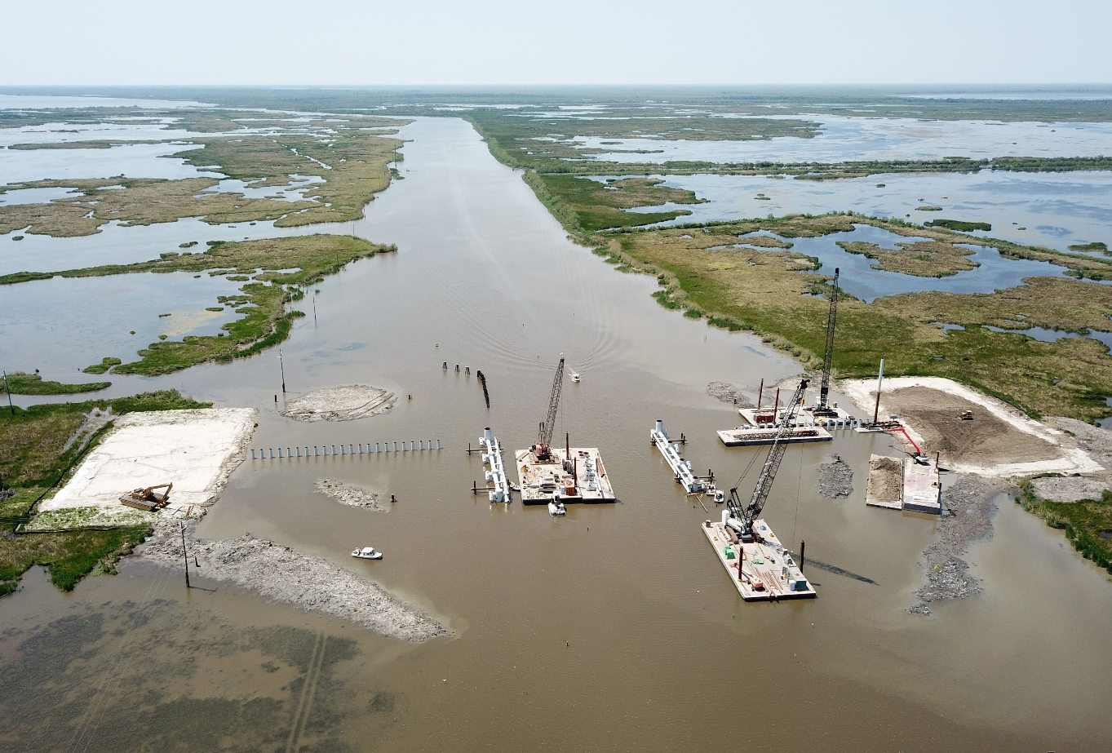
Crown Point Tidal Protection | $24M
Grand Bayou Ridge Restoration/Canal Backfilling | $3M
Northwest Little Lake Marsh Creation Increment 2 | $11.4M
Breton Landbridge Marsh Creation (West) | $8M
Southwest Coastal Louisiana | $13M
West Shore Lake Pontchartrain | $13.2M
LaBranche Shoreline Protection Project | $5.7M
Chandeleur Islands Restoration | $2.7M
HNC Lock Complex (Phase 3) | $6M
West Belle Headland Repairs | $14M
Vermilion Ridge Restoration/Shoreline Protection | $3.5M
St. Tammany Restoration Project (E&D) | $0.4M
Amite River Diversion Canal Swamp Restoration | $3M
St. Charles Crawford Canal/Sunset Pump Station | $6M
Sugar Ridge Pump Station | $5M
NLLD Levee Improvements (Including MTG) | $8M
SLLD Levee Improvements (Including MTG) | $5M
TLCD Levee Improvements (Including MTG) | $5M
State Refuge Restoration | $1M
Cameron Gulf Shoreline Protection Increment 2 | $6M
Schooner Bayou Restoration | $1M
GIWW Shoreline Protection | $2M
Atchafalaya Basin Program | $3M
Restoration Partnerships | $1M
Parish Matching Program | $6M
New Surplus Projects
Funded with fy22 budget surplus
25 Projects & programs
$157.4 million total value

Slide 15
Federal Funding Update
Infrastructure Investment and Jobs Act (IIJA)
$836 million in funding for 17 Louisiana coastal and water management projects, including:
$378.5 million for Morganza to the Gulf
$296 million for Southwest Coastal
$52.9 million for Atchafalaya Basin
$23.2 million for the Gulf Intracoastal Waterway
$15 million to repair the South Pass Jetties
Supplemental Disaster Relief Bill
$2 billion in funding for coastal and other flood protection projects in Louisiana, including:
$783 million for New Orleans to Venice Hurricane Protection Project
$453 million for West Shore Lake Pontchartrain
$163 million for Atchafalaya Basin
$128 million for Comite River Diversion
$94.3 million for Southeast Louisiana
$8 million for Upper Barataria Basin
$3.8 million for Grand Isle and Vicinity
$3.5 million for Bayou Segnette Waterway
$3 million for Tangipahoa Parish

Slide 16
RISEE Act Reinvesting in Shoreline Economies and Ecosystems
Removes revenue sharing limitation in GOMESA
Eliminate statutory cap of $375 million to GOMESA states and $125 million to Land and Water Conservation Fund (LWCF)
Removing this arbitrary cap could provide an estimated $1.9 billion additional dollars to Louisiana in the next ten years based on 2021 forecasts. The price of oil and gas is now expected to be much higher, meaning RISEE would be even more valuable.
Revenue sharing from offshore wind development, split similarly to GOMESA, albeit with no limiting cap:
37.5% to coastal states based on distance to project
12.5% to National Oceans and Coastal Security Fund (NOCSF)
50% to U.S. Treasury
If enacted, Louisiana would benefit from an upcoming Gulf of Mexico wind lease sale in 2023

Slide 17
RISEE Act Reinvesting in Shoreline Economies and Ecosystems
Louisiana is forecasted to gain $1.9 billion over 10 years (FY23-FY32) from removing the cap.
Louisiana would receive approximately $34.1 million from wind leasing bids to date, plus additional shared revenues from local wind lease sales in 2023.
Bicameral and Bipartisan Bills:
S. 373 - Introduced by Senator Sheldon Whitehouse (D-RI) and Senator Bill Cassidy (R-LA), has 21 additional cosponsors (16 Democrats and 5 Republicans, has support from 16 states
H. 913 - Introduced by Representative Lizzie Fletcher (D-TX-07) and Representative Randy Weber (R-TX-14), has 7 additional cosponsors (5 Democrat and 2 Republican), has support from 6 states

Slide 18
BREEZE Act Budgeting for Renewable Electrical Energy Zone Earnings
Removes revenue sharing limitation in GOMESA
Eliminate statutory cap of $375 million to GOMESA states and coastal political subdivisions and $125 million to Land and Water Conservation Fund (LWCF).
Increases percentage shared with states to 50%, on par with interior states.
Exempts funds from budget sequestration.
Waives 2% administrative fee for inland states.
Affirms that revenue sharing is not equivalent to a federal grant or award.
Revenue sharing from offshore wind development, split similarly to GOMESA, albeit with no limiting cap:
50% to coastal states based on distance to project
37.5% to North America Wetlands Conservation Act
12.5% to U.S. Treasury

Slide 19
BREEZE Act Budgeting for Renewable Electrical Energy Zone Earnings
Louisiana is forecasted to gain $3.1 billion over 10 years (FY23-FY32) from removing the GOMESA cap and increasing the GOMESA percentage to 50%.
If BREEZE is passed ahead of this summer’s Gulf of Mexico offshore wind lease sale, then Louisiana could receive 50 percent of the proceeds, alongside Texas.
H.R. 1 INCLUDED BREEZE ACT
Led by Majority Leader Scalise, the Lower Energy Costs Act received the prestigious bill number of H.R. 1 from Speaker McCarthy to show the top importance of the legislation to the House Majority for the Congress.
The bill brought together 25 separate Republican bills that shared a goal to increase the production and export of American energy and reduce the regulatory burdens that make it harder to build American infrastructure.
H.R. 1 passed 225-204, with all but 1 Republicans and 4 Democrats supporting.
Leader Scalise included the text of the BREEZE Act, which he introduced last Congress with Congressman Troy Carter.
Congressman Graves’ BUILDER Act to reform NEPA is a major component of the permitting reform in H.R. 1

Slide 20
WRDA
Water Resources Development Act
A selection of key provisions for coastal Louisiana within WRDA 2022 include:
Authorizing the Upper Barataria Basin Hurricane and Storm Damage Risk Reduction project, a $1.8 billion risk reduction project in St. Charles, St. John, St. James, Jefferson, Ascension, Lafourche, and Assumption parishes.
Authorizing the South Central Coast, Louisiana Hurricane and Storm Damage Risk Reduction project, a $1.2 billion risk reduction investment in St. Mary, St. Martin, and Iberia parishes.
Extending the deadline from 2023 to 2032 for the third and final HSDRRS payment, as well as providing more opportunity for using state-led coastal restoration projects for crediting.

Slide 21
WRDA
Water Resources Development Act
A selection of key provisions for coastal Louisiana within WRDA 2022 include:
Prioritizing coastal restoration as a main mission of USACE by including provisions of the Shoreline Health Oversight, Restoration, Resilience, and Enhancement Act (SHORRE Act)
Clarifying that the following will be funded at 100% federal expense:
The Ecosystem restoration of the Mississippi River Gulf Outlet (MRGO)
The Lower Mississippi River Comprehensive Management Study
Upkeep of the Algiers Canal Levees

Slide 22
CONNECT WITH US!
SUBSCRIBE
@LouisianaCPRA

