Slide 1
Association of levee boards of Louisiana
U.S. ARMY CORPS OF ENGINEERS
NEW ORLEANS DISTRICT UPDATE
COL Cullen Jones
Commander
27 April 2023

Slide 2
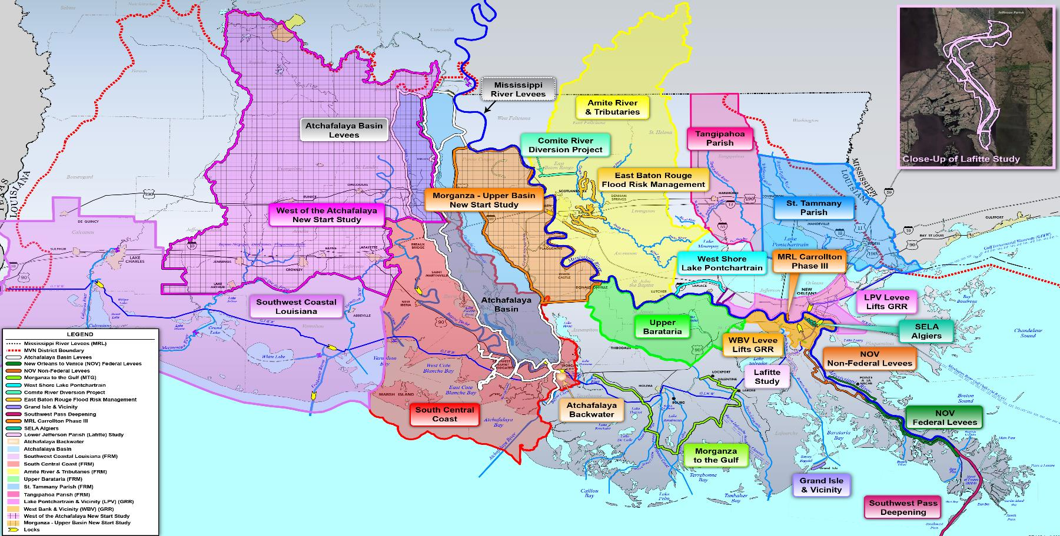
New Orleans District
South Louisiana Flood Risk Management

Slide 3
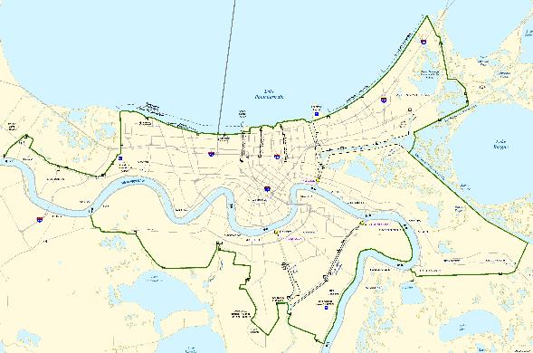
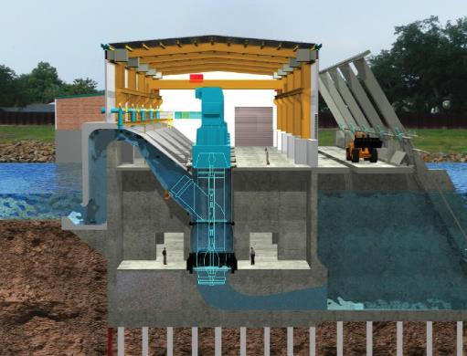
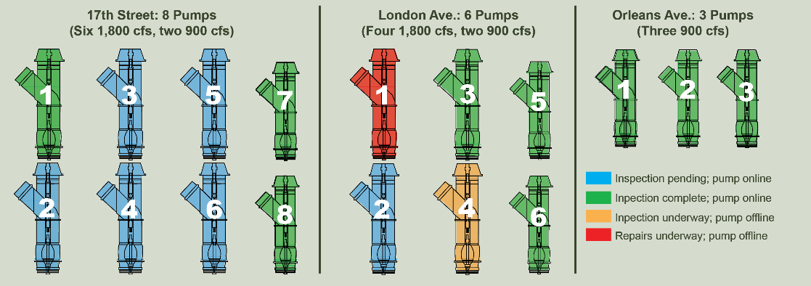
2023 ATLANTIC HURRICANE SEASON
HSDRRS Permanent canal closures and pumps (PCCP)
PHASE I
Inspect and repair all 17 pumps to ensure readiness for 2023 Hurricane Season
If necessary, implement supplemental pumping capacity at the London Ave. PCCP (US Navy SUPSALV)
Identify cause for corrosion and path forward for long-term reliability
Current inspection & Repair status
PHASE II
Undertake measures to deliver sustainable and reliable pumps that meet 35-year design specifications

Slide 4
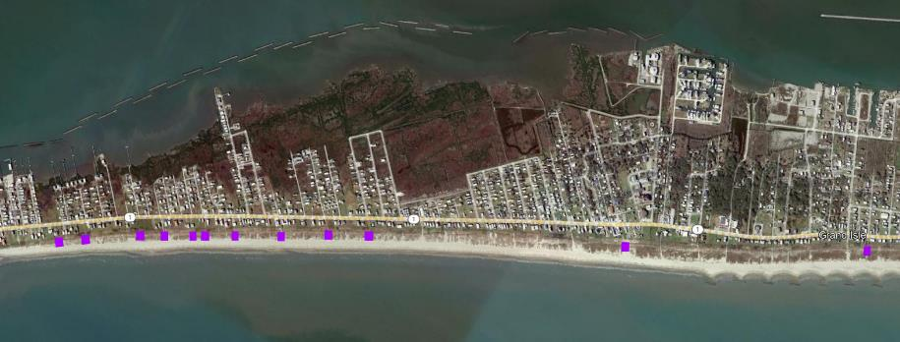
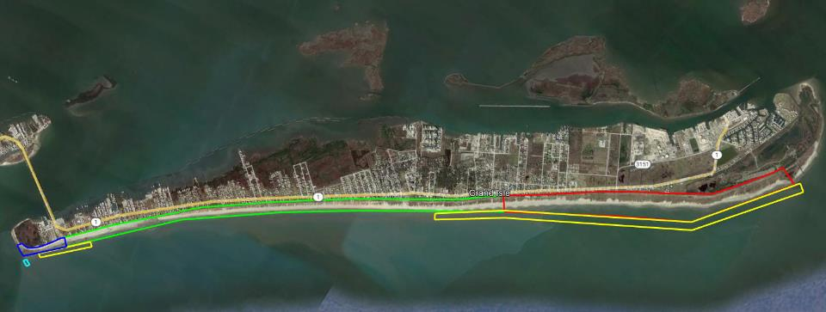
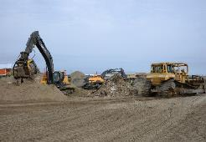
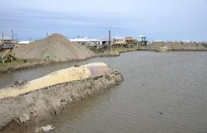
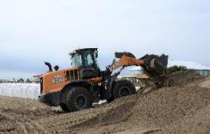
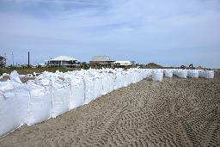
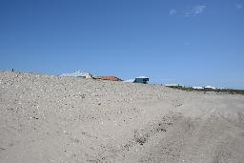
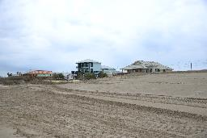
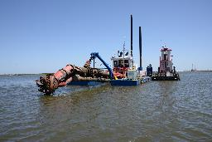
2023 ATLANTIC HURRICANE SEASON
Grand Isle Hurricane and storm Damage risk reduction
Interim repairs (12 locations) Complete
Restoration of the federal project
DRSAA:
Provided approx. $122M for repair and restoration
Includes funding to evaluate long-term sustainable alternatives
Restoration: Stone Contract Awarded
Install 2,200’ of stone dune core and 21,000’ of clay-filled geotextile core.
Repair breakwaters, western jetty and sand-filled geotube.
Restore seven miles of dune and beach.
Interim Repairs: Complete
Repair dune foundation and install supersack sandbags

Slide 5
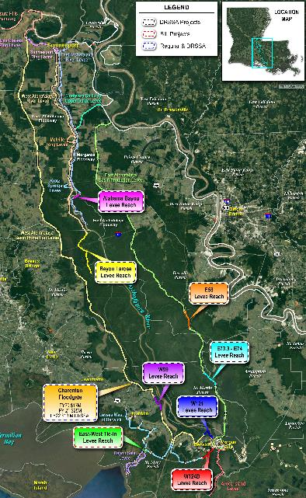
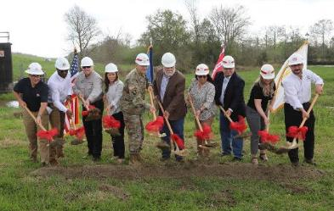
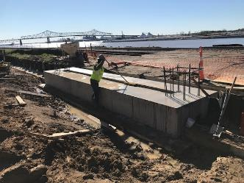
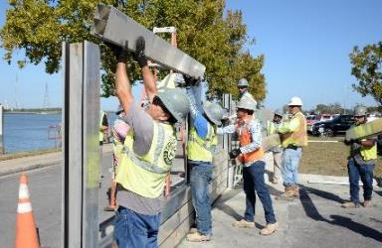
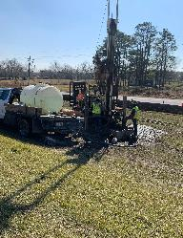
2023 Mississippi River high water SEASON
Mississippi river and tributaries
Mississippi River Levees
$80.5M in regular and supplemental funding
12 projects under construction; nine in design.
Additional $108M in DRSSA funding for 20 projects in South LA (Vicksburg District lead)
Atchafalaya Basin Levees
$85M in DRSSA funding received
One under construction (Charenton Floodgate); seven reaches under design.
$10M in BIL for Bayou Sale East West Tie-In (in design)

Slide 6
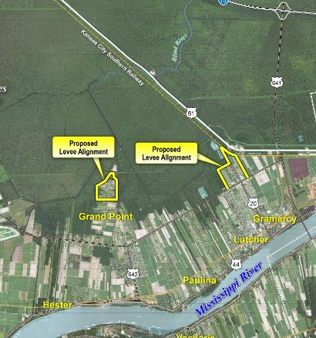
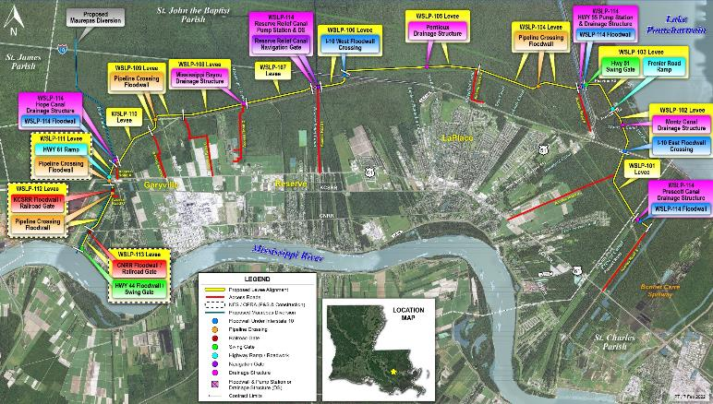
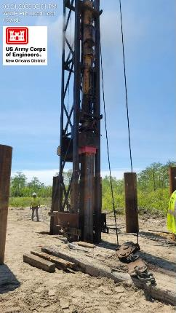
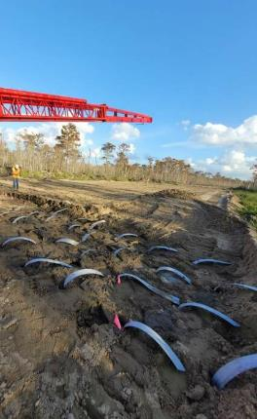
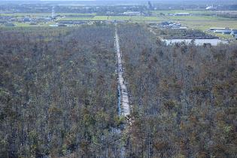
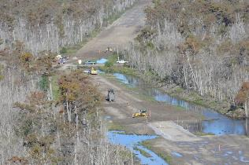
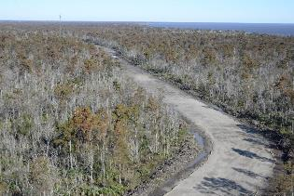
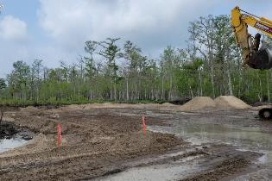
2023 flood risk management construction
West shore lake pontchartrain
Underway
Levee Test Section (WSLP-101): Complete
Sand Placement 1 & 2: Complete
Clay and Sand Stockpile: 2 of 3 Complete
Access Road Construction: Substantially Complete
Pile Load Testing: Underway
Levee Construction (WSLP-110 and 107): Two contracts awarded.
Upcoming
Two levee construction contracts (WSLP-101a and 106): May 2023.
General Reevaluation Report
Feasibility Cost Share Agreement signed FEB 2023

Slide 7
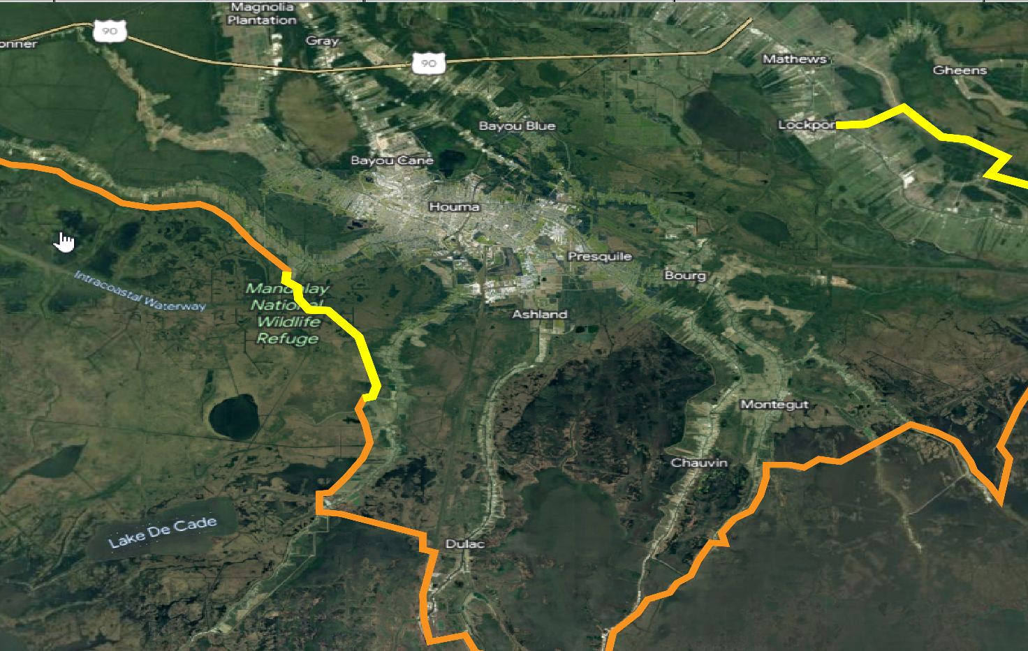
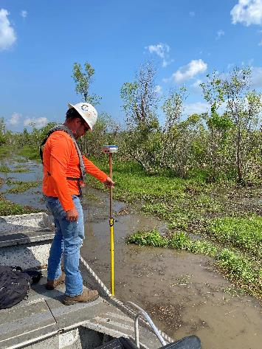
2023 flood risk management construction
Morganza to the gulf of mexico
Funding
$397M
BIL: $378.5M
Lockport to Larose Levee Alignment
GIWW West Floodgate
Construction
Humble Canal Preload: 33% complete
GIWW East Floodgate
Minors Canal Floodgate
Design
Humble Canal Floodgate
Minors Canal Floodgate
Lockport to Larose Levee Reach
GIWW East& West Floodgates
Reach A Levee
$378
million
in funding
Reach A Levee Alignment
Reach A Levee Alignment Surveys
Humble Canal Floodgate

Slide 8
Upper barataria basin
Contiguous Flood Risk Management

Slide 9
Upper Barataria basin
Contiguous Flood Risk Management

Slide 10
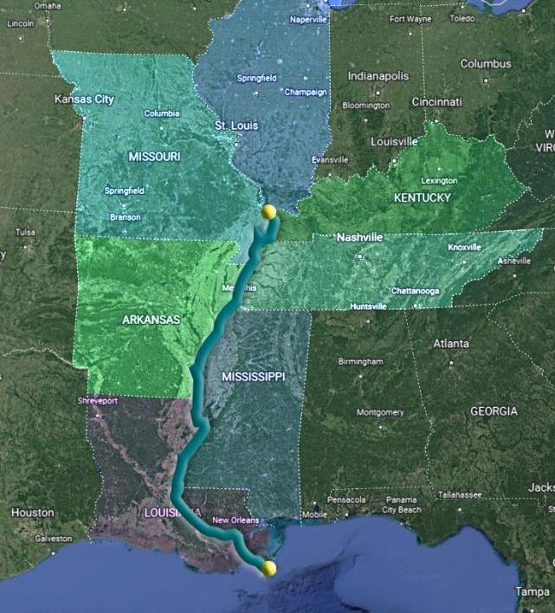
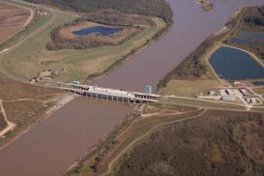
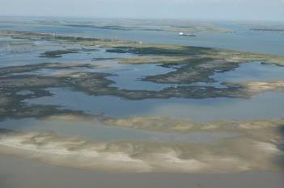
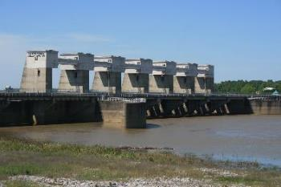
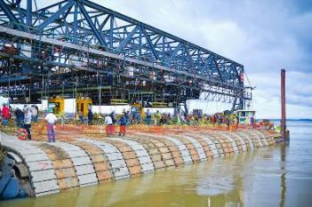
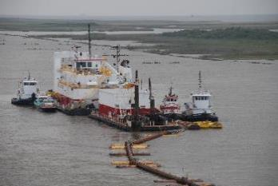
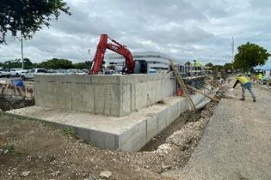
Defining the future of the Mississippi River
Lower Mississippi Comprehensive Study
$25M five-year study
River from Cape Girardeau, IL to Gulf of Mexico, including 7 states
Illinois, Missouri, Kentucky, Tennessee, Arkansas, Mississippi & Louisiana
Identify actionable recommendations
Annual updates to Congress

Slide 11
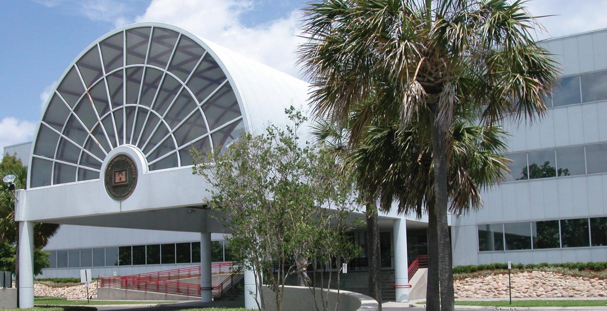
Collaboration, Cooperation and COmmunication
Risk Management Partners
CONTACT US
COL Cullen A. Jones, Commander
Phone: 504-862.2077
Email: Cullen.A.Jones@usace.army.mil
Mark Wingate, Deputy District Engineer
Phone: 504-862.2204
Email: Mark.R.Wingate@usace.army.mil
Regulatory Questions
Steve Roberts, Executive Assistant
Phone: 504-862.2517
Regulatory: 504-862-2207
Email: Steve.W.Roberts@usace.army.mil

