Slide 1

Public Works
Edward M. Knight, P.E.
Deputy Assistant Secretary
Office of Public Works
April 27, 2023
Notes:
Next Slide - Just a quick look at what I hope to cover very briefly.

Slide 2
Today’s Discussion
Public Works & Water Resources:
  Hydraulics Section
    Louisiana Watershed Initiative
    Statewide Flood Control Program
    Roadway Flooding Program
  Floodplain Management Section
  Levee & Dam Safety Section
Notes:
I struggle with LWI within Hyd because it has been a big part of all the aspects of PW.
Right now it is most active within the Hydraulics Section but early on in the process FPM Dams and Levees play huge roles in setting up the program
NEXT SLIDE – Hydraulics

Slide 3
Hydraulics Section Responsibilities
Hydraulic reviews and analysis (≈ 300/yr)
  Review plans and calculations for highway projects to ensure compliance with LA DOTD hydraulic policies and performance criteria
  Hydraulic design for bridges, culverts, and storm sewer systems
  Provide technical expertise to consultants and other DOTD sections for complex or unusual drainage problems
Notes:
300 hydraulic reviews per year. Some are project specific, evaluations
NEXT SLIDE – Hydraulics

Slide 4
Hydraulics Section Responsibilities
Maintenance of hydraulic related policies, performance criteria, and standard plans
  LA DOTD Hydraulics Manual (2011)
  LA DOTD Hydraulics software
  Maintaining the Engineering Directives and Standards Manual (EDSM) for pipe material, pipe life expectancy, and installation
  Drainage structure standard plans and special details
Notes:
NEXT SLIDE – Hydraulics

Slide 5
Hydraulics Section Responsibilities
Drainage complaints & lawsuits
  Investigate complaints of roadway flooding and flooding of property potentially caused by DOTD roads and/or drainage structures
  Assist attorneys and serve as expert witnesses for drainage/flooding lawsuits brought against DOTD
Notes:
NEXT SLIDE – Floods of 2016

Slide 6
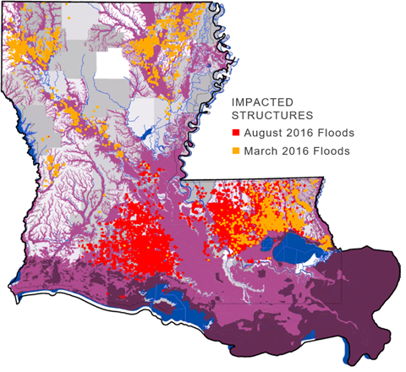
The Floods of 2016
145,000 structures impacted
  ~80% uninsured
>$10B in damages
Notes:
MID’s – Ouachita, EBR, Livingston, Ascension, Tangipahoa,
NEXT SLIDE – LWI

Slide 7
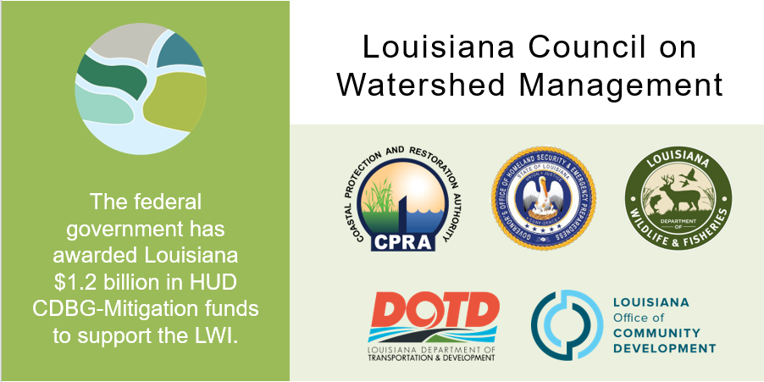
Louisiana Watershed Initiative
The federal government has awarded Louisiana $1.2 billion in HUD CDBG-Mitigation funds to support the LWI.
Notes:
Remember to say this: Council on Watershed Management was formed by Gov. John Bel Edwards in 2018.
NEXT SLIDE – Watershed Regions

Slide 8
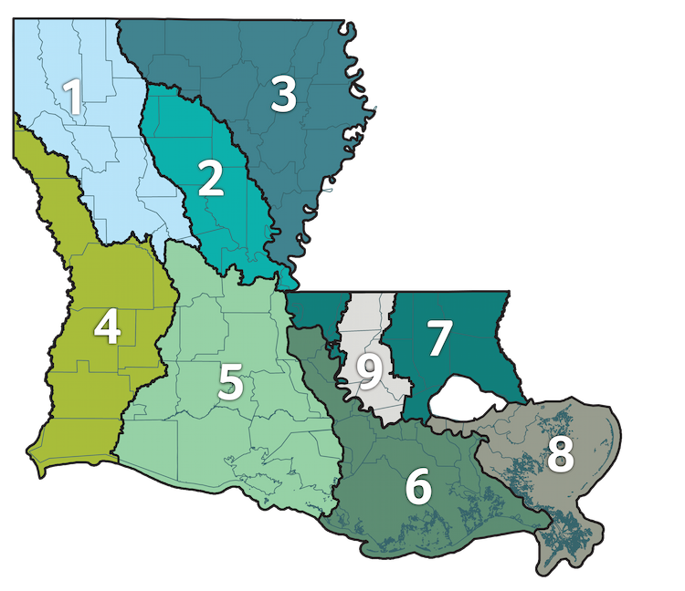
Louisiana Watershed Initiative
LWI Watershed Programs:
Statewide Data & Modeling Program
State Projects Program
Regional Capacity Building Grant Program
Nature-Based Solutions Program
Statewide Buyout Program
Non-Federal Cost Share Assistance Program
Notes:
Mention the addition of reion 9
Buyout-primarily benefit LMI residents, offers an incentive—payment above fair market value
Cost Share-25% cost share of HMGP awards the state received from FEMA as a result of the 2016 floods
NEXT SLIDE – LWI Modeling Regions

Slide 9
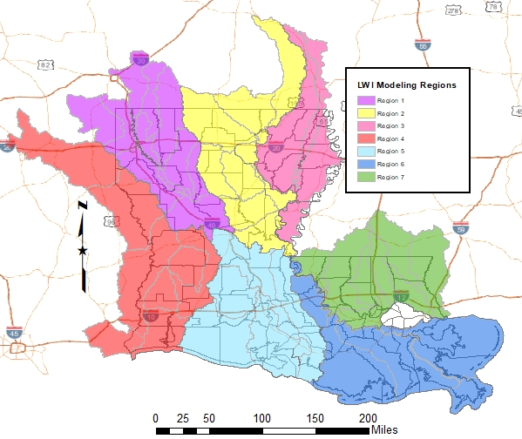
Louisiana Watershed Initiative
Regional Watershed Hydrologic & Hydraulic Modeling
Selected Firms by Region:
Atkins North America
Freese & Nichols
Wood E&I Solutions
C.H. Fenstermaker
HDR Engineering
Michael Baker International
Dewberry Engineers
1
2
3
4
7
5
6
Notes:
Modeling – MUSM Plan, River and Rain gauge Network, Data Collection Storage and Mgt and Sharing
NEXT SLIDE – LWI SPP at DOTD

Slide 10
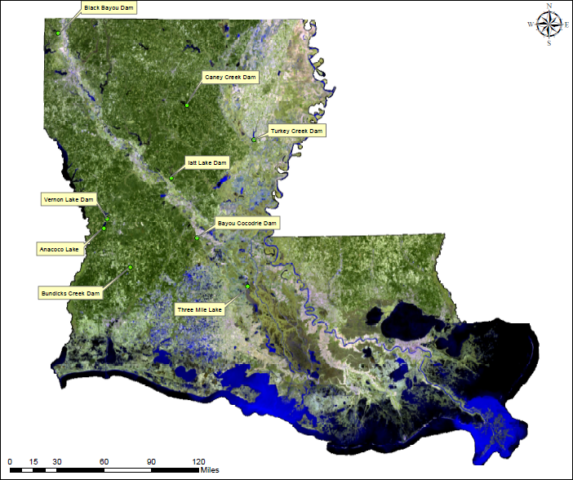
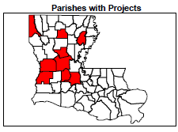
State Sponsored DOTD Projects
Black Bayou Dam
Caney Creek Dam
Bayou Cocodrie Dam
Iatt Lake Dam
Turkey Creek Dam
Bundick Creek Dam
Anacoco Lake
Vernon Lake Dam
Three Mile Lake
Cost = $53M
Notes:
NEXT SLIDE – LWI Contacts

Slide 11



Stay Engaged
Email: watershed@la.gov
Website: watershed.la.gov
Notes:
Follow us on social media to learn more about our work on Facebook and Twitter
Reach out any time via email at watershed@la.gov and a member of our team will be in touch
NEXT SLIDE – Statewide Flood Control

Slide 12
Statewide Flood Control Program
$20M in total annual program (funded by Transportation Trust Fund)
Project requirements
  Must reduce existing flood damages of structures
  Does not encourage additional development in flood prone areas
  Does not adversely affect upstream or downstream flooding
  Must have a construction cost of $100,000 or more (Maximum SWFC Participation - $5M)
  Must be a stand-alone project
  Cannot serve the primary purpose of protection against coastal storm surge
Rural Grant Opportunity Act 384
  Eliminates 10% match requirement for parishes with less than 50,000 residents and municipalities less than 5,000 residents
Notes:
NEXT SLIDE – Flood Control continued

Slide 13
Statewide Flood Control Program
Competitive & Cost-Shared
  Projects are evaluated based on potential damage reduction versus State investment
  Provides up to 90% of the construction cost for non-federal projects
  Does not cover engineering costs, utility relocations or r/w purchases
  Provides up to 70% of non-federal participants share of federal projects
Application Deadlines
  Pre-Applications due by May 1st
  Full Applications due by October 1st
Notes:
NEXT SLIDE – Flood Control funding.

Slide 14
Statewide Flood Control Program
Application Timeline
APR | MAY | JUNE | JULY | AUG | SEPT | OCT | NOV | DEC | JAN | FEB | MAR | APR | MAY | JUNE
Pre-Application Submission
 | Evaluation Committee Review
 |  | Application Preparation
 |  |  |  |  |  | Evaluation Committee Review
 |  |  |  |  |  |  |  |  | Public Hearings
 |  |  |  |  |  |  |  |  |  |  | Joint Legislative Committee Review
 |  |  |  |  |  |  |  |  |  |  |  | Appropriation of Funds
Notes:
Eval Committee – DNR, LDWF, DEQ
NEXT SLIDE – Flood Control continued

Slide 15
Statewide Flood Control Program
Funding Distribution
Funds are distributed between the Urban Program and Rural Program:
  Urban Areas (45%)
    Shreveport, Monroe, Alexandria, Lake Charles, Lafayette, Baton Rouge, New Orleans, Hammond, Mandeville-Covington, Slidell, and Houma Urban Areas
  Rural Funding Districts (55%)
Rural Funding District | Percentage of Rural Funding
Northwest | 28.589
Northeast | 19.644
Southwest | 18.199
South Central | 16.907
Southeast | 16.661
Notes:
Rural funding percentages are
NEXT SLIDE – Flood Control continued
NEXT SLIDE – Flood Control contined

Slide 16
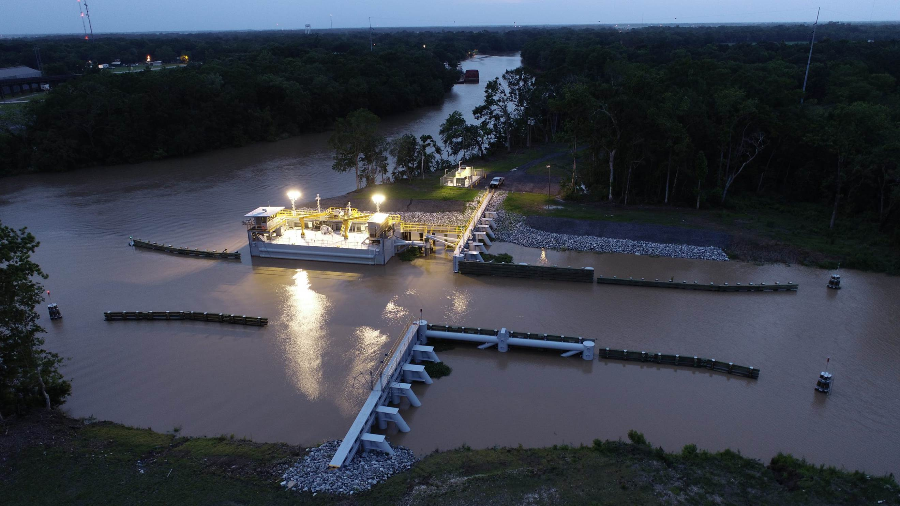
Statewide Flood Control Program
Bayou Têche Flood Protection
St. Mary Parish
$9.75M SWFC Share
Completed Summer 2021
Notes:
Floodgate at the confluence of Bayou Teche and the Charenton Canal in southern St. Mary Parish.
NEXT SLIDE – Flood Control continued
NEXT SLIDE – Flood Control contined

Slide 17
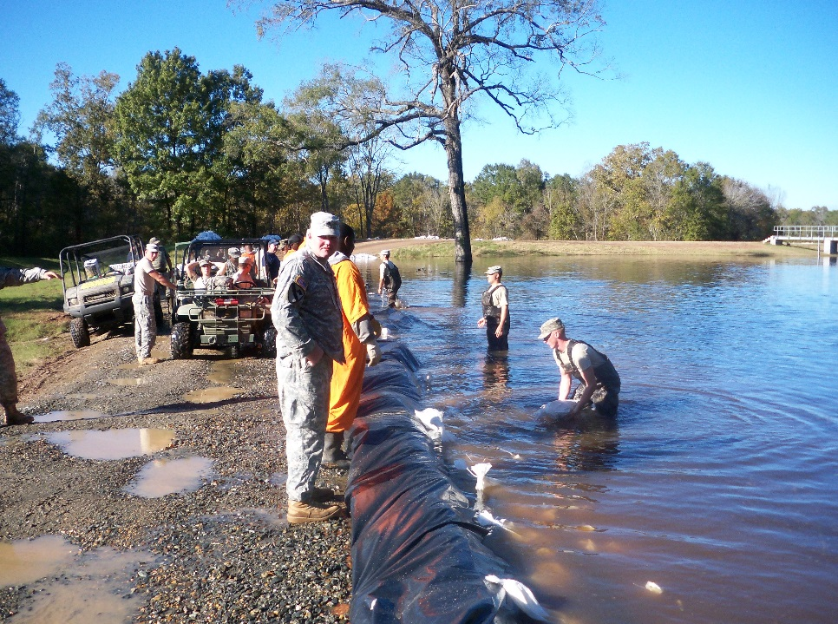
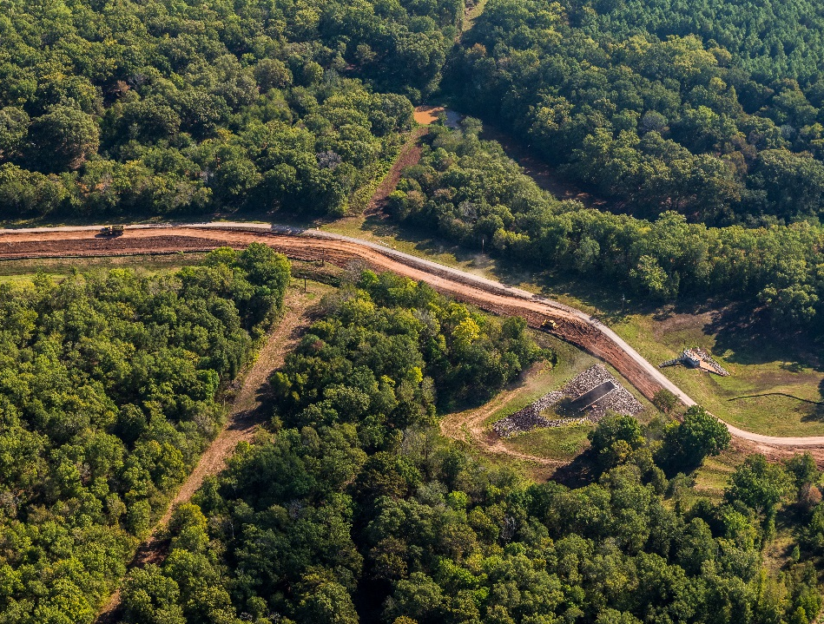
Statewide Flood Control Program
Raising of the Red Chute Levee
Bossier Parish
Phase I – Widening
$4.6M SWFC Participation
Completed Fall 2021
2009 Flood Event
2021 – 9.5 Miles Widened
Notes:
Red Chute Levee –Widened to facilitate flood-fighting Phase 2 will be raising but waiting on 401 permit
NEXT SLIDE – Flood Control continued

Slide 18
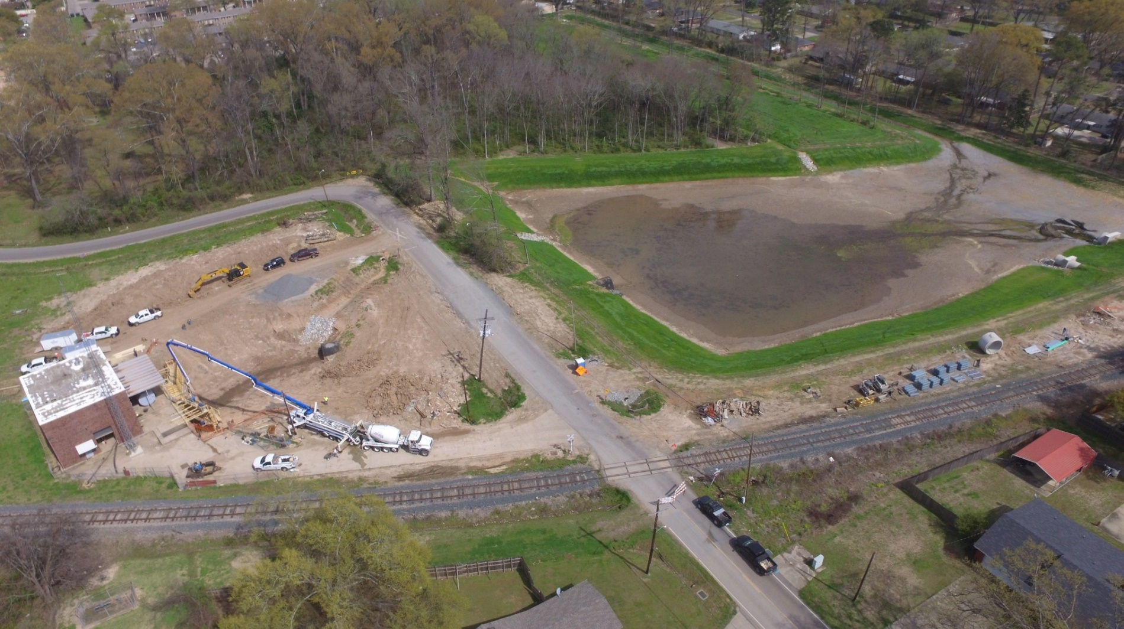
Statewide Flood Control Program
Rochelle Street Pump Station
City of Monroe
$1.45M SWFC Share
Completed June 2019
Photo courtesy of Denmon Engineering
Notes:
Construction of an enlarged sump area and improvements to subsurface drainage to improve conveyance and reduce pump cycling.
NEXT SLIDE – Flood Control continued
NEXT SLIDE – Flood Control continued

Slide 19
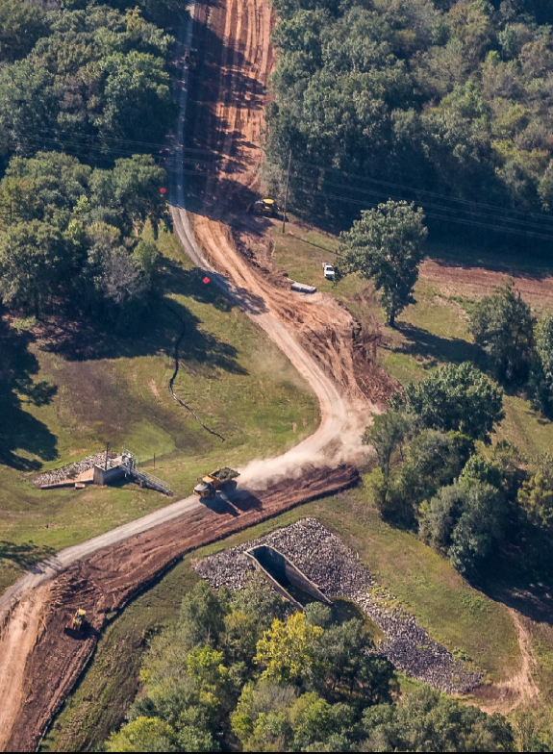
Statewide Flood Control Program
2022 - 2023 Application Cycle
Red Chute Levee
Bossier Parish
17 pre-applications received ($47.2M)
  9 determined eligible
6 full applications received ($25.1M)
  2 City-Parish/Consolidated Parish
  1 City
  2 Parishes
  1 Levee District
4 Projects Recommended
Notes:
2022-2023 cycle: 4 of 6 project applications approved ($17.8M)
NEXT SLIDE – Flood Control continued
NEXT SLIDE – Red Chute Levee Phase I – Widening

Slide 20
Statewide Flood Control Program
Accomplishments
Approved projects in 43 of 64 parishes
129 projects completed
$305.5M Expended
$2.876B in Flood Reduction Benefits
10.76 Benefits/Cost Ratio
Notes:
Still only have done project s in 43 parishes. Three more projects completed last year and the BC went up almost 4 tenths
(St. Landry, Red River Parishes, Desoto, Tensas, St. Martin, Pointe Coupee, Union, West Baton Rouge)
Next Slide – Roadway Flooding Program
NEXT SLIDE – Flood Control contined

Slide 21
The
Roadway Flooding Program
DOTD
is the
State Coordinating Agency
for the Roadway Flooding Program
(in association with FHWA)
Notes:
The Department of Transportation and Development is the State Coordinating Agency for the Roadway Flooding Program.
Roadway Flooding Program

Slide 22
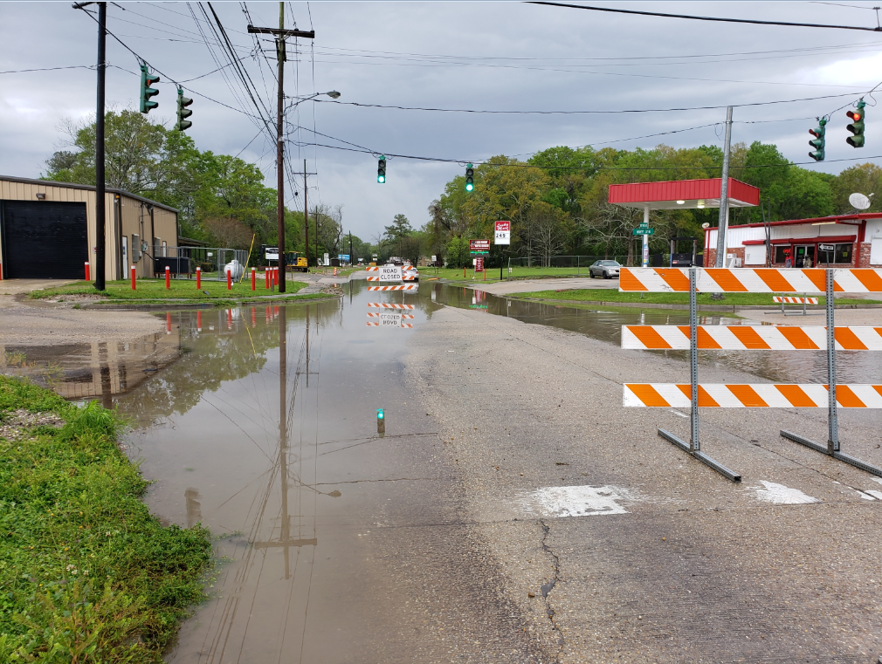
Roadway Flooding Program
Project Types Qualifying
  Replacement of undersized cross drains
  Replacement of undersized storm drains
  Elevating roadways (primarily overlays)
Project Types Not Qualifying
(No Maintenance Projects)
  Cleaning out silted pipes
  Videoing inside of pipes to report damage
  Replacement of damaged structures
Funding
  Approximately $4M Annual Budget
  80% FHWA & 20% DOTD Terrebonne Parish Project LA 24
Notes:
Things to look out for: ROW, Utilities, RR permitting, Environmental
NEXT SLIDE – Roadway Flooding Program

Slide 23
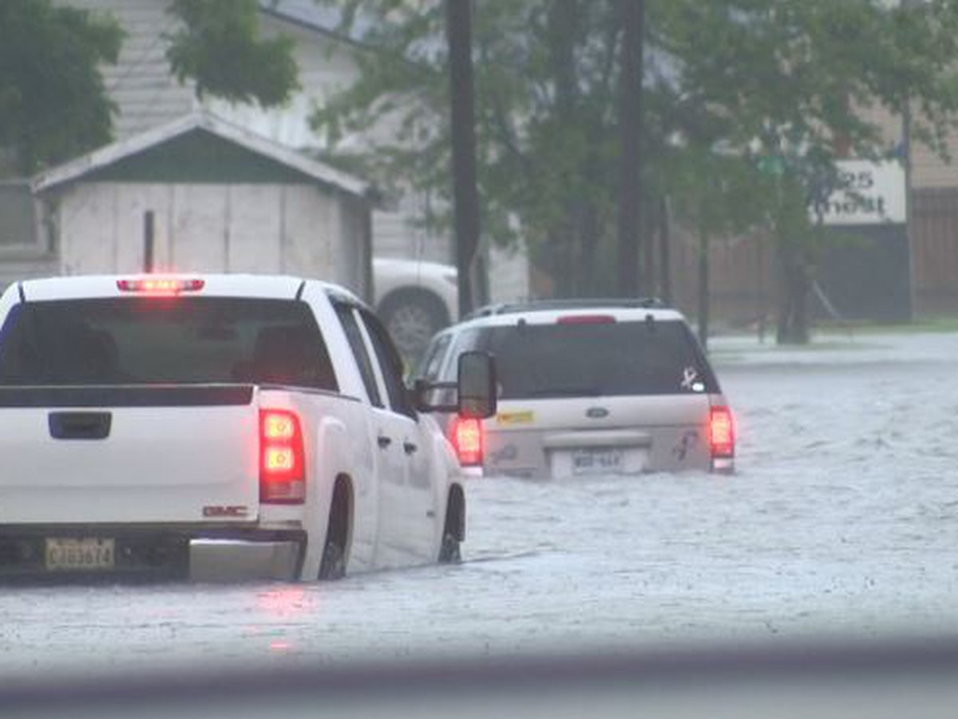
Roadway Flooding Program
Project Selection Criteria
  Projects are evaluated based on:
  State Highway
  frequency of flooding
  depth of flooding
  duration of flooding
  detour length
  Average Daily Traffic
  property damage
  damage to roadway
  disruption in emergency services
Project Selection Process
  DOTD Districts submits all potential projects & performs design work
  Roadway Flooding Committee selects projects based on the selection criteria and a cost-benefit analysis (meets yearly August/September)
Notes:
NEXT SLIDE – Roadway Project

Slide 24
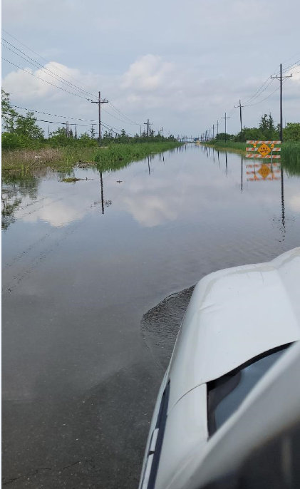
Roadway Flooding Program
LA 70 (Assumption Parish)
  Floods avg. 5 times/year
  Project Length - 0.44 miles
  Overlay up to 16”
  $800,000
  Project scheduled to finish in May 2024
Notes:
Advertised and let in September of 2022

Slide 25
Roadway Flooding Program
Past Projects
  149 projects completed
  $97 million spent
  Projects in 45 out of 64 parishes
Future Projects
30 projects currently in program
$19 million to be spent
Projects in 25 out of 64 parishes
Notes:
4 projects completed from last year 19 mil is small decrease from last year but we moved up to 25 of 64 parishes
Next slide – NFIP

Slide 26
The
National Flood
Insurance Program
DOTD
is the
State Coordinating Agency
for the National Flood Insurance Program
Notes:
The Department of Transportation and Development is the State Coordinating Agency for the National Flood Insurance Program (NFIP).
Next Slide – Floodplain Mgt

Slide 27
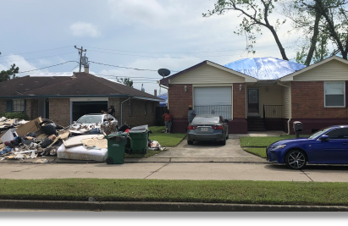
Floodplain Management
Community Assistance Visits:
    Assess floodplain activities of 318 NFIP communities
    Inspect SFHA (over 50% of state) (#1)
    Review permits & elevation certificates
    Meet with community officials to determine assistance they need
Disasters:
    Respond to Presidentially declared disasters
    Assist FEMA helping communities comply with post disaster regulations
Notes:
Next Slide – Floodplain Mgt

Slide 28
Floodplain Management
Training & Workshops:
    Assists multiple agencies with various workshops and classes
Outreach:
    Publish a quarterly newsletter – the Floodplain Management Factsheet distributed to all 318 NFIP communities, lending institutions, insurance agents, realtors, engineers, etc.
Notes:
Next Slide – CRS

Slide 29
Community Rating System (CRS)
Voluntary program that credits community efforts to go above minimum requirements by reducing flood insurance premiums from 5% to 45%
41 communities currently receive a discount
Notes:
Community Rating System Class Ratings are similar to Fire Ratings for your Homeowners’ Policy. Each lower class receives a 5% decrease in flood insurance premiums.
Louisiana achieved its first Class 5 rating in May of 2019. Jefferson Parish flood insurance policyholders now receive a 25% discount.
Next Slide – CRS

Slide 30
Community Rating System
78% of Louisiana Flood Insurance Policies are in CRS Communities (LA ranked in Top 5)
+386,000 Flood Insurance Policies in Force
+$27,000,000 savings annually
Notes:
Louisiana is ranked in the Top 5 nationwide with 78% of the state’s flood insurance polices located in CRS communities.
Participation in the Community Rating System saves Louisiana flood insurance policyholders more than $27 million annually.
Next Slide – CTP

Slide 31
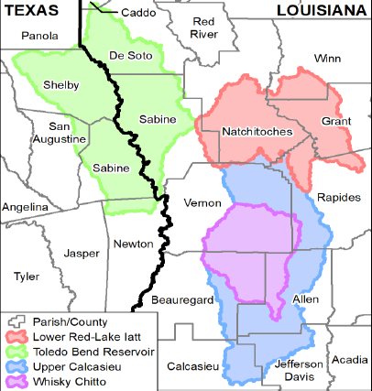
Cooperating Technical Partners (CTP)
Working with FEMA to release updated flood risk information to communities
CTP overall objective: Update the nation’s flood maps
Currently under contract with two consulting firms to assist with CTP/NFIP task orders
Total CTP/NFIP contract amount: $10M for 5 years
Discoveries in 7 watersheds
Notes:
Okay, next slide is……wait a minute let me see if I can borrow one of the Col’s IBA
Next Slide – Risk Rating 2.0

Slide 32
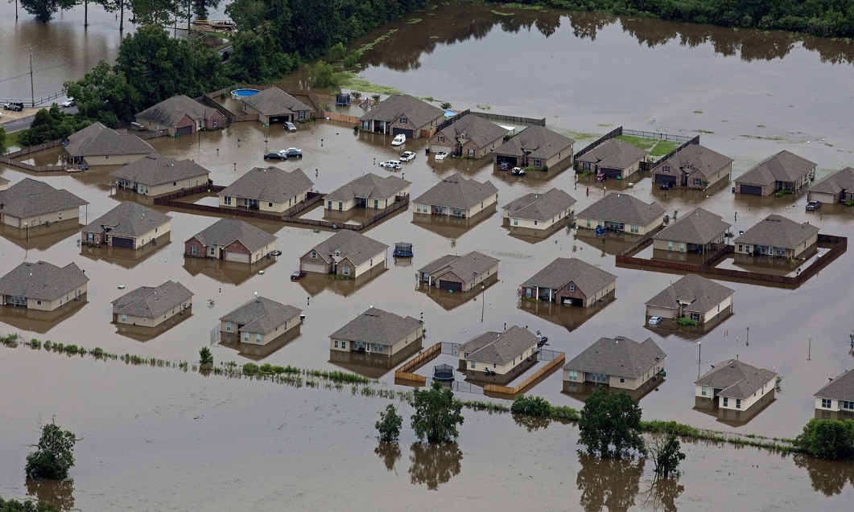
Risk Rating 2.0
New policies – 10/21
Renewals – 4/22
Phased In increases for majority of policies
20% policyholders will see a decrease
NOTE: For more information on Risk Rating 2.0, visit the Floodplain Management booth at the conference and speak to a FEMA Insurance Specialist
Notes:
DOTD does not administer the RR 2.0 but many of the elements we discussed inform 2.0
Next Slide –Levees

Slide 33
The
Levee Safety Program
DOTD
is the
State Coordinating Agency
for the Non-Coastal Levees
Notes:
The Department of Transportation and Development is the State Coordinating Agency for the National Flood Insurance Program (NFIP).
Next Slide – Non Coastal Levees

Slide 34
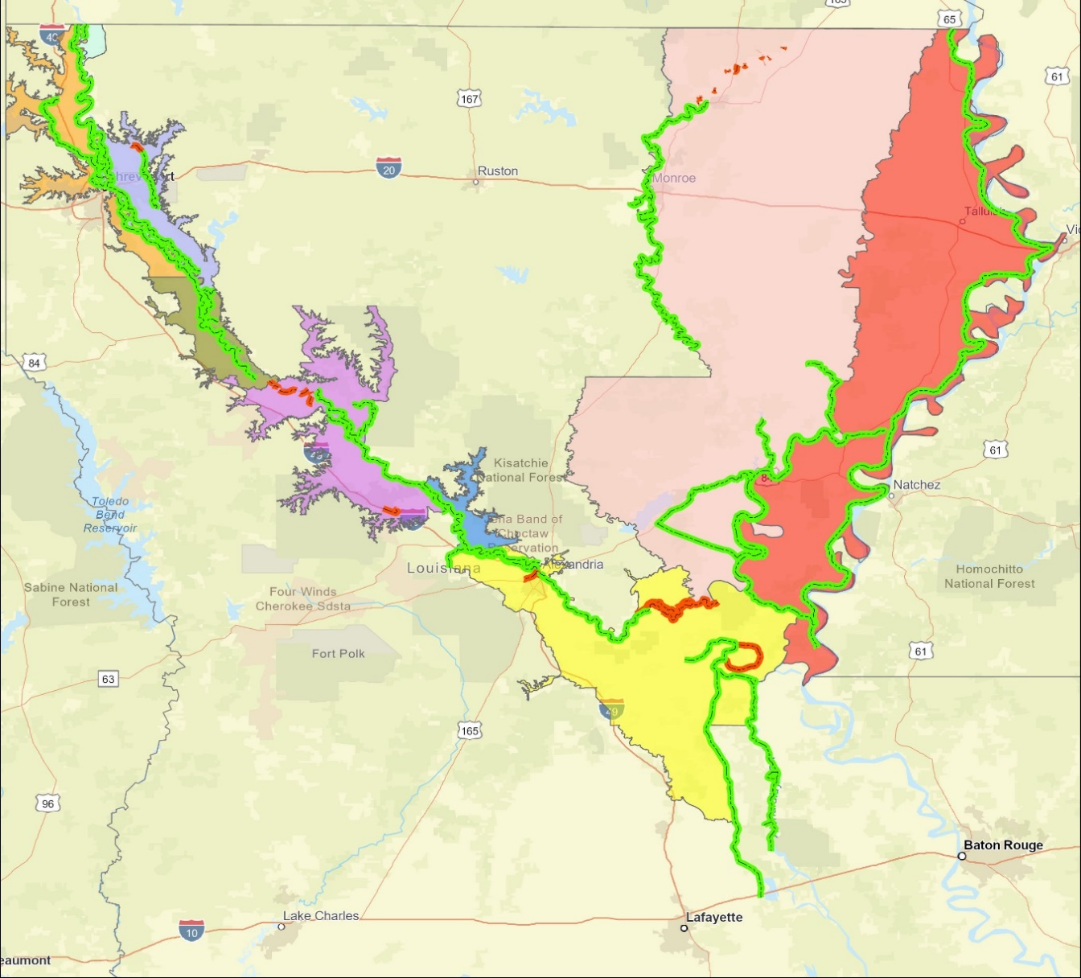
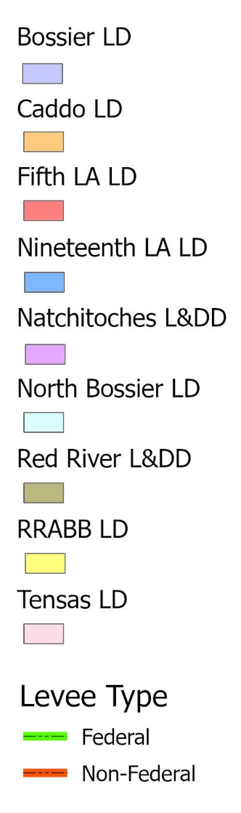
Levee Safety Program
Non-Coastal Levee Districts (9)
Federal 65.1
Non- Federal 4.3
Federal 116.7
Federal 306.3
Federal 26.2
Federal 69.3
Non- Federal 17.5
Federal 3.4
Federal 51.7
Federal 196.7
Non- Federal 55.2
Federal 249.9
Non- Federal 4.7
1,085 miles of levees inspected semi-annually
Notes:
Here are the nine Non-Coastal levee districts that are inspected showing their respective Federal and Non- Federal inspection miles. The levee safety program inspects about 1,000 miles of levees each quarter.
Next Slide – Levee Safety Services
NEXT SLIDE – Levee Safety Program Continued - Inspections

Slide 35
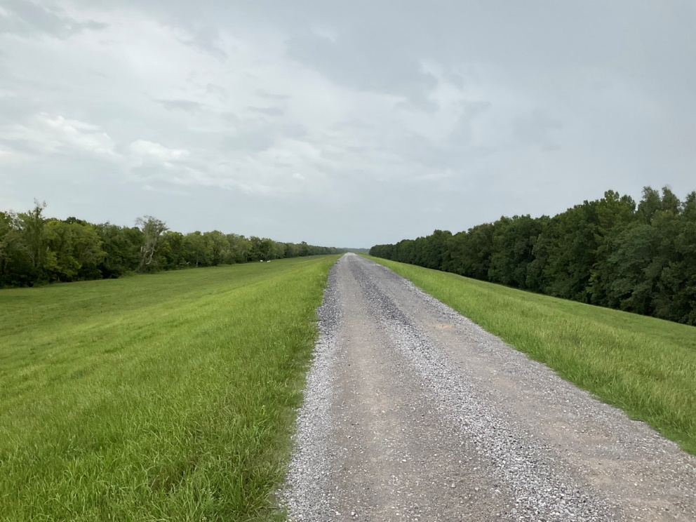
Levee Safety Program
Inspections
  Assist Levee Districts with their Inspections
  Provide Semi-Annual Inspection Reports
  Provide Recommendations/Options for Corrective Actions
  Flood inspections / Monitoring
Inventory/Mapping
  Inventory Levee Assets
  Develop GIS Maps
Training Compliance
  Online training for levee inspectors
Typical Crown with Vegetative Cover
Notes:
-Talk about the GIS platform – inventory, condition asses, closure plans, Emergency actions all at your finger tips
-Working through the technical issues of levee staff access
Next Slide – LS Capital Outlay
NEXT SLIDE – Dam Safety

Slide 36
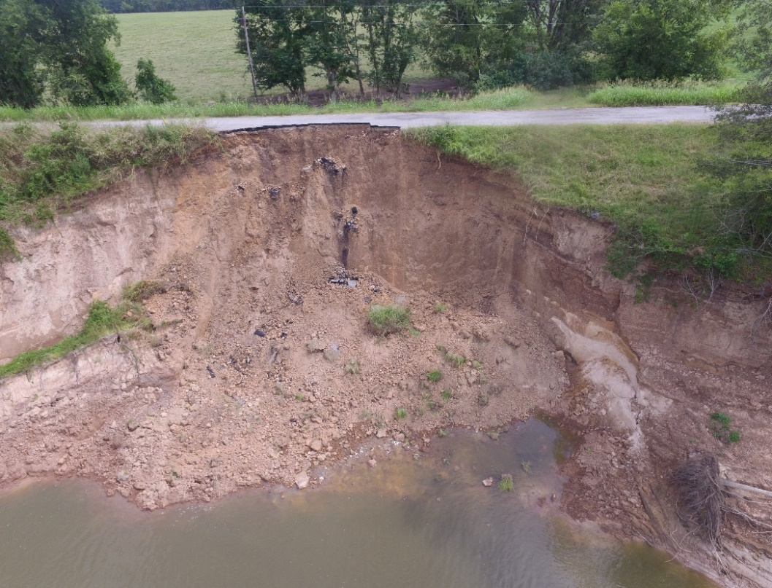
Levee Safety Program
Other Services: Capital Outlay Requests
Tensas Basin Levee District:
  $24 million approved in fall of 2020
  TBLD is currently utilizing $5.43M on existing projects
  $5 million requested for FY23-24
Natchitoches Levee & Drainage District:
  Currently under construction:
    $700K levee crown restoration
    $200k drainage structure protection
  Preliminary design for FY 23-24 setbacks for two levees
Bank Caving
Notes:
The Levee Safety Program also provides project management for Capital Outlay Requests to finance levee projects.
We are developing another set of projects for FY 24-25
Next Slide – Dam Safety Program

Slide 37
The
Dam Safety Program
DOTD
is the
Statewide Coordinating Agency
RS 38: 21-28
Notes:
The Department of Transportation and Development is the State Coordinating Agency for the National Flood Insurance Program (NFIP).
Next Slide – Dam Safety numbers

Slide 38
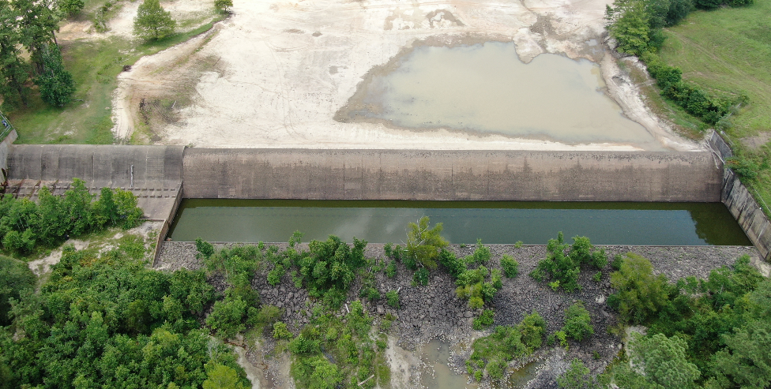
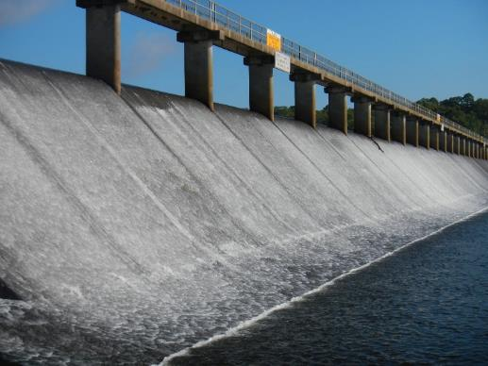
Dam Safety Program
659 Regulated Dams
(As of April 4, 2023)
41 High Hazard
68 Significant Hazard
550 Low Hazard
16 Under Investigation
Ogee weir spillway during lake draw down
Lower Anacoco Dam, Vernon Parish
Spillway at Bayou D’Arbonne,
Union Parish
Notes:
State Dam Safety Program – number of dams has decreased in the last year or so by about 30
NEXT SLIDE – Dam Inspections

Slide 39
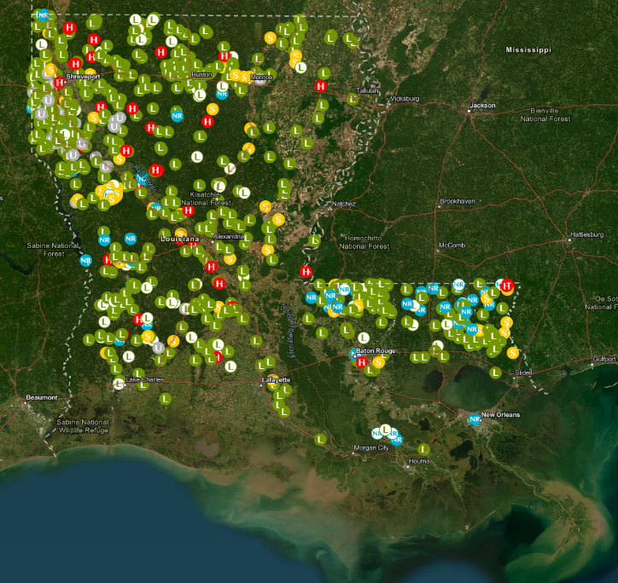
Dam Safety Program
Inspections
Dam Inspection Frequency Based on Downstream Hazard Potential:
  High Hazard – Annually
  Significant Hazard – 3 years
  Low Hazard – 5 years
Dams in Louisiana
Notes:
Map showing distribution of dams in the Dam Safety Program
NEXT SLIDE –State Maintained Dams

Slide 40
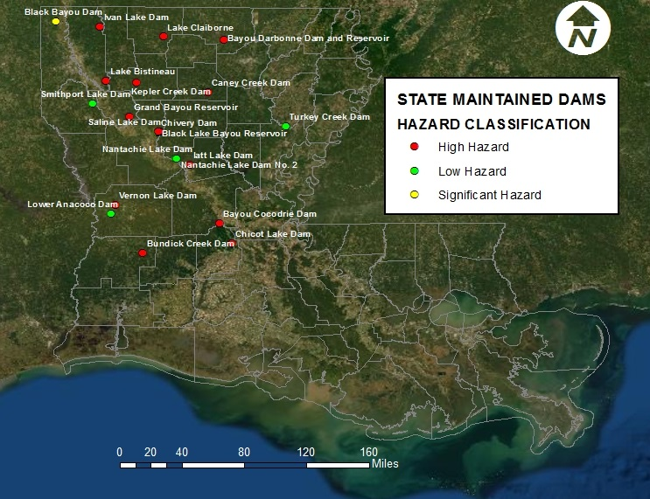
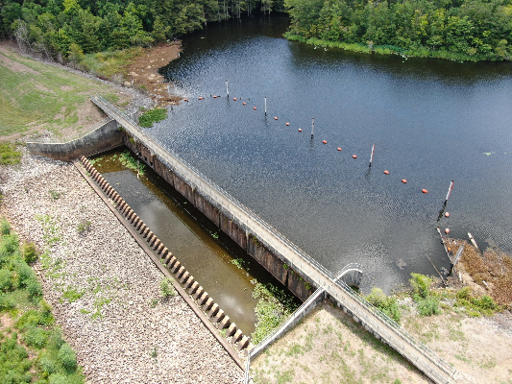
Dam Safety Program
DOTD Maintained Dams
LA RS 38:26
21 DOTD Maintained Dams
  13 High Hazard
  2 Significant Hazard
  6 Low Hazard
(All DOTD Maintained dams are inspected annually)
Spillway at Chicot Lake Dam, Evangeline Parish
Notes:
Location of 21 Dams that DOTD operates and maintains per statute LA RS 38:26
NEXT SLIDE – Dams – Capital Outlay Projects

Slide 41
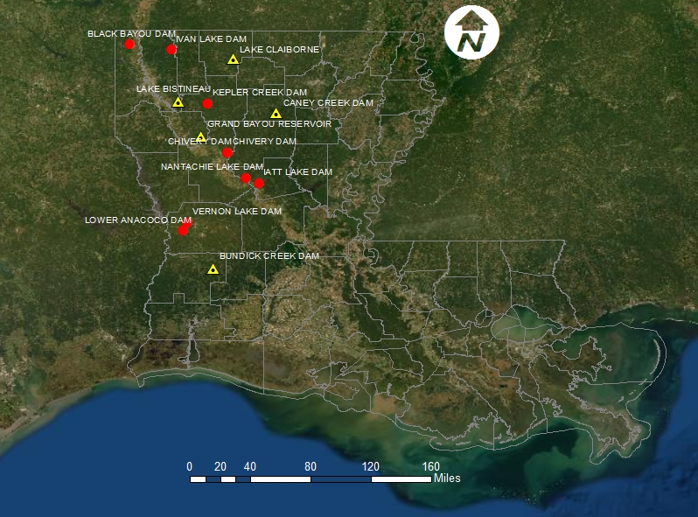
Dam Safety Program
State Maintained Dams – Capital Outlay Projects (14)
Safety Measures Only (9 Projects)
Gate Rehab/Maintenance & Safety Measures (5 Projects)
Total Projects = $2.5 Million
Notes:
Total Capital Outlay $2.5 Million
Safety Measures – warning signs, boater barriers, fences
(Bundick Lake Gate Replacement) $890,812; on hold -Drawdown begins again in May-lake levels are a challenge
Three Safety Measures projects (Anacoco Lake Dam, Vernon Lake Dam & Lake Bistineau Lake Dam) are being designed
NEXT SLIDE – Other Services

Slide 42
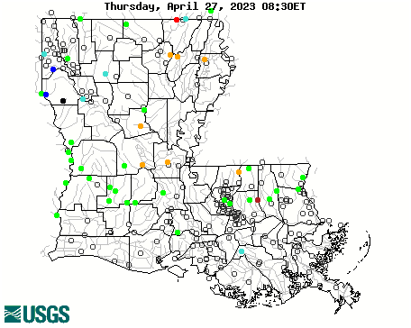
Other Services in
Public Works and Water Resources
USACE Non–Federal Sponsor
Red River Compact
USGS/DOTD Cooperative Programs
Support DNR - Water Well Inspection
Notes:
NEXT SLIDE – Questions

Slide 43
Questions ?

