Slide 1
Louisiana Levee Safety Program-Overview
Public Works and Water Resources
Curt J. Boniol, P.E.
Levee Safety Engineer / Program Manager

Slide 2
Levee Safety Program Topics
Regulations (Federal and State)
Purposes of DOTD Levee Safety
DOTD Inspection Jurisdiction
ESRI Software –Levee Data Viewer\Dashboard\Field Maps
Levee Inspections – Report Types\Maps
Common Levee Deficiencies
Records Management- FileNet

Slide 3
What Regulations govern DOTD Levee Safety?
Federal Regulations
33 CFR 208.10
Inspections conducted prior to beginning of flood season
Inspections conducted after high water period (otherwise at intervals not to exceed 90 days)
Times as may be necessary to insure the best possible care of the levee
State Regulations
RS 38.2
A. The functions of the Department of Public Works shall comprise all of the administrative functions of the state in relation to the planning, design, survey and construction, operation, and maintenance and repair of public buildings used in connection with the operation of the department, and of levees, canals, dams, locks, spillways, reservoirs, drainage systems, etc… The Department of Transportation and Development can collect fees or be reimbursed for engineering or other services that it provides to the levee boards and drainage districts.
Notes:
This is the Federal Regulation that governs our program - 33 CFR 208.10 Inspect levees prior to beginning of flood season, after a high water event and at intervals not exceeding 90 days.
State Regulation that governs our program - RS 38.2 Services that The Department of Public Works provides - DOTD can collect fees or be reimbursed for engineering services that it provides to the levee districts.

Slide 4
Purposes of DOTD Levee Safety Program
Inspections
Assist levee districts with their inspections
Provide inspection reports
Provide recommendations\options for corrective actions
Inventory \ Mapping
Create maps for inspection reports
Inventory Levee Assets
GIS Mapping
Assist with project management and using various funding for levee improvement projects
Capital Outlay funding requests and project management
Training
Assist in providing Levee Inspection Certification on-line training in conjunction with CPRA website for inspectors
Notes:
This is what services we provide to our levee districts. Inspections, inventory \mapping, Project Management (Various funding sources), On-Line levee certification training.

Slide 5
Purposes of DOTD Levee Safety Program
Permits
Levee Board permitting and tracking permits in DOTD Levee Permit Database and oversight of Letters of No Objection at the district level
Flood fight coordination\monitoring
Notes:
Topics for discussion are:
Levee Permits (LONO’s) and Flood Fight Coordination

Slide 6
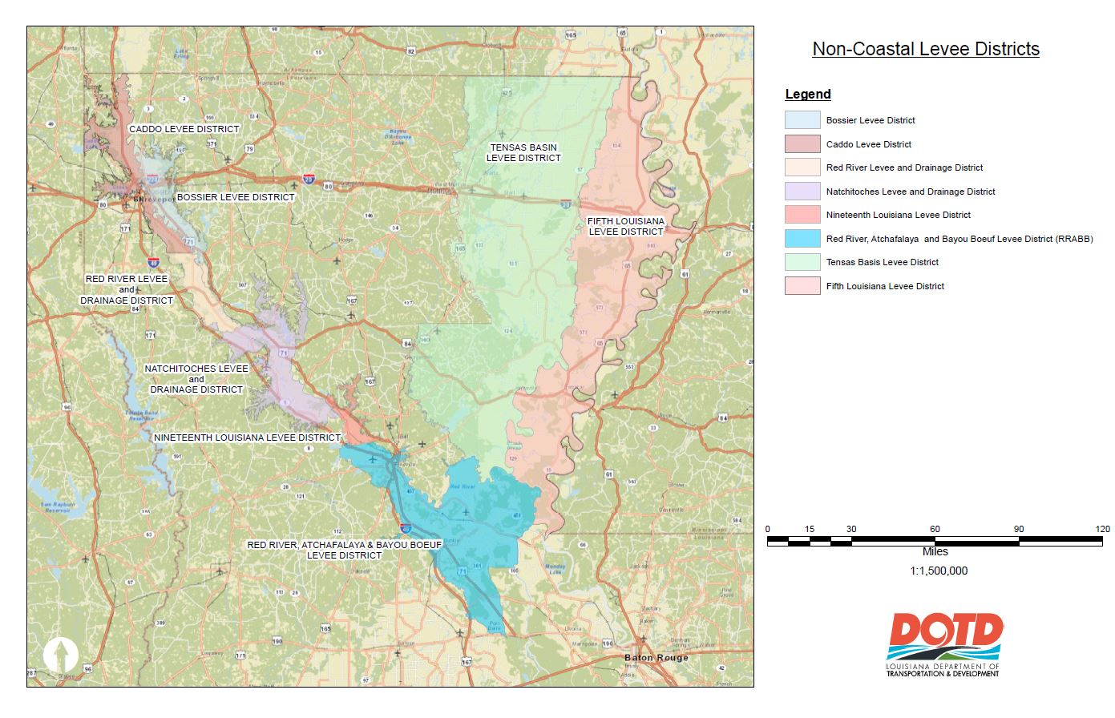
Levee Districts DOTD Works With
Notes:
DOTD Works with 8 Non-Coastal Levee Districts.

Slide 7
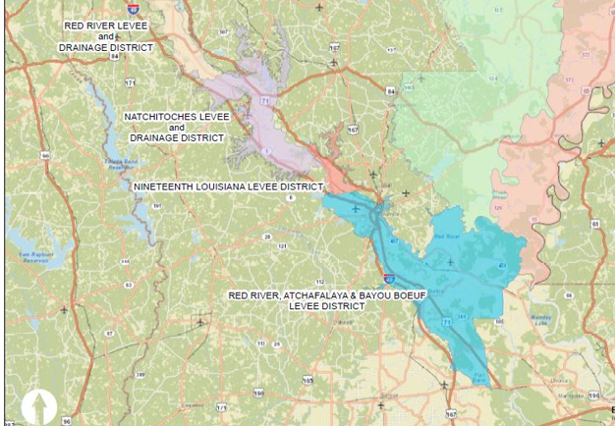
Levees inspected in District 08
Natchitoches Levee and Drainage District
19th Louisiana Levee District
Red River Atchafalaya and Bayou Boeuf Levee District
Notes:
These are the 3 levee districts within the District 08 region.

Slide 8
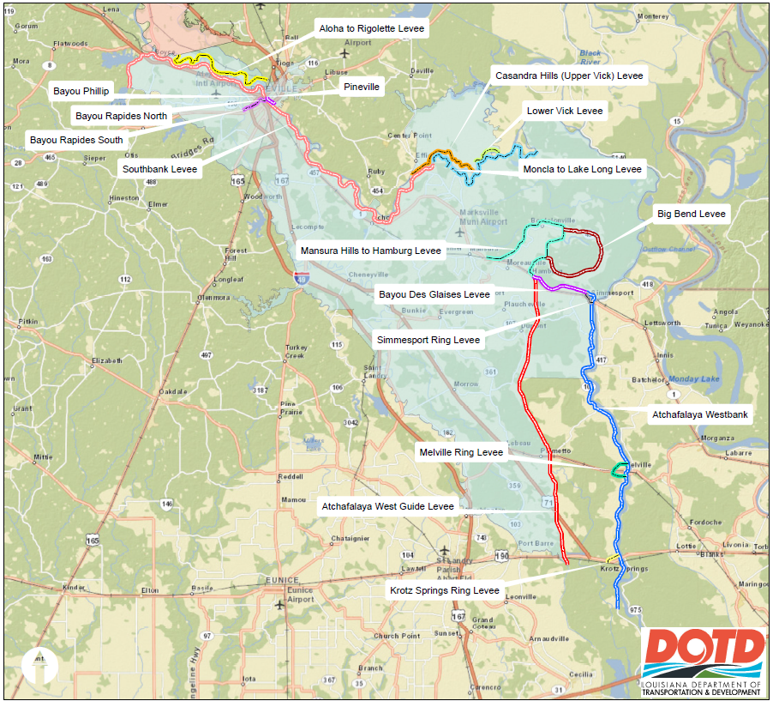
RRABB Levee District
Notes:
RRABB levee district segments

Slide 9
Introduction to ESRI Resources
Online resources available
ESRI Field Maps App (conducting inspections)
Levee Data Viewer (DOTD only)
Levee Dashboard (read only - available to certain DOTD district personnel – retrieve documentation)
Notes:
This is the ESRI resources that the Levee Safety Program uses for keeping / tracking inspection data. I will give you a preview later on the Data Viewer and Dashboard filters for Levee Districts, Inspection segments, Rated Items and the Status.

Slide 10
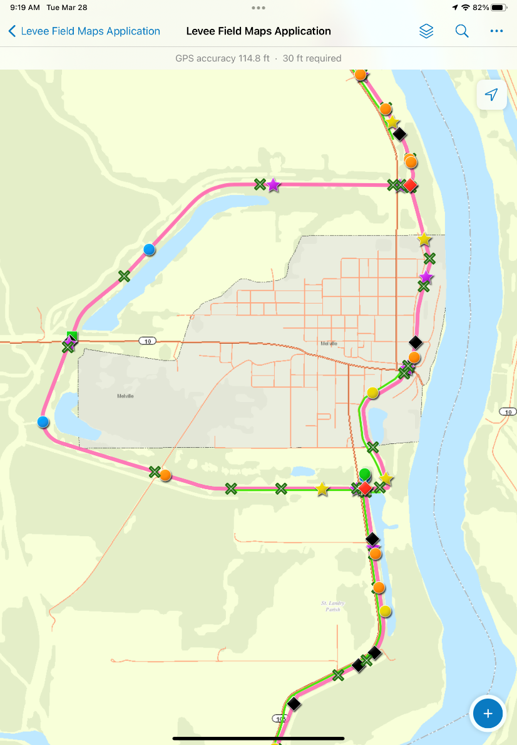
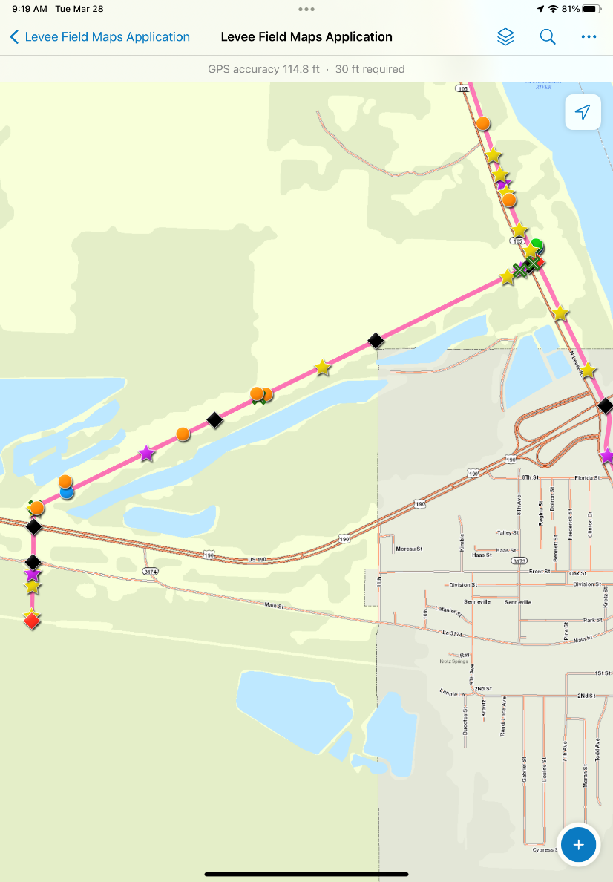
ESRI Field Maps for Inspections
Melville Levee
Krotz Springs Levee
Notes:
The levee safety program uses Field Maps for performing our levee inspections. The Field Maps software was developed by ESRI specifically for the DOTD Levee Safety program.

Slide 11
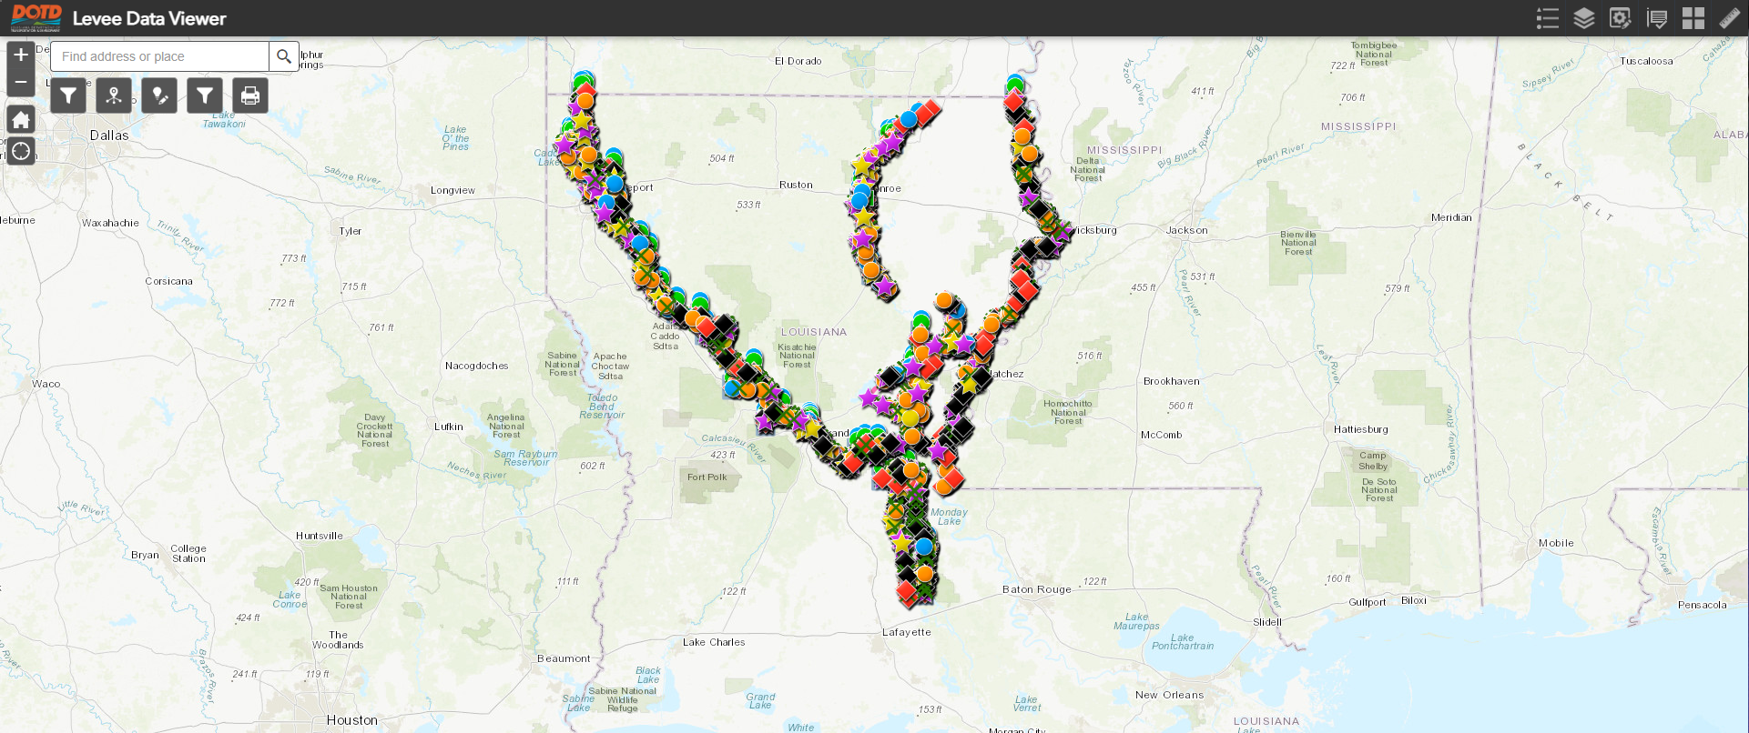
Levee Data Viewer
Notes:
Levee Data Viewer Screenshot of the Non- Coastal levees we inspect.

Slide 12
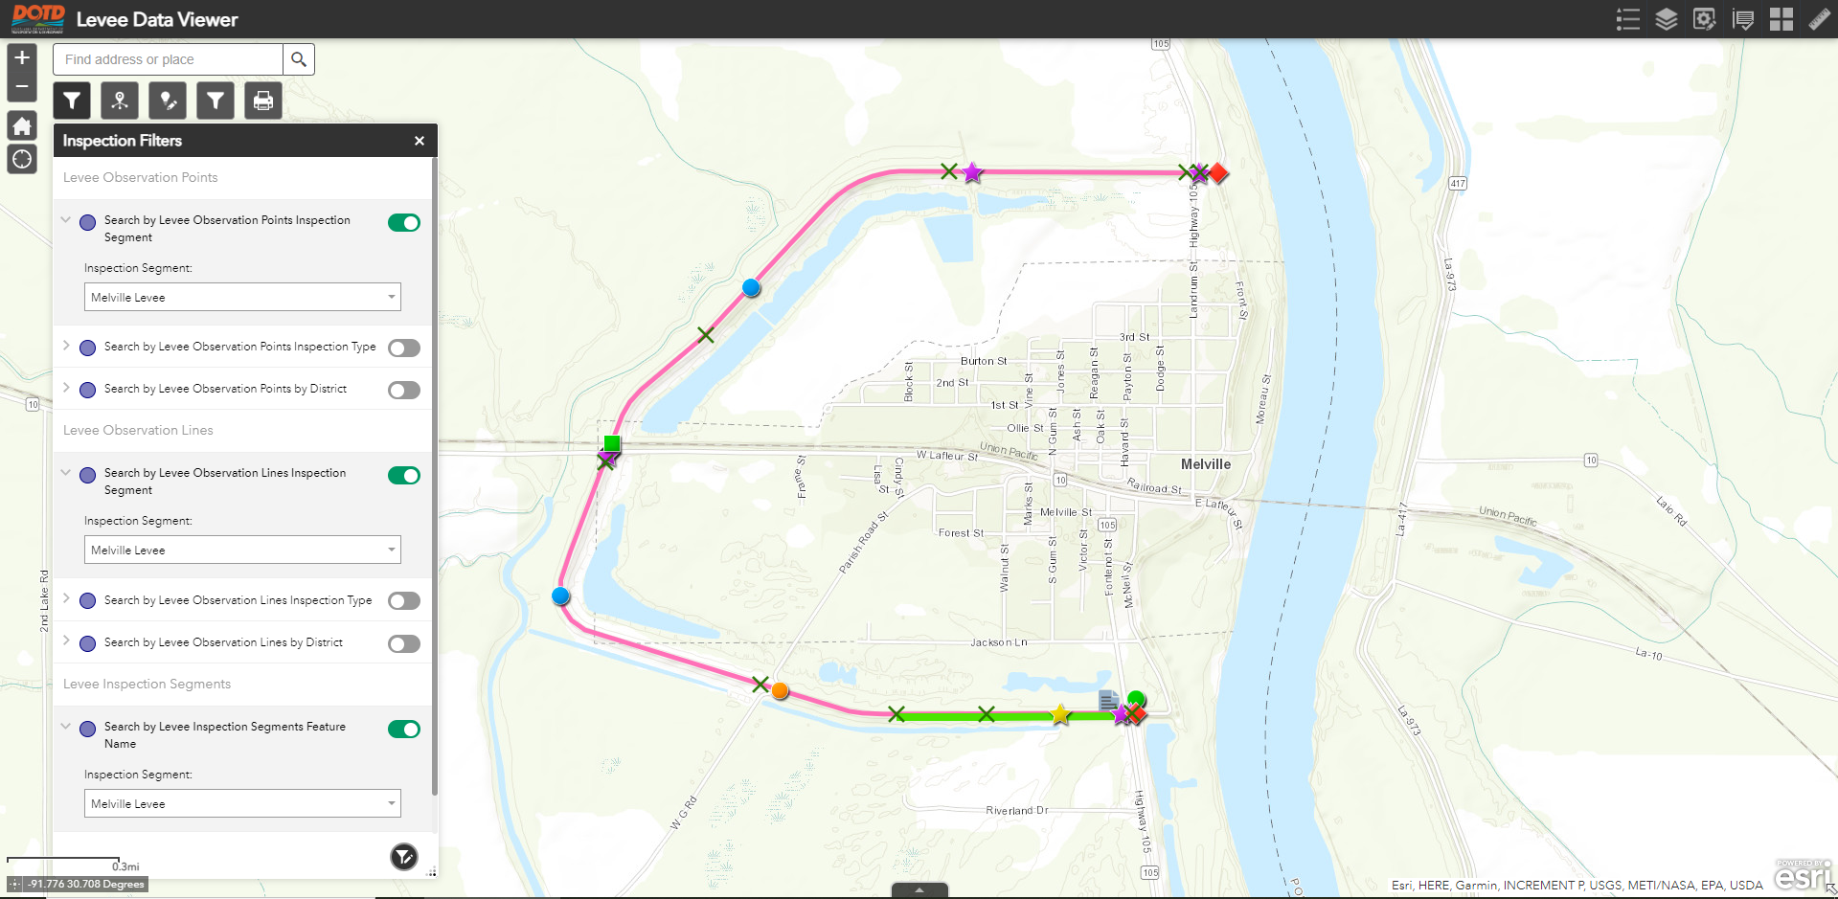
Levee Data Viewer
Notes:
Levee Data Viewer inspection filters applied for the Melville Ring Levee.

Slide 13
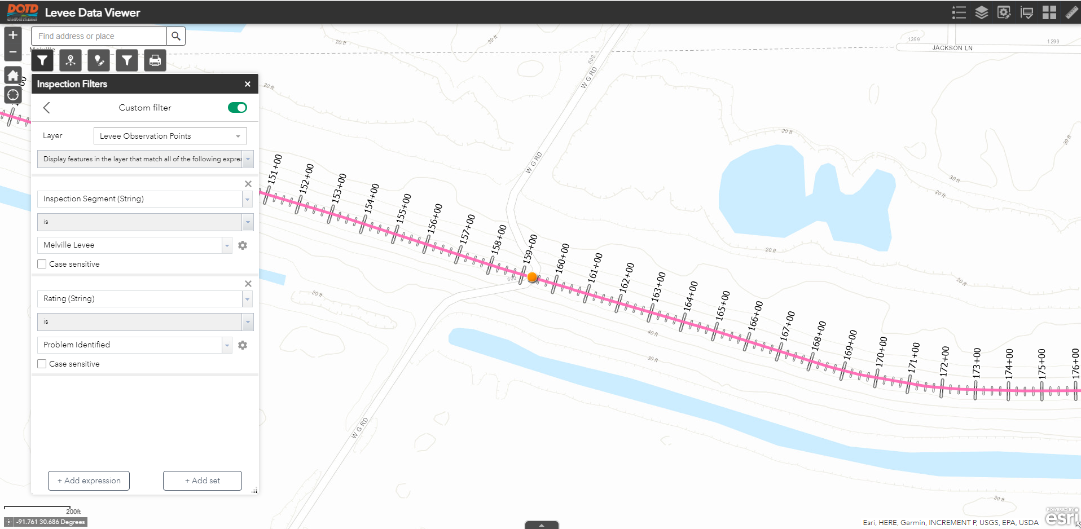
Levee Data Viewer
Notes:
Custom filters for Melville Ring Levee being applied for Problem Identified.

Slide 14
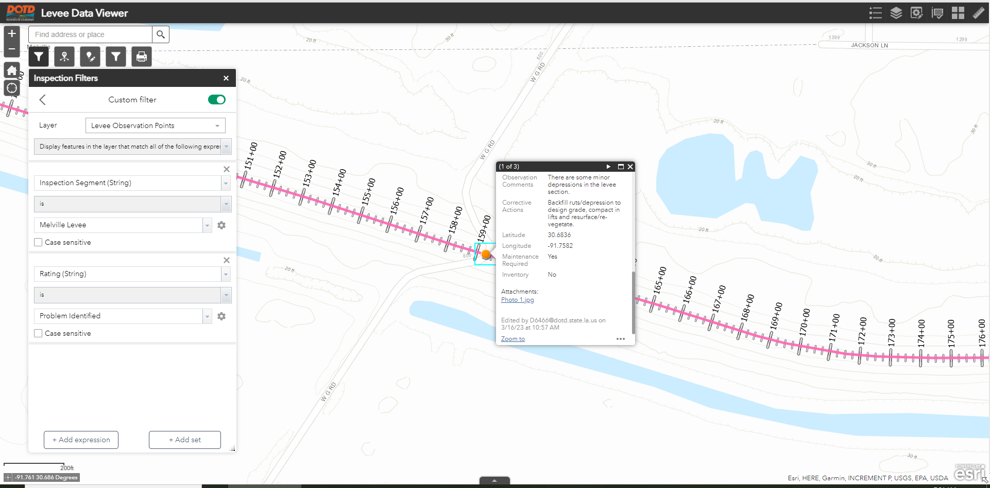
Levee Data Viewer
Notes:
Using custom filters for Melville Ring Levee for Problem Identified with form.

Slide 15
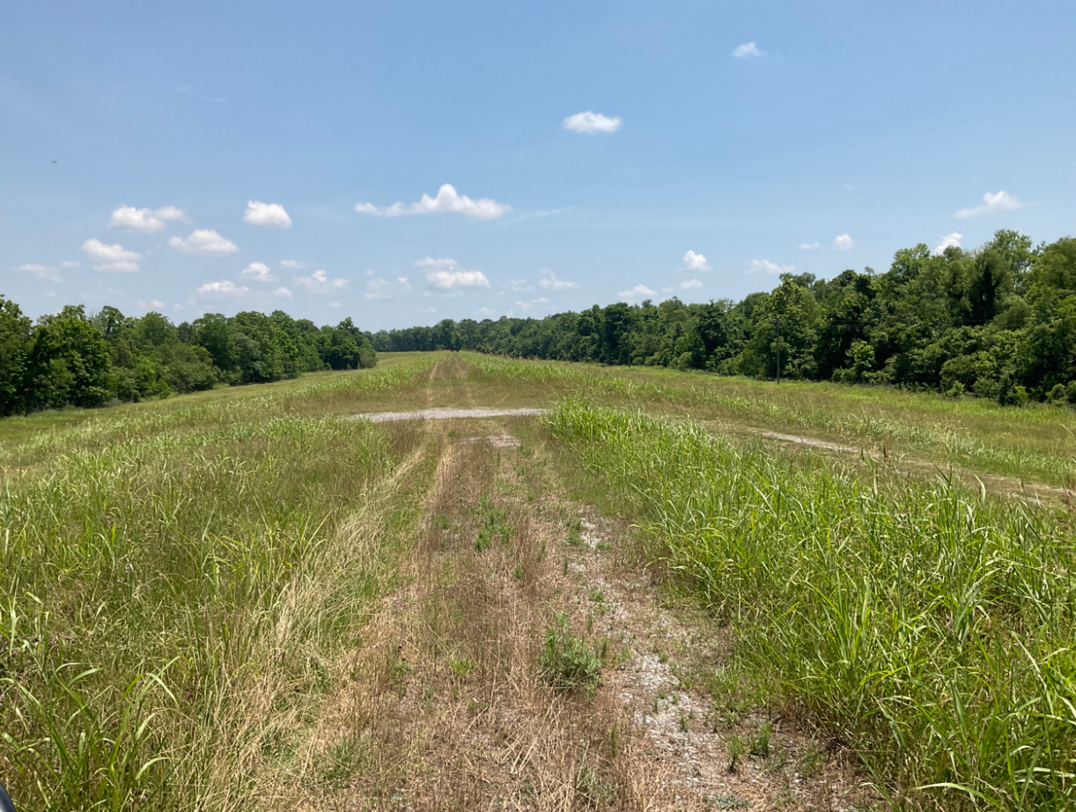
Levee Data Viewer
Notes:
Problem Identified on Melville Ring Levee for a degraded ramp.

Slide 16
Levee Data Viewer
Cataloging Levee Deficiencies
Deficiency Type (Rated Items)
Latitude / Longitude
Pictures (Problem deficiencies and resolved items)
Tracking Repairs (Resolved Items)
Tracking Improvements
Generating Reports
Notes:
This is what the software is capable of doing for the Levee Safety Program and has read /write access capabilities to the Data Viewer.

Slide 17
Levee Data Viewer
Functions
View data
Current
Archived (aka Snapshot)
Add new data
Edit the current data
Export map
Notes:
This is what the software is capable of doing for the Levee Safety Program and has read /write access capabilities to the Data Viewer.

Slide 18
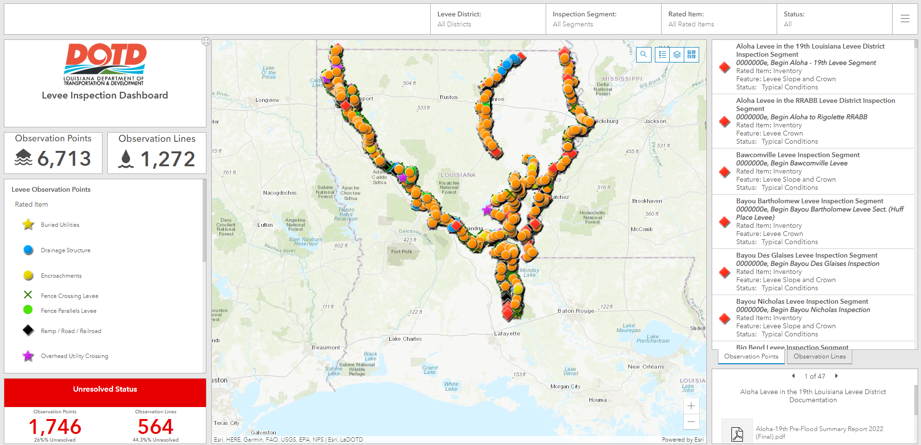
Levee Inspection Dashboard
Notes:
The screen will be set to the default view to show you all the points and lines without any filters applied. This is read only with pulldown menus. Documentation is also available to preview on bottom right of the screen.

Slide 19
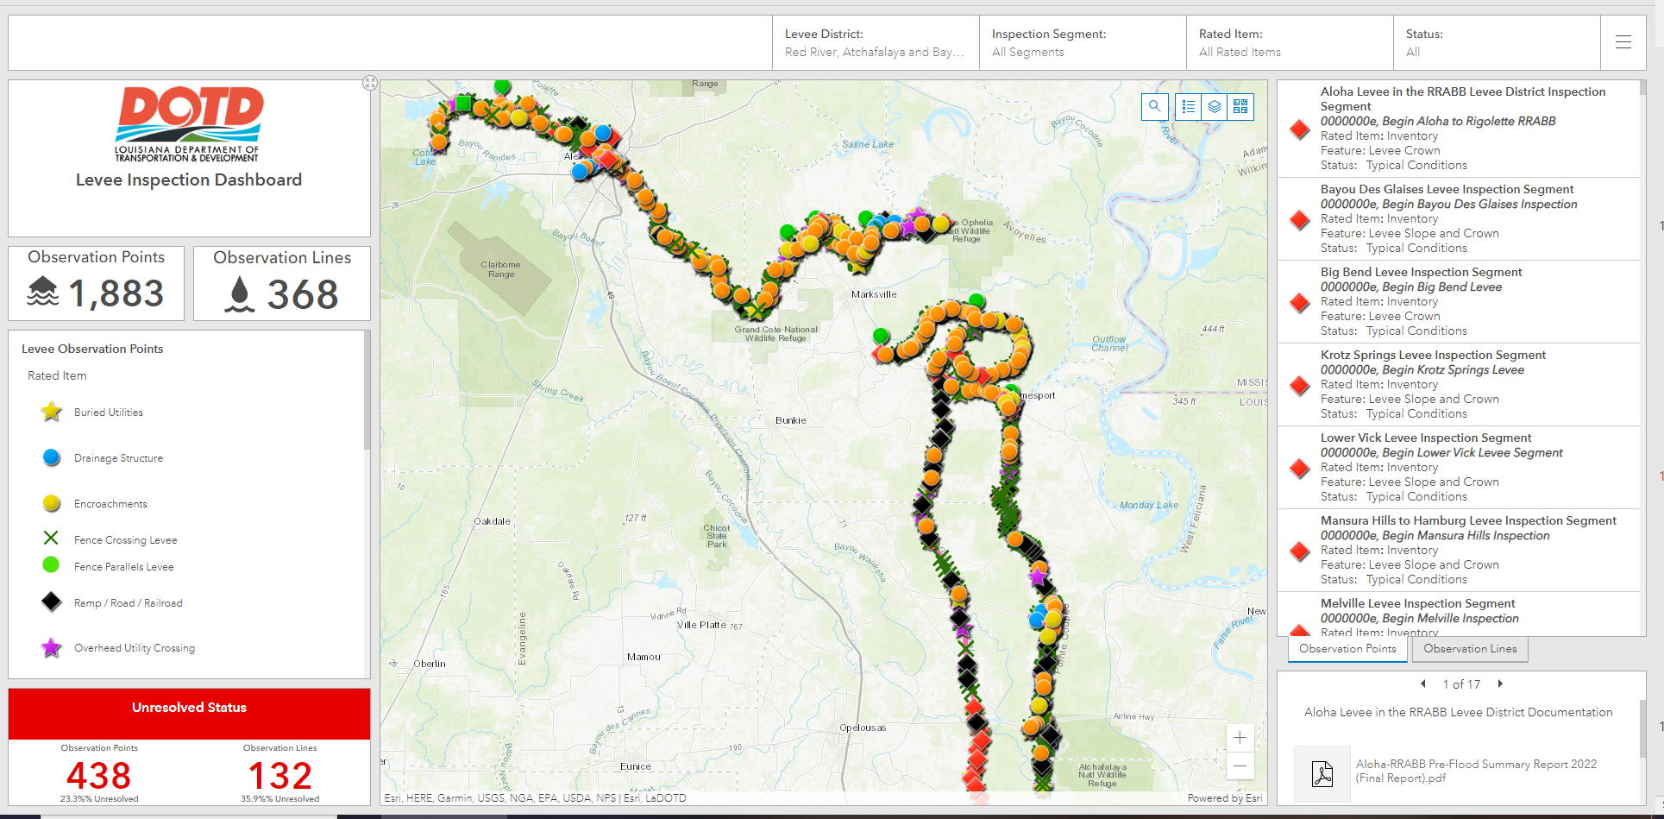
RRABB Levee Inspection Dashboard
Notes:
The screen will show the RRABB Levee District since this filter is applied. Documentation is also available to preview on bottom right of the screen.

Slide 20
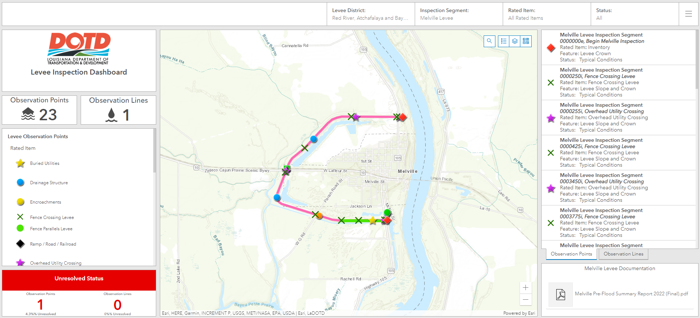
RRABB Levee Inspection Dashboard
Notes:
The screen will show the RRABB levee district with the Melville inspection segment filter applied. Documentation is also available to preview on bottom right of the screen.

Slide 21
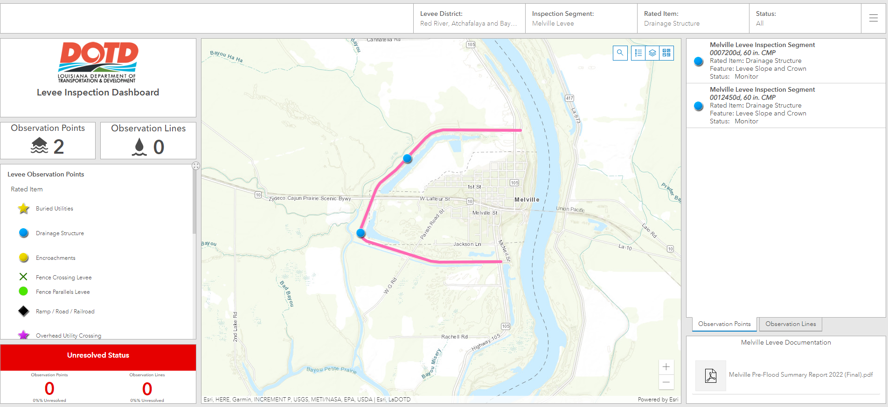
RRABB Levee Inspection Dashboard
Notes:
The screen will show the RRABB Levee District with the Melville inspection segment and the Rated Item filter applied for Drainage Structure. Documentation is also available to preview on bottom right of the screen.

Slide 22
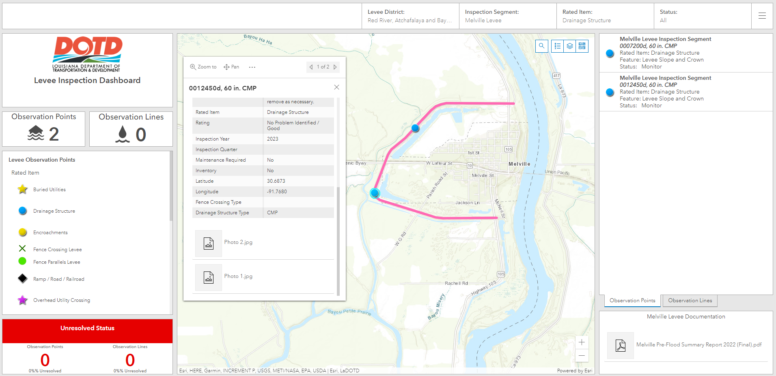
RRABB Levee Inspection Dashboard
Notes:
The screen will show the RRABB Levee District with the Melville inspection segment and rated item Drainage Structure. The drainage structure form opens when the blue drainage structure dot is selected. Documentation is also available to preview on bottom right of the screen.

Slide 23
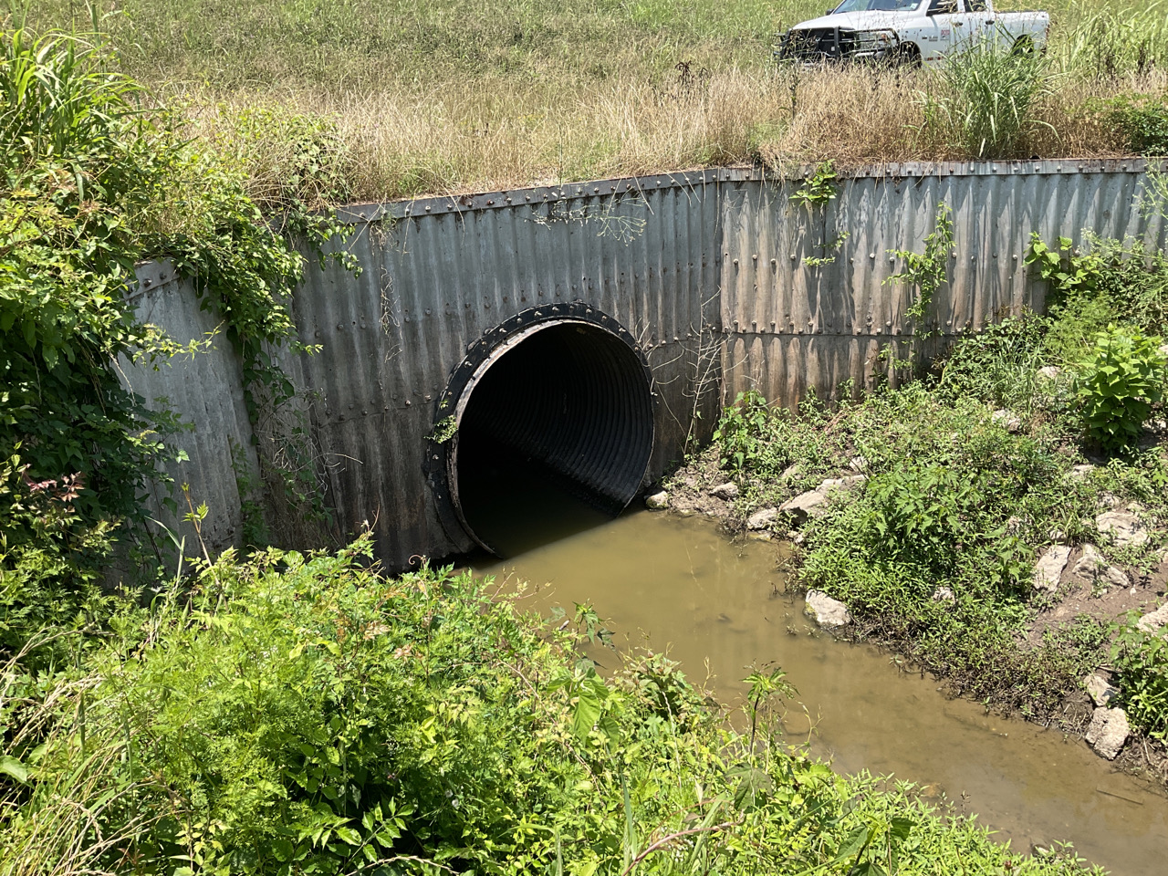
RRABB Levee Inspection Dashboard
Notes:
The screen shows the photo of RRABB Melville drainage structure Photo 1 .

Slide 24
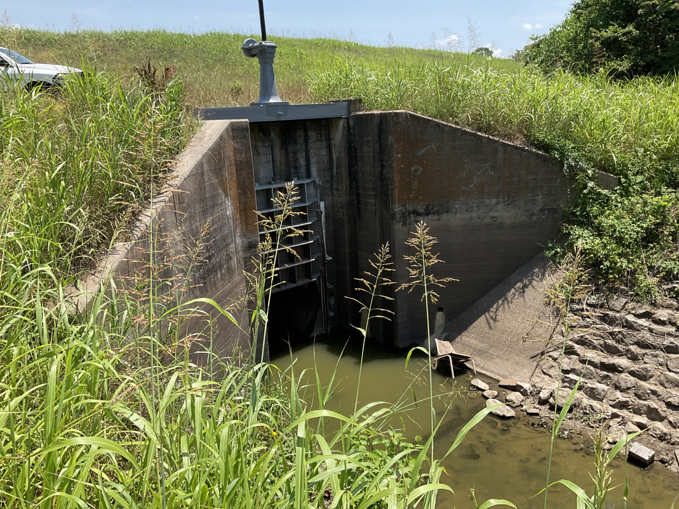
RRABB Levee Inspection Dashboard
Notes:
The screen shows the photo of RRABB Melville drainage structure Photo 2 .

Slide 25
Levee Inspection Dashboard
View Current Data
Can be filtered by District, Segment, Rated Item and Status
Map
Multiple basemaps available
Documentation
Viewable under inspection segment Levee Documentation window
Notes:
The Inspection Dashboard allows you to filter the data by Levee District, Inspection Segment, Rated Item and Status. Multiple basemaps are also available per your viewing preference. Documentation is also available to preview on bottom right of the screen.

Slide 26
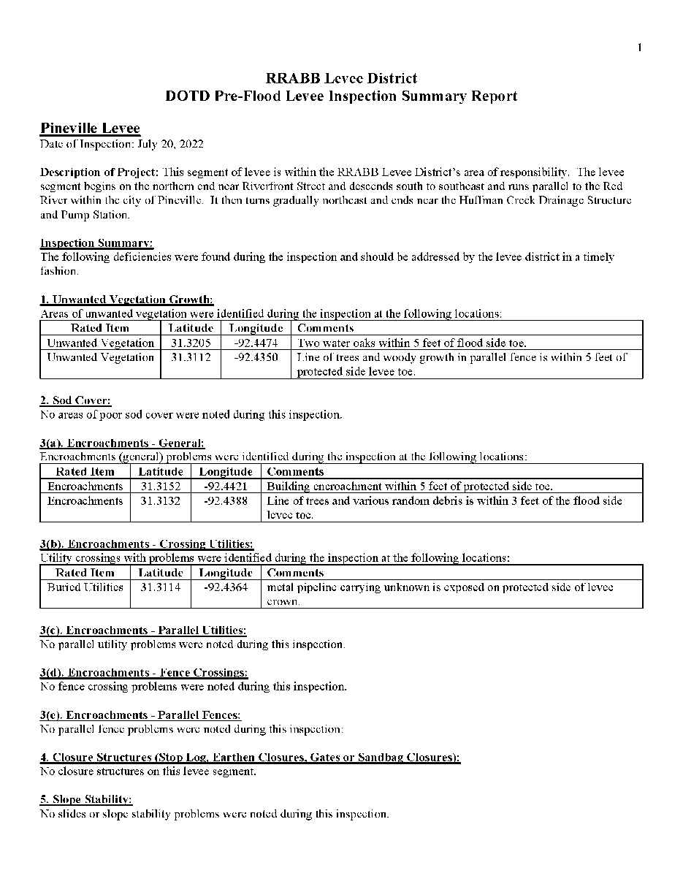
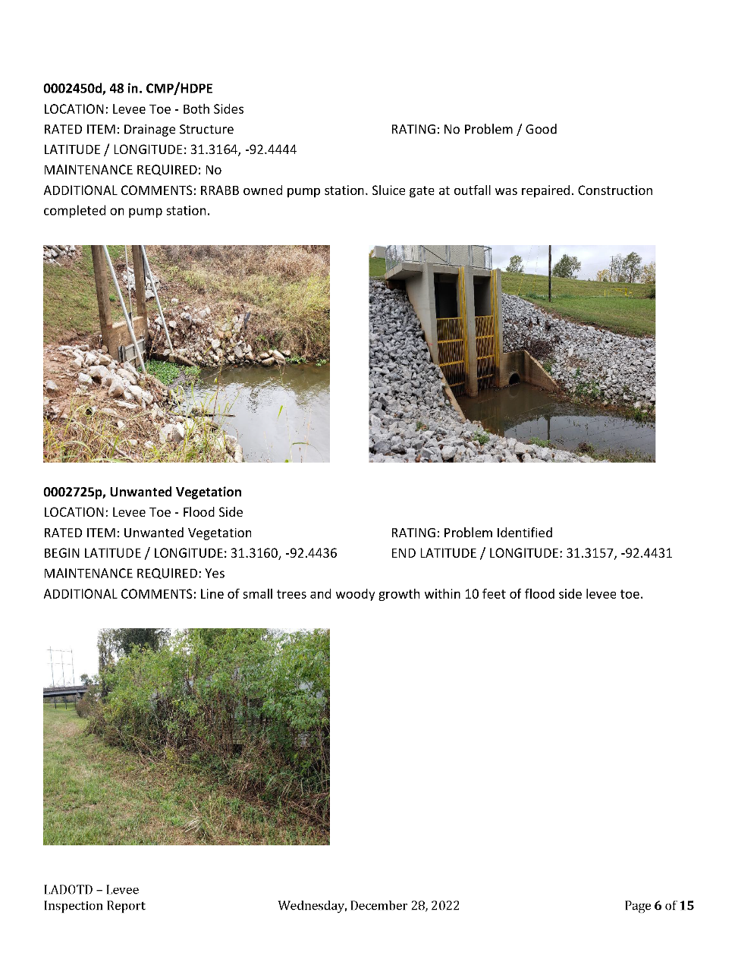
Inspection Report Types
Notes:
The screen will show the different report formats we are capable of producing. One on left is the summary report and one on right is the full report format showing attached pictures.

Slide 27
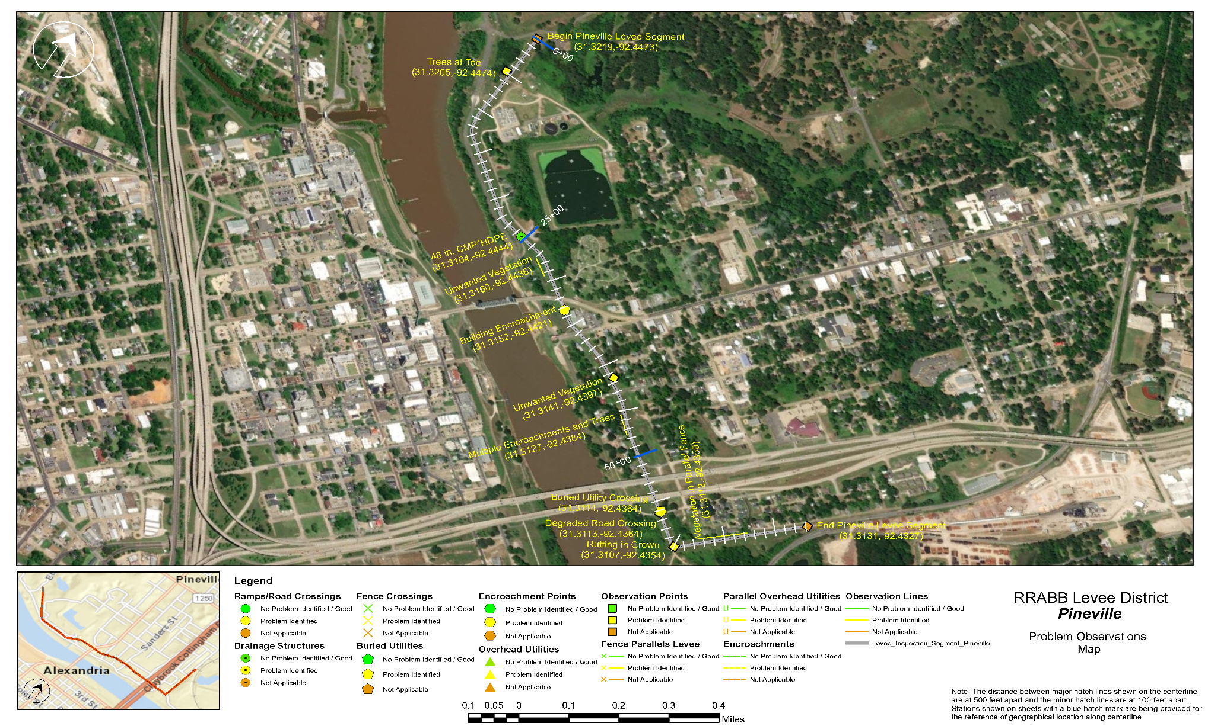
Inspection Report Maps
Notes:
The Pineville Levee map shows only the problems labeled with their latitude and longitude and their respective geographic locations.

Slide 28
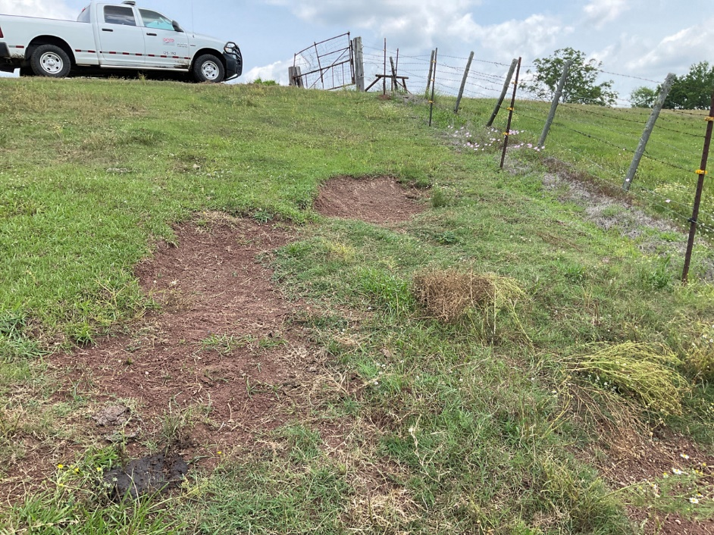
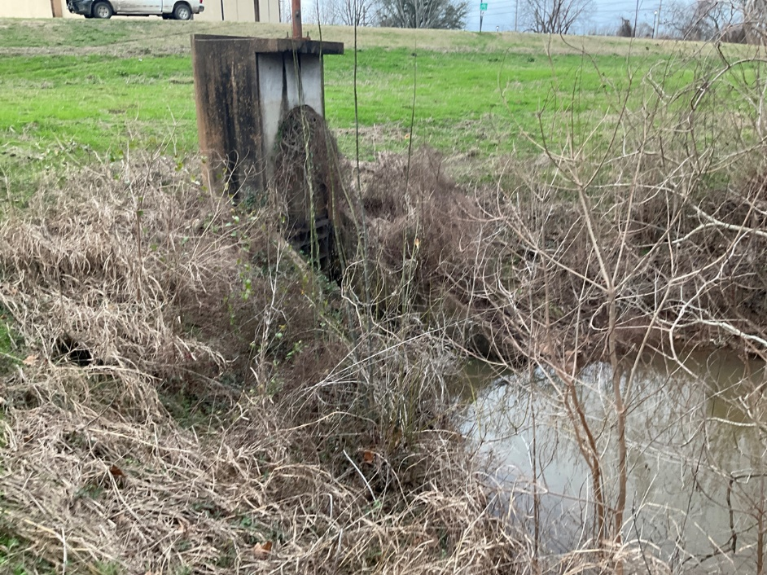
Common Levee Deficiencies
Bull Rub
Drainage Structure
Notes:
Common levee deficiencies.

Slide 29
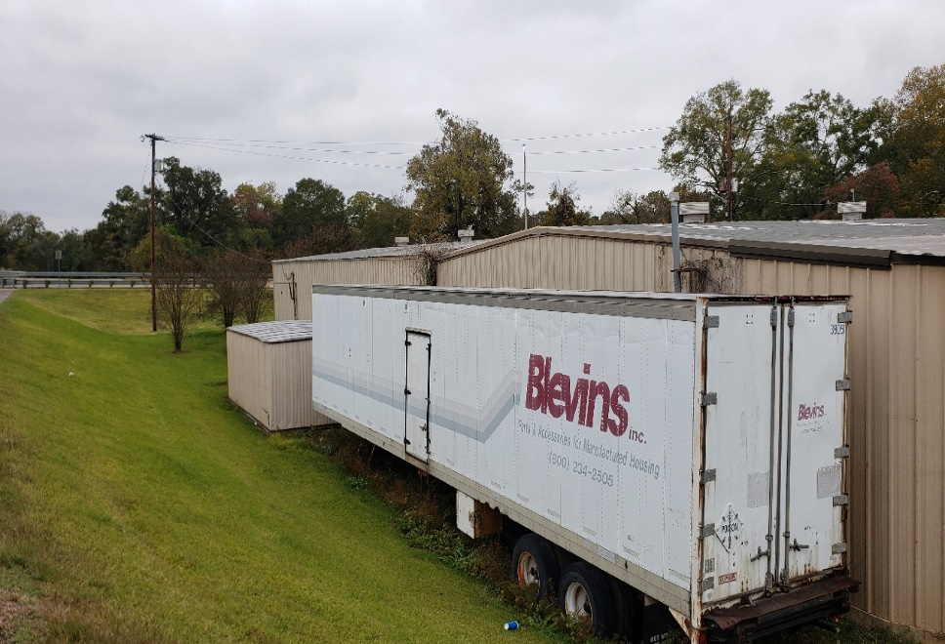
Common Levee Deficiencies
Cattle Trails
Encroachments
Notes:
Common levee deficiencies.

Slide 30
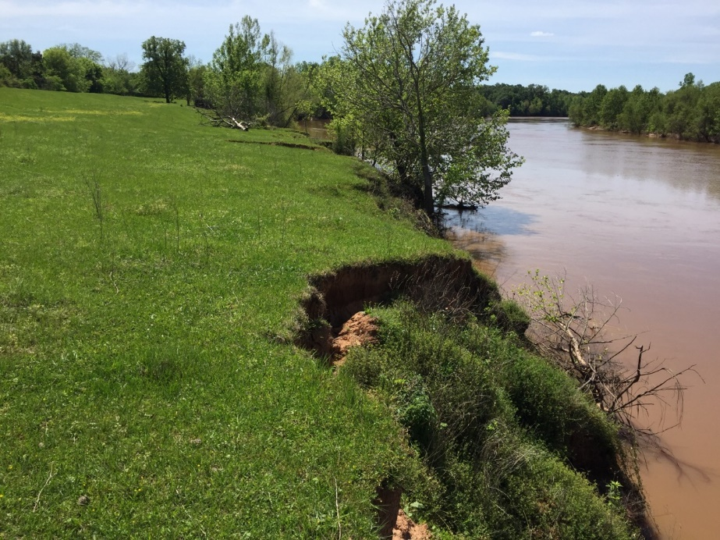
Common Levee Deficiencies
Tree on Slope
Bank Caving
Notes:
Common levee deficiencies.

Slide 31
Records Management - FileNet
Records Management System – FileNet (DOTD Document of Record)
Storing and organizing documents
Historical Public Works documents
Permits
Levee \ Dam Reports, EAP’s
Correspondence
As - Builts - Engineering drawings, Etc….
Central Scanning – Documents scanned or imported
DOTD’S records can legally be kept soley in electronic format through FileNet (currently the only electronic storage option approved by for long-term storage of DOTD’s records by LA. Secretary of State’s Office)
Notes:
Records Management-FileNet and Central Scanning capabilities and why we use it.

Slide 32
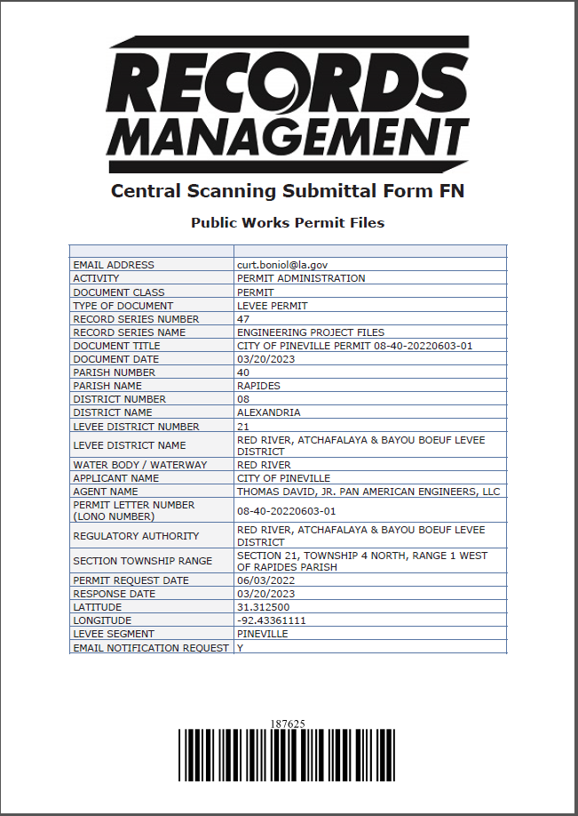
Records Management - FileNet
Notes:
The screen will show the automatic PDF that is created when the person submits the form in DOCS. You can then download it to your computer for your records.

Slide 33
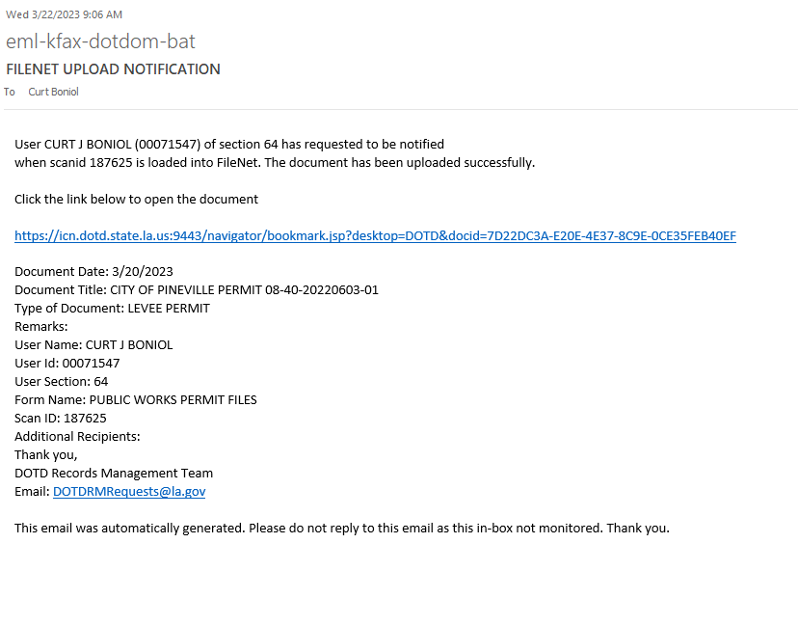
Records Management - FileNet
Notes:
The screen will show the automatic email that is sent to the person who submitted the form in DOCS. This can be a report, permit, historic files. etc….

Slide 34
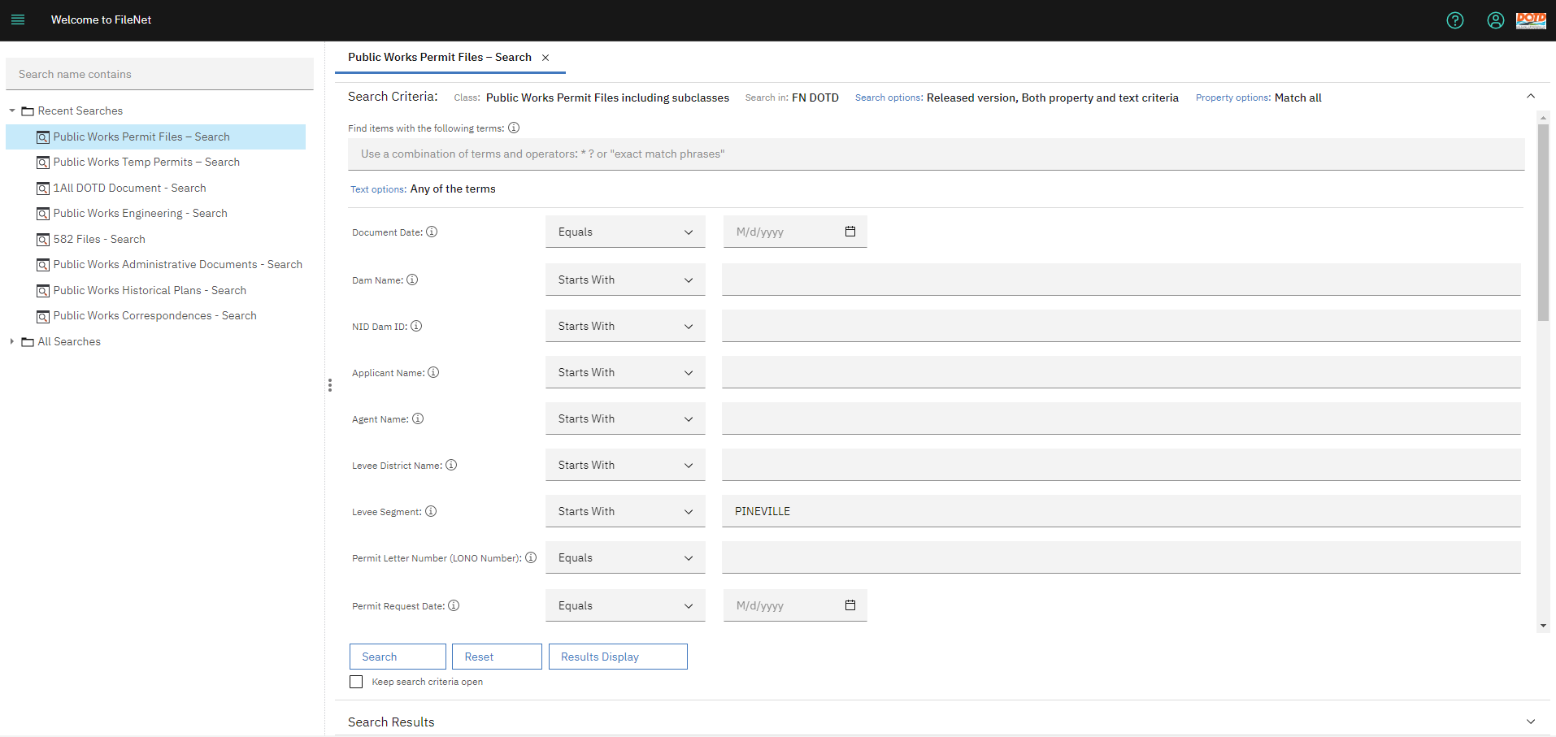
Records Management - FileNet
Notes:
The screen will show the search criteria for the Pineville levee segment under the Public Works Permit Files search criteria.

Slide 35
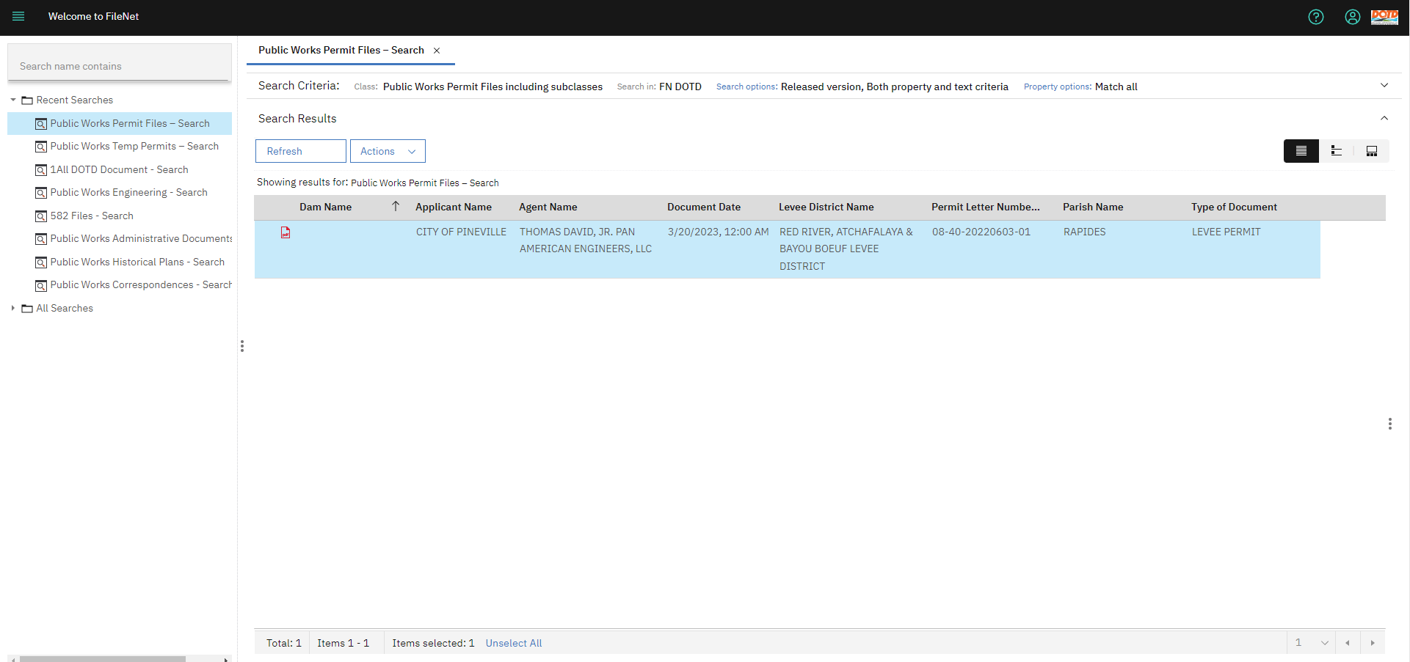
Records Management - FileNet
Notes:
The available results of your search.

Slide 36
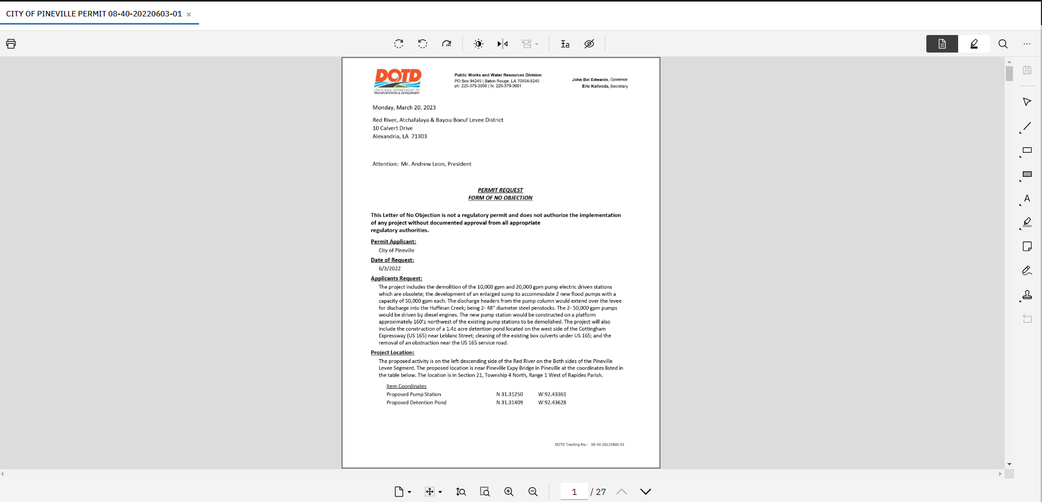
Records Management - FileNet
Notes:
The Letter of No Objection and any other additional documents that were uploaded for this specific permit.

Slide 37
Resources
Levee Inspector Certification
Coastal Protection and Restoration AuthorityLevee Inspector Certification | Coastal Protection And Restoration Authority (la.gov)
Notes:
You can copy and paste the link above in you browser (Chrome preferred) so you can get to the CPRA page and get to the Inspector Certification.

Slide 38
Questions?
Thanks
Curt J. Boniol, P.E.
Curt.Boniol@la.gov

