Slide 1
Right of Way Appraisals
What are They and Why are They Necessary?

Slide 2
Rebecca Ann Rothschild
RRL Real Estate Appraisal, LLC

Slide 3
Why?
The Law

Slide 4
5th Amendment: No person shall be held to answer for a capital, or otherwise infamous crime, unless on a presentment or indictment of a Grand Jury, except in cases arising in the land or naval forces, or in the Militia, when in actual service in time of War or public danger; nor shall any person be subject for the same offense to be twice put in jeopardy of life or limb; nor shall be compelled in any criminal case to be a witness against himself, nor be deprived of life, liberty, or property, without due process of law; nor shall private property be taken for public use, without just compensation.

Slide 5
Definition of Market Value: the amount in cash, or on terms reasonably equivalent to cash, for which in all probability the property would have sold on the effective date of value, after a reasonable exposure time on the open competitive market, from a willing and reasonably knowledgeable seller to a willing and reasonably knowledgeable buyer, with neither acting under any compulsion to buy or sell, giving due consideration to all available economic uses of the property

Slide 6
State Law

Slide 7
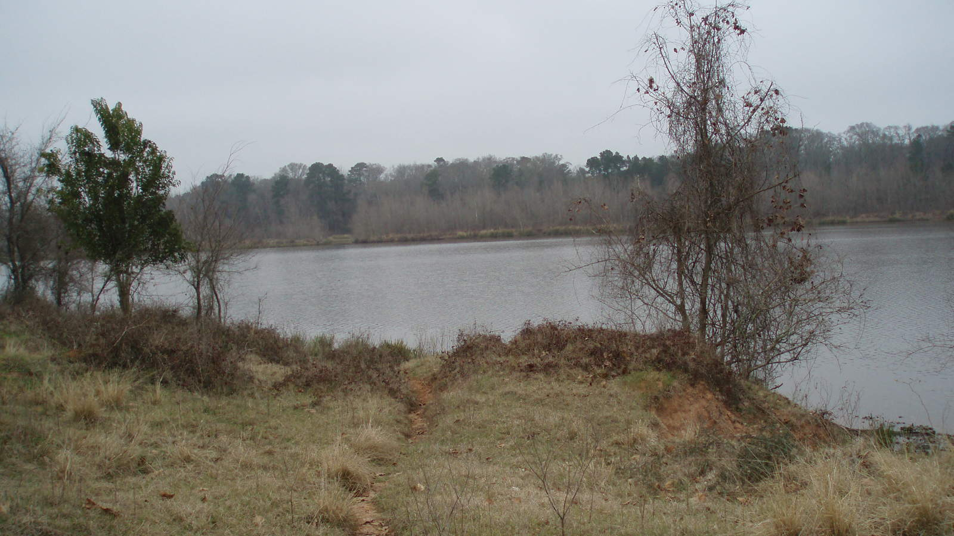
The New Law
State Law: RS 49:214.6.5- Hurricane protection and flood control activities; levees or levee drainage purposes; taking of property; compensation
A. Pursuant to Article I, Section 4(G) and Article VI, Section 42(A) of the Constitution of Louisiana, compensation paid for the taking of, or loss or damage to, property rights affected by the construction, enlargement, improvement, or modification of federal or non-federal hurricane protection projects, including mitigation related thereto, shall not exceed the compensation required by the Fifth Amendment of the Constitution of the United States of America.
B. For the purposes of this Section, "full extent of the loss" as provided in any law or rule affecting taking of property for the purposes set forth in Subsection A of this Section shall mean compensation required by the Fifth Amendment of the Constitution of the United States of America.
C. The provisions of this Section shall supersede and control to the extent of conflict with any other provision of law.
D. As provided in Article I, Section 4(G) of the Constitution of Louisiana, the provisions of this Section shall not apply to compensation paid for a building or structure that was destroyed or damaged by an event for which a presidential declaration of major disaster or emergency was issued, if the taking occurs within three years of such event.

Slide 8
What is a levee?
an embankment built to prevent the overflow of a river.
A ridge of sediment deposited naturally alongside a river by overflowing water

Slide 9
There are over three thousand miles of levees and floodgates on each side of the entire River and its tributaries. The Flood Protection Authority-East is responsible for maintaining nearly 40 miles of levees and many floodgates along the River in East Jefferson, Orleans, and St. Bernard Parishes.

Slide 10
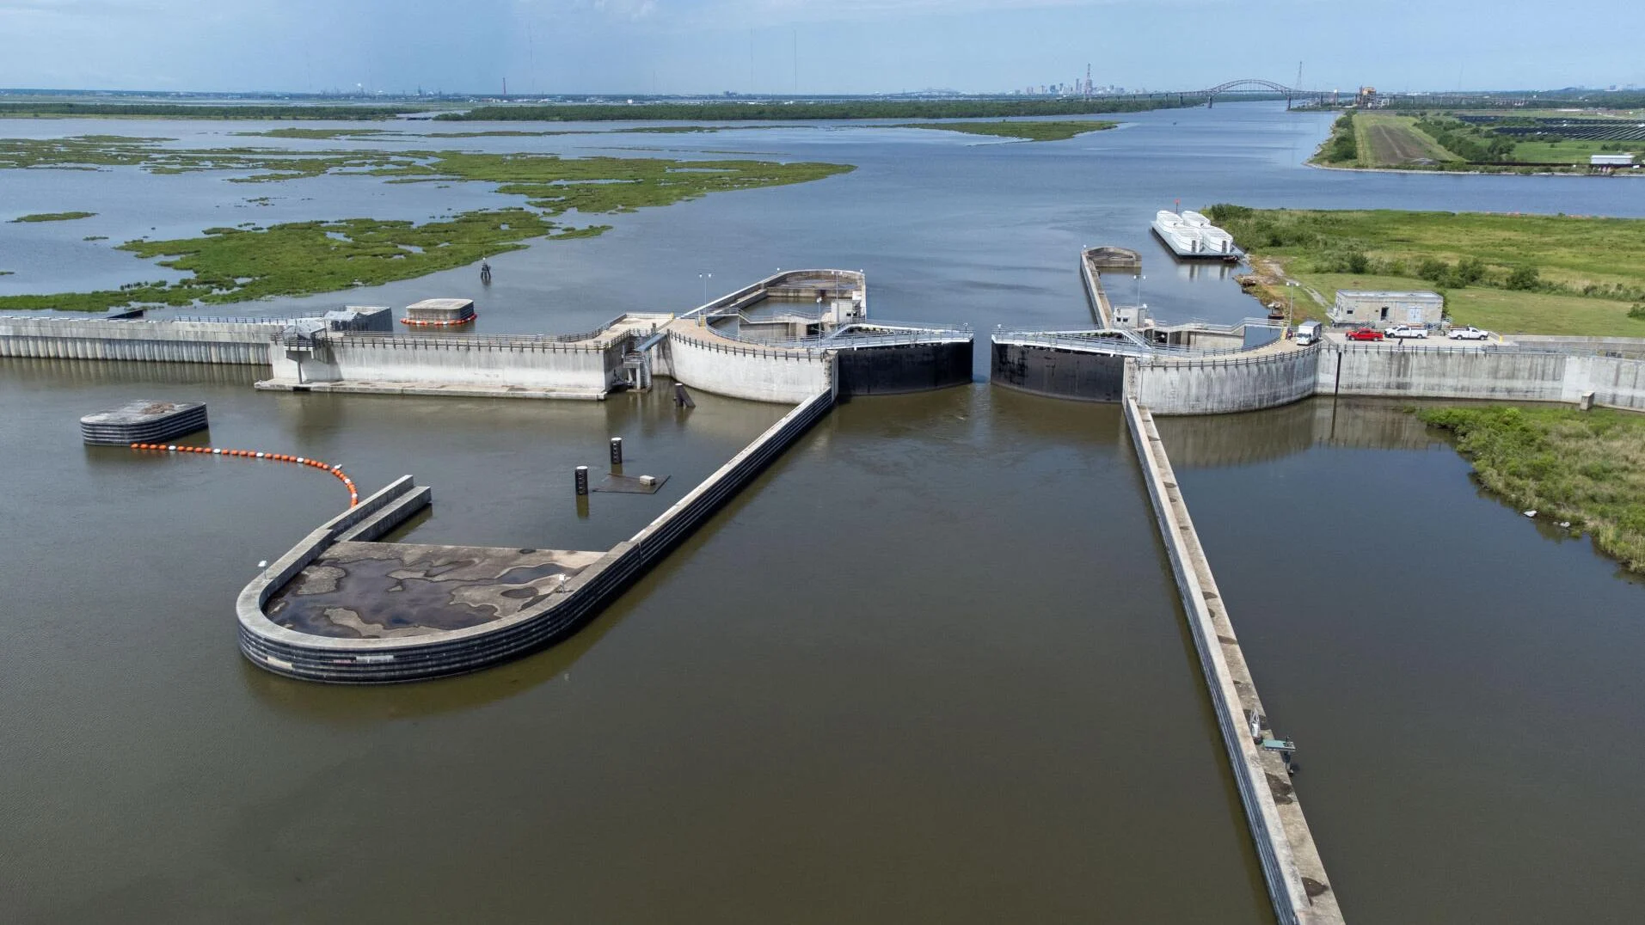
What is the biggest levee in Louisiana?
The “Great Wall of Louisiana,” otherwise known by its technical name, the IHNC-Lake Borgne Surge Barrier. It's a 1.8-mile barrier that can be closed during storms. It spans the area where the Gulf Intracoastal Waterway and the Mississippi River Gulf Outlet meet east of the city. Cost: $1.2 billion.

Slide 11
Expropriation v. Appropriation

Slide 12
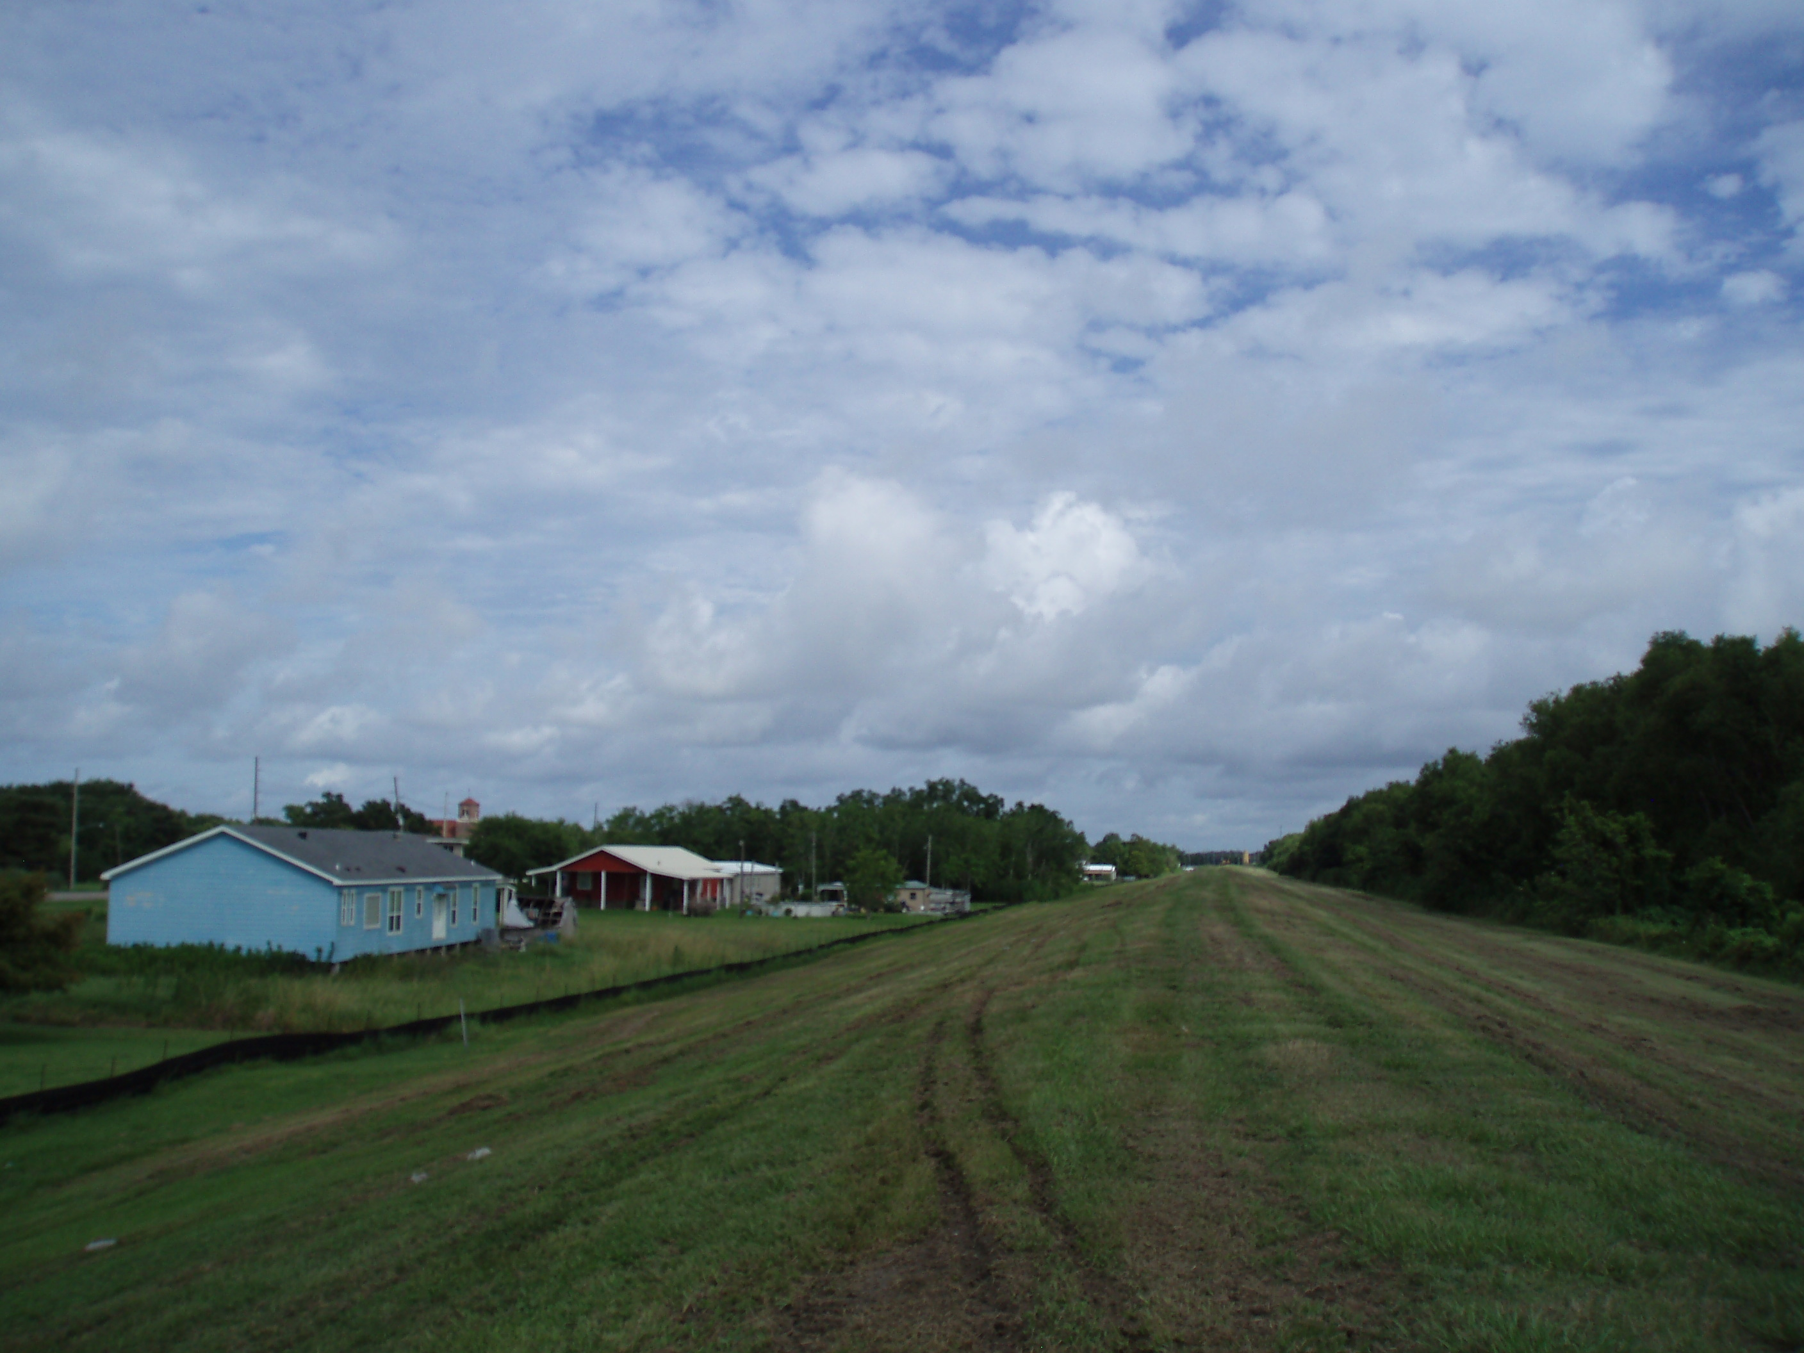
Expropriation: In every expropriation, a party has the right to trial by jury to determine compensation, and the owner shall be compensated to the full extent of his loss. No business enterprise or any of its assets shall be taken for the purpose of operating that enterprise or halting competition with a government enterprise.

Slide 13
Appropriation
Thus, public levee servitudes have been around for centuries, and the establishment thereof is deeply rooted in the Louisiana French and Roman civil law tradition. As noted by the U.S. Supreme Court, “the riparian owner enjoys his property sub modo, i.e. subject to the right of the public to reserve space enough for levees, public roads and the like” and “never acquires complete dominion”.
The property “never passes free of this reservation by a deed to a purchaser.”
While the land in the remaining states of the United States necessary for levee purposes can only be used after expropriation and proper indemnification, the State of Louisiana and its designated levee districts and other political subdivisions have the right to act first, i.e. the authority to appropriate such land to a use to which it is subject under Civil Code Article 665, and talk later. Put simply, the act of appropriation does not involve the acquisition of a right in property but the act of the levee board providing notice to the owner of the land burdened with such servitude that the levee district intends to exercise the public right to the property. As noted by the La. Supreme Court: “[H]owever unfair it may seem to the owners of this type of land they are without right to complain because their acquisition of such land was subject by law to this ancient servitude and the private mischief must be endured rather than the public inconvenience or calamity.”
Louisiana levee districts are authorized to adopt acts of appropriation through resolution to exercise this public servitude when the levee district board determines that land burdened by the servitude is necessary for levee or levee drainage purposes
While Article I, §4 of the Louisiana Constitution guarantees that one cannot be deprived of his property except for public purpose and with just compensation paid to the owner or into the court for his benefit, such guarantee is not provided to owners of land burdened by a levee servitude under Article 665.
The reason the right to compensation is not extended to appropriated property is because the laws of the State of Louisiana have long provided, even prior to the Louisiana Purchase,
that a servitude is imposed on all lands bordering on navigable rivers and streams for construction and maintenance of levees, roads, and other common or public works.

Slide 14
What is an appraisal?

Slide 15
Definition of Appraisal: An appraisal is a valuation of property, such as real estate, a business, collectible, or an antique, by the estimate of an authorized person.

Slide 16
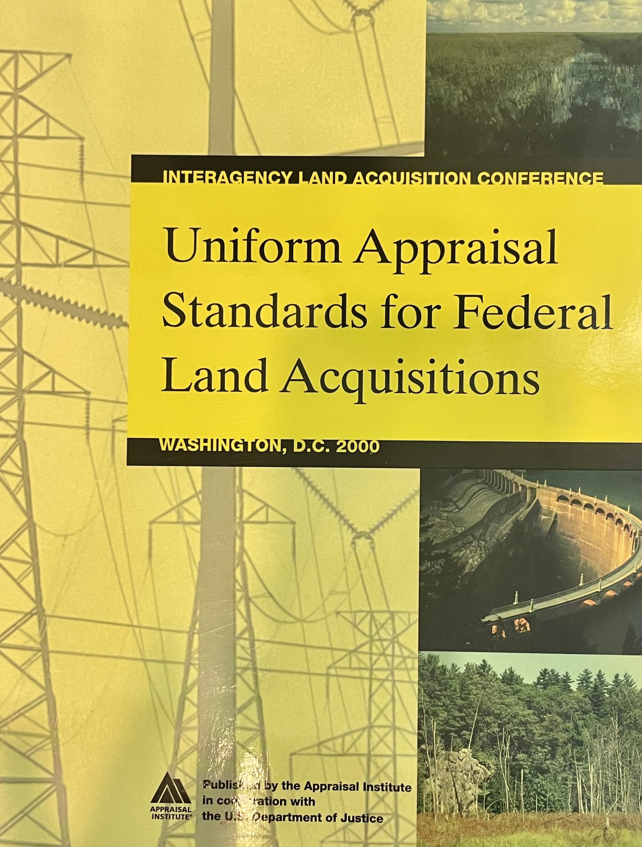
Types of Appraisals
Mortgage Appraisals
Narrative
Right of Way
Yellow Book

Slide 17
What is an easement?
The right to use another’s land for a stated purpose

Slide 18
What is partial interest?
Divided or undivided rights in real estate that represent less than the whole, i.e., a fractional interest such as a tenancy in common, easement, or life interest

Slide 19
Types of Servitudes/Easements
Permanent
Temporary

Slide 20
Who?

Slide 21
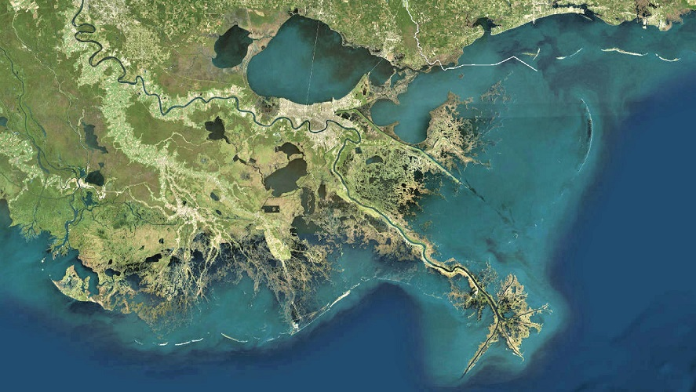
USACE: US Army Core of Engineers

Slide 22
CPRA: Coastal Protection and Restoration Authority

Slide 23
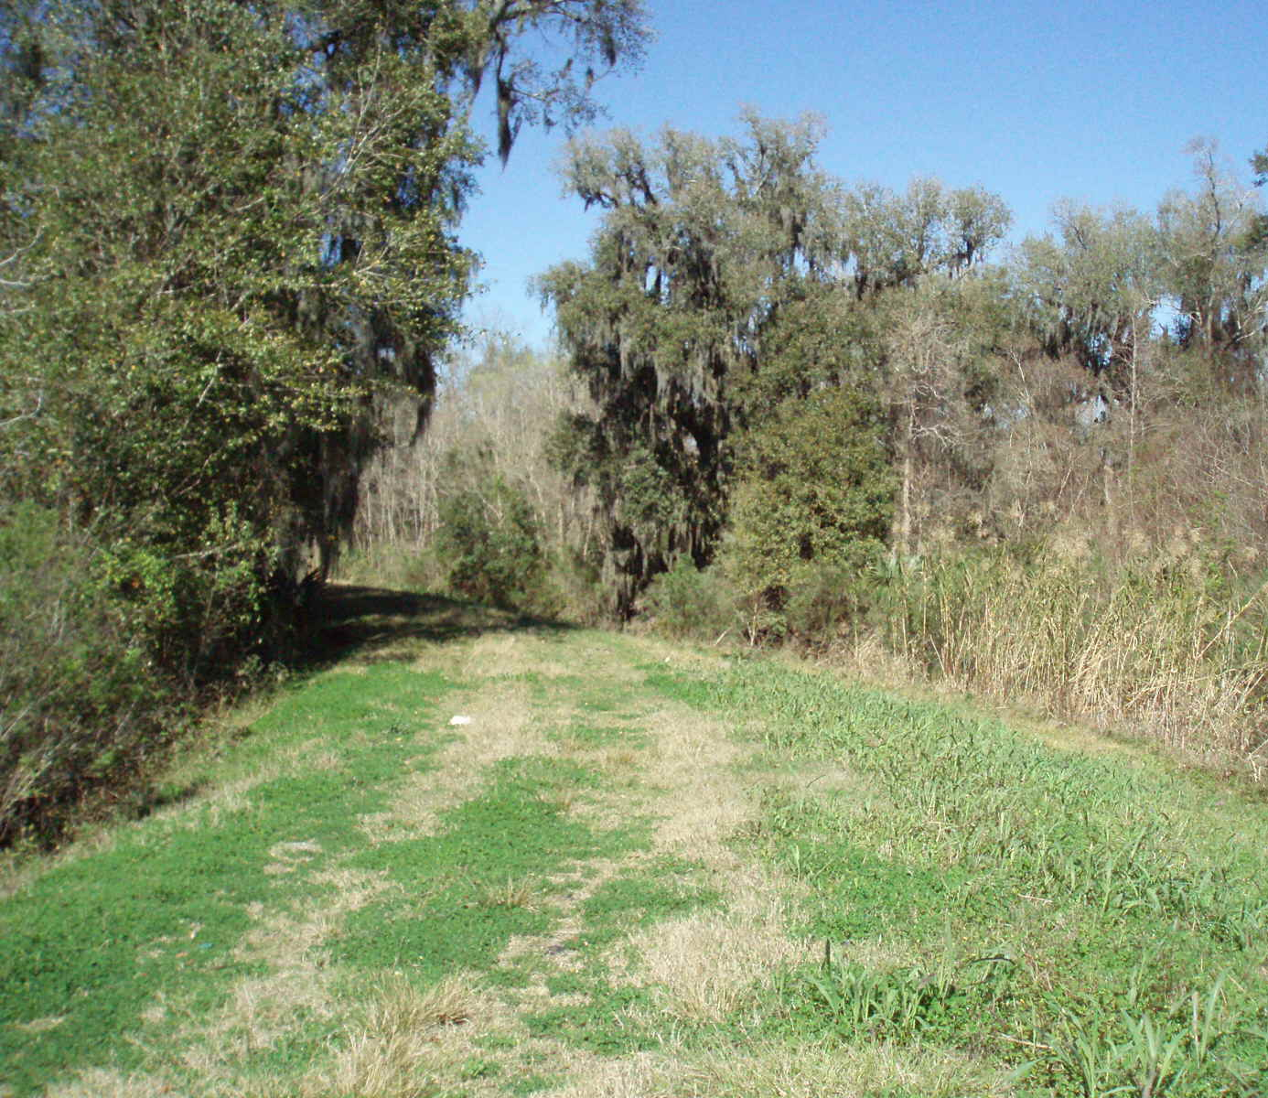
Levee Boards: 23 individual Boards
Parish Entities

Slide 24
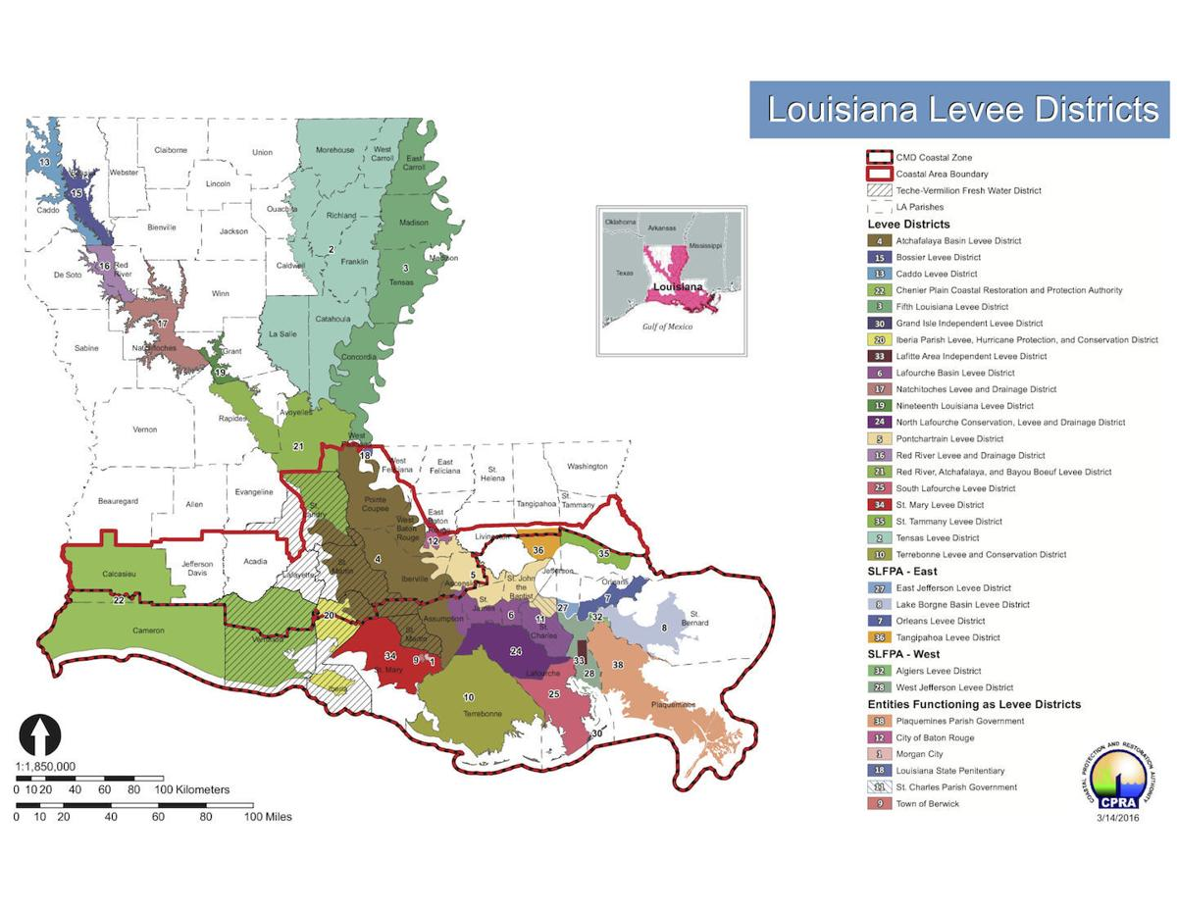

Slide 25
What to Look For When Hiring an Appraiser

Slide 26
Ways to Better Utilize Appraisal Services

Slide 27
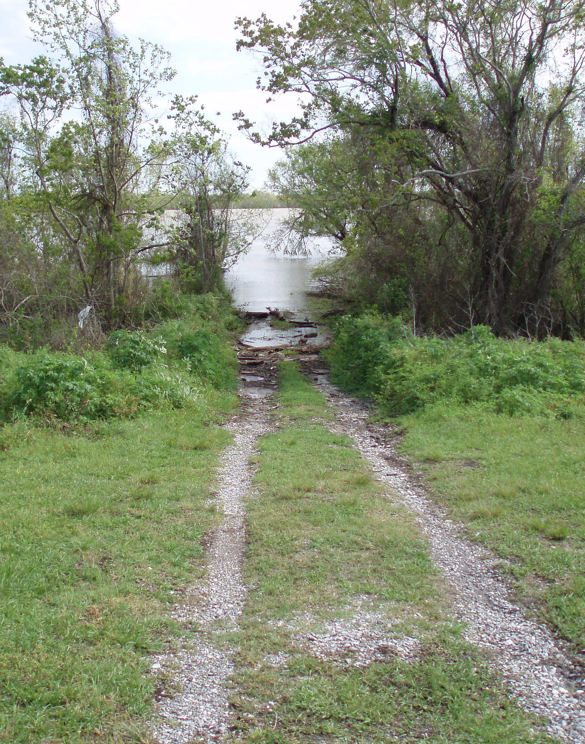
Appraisals

Slide 28
Market Data

Slide 29
Route Selection

Slide 30
Budget Projections

Slide 31
Problem Indicators

Slide 32
Cultural Sensitivity

Slide 33
Questions?

Slide 34
Thank You!

