Slide 1

Public Works & Water Resources
Edward M. Knight, P.E.
Deputy Assistant Secretary
Office of Public Works
December 6-7, 2023
Notes:
Next Slide - Mission.

Slide 2
Public Works & Water Resources
Mission:
  The mission of Public Works is to develop the potential of Louisiana's water related resources by administering programs and implementing infrastructure projects relating to controlling, developing, conserving and protecting all aspects of the resources.
Notes:
The second D, not here to talk roads and highways (RS 38)
Heard it put really well in by our federal partner in Vicksburg and a few Turkey jokes while at LMR Mega Study
Legislative reviews – composition of districts, all manner of studies,
Next Slide: Sections in Public Works

Slide 3
Today’s Discussion
Public Works & Water Resources:
  Section 32: Hydraulics
  Section 79: Floodplain Management
  Section 64: Levee & Dam Safety
Notes:
Hydraulics Section
Louisiana Watershed Initiative
Statewide Flood Control Program
Roadway Flooding Program
Floodplain Management Section
Levee & Dam Safety Section
NEXT SLIDE – Hydraulics

Slide 4
Section 32 (Hydraulics)
Statewide Flood Control Program
Roadway Flooding Program
Regional Watershed Modeling
Notes:
Modeling production in Hydraulics but much of the model development and initial effort was in initiated in Dams
After development it made sense to put the production in Hydraulics
Next Slide – Hydraulics responsibilities

Slide 5
Hydraulics Section Responsibilities
Hydraulic reviews and analysis
  Review plans and calculations for highway projects to ensure compliance with LA DOTD hydraulic policies and performance criteria
  Hydraulic design for bridges, culverts, and storm sewer systems
  Hydraulic review for the Off-System Bridge Replacement Program
Notes:
300 hydraulic reviews per year. Some are project specific, evaluations
NEXT SLIDE – Hydraulics

Slide 6
Hydraulics Section Responsibilities
Hydraulic reviews and analysis
  Provide technical expertise to consultants and other DOTD sections for complex or unusual drainage problems
  Specialty Products Evaluation Committee
Bridge scour monitoring
  Tracking and analysis of hydrographic surveys for bridges being monitored for known or potential scour problems
Notes:
300 hydraulic reviews per year. Some are project specific, evaluations
NEXT SLIDE – Section Resonsiblities

Slide 7
Hydraulics Section Responsibilities
Maintenance of hydraulic-related policies, guidelines, design criteria, and standard plans
  LA DOTD Hydraulics Manual
  Hydraulic Design Guidelines for the Off-System Bridge Replacement Program
  LA DOTD Hydraulics software
Notes:
NEXT SLIDE – Hydraulics

Slide 8
Hydraulics Section Responsibilities
  Policy and permit requirements for drainage tie-ins
  Engineering Directives and Standards Manual (EDSM) for pipe material, pipe life expectancy, and installation
  Drainage structure standard plans and special details
  Erosion and sediment control guidelines
Notes:
NEXT SLIDE – Hydraulics

Slide 9
Hydraulics Section Responsibilities
Drainage complaints & lawsuits
  Investigate complaints of roadway flooding and flooding of property potentially caused by DOTD roads and/or drainage structures
  Assist attorneys and serve as expert witnesses for drainage/flooding lawsuits brought against DOTD
Notes:
NEXT SLIDE – Floods of 2016

Slide 10
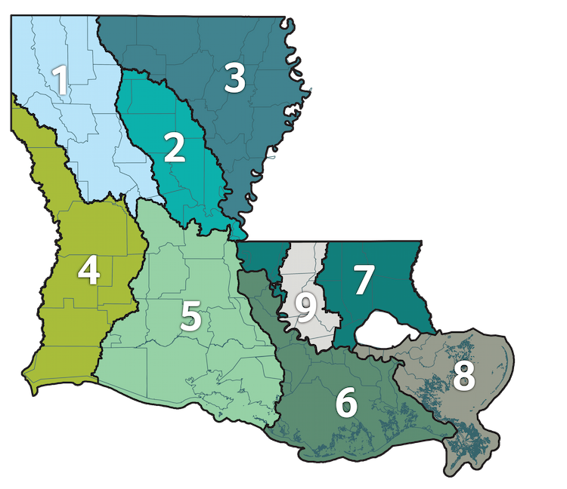
Louisiana Watershed Initiative
LWI Watershed Programs:
Statewide Data & Modeling Program
State Projects Program
Regional Capacity Building Grant Program
Nature-Based Solutions Program
Statewide Buyout Program
Non-Federal Cost Share Assistance Program
Notes:
Mention the addition of region 9
Buyout-primarily benefit LMI residents, offers an incentive—payment above fair market value
Cost Share-25% cost share of HMGP awards the state received from FEMA as a result of the 2016 floods
NEXT SLIDE – LWI Modeling Regions

Slide 11
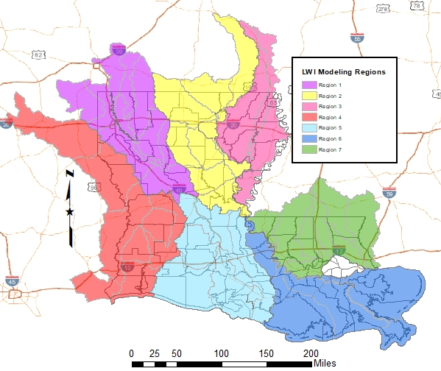
Louisiana Watershed Initiative
Regional Watershed Hydrologic & Hydraulic Modeling
Prime Consultants by Region:
Atkins North America
Freese & Nichols
Wood E&I Solutions
C.H. Fenstermaker
HDR Engineering
Michael Baker International
Dewberry Engineers
1
2
3
4
7
5
6
Notes:
Modeling – MUSM Plan, River and Rain gauge Network, Data Collection Storage and Mgt and Sharing
NEXT SLIDE – LWI SPP at DOTD

Slide 12
Statewide Flood Control Program
DOTD
is the
State Coordinating Agency
for the Flood Control Program
(fully funded by the state)
Notes:
Revised Statute 38:90.1 – 38:90.17
Roadway Flooding Program

Slide 13
Statewide Flood Control Program
$20M in total annual program (funded by Transportation Trust Fund)
Project requirements
  Must reduce existing flood damages of structures
  Does not encourage additional development in flood prone areas
  Does not adversely affect upstream or downstream flooding
  Must have a construction cost of $100,000 or more
    (Maximum SWFC Participation - $5M)
  Must be a stand-alone project
  Cannot serve the primary purpose of protection against coastal storm surge
Rural Grant Opportunity Act 384
  Eliminates 10% match requirement for parishes with less than 50,000 residents and municipalities less than 5,000 residents
Notes:
NEXT SLIDE – Flood Control continued

Slide 14
Statewide Flood Control Program
Competitive & Cost-Shared
  Projects are evaluated based on potential damage reduction versus State investment
  Provides up to 90% of the construction cost for non-federal projects
    Does not cover engineering costs, utility relocations or r/w purchases
  Provides up to 70% of non-federal participants share of federal projects
Application Deadlines
  Pre-Applications due by May 1st
  Full Applications due by October 1st
Notes:
NEXT SLIDE – Rural Grant Opportunity

Slide 15
Rural Grant Opportunity
Statewide Flood Control Program
Created by Act 384 of the 2018 Regular Legislative Session
Eliminates 10% construction match requirement for parishes with less than 50,000 residents and municipalities less than 5,000 residents
Notes:
NEXT SLIDE – Application Timeline

Slide 16
Statewide Flood Control Program
Application Timeline
APR | MAY | JUNE | JULY | AUG | SEPT | OCT | NOV | DEC | JAN | FEB | MAR | APR | MAY | JUNE
Pre-Application Submission
 | Evaluation Committee Review
 |  | Application Preparation
 |  |  |  |  |  | Evaluation Committee Review
 |  |  |  |  |  |  |  |  | Public Hearings
 |  |  |  |  |  |  |  |  |  |  | Joint Legislative Committee Review
 |  |  |  |  |  |  |  |  |  |  |  | Appropriation of Funds
Notes:
Eval Committee – Office of State Planning, NRCS, CPRA, DOTD
Pre-Applications due by May 1st
The pre-application should justify the project need with substantial documentation: photos, public records, news articles, videos, affidavits
Full Applications due by October 1st
The full application should include any and all engineering analysis necessary to evaluate the claimed benefits and any potential adverse impacts:
NEXT SLIDE – Flood Control funding

Slide 17
Statewide Flood Control Program
Funding Distribution
Funds are distributed between the Urban Program and Rural Program:
  Urban Areas (45%)
    Shreveport, Monroe, Alexandria, Lake Charles, Lafayette, Baton Rouge, New Orleans, Hammond, Mandeville-Covington, Slidell, and Houma Urban Areas
  Rural Funding Districts (55%)
Rural Funding District | Percentage of Rural Funding
Northwest | 28.589
Northeast | 19.644
Southwest | 18.199
South Central | 16.907
Southeast | 16.661
Notes:
Rural funding percentages are
NEXT SLIDE – Flood Control continued
NEXT SLIDE – Flood Control contined

Slide 18
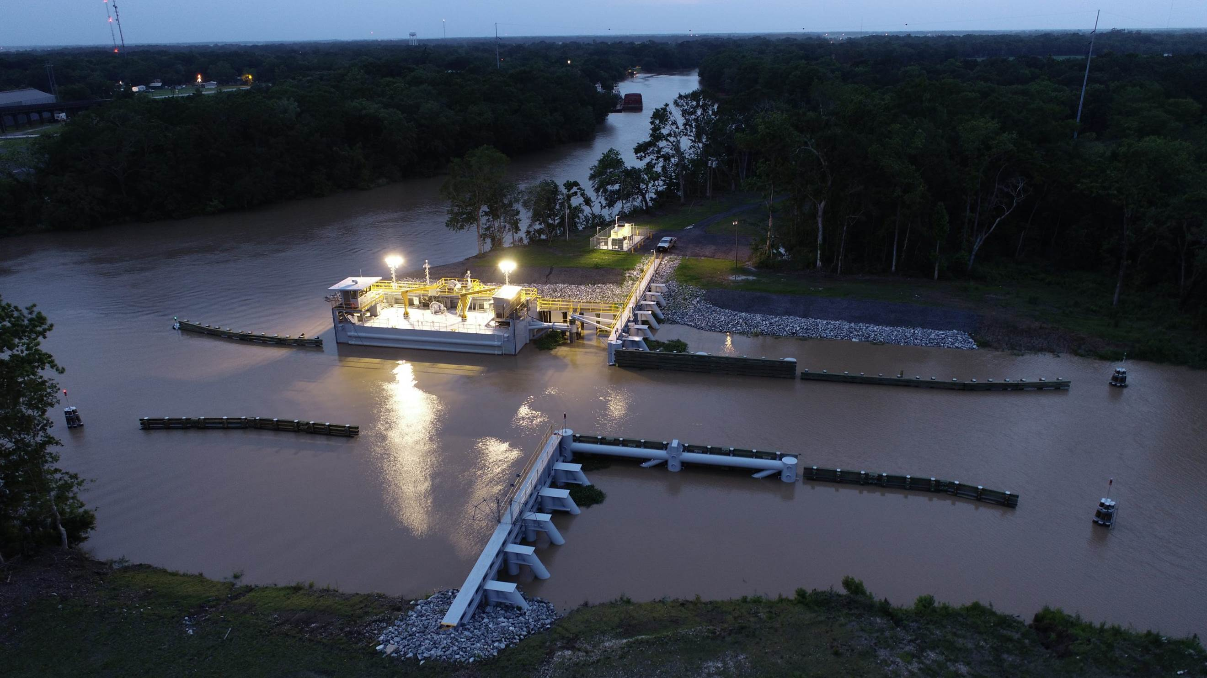
Statewide Flood Control Program
Bayou Têche Flood Protection
St. Mary Parish
$9.75M SWFC Share
Completed Summer 2021
Notes:
Floodgate at the confluence of Bayou Teche and the Charenton Canal in southern St. Mary Parish.
NEXT SLIDE – Flood Control continued
NEXT SLIDE – Flood Control contined

Slide 19
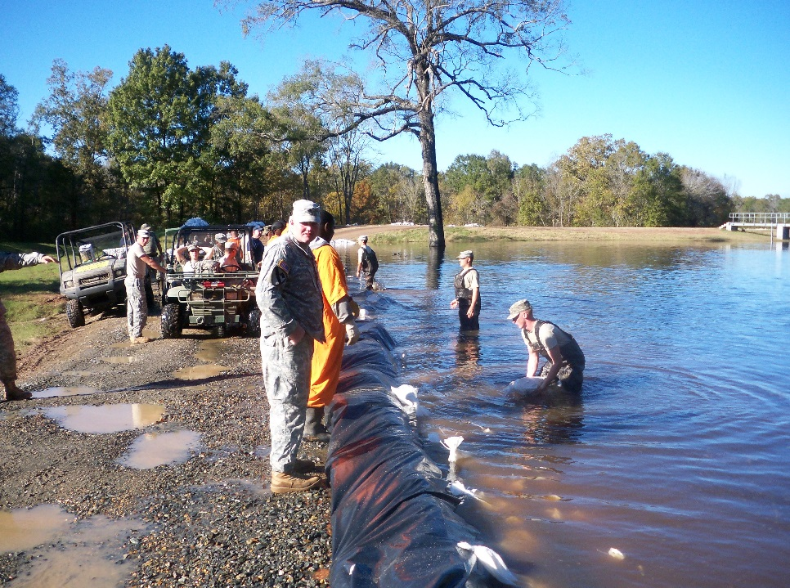
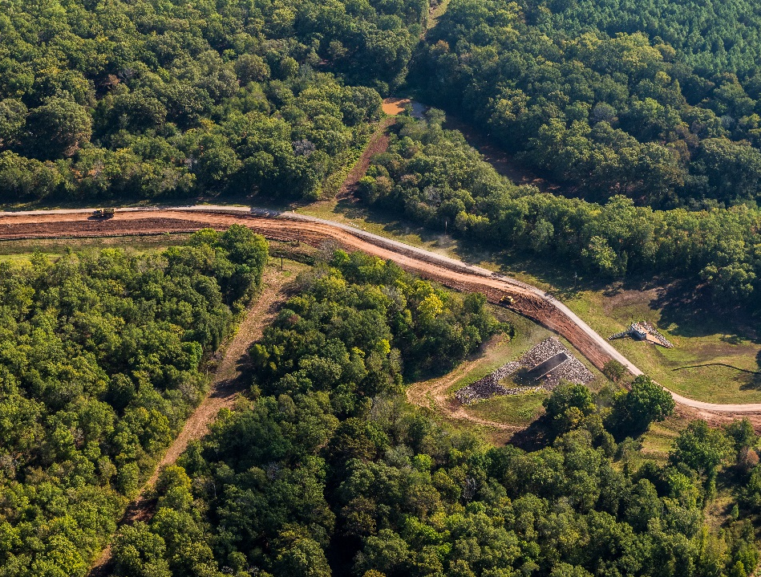
Statewide Flood Control Program
Raising of the Red Chute Levee
Bossier Parish
Phase I – Widening
$4.6M SWFC Participation
Completed Fall 2021
2009 Flood Event
2021 – 9.5 Miles Widened
Notes:
Red Chute Levee –Widened to facilitate flood-fighting Phase 2 will be raising but waiting on 401 permit
NEXT SLIDE – Flood Control continued

Slide 20
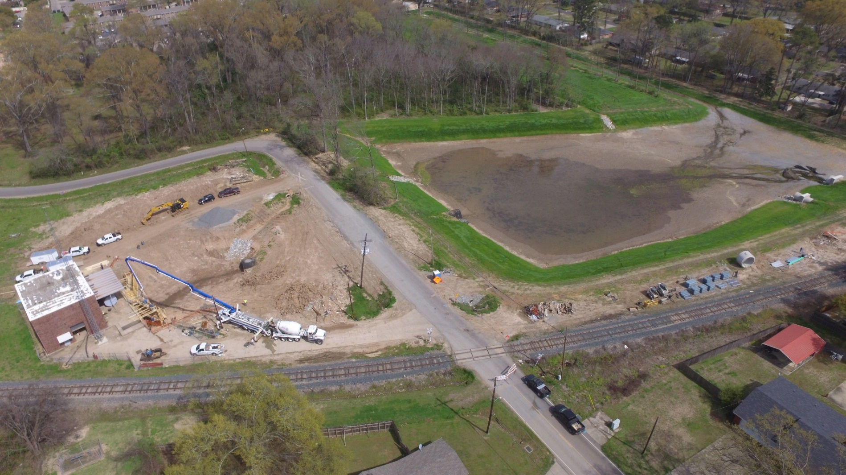
Statewide Flood Control Program
Rochelle Street Pump Station
City of Monroe
$1.45M SWFC Share
Completed June 2019
Photo courtesy of Denmon Engineering
Notes:
Construction of an enlarged sump area and improvements to subsurface drainage to improve conveyance and reduce pump cycling.
NEXT SLIDE – Flood Control continued
NEXT SLIDE – Flood Control continued

Slide 21
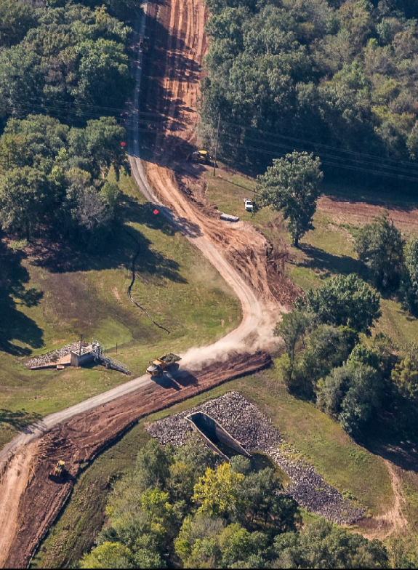
2023 - 2024 Application Cycle
Statewide Flood Control Program
Red Chute Levee
Bossier Parish
11 pre-applications received ($38.88M)
  7 determined eligible
7 full applications received ($17.99M)
  1 Town
  2 Cities
  4 Parishes
  1 Levee and Conservation District
Notes:
2023-2024 cycle: Applications currently under Evaluation Committee review
NEXT SLIDE – Flood Control continued
NEXT SLIDE – Red Chute Levee Phase I – Widening

Slide 22
Accomplishments
Statewide Flood Control Program
Approved projects in 43 of 64 parishes
130 projects completed
$309.7M Expended
$2.975B in Flood Reduction Benefits
11.13 Benefits/Cost Ratio
Notes:
Still only have done projects in 43 parishes. One major project closed out last year brought the BC went up almost 4 tenths
(No projects in St. Landry, Red River, Desoto, Tensas, St. Martin, Pointe Coupee, Union, and West Baton Rouge Parishes)
Next Slide – Roadway Flooding Program
NEXT SLIDE – Flood Control contined

Slide 23
Roadway Flooding Program
DOTD
is the
State Coordinating Agency
for the Roadway Flooding Program
(in association with FHWA)
Notes:
The Department of Transportation and Development is the State Coordinating Agency for the Roadway Flooding Program.
Roadway Flooding Program

Slide 24
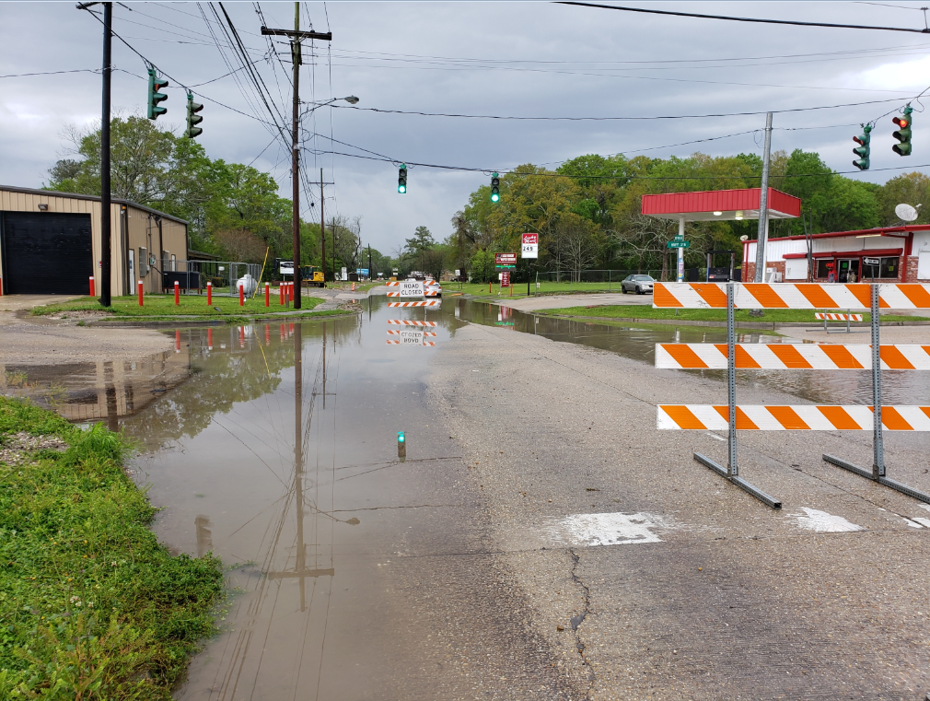
Roadway Flooding Program
Project Types Qualifying
  Replacement of undersized cross drains
  Replacement of undersized storm drains
  Elevating roadways (primarily overlays)
Project Types Not Qualifying
(No Maintenance Projects)
  Cleaning out silted pipes
  Videoing inside of pipes to report damage
  Replacement of damaged structures
Funding
  Approximately $4M Annual Budget
  80% FHWA & 20% DOTD
Terrebonne Parish Project
LA 24
Notes:
Things to look out for: ROW, Utilities, RR permitting, Environmental
NEXT SLIDE – Roadway Flooding Program

Slide 25
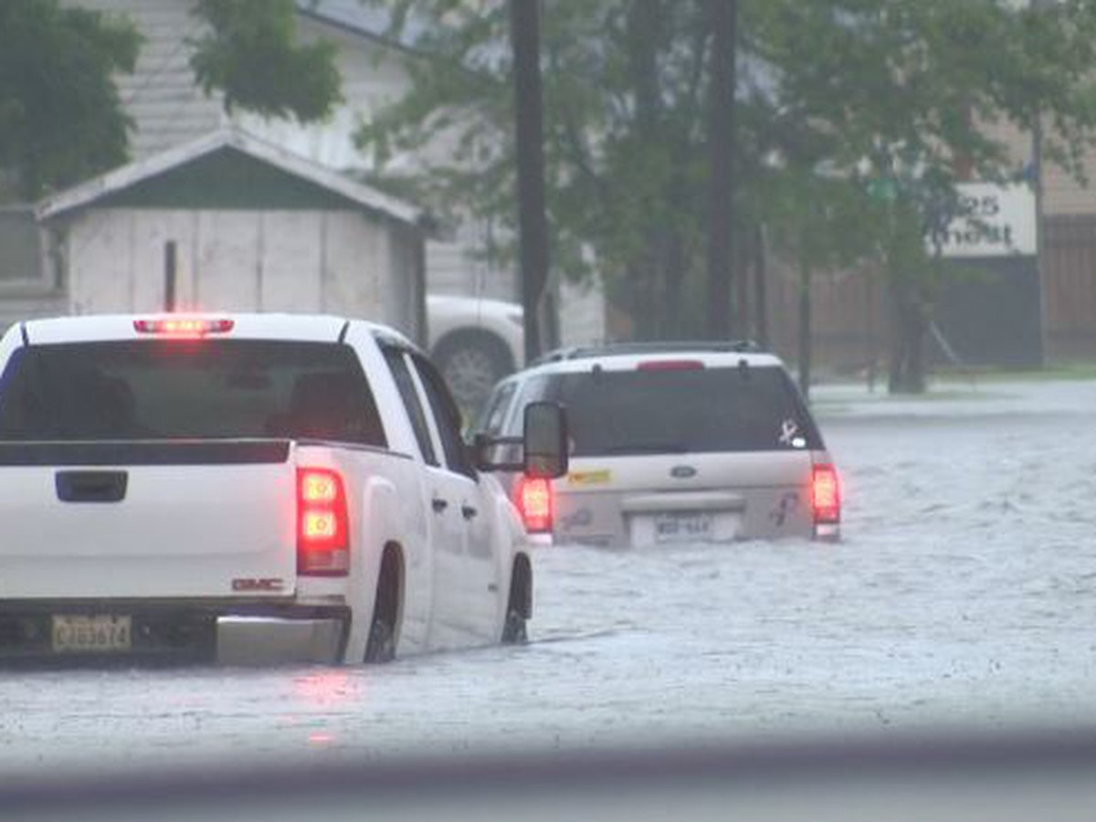
Roadway Flooding Program
Project Selection Criteria
  Projects are evaluated based on:
  State Highway
  frequency of flooding
  depth of flooding
  duration of flooding
  detour length
  Average Daily Traffic
  property damage
  damage to roadway
  disruption in emergency services
Project Selection Process
  DOTD Districts submits all potential projects & performs design work
  Roadway Flooding Committee selects projects based on the selection criteria and a cost-benefit analysis (meets yearly August/September)
Notes:
NEXT SLIDE – Roadway Project

Slide 26
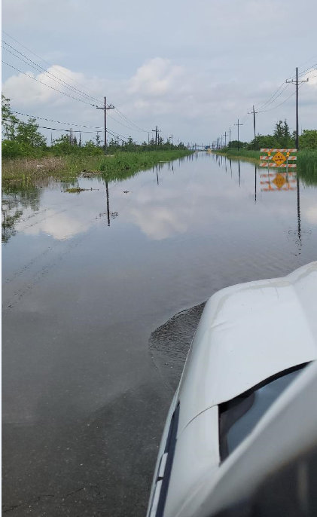
Roadway Flooding Program
LA 70 (Assumption Parish)
  Floods avg. 5 times/year
  Project Length - 0.44 miles
  Overlay up to 16”
  $800,000
  Project scheduled to finish in May 2024
Notes:
Advertised and let in September of 2022

Slide 27
Roadway Flooding Program
Past Projects
  152 projects completed
  $97 million spent
  Projects in 45 out of 64 parishes
Future Projects
29 projects currently
$18 million to be spent
Projects in 25 out of 64 parishes
Notes:
4 projects completed from last year 19 mil is small decrease from last year but we moved up to 25 of 64 parishes
Next slide – NFIP

Slide 28
Section 79
Floodplain Management Programs
National Flood Insurance Program
Cooperating Technical Partners Program
Notes:
Section
Next Slide – Non Coastal Levees

Slide 29
National Flood
Insurance Program
DOTD
is the
State Coordinating Agency
for the National Flood Insurance Program
Notes:
The Department of Transportation and Development is the State Coordinating Agency for the National Flood Insurance Program (NFIP).
Next Slide – Floodplain Mgt

Slide 30
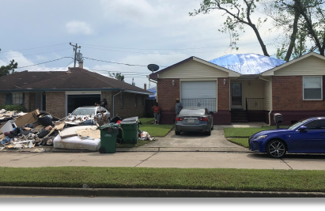
Floodplain Management
Community Assistance Visits:
    Assess floodplain activities of 318 NFIP communities
    Inspect SFHA (over 50% of state)
    Review permits & elevation certificates
    Meet with community officials to determine assistance they need
Disasters:
    Respond to Presidentially declared disasters
    Assist FEMA helping communities comply with post disaster regulations
Notes:
Next Slide – Floodplain Mgt

Slide 31
Floodplain Management
Training & Workshops:
    Assists multiple agencies with various workshops and classes
Outreach:
    Publish a quarterly newsletter – the Floodplain Management Factsheet distributed to all 318 NFIP communities, lending institutions, insurance agents, realtors, engineers, etc.
Notes:
Next Slide – CRS

Slide 32
Community Rating System (CRS)
Voluntary program that credits community efforts to go above minimum requirements by reducing flood insurance premiums from 5% to 45%
39 communities currently receive a discount
Notes:
Community Rating System Class Ratings are similar to Fire Ratings for your Homeowners’ Policy. Each lower class receives a 5% decrease in flood insurance premiums.
Louisiana achieved its first Class 5 rating in May of 2019. Jefferson Parish flood insurance policyholders now receive a 25% discount.
Next Slide – CRS

Slide 33
77% of Louisiana Flood Insurance Policies are in CRS Communities (LA ranked in Top 5)
Community Rating System (CRS)
+386,000 Flood Insurance Policies in Force
+$29,000,000 savings annually
Notes:
Louisiana is ranked in the Top 5 nationwide with 78% of the state’s flood insurance polices located in CRS communities.
Participation in the Community Rating System saves Louisiana flood insurance policyholders more than $27 million annually.
Next Slide – CTP

Slide 34
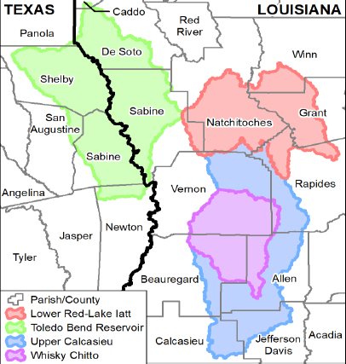
Cooperating Technical Partners (CTP)
Works with FEMA to release updated flood risk information to communities
  Could lead to updated Insurance Rate Maps
CTP overall objective: Update the nation’s flood hazard maps and flood hazard information
Currently under contract with two consulting firms to assist with CTP/NFIP task orders
  Total CTP/NFIP contract amount: $10M for 5 years
  Discoveries in 8 watersheds
Notes:
7 Discoveries are closing next week:
Discoveries have been initiated in 8 additional watersheds: Cross Bayou, Middle Red
Next Slide – Policy Information

Slide 35
NFIP First Floor Elevation Program
Substantial Damage Project in Terrebonne Parish
Following Hurricane Ida, DOTD identified a need to support the communities in their substantial damage determinations after a disaster, since FEMA is no longer performing this task
Developed a process to create a digital inventory of structures to aid communities when performing their substantial damage assessments
Notes:
7 Discoveries are closing next week:
Discoveries have been initiated in 8 additional watersheds: Cross Bayou, Middle Red
Next Slide – Policy Information

Slide 36
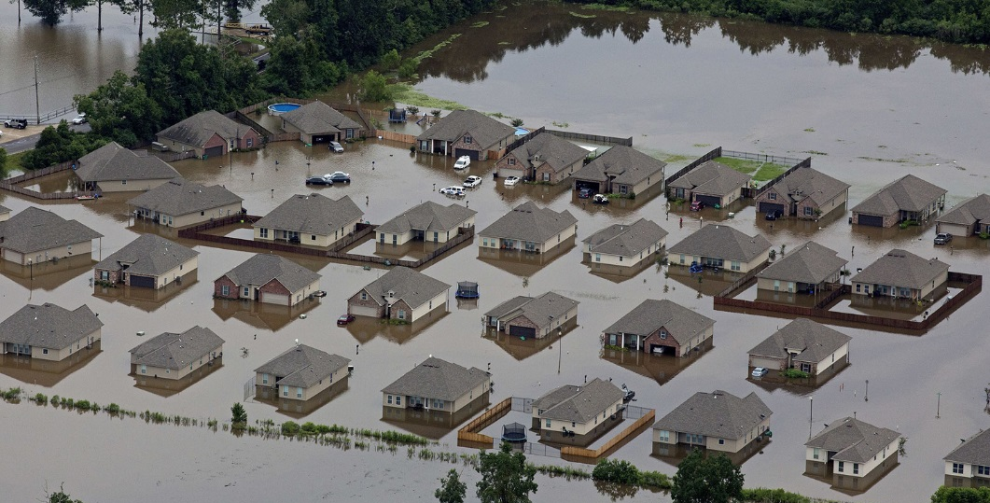
Risk Rating 2.0
As of April 1, 2023, FEMA has fully implemented the NFIP’s pricing approach, previously called Risk Rating 2.0
  This rating methodology is actuarially sound, equitable, easier to understand and better reflect a property’s flood risk
  Was implemented in phases from Oct. 1, 2021 through April 1, 2023
  FEMA is using new capabilities and tools to address rating disparities by incorporating more flood risk variables
Phased-In increases for majority of policies
20% of policyholders expected to see a decrease
All policy holders in CRS communities will receive the discount once they reach their full risk rate
Notes:
DOTD does not administer the RR 2.0 but many of the elements we discussed inform 2.0
Next Slide – Section 64

Slide 37
Section 64
Dam Safety Program
Levee Safety Program
Capital Outlay
Resilience Coordination
Notes:
Section
Next Slide – Non Coastal Levees

Slide 38
The
Levee Safety Program
DOTD
is the
State Coordinating Agency
for the Non-Coastal Levees
Notes:
The Department of Transportation and Development is the State Coordinating Agency for the National Flood Insurance Program (NFIP).
Next Slide – Non Coastal Levees

Slide 39
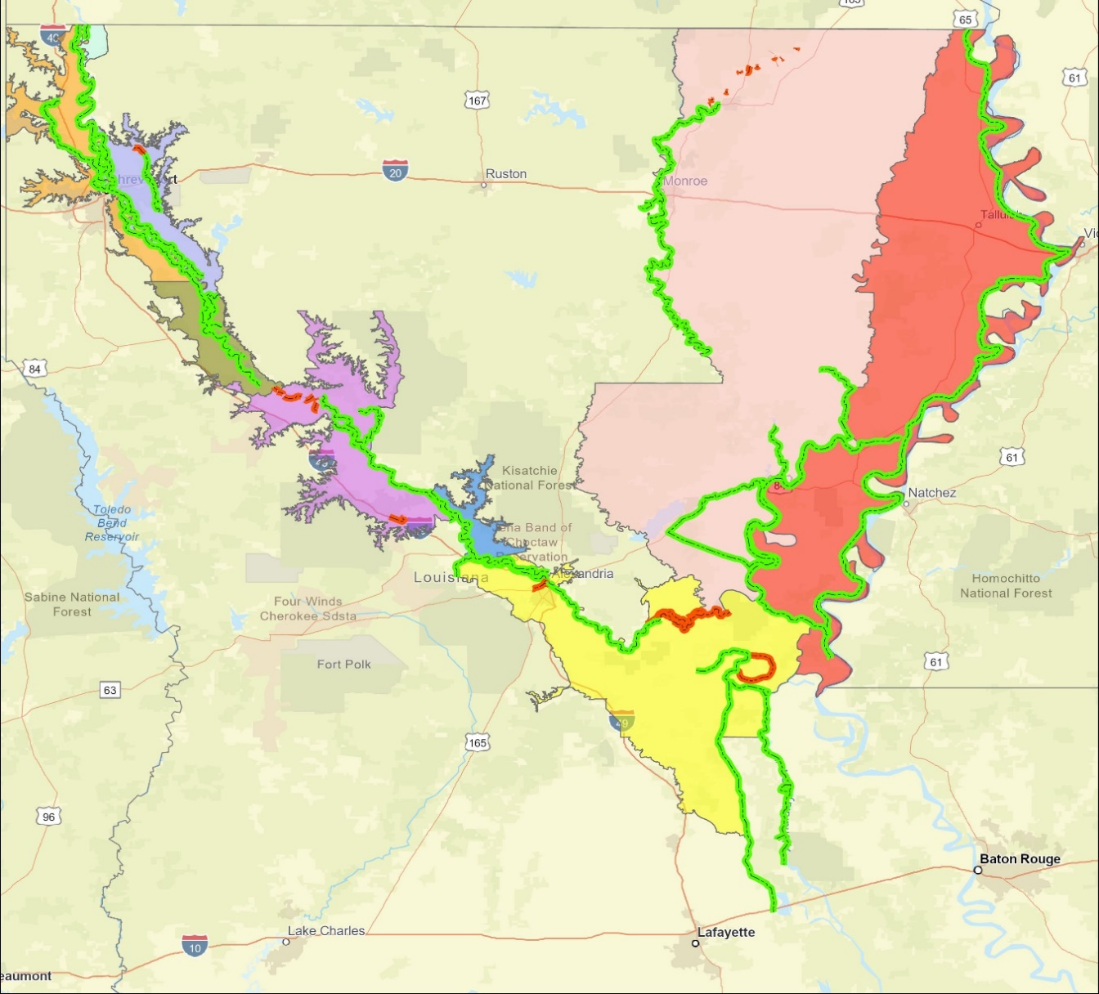
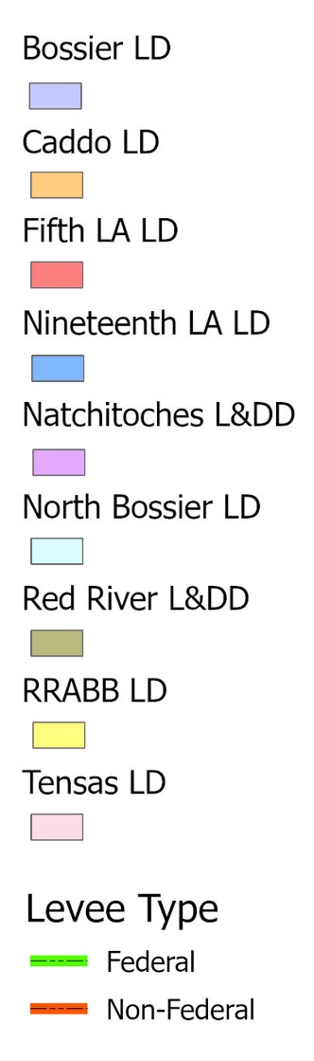
Levee Safety Program
Non-Coastal Levee Districts (9)
Federal 65.1
Non- Federal 4.3
Federal 116.7
Federal 306.3
Federal 26.2
Federal 69.3
Non- Federal 17.5
Federal 3.4
Federal 51.7
Federal 196.7
Non- Federal 55.2
Federal 249.9
Non- Federal 4.7
1,085 miles of levees inspected semi-annually
Notes:
Here are the nine Non-Coastal levee districts that are inspected showing their respective Federal and Non- Federal inspection miles. The levee safety program inspects about 1,000 miles of levees each quarter.
Next Slide – Levee Safety Services
NEXT SLIDE – Levee Safety Program Continued - Inspections

Slide 40
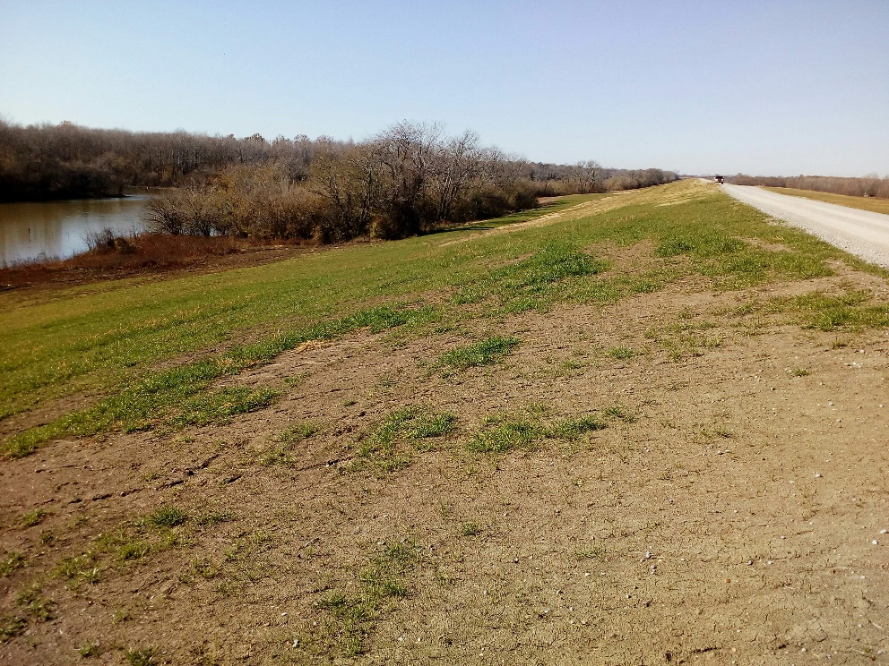
Levee Safety Program
Inspections
  Assist Levee Districts with their Inspections
  Provide Semi-Annual Inspection Reports
  Provide Recommendations/Options for Corrective Actions
  Flood inspections / Monitoring
Inventory/Mapping
  Inventory Levee Assets
  Develop GIS Maps
Training Compliance
  Online training for levee inspectors
Vegetation Established over Repaired Slide
Notes:
-Talk about the GIS platform – inventory, condition asses, closure plans, Emergency actions all at your finger tips
-Working through the technical issues of levee staff access
Next Slide – LS Capital Outlay
NEXT SLIDE – Dam Safety

Slide 41
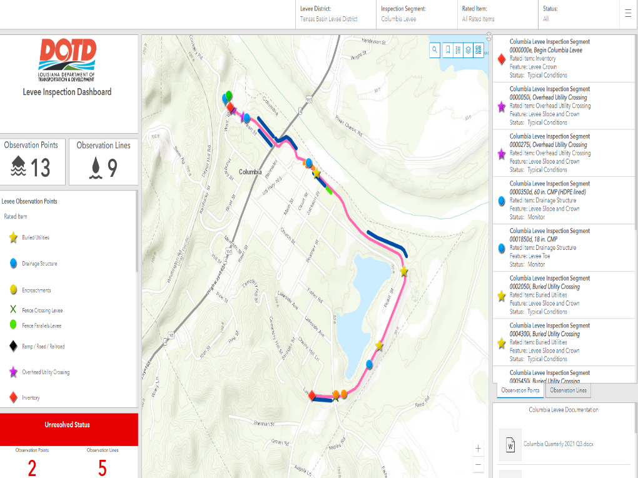
Levee Safety Program
Levee District Dashboards
  Ability to see current data (read only)
  Capable of downloading reports \ maps
Notes:
-Talk about the GIS platform – Levee District Dashboards developed for levee districts to view the current status of rated items and have the ability to download inspection reports/maps..
Next Slide – LS Capital Outlay
NEXT SLIDE – Dam Safety

Slide 42
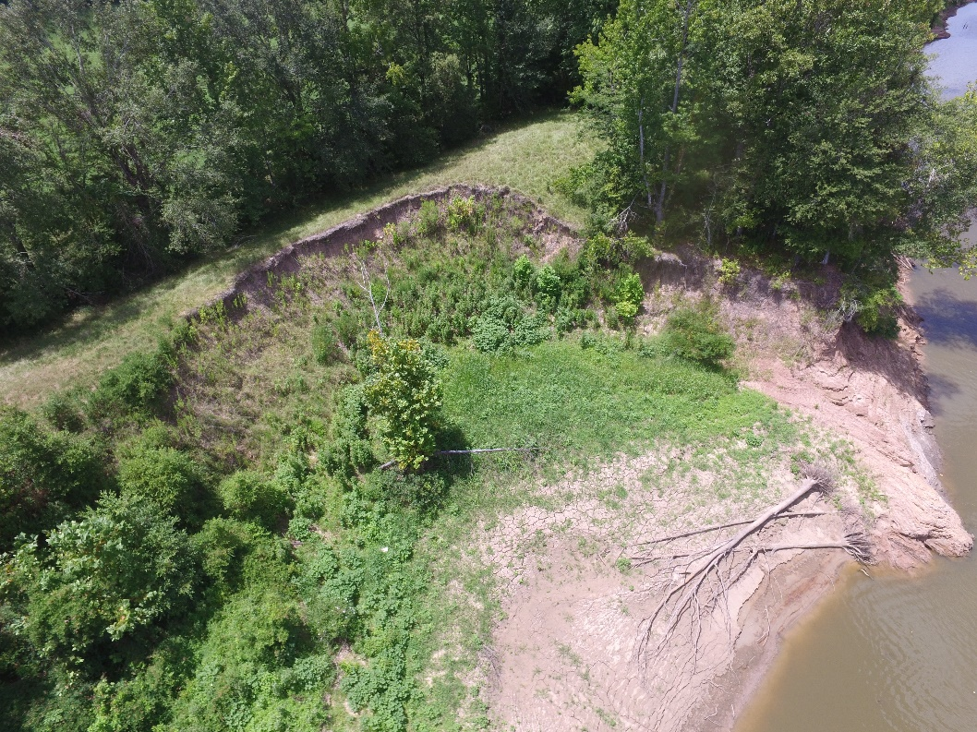
Levee Safety Program
Other Services: Capital Outlay Requests
Tensas Basin Levee District:
  $24 million approved in fall of 2020
  TBLD is currently utilizing $5.43M on existing projects
Natchitoches Levee & Drainage District:
  Recently completed:
    $500K levee crown restoration
    $200k drainage structure protection
  Additional levee crown restoration planned for CY 2024
Bank Caving
Notes:
The Levee Safety Program also provides project management for Capital Outlay Requests to finance levee projects
Next Slide – Dam Safety Program

Slide 43
The
Dam Safety Program
DOTD
is the
Statewide Coordinating Agency
RS 38: 21-28
Notes:
The Department of Transportation and Development is the State Coordinating Agency for the National Flood Insurance Program (NFIP).
Next Slide – Dam Safety numbers

Slide 44
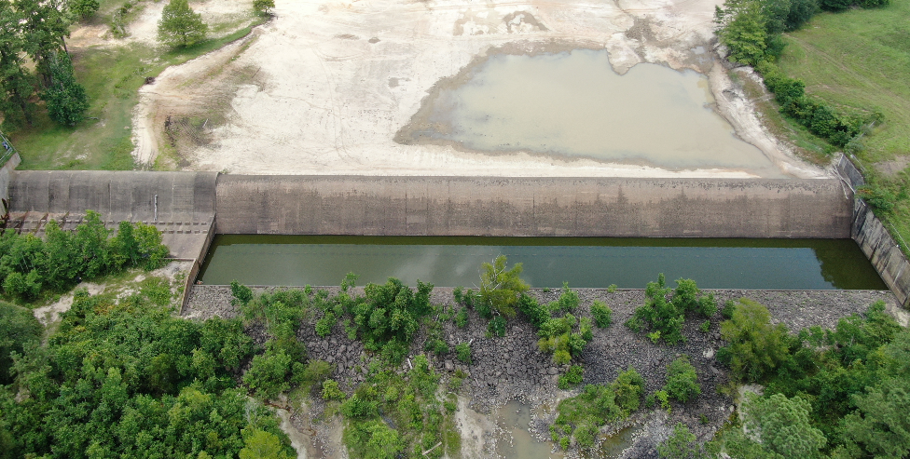
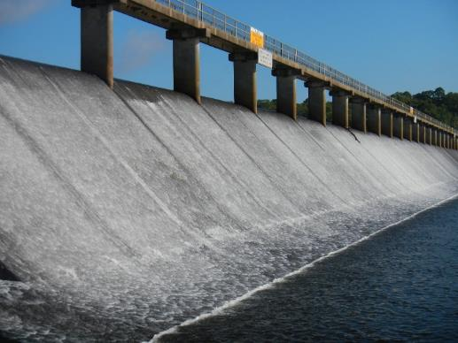
Dam Safety Program
660 Regulated Dams
(As of November 20, 2023)
43 High Hazard
67 Significant Hazard
550 Low Hazard
16 Under Investigation
Ogee weir spillway during lake draw down
Lower Anacoco Dam, Vernon Parish
Spillway at Bayou D’Arbonne,
Union Parish
Notes:
State Dam Safety Program – number of dams has decreased in the last few years by about 30.
NEXT SLIDE – Dam Inspections

Slide 45
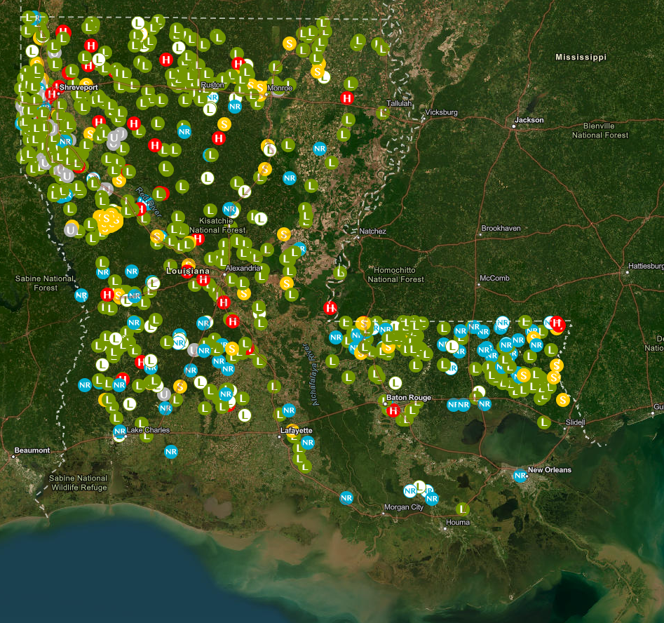
Dam Safety Program
Inspections
Dam Inspection Frequency Based on Downstream Hazard Potential:
  High Hazard – Annually
  Significant Hazard – 3 years
  Low Hazard – 5 years
Dams in Louisiana
Notes:
Map showing distribution of dams in the Dam Safety Program
NEXT SLIDE –State Maintained Dams

Slide 46
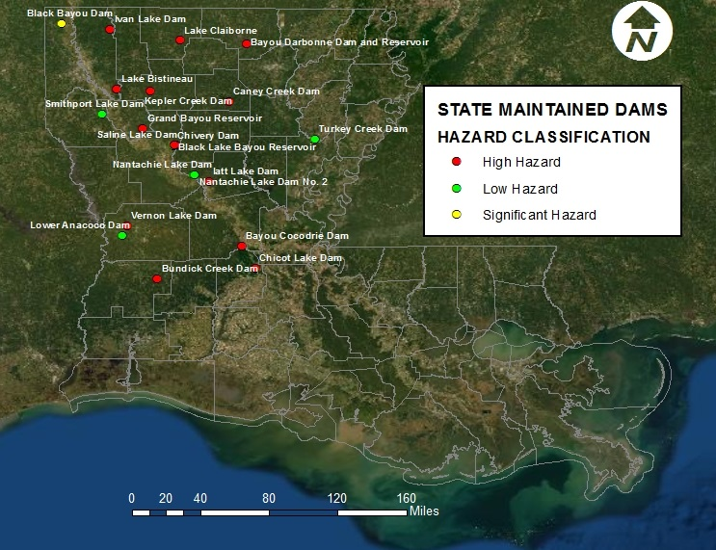
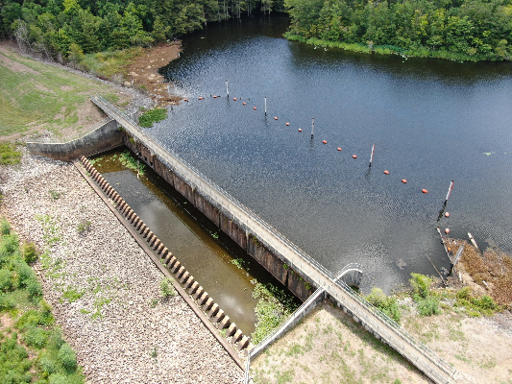
Dam Safety Program
DOTD Maintained Dams
LA RS 38:26
21 DOTD Maintained Dams
  13 High Hazard
  2 Significant Hazard
  6 Low Hazard
(All DOTD Maintained dams are inspected annually)
Spillway at Chicot Lake Dam, Evangeline Parish
Notes:
Location of 21 Dams that DOTD operates and maintains per statute LA RS 38:26
NEXT SLIDE – Dams – Capital Outlay Projects

Slide 47
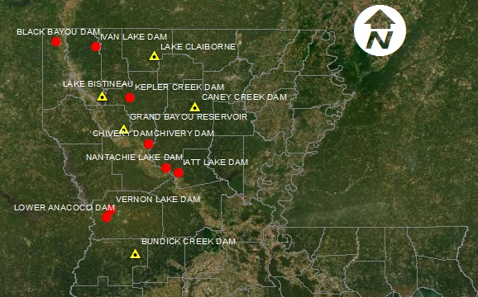
Dam Safety Program
State Maintained Dams – Capital Outlay Projects (14)
Safety Measures Only (9 Projects)
Gate Rehab/Maintenance & Safety Measures (5 Projects)
Total Projects = $2.5 Million
Notes:
Total Capital Outlay $2.5 Million
Safety Measures – warning signs, boater barriers, fences
(Bundick Lake Gate Replacement) $890,812; on hold -Drawdown begins again in May-lake levels are a challenge
Three Safety Measures projects (Anacoco Lake Dam, Vernon Lake Dam & Lake Bistineau Lake Dam) are being designed
NEXT SLIDE – Other Services

Slide 48
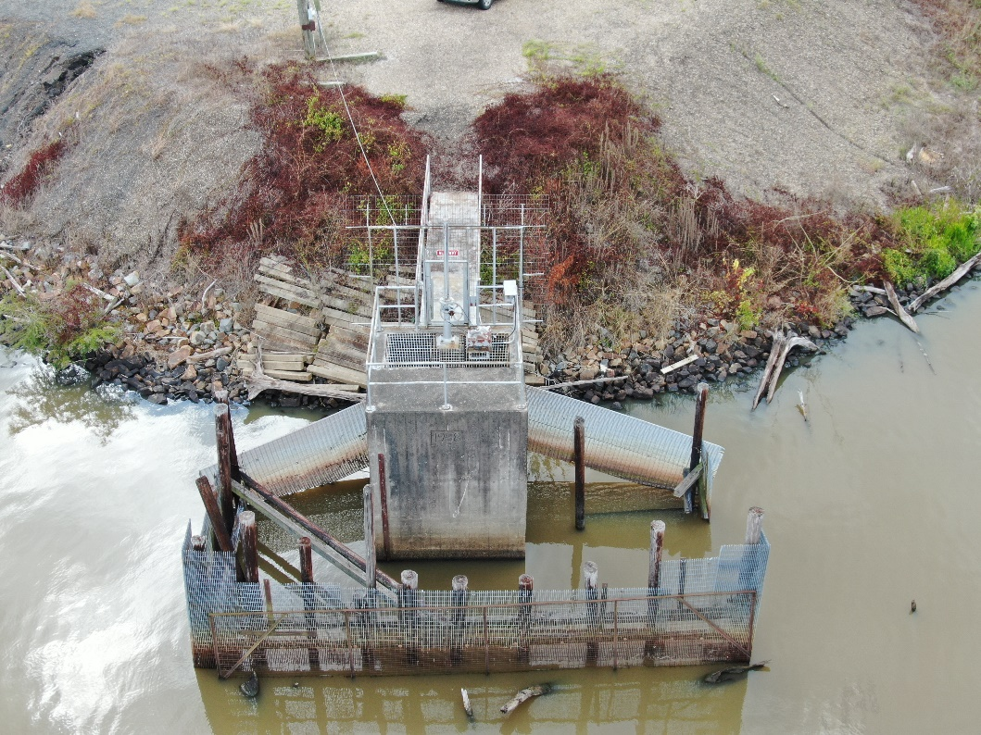
Capital Outlay Projects
H.007773/Bundick Lake Gate Replacement
Projected Completion Summer 2024
Total Costs = $900,000
Replace Drawdown Gate
Replace Trash Screen
Replace Handrails
Safety Buoys @ spillway
Safety Signs

Slide 49
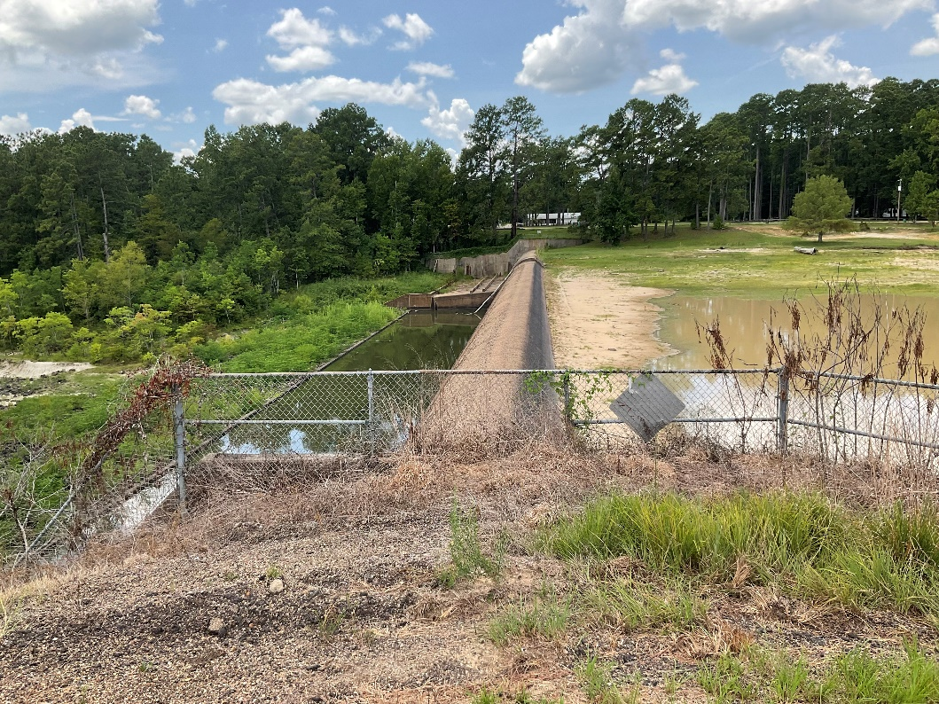
Capital Outlay Projects
H.014935/Safety Measures at Lower Anacoco Dam
Projected Completion Summer 2024
Total Costs = $410,000
Replace Handrails
Safety Buoys @ spillway
Safety Signs
Fencing/Access Control @drawdown structure

Slide 50
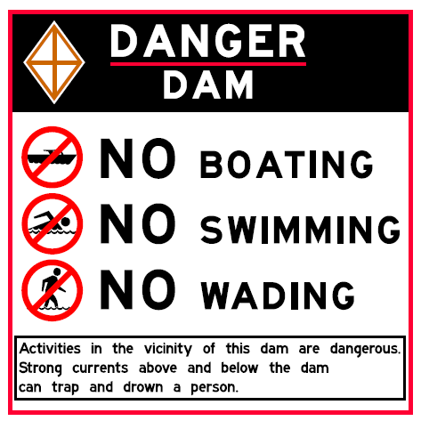
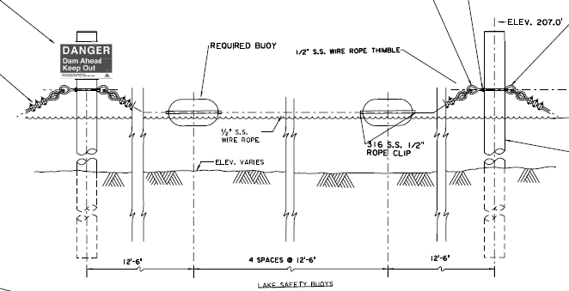
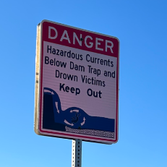
State Maintained Dams
Safety Measures
P&S for safety signage and buoys
Sign installation underway
Signs tracked in inspection app
Notes:
P&S done in-house. Thank You Morgan Barranco for your efforts.
Most signs to be installed by districts. Some signs and buoy system to be a contracted installed.

Slide 51
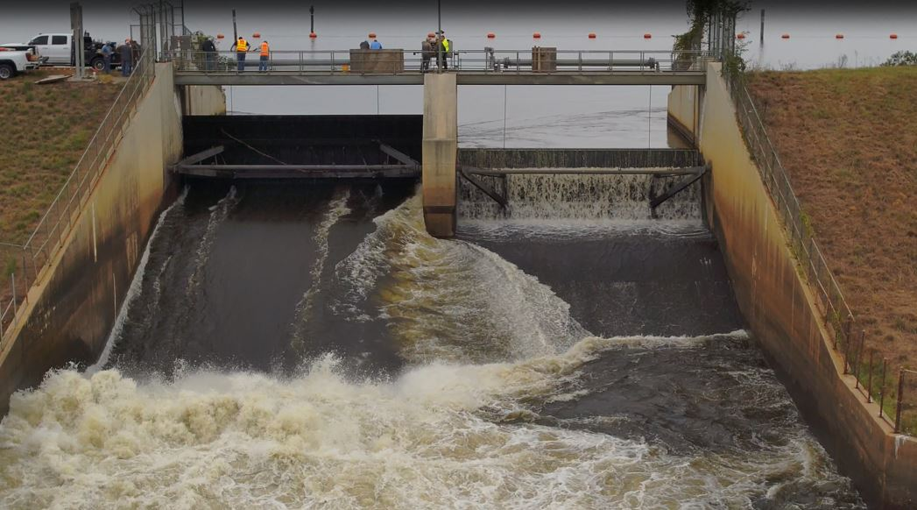
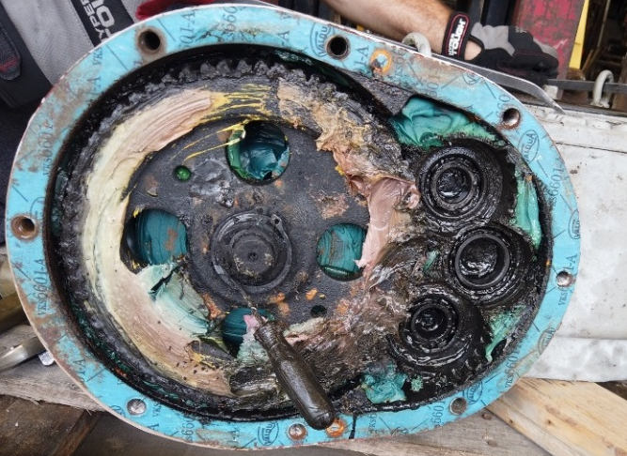
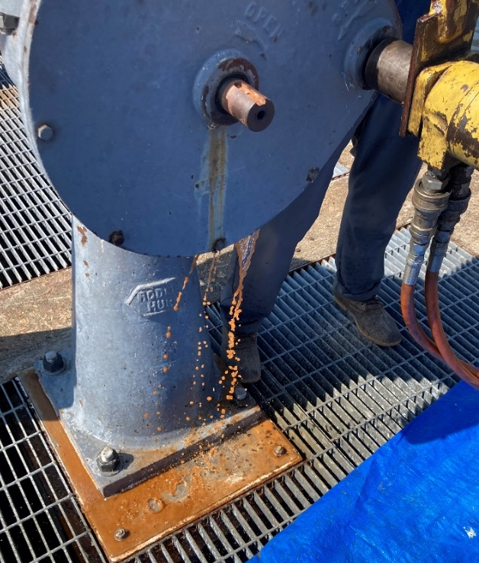
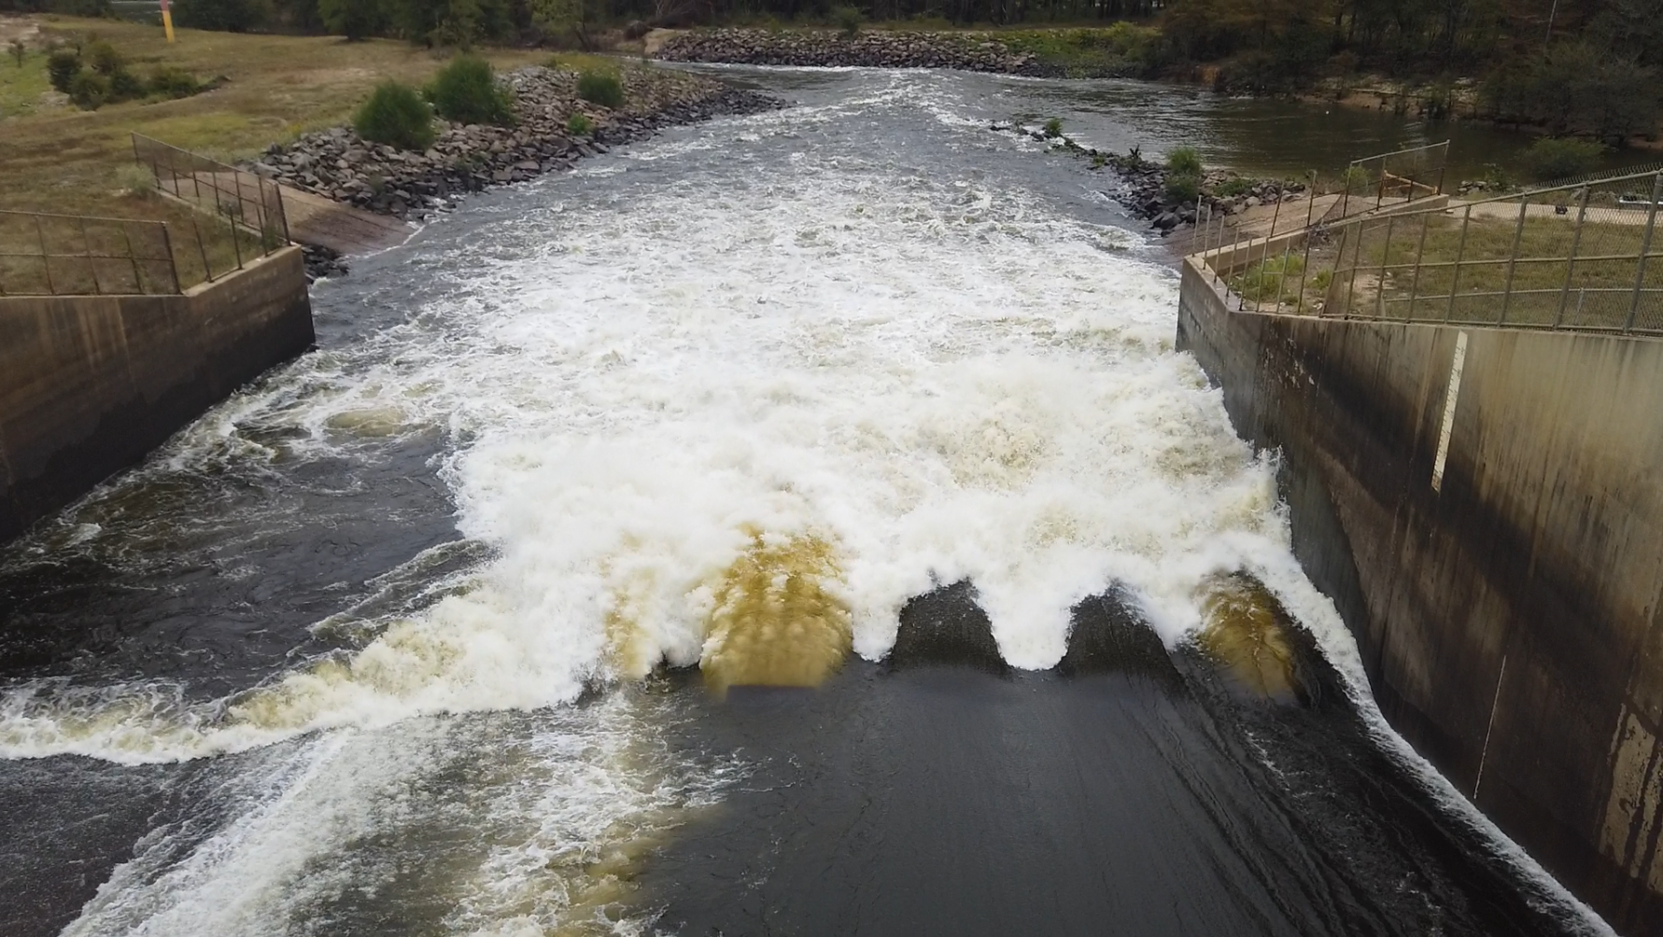
State Maintained Dams
Gearbox Repairs
Lake D’Arbonne (complete)
Vernon Lake (underway)
Repair vs. Replace?
Re-visiting Maintenance Procedures
Notes:
As we extend the service lives of many of our structures, it is becoming more and more difficult to reliably source replacement parts, even custom-made.

Slide 52
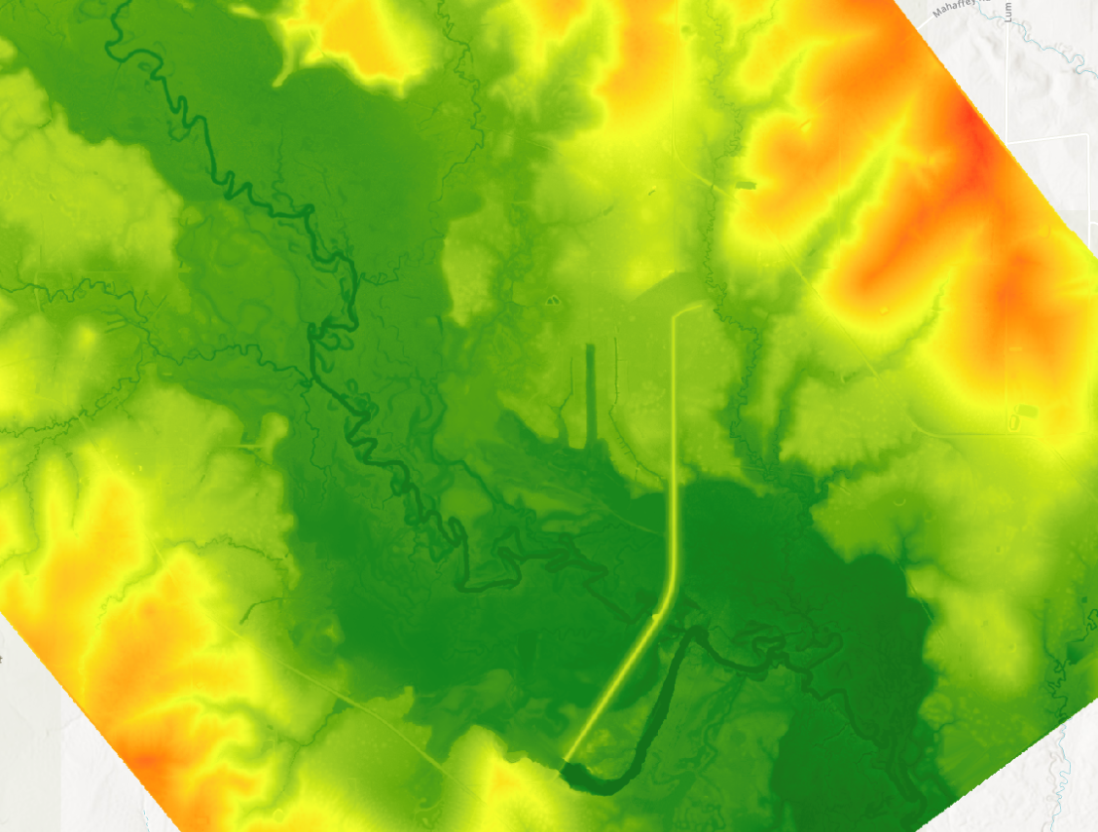
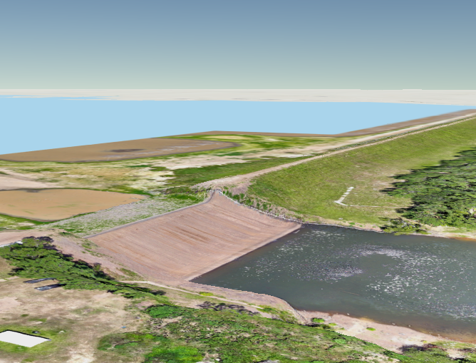
State Maintained Dams
Drawdowns and Data Collection
Coordination and collection of LiDAR during drawdowns
Drone imagery for photogrammetry
Notes:
In addition to ongoing coordination with DOTD Location & Survey, Dam Safety staff have also become certified drone pilots, using in-house equipment to collect valuable information about dam across the state. This program is still being developed further.

Slide 53
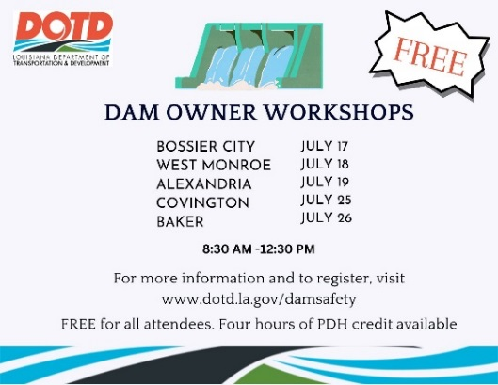
State Maintained Dams
Dam Owner Workshops

Slide 54
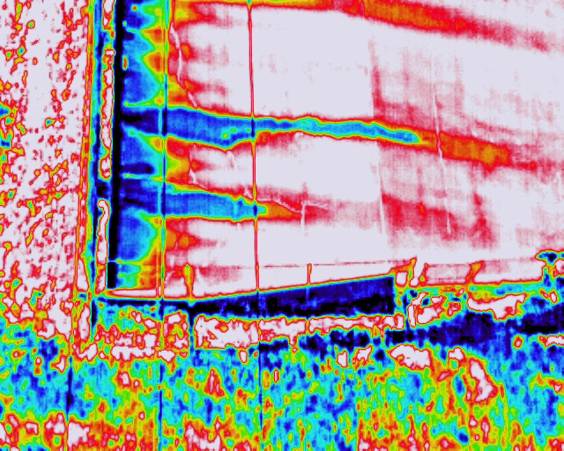
State Maintained Dams
Other Activities
Inspection app Refinements
  Letter generator
  Signage Layer
  Low Head Dams
Ongoing Efforts
  Evaluation of embankments using thermal imaging
  Installation of Gate Actuators

Slide 55
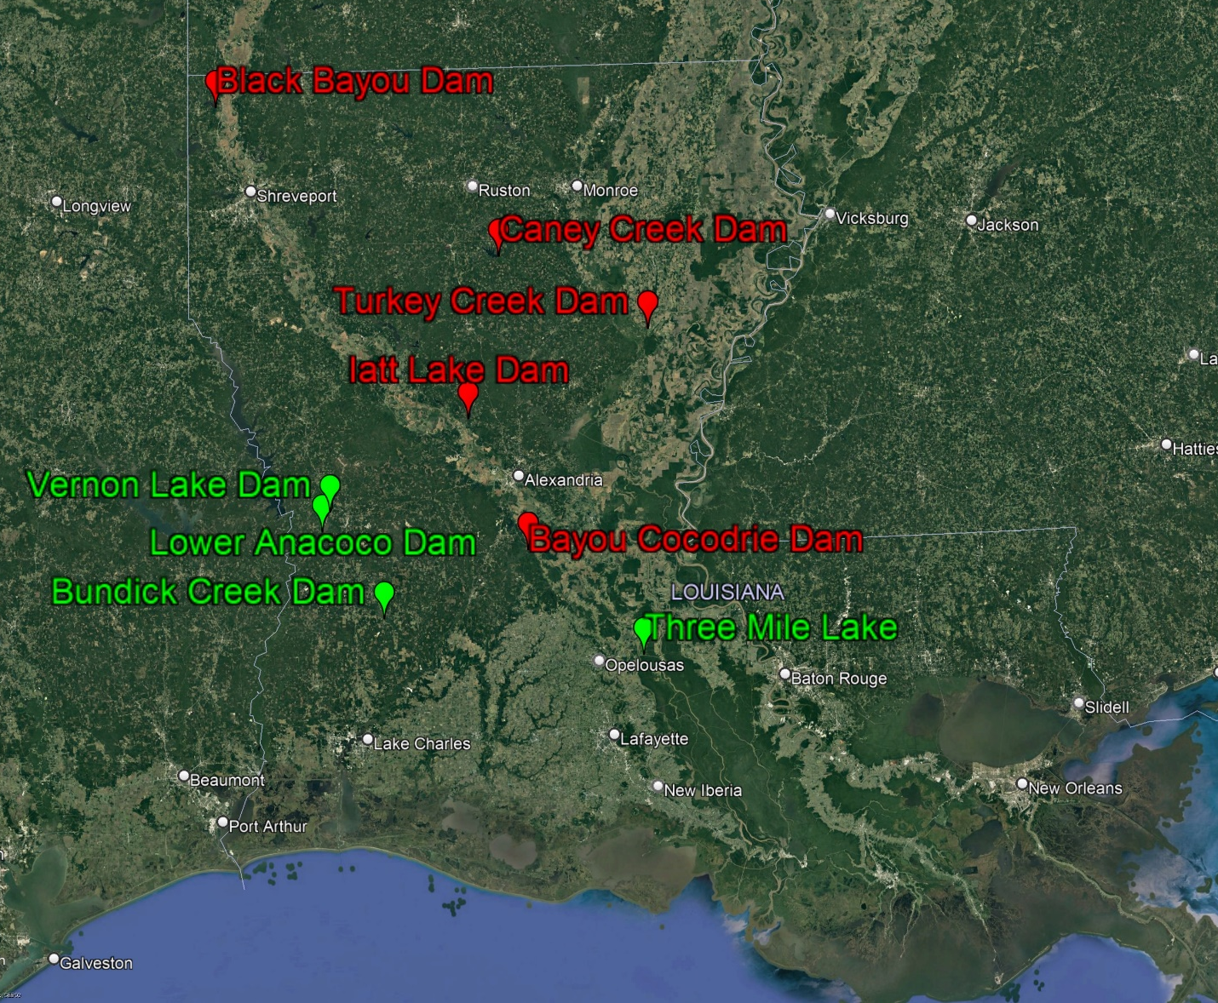
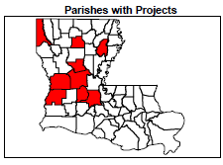
LWI State Projects
Group 1
  Michael Baker International
Group 2
  Freese and Nichols
Cost = $53M
Notes:
NEXT SLIDE – Group 1 Projects

Slide 56
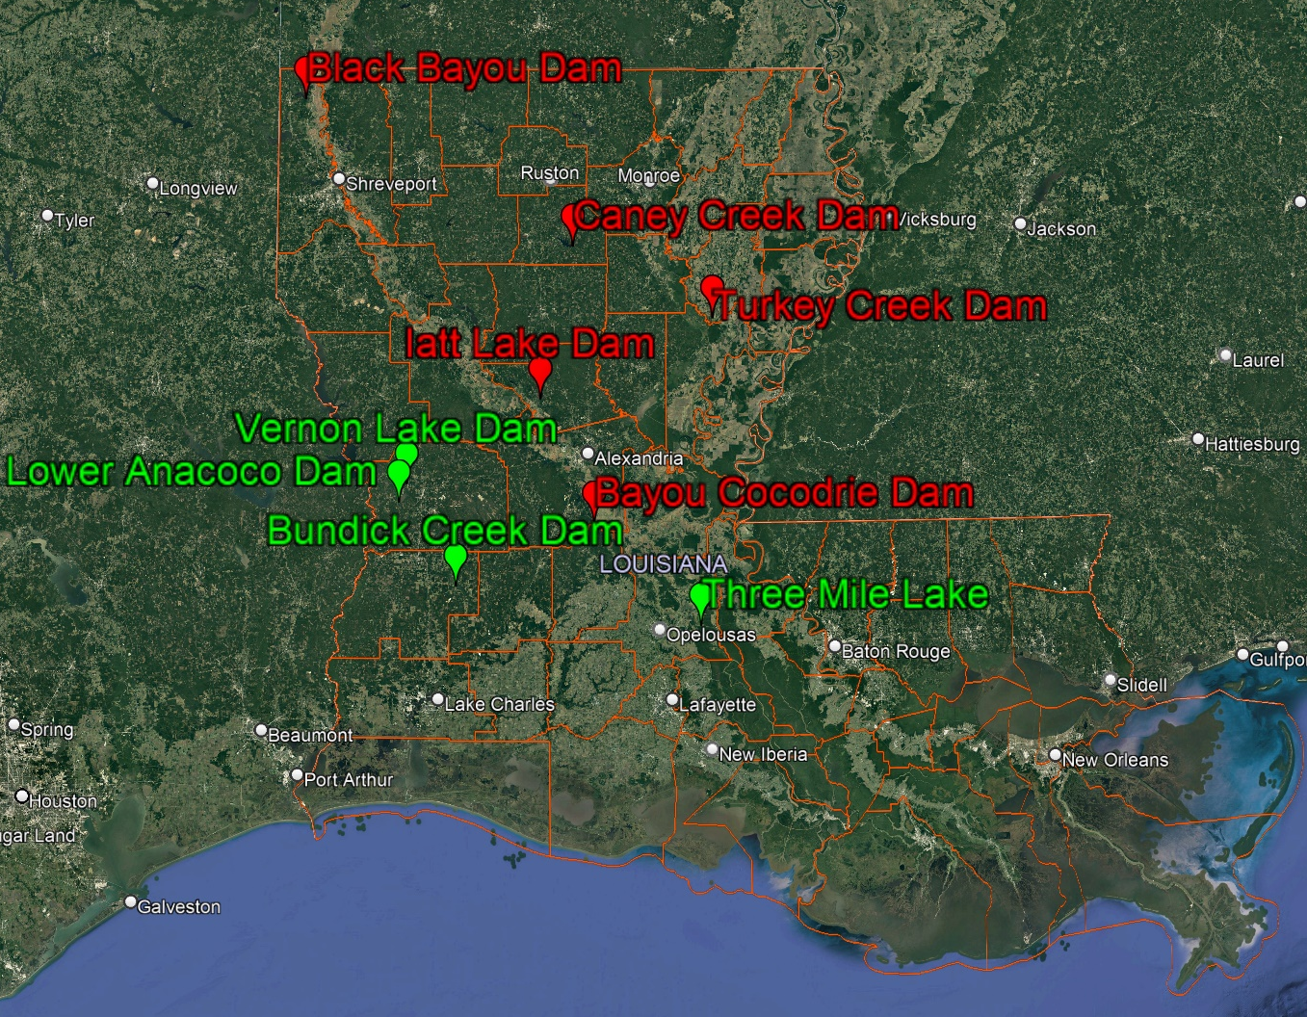
LWI State Projects
Group 1
  Michael Baker International
Group 2
  Freese and Nichols
Cost = $53M
Notes:
NEXT SLIDE – Group 1 Projects

Slide 57

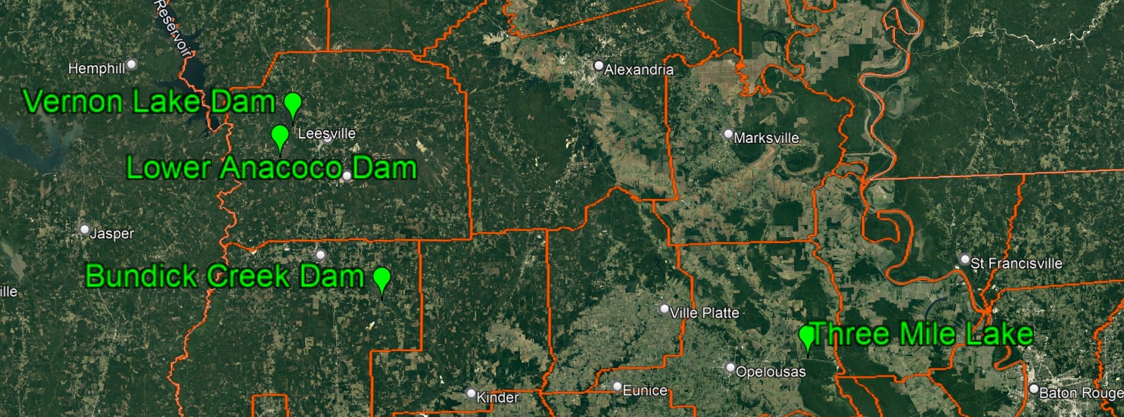
LWI State Projects
Group 1 Projects
Anacoco Creek Watershed: Flood surcharge management
  Anacoco Lake Dam & Vernon Lake Dam
Bundick Creek Dam: Flood surcharge management
Three Miles Lake: Backwater Flood Reduction
Notes:
Contract Amount – $2.2 Million
Contract Time – 5 Years
Executed on April 21, 2022
Submit Feasibility Report & H&H Models in December 2023
NEXT SLIDE – Group 2 Projects

Slide 58

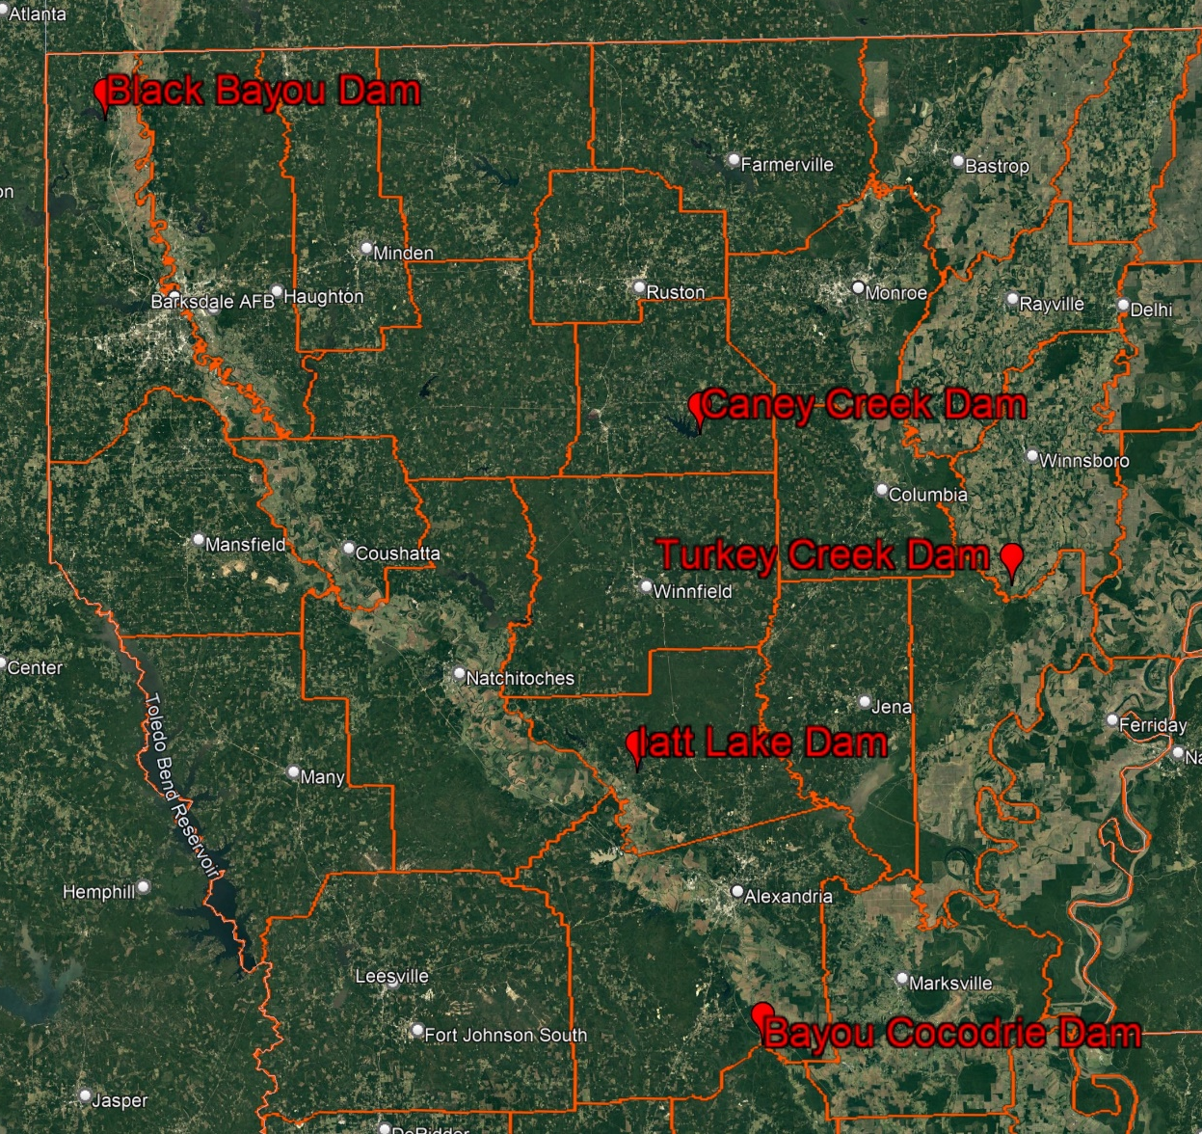
LWI State Projects
Group 2 Projects
Black Bayou Dam: Hardening and Retention Improvement
Caney Creek Dam: Flood Surcharge Management
Bayou Cocodrie Dam: Retention Improvement and Critical Infrastructure Improvement
Iatt Lake Dam: Drawdown Improvements
Turkey Creek Dam: Retention Improvement and Critical Infrastructure Improvement
Notes:
Contract Amount – $1.7 Million
Contract Time – 5 years
Executed on April 26, 2022
Completed Feasibility Report & H&H Models in October 2023
NEXT SLIDE –

Slide 59
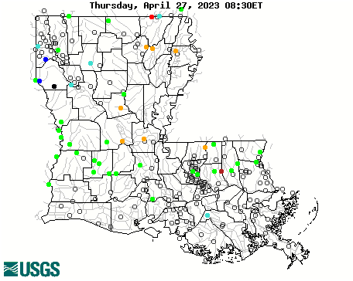
Other Services in
Public Works and Water Resources
USACE Non–Federal Sponsor
Red River Compact
USGS/DOTD Cooperative Programs
Support DNR - Water Well Inspection
Notes:
NEXT SLIDE – Questions

Slide 60
Questions ?

