Slide 1
NATIONAL LEVEE SAFETY PROGRAM

Slide 2
AGENDA
Overview of the National Levee Safety Program
USACE Levee Safety Program & National Levee Safety Program Connections
Stakeholder Engagement & Feedback
Products & Next Steps

Slide 3
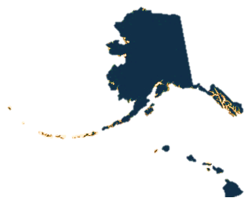
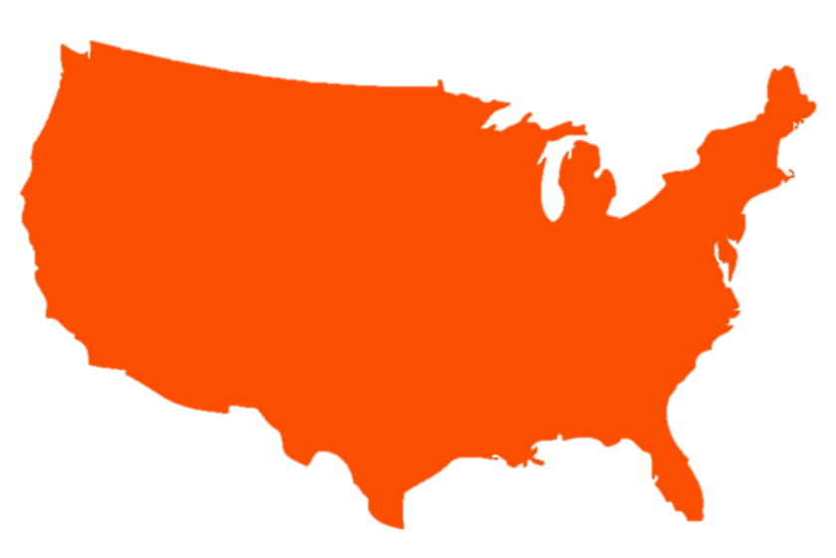
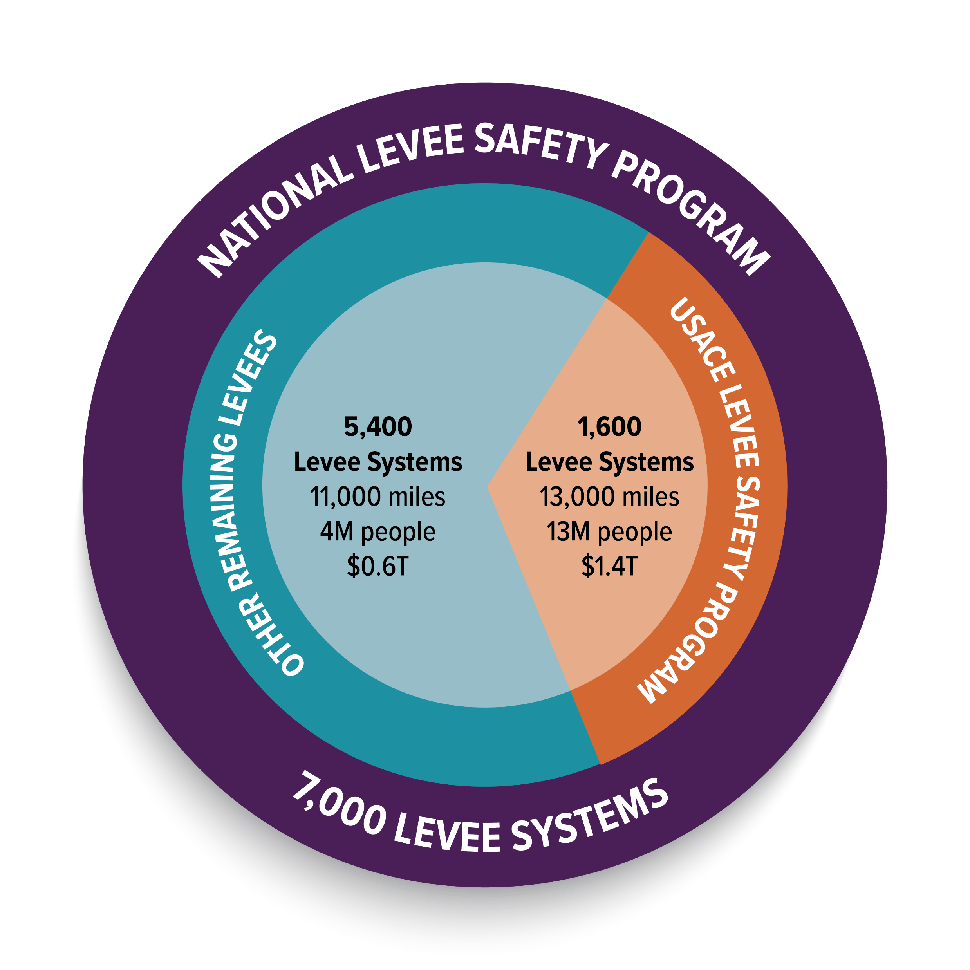
Levees-at-a-Glance
Main Sources of Information
USACE/Levee Sponsors
FEMA (location of 4,000 levees)
States/Federal Agencies (info on 1,000 levees)
Notes:
We already know a lot levees. So let’s start with what we already know about levees in the Nation.
It’s important to see that the remaining 5400 levees in the Nation have some differences when looking at the levees that have been managed under the USACE LSP.

Slide 4
A Vision for Flood Risk Management
A more aware, prepared, and flood resilient Nation.
National approach
Improved public awareness
Timely and accurate data
Complementary roles and responsibilities
4
Notes:
We want to learn from history, not repeat it, so we’ve looked at a lot of historical reports written about this challenges.

Slide 5
NATIONAL LEVEE SAFETY PROGRAM Vision, Mission, Objectives
VISION: Reduce the impacts of flooding and improve community resilience in areas behind levees.
MISSION: To facilitate an integrated framework for managing reliable levee systems to protect people and reduce property damage from floods.
OBJECTIVES:
Clarifying roles and responsibilities.
Providing resources and tools to manage levees.
Access to information.
Reduce environmental impacts.
Align federal agency programs starting with USACE and FEMA.

Slide 6
National Levee Safety Program Purposes (33 USC 46)
(1) ensure human lives and property that are protected by new and existing levees are safe
(2) encourage the use of appropriate engineering policies, procedures, and technical practices for levee site investigation, design, construction, operation and maintenance, inspection, assessment, and emergency preparedness
(3) develop and support public education and awareness projects to increase public acceptance and support of levee safety programs and provide information
(4) build public awareness of the residual risks associated with living in levee-protected areas
(5) develop technical assistance materials, seminars, and guidelines to improve the security of levees of the United States
(6) encourage the establishment of effective state, regional, and tribal levee safety programs
Notes:
The National Levee Safety Program was designed with these challenges in mind.
USACE & FEMA designing this together.

Slide 7
Main Components of the National Levee Safety Program (33 USC Ch. 46)
Notes:
What is the National Levee Safety Program
Congress told USACE and FEMA through legislation to stand up the NLSP.
Started back in 2007 after Katrina, really got momentum in and around 2014 after report when to Congress with some framework for the program.
The legislation has been amended serval times but you can see the compiled legislation in 33 USC Chapter 46.

Slide 8
National Levee Safety Guidelines
GOAL: Serve as a national resource of voluntary, best practices to help achieve nationwide consistency in improving the reliability of levees & resiliency of communities behind levees throughout the nation
Federal agency partners help ensure:
Technical accuracy and quality of content in their area of expertise
Consistent use of concepts and terminology
No content redundancies or contradictory information exists
Notes:
Will be out in the spring of next year.
How it’s being developed.
Started with extensive review of existing literature on best practices for levees throughout the nation
Written by chapter leads from outside USACE.
Extensive internal and external review process.

Slide 9
National Levee Safety Guidelines General Topics
Ch. 2 Understanding Levee Fundamentals
Ch. 4 Estimating levee Risk
Ch. 5 Managing Levee Risk
Ch. 9 Operating and Maintaining a Levee
Ch. 10 Managing Levee Emergencies
LEVEE BASICS, ESTIMATING & MANAGING LEVEE RISK
OWNER/ OPERATOR RELATED
CLIMATE CHANGE
UNDER-SERVED COMMUNITIES
FLOODPLAIN BENEFITS
Ch. 6 Formulating a Levee Project
Ch. 7 Designing a Levee
Ch. 8 Constructing a Levee
Ch. 11 Reconnecting the Floodplain
Ch. 1 Managing Flood Risk
Ch. 3 Engaging Communities
Ch. 12 Enhancing Community Resilience
INFRASTRUCTURE RELATED
COMMUNITY
RELATED
Notes:
Will help develop a set of best practices and guidelines for the Nation.
Helps us prepare for adapt to climate change, increased development within floodplains.. And most importantly how we consider all of these factors as we make decisions in a consistent approach.
Guidelines will be one the first products that we roll out and the first draft will be sometime in early 2024.

Slide 10
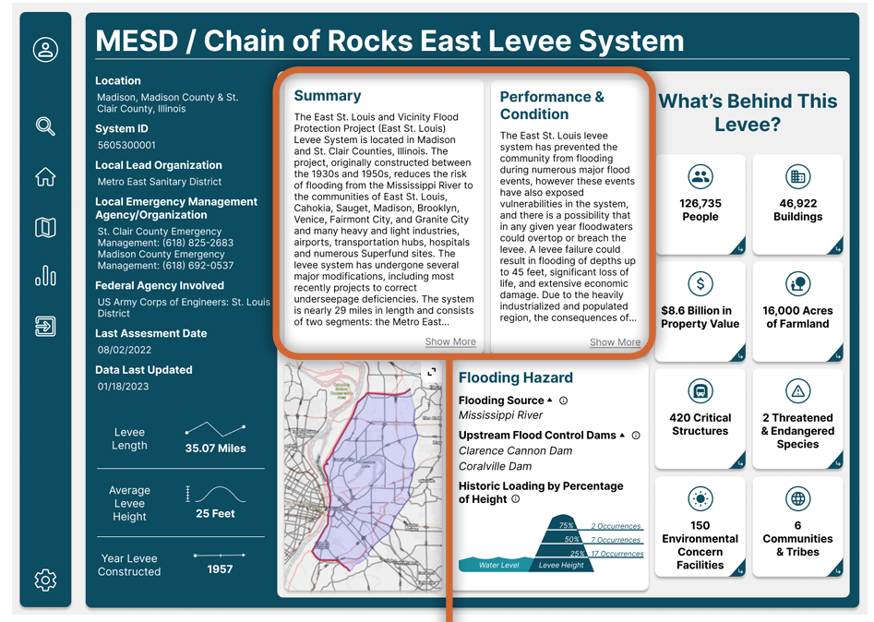
National Levee Database A resource for many
Appropriators –understand how levees may be ranked with other national priorities
Federal Agencies – For supporting programs in FEMA, National Weather Service, Dept of Homeland Security, Dept Housing and Urban Development
Agencies that Manage Levees – manage inventory, prioritize activities/resources, track risk reduction, flood response
Levee Owner/Operators - operations and maintenance priorities; emergency planning and response; track condition over time; inform community leaders
Local Government Agencies - use information to inform floodplain management, permitting and land use decisions
Private Sector – for public and private sector projects
Academia and Researchers – to advance science

Slide 11
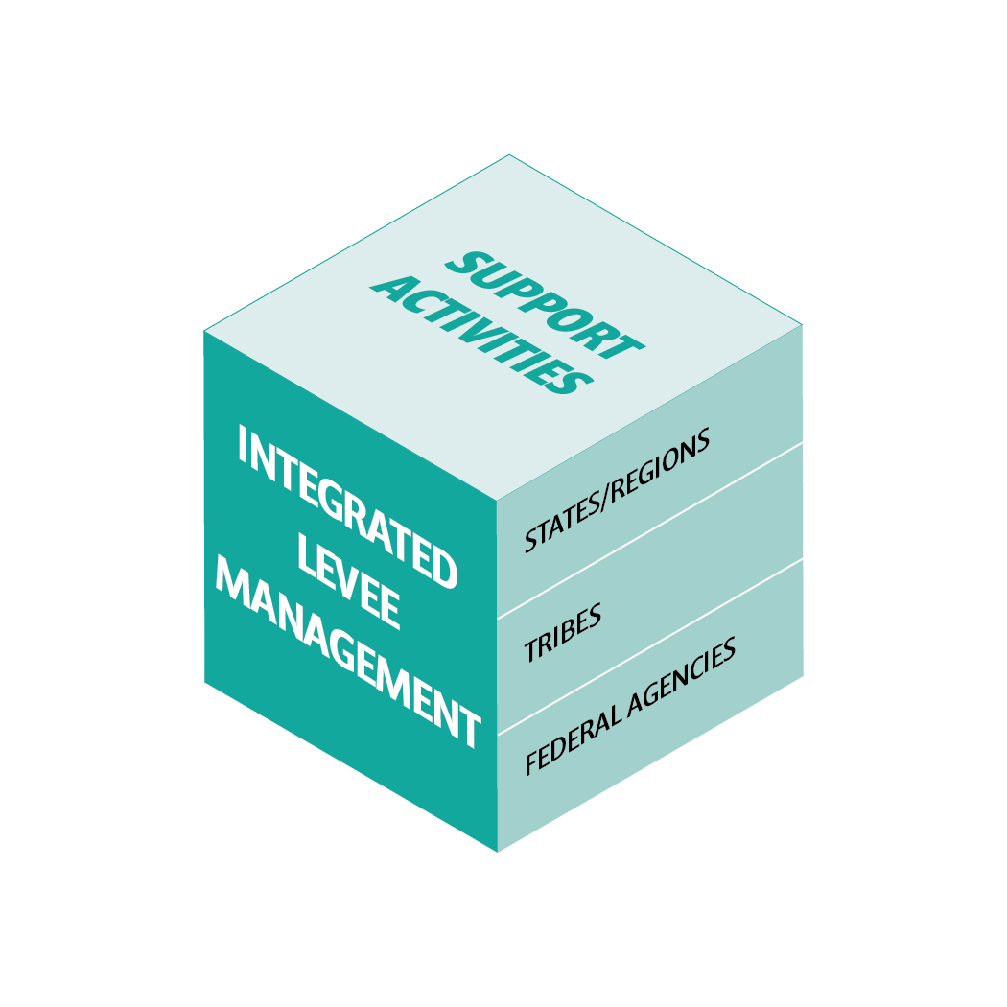
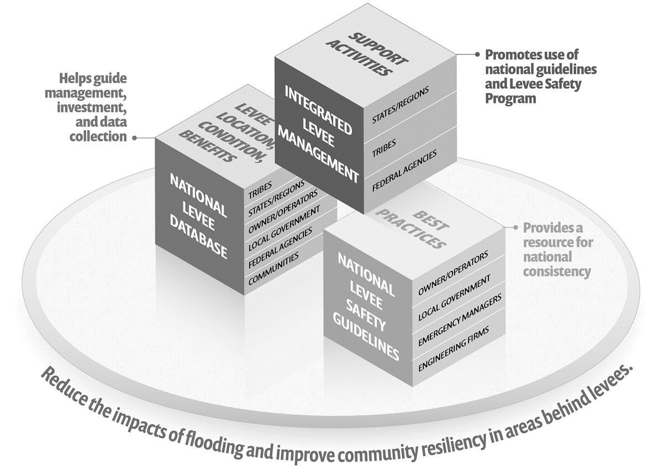
Integrated Levee Management
GOALS:
Clarify roles and responsibilities to improve coordination and implementation in order to be more complementary, streamlined, and effective in managing all levees in the Nation.
Promote and encourage formal levee safety programs at the state level to serve as key integrators with other entities that have levee responsibilities.

Slide 12
Levee Review
WHAT: Conducting a levee assessment with states and participating levee owner/operators to understand levee conditions
WHY PARTICIPATE: Provides information to help
States make more informed decisions when providing state assistance or when seeking federal assistance for levee-related projects
Levee owners make more informed decisions about operation and maintenance activities
Communities to use for emergency planning or land-use decisions
Notes:
Will help refine the unknown owners
Will help states, regions, tribes understand the landscape in their backyard.
See bullets on the WHY TO PARTICIPATE.

Slide 13
USACE & NSLP Connections?

Slide 14
Programs Recap
Notes:
The INTENT is to provide a consistent framework for making decisions for ALL levees in the Nation… I like the phrase, NO LEVEE LEFT BEHIND….
Currently, there is a consistent framework for the 1600 Federal levees, established by USACE’s LSP.
The intent is for the NSLP (a) to make available a consistent BUT scalable framework to make decisions for the 5400 levees. For the 1600 levees, much of what is already being done under the USACE LSP will be complimentary to the NLSP.

Slide 15
Connection – USACE Levee Safety Program
The USACE Levee Safety Program applies to approximately 1,600 levees in the US. The program brings a consistent framework for federal USACE levees, emphasizing working with levee sponsors to better understand, prioritize, manage, and build awareness regarding the flood risks associated with levees.
USACE Levee Safety Program
Specific to USACE authorities for levees
Will align and not conflict with the approaches of the National Levee Safety Guidelines
USACE uses the National Levee Database to manage its levee information

Slide 16
Connection – Section 408
Section 408 allows USACE to grant permission to other entities to alter USACE Civil Works projects, including levees.
Section 408
Requirements are dictated by Section 408 regulations and only applies to USACE federally authorized levees
Levee sponsors will have access to the National Levee Safety Guidelines to help them meet requirements
The National Levee Database is linked to the Section 408 database

Slide 17
Vegetation Management
Section 3013 of WRRDA 2014 requires USACE to conduct a comprehensive review of its vegetation management policies for levees in order to develop approaches that take into account local and regional factors.
Vegetation management will be part of the development of the National Levee Safety Guidelines. Once complete, USACE will revise its policies to align with those best practices.
Workshop 1 (May 2023) – Develop or improve information for assessing environmental & engineering benefits of woody vegetation
Workshop 2 (June 2023) – Improve or identify vegetation information collection; develop a process to access vegetation information and impacts to levee performance; develop guidance for how environmental and engineering benefits of woody vegetation should be considered for levee O&M

Slide 18
Stakeholder engagement & feedback

Slide 19
Development of Program Components Through Stakeholder Feedback Phases
Phase 1 Activities (Ended March 2022)
Conducted 3 public launch webinars
Conducted 9 virtual four-hour workshops (~600 attendees)
Initiated tribal engagement activities (webinars, phone calls, and emails)
Developed Phase 1 Public Comment Feedback Report and Theme Summary
Phase 2 Activities (Ended June 2023)
Conducted 8 topic-specific webinars (~220 attendees)
Conducted 8 in-person meetings (~60 attendees)
State workshops
Owner/Operator Workshop
Topic-specific workshops with experts on vegetation
Tribal engagement activities
Developed Phase 2 Public Comment Feedback Report and Theme Summary

Slide 20
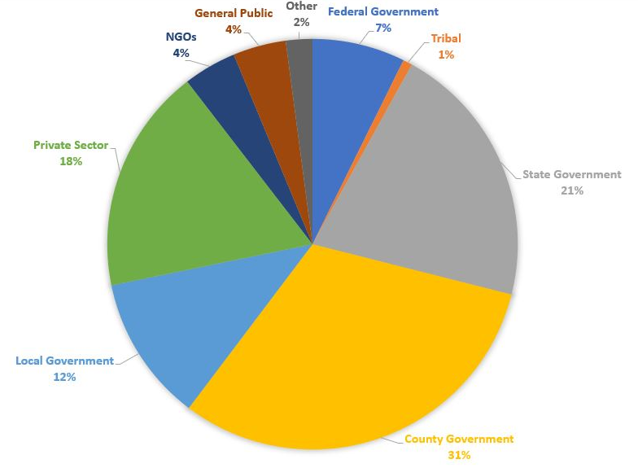
Overview of Stakeholders We Talked To
Notes:
Quick “strawpoll” indicated that between 50-75 percent of all participants on these calls were owner/operators.

Slide 21
Stakeholder Feedback to Date
UNCERTAINTY REGARDING PROGRAM IMPLEMENTATION
Concerns about how this will help
Unclear about what a risk-informed approach is and how it affects stakeholders
Concern that there is less focus on stronger/taller levees
Local vs. state vs. federal roles are unclear
FUNDING CONCERNS
Lack of funding to perform just basic maintenance
Concerns about increased costs with:
Aging infrastructure
Climate change
Extreme weather events
PARTNERSHIP WITH FEMA
Alignment is needed
Processes are challenging between the two agencies
Unclear how data are shared between agencies
Fear of impacts to flood insurance rates and levee accreditation
ADDED BURDENS
Fear of expanding levee owner responsibilities
Unclear who is responsible for ensuring public awareness of flood risk
Risk assessments seem costly and time consuming, and do not understand the value
Could lead to redundant oversight burdens
Notes:
General Program Feedback

Slide 22
Products & NEXT STEPS

Slide 23
Products & Next Steps
NEAR TERM
NEXT STEPS
Levee Cost Brochure - Available Now
National Levee Safety Guidelines - Spring 2024
National Levee Database Update/Launch - Spring 2024
One Time Levee Review - 2024
Levee Management Guide - TBD
Supplemental Products (EAP Template, O&M Template, Inspection Template) - TBD
USACE/FEMA Programs Guide - TBD
Model Levee Safety Programs Guide - TBD

Slide 24
National Levee Safety Program Website (www.leveesafety.org)
Notes:
This slide represents the entire stakeholder engagement process we have designed for this program.
As you can see, stakeholder engagement is at the foundation of developing a program that has so many potential audiences, each with distinctive needs and all the must work together for this to be successful.
Each of the phases has a particular purpose and as we go along will seek more detail on some of the activities, program components and materials.
Currently we are in the middle of Phase I: Scoping Phase.
We have recently completed 8 virtual scoping stakeholder meetings with over 500 people.

Slide 25
More Information
Michael Bachand, P.E.
Technical Manager
National Levee Safety Program
michael.l.bachand@usace.army.mil
www.leveesafety.org

Slide 26
QUESTIONS

Slide 27
More Information

Slide 28
National Levee Safety Guidelines Development Timeline
2015 - 2017
Source Review
2021 Kick-Off
2022
Confirm
Guideline Topics
2021 - 2023
Develop Content
Spring 2023
Refine Draft
2024
Independent Peer Review
Spring/Fall 2023
Federal Agency Partners Review Draft
Fall 2023/Spring 2024
Public Review
Notes:
This graphic represents a general timeline of guidelines development thus far & where we’re headed. Starting with an extensive literature review back in 2015 which I’ll discuss in more detail in a following slide. Upon receipt of funding for the initiative we held a kick-off meeting with the team, providing authors initial instructions to get started on developing content. For those of you who participated in the Phase 1 engagement sessions last year we took the opportunity to vett & refine the topics incorporated into the NLSG and author teams have been developing chapter content since that time.
The activities we have planned for this spring include several engagement sessions, both virtual and in-person in addition to a controlled release review of the draft content by fed partners. This summer we will incorporate feedback received from the review into the working draft with the goal of disseminating a comprehensive draft of the guidelines for public review and comment in the fall. We are also planning to have an independent peer review of the draft by scientists, engineers, and other technical experts to help inform future editions of the NLSG.

Slide 29
National Levee Database (New Homepage)
Quicker access to Search, Mapping, Data
Facts about levees in the Nation
Help guides for website and data management
Guidance on how to submit updated data
Levee 101 Basics

Slide 30
New Levee System Summary Format
High-level summary
Performance & Levee Condition
Identification of flood hazards / sources
People, infrastructure, other info of what is behind the levee
Basic Levee Facts

Slide 31
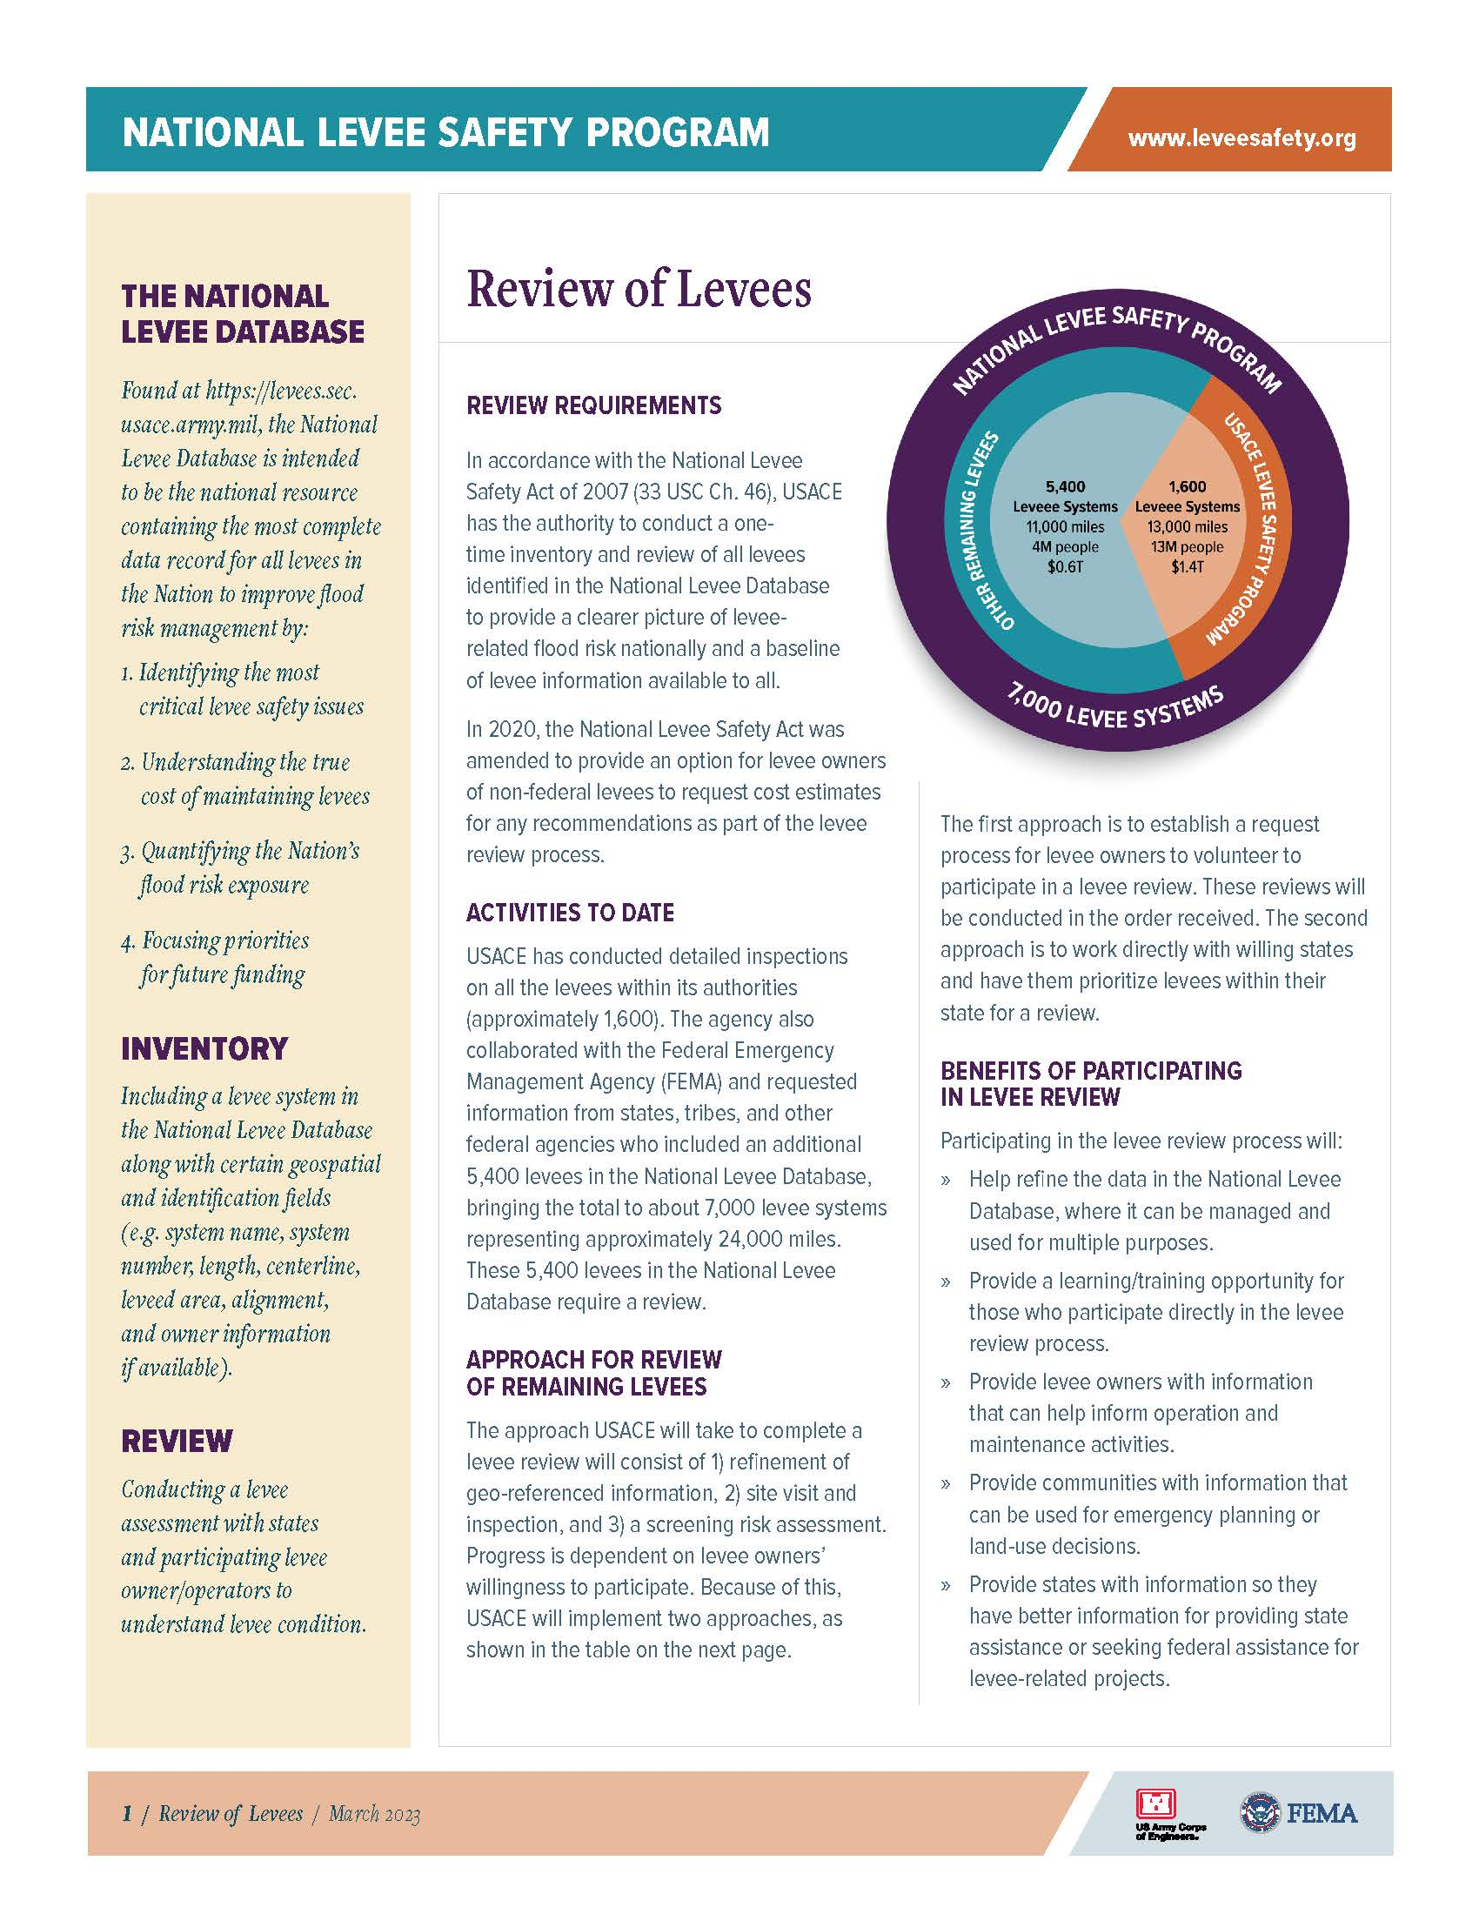
Levee Review
USACE is authorized to carry out a one-time inventory and review of all levees identified in the National Levee Database
Purpose - provide a clearer picture of levee-related flood risk nationally and a baseline of levee information available to all
Levee owners can volunteer to participate in a levee review
Conducted in the order received
Work directly with willing states to have them prioritize levees within their state

Slide 32
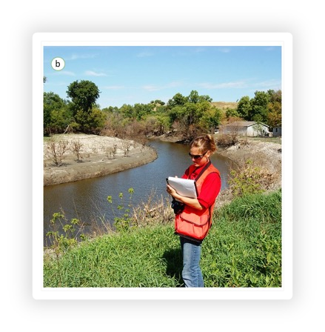
Levee Review Process
Refine geo-referenced information
Conduct site visit and inspection
Conduct screening risk assessment
Levee owners of non-federal levees can request cost estimates for recommended actions identified during the review process (new requirement from WRDA 2020)

Slide 33
Benefits of Participating in Levee Review
Help refine the data in the National Levee Database
Learning/training opportunity for participants
Levee owners obtain information to inform operation and maintenance activities
Communities obtain information to support emergency planning and land-use decisions
States obtain better information to provide support or seek federal assistance

Slide 34
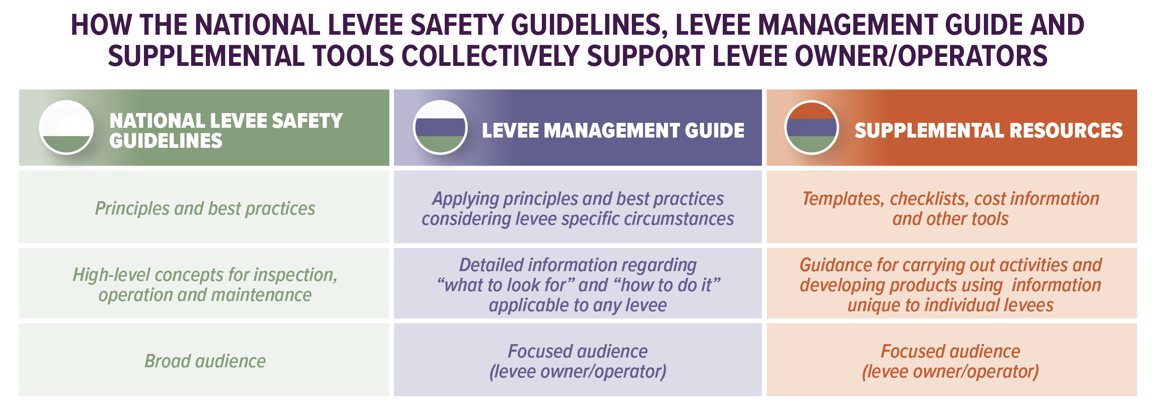
Levee Management Guide in Context

Slide 35
USACE/FEMA PROGRAM GUIDE FOR LEVEES

Slide 36
Existing Programs and Products that Could Support Levee Activities
USACE Programs
Planning Assistance to States
Flood Plain Mangement Services
Corps Water Infrastructure Financing Program
PL 84-99
Levee Rehabilitation (NLSP)
FEMA Programs
Building Resilient Infrastructure and Communities Funding
Flood Mitigation Assistance Grants
Hazard Mitigation Grant Program
Community Rating System
Safeguarding Tomorrow Revolving Loan Fund (STORM)
Assistance to States Levee Grant (NLSP)

Slide 37
Products That Guide Levee Activities
Hazard Mitigation Plans
Floodplain Management Plans
Operation & Maintenance Plans
Emergency Action Plans
Emergency Preparation Plans
Communication/Outreach Plans
Inundation Maps

Slide 38
Levee Related Activities
Inspection
Risk Assessment
Levee Repair/Rehabilitation
Culvert/pipe enlargement
Pump resizing
Data collection/management
Levee design/construction
Levee removal/setback
Awareness/communication
Improvements to community lifelines
House raises
Flood proofing
Property buyouts
Emergency exercises
H&H modeling
Future options analysis

