Slide 1
Association of levee boards of Louisiana
Pat Forbes, Executive Director LA Office of Community Development
LWI Overview Dec. 6, 2023

Slide 2
LWI Overview and Progress to Date

Slide 3
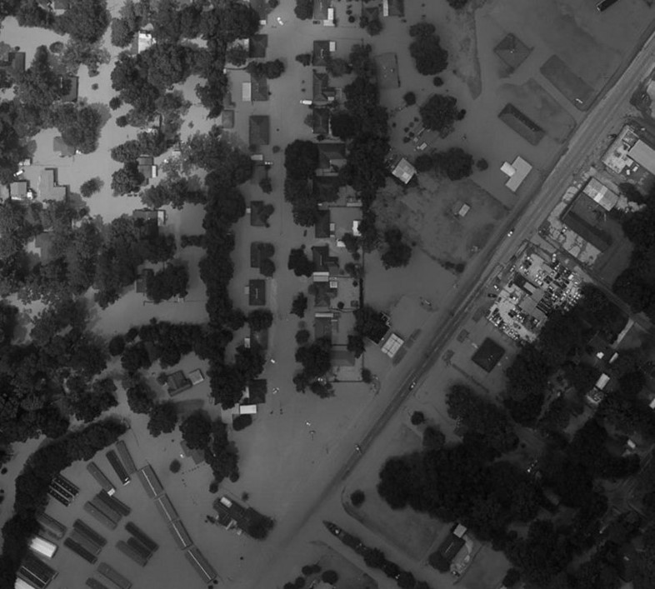
The challenge
Flooding does not follow political boundaries, as major watersheds cross parish and state lines.
Actions in one community can impact entire ecosystems.
2016 FLOOD, DENHAM SPRINGS

Slide 4
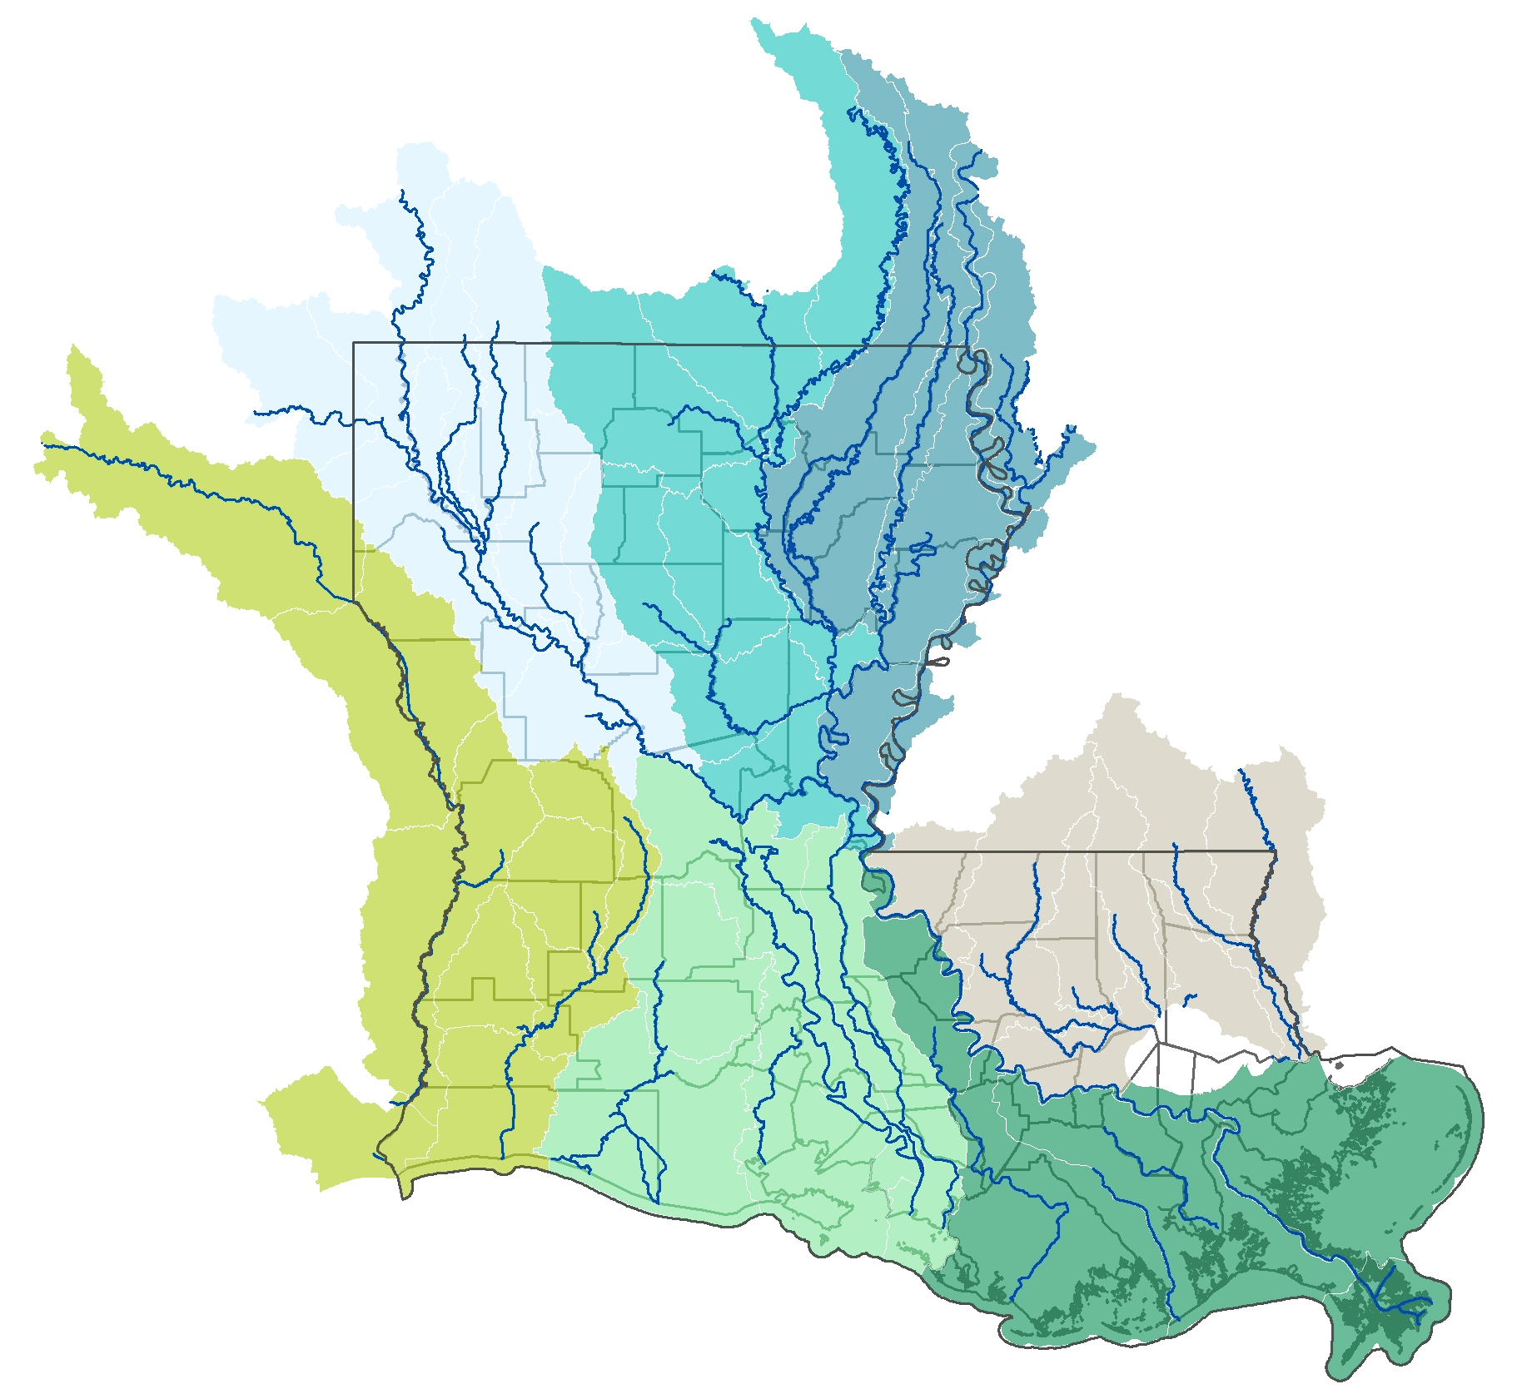
The opportunity
Fundamentally change the state’s approach to flood risk reduction
Proactively address flood risk and improve floodplain management through a watershed-based approach

Slide 5
Funding focus areas
Regional water management
Modeling and data
Flood risk reduction projects
Regional watershed management
Improved building and land use practices to reduce flood risk
High-quality gauge network
Watershed models and maps
User-friendly data portal
Enhanced retention, drainage and protection
Moving people and property out of harm’s way

Slide 6
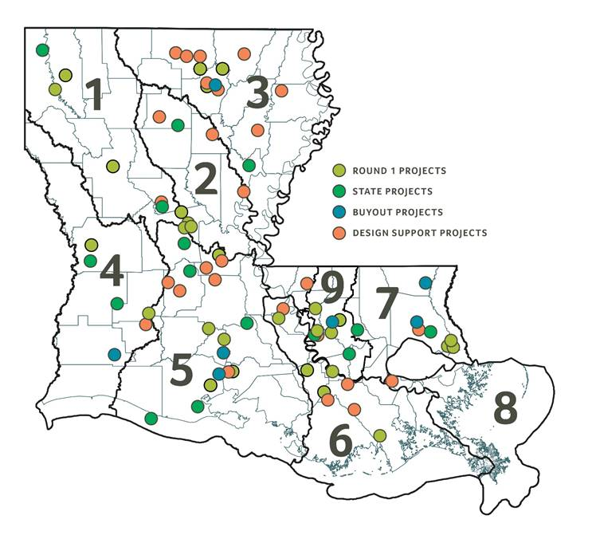
Funding progress
$1.2 billion CDBG-MIT FUNDING
$440 million awarded to flood risk reduction projects throughout the state
Including dam, drainage, infrastructure, flood storage and buyout projects
$145 million dedicated to the statewide watershed modeling effort
Developing models of major watersheds to simulate flood scenarios and analyze solutions
$15 million dedicated to enhancing the statewide river and rain gauge network
Installing gauges at 100 sites throughout the state over six years
$100 million awarded to Design Support Program for 27 flood risk reduction projects
- Providing technical assistance to support and fund the projects in 2023
$100 million committed to Round 2 for flood risk reduction projects that benefit low-to-moderate income communities

Slide 7
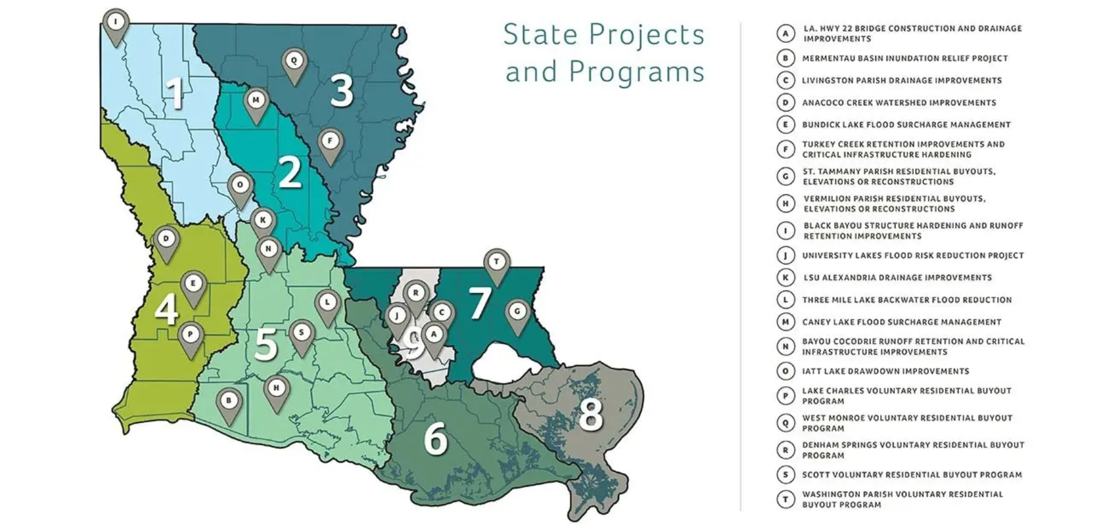

Slide 8
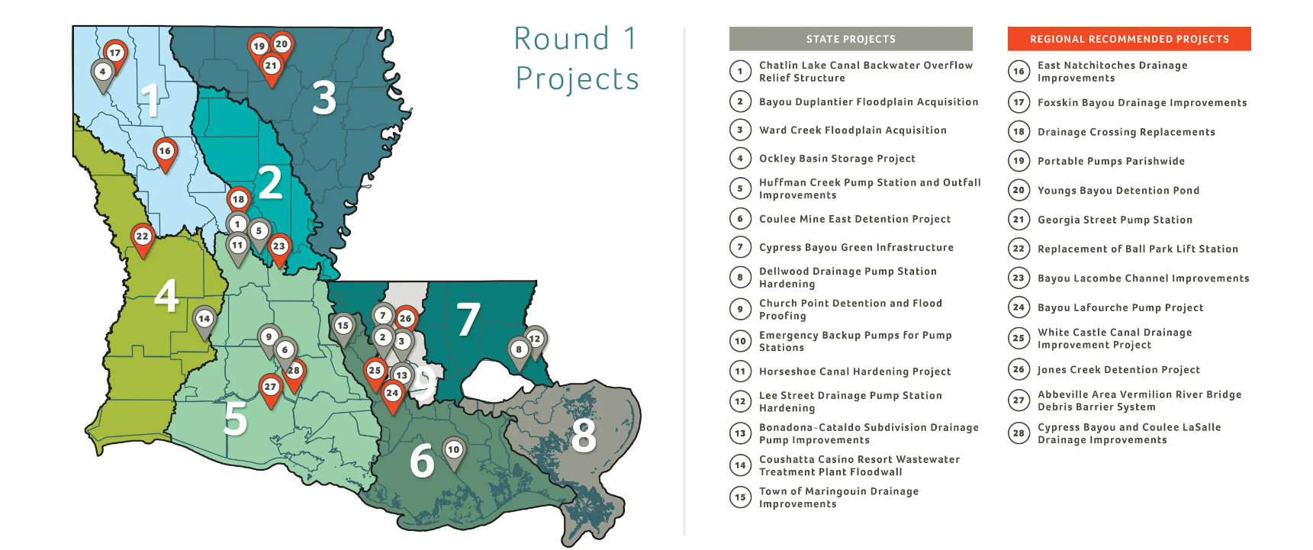

Slide 9
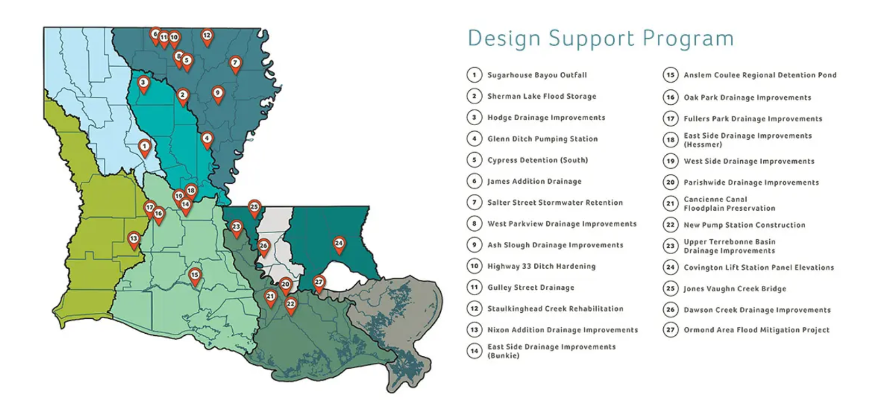

Slide 10
LWI Projects Funded By Region
Current Commitments By Region Round 1, DSP, SPP, HMGP
Region | Amended Funding Request | # Projects | %
1 | 21,010,383.00 | 6 | 4%
2 | 22,693,177.75 | 6 | 4%
3 | 55,623,113.51 | 17 | 11%
4 | 84,718,220.00 | 7 | 16%
5 | 84,253,513.45 | 18 | 16%
6 | 24,316,447.16 | 9 | 5%
7 | 29,008,069.00 | 5 | 6%
8 | 6,000,000.00 | 1 | 1%
9 | 198,587,749.67 | 14 | 38%
 | 526,210,673.54 | 83

Slide 11
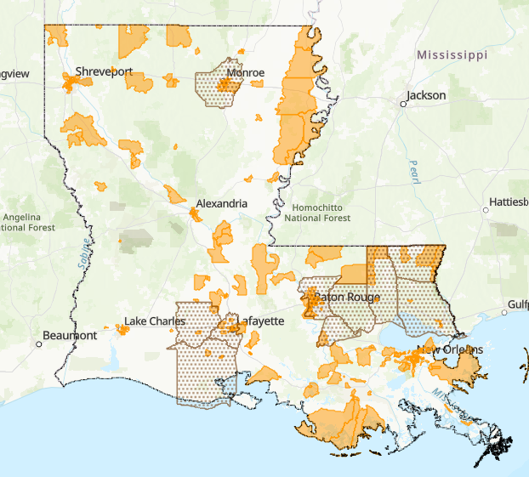
Round 2
LWI launched the pre-application period for the Round 2 project funding opportunity as part of its Local and Regional Projects grant program, which distributes funding in three rounds to flood risk reduction projects submitted by local and regional entities. Round 1 awarded $100 million to 29 projects statewide in 2021. Round 2 is offering another $100 million for local and regional projects.
To be eligible for funding, projects must benefit low- to moderate-income and/or disadvantaged communities in parishes designated as most impacted and distressed by the 2016 floods. The state will provide feedback to all applicants regarding their projects, including other potential funding sources for those ineligible for Round 2.
Regional selection
Regional steering committees will review eligible project pre-applications in their respective watershed regions. ​With support from the state, RSCs will select projects to move on to the full application phase.
The Council will approve the RSC selected applicants and the state will issue conditional award letters immediately following HUD’s approval of APA 3 this month.

Slide 12
APA 3 Summary
LOCAL AND REGIONAL PROJECTS AND PROGRAMS:
APA 3 increases the Local and Regional Projects and Programs allocation by $15M.
APA 3 allocates $100M to LWI Region 9 for development of large, transformative projects in MID areas within Region 9.
APA 3 increases Round 1 and DSP allocations up to $130M: Funds will be reserved for all Round 1 and DSP projects awarded to allow for cost increases due to inflation.
APA 3 increases Round 2 to $225M.
APA 3 removes Round 3.

Slide 13
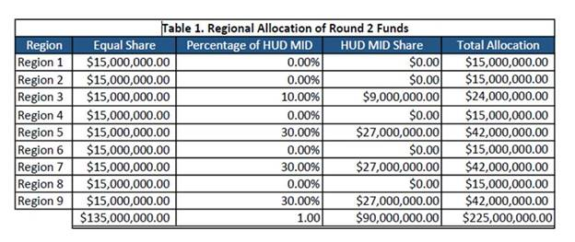
Round 2 Allocations

Slide 14
LWI Projects Funded By Region
Projected By Region Round 1, DSP, Round 2, SPP, HMGP
Region | Amended Funding Request | # Projects | %
1 | 40,212,459.60 | 12 | 4%
2 | 42,231,813.30 | 10 | 4%
3 | 86,857,840.34 | 19 | 9%
4 | 110,661,864.00 | 9 | 11%
5 | 139,014,081.54 | 27 | 14%
6 | 44,179,736.59 | 11 | 5%
7 | 97,809,682.80 | 14 | 10%
8 | 22,200,000.00 | 3 | 2%
9 | 383,840,516.67 | 21 | 40%
 | $967,007,994.84 | 126

Slide 15
LMI Based On Total Round 2 Allocations

Slide 16
MID Based On Round 2 Allocations
MID Projections
 | Projected Budget | MID %
State-MID | 422,455,881 | 42.4%
HUD-MID | 572,956,059 | 57.6%
Total | 995,411,940 | 100.0%

Slide 17
Statewide watershed modeling
Model development
Model development is ongoing under Task Orders 2 and 3
Surveying and initial modeling complete in all regions
All models due for completion by February ‘24
Task Order 4 to include:
Design storm development
Production runs
Consequence model development
Project proof-of-concept evaluation

Slide 18
Statewide watershed modeling
Project proof-of-concept evaluation
Evaluate watershed-scale concepts
Regional consultants:
Work with regional steering committees to identify watershed-scale project concepts
Incorporate proposed concept into calibrated models
Run all relevant design storm scenarios
Perform regional consequence analysis for full suite of storm runs

Slide 19
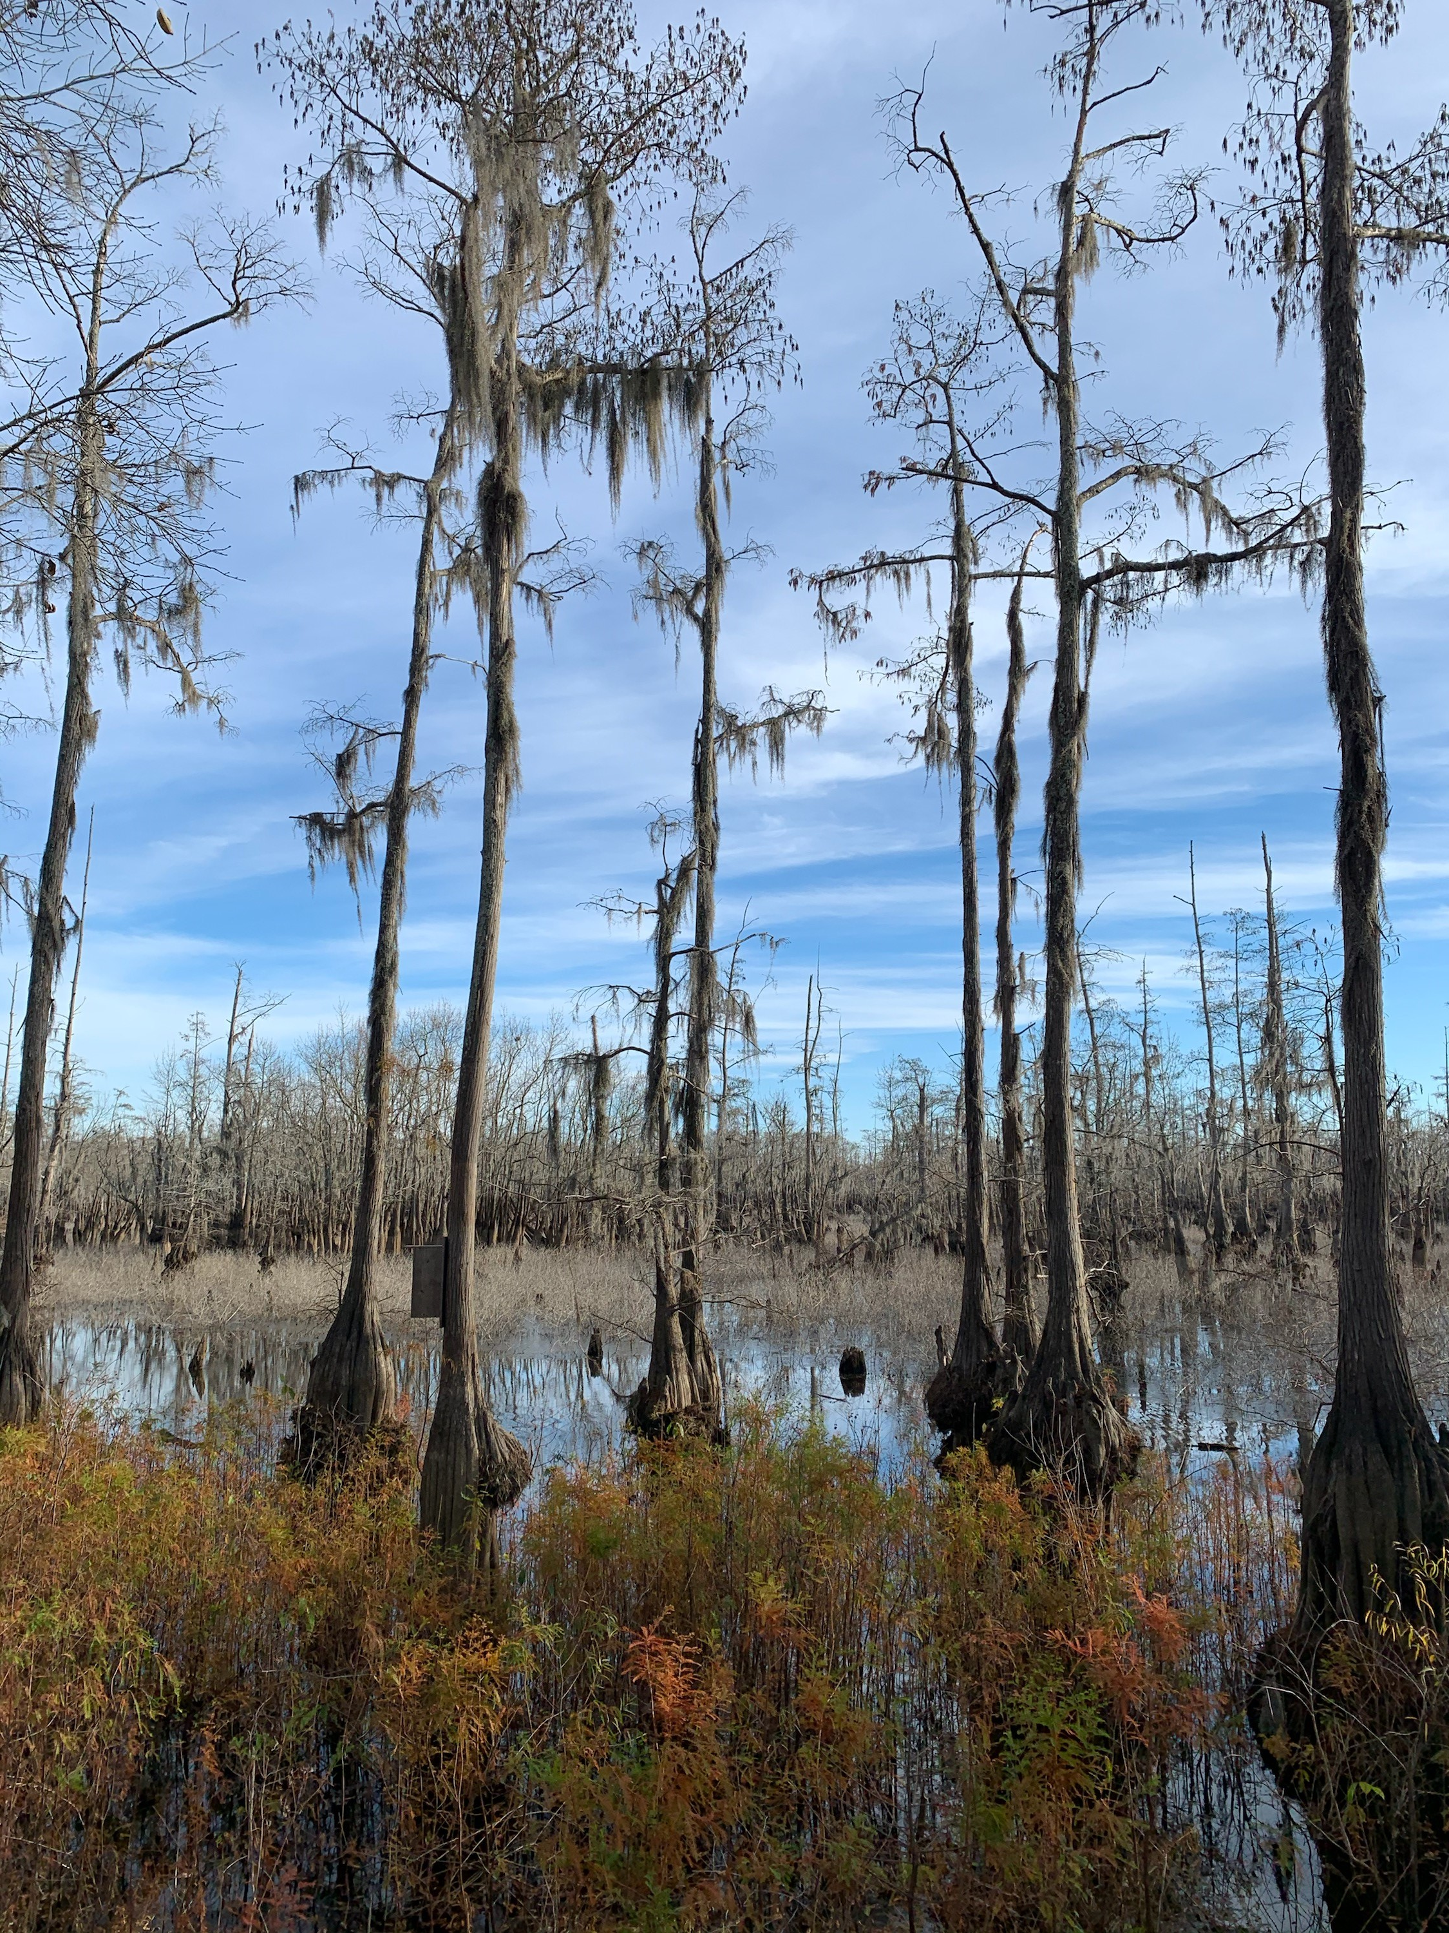
Model Use, Storage and Maintenance Plan
The MUSM plan provides the framework for long-term management of watershed models, with recommendations on use, storage and maintenance.
The state accepted public comments and has incorporated them into the final plan, which will be submitted to LWI working groups and the watershed council for review.
Cheniere lake

Slide 20
THANK
YOU
@ L A W AT E R S H E D I N I T I AT I V E
@ L A W AT E R S H E D
W AT E R S H E D @ L A . G O V
W AT E R S H E D . L A . G O V
W O R K I N G T O G E T H E R F O R S U S T A I N A B I L I T Y A N D R E S I L I E N C E

