Slide 1
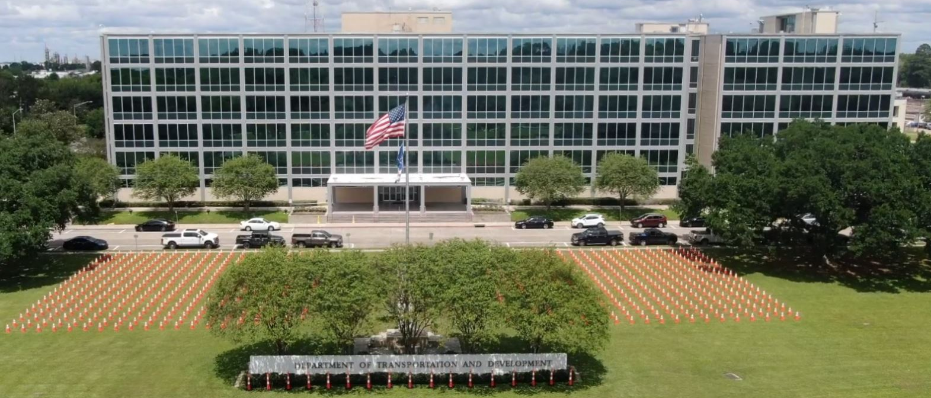
Association of Levee Boards of Louisiana
Joe Donahue
Secretary
May 2, 2024

Slide 2

Today’s Discussion
Levee Safety Program
Dam Safety Program
Louisiana Watershed Initiative
Statewide Flood Control Program
Floodplain Management
Ports & Waterways
Notes:
Hydraulics Section
Louisiana Watershed Initiative
Statewide Flood Control Program
Roadway Flooding Program
Floodplain Management Section
Levee & Dam Safety Section
NEXT SLIDE – Hydraulics

Slide 3
DOTD – Public Works and Water Resources
Mission:
  The mission of Public Works is to develop the potential of Louisiana's water related resources by administering programs and implementing infrastructure projects relating to controlling, developing, conserving and protecting all aspects of the resources.
Notes:
The second D is Public Works and Water Resources
Next Slide: Levee Safety Program

Slide 4
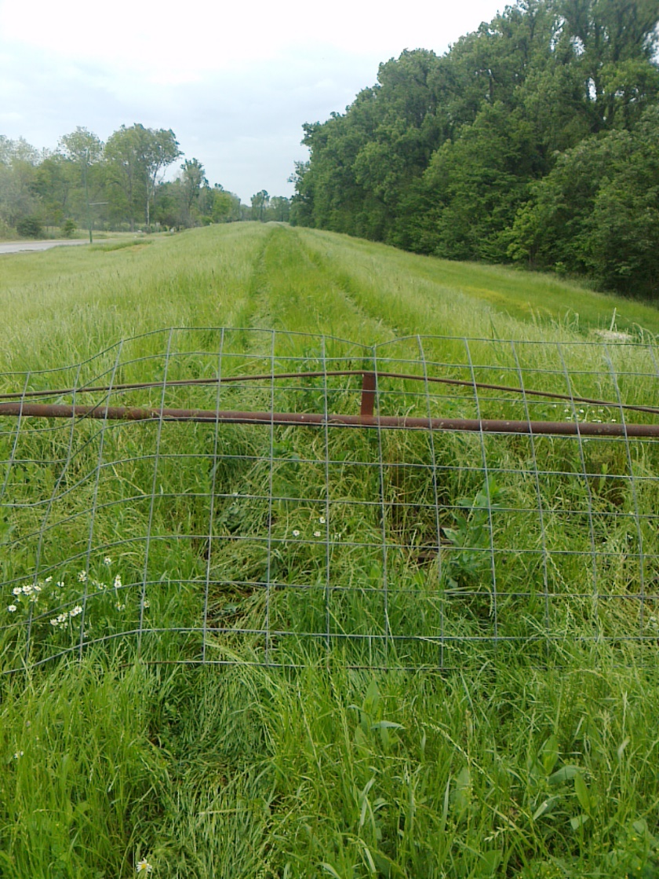
Levee Safety Program
Current Services
Inspections
  Assist Levee Districts with their Inspections
  Provide Semi-Annual Inspection Reports
  Provide Recommendations/Options for Corrective Actions
  Flood inspections / Monitoring
Inventory/Mapping
  Inventory Levee Assets
  Develop GIS Maps
Training Compliance
  Online training for levee inspectors
Notes:
Next Slide: Levee Safety Program – Services Continued

Slide 5
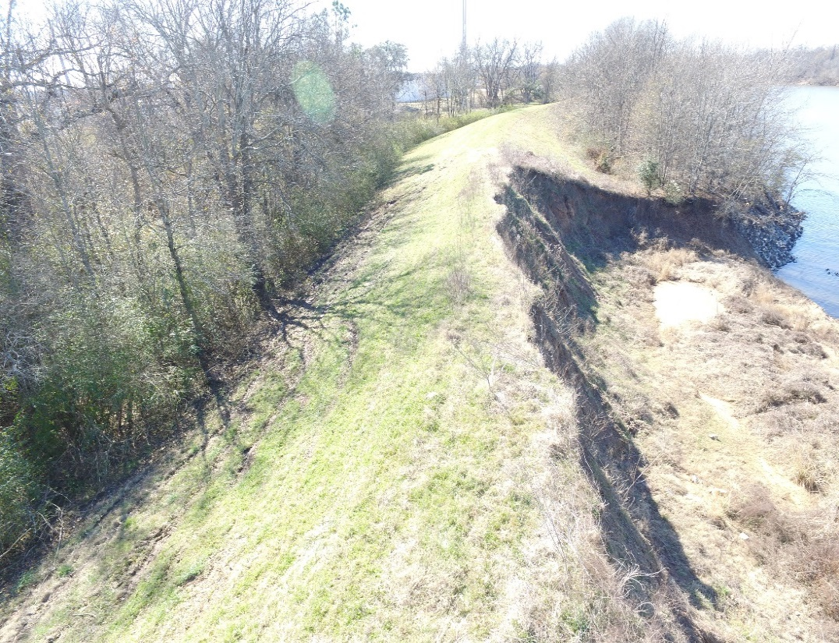
Levee Safety Program
Additional Services
Capital Outlay
  Assist levee districts with funding requests
  Project management
Regulatory Support
  Coordination for certifications
  Stakeholder meetings with USACE
Strategic Planning
  Review of USACE and FEMA guidance documents to identify upcoming requirements
  Interface with resources to determine if legislative activity should be considered
Notes:
NEXT SLIDE – 9 Non-coastal area levee districts

Slide 6
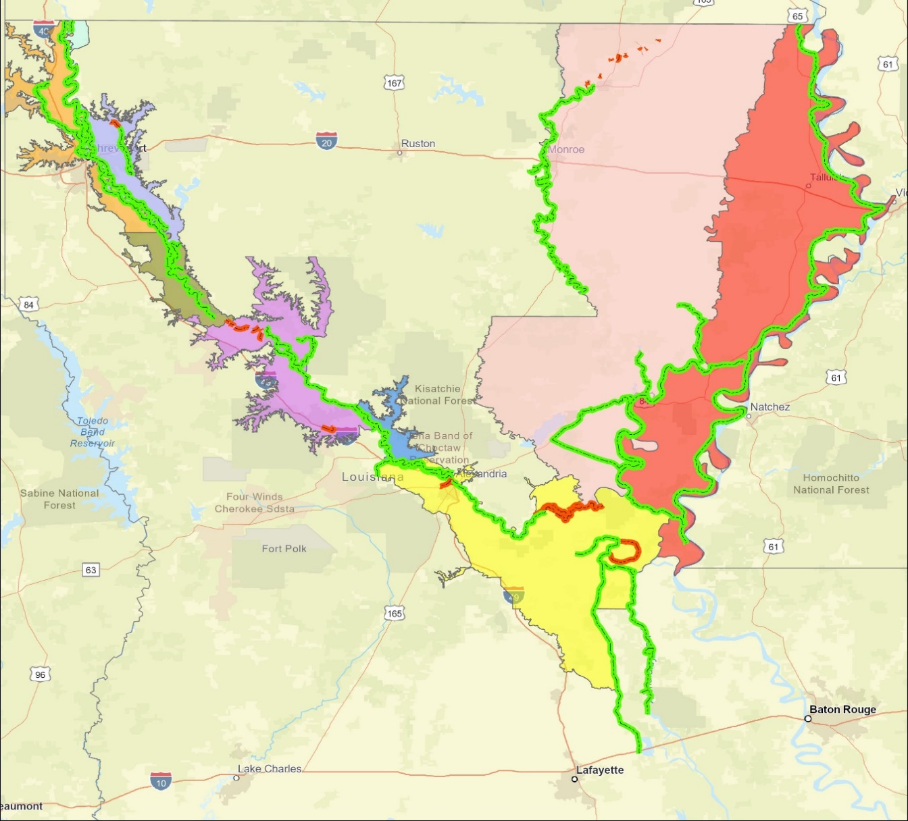
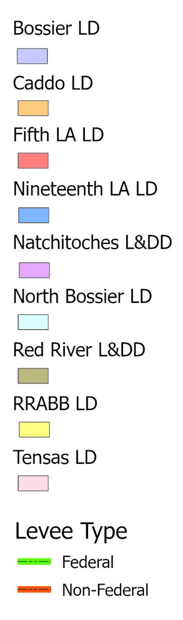
Levee Safety Program
Non-Coastal Levee Districts (9)
Federal 65.1
Non- Federal 4.3
Federal 116.7
Federal 306.3
Federal 26.2
Federal 69.3
Non- Federal 17.5
Federal 3.4
Federal 51.7
Federal 196.7
Non- Federal 55.2
Federal 249.9
Non- Federal 4.7
Notes:
Nine Non-Coastal levee districts
Program inspects about 1,000 miles of levees semi-annually
1085 miles of Federal Levees
81.7 miles of non-federal levees
Next Slide – Levee Safety Current Services

Slide 7
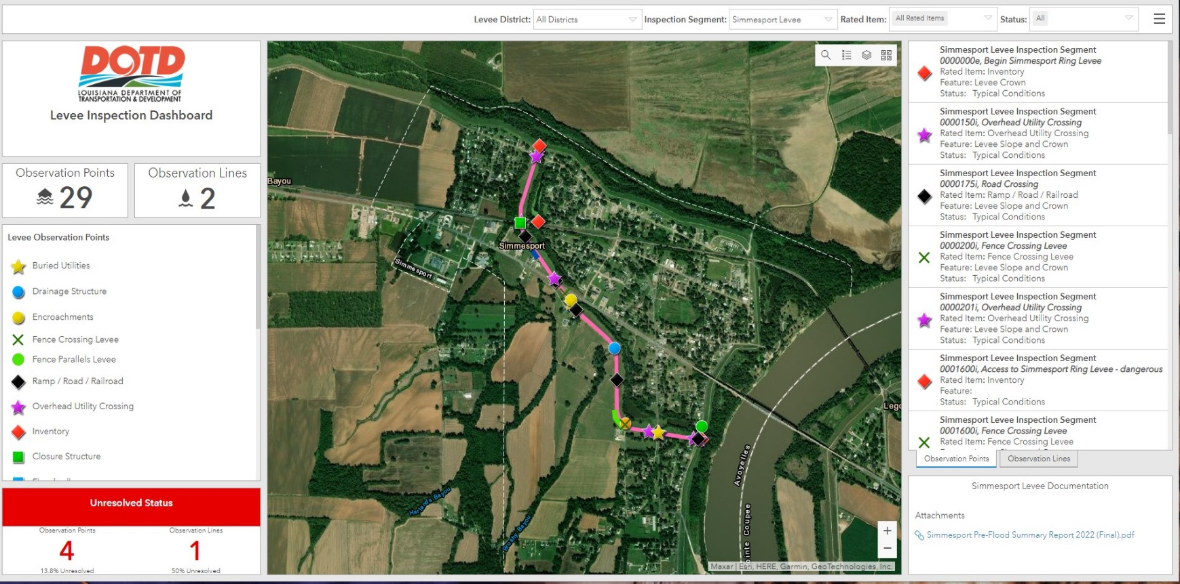
Levee Safety Program
Inspection Software
Notes:
This is an example of the inspection software that was recently developed by the levee safety program with ESRI
using GIS based technology to modernize the inspection and documentation process for each levee system
DOTD Levee inspection documents the status of the levees before flood season and after for use in rehabilitation submittals
The reports provide photo-documentation and are tied to specific locations along the levees.
NEXT SLIDE – Project Management & Capital Outlay Activities

Slide 8
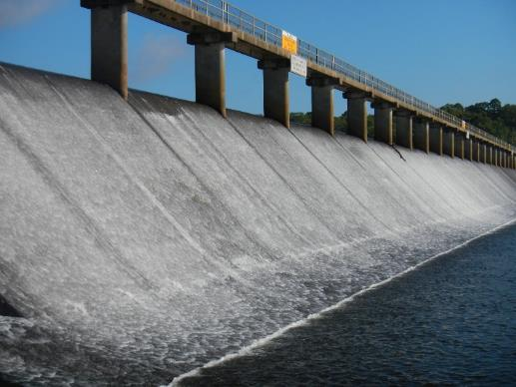
Dam Safety Program
660 Regulated Dams
(As of November 20, 2023)
43 High Hazard
67 Significant Hazard
550 Low Hazard
16 Under Investigation
Impact Classification | Potential Loss of Life | Potential Economic Loss | Inspection Frequency
High | Likely | Excessive | Annually
Significant | Possible | Appreciable | 3 years
Low | Not Likely | Minimal | 5 years
It is the responsibility of the owner/applicant to establish impact classification, and all dams will be considered to be of High Impact potential until demonstrated to be otherwise by a documented analysis provided by the applicant.
Spillway at Bayou D’Arbonne Dam
Union Parish
Notes:
State Dam Safety Program – number of dams has decreased in the last few years by about 30.
NEXT SLIDE – State-maintained dams

Slide 9
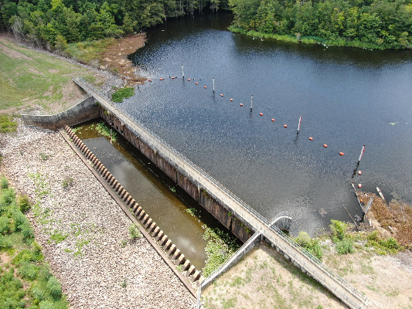
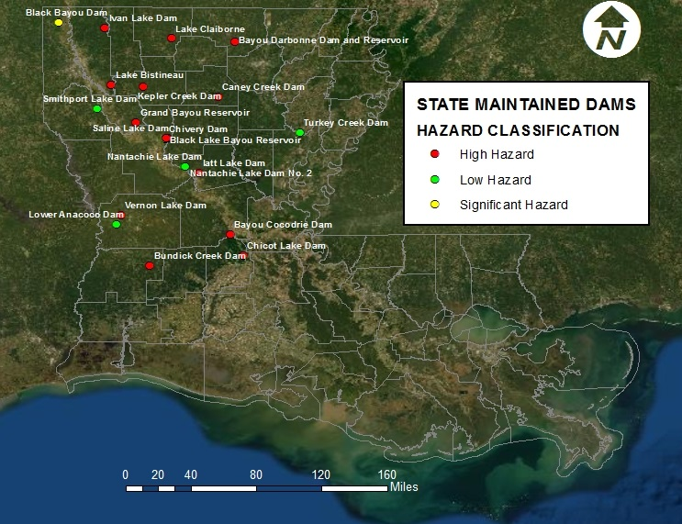
Dam Safety Program
R.S. 38:26: State-Maintained Dams
Spillway at Chicot Lake Dam
Evangeline Parish
21 DOTD Maintained Dams
  13 High Hazard
  2 Significant Hazard
  6 Low Hazard
(All DOTD Maintained dams are inspected annually)
Notes:
Location of 21 Dams that DOTD operates and maintains per statute LA RS 38:26
These dams are inspected annually
NEXT SLIDE – Dams – Mobile Inspection App

Slide 10
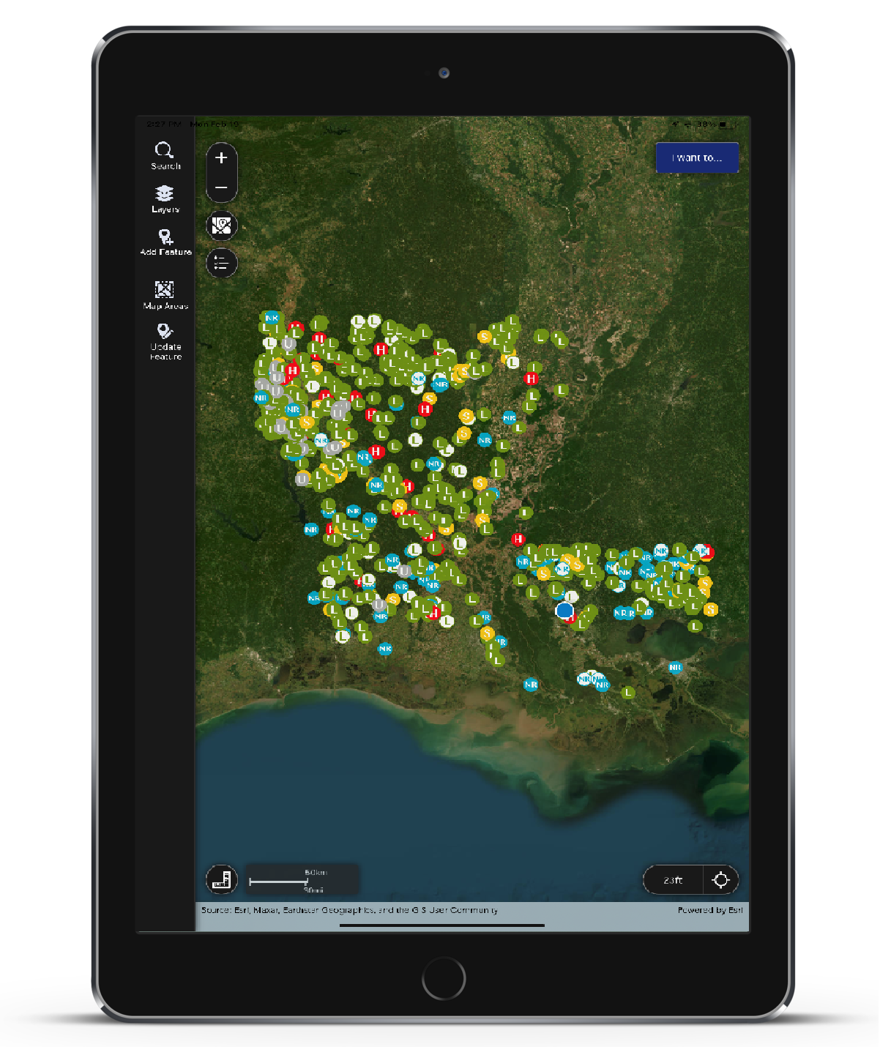
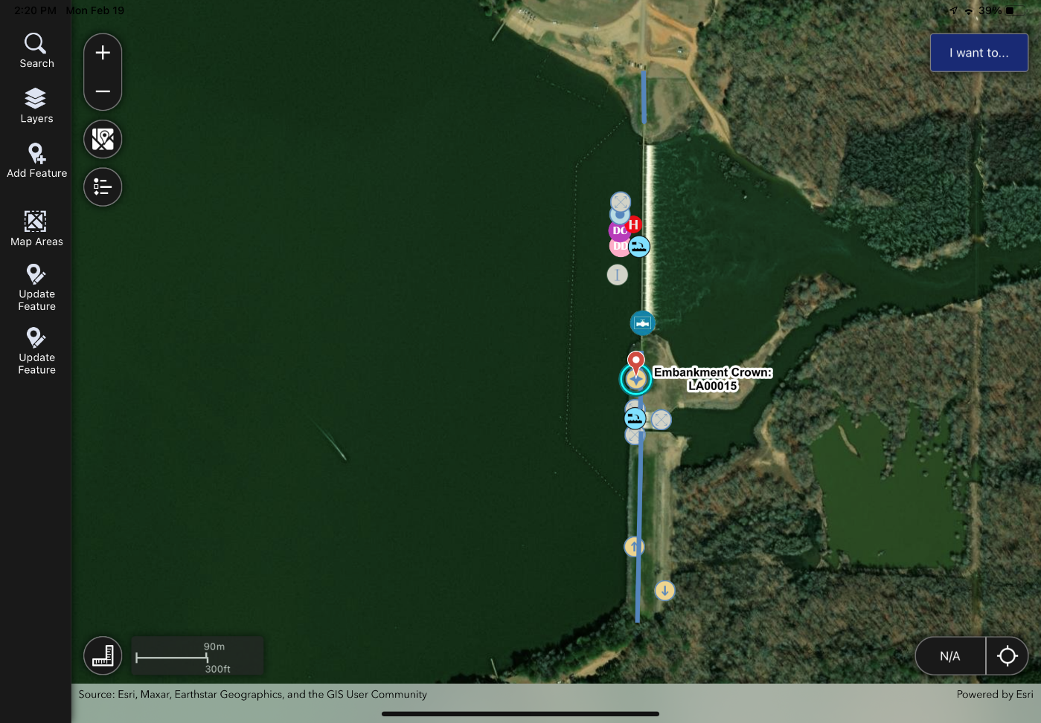
Mobile Dam Inspection App
Notes:
Allows DOTD staff and consultants to seamlessly perform inspections and consolidate inspection data
NEXT SLIDE – State Maintained Dams – Capital Outlay Projects

Slide 11
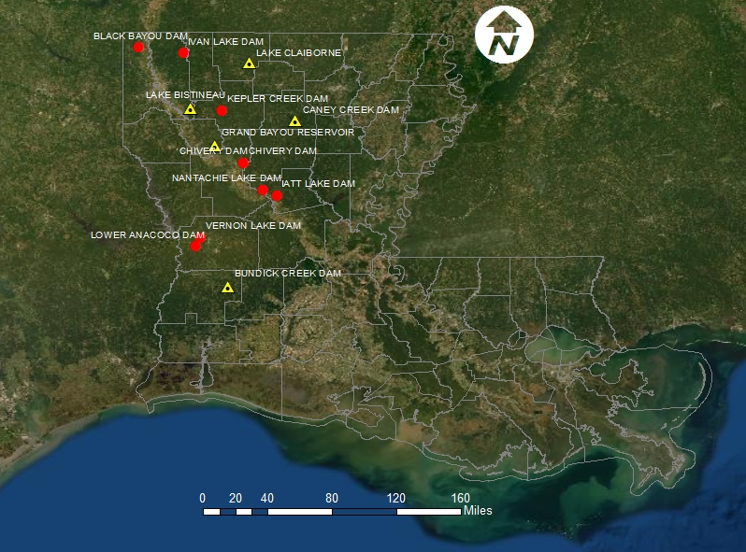
Dam Safety Program
State Maintained Dams – Capital Outlay Projects (13)
Safety Measures Only (8) (signs, boat barriers, fences)
Gate Rehab/Maintenance & Safety Measures (5 Projects)
Total Projects = $2.5 Million
Notes:
Total Capital Outlay $2.5 Million
Safety Measures – warning signs, boater barriers, fences
Bundick Creek Dam repairs and safety improvements is under contract and is scheduled to be completed this spring
Three projects (Lower Annacoco Dam, Vernon Lake Dam & Lake Bistineau) are being designed but safety improvements are planned for all of our state maintained dams
NEXT SLIDE – Dam Owner Workshops

Slide 12
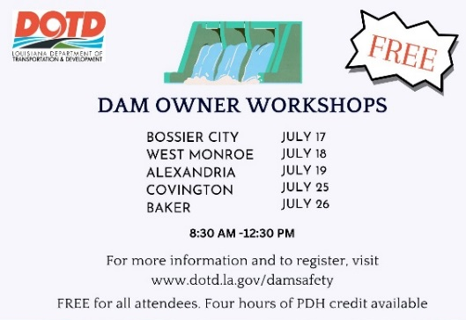
Dam Safety Program
Dam Owner Workshops
Notes:
Dam Owner Workshops will be held each summer to inform dam owners of their responsibilities and services available to them.
Next slide: Levee Safety

Slide 13
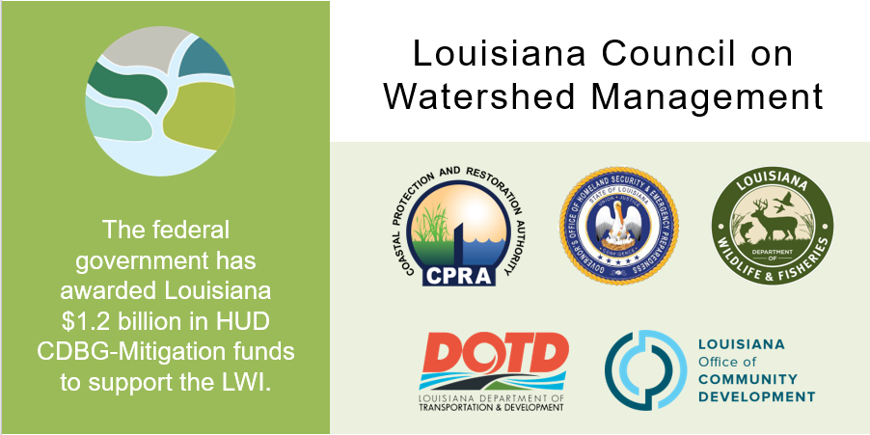
Louisiana Watershed Initiative
The federal government has awarded Louisiana $1.2 billion in HUD CDBG-Mitigation funds to support the LWI.
Notes:
Remember to say this: Council on Watershed Management was formed by Gov. John Bel Edwards in 2018.
NEXT SLIDE – Watershed Modeling

Slide 14
Louisiana Watershed Initiative
Statewide Watershed Modeling
$94M (Modeling Budget)
HUC8 Models (48 total)
  Delivered by end of 2023
Coupled 1D/2D or Full 2D
Tiered Approach Factors
  Population
  Complexity
  Known Risk
Notes:
NEXT SLIDE – LWI-SPP (State Projects Program)

Slide 15
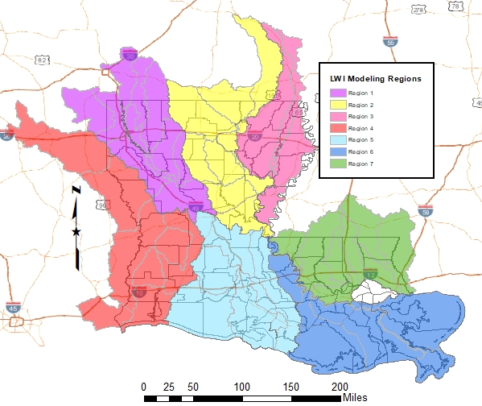
Louisiana Watershed Initiative
Statewide Watershed Modeling
Prime Consultants by Region:
AtkinsRéalis
Freese & Nichols
WSP
C.H. Fenstermaker & Associates
HDR Engineering
Michael Baker International
Dewberry Engineers
Notes:
NEXT SLIDE – LWI-SPP (State Projects Program)

Slide 16
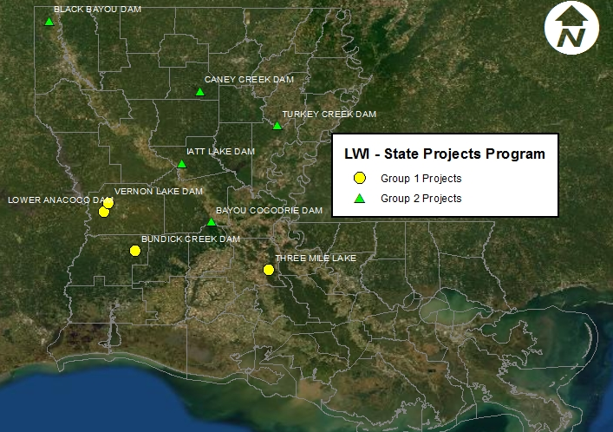
Louisiana Watershed Initiative
State Projects Program (SPP)
$53M (CDBG-DR MIT)
8 Projects
  8 dams
  1 ring levee
2 Consultant Contracts:
  Michael Baker International
  Freese & Nichols
NTPs issued 12/2022
5-year project timeline
Notes:
Map showing 9 site locations that make up the 8 projects
8 Dams (2 in one project – Anacoco and Vernon) and 1 backwater flooding project
Total project cost of $53M
NEXT SLIDE – Statewide Flood Control Program

Slide 17
Statewide Flood Control Program
Background
Created by Act 351 of the 1982 Regular Session
Primary goal is to reduce existing flood damages through an active, innovative approach that considers both structural and non-structural solutions
Funded by Louisiana Transportation Trust Fund
  $20M in total annual program funding
Project applications and funding amounts are approved by the Joint Transportation Committee
Notes:
NEXT SLIDE – Statewide Flood Control Program cont’d
NEXT SLIDE – Flood Control contined

Slide 18
Statewide Flood Control Program
Project Requirements
Must reduce existing flood damages of structures
Does not encourage additional development in flood prone areas
Does not adversely affect upstream or downstream flooding
Must have a construction cost of $100,000 or more
Must be a stand-alone project
Cannot serve the primary purpose of protection against coastal storm surge
Maximum SWFC Participation: $5M per project (New requirement)
Notes:
NEXT SLIDE – Statewide Flood Control Program cont’d
NEXT SLIDE – Flood Control contined

Slide 19
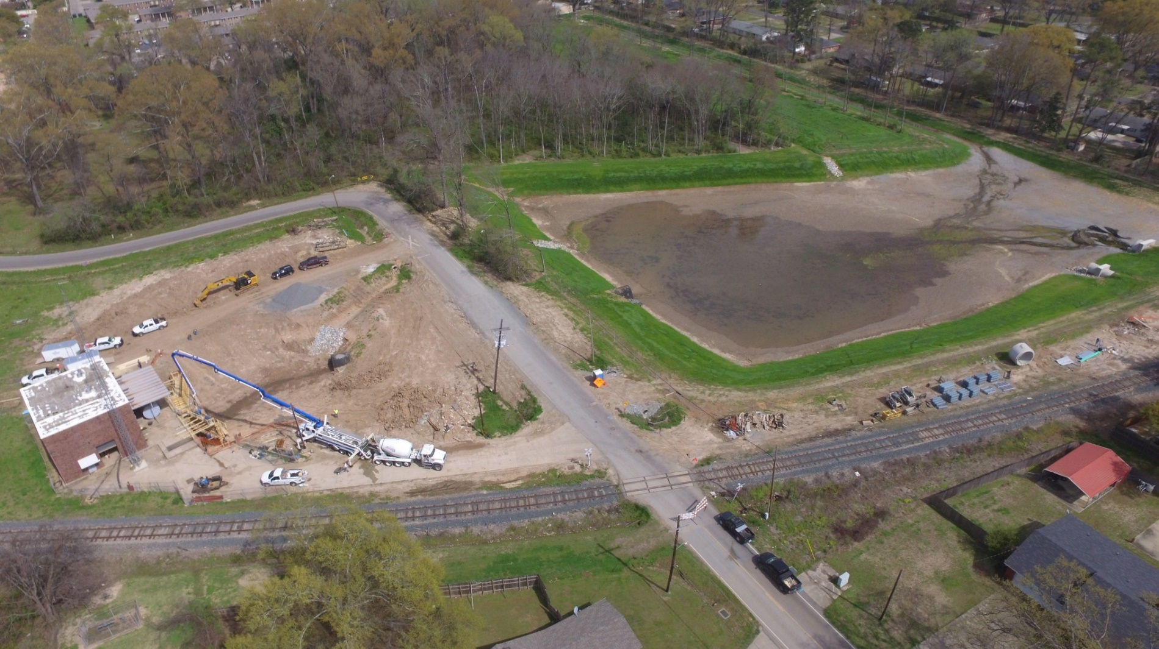
Statewide Flood Control Program
Competitive & Cost-Shared
  Projects are evaluated based on potential damage reduction versus State investment
  Provides up to 90% of the construction cost for non-federal projects
  Provides up to 70% of non-federal participants’ share of federal projects
  Rural Grant Opportunity may eliminate 10% match requirement for parishes with less than 50,000 residents and municipalities less than 5,000 residents
Uniquely structured to ensure:
  Equitable distribution of funds statewide
  All levels of local government can compete successfully
Notes:
NEXT SLIDE – Funding Distribution
NEXT SLIDE – Flood Control contined

Slide 20
Statewide Flood Control Program
Funding Distribution
Funds are distributed between the Urban Program and Rural Program:
  Urban Areas (45%)
    Shreveport, Monroe, Alexandria, Lake Charles, Lafayette, Baton Rouge, New Orleans, Hammond, Mandeville-Covington, Slidell, and Houma Urban Areas
  Rural Funding Districts (55%)
Rural Funding District | Percentage of Rural Funding
Northwest | 28.589
Northeast | 19.644
Southwest | 18.199
South Central | 16.907
Southeast | 16.661
Notes:
NEXT SLIDE – Statewide Flood Control Program - 2022-2023 Application Cycle
NEXT SLIDE – Flood Control contined

Slide 21
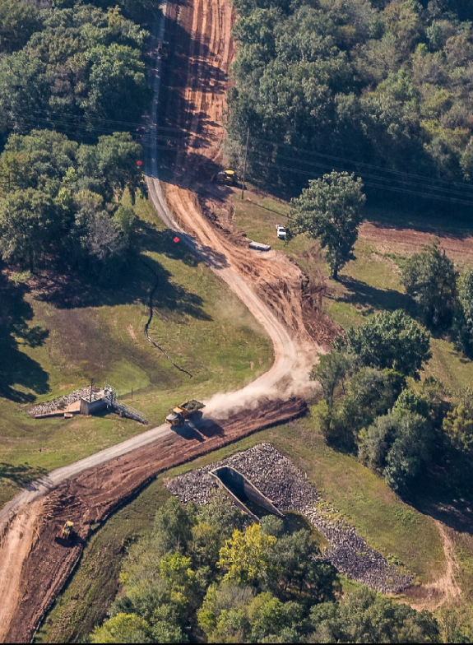
Statewide Flood Control Program
2023 - 2024 Application Cycle
Red Chute Levee
Bossier Parish
11 pre-applications received ($38.8M)
  8 determined eligible
7 full applications received ($15.7M)
6 applications approved ($10.7M)
Notes:
2023-2024 cycle: 6 applications were approved for funding during the 2024 Regular Session. This includes 4 new projects, and 2 project revisions.
NEXT SLIDE – Statewide Flood Control Program – Accomplishments

Slide 22
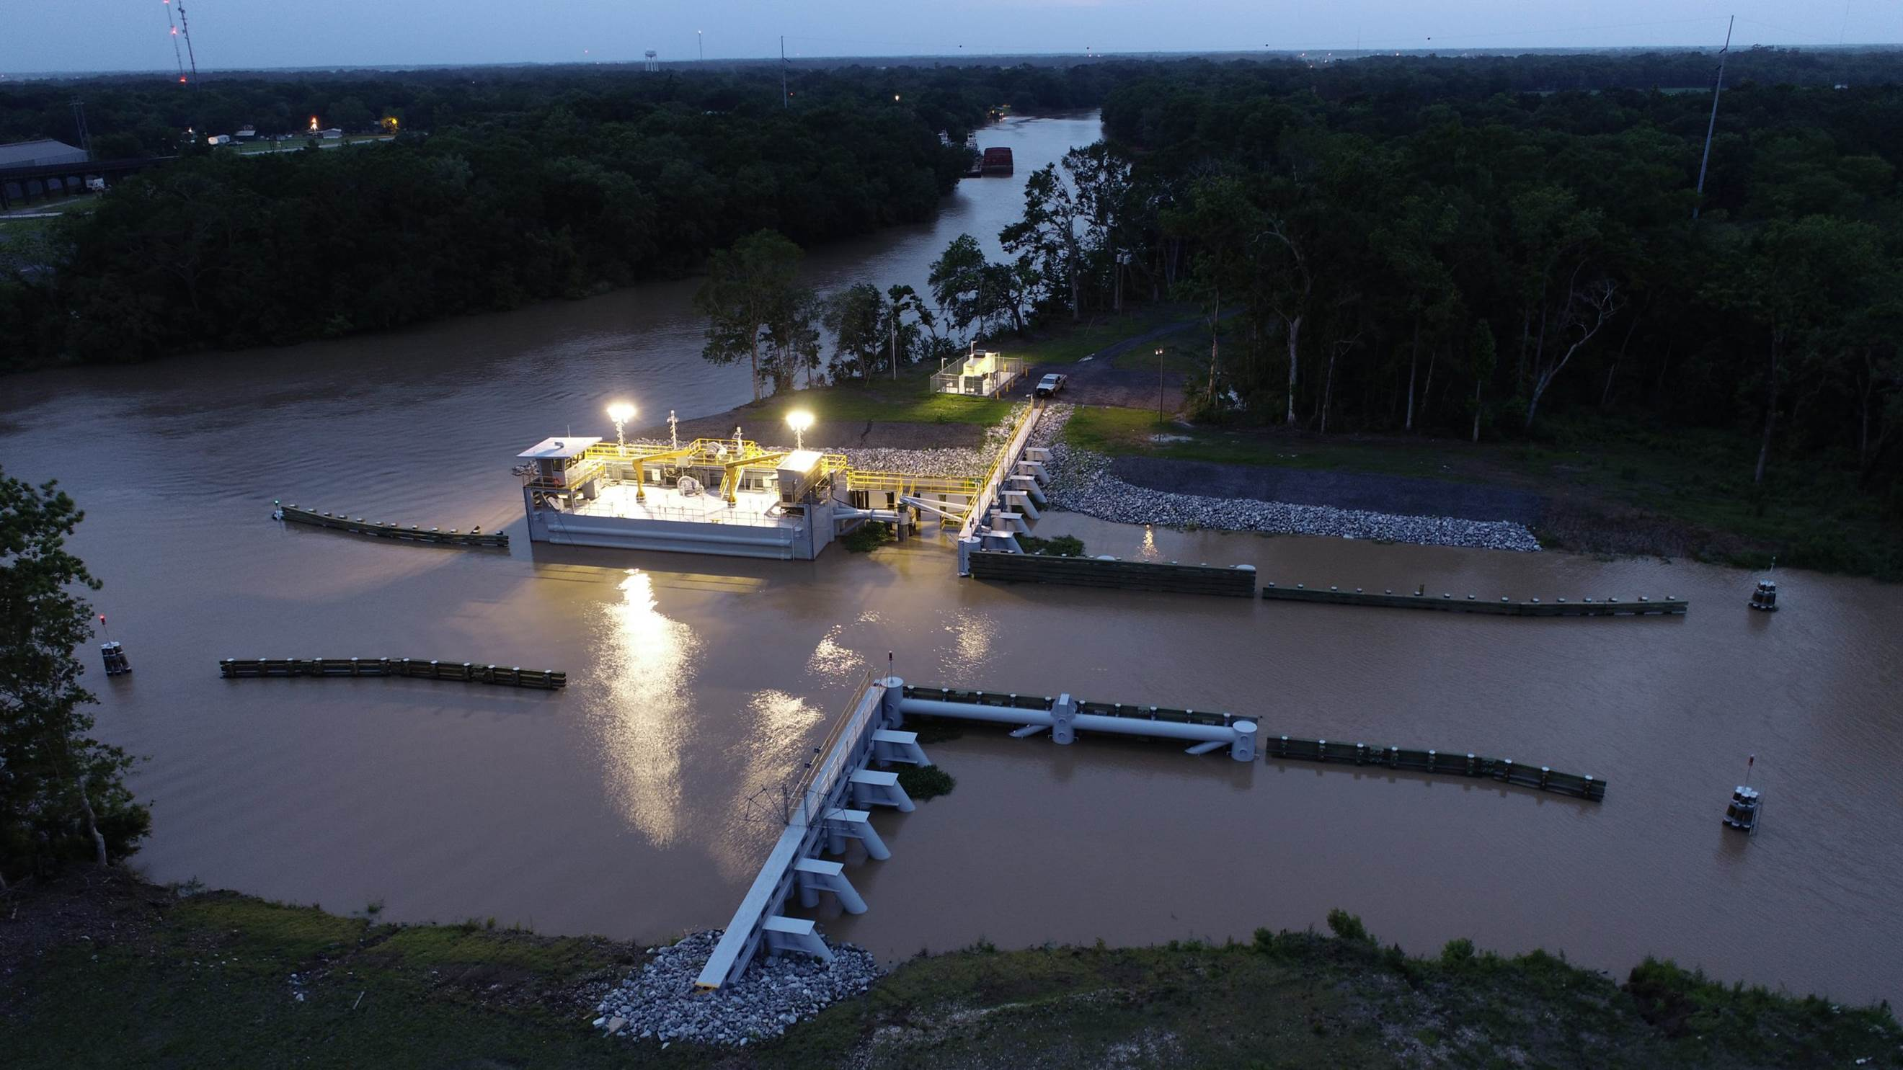
Statewide Flood Control Program
Accomplishments to Date
Approved projects in 43 of 64 parishes
129 projects completed
$305.5M Expended
$2.876B in Flood Reduction Benefits
10.76 Benefits/Cost Ratio
Notes:
NEXT SLIDE – Floodplain Management

Slide 23
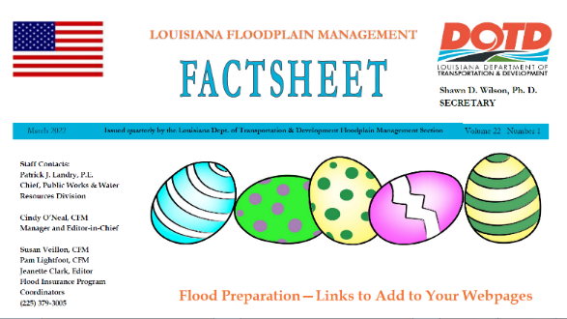
Floodplain Management
Training and Outreach
Training & Workshops:
  Assists multiple agencies with various workshops and classes
Outreach:
  Publish a quarterly newsletter – the Floodplain Management Factsheet distributed to all 318 NFIP communities, lending institutions, insurance agents, realtors, engineers, etc.
Notes:
NEXT SLIDE – Community Rating System

Slide 24
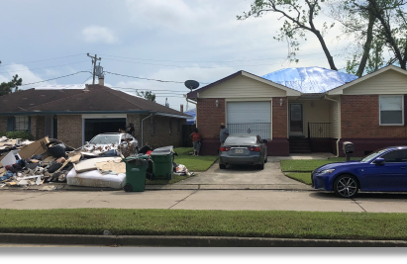
Floodplain Management
Community Assistance Visits:
  Assess floodplain activities of 318 NFIP communities
  Inspect SFHA (over 50% of state) (#1)
  Review permits & elevation certificates
  Meet with community officials to determine any assistance they need
Disasters:
  Respond to Presidentially declared disasters
  Assist FEMA helping communities comply with post disaster regulations
Notes:
NEXT SLIDE – Training and Outreach

Slide 25
Floodplain Management
Community Rating System (CRS)
Voluntary program that credits community efforts to go above minimum requirements by reducing flood insurance premiums from 5% to 45%
39 communities currently receive a discount
Notes:
Community Rating System Class Ratings are similar to Fire Ratings for your Homeowners’ Policy. Each lower class receives a 5% decrease in flood insurance premiums.
Class 1 is the “best” rating and results in the highest premium reductions available through the program.
Louisiana achieved its first Class 5 rating in May of 2019. Jefferson Parish flood insurance policyholders now receive a 25% discount.
Next Slide – CRS

Slide 26
Floodplain Management
Community Rating System (CRS)
Over 291,000 (77%) of Louisiana’s Flood Insurance Policies are in CRS Communities
Over $29M in premium savings annual
Notes:
Rating System saves Louisiana flood insurance policyholders more than $29 million annually.
Worth noting: Louisiana is ranked in the Top 5 nationwide with 77% of the state’s flood insurance polices located in CRS communities.
NEXT SLIDE – Cooperating Technical Partner (CTP)

Slide 27
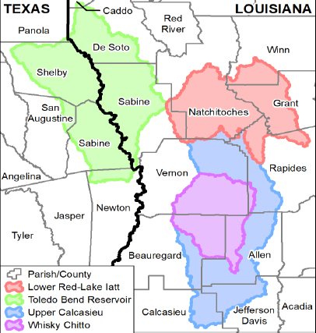
Floodplain Management
Cooperating Technical Partners (CTP)
Works with FEMA to release updated flood risk information to communities
  Could lead to updated Insurance Rate Maps
Currently under contract with two consulting firms to assist with CTP/NFIP task orders
  Total CTP/NFIP contract amount: $10M for 5 years
  Discoveries in 7 watersheds recently completed
  Discoveries in 8 watersheds underway
  Phase 2: Risk Analysis and Mapping in Rapides Parish
Notes:
7 Discoveries closed in the last 6 months
Discoveries have been initiated in 8 additional watersheds
Efforts in Rapides Parish have advanced to Phase 2: Risk Analysis and Mapping
NEXT SLIDE – Policy Information

Slide 28
Floodplain Management
Policy Information
Policies in Force: 380,753
Premiums Paid: $280,009,480
Total Coverage: $109,762,301,000
Notes:
39% of the flood insurance policies are for properties located in the Special Flood Hazard Area.
61% of the flood insurance policies are for properties located in a No Special Flood Hazard Area or X Zone.
-15.8% policies
-0.7% premiums/policy
+6.7% coverage/policy
+7.4% coverage/premium
NEXT SLIDE – Ports & Waterways

Slide 29
DOTD – Ports and Waterways
Mission:
  The mission of the Ports & Waterways Division is to continuously improve the maritime transportation infrastructure for freight movement and river cruise industry, by nurturing economic development and enhancing quality of life through the implementation of efficient, safe, and seamless multimodal transportation systems in accordance with the Louisiana Statewide Transportation Plan.
Notes:
Ports and Waterways is a part of DOTD’s Office of Multimodal Commerce.
Next Slide: Port Priority Program

Slide 30
Port Priority Program
  To ensure that adequate land side facilities are available by providing guidance and public funds
    To meet a definite market need
    To build land side infrastructure
    To provide jobs, minimize congestion, & improve safety
  Primary goal is to improve the infrastructure of LA ports and harbors
Notes:
To access these public dollars, the projects the ports submit must show that they meet a definite market, build land side infrastructure, and provide jobs, minimize congestion, & improve safety.
Next Slide… State Port Map

Slide 31
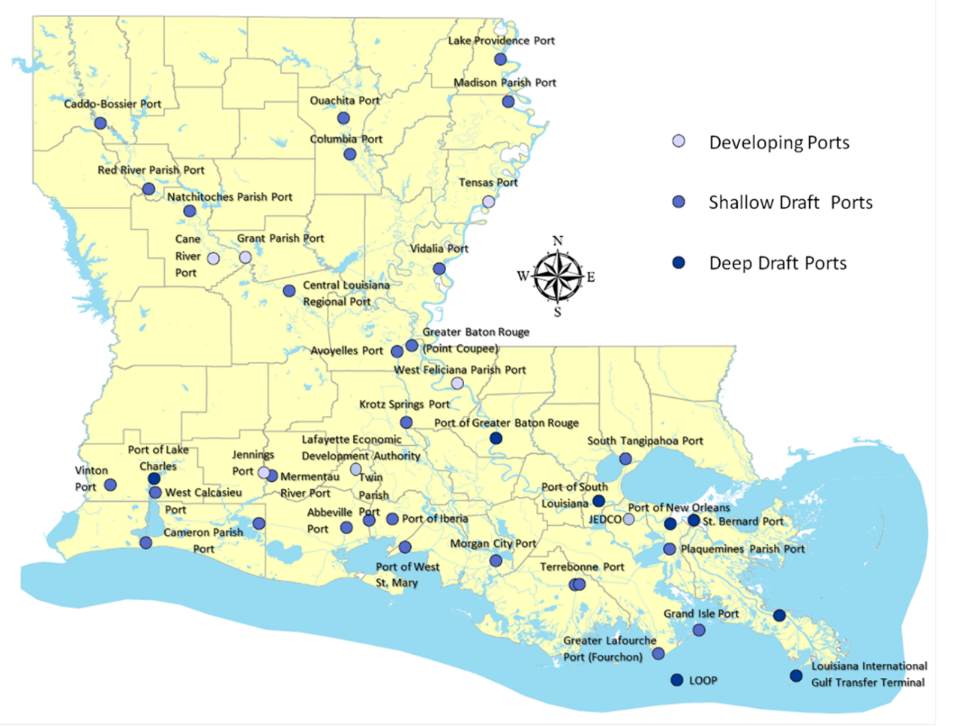
Louisiana Ports
  42 Port Authorities
  32 Active Ports
Notes:
There are 42 Ports laid out in Revised Statute, but only 32 are active Ports.
“Developing Ports” are ports that have not received funding through the Port Program or do not have the infrastructure to function as a port.
Next Slide… Port Construction and Development Priority Program

Slide 32
Port Construction & Development Priority Program
  Created by Act 452 of the 1989 Regular Session
  Provide 90% of construction cost
  Funded by the LA Transportation Trust Fund
  Applications submitted four times a year (March, June, Sept, & Dec)
  Applications are similar to a business plan
  Projects must have:
    B/C ratio of at least one
    Rate of Return on State’s investment of 2.375
Notes:
The 2.375 is based on the interest rate paid on 20-year U.S. Treasury Inflation Protected Securities.
- We actually get about $7 for every dollar invested.
Completed applications reviewed for compliance and a priority list prepared.
Joint Transportation Committee holds public hearings to review the projects and then approve them.
NEXT SLIDE - Funding

Slide 33
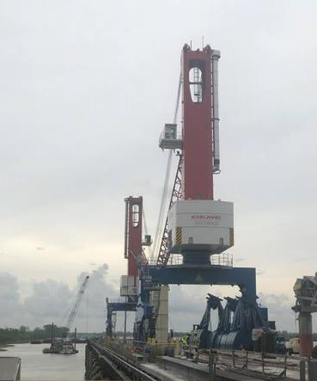
Port Priority Program Funding
$39.4M Current Funding Level
Since 1989
  $751M Expended
  413 Contracts Completed
17 Active Construction Contracts
  $112M in State Funding
  $225M from Other Sources
  42 Active Design Projects
  $222M in State Funding
  $358M from Other Sources
Notes:
Since 1989 $751 Million has be expended to complete 413 contracts and create or retain over 16,338 jobs.
Currently there are 17 Active Construction Projects around the State utilizing $112 Million in State Funds and $225 Million in Local Port Funding and Federal Funding.
Our program is limited to contributing only $15 million to anyone project and that is distributed at $5 million per year.
In some cases, the port can fund the project and we will reimburse them when funding becomes available.
The Program also has 42 Active Design Projects utilizing $222 Million in State Funding and $358 Million in Local Port Funding and Federal Funding.
The picture shows a recently completed project at the Port of Lake Charles to upgrade and replace the existing wharf structure at the City Docks terminal.
NEXT SLIDE. . . Various port projects

Slide 34
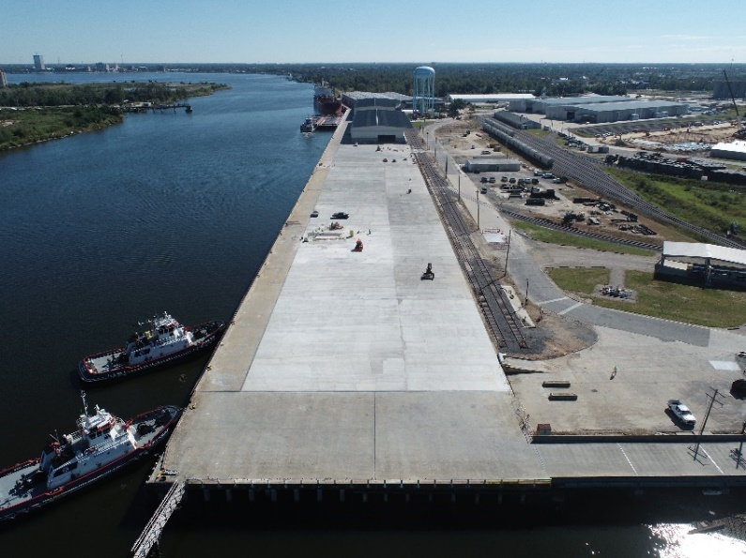
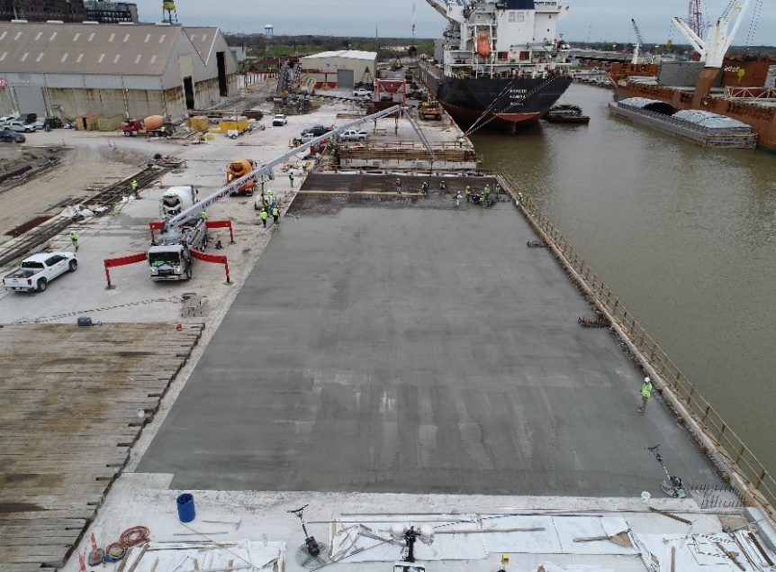
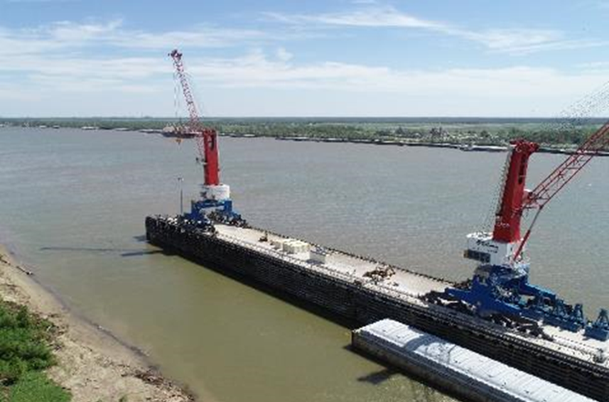
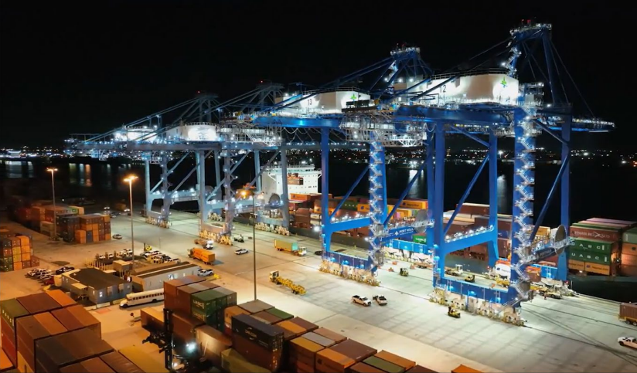
Port of Lake Charles – Berth Rehab
Port of St. Bernard – Dock Rehab
Port of South Louisiana - Cranes
Port NOLA Crain Rail Extension
Notes:
Port of Lake Charles Berth Rehabilitation
Recently completed construction of new bulkhead and concrete decking to replace the existing wharf structure at the City Docks Terminal.
Port of St. Bernard
Ongoing reconstruction of sections A and F of the port’s Chalmette Slip docks
Port of South Louisiana Cranes
Procurement of two mobile harbor cranes for the Port’s Globalplex Intermodal Terminal cargo dock, as well as an upgrade and extension of the crane rail across the entire length of the dock and reinforcement of the dock itself.
Port of New Orleans Crane Rail Extension
Conversion of the Nashville Avenue Terminal from a breakbulk facility to a container facility by extending the 100 ft. gauge crane rail to support the Port’s addition of four new fully electric ship-to-shore container gantry cranes, which are currently being brought online.

Slide 35
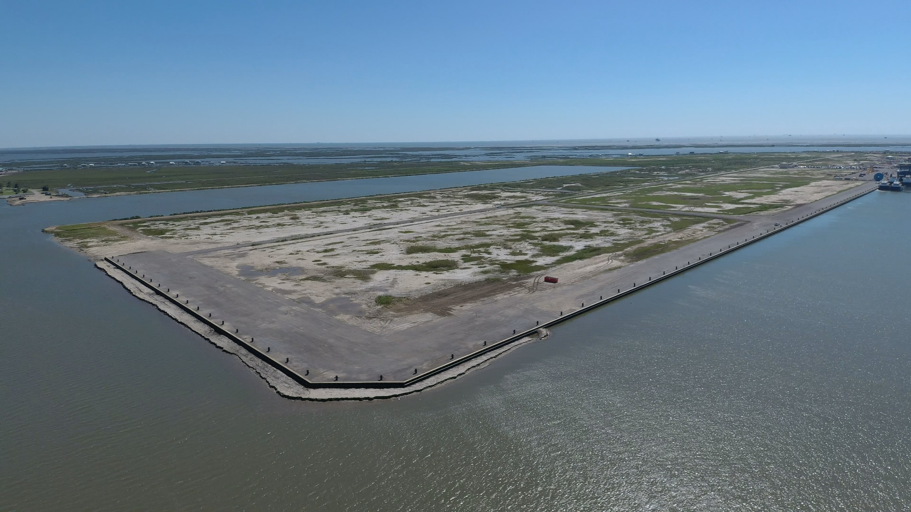
Port Fourchon – Bulkhead and Dredging
Notes:
Port Fourchon Bulkhead
Construction of approximately 2,328 linear feet of steel sheet pile bulkhead with 48 mooring bits and associated sweep dredging along Slip C and Flotation Canal in the Port’s northern expansion. This project created 30 acres of leasable waterfront property to accommodate additional businesses that service the deepwater exploration and production process.

Slide 36
Waterways Section
Continuously improve the State’s waterway infrastructure, maritime access and port connectivity
Work “hand in hand” with our partners
  U.S. Corps of Engineers
  Ports
  Congressional Delegation
  State Leaders
  Various Associations
Notes:
The functions of our Waterways Section is to continuously improve the state’s waterway infrastructure, maritime access and port connectivity to facilitate an efficient, safe and seamless marine transportation system.
We work hand in hand with our various partners to ensure that the State’s inland waterway system including locks and dams, coastal channels and deep draft channels are improved and maintained to accommodate commercial navigation.
NEXT SLIDE -- Current Waterway Projects

Slide 37
Current Waterway Projects
Mississippi River Deepening:
  Deepen from 45 ft to 50 ft (Gulf of Mexico through the Port of Baton Rouge)
Houma Navigation Canal Deepening:
  Deepen from 15 ft to 20 ft
J. Bennett Johnston Waterway (Red River)Deepening:
  Deepen from 9 ft to 12 ft
Acadiana to Gulf of Mexico Access Channel
  Deepen from 12 ft to 16 ft from the Gulf of Mexico to the Port of Iberia
  DOTD is the federally designated non-federal sponsor
Notes:
As you can see Louisiana is involved in four deepening projects:
Mississippi River Ship Channel
International shipping is using larger vessels with deeper drafts. With the deepening of the Panama Canal, Louisiana needs a deeper Mississippi River to be able to accommodate the larger vessels and stay competitive in international trade. OMC Waterways is the Non-Federal Sponsor for the Mississippi River Ship Channel Navigation Project.
Houma Navigation Canal Deepening
The Port of Terrebonne is home to businesses that build and repair supply vessels, topsides, and platforms for the oil and gas industry. The Houma Navigation Canal is used to transport these massive structures and is currently maintained at a depth of 15 feet. OMC Waterways Section, serving as the Non-Federal Sponsor, led a feasibility deepening study with a goal of retaining business industries in Terrebonne Parish while also providing an environmental benefit with the use of dredged material.
Acadiana Gulf of Mexico Access Channel
Fabricating facilities at the Port of Iberia require deeper channels to get today’s larger offshore oil platform components to the Gulf of Mexico. The Acadiana to Gulf of Mexico Access Channel provides those facilities the direct access to the Gulf of Mexico.
Red River Waterway Deepening: Proposed deepening of the Red River Waterway from 9 feet to 12 feet
DOTD and Red River Waterway Commission received approval for a Corps of Engineers feasibility study to deepen the river from Old River to Shreveport
Sen. Cassidy has secured 500k to begin the study in FY24 and be complete in FY 27.
DOTD is providing $1.5 M as a cost share for the study
NEXT SLIDE – Mississippi River Ship Channel deepening to 50 feet

Slide 38
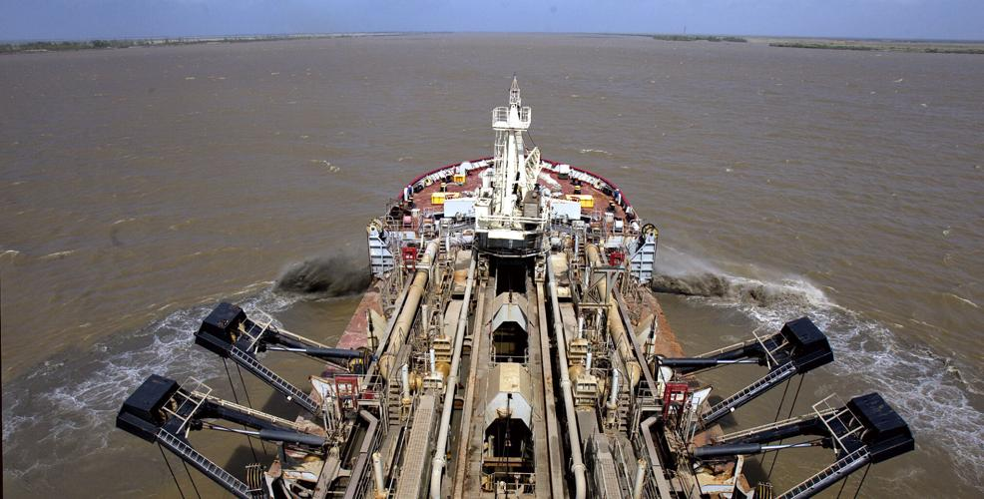
Mississippi River Ship Channel Deepening to 50 ft.
From the Gulf Sea Buoy through the Port of BR MM 232
Total Project Cost $245M
State’s Share: $81M (Capital Outlay Funds)
Current controlling max draft is 50 ft from Gulf Sea Buoy to MM 175
Total project is scheduled for completion in 2026
Notes:
The Mississippi River has been deepened to 50 feet from Southwest Pass in the Gulf of Mexico to river mile marker 175 at the Port of South Louisiana
The Corps of Engineers and DOTD are working with pipeline owners to relocate 7 pipelines. Once the pipelines are relocated, the deepening project will be completed to the Port of Baton Rouge in 2026.
Total Project Cost $245 M
State Share is $81 M ($40 M for pipeline relocation and $41 M for construction) – Capital Outlay Funds
$2 M from Soy Transportation Alliance for Pre-construction Engineering and Design
To date $39.9 M has been expended
NEXT SLIDE – Houma Navigation Canal Deepening

Slide 39
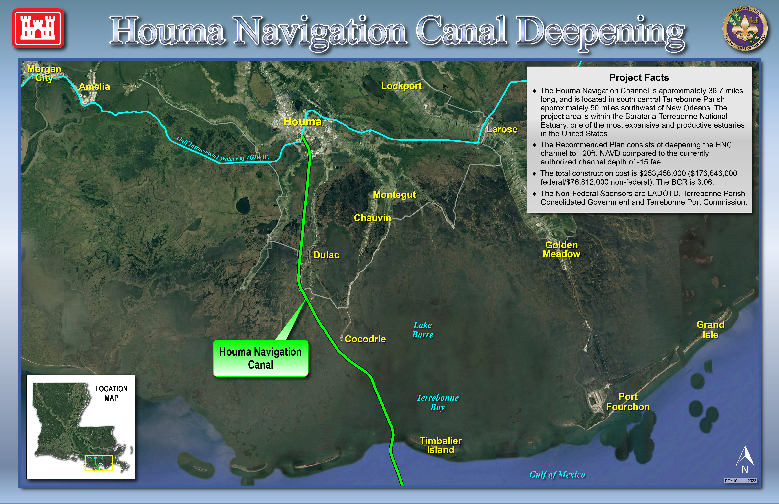
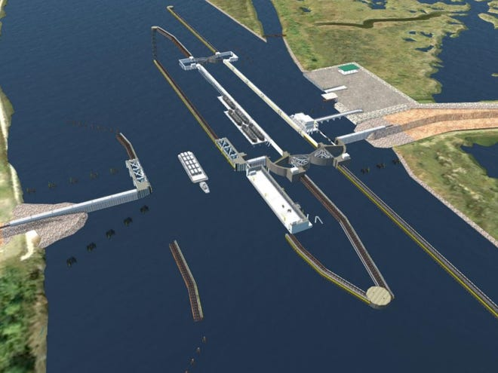
Houma Navigation Canal Deepening
Deepen the channel from 15 ft to 20 ft
Total construction cost is $253,458,000
State Share $76.8M (State Capital Outlay)
Non-Federal Sponsors are DOTD, Terrebonne Parish Consolidated Government, and Terrebonne Port Commission
Notes:
As the “Non-Federal Sponsor” we are overseeing Deepening the Houma Navigation Canal from 15 feet to 20 feet
DOTD and Port of Terrebonne are working with utility owners to relocate the necessary utilities.
Construction on the canal deepening cannot begin until the new Houma Canal Lock is completed in 2026
Total Project Cost $253 M
Non-federal share $76 M
To date $3.3 M expended to date
NEXT SLIDE – J. Bennett Johnston Waterway (Red River) Deepening

Slide 40
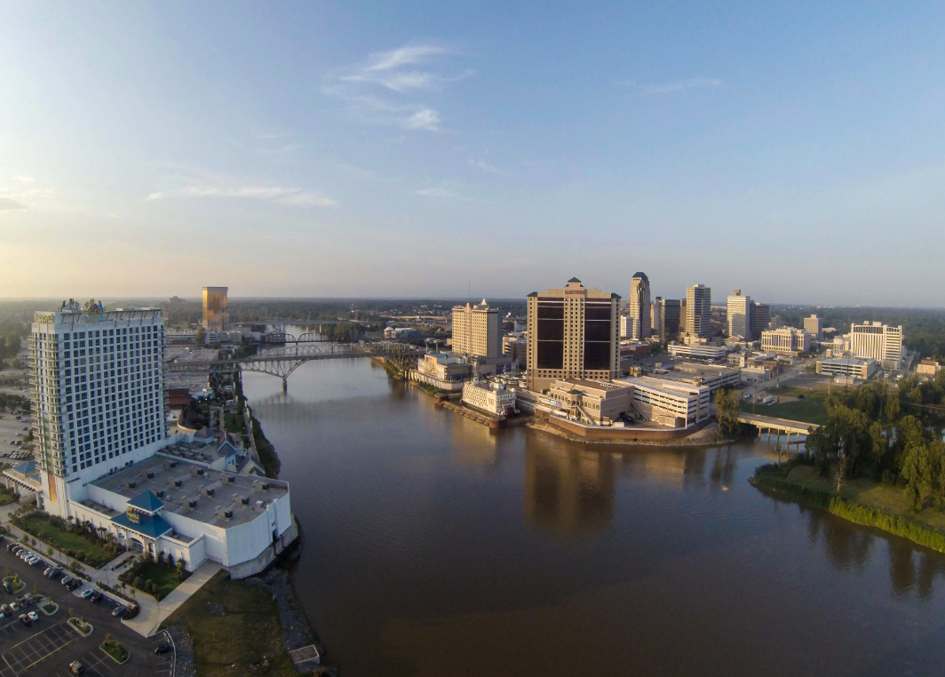
J. Bennet Johnston Waterway (Red River) Deepening
Water Resources Development Act (WRDA) 2018 gave approval for a feasibility study to deepen the Red River Waterway from 9 ft. to12 ft.
Study to begin in FY 24 and complete in FY 27
State Share is $1.5M (State Capital Outlay)
DOTD Secretary is the Chair of the Red River Waterway Commission
Notes:
DOTD and Red River Waterway Commission received approval for a Corps of Engineers feasibility study to deepen the river from 9 to 12 feet
Sen. Cassidy has secured 500k to begin the study in FY24 and be complete in FY 27.
DOTD is providing $1.5 M as a cost share for the study, divided into $500,000 over 3 years.
Corps of Engineers is the led agency
NEXT SLIDE – Acadiana to Gulf of Mexico Access Channel/Port of Iberia Deepening

Slide 41
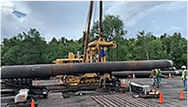
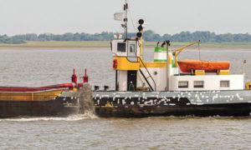
Acadiana to Gulf of Mexico
Access Channel/Port of Iberia Deepening
Deepen the channel from 12 ft. to 16 ft. from the Port of Iberia to the Gulf of Mexico – 53 miles
Total construction cost is $60M
State Share $59.3M (State Capital Outlay)
Notes:
Deepening from 12 feet to 16 feet Company Canal and Freshwater Bayou. DOTD OMC is managing the Capital Outlay funds as a “flow through project”
Port of Iberia is working with utility owners to relocate the necessary utilities.
Channel dredging of Company Canal is ongoing
Corps of Engineers and DOTD are cost sharing in a reevaluation study of Freshwater Bayou to determine the feasible of the Corps of Engineers to cost share in the construction cost of the deepening of Freshwater Bayou
Estimated construction cost $60 M
Port of Iberia is the led agency unless the Corps of Engineers determine the project is feasible for them.
Estimated completion is 2024
To date $45.9 M has been expended

Slide 42
Questions ?

