Slide 1
Public Works & Water Resources
Evolving Landscape of Dam and Levee Safety in Louisiana
Billy Williamson, P.E.
Director of Dams, Levees, and Reservoir Development
May 2, 2024
Notes:
Intro:

Slide 2

Today’s Discussion
The Information Age
Dam Safety in Louisiana
Levee Safety in Louisiana
Gordon Moore (1978)
Notes:
It has been nearly 60 years since an engineer named Gordon Moore first projected an exponential growth in computing power. Moore’s Law predicted technological advancements that have put more computing power in our pockets and on our wrists than NASA used to put humans on the moon. This rapid evolution of computing power has had positive impacts on the ability of owners and regulators to inspect and monitor their dams and levees. Just 10 years ago, levee and dam inspections were performed using pen, paper, and digital camera. Today, those have all been replaced by a single smartphone or tablet. Additionally, these technological improvements have allowed for highly sophisticated sensors and processing, putting powerful drones in the hands of engineers and technicians. In this presentation, you will gain an understanding of how DOTD is using new technology to streamline and improve our inspections and maintenance of dams and levees across the state of Louisiana.
NEXT SLIDE – ENIAC

Slide 3

Electronic Numerical Integrator and Computer (1945)
400 Flops
150 kW
1,800 s.f.
30 tons
Manhattan Project
Origin of Monte Carlo
5000 calculations per second!
Notes:
ENIAC
2400x faster than human mathematician
37,500 times the power consumption of my cellphone
NEXT SLIDE – iPad Pro

Slide 4

iPad Pro (2022)
2 Terabytes
3 Watts
12.9” screen
12 Megapixels
4K Video
1.5 Pounds
GPS
3.5B calculations per second!
Notes:
700,000 faster than ENIAC
50,000 times less power consumption (0.002%)
40,000 times lighter
Pixel 6 Pro: 2170.9 gigaflops (5.4 billion times faster)
NEXT SLIDE – Metadata Circa 2001

Slide 5
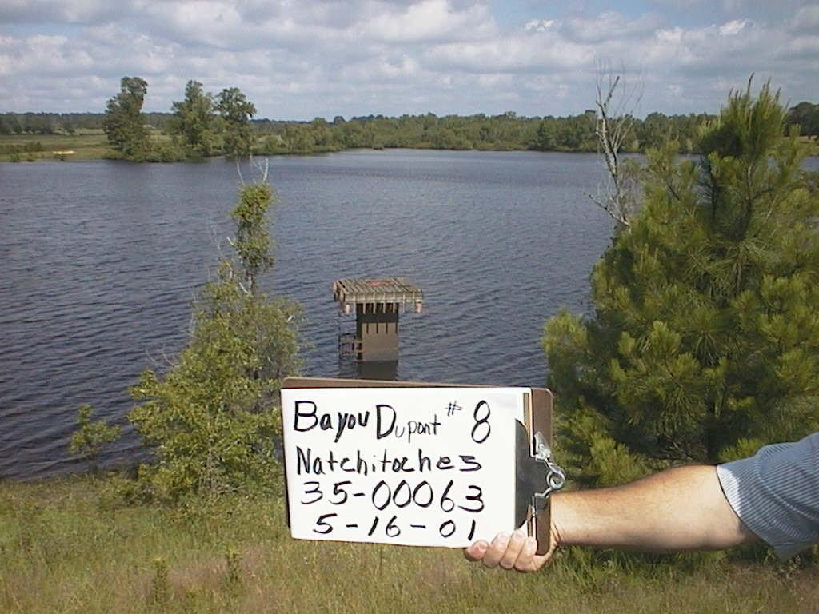
Metadata Circa 2001
Notes:
NEXT SLIDE – Metadata Circa 2016

Slide 6
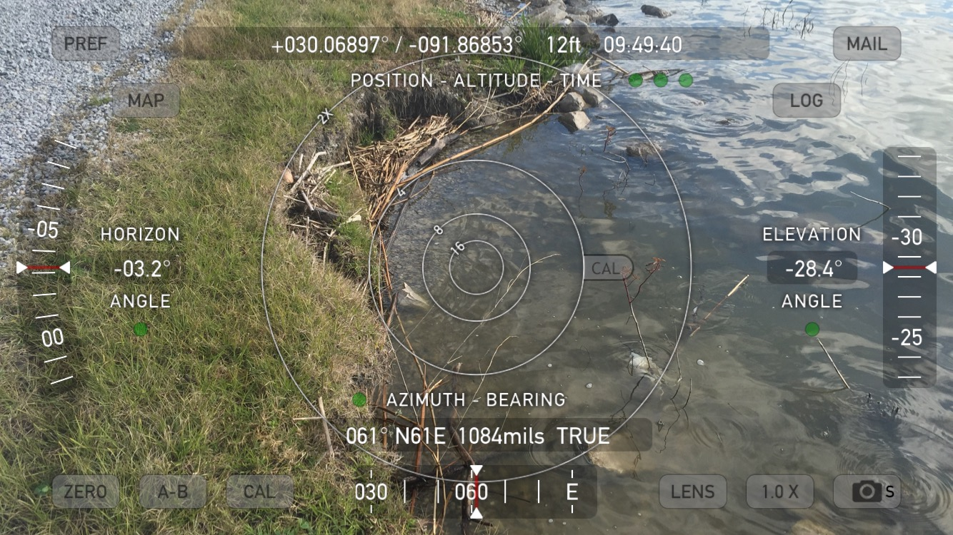
Metadata Circa 2016
Notes:
Next Slide: Determining Areas (Then)

Slide 7
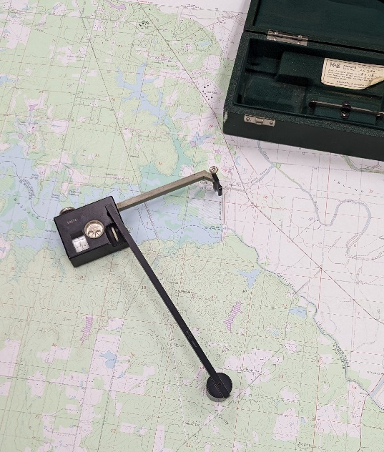
Determining Areas (Then)
Polar Planimeter
USGS Quadrangle Maps
  10’ – 20’ Contours
Accuracy increases as Area increases
Notes:
NEXT SLIDE – Determining Areas: LiDAR

Slide 8
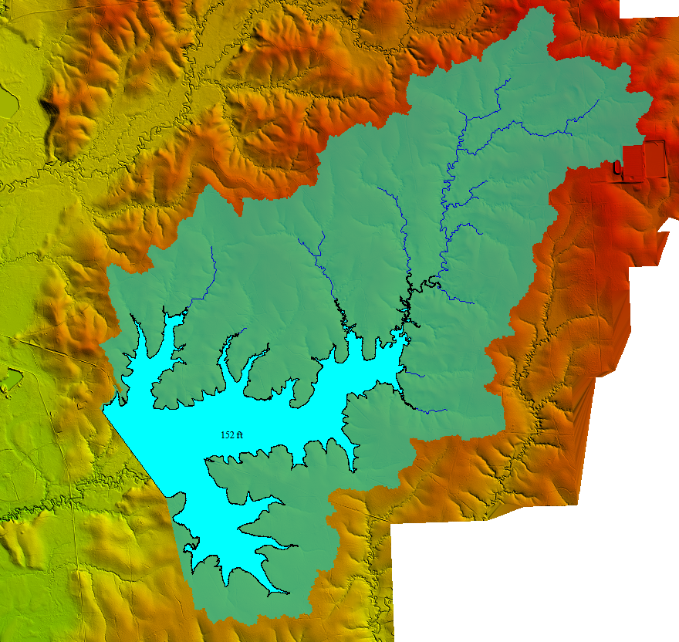
Determining Areas (Now)
Global Mapper/ArcGIS/WMS/DSS-wise
USGS 3DEP Lidar
  ½ - 1 meter sampling
  <1’ vertical accuracy
Less subjective
  Can be as accurate as LiDAR
Notes:
Next Slide: Bailey’s Dam

Slide 9

Dams & Levees
Structures and embankments built to hold back water
  But which is it?
Notes:
Next Slide: Bailey’s Dam

Slide 10
Levees & Dams
Levee
  Prevent water from spreading into unprotected areas
Dam
  Retain water upstream
  Typically cross a water course
  Has a spillway (hopefully)
Notes:
Next Slide: Bailey’s Dam

Slide 11
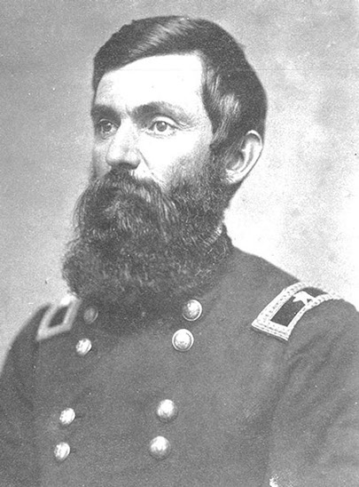
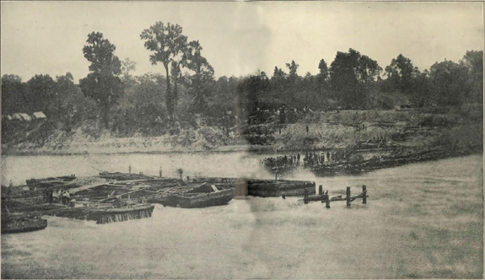
Dam Safety in Louisiana
Bailey’s Dam Under Construction, Red River, May 1864
Notes:
First known dam in Louisiana
Lieutenant Colonel Joseph Bailey, an engineer and future United States general conceived and designed Bailey’s Dam to allow safe passage for a Union naval floatilla over rocky rapids.
NEXT SLIDE – Modern Solution

Slide 12
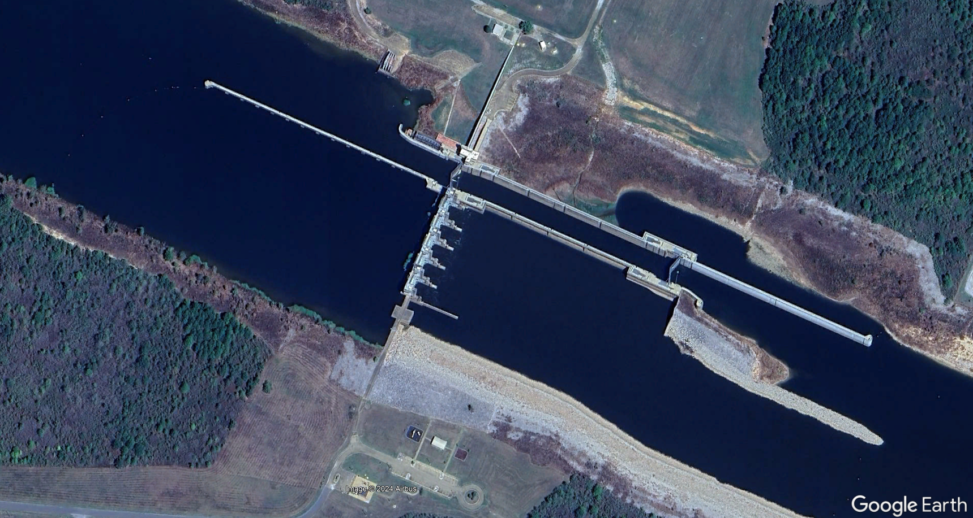
Dam Safety in Louisiana
Red River Lock & Dam #2
Notes:
Built in 1982
#2 of 5 lock and dam structures
~15 miles downstream of Bailey’s Dam
Pool Stage 64 ft ngvd
NEXT SLIDE –

Slide 13
Dam Safety Program
Revised Statutes 38:21
It is the responsibility of the state to provide a means for the inspection, regulation, and supervision of all present or future dams within the state and the operation and maintenance of those as specified in this Chapter, both federal and nonfederal but excluding the Toledo Bend Dam, and the locks and dams on the Red River, Ouachita River, Black River, Mississippi River, and tributaries under the jurisdiction of the United States Army Corps of Engineers, in order to prevent and correct potential hazards to downstream life and property in the event of failure of any dam.
Notes:
(1) "Dam" is any artificial barrier, including appurtenant works, which does or will impound or divert water or any other liquid substance and which has or will have a dam height of twenty-five feet or more or has or will have a maximum liquid storage capacity of fifty acre-feet or more.
This definition does not include any dam or barrier that is not or will not be in excess of six feet in height, regardless of storage capacity, or which has or will have a storage capacity of maximum water storage capacity not in excess of fifteen acre-feet, regardless of height.
(2) "Dam height" means the difference in elevation of the bed of the watercourse measured at the downstream toe of the barrier or from the lowest elevation of the outside limit of the barrier, if it is not across a stream channel or watercourse, to the lowest point on the crest of the dam excluding any spillways or controlled openings.
(3) "Modification" means enlargements or changes that may affect the safety of the dam, including but not limited to adding significant amounts of material to, or removing material from, the cross-section of a dam; changing the dimensions or elevations of spillways; correcting damages associated with significant seepage through or under the dam; building a roadway or placing utilities on or in any part of the dam or altering the operational features of a dam excluding activities associated with routine maintenance.
USACE language was added by Acts 2022, No. 687, §1, eff. June 18, 2022.
Next Slide: 38:28 Engineer’s Responsibility

Slide 14
Dam Safety Program
Revised Statutes 38:28
  “Any engineer providing professional services who designs a new dam or a modification or removal of an existing dam without notifying the owner in writing of the owner's obligation to obtain a permit or written consent of the chief engineer prior to the start of construction shall be reported to the Louisiana Professional Engineering and Land Surveying Board (LAPELS).”
Notes:
Acts 2022, No. 687, §1, eff. June 18, 2022.
Next Slide: Regulated Dams

Slide 15
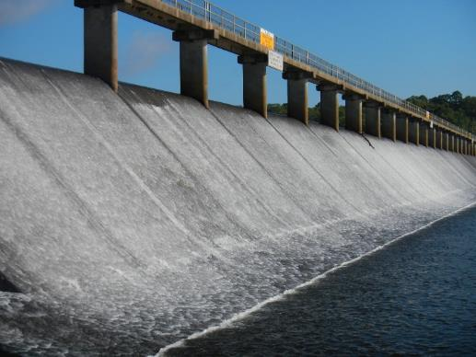
Dam Safety Program
660 Regulated Dams
(As of November 20, 2023)
43 High Hazard
67 Significant Hazard
550 Low Hazard
16 Under Investigation
Impact Classification | Potential Loss of Life | Potential Economic Loss | Inspection Frequency
High | Likely | Excessive | Annually
Significant | Possible | Appreciable | 3 years
Low | Not Likely | Minimal | 5 years
It is the responsibility of the owner/applicant to establish impact classification, and all dams will be considered to be of High Impact potential until demonstrated to be otherwise by a documented analysis provided by the applicant.
Spillway at Bayou D’Arbonne Dam
Union Parish
Notes:
State Dam Safety Program – number of dams has decreased in the last few years by about 30.
NEXT SLIDE – State-maintained dams

Slide 16
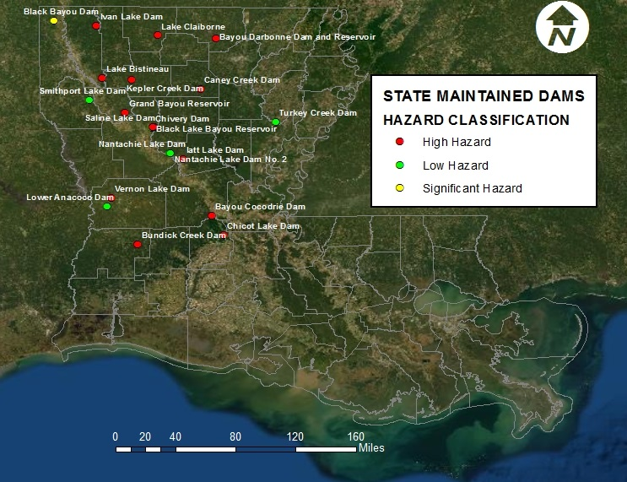
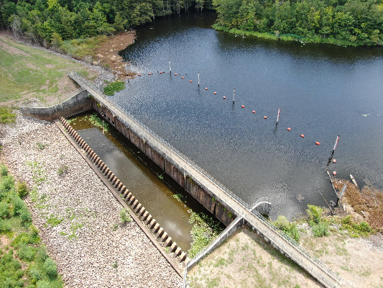
Dam Safety Program
State-Maintained Dams
Spillway at Chicot Lake Dam
Evangeline Parish
21 DOTD Maintained Dams
  13 High Hazard
  2 Significant Hazard
  6 Low Hazard
(All DOTD Maintained dams are inspected annually)
Notes:
Location of 21 Dams that DOTD operates and maintains per statute LA RS 38:26
These dams are inspected annually
NEXT SLIDE – Dams – Capital Outlay Projects

Slide 17
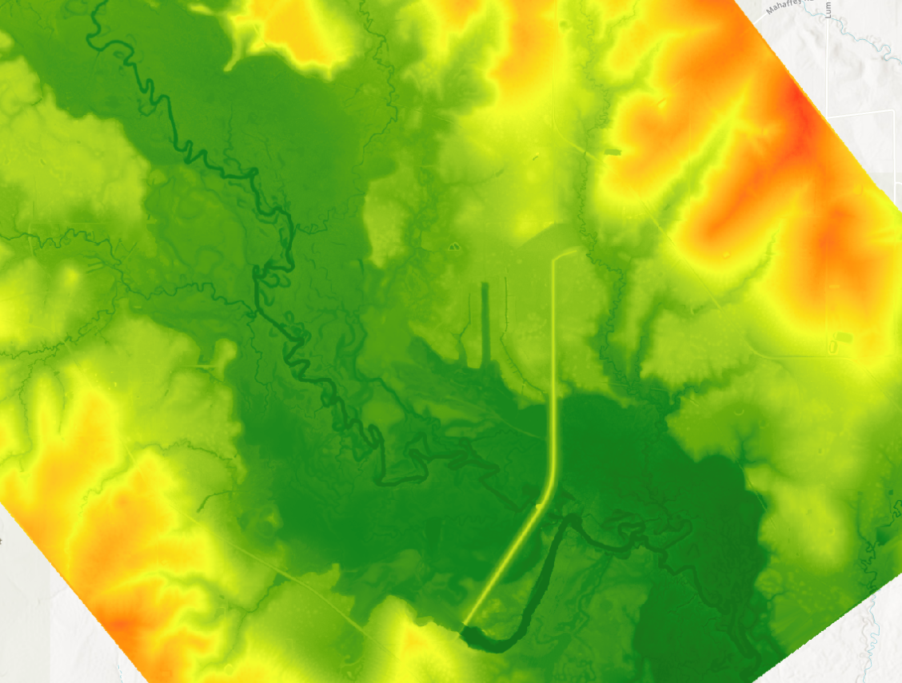
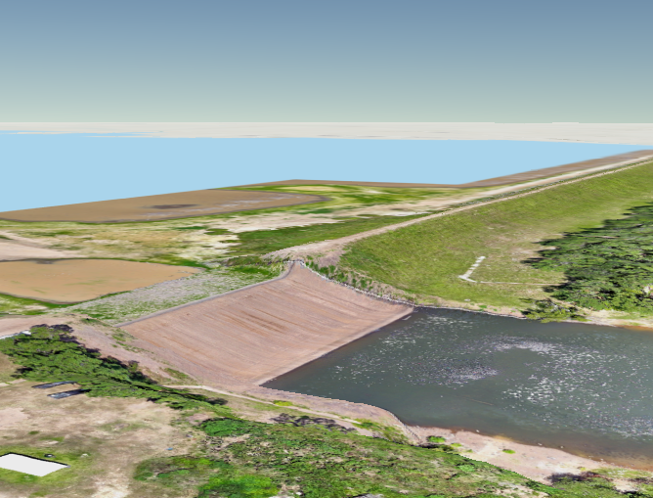
Dam Safety Program
State-Maintained Dams – Drawdowns & Data Collection
Coordination and collection of LiDAR during drawdowns
Drone imagery for photogrammetry
Notes:
We are responsible for coordinating planned lake drawdowns with WLF and lake commissions.
In addition to ongoing coordination with DOTD Location & Survey, Dam Safety staff have also become certified drone pilots, using in-house equipment to collect valuable information about dam across the state. This program is still being developed further.
Next Slide: Mobile Inspection App

Slide 18
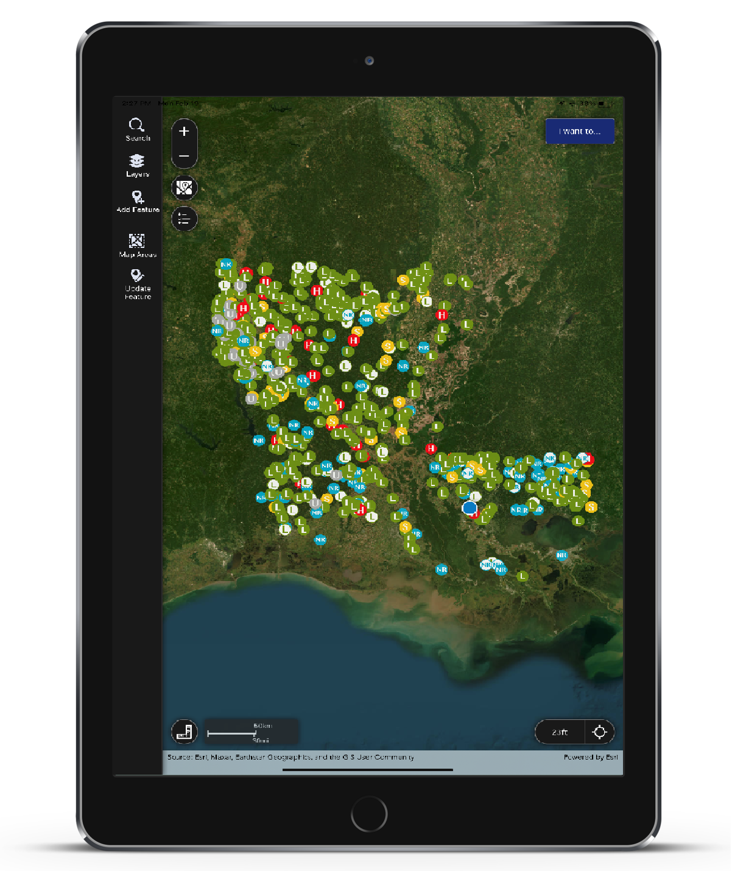
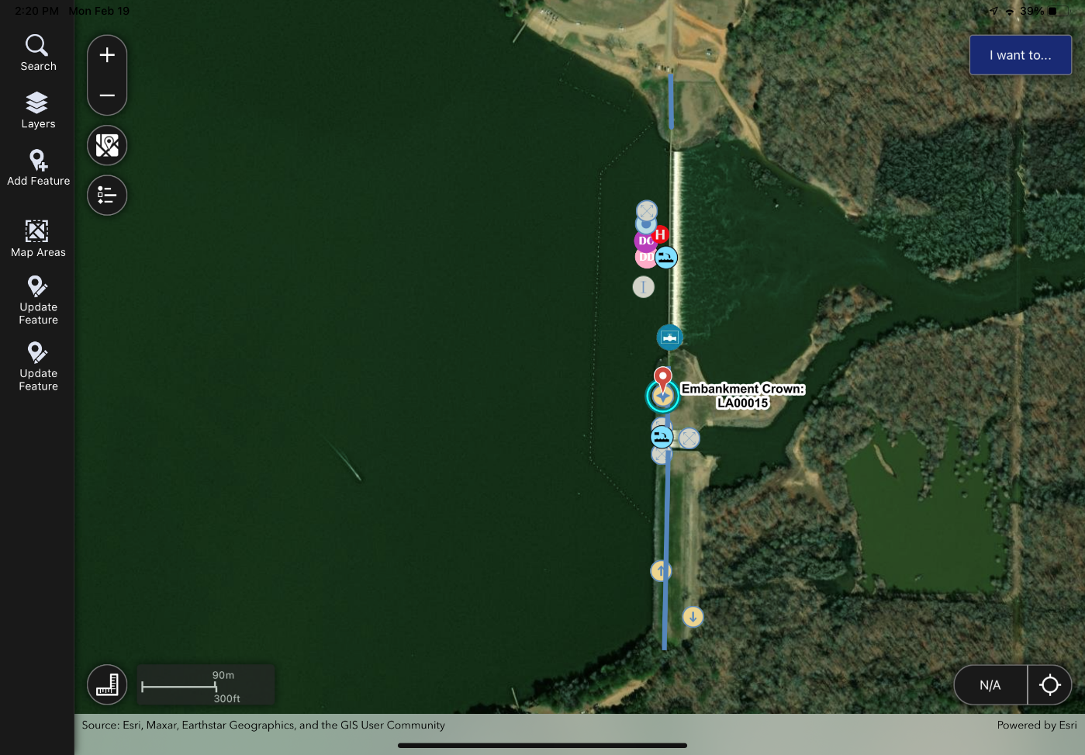
Mobile Inspection App
Notes:
Piezometer Readings Chart available in menu
This was added to quickly see trends in piezometer readings
NEXT SLIDE – Mobile Inspection App Continued

Slide 19
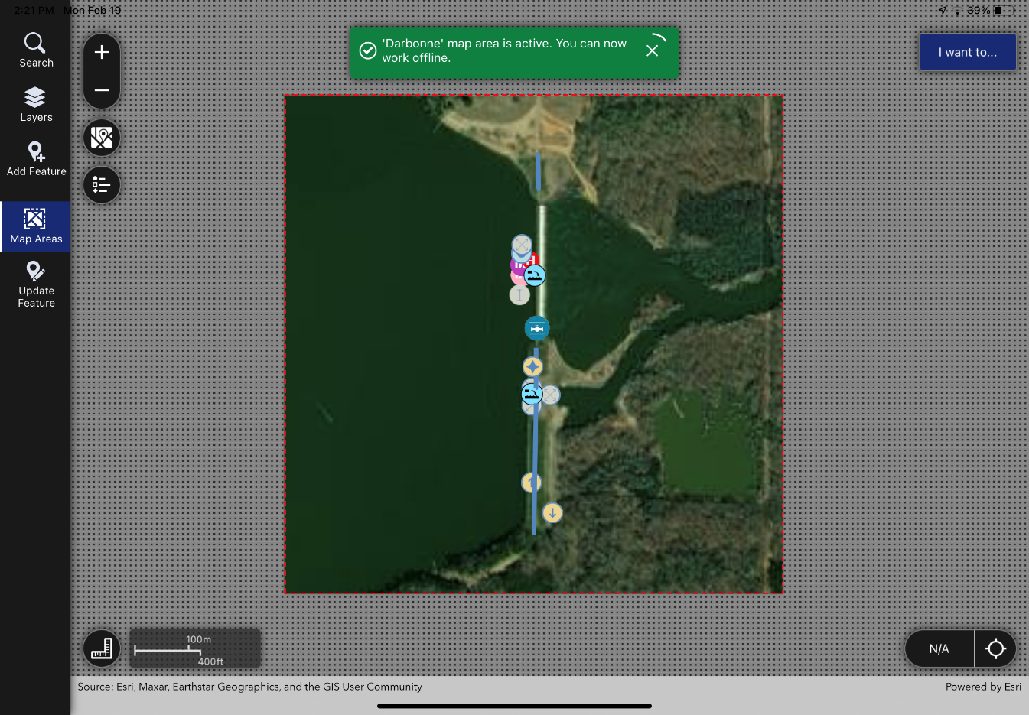
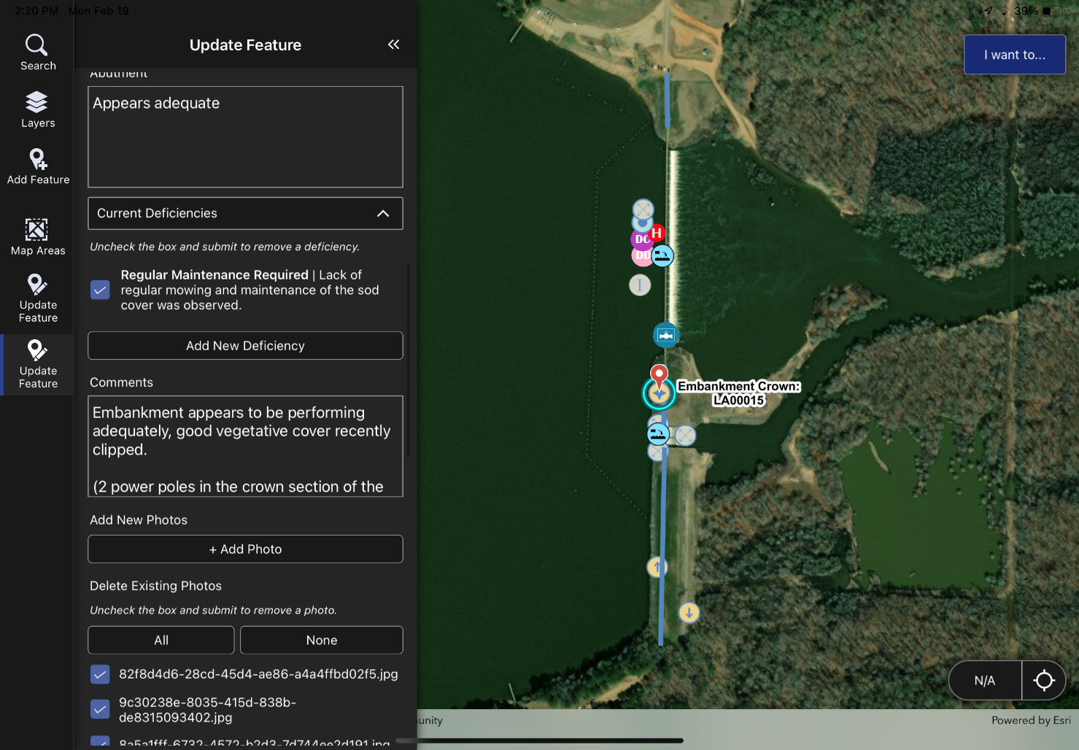
Mobile Inspection App
Notes:
Inspectors are able to download offline maps for seamless operation in remote locations
In addition to adding any new features (like deficiencies) Previous features can be updated during the inspection.
NEXT SLIDE – Dams Data Viewer

Slide 20
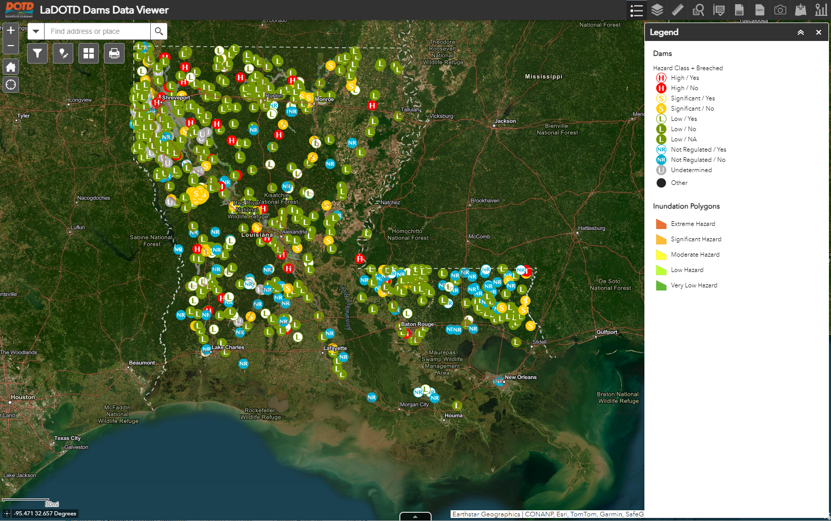
LaDOTD Dams Data Viewer
View, edit, or generate reports for dam inspections.
ESRI ArcGIS Web Application
Notes:
NEXT SLIDE – Dam Viewer

Slide 21
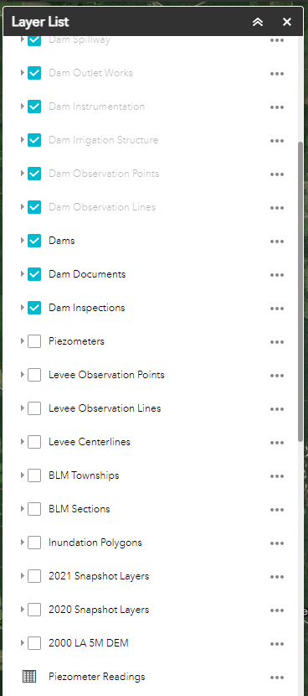
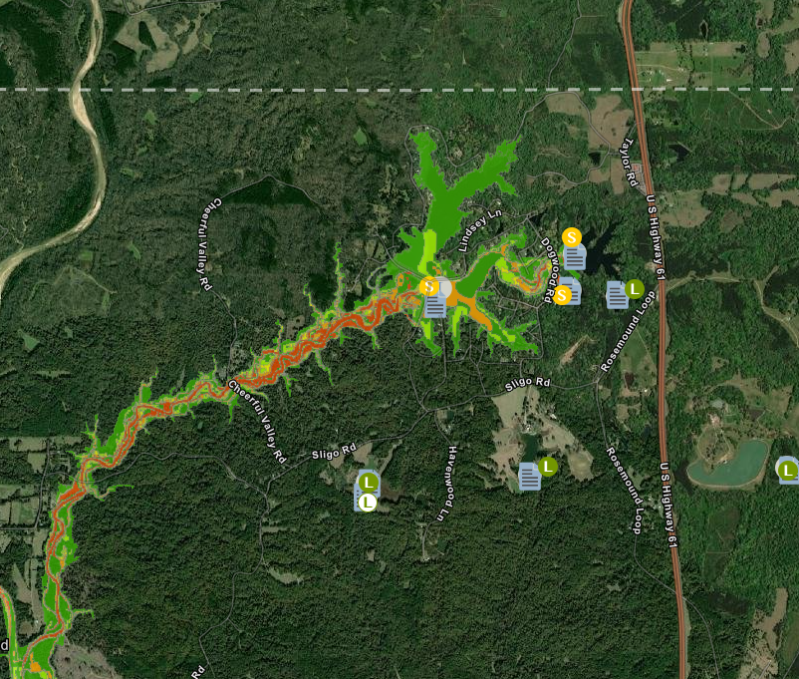
LaDOTD Dams Data Viewer
Inundation Polygons
Notes:
Only available for High and Significant Hazard Dams
Off by default
Shows partial reservoir breach completed in DSS-Wise
NEXT SLIDE – Dams – Capital Outlay Projects

Slide 22
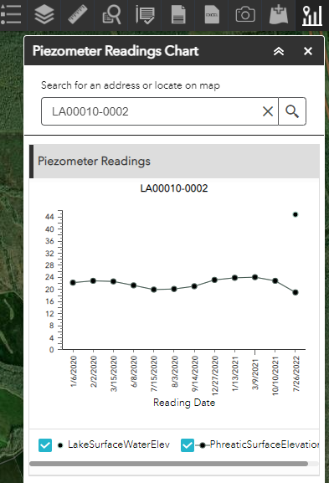
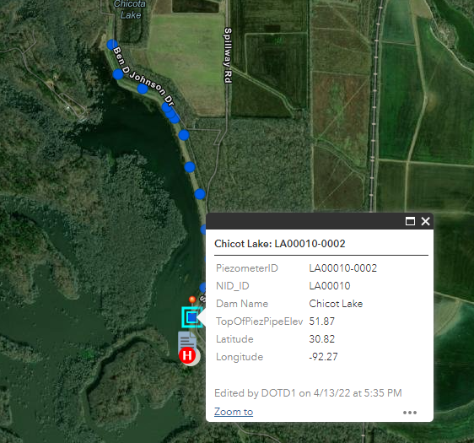
LaDOTD Dams Data Viewer
Piezometers
Notes:
Piezometer Readings Chart available in menu
This was added to quickly see trends in piezometer readings
NEXT SLIDE – Drone Program

Slide 23
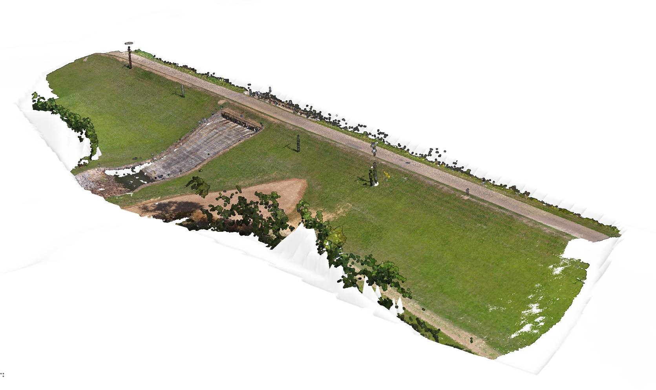
Dam Safety Program
Drone Program
Since January 2023
Skydio X2E
  Photogrammetry
  Thermal Imaging
Limitations:
  1 Drone
  2 Pilots
  LiDAR
  Data Volumes
Notes:
Developing Program
Next Slide: Drone Program – Thermal Evaluation

Slide 24
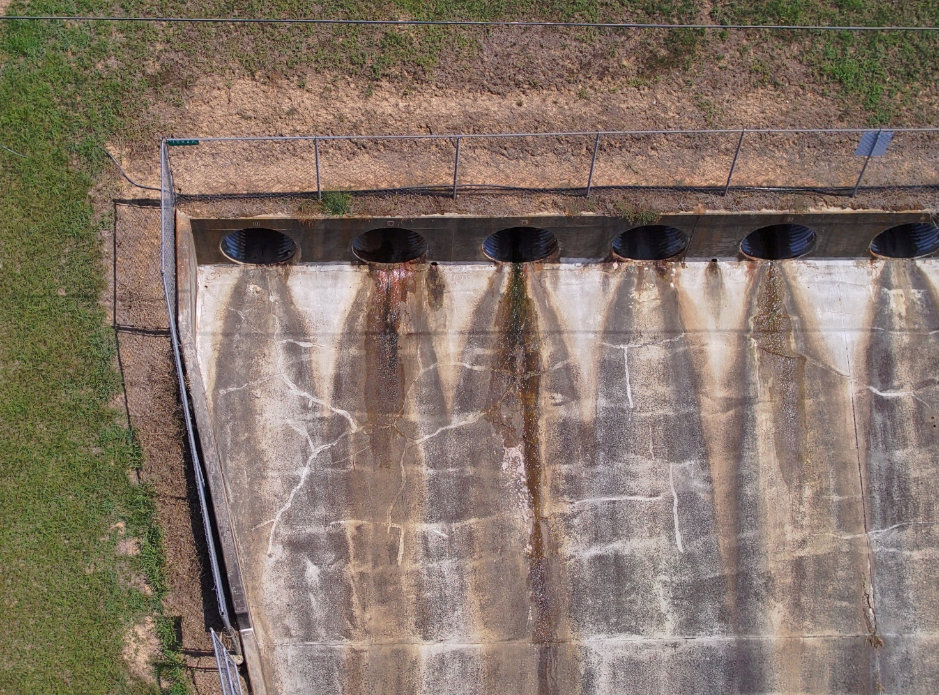
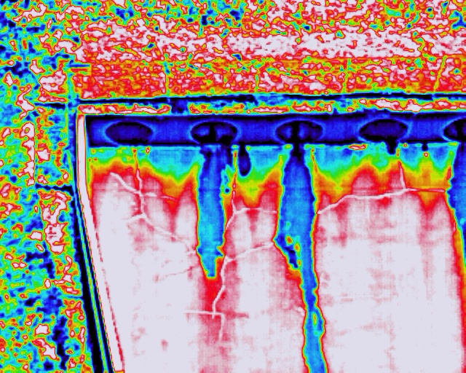
Dam Safety Program
Thermal Evaluation
  Seepage
  Voids
Drone Program
Notes:
Next Slide: Thermal Evaluation continued

Slide 25
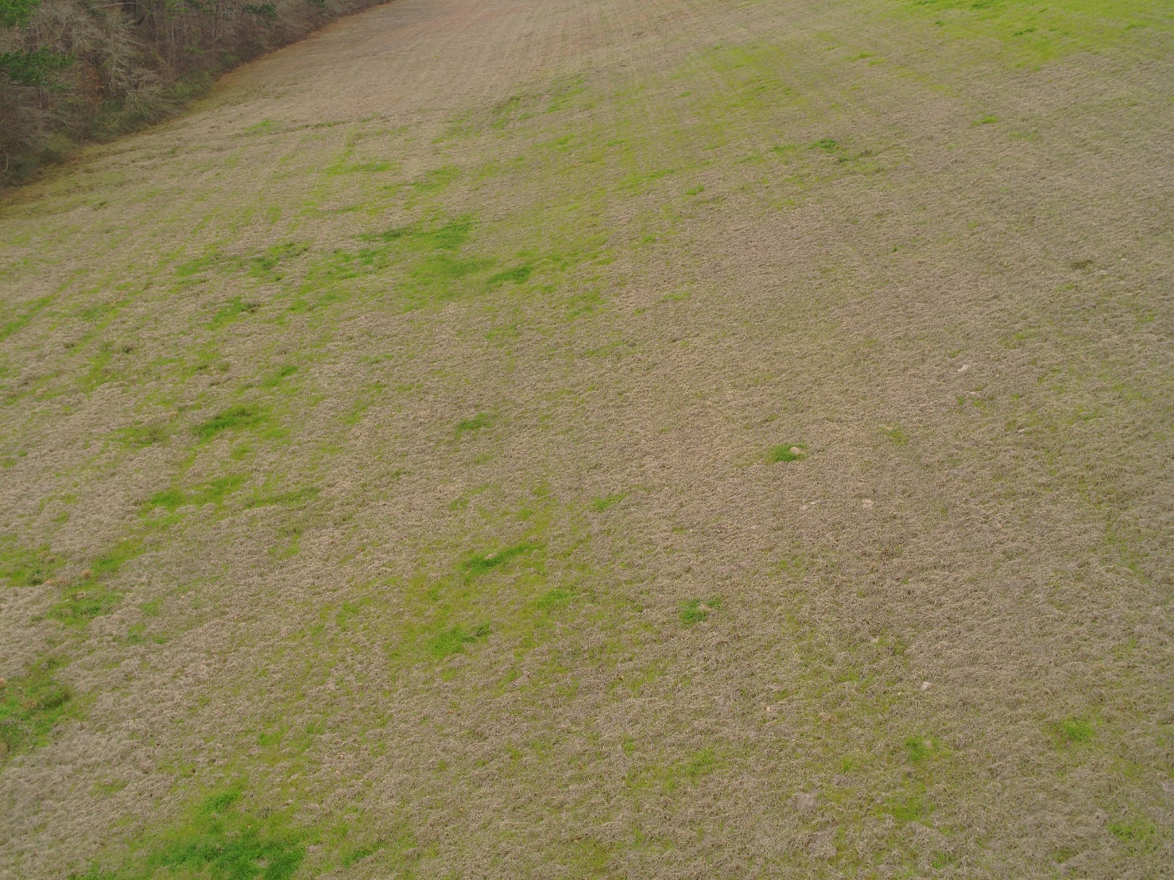
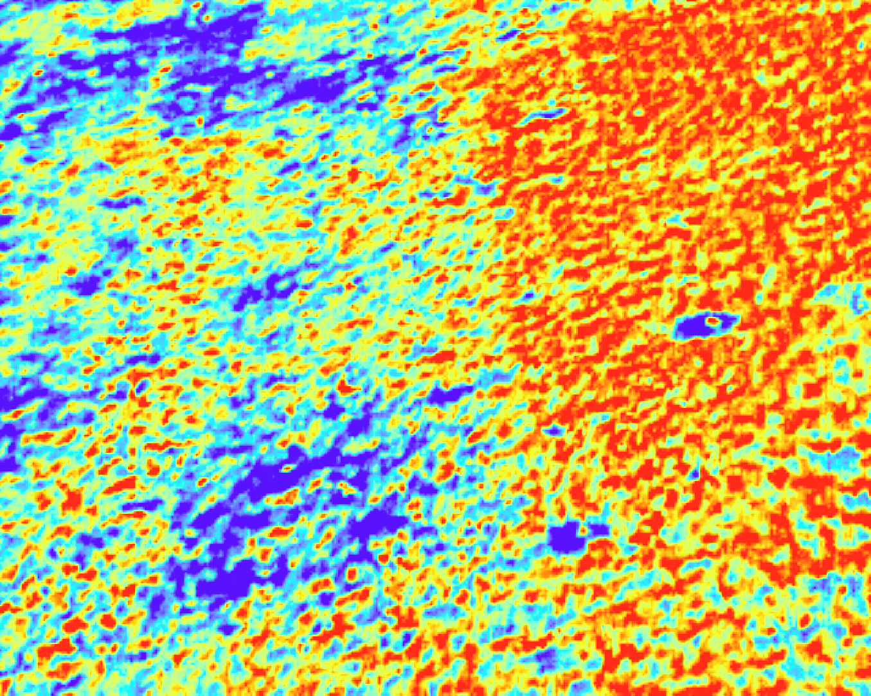
Dam Safety Program
Thermal Evaluation
  Seepage
  Voids
Drone Program
Notes:
Next Slide: Remote Monitoring, Data Collection and Controls

Slide 26
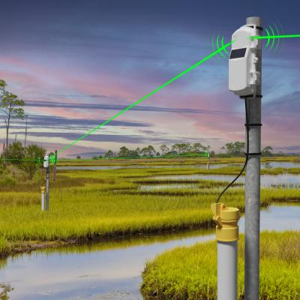
Dam Safety Program
Remote Monitoring, Data Collection, and Controls
Remote Monitoring and Data Collection
  Data Loggers
  Automated Piezometers
  Remote Water Level Sensors
Control Structure Actuators
Photo Courtesy of HOBO Data Loggers
Notes:
Next Slide: Pipe Crawler

Slide 27
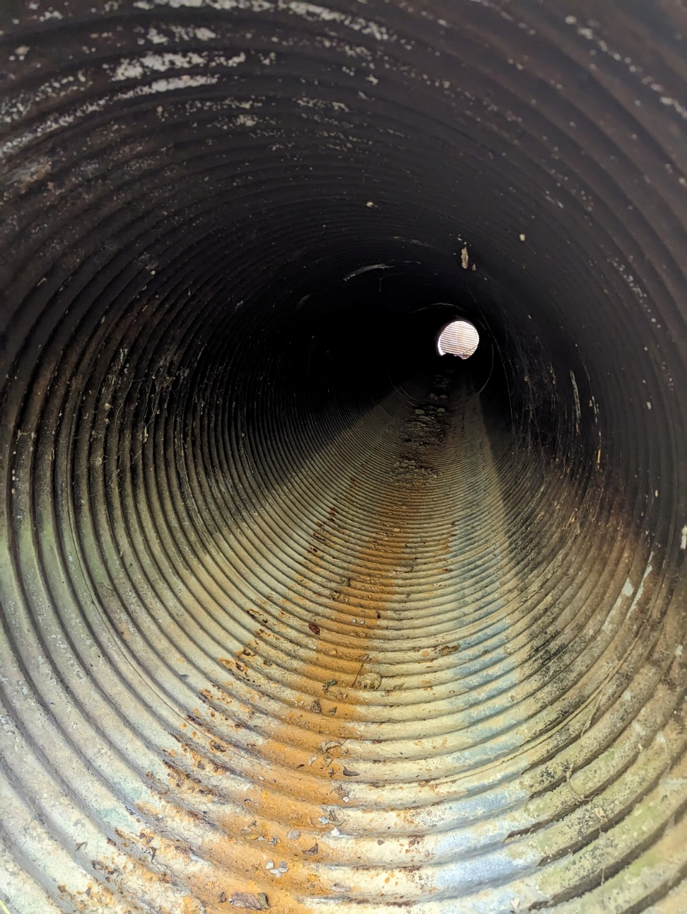
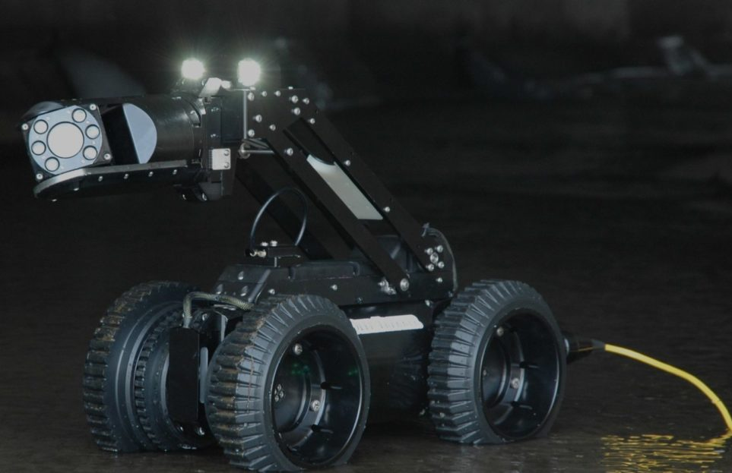
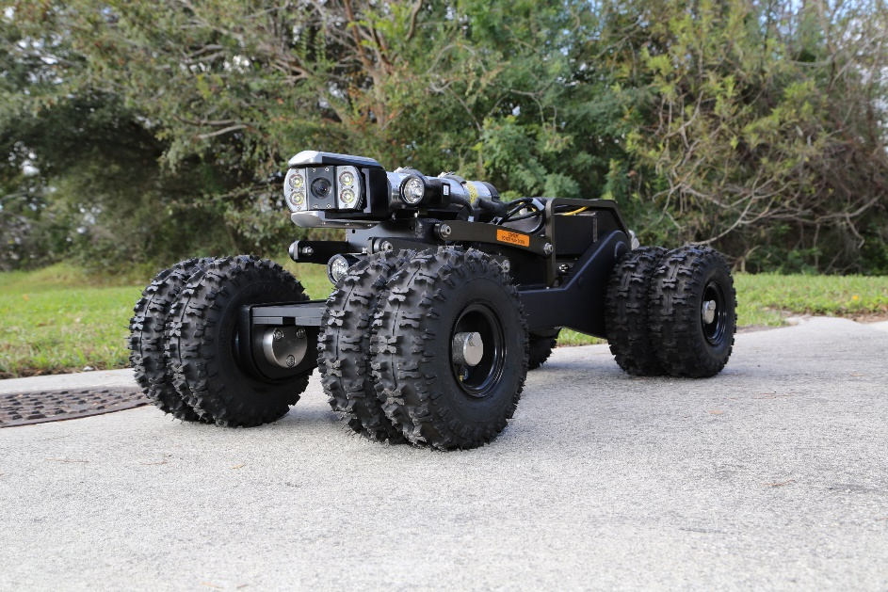
Wish List – Pipe Crawler
Deep Trekker, Inc.
CUES, Inc.
Notes:
Next slide: Bathymetry

Slide 28
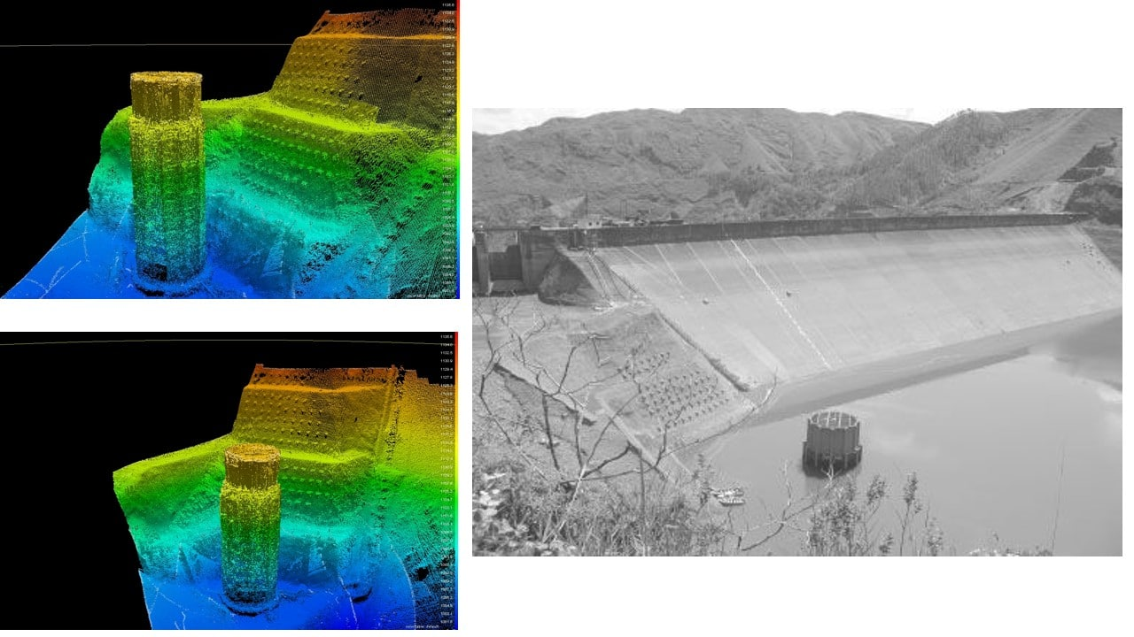

Wish List
Photo Courtesy of Geomares.com
Notes:
Next slide: Special Request USV

Slide 29
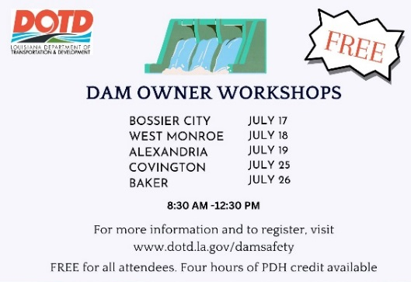
Dam Safety Program
Dam Owner Workshops
Notes:
Next slide: Levee Safety

Slide 30
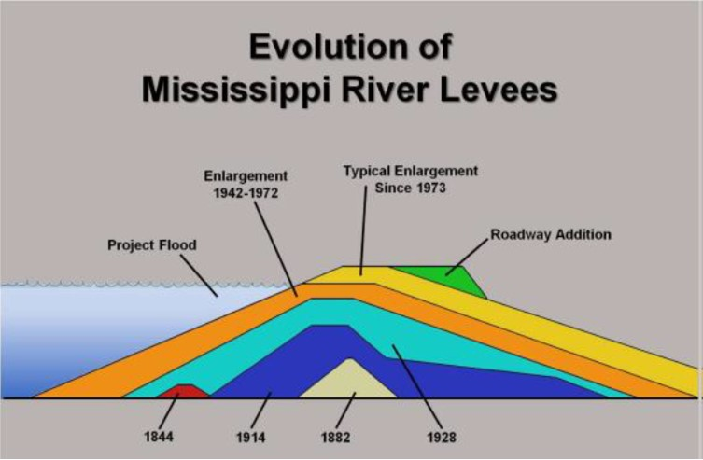
Levee Safety in Louisiana
The first man-made levee in Louisiana was a 3-foot tall embankment built by the French in the early 18th century to protect New Orleans from the Mississippi River.
Notes:
5400 feet of levee
Built by the French under Bienville from 1718 to 1727
Next Slide: Non-Coastal Levee Districts

Slide 31
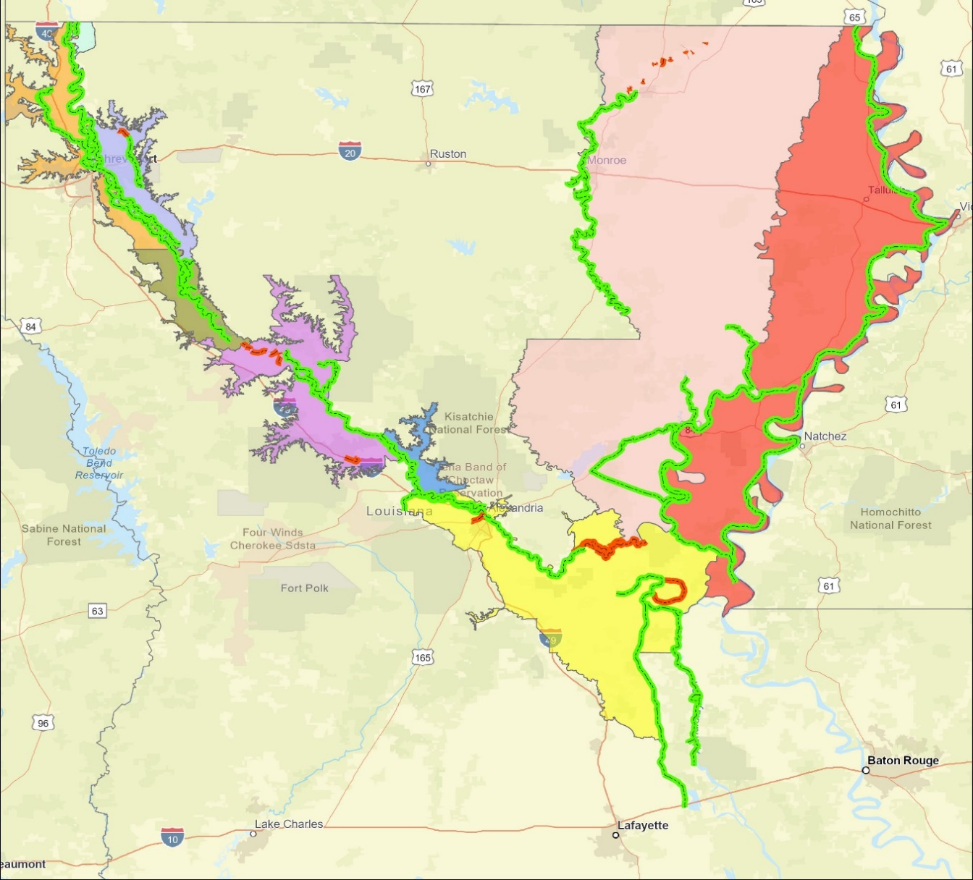
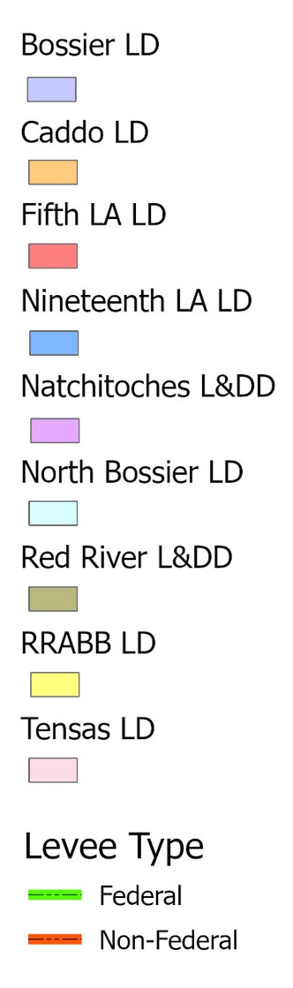
Levee Safety Program
Non-Coastal Levee Districts (9)
Federal 65.1
Non- Federal 4.3
Federal 116.7
Federal 306.3
Federal 26.2
Federal 69.3
Non- Federal 17.5
Federal 3.4
Federal 51.7
Federal 196.7
Non- Federal 55.2
Federal 249.9
Non- Federal 4.7
Notes:
Nine Non-Coastal levee districts
Program inspects about 1,000 miles of levees semi-annually
1085 miles of Federal Levees
81.7 miles of non-federal levees
Next Slide – Levee Safety Current Services

Slide 32
Levees
Riverine
  Loaded for weeks or months
  Parallel flows
Coastal
  Typically loaded for days
  Perpendicular flows
Notes:
Next Slide: Levee Safety Program Services

Slide 33
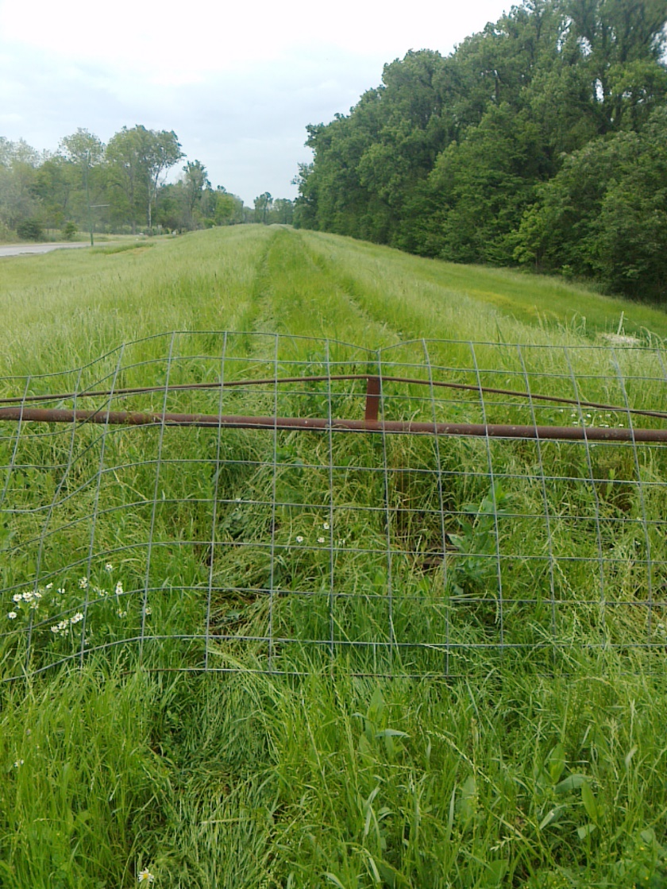
Levee Safety Program
Current Services
Inspections
  Assist Levee Districts with their Inspections
  Provide Semi-Annual Inspection Reports
  Provide Recommendations/Options for Corrective Actions
  Flood inspections / Monitoring
Inventory/Mapping
  Inventory Levee Assets
  Develop GIS Maps
Training Compliance
  Online training for levee inspectors
Notes:
Next Slide: Levee Safety Into the Future

Slide 34
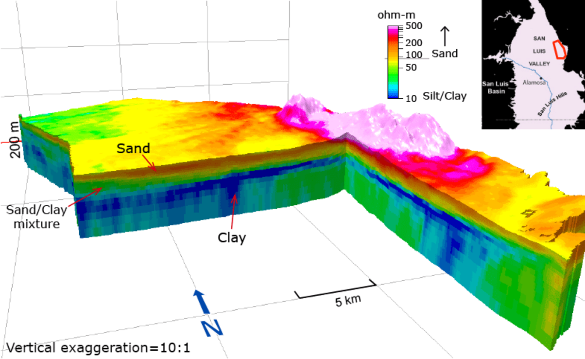
Levee Safety Program
Into the Future
Evaluation of Electromagnetic Geophysics
  Partnership with USGS for ongoing collection
  Identification of Potential Seepage Locations
Levee Centerline Surveys (RTK)
Integration of Drones, Crawlers, and USVs
Notes:
Next Slide: National Levee Safety Program

Slide 35
Levee Safety Program
National Levee Safety Program
Redesigned National Levee Database
New National Levee Safety Guidelines
Integrated Levee Management
  clarifying roles and responsibilities to improve coordination and implementation in order to be more complimentary, streamlined, and effective in managing all levees in the Nation; and
  promoting and encouraging formal levee safety programs at the state level to serve as key integrators with other entities that have levee responsibilities.
Implementation Support
Notes:
An integrated approach to levee safety requires each entity (federal, state, tribes, levee owner/operator, and communities "to understand and fulfill their responsibilities and to do so in coordination with each other". It is envisioned that the lynchpin to success is having states serve in a key integrator role. States have existing legal authorities to implement floodplain management regulations and have long-standing relationships with local governments in areas such as emergency planning and response. Even though federal agencies and tribes can have their own levee safety programs for management of levees within their authorities, their levees still influence watersheds that exist within states.
As part of the legislation for the National Levee Safety Program, Congress envisioned that state levee safety programs would adopt and implement consistent national levee safety practices; be able to receive federal assistance in support of levee safety; carry out public education activities to improve awareness of flood risk; and collect and share levee information using the National Levee Database. In addition, there is opportunity for state levee safety programs to:
Help build capacity in levee owners/operators to inspect, assess, repair, and rehabilitate levees;
Collaborate across programmatic and political jurisdictions to ensure that all levees have adequate oversight; and
Apply services in a fair and equitable way across the landscape with special attention to underserved communities, tribes, and individuals particularly vulnerable to flooding.
Next Slide: USGS Programs

Slide 36
Questions ?

