Slide 1
Louisiana Levee Safety Program - Overview
Public Works and Water Resources
Curt J. Boniol, P.E.
Levee Safety Engineer / Program Manager

Slide 2
Levee Safety Program Topics
Services Provided by DOTD Levee Safety Program
DOTD Inspection Jurisdiction
ESRI Software –Levee Data Viewer\Levee Dashboard\Field Maps Software
Levee Inspections – Report Formats\Maps
Levee Permit Database
Columbia Levee Centerline Survey

Slide 3
DOTD Levee Safety Program
Inspections
Assist the levee districts with their inspections
Provide inspection reports
Provide recommendations\options for corrective actions
Inventory \ Mapping
Create maps for inspection reports & Inventory Levee Assets
GIS Mapping
Assist with project management funding for levee improvement projects
Capital Outlay funding and project management
Training
Assist in providing Levee Inspection Certification on-line training in conjunction with CPRA website for inspectors\Levee Districts
Notes:
This is what services we provide to our levee districts. Inspections, inventory \mapping, Project Management (Various funding sources), On-Line levee certification training.

Slide 4
DOTD Levee Safety Program
Permits
Levee Board permitting and tracking permits in DOTD Levee Permit Database and oversight of Letters of No Objection at the DOTD district level
Flood fight coordination with Levee Districts\monitoring
Notes:
Topics for discussion are:
Levee Permits (LONO’s) and Flood Fight Coordination

Slide 5
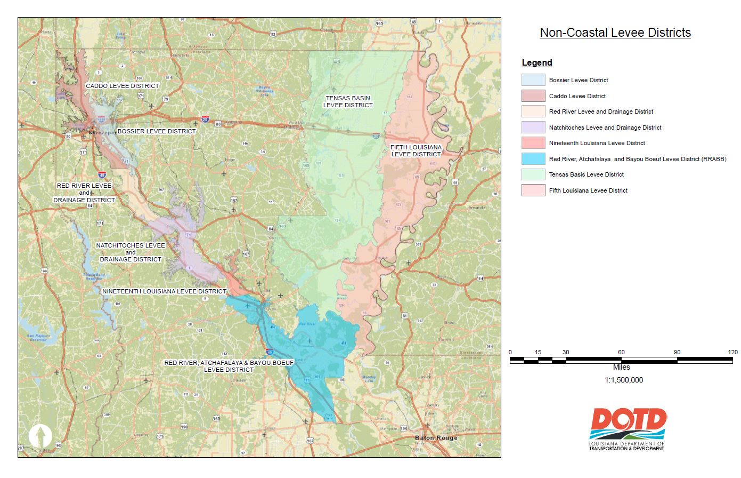
Levee Districts DOTD Works With
Notes:
DOTD Works with 8 Non-Coastal Levee Districts.

Slide 6
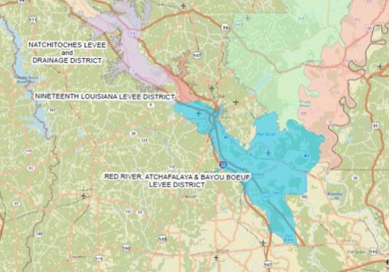
Levees inspected in District 08
Natchitoches Levee and Drainage District
19th Louisiana Levee District
Red River Atchafalaya and Bayou Boeuf Levee District
Notes:
These are the 3 levee districts within the District 08 region.

Slide 7
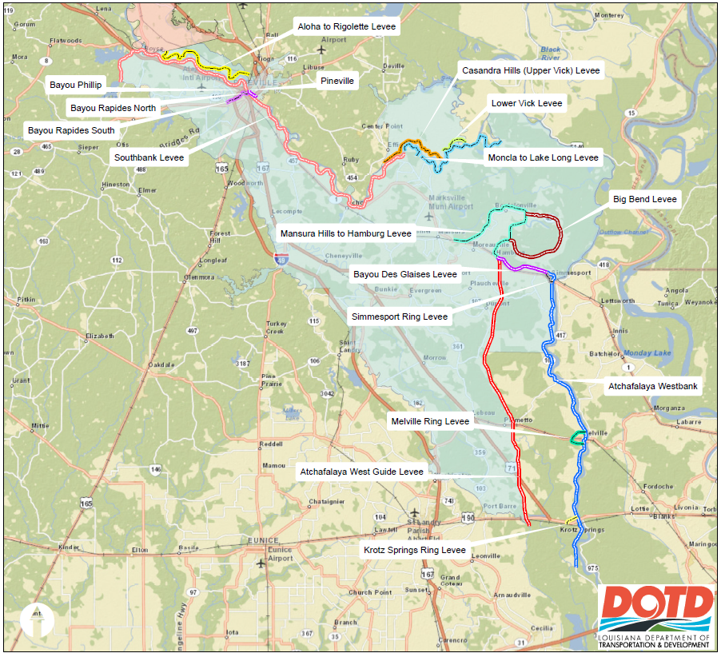
RRABB Levee District
Notes:
RRABB levee district segments

Slide 8
ESRI Resources
Online resources available
ESRI Field Maps App (conducting inspections)
Levee Data Viewer (DOTD only)
Levee Dashboard (read only - available to certain DOTD district personnel and to Non-Coastal Levee Districts - retrieve documentation)
Notes:
This is the ESRI resources that the Levee Safety Program uses for keeping / tracking inspection data. I will give you a preview later on the Data Viewer and Dashboard filters for Levee Districts, Inspection segments, Rated Items and the Status.

Slide 9
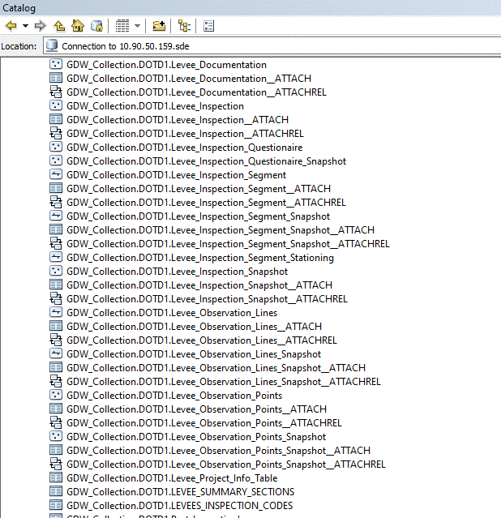
Arc Catalog Data Base
Notes:
The Geo Data Warehouse database was established by ESRI and it migrated all of our data over from Terra-Flex (software previously used). This shows where the current data is located for our Levee Safety Program.

Slide 10
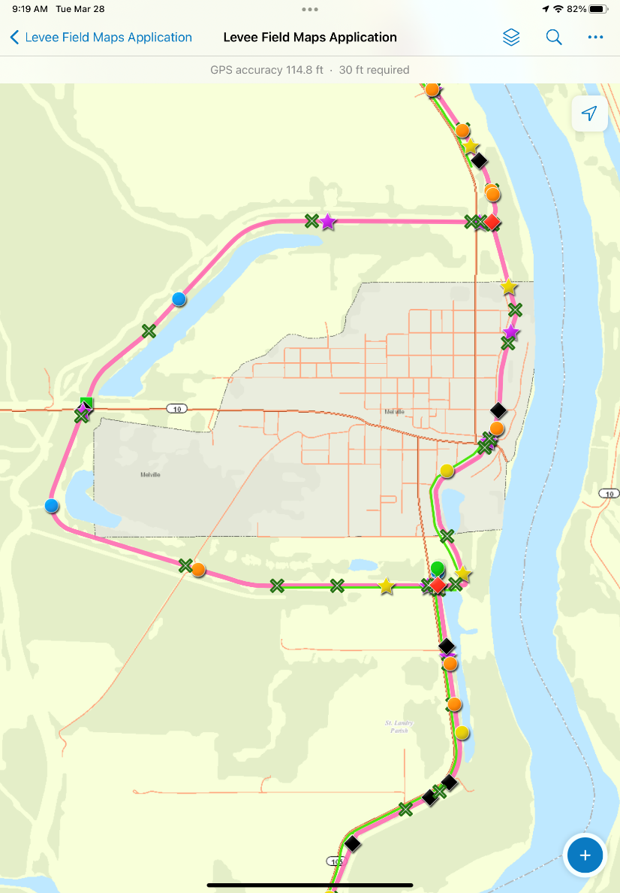
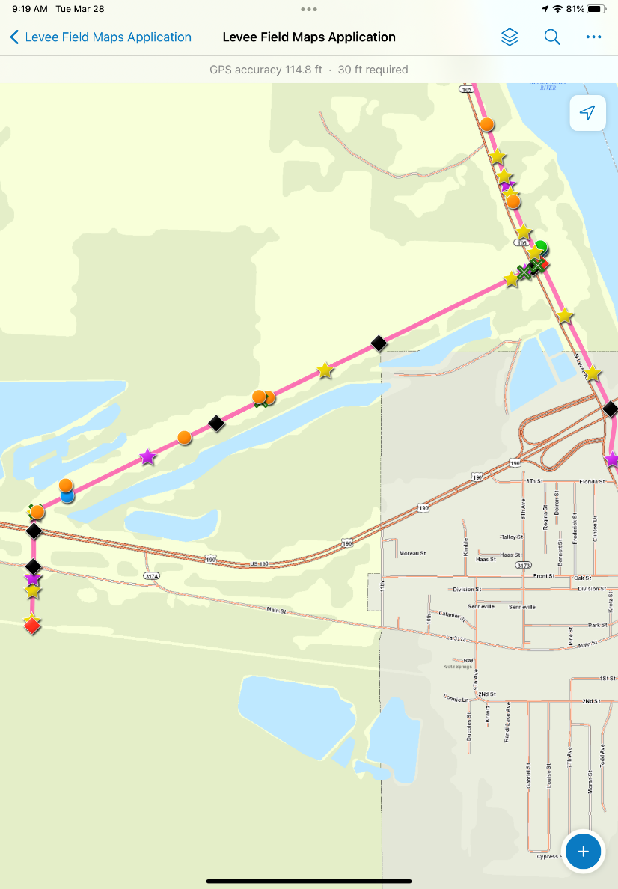
ESRI Field Maps for Inspections
Melville Levee
Krotz Springs Levee
Notes:
The levee safety program uses Field Maps for performing our levee inspections. The Field Maps software was developed by ESRI specifically for the DOTD Levee Safety program.

Slide 11
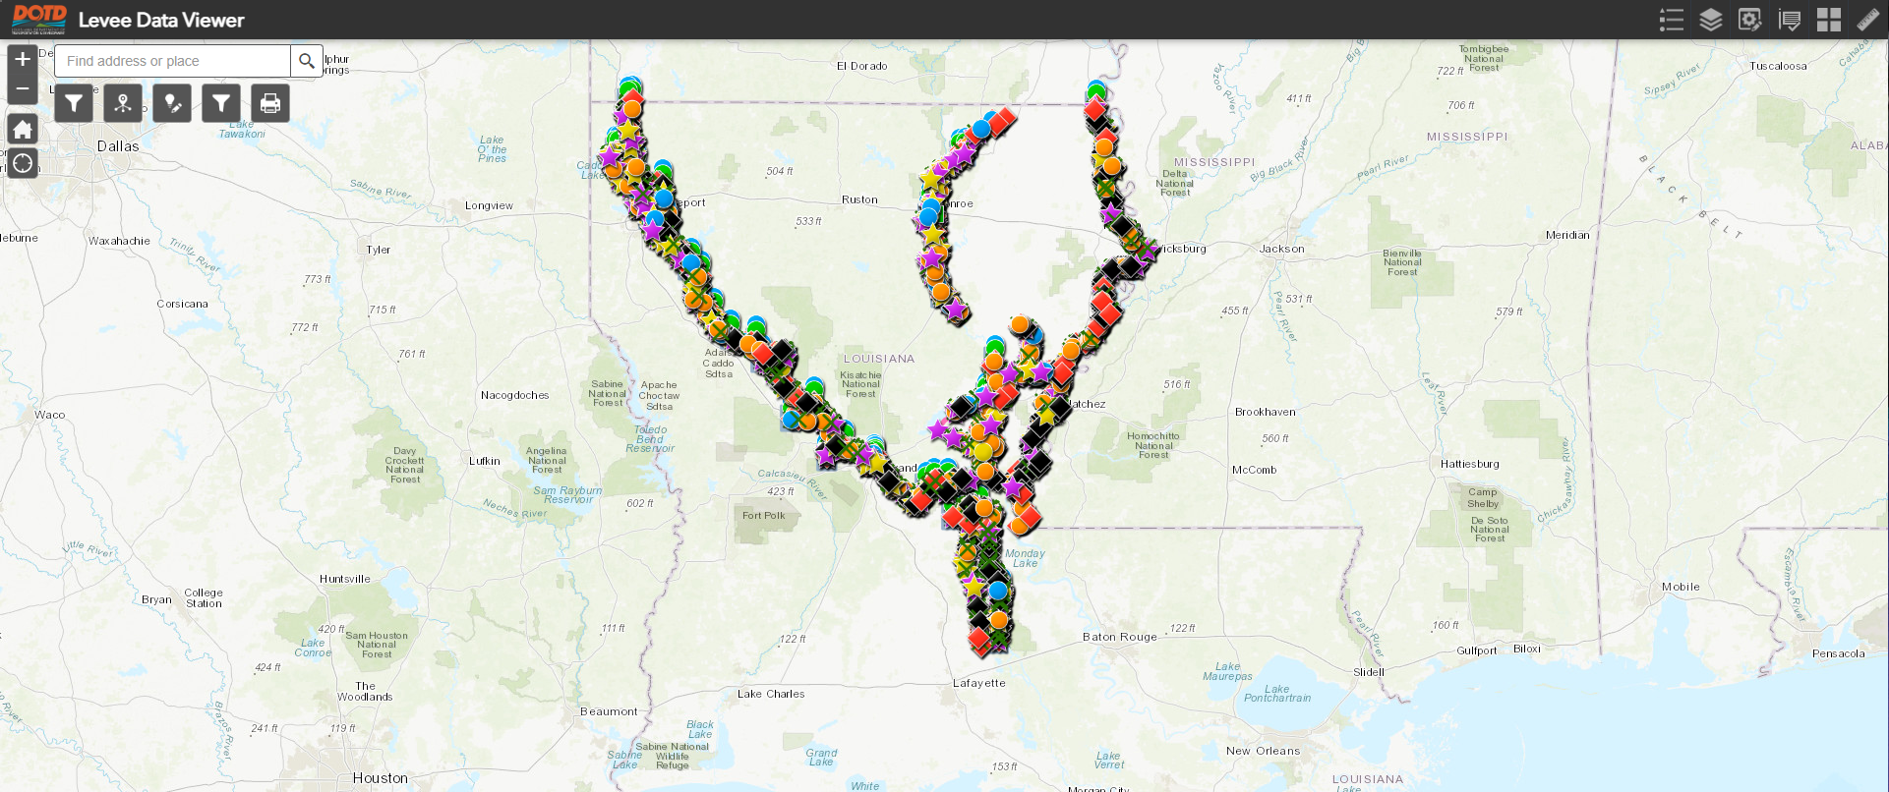
Levee Data Viewer
Notes:
Levee Data Viewer Screenshot of the Non- Coastal levees we inspect.

Slide 12
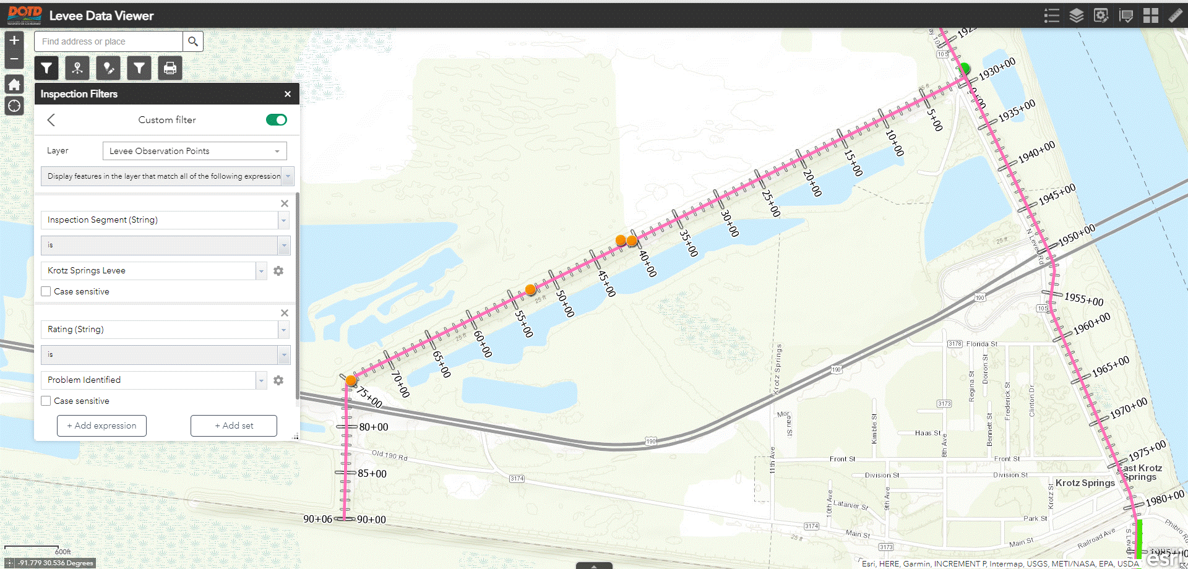
Levee Data Viewer Custom Filter
Notes:
Using custom filters for Melville Ring Levee for Problem Identified with form.

Slide 13
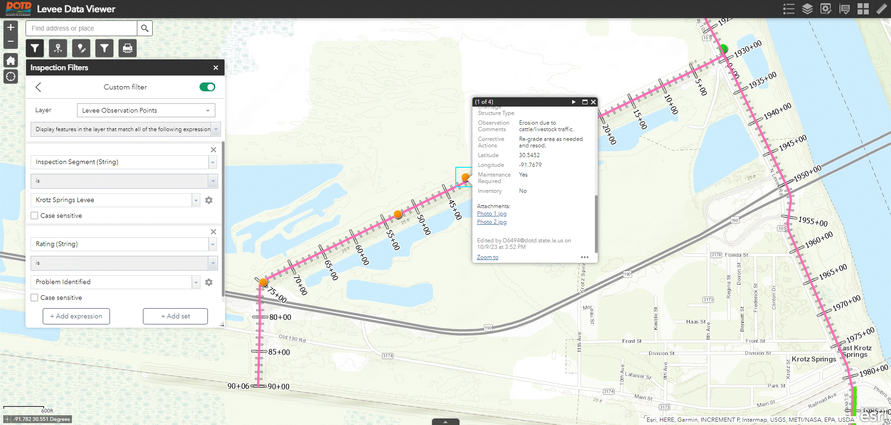
Levee Data Viewer Custom Filter
Notes:
Using custom filters for Melville Ring Levee for Problem Identified with form.

Slide 14
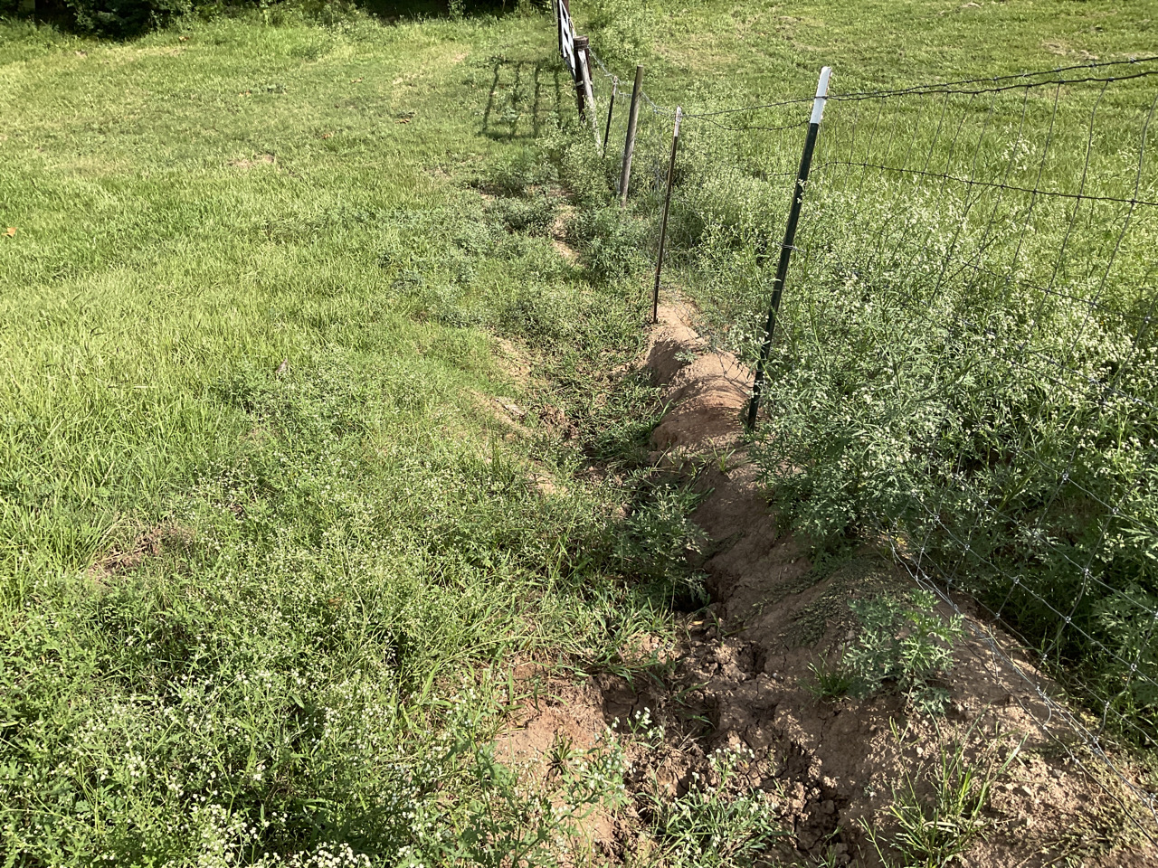
Levee Data Viewer
Notes:
Problem Identified on Melville Ring Levee for a degraded ramp.

Slide 15
Levee Data Viewer
Cataloging Levee Deficiencies
Deficiency Type (Rated Items)
Latitude / Longitude
Pictures (Problem deficiencies and resolved items)
Tracking Repairs (Resolved Items)
Tracking Improvements
Generating Reports
Notes:
This is what the software is capable of doing for the Levee Safety Program and has read /write access capabilities to the Data Viewer.

Slide 16
Levee Data Viewer
Functions
View data
Current
Archived (aka Levee Snapshot)
Add new data (in office or in the field)
Edit the current data
Export map
Notes:
This is what the software is capable of doing for the Levee Safety Program and has read /write access capabilities to the Data Viewer.

Slide 17
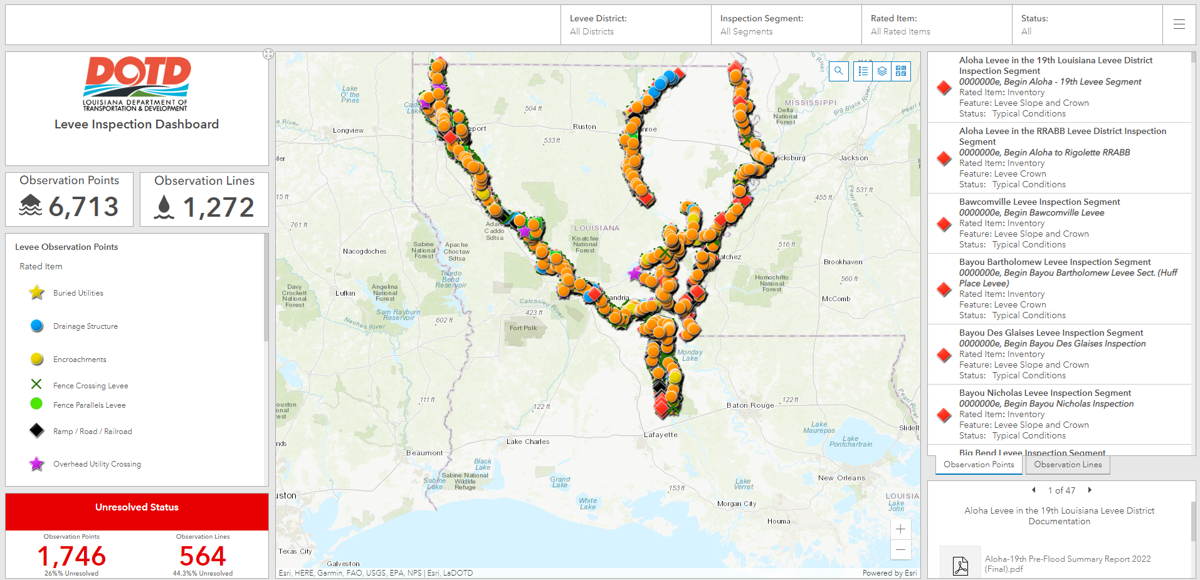
Levee Inspection Dashboard
Notes:
The screen will be set to the default view to show you all the points and lines without any filters applied. This is read only with pulldown menus. Documentation is also available to preview on bottom right of the screen.

Slide 18
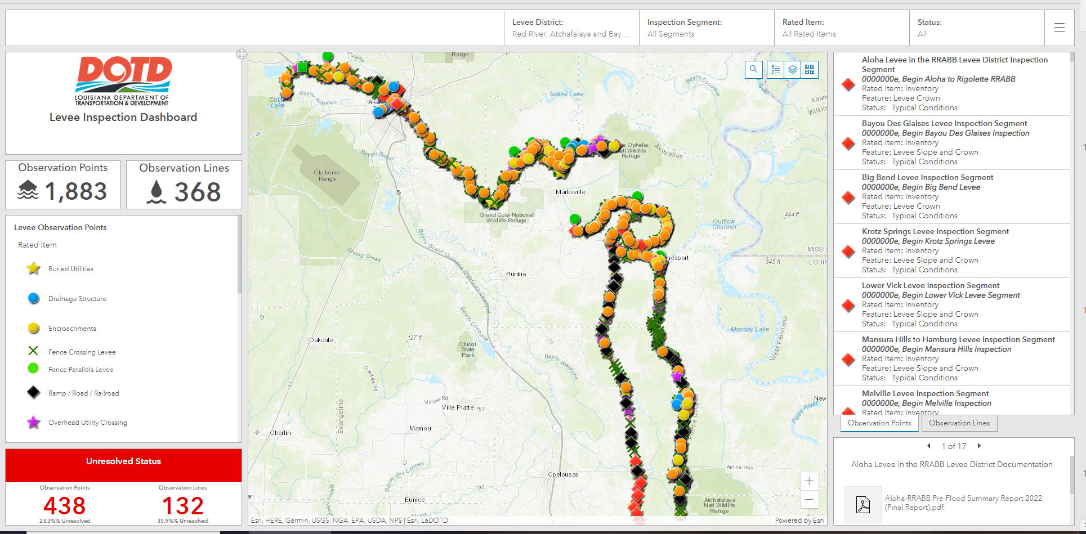
RRABB Levee Inspection Dashboard
Notes:
The screen will show the RRABB Levee District since this filter is applied. Documentation is also available to preview on bottom right of the screen.

Slide 19
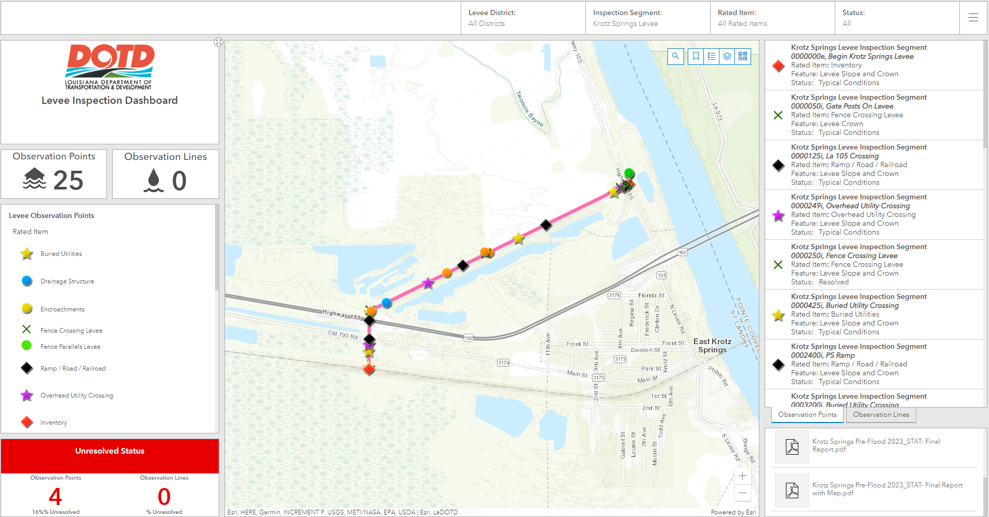
RRABB Levee Inspection Dashboard
Notes:
The screen will show the RRABB levee district with the Krotz Springs inspection segment filter applied. Documentation is also available to preview on bottom right of the screen.

Slide 20
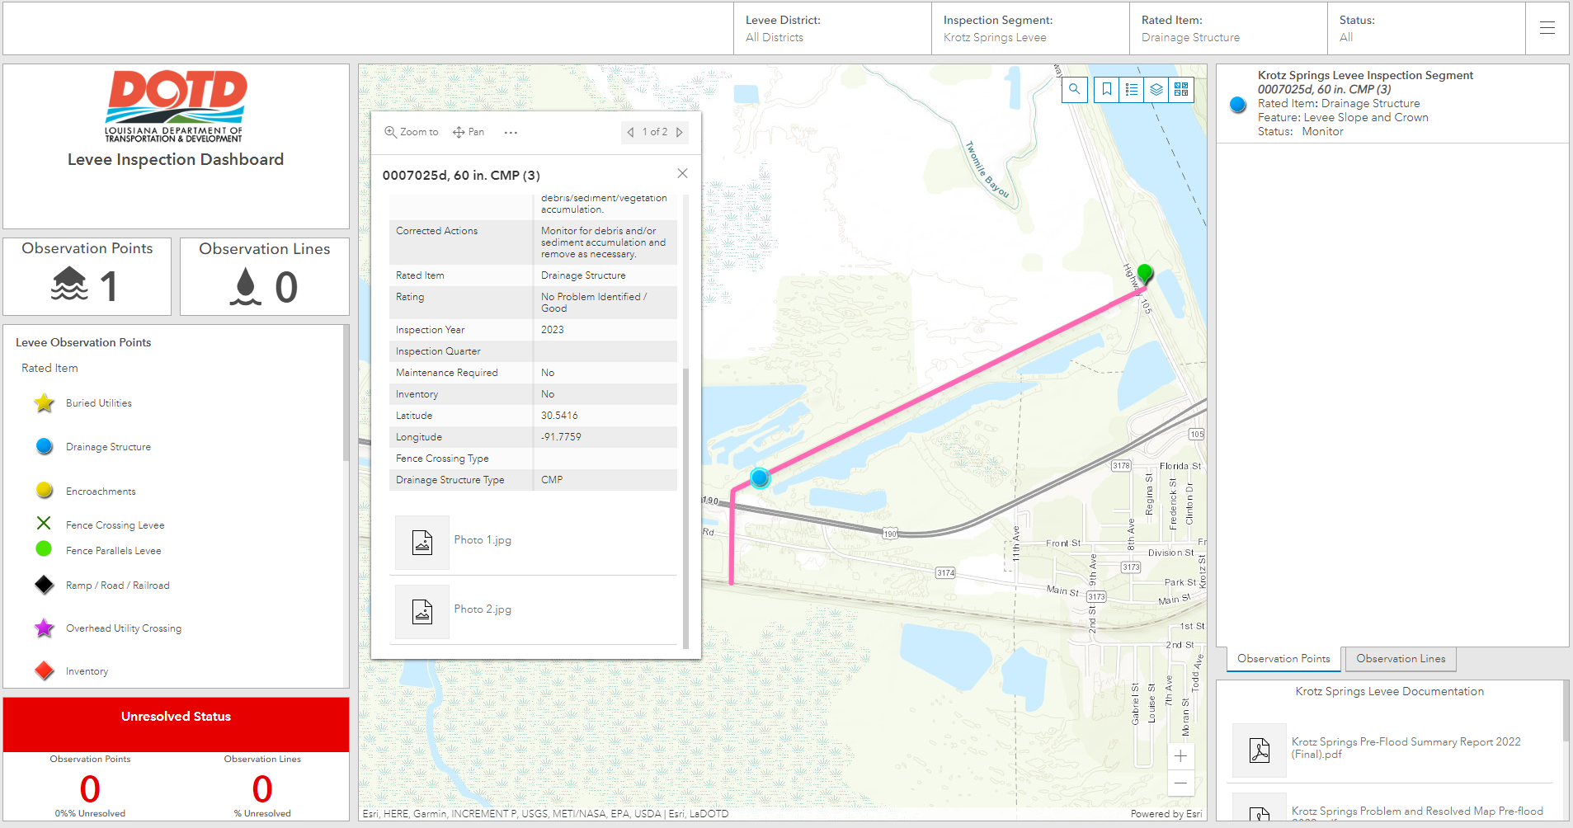
RRABB Levee Inspection Dashboard
Notes:
The screen will show the RRABB Levee District with the Krptz Springs inspection segment and rated item Drainage Structure. The drainage structure form opens when the blue drainage structure dot is selected. Documentation is also available to preview on bottom right of the screen.

Slide 21
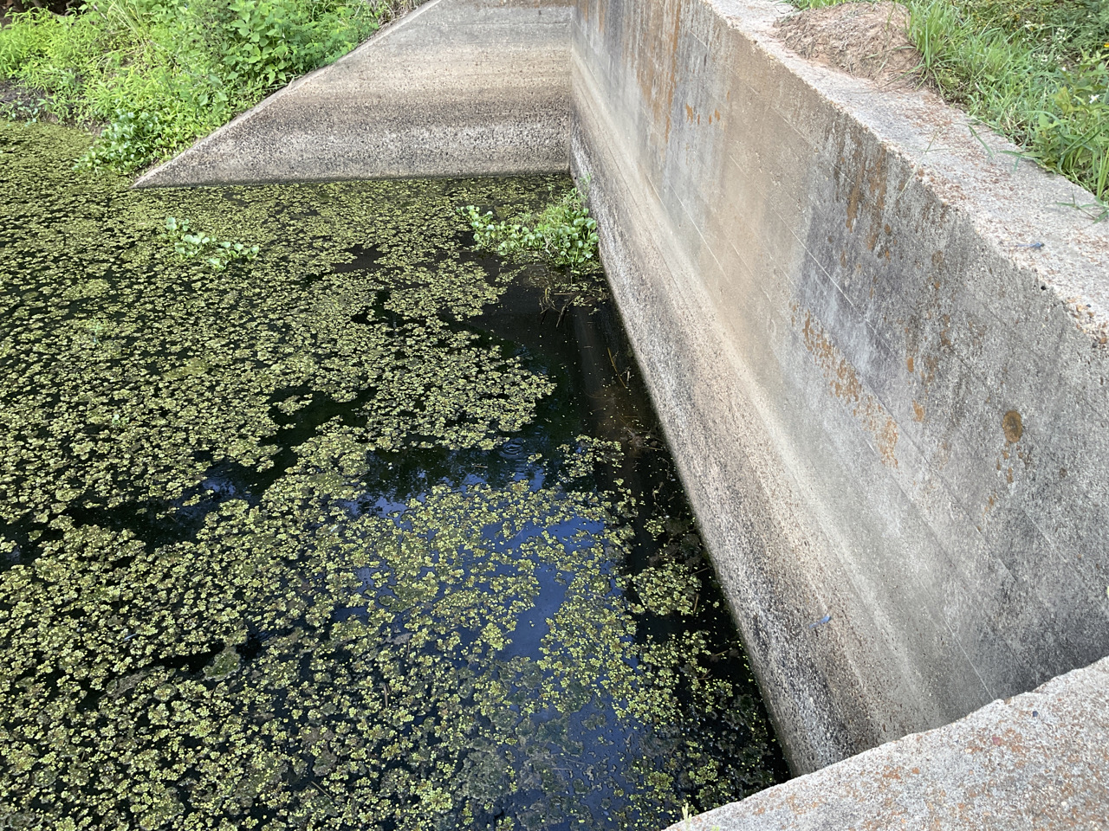
RRABB Levee Inspection Dashboard
Notes:
The screen shows the photo of RRABB Krotz Springs drainage structure Photo 1 .

Slide 22
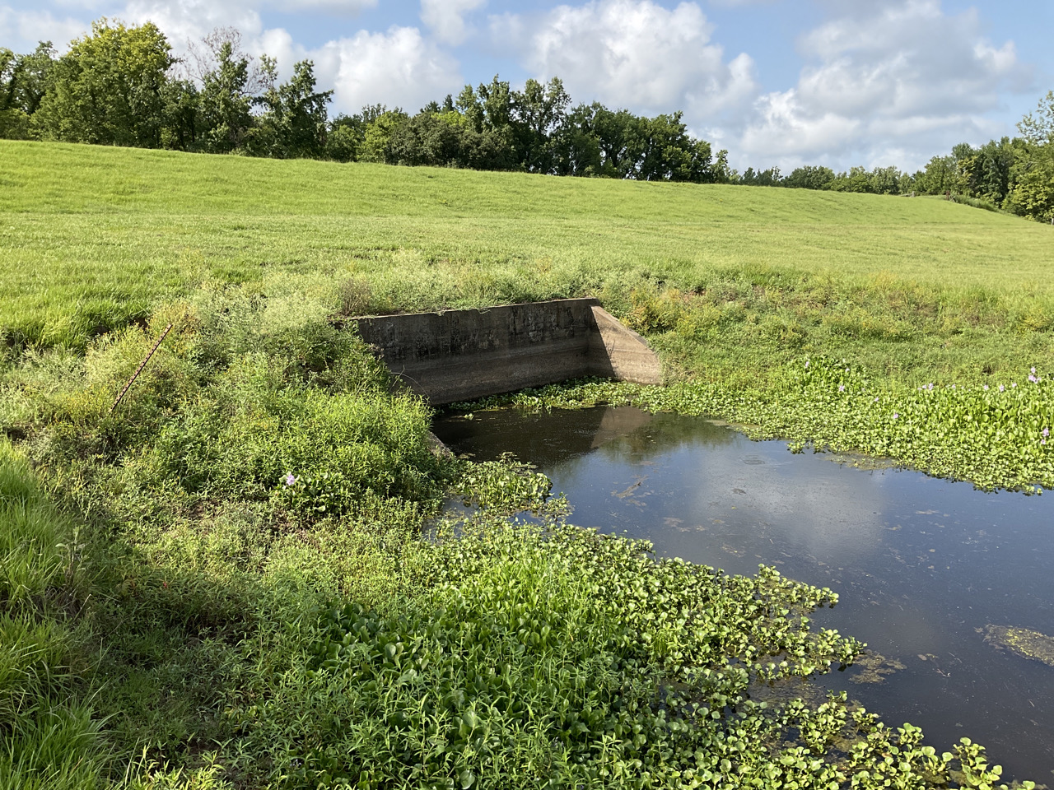
RRABB Levee Inspection Dashboard
Notes:
The screen shows the photo of RRABB Krotz Springs drainage structure Photo 2 .

Slide 23
Levee Inspection Dashboard
View Current Data
Can be filtered by District, Segment, Rated Item and Status
Map
Multiple basemaps available
Documentation
Viewable under inspection segment Levee Documentation window
Notes:
The Inspection Dashboard allows you to filter the data by Levee District, Inspection Segment, Rated Item and Status. Multiple basemaps are also available per your viewing preference. Documentation is also available to preview on bottom right of the screen.

Slide 24
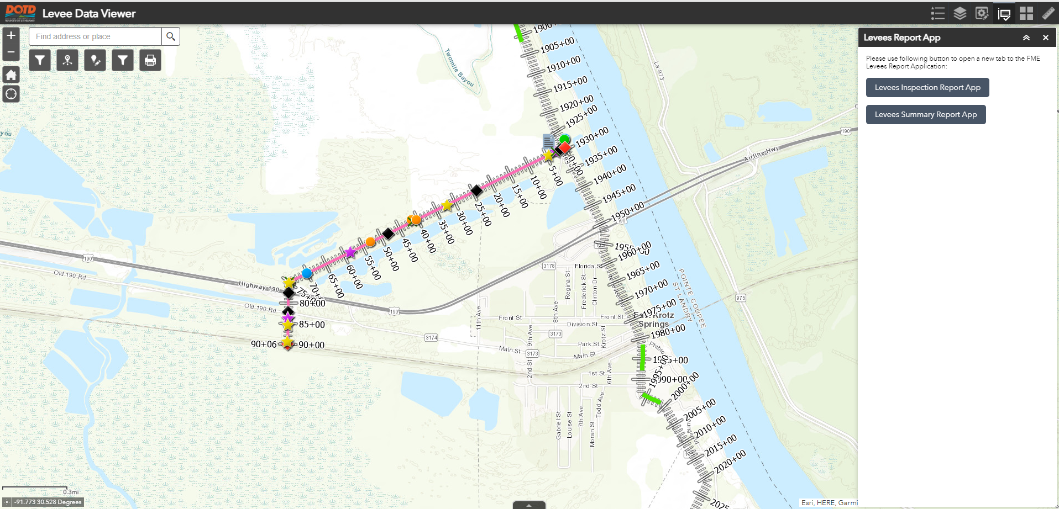
Inspection Report Types
Notes:
The screen will show report generator within the Levee DataViewer.

Slide 25
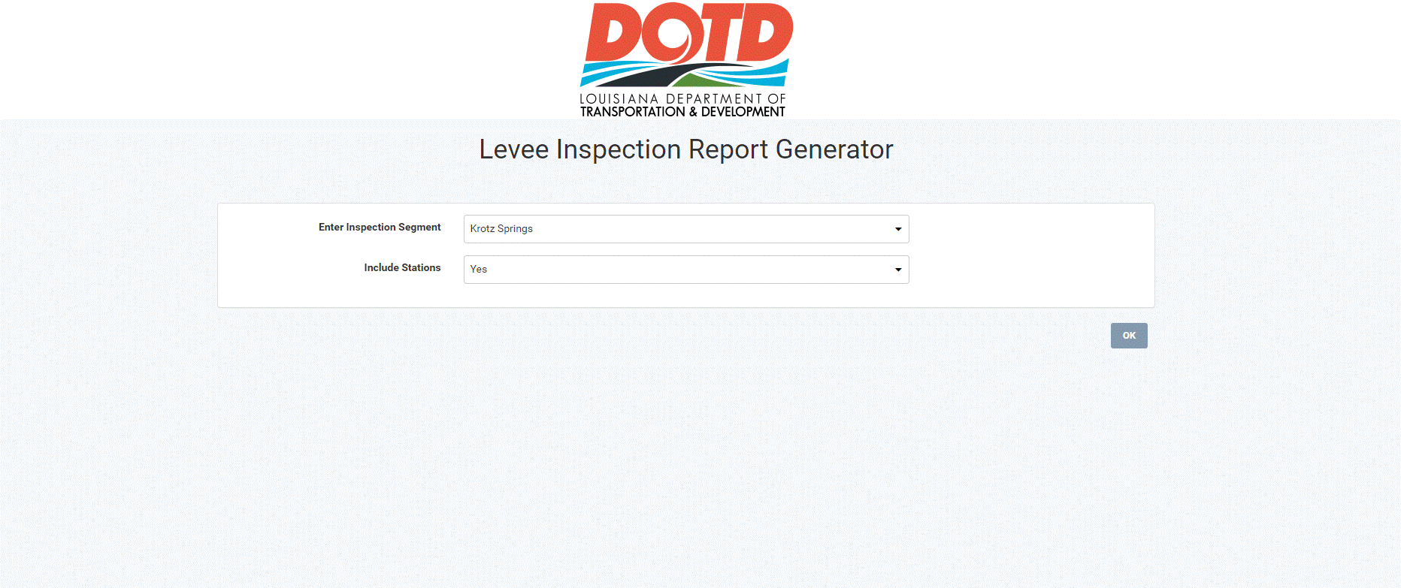
Inspection Report Types Summary Report
Notes:
The screen shows the input to produce the summary report.

Slide 26
Inspection Report Types
Notes:
The screen will show the summary report formats we are capable of producing.

Slide 27
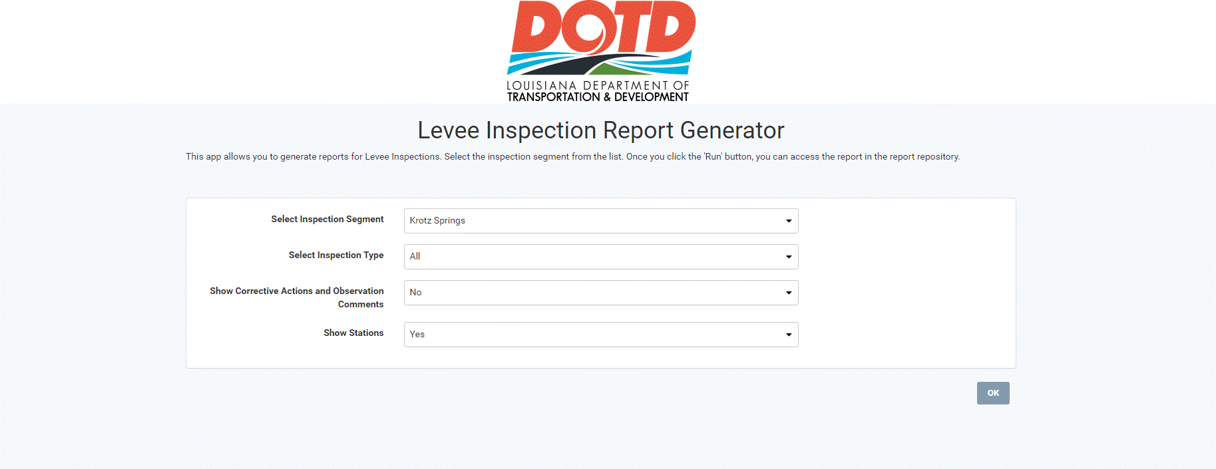
Inspection Report Types Full Report
Notes:
The screen shows the input to produce the full report.

Slide 28
Inspection Report Types
Notes:
The screen will show the full report formats we are capable of producing with attached pictures

Slide 29
Inspection Report Maps
Notes:
The Krotz Springs Levee map shows only the problems labeled with their latitude and longitude and their respective geographic locations.

Slide 30
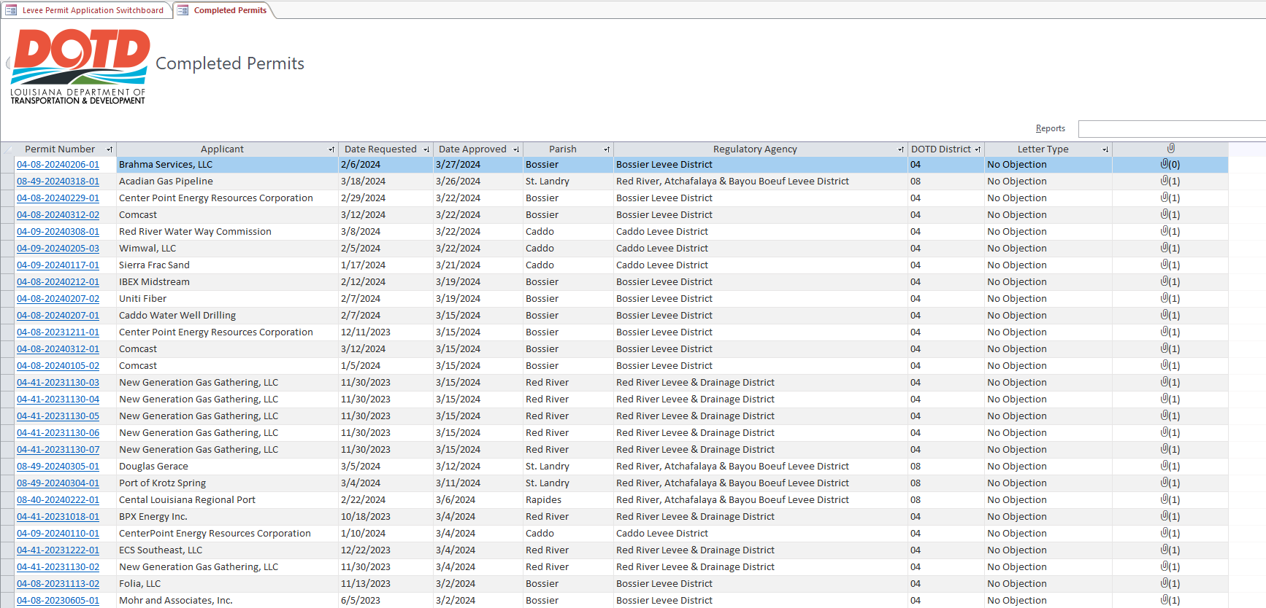
Levee Permit Database
Notes:
The Levee Permit Database for completed permits.

Slide 31
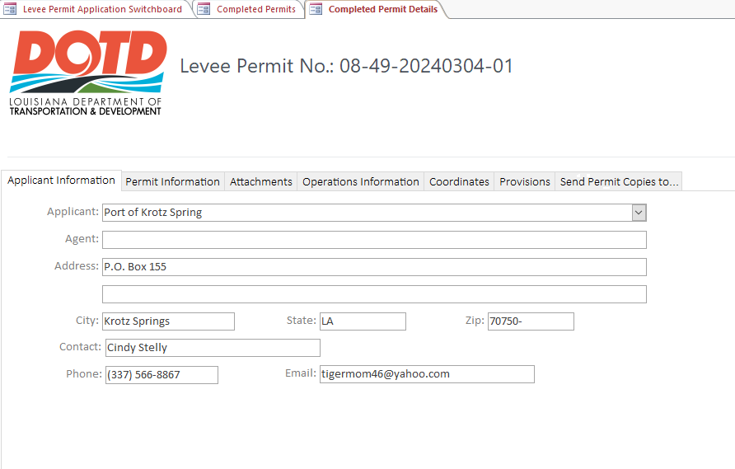
Levee Permit Database
Notes:
The Levee Permit Database tab for Applicant Information.

Slide 32
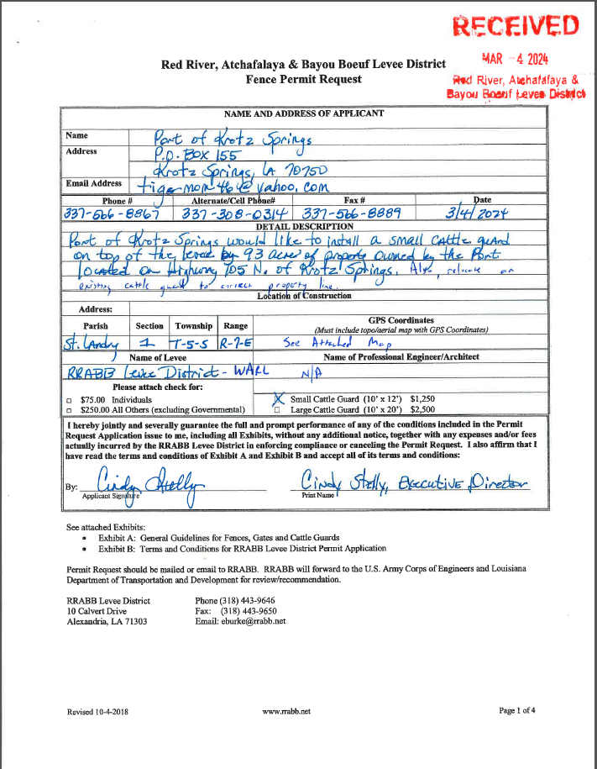
Levee Permit Database
Notes:
The Levee Permit Database - filled out RRABB permit request form.

Slide 33
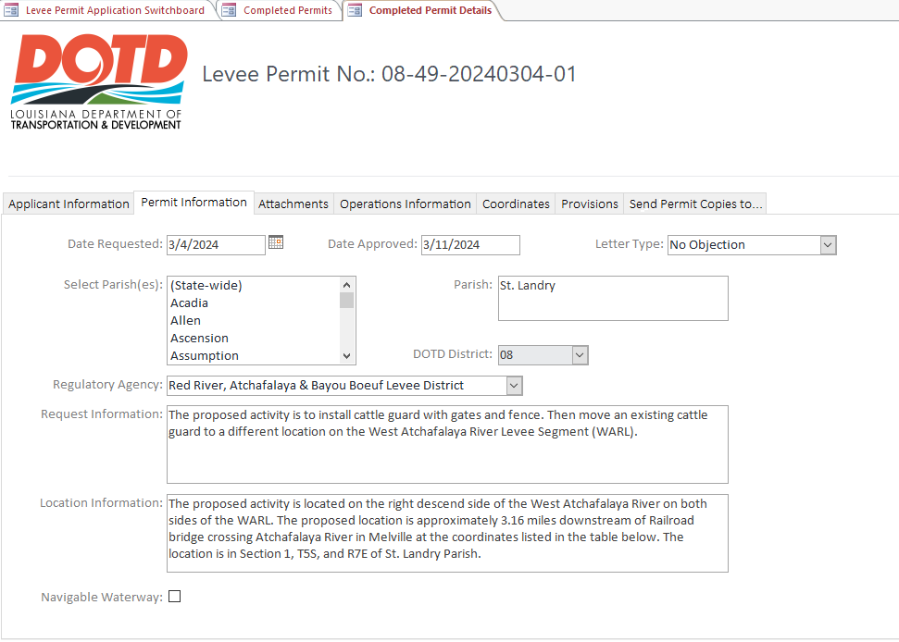
Levee Permit Database
Notes:
The Levee Permit Database Permit Information Tab.

Slide 34
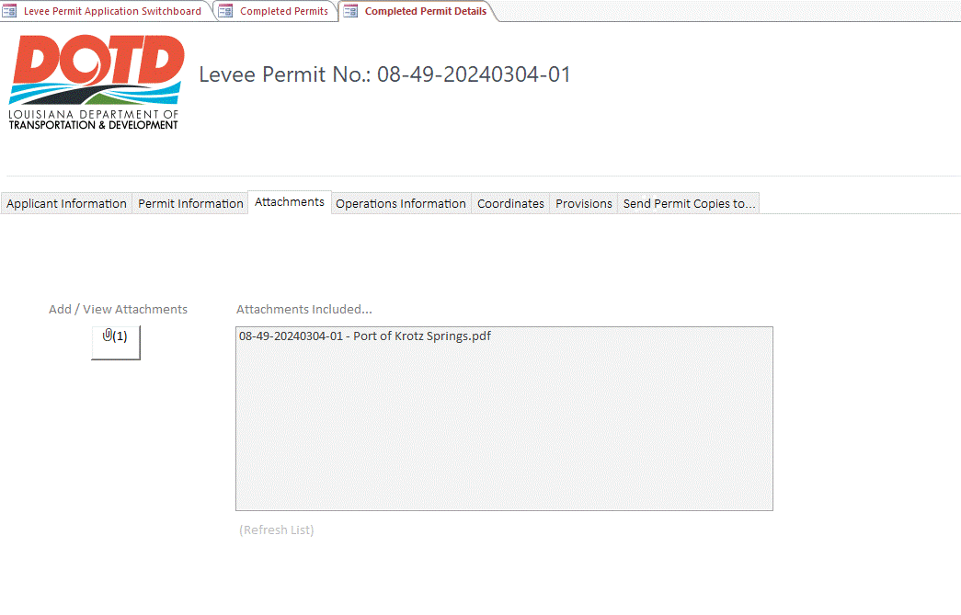
Levee Permit Database
Notes:
Attachments Tab which includes required forms relevant to this permit.

Slide 35
Levee Permit Database
Notes:
The Levee Permit Database - filled out RRABB permit request form.

Slide 36
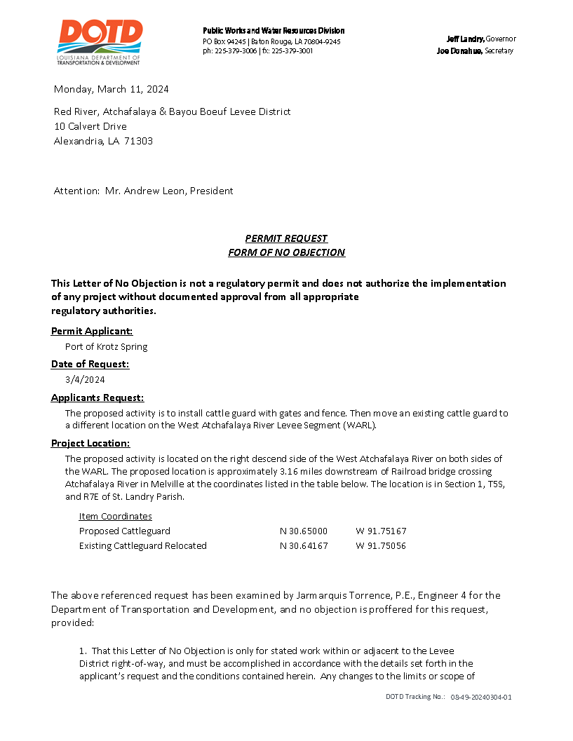
Levee Permit Database
Notes:
The Letter of No Objection.

Slide 37
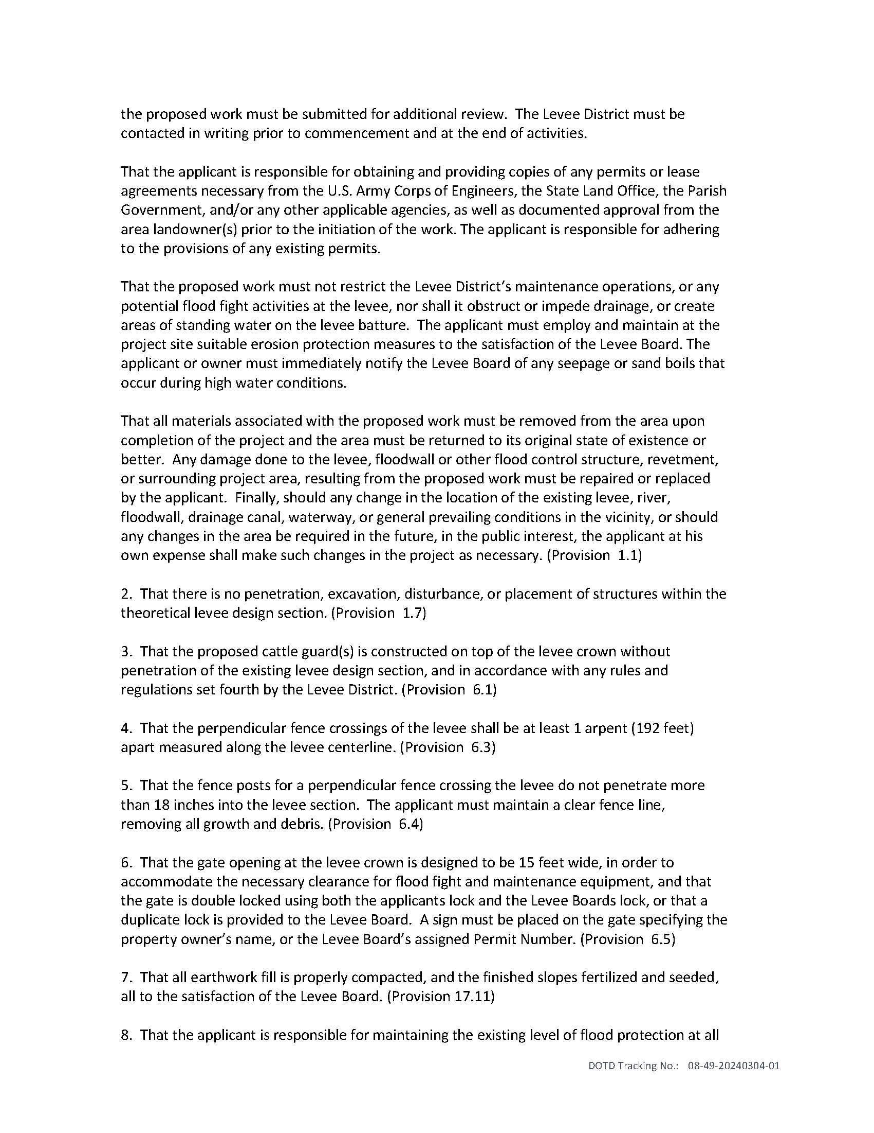
Levee Permit Database
Notes:
The Letter of No Objection

Slide 38
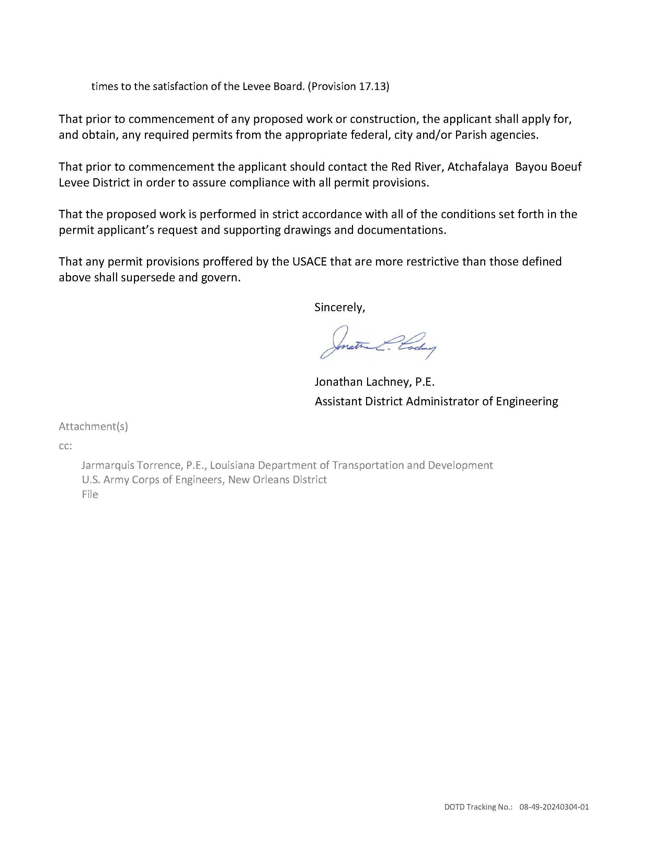
Levee Permit Database
Notes:
The Letter of No Objection

Slide 39
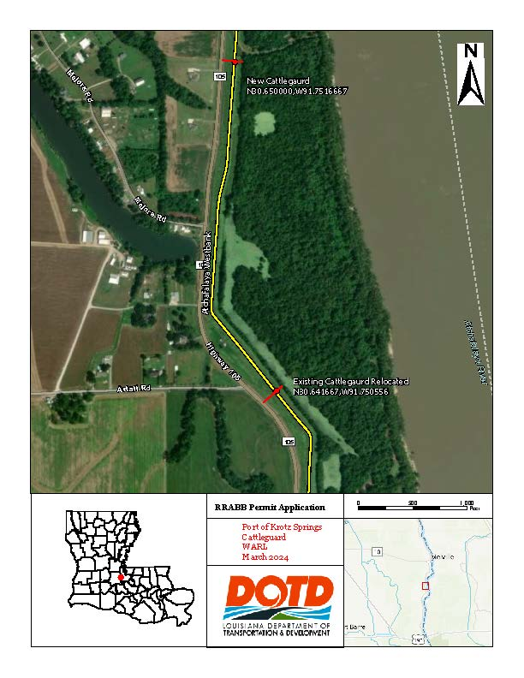
Levee Permit Database
Notes:
Aerial drawing showing where the work will be done.

Slide 40
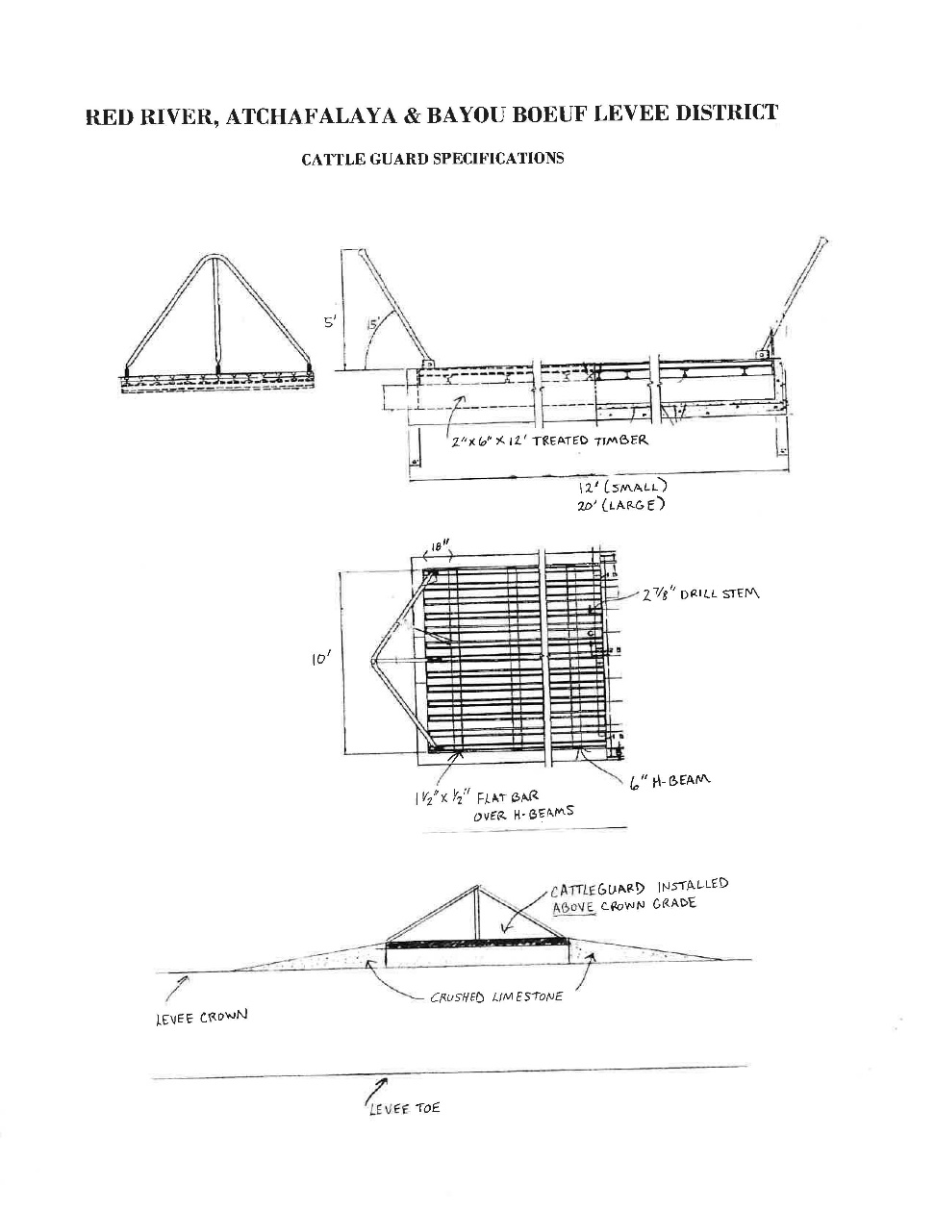
Levee Permit Database
Notes:
The Letter of No Objection and any other additional documents that were uploaded for this specific permit.

Slide 41
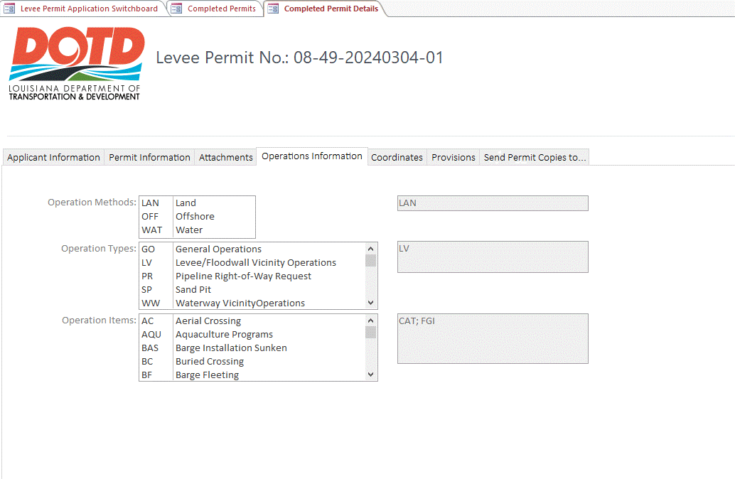
Levee Permit Database
Notes:
Operations tab showing the Operations Methods, Operation Types and the Operation Items

Slide 42
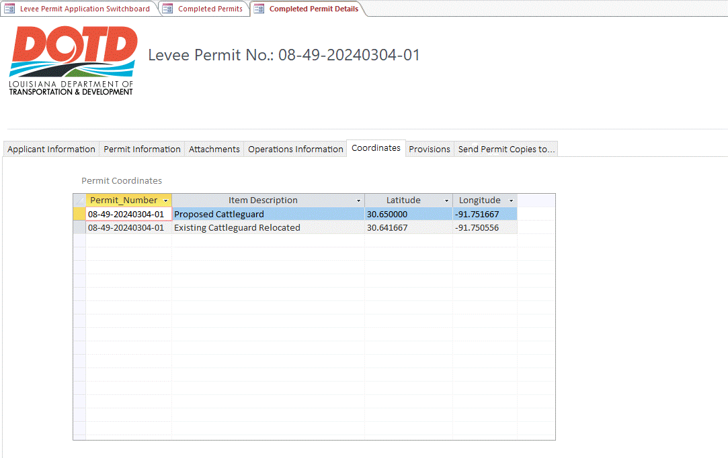
Levee Permit Database
Notes:
The Coordinates Tab that shows the Latitude and longitude

Slide 43
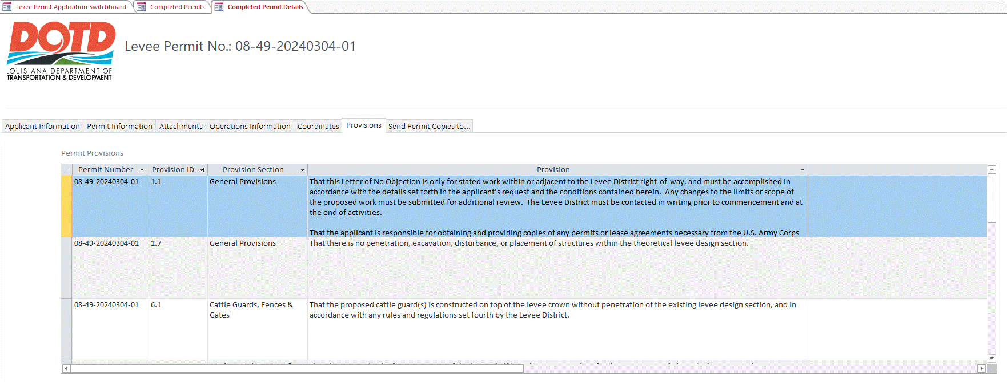
Levee Permit Database
Notes:
The Provisions tab that shows the provisions that were shown in the LONO.

Slide 44
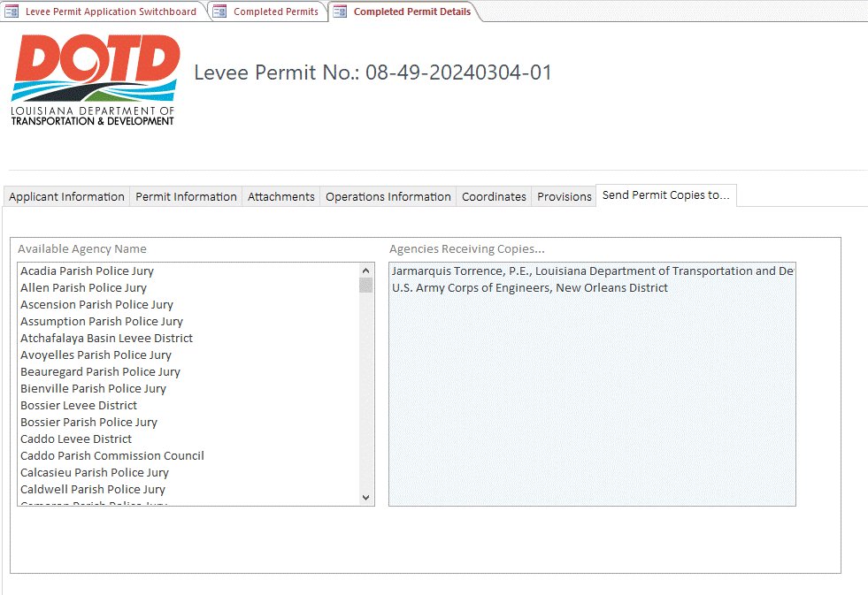
Levee Permit Database
Notes:
The Send Permit copies To tab that shows Which agencies receives a copy.

Slide 45
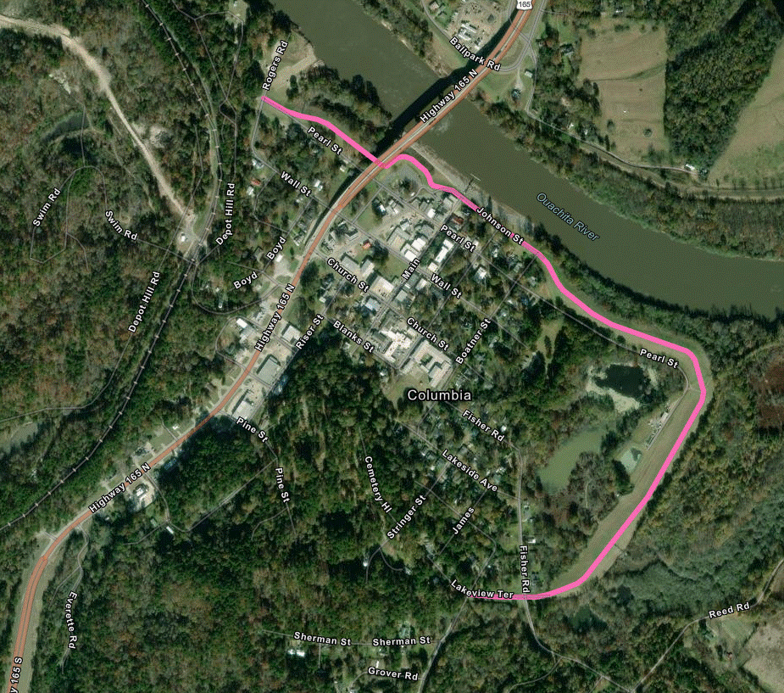
Columbia Centerline Survey
Notes:
Columbia Levee

Slide 46
Columbia Centerline Survey
Pilot between TBLD, DOTD Location & Survey Unit & District 58 Survey Unit
LSU Center for GeoInformatics Real-Time Network was used for this survey
This network is fully updated in this state to
see all constellations and new frequencies
This means we get to fully utilize strength of R-12 receiver
No need to setup a physical base, uses specially calculated virtual base
Notes:
Columbia Levee Centerline survey Pilot between TBLD, DOTD Location & Survey and District 58 survey. LSU Center for GeoInformatics Real-Time Network was used for this survey. This network is fully updated in this state to see all constellations and new frequencies .This means we get to fully utilize strength of R-12 receiver and there is no need to setup a physical base, uses specially calculated virtual base.

Slide 47
Columbia Centerline Survey
Trimble R-12 GNSS Receiver Specifications
Can see all 4 major constellations and their
available frequencies
See up to 30 plus satellites at once
More satellites means better results
Newer frequencies help with multipath
rejections\interference
Centerline information can be uploaded into the National Levee Database
https://levees.sec.usace.army.mil/submitting-
data/updates/
Notes:
Trimble R-12 GNSS Receiver Used to perform Survey. Can see all 4 major constellations and their available frequencies.
See up to 30 plus satellites at once
More satellites means better results
Newer frequencies help with multipath rejections\interference
Centerline information can be uploaded into the National Levee Database

Slide 48
Columbia Centerline Survey
Notes:
Trimble R-12 Receiver used to do survey and some of its specifications

Slide 49
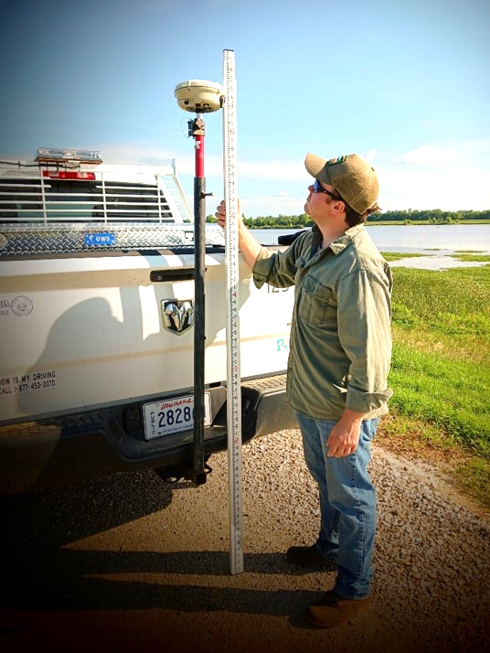
Columbia Centerline Survey
Notes:
Centerline survey was done on the Columbia levee using the same configuration that DOTD District o8 used to do centerlines in RRABB. A bracket was made so it could fit into a receiver hitch and the R-10 shown here was mounted in it. The height was measured from receiver antenna to the ground using a tape measure and adjustments were made to the centerline. This is a picture of how the setup was mounted to the truck.

Slide 50
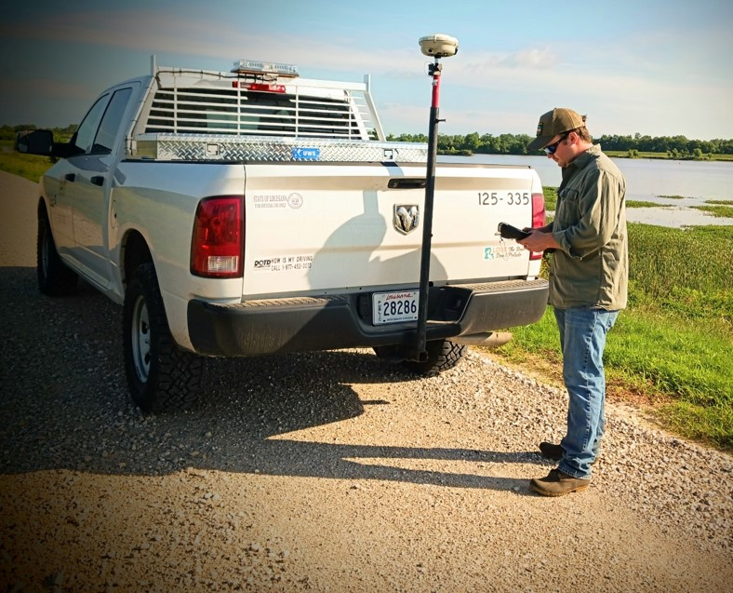
Columbia Centerline Survey
Notes:
Centerline survey was done on the Columbia levee using the same configuration that DOTD District o8 used to do centerlines in RRABB. A bracket was made so it could fit into a receiver hitch and the R-10 shown here was mounted in it. The height was measured from receiver antenna to the ground using a tape measure and adjustments were made to the centerline. This is a picture of how the setup was mounted to the truck.

Slide 51
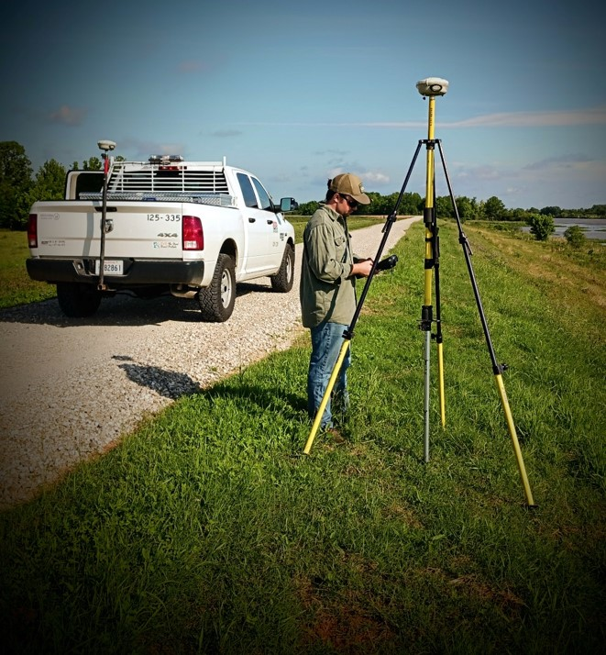
Columbia Centerline Survey
Notes:
Centerline survey was done on the Columbia levee using the same configuration that DOTD District o8 used to do centerlines in RRABB. A bracket was made so it could fit into a receiver hitch and the R-10 shown here was mounted in it. The height was measured from receiver antenna to the ground using a tape measure and adjustments were made to the centerline. This is a picture of how the setup was mounted to the truck and the tripod was setup

Slide 52
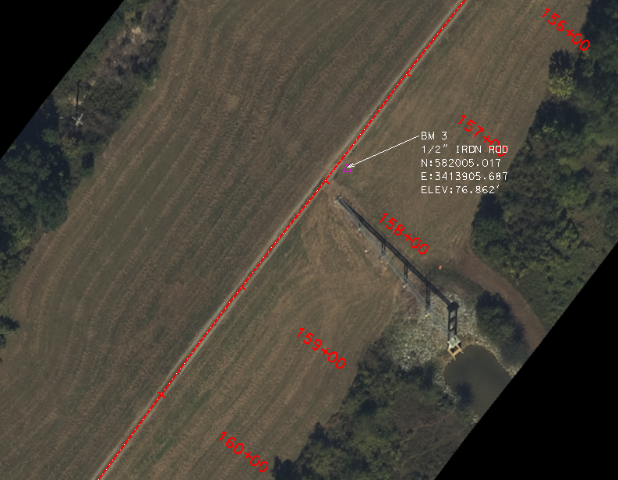
Columbia Centerline Survey
Notes:
4 benchmarks were placed with an iron rod with a Northing, Easting and Elevation established.

Slide 53
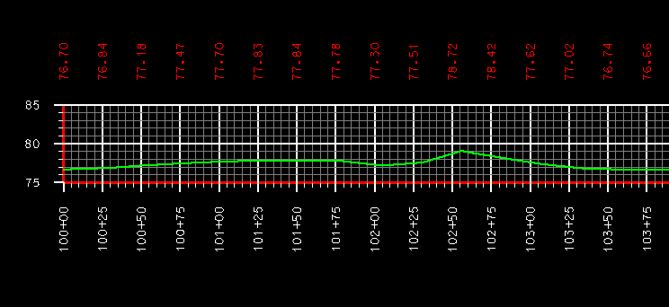
Columbia Centerline Survey
Notes:
Centerline profile results once the data was extrapolated from the R-12 and cleaned up to plot in Micro-Station.

Slide 54
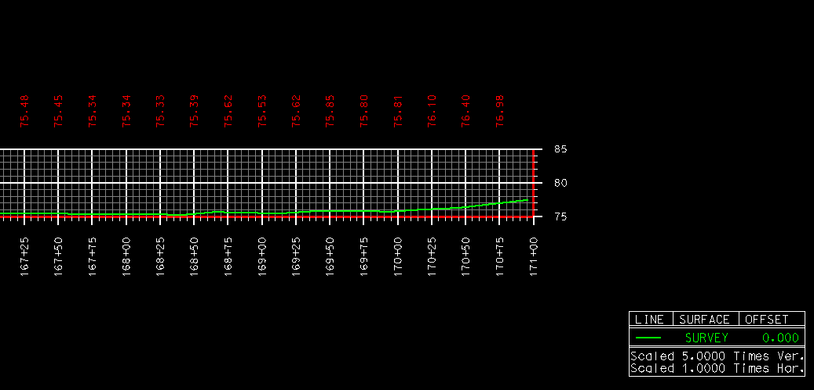
Columbia Centerline Survey
Notes:
Centerline profile results once the data was extrapolated from the R-12 and cleaned up to plot in Micro-Station.

Slide 55
Resources
Levee Inspector Certification
https://coastal.la.gov/resources/levee-inspector-certification/
Notes:
You can copy and paste the link above in you browser (Chrome preferred) so you can get to the CPRA page and get to the Inspector Certification.

Slide 56
Questions?
Thanks
Curt J. Boniol, P.E.
Curt.Boniol@la.gov

