Slide 1
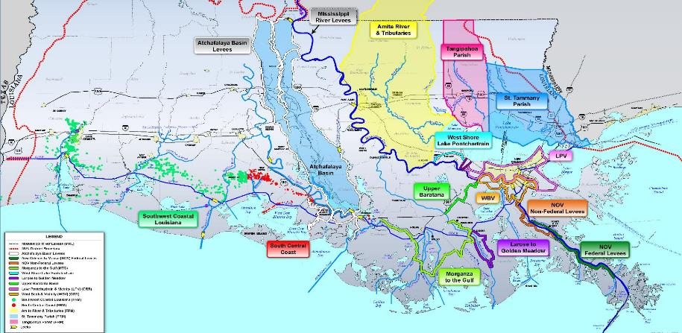
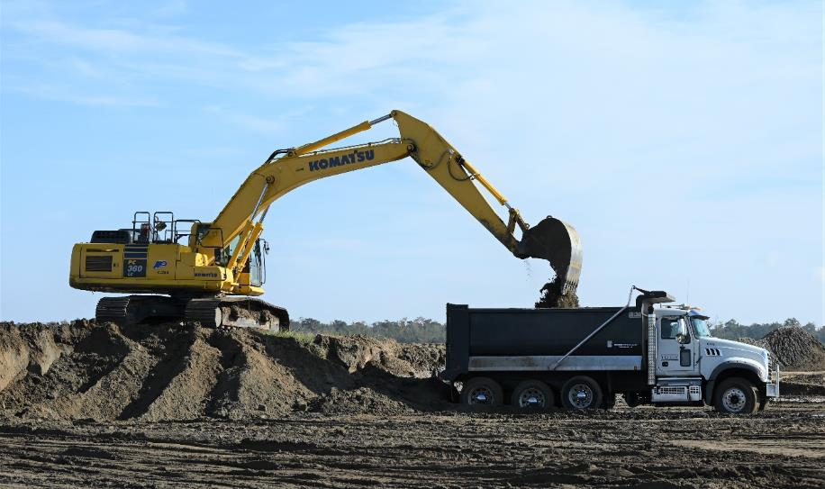
Association of levee boards of Louisiana
Flood risk management in south louisiana
U.S. ARMY CORPS OF ENGINEERS
NEW ORLEANS DISTRICT UPDATE
COL Cullen Jones, P.E., PMP
Commander
4 December 2024
The New Orleans District obligated more than $1B during the 2024 Fiscal Year, the most of any USACE civil works district. Current target is to award another billion this fiscal year.
Notes:
Good morning. I am COL Cullen Jones, 65th Commander of the New Orleans District, and on behalf of the New Orleans team, I welcome you back to the great city of New Orleans. I always look forward to this opportunity to share insight into a few of the US Army Corps of Engineers’ accomplishments in Coastal Louisiana over the last year as well as what is on the schedule for the coming months. Since we do not undertake our mission alone, our accomplishments are also the accomplishments of the state of Louisiana and you, our levee district partners.
ACTION: CLICK/FWD TO MOVE TO FIRST TOPIC

Slide 2
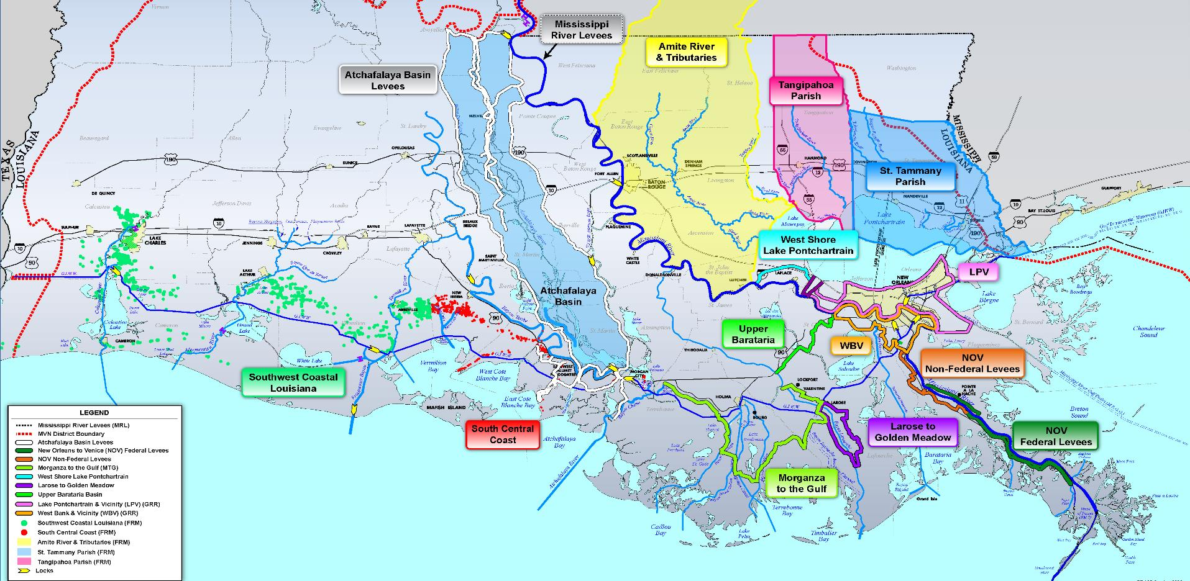
Association of levee boards of Louisiana
$3.9B INVESTMENT
FLOOD RISK MANAGEMENT
in south Louisiana
U.S. ARMY CORPS OF ENGINEERS
NEW ORLEANS DISTRICT UPDATE
COL Cullen Jones, P.E., PMP
Commander
4 December 2024
The New Orleans District obligated more than $1B during the 2024 Fiscal Year, the most of any USACE civil works district. Current target is to duplicate this production during 2025 fiscal year.
Notes:
NO ACTION REQUIRED/AUTO TRANSITION SLIDE

Slide 3
Association of levee boards of Louisiana
FLOOD RISK MANAGEMENT
$3.9B INVESTMENT
in south Louisiana
St. Tammany Parish
Nonstructural and Structural Approach
Signed Chief’s Report in May
Upper Barataria Basin
Structural Risk Reduction Approach
Will close the gap between WBV and MTG
Southwest Coastal LA
Nonstructural and Coastal Protection Approach
Broke ground for the 1st Home in October
The New Orleans District obligated more than $1B during the 2024 Fiscal Year, the most of any USACE civil works district. Current target is to duplicate this production during 2025 fiscal year.
Notes:
I said a few of our accomplishments because we currently charged with a $3.9 Billion investment in Coastal Louisiana. Never afraid to brag a little on our team, the New Orleans District obligated a little more than $1 Billion dollars in Fiscal Year 2024, giving us the largest district civil works program in USACE. None to eager to give up this status, our target is to duplicate this effort again this fiscal year.
Where is this funding going? As you can see, from heel to toe, you do not have to travel far in South Louisiana to find a project either underway or in the pipeline. Efforts like achieving a positive Chief’s Report in support of a $XB structural and nonstructural approach to flood risk management in St. Tammany Parish.
And with the Mississippi Valley Division’s regional implementation initiative, our fellow districts are making great strides in South Louisiana as well such as St. Paul District’s progress in implementing the $8 million preconstruction Engineering and Design for the Upper Barataria Project that will close the gap in risk reduction between the West Bank and Vicinity levee system here in the New Orleans area and the Morganza to the Gulf system in Terrebonne and Lafourche parishes. Further west, the Southwest Coastal LA project, led by the Rock Island District, broke ground in October for the first home to be elevated to the 1-percent level of risk reduction.
Now before I provide an update on other items on the map, I would like to take a few minutes to address a couple of response efforts for this year.
ACTION REQ: CLICK/FORWARD FOR TRANSITION TO NEXT TOPIC (PCCP)

Slide 4
2023-24: 4 PUMPS
COMPLETED
2024-25: 8 PUMPS TARGETED FOR COMPLETION
PERMANENT CANAL CLOSURES AND PUMPS
HONORING OUR COMMITMENT TO DELIVER THE 35-YEAR DESIGN SPECIFICATIONS
A multiyear effort to address corrosion levels that exceeded the 35-year design specifications.
Permanent repairs were completed on four of the 17 pumps during the 2023-24 work season. With the close of hurricane season, USACE and its contractor has resumed its on-site work to repair the remaining pumps.
Notes:
NO ACTION/AUTO TRANSITION SLIDE

Slide 5
2023-24: 4 PUMPS
COMPLETED
2024-25: 8 PUMPS TARGETED FOR COMPLETION
PERMANENT CANAL CLOSURES AND PUMPS
HONORING OUR COMMITMENT TO DELIVER THE 35-YEAR DESIGN SPECIFICATIONS
A multiyear effort to address corrosion levels that exceeded the 35-year design specifications.
Permanent repairs were completed on four of the 17 pumps during the 2023-24 work season. With the close of hurricane season, USACE and its contractor has resumed its on-site work to repair the remaining pumps.
Notes:
The District continues its work to address pump corrosion and restore the 35 year design specifications at the three Permanent Canal Closures and Pumps. Prior to hurricane season, we and our contractor, the PCCP Joint Venture, completed permanent repairs to four pumps…two at the London Ave. station and two at the 17th St. station. During hurricane season, we focused on apply lessons learned during the last work season as well as fabricating and stockpiling the necessary pump parts to improve our efficiency in repairs this season. Today, we have 2 full sets in house with another three coming in next week. By early January, we will have the remaining eight sets on hand.
During the last couple of weeks, we remobilized to conduct pre-pump removal site preparations and are now in the process of removing Pump #1 at the Orleans Ave structure and Pump #3 at London Ave. Next week, we will begin removing Pump #5 at the 17th Street location.
It is important to note that this work is being funded through a combination of federal and contractor funds so there is no need for additional state or local contributions.
Next, I would like to take a few minutes to recap the recent Mississippi River low water season…
ACTION: CLICK/FWD FOR TRANSISTION TO THE NEXT TOPIC (MISS RIVER LOW WATER)

Slide 6
2024
MISSISSIPPI RIVER LOW WATER SEASON
The Mississippi River experienced extreme drought conditions for the third consecutive year. The submarine sill, constructed to mitigate Ship Channel influence on the saltwater intrusion, performed as designed. Successful implementation of reverse osmosis water purification units by Plaquemines Parish eliminated the need for water barging.
Notes:
NO ACTION/AUTO TRANSITION SLIDE

Slide 7
2024
MISSISSIPPI RIVER LOW WATER SEASON
The Mississippi River experienced extreme drought conditions for the third consecutive year. The submarine sill, constructed to mitigate Ship Channel influence on the saltwater intrusion, performed as designed. Successful implementation of reverse osmosis water purification units by Plaquemines Parish eliminated the need for water barging.
Notes:
Historically, we experience extreme low water events and the corresponding saltwater intrusion in the Mississippi River about every 10 to 12 years: 1988, 1999, 2012, 2022. Last year, for the first time, we had to build the saltwater intrusion mitigation sill in consecutive years. This year, Mother Nature continued an unfortunate trend of extreme low water seasons so we had to construct the sill for the third consecutive year.
Fortunately, this year’s season was not as long or extreme as last years. In comparison to the last year’s 209 days, this year we counted 98 days from the time we reached our sill construction trigger to when it was no longer needed. Ultimately, the initial sill design of raising the bed of the river up to -50 feet was sufficient so we did not have to augment the sill this season.
For every event, we look to apply lessons to better improve our response. This year, I would like to commend Plaquemines Parish for their forward posture and use of Reverse Osmosis Water Purification Units to ensure safe drinking water for its residents. These systems performed as intended, negating the need to barge fresh water to the water treatment facilities as required in 1988, 2012 and 2023. We’ve also applied the lessons learned in South Louisiana over the last couple of years to other USACE mission areas, such as the New Orleans District’s ability to support the Hurricane Helene Recovery Task Force Water’s mission of restoring potable water in North Carolina.
On a personal note, while I may be the first New Orleans District commander to have overseen construction of three submarine sills, with one high river season remaining, I still have a chance of doing what my five predecessors could not…and that is NOT operate the Bonnet Carre’ Spillway.
OK, now that I have successfully jinxed us all, let’s talk Hurricane and Storm Damage Risk Reduction
ACTION REQ: CLICK/FORWARD FOR TRANSITION TO NEXT TOPIC (NOV)

Slide 8
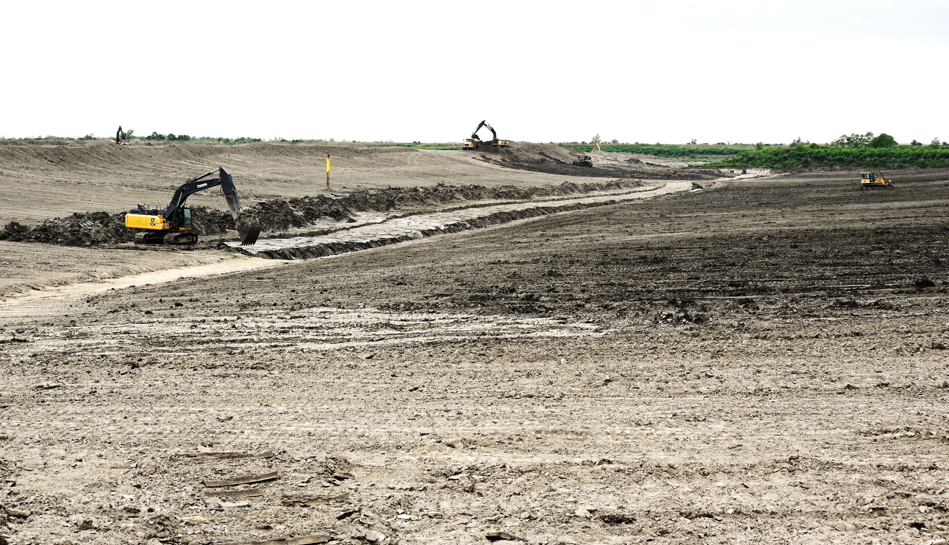
New Orleans to Venice hurricane and storm damage risk reduction in Plaquemines Parish. USACE received additional $783M under the 2022 Disaster Relief and Recovery Supplemental Act. Memphis District is leading the construction effort as part of the MVD regional delivery initiative.
Notes:
NO ACTION/AUTO TRANSITION SLIDE

Slide 9
New Orleans to Venice hurricane and storm damage risk reduction in Plaquemines Parish. USACE received additional $783M under the 2022 Disaster Relief and Recovery Supplemental Act. Memphis District is leading the construction effort as part of the MVD regional delivery initiative.
Notes:
Since I just mentioned low water in Plaquemines Parish, I would like to start with our continuing effort to improve the level of hurricane damage risk reduction in the area.
We continue to make good progress with the Happy Jack to Nairn and Woodpark to Point Celeste levee reaches standing at 99% complete with the Point Celeste to West Pointe a La Hache levee lift and drainage canal relocation at 94% complete. The Myrtle Grove to Woodpark Levee follows at 75% complete and La Reussite to Myrtle Grove is approximately 60% complete.
We also continue our work at the Wilkinson Canal Pump Station and expect to have 100% pumping capacity at the station for the 2025 Hurricane Season.
In 2022, Congress and the Administration renewed its commitment to the New Orleans to Venice system by including more than $780 million in the Disaster Relief and Recovery Act. Another of our important regional delivery projects, this work conducted with this funding is being spearheaded by the Memphis District.
If you traveled to New Orleans by traveling east on I-10, you may have caught a glimpse of the next project I would like to update.
ACTION REQ: CLICK/FORWARD FOR TRANSITION TO NEXT TOPIC (WSLP)

Slide 10
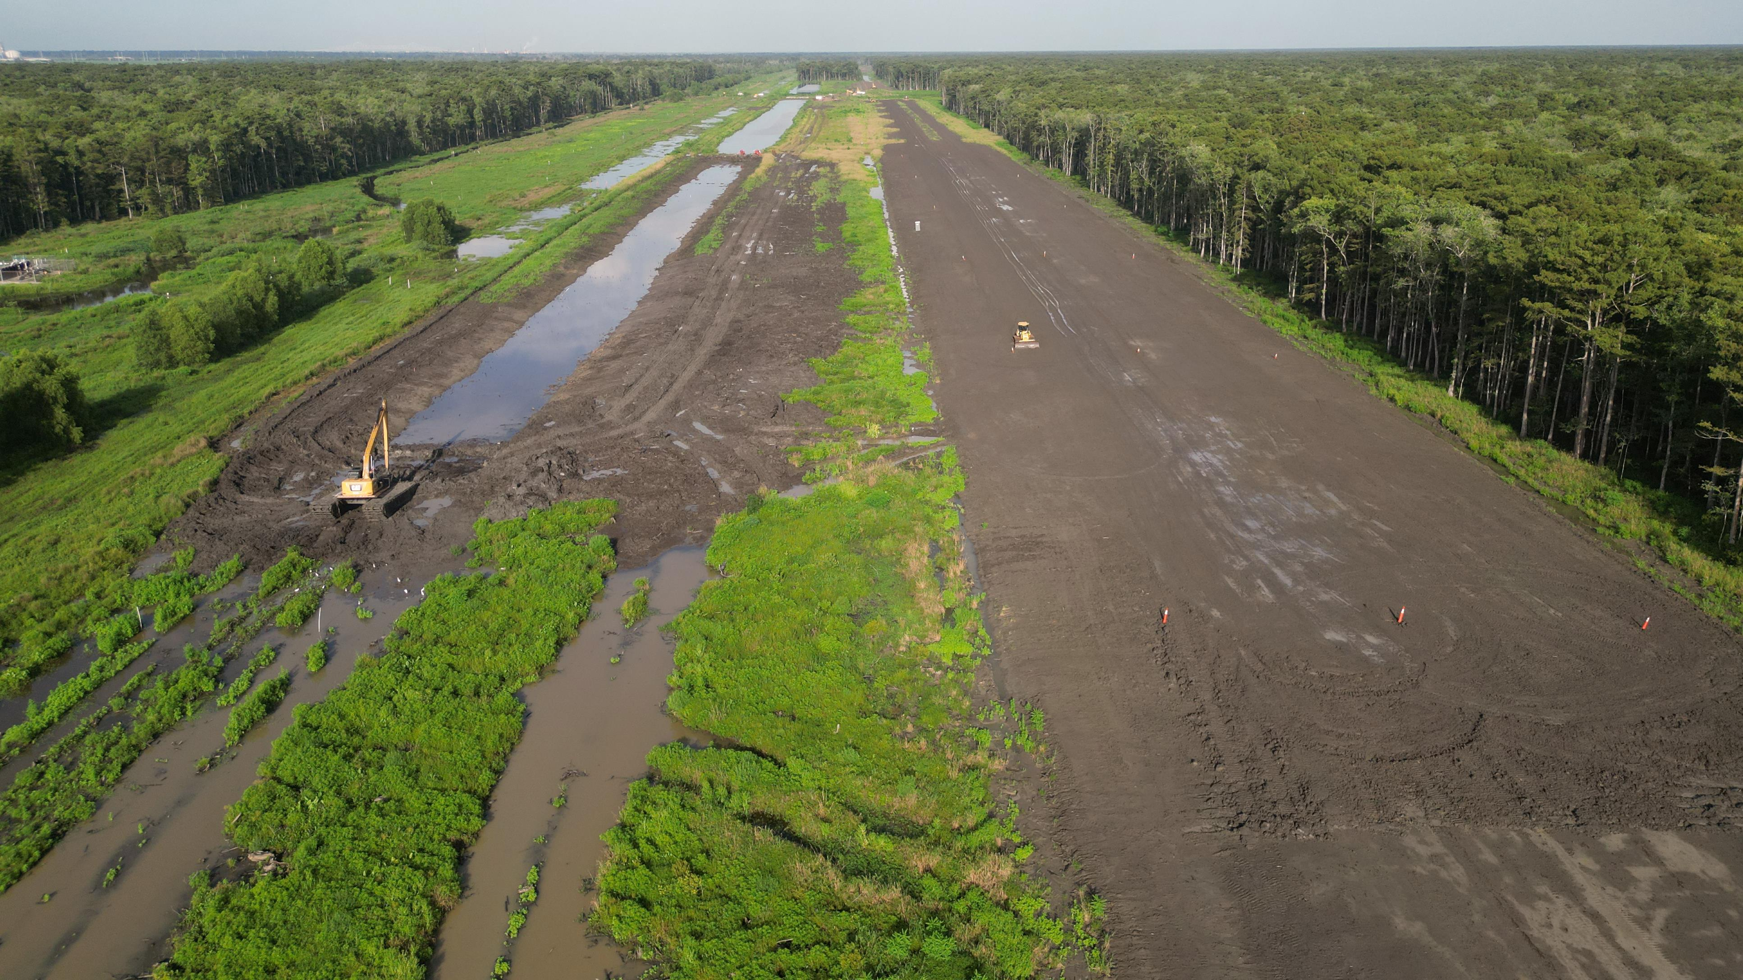
WEST SHORE LAKE PONTCHARTRAIN
WSLP will deliver the 1% level of risk reduction for 60,000 residents. System includes levees, floodwalls, pump stations, and drainage structures as well as nonstructural measures for the less densely populated areas. Additional resiliency measures are being evaluated as part of the General Reevaluation Report funding under DRSSA 2022.
Notes:
NO ACTION/AUTO TRANSITION SLIDE

Slide 11
WEST SHORE LAKE PONTCHARTRAIN
WSLP will deliver the 1% level of risk reduction for 60,000 residents. System includes levees, floodwalls, pump stations, and drainage structures as well as nonstructural measures for the less densely populated areas. Additional resiliency measures are being evaluated as part of the General Reevaluation Report funding under DRSSA 2022.
Notes:
Since I last spoke to you, we have made significant progress on the West Shore Lake Pontchartrain Hurricane and Storm Damage Risk Reduction System.
With the contract awards for Reach 109 and 114a in September, we have 11 active construction contracts underway. Reach 110 to the north of Garyville is approximately 98% complete as we work to establish resilient turf along the reach.
We have another three projects under design with the next contract, for the pump stations and drainage structures, scheduled to be awarded this spring.
Concurrent to construction, USACE is conducting a study to identify the best approaches for providing additional resiliency to the system. Our targeted date for providing our tentatively selected plan and draft report to the public is Spring of 2024.
In recent weeks, we have received concerns that construction has led to flooding behind the levee system. In developing our construction processes, we conducted modeling to ensure there would be no induced flooding. To confirm and verify, we are now in the process of evaluating data from Hurricane Francine and remain committed to working with our partners and stakeholders in addressing any other concerns residents may have regarding our construction efforts.
Understanding good communication is critical, we have also established a dedicated Facebook page for the project, just search West Shore Lake Pontchartrain Facebook to find it. We are using this site to not only provide regular updates, including quarterly videos that walk through the status of each contract, but to also created an avenue for communicating directly with residents.
From Lake Pontchartrain, let’s move south to the Gulf of Mexico and the state’s most known barrier island.
ACTION: CLICK/FWD FOR TRANSISTION TO THE NEXT TOPIC (GRAND ISLE)

Slide 12
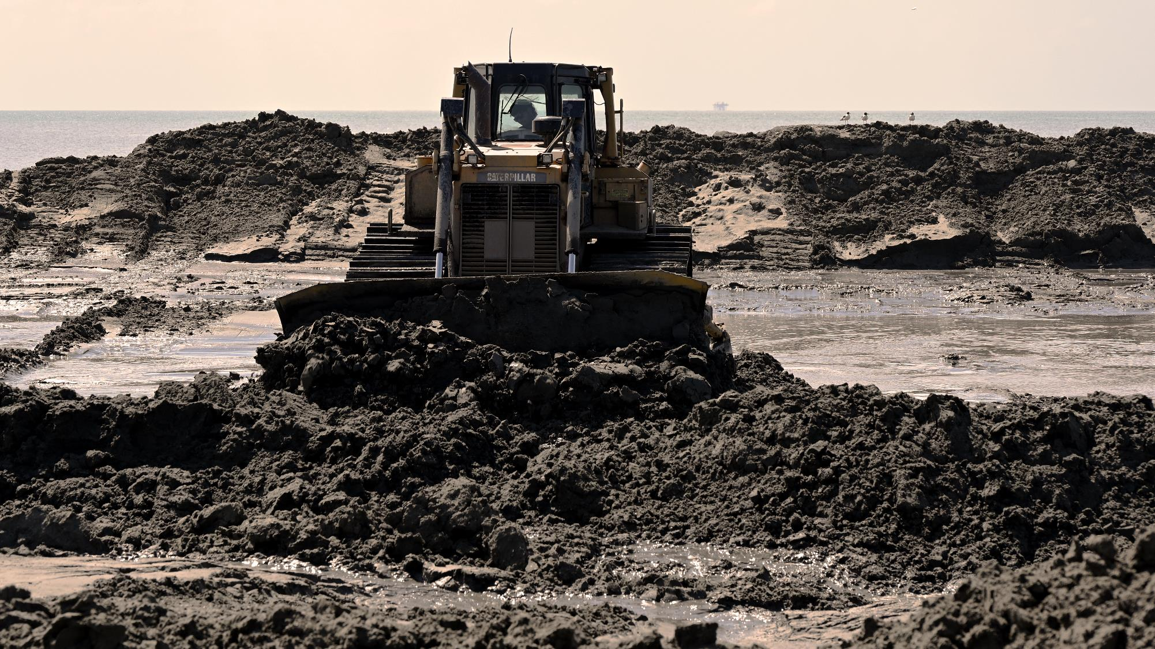
GRAND ISLE AND VICINITY
Efforts to repair damages to the federal system as a result of recent hurricanes, to include Hurricane Ida in 2020, are underway. This work includes repairs to the geotextile dune and beach berm; repairs to existing breakwaters; and beach nourishment.
Study underway to identify best approach for delivering resilient and sustainable risk reduction for one of the state’s most important barrier islands.
Notes:
NO ACTION/AUTO TRANSITION SLIDE

Slide 13
GRAND ISLE AND VICINITY
Efforts to repair damages to the federal system as a result of recent hurricanes, to include Hurricane Ida in 2020, are underway. This work includes repairs to the geotextile dune and beach berm; repairs to existing breakwaters; and beach nourishment.
Study underway to identify best approach for delivering resilient and sustainable risk reduction for one of the state’s most important barrier islands.
Notes:
We also continue to make progress on repair and restore the hurricane-induced damages to the Grand Isle federal risk reduction features. The Disaster Relief Supplemental Appropriations Act provided more than $120M to address these damages. We have completed the interim repair work and begun the more extensive restoration of the authorized system. We have installed the stone dune core, conducted jetty and breakwater repairs and are underway with the clay core installation.
In addition to the repair work, we have also received funding under the DRSAA to conduct a General Reevaluation Report, the purpose of which is to evaluate alternatives for delivering a sustainable and resilient approach for risk management. We have executed our feasibility cost share agreement with CPRA and are focused on the economic modeling, alternatives analysis, and NEPA compliance work. Our target is to reach a tentatively selected plan by next Spring.
ACTION: CLICK/FWD FOR TRANSISTION TO THE NEXT TOPIC (MTG)

Slide 14
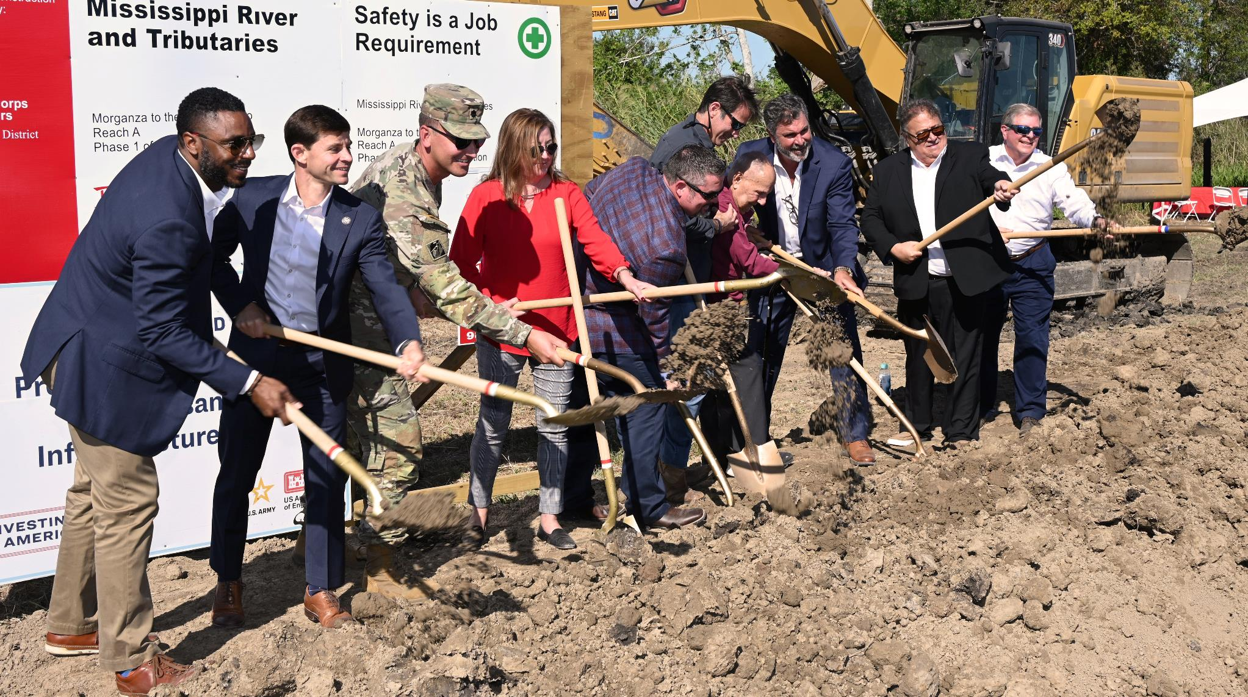
Critical risk reduction system serving more than 200,00 residents in Terrebonne and Lafourche parishes. Congress and the Administration has provided more than $460M to support completion of the system. USACE broke ground on Reach A, a priority reach, in October 2024.
MORGANZA TO THE GULF
Notes:
NO ACTION/AUTO TRANSITION SLIDE

Slide 15
Critical risk reduction system serving more than 200,00 residents in Terrebonne and Lafourche parishes. Congress and the Administration has provided more than $460M to support completion of the system. USACE broke ground on Reach A, a priority reach, in October 2024.
MORGANZA TO THE GULF
Notes:
Stepping just west of Grand Isle, we have the Morganza to the Gulf system. This work is a true local, state and federal partnership with the state and local partners of the Coastal Protection and Restoration Authority and the Terrebonne Levee and Conservation District having already contributed more than $1B toward construction of the system. Earlier this year, I had the opportunity to participate in their groundbreaking for the Houma Navigation Canal Lock, a key element of the system. I was excited to return the favor a few weeks ago by inviting them to participate in our groundbreaking for construction of Reach A, a critical reach that closes the gap on the west side of the system.
Another 13 features, including Reach F and the GIWW East Floodgates are currently in design, in large part from funds received through the Bipartisan Infrastructure Law. We continue to make good progress in our environmental reviews and completed a series of Environmental Justice engagements last in August to ensure we understand and consider the needs of underserved communities in the area.
ACTION: CLICK/FWD FOR TRANSISTION TO THE NEXT TOPIC (LMRCOMP)

Slide 16
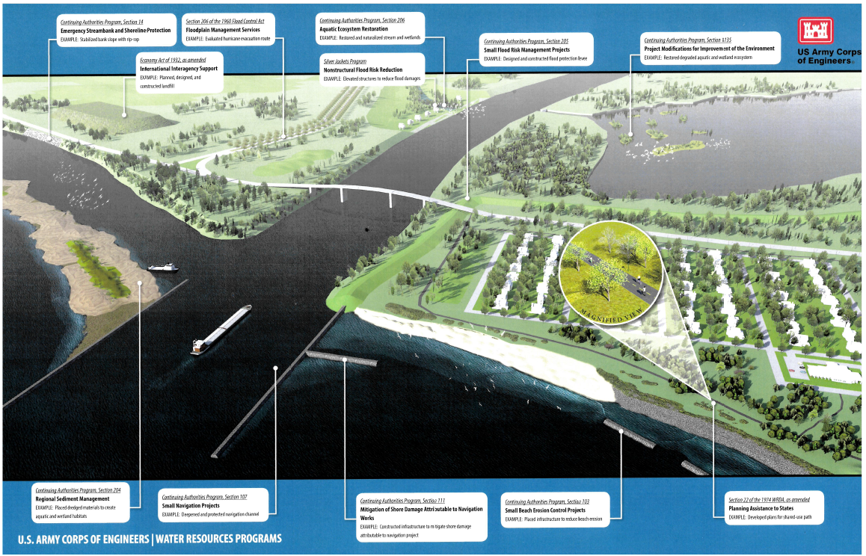
Section 208
Snagging/Clearing for Flood Damage Reduction
Section 206
Aquatic Ecosystem Restoration
Section 1135
Project Modifications for Improvements to the Environment
Section 14
Emergency Streambank & Shoreline Protection
Section 205
Flood Damage Reduction
Continuing Authorities Program (CAP)
Section 204
Regional Sediment Management
Section 107
Navigation Improvements
Section 111
Mitigation of Shoreline Damage From Navigation Works
Section 103
Hurricane & Storm Damage: Beach Erosion
CAP Proposals are Due Every February
For more information contact:
Nik Richard
MVN CAP Program Manager Nikolaus.C.Richard@usace.army.mil
Notes:
Continuing Authorities Program (CAP)
A group of nine legislative authorities that allow USACE to plan, design, and implement certain types of water resource projects without additional project-specific congressional authorization
The purpose of CAP is to plan, design, and construct water resource projects of limited scope and complexity
All projects include a feasibility phase and an implementation phase
Maximum Federal project limit is $10,000,000
Construction projects are usually cost shared 65/35, with the feasibility phase being 100% federally funded up to $100,000
CAP proposals are due every February
MVN has the ultimate goal of increasing participation in the CAP program and is making an effort to promote the program state-wide so all of our partners are aware of the requirements and opportunity to participate.
Recently, HQ accepted applications for the 165a pilot program which would have waved the cost share for CAP projects within EJ communities. MVN had 8 applications through this program, but none of them made the top 10 list of selected proposals.
There may be an opportunity for NFS who submitted applications via the 165a program to go the traditional CAP project request route if they have the ability to cost share.
MVN recently saw the successful construction completion of the Port of New Orleans deepening project via the CAP program, and is currently underway with a Section 14 streambank stabilization project along Highway 77 in Bayou Plaquemines.

Slide 17
Section 208
Snagging/Clearing for Flood Damage Reduction
Section 206
Aquatic Ecosystem Restoration
Section 1135
Project Modifications for Improvements to the Environment
Section 14
Emergency Streambank & Shoreline Protection
Section 205
Flood Damage Reduction
CAP Proposals are Due Every February
For more information contact:
Nik Richard
MVN CAP Program Manager Nikolaus.C.Richard@usace.army.mil
Continuing Authorities Program (CAP)
Section 204
Regional Sediment Management
Section 107
Navigation Improvements
Section 111
Mitigation of Shoreline Damage From Navigation Works
Section 103
Hurricane & Storm Damage: Beach Erosion

Slide 18
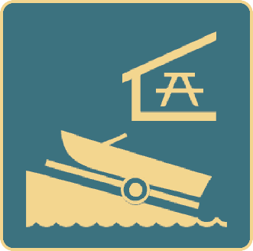
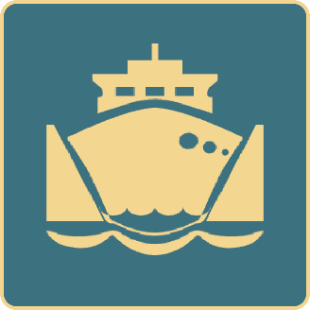
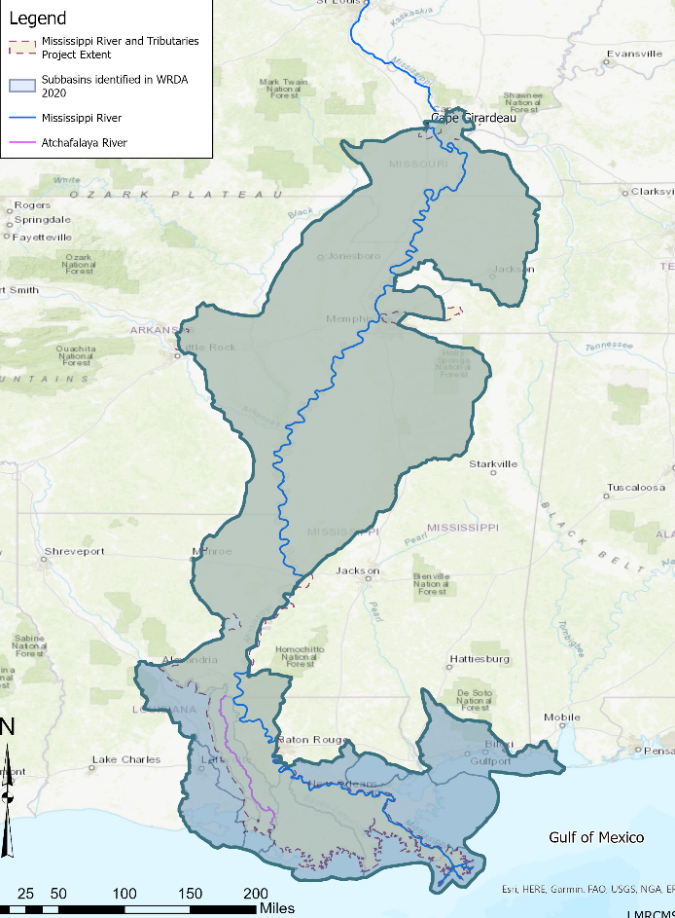
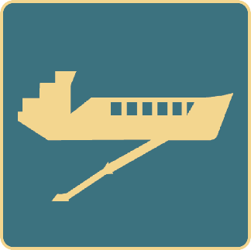
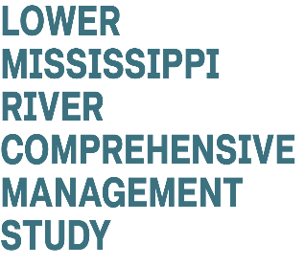
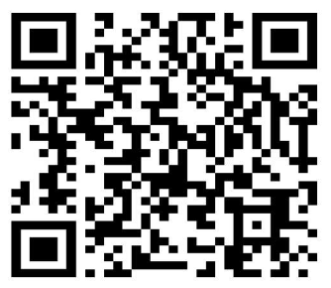
LOWER MISSISSIPPI RIVER COMPREHENSIVE MANAGEMENT
Evaluate alternatives to identify Tentatively Selected Plan.
Prepare and release Draft Integrated Feasibility Report and Environmental document.
Collect and review comments to inform Agency decisions
Notes:
NO ACTION/AUTO TRANSITION SLIDE

Slide 19
LOWER MISSISSIPPI RIVER COMPREHENSIVE MANAGEMENT
Evaluate alternatives to identify Tentatively Selected Plan.
Prepare and release Draft Integrated Feasibility Report and Environmental document.
Collect and review comments to inform Agency decisions
Notes:
Congress authorized the Lower Mississippi River Comprehensive Management Study in Section 213 of the Water Resources Development Act of 2020. In this authority, the Corps is directed to conduct a comprehensive study of the Lower Mississippi River basin from Cape Girardeau, Missouri, to the Gulf of Mexico. The study will identify actionable recommendations for the comprehensive management of the basin for multiple purposes, including flood risk, navigation, ecosystem restoration, water supply, hydropower and recreational use. ​The Study is a unique and historic opportunity to improve upon the existing Mississippi River and Tributaries Project by providing recommendations that could result in an adaptable, resilient, and sustainable river for the next 100 years. ​
​The study area touches on 7 States: Illinois, Missouri, Kentucky, Arkansas, Tennessee, Mississippi, and Louisiana​. There are six USACE Districts involved in the study. Little Rock, St. Louis, Memphis, Vicksburg, New Orleans and Mobile. ​
​
During the Scoping Phase, the team held 32 public meetings and posted a scoping report to the study website that can be reached by utilizing the QR Code on the slide. The report summarizes and groups feedback heard into mission areas, geographic locations, and measure type. With the development of the scoping report, the scoping phase has been completed, and the team has moved into the Alternatives evaluation phase. This includes reviewing the feedback that were heard during scoping and modeling water and sediment within the system to identify what alternatives are feasible and should move forward in the study. The team is currently comparing measures and alternatives utilizing qualitative and quantitative metrics and forming alternatives that will be carried forward in the study. The team holds quarterly public meetings where they provide status updates and answer questions. The next update will be provided in January 2025, please reach out via LMRComp@usace.army.mil to be added to our stakeholder list if you are not receiving communications about these meetings.
ACTION: CLICK/FWD FOR TRANSISTION TO THE NEXT TOPIC (close out slides)

Slide 20
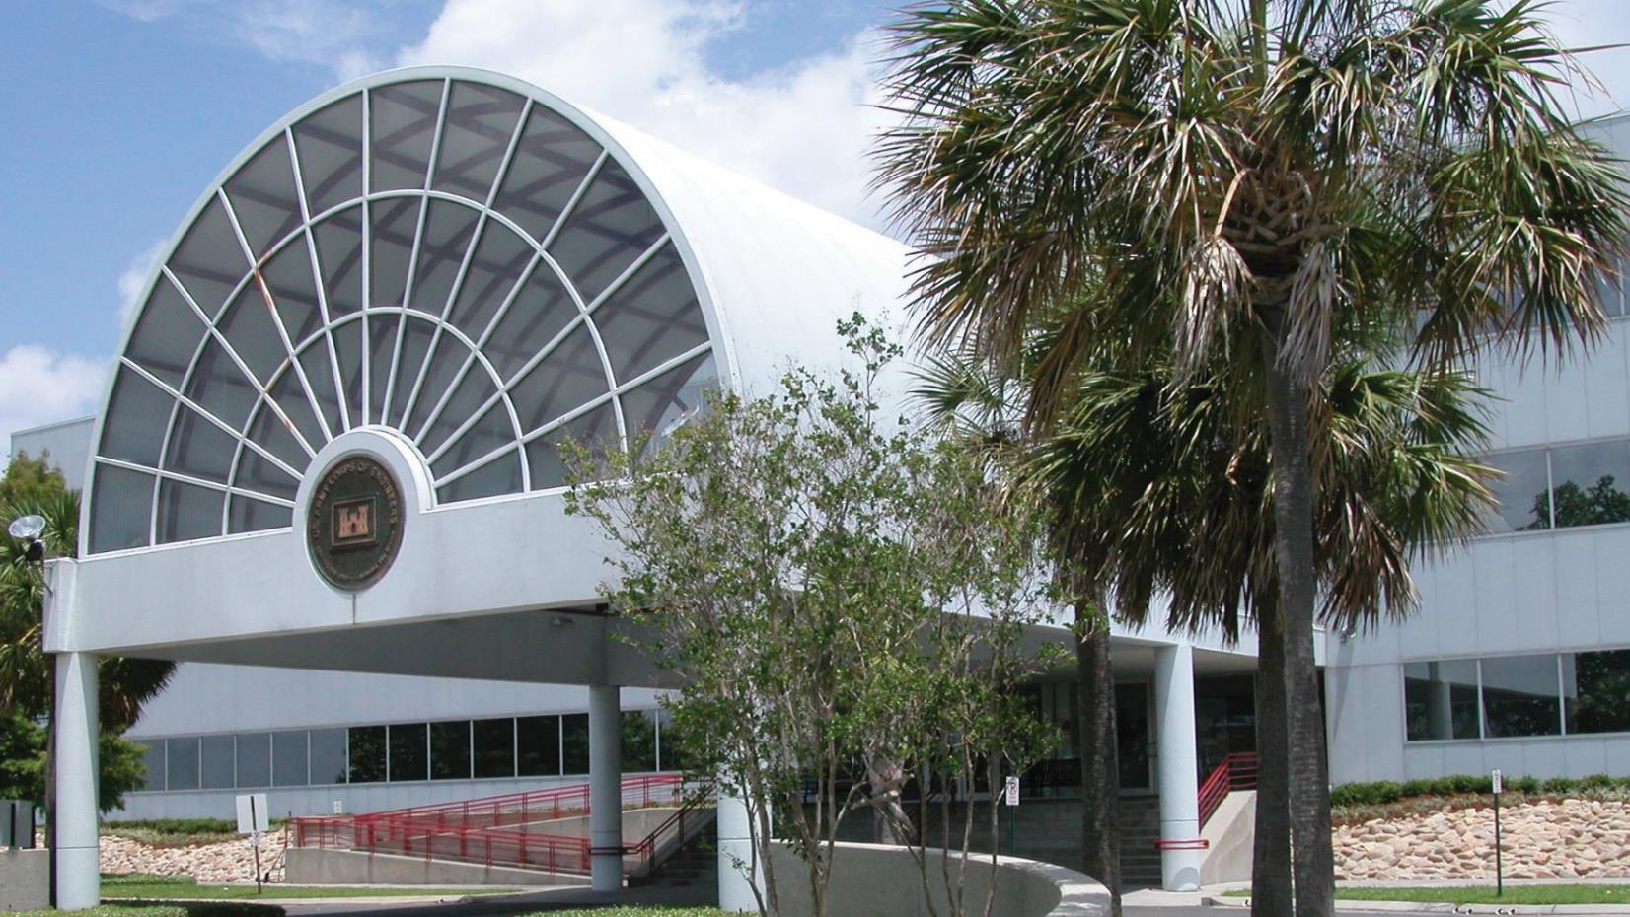
COMMUNICATION, COLLABORATION AND COOPERATION
CONTACT US
COL Cullen A. Jones, Commander
Phone: 504-862.2077
Email: Cullen.A.Jones@usace.army.mil
Durund Elzey, Deputy District Engineer
Phone: 504-862.2204
Email: Durund.Elzey@usace.army.mil
Regulatory Questions
Steve Roberts, Executive Assistant
Phone: 504-862.2517
Regulatory: 504-862-2207
Email: Steve.W.Roberts@usace.army.mil
Notes:
ACTION: CLICK/FWD FOR TRANSISTION TO THE NEXT TOPIC (Social Media)

Slide 21
FOLLOW US FOR THE LATEST ANNOUNCEMENTS
District website
www.mvn.usace.army.mil
Facebook
www.facebook.com/usacenola
Instagram
www.instagram.com/usace_nola
X (Twitter)
twitter.com/usacenola
Notes:
FINAL SLIDE

