Slide 1
Louisiana Governor’s Office of Homeland Security and Emergency Preparedness (GOHSEP)
As of November 25, 2024

Slide 2
GOHSEP as an Organization
2025 Budget $3,132,866,422
State General Fund (Direct) $70,943,906
Interagency Transfers $801,087
Fees & Self-generated $1,265,396
Statutory Dedications $101,500,000
Federal Funds (94%) $2,958,456,033
Six HQ Divisions
Cyber & Emerging Threats
Emergency Management
Security & Interoperability
Financial Operations & Administration
Public Assistance
Hazard Mitigation
Regional Support Operations
Three Louisiana Areas
Nine Geographic Regions

Slide 3
GOHSEP Vision, Mission and Strategic Goals
Vision: To serve as an extension of the Office of the Governor and provide sound leadership during crisis events while also enhancing the day-to-day state agency programs servicing Louisiana residents, businesses and organizations.
Mission: The mission of GOSHEP is to utilize three priorities to save lives, protect property and maintain infrastructure:
Ensure that GOHSEP serves as the emergency arm of the Governor and works hand in hand with all emergency support/recovery function agencies as part of the U.S. National Response Framework and the Louisiana Homeland Security, Emergency Assistance and Disaster Act in preparation, response, recovery, mitigation and prevention of crisis events.
Ensure that all Municipalities, Parishes/Parish Organizations, Sub-Recipients and State Agencies have a voice and an agency to champion for them in obtaining maximum funds in all applicable federal and state programs in an expeditious manner.
Consistently review internal best business practices and potential for Improvements. It is essential to review the actual mission and output of internal departments to ensure elite levels of support to all stakeholders in Louisiana.
Goals:
GOHSEP will apply leadership directly towards lifesaving measures, mitigation efforts to protect public/private property and establish/maintain a safety net to protect, operate and improve our infrastructure.
GOHSEP will quickly and efficiently move resources through the emergency management cycle: preparation, response, recovery, mitigation and prevention. The definition of resources at each stage involves all five divisions and changes depending upon the stage. The five divisions will all operate in support of each other in a deliberate, synchronized fashion.
GOHSEP will internally hold ourselves accountable as an operational arm of government with a strategic directive: GOHSEP will be unwavering in our efforts to save lives, protect property and maintain infrastructure.
GOHSEP will standardize internal strategic concepts in a specific format to streamline communication into clear concise products. The format is task, purpose, issue, discussion and recommendation:
Task- What is this situation?
Purpose- What is the real problem? What is likely to happen? What is the center of gravity of the issue?
Issue- How should I think about this situation to define the problem or opportunity? How could this situation happen? What do I know about situations like this? What do I not know that I should?
Discussion- What other situation is like this one? What is this situation not like? What else could this situation or solution be? How should I prepare for future situations?
Recommendation- What needs to be accomplished? What is the solution or plan? Is there a specific path to decide the solution? Does the solution support the purpose (center of gravity)?

Slide 4
What are we really talking about?
Our vision is how we want to be remembered: Serve as an extension of the Office of the Governor and provide sound leadership
Our mission statement is an extension of our vision and applies key tasks and their respective purpose to it: Utilize three priorities to save lives, protect property and maintain infrastructure:
Ensure that GOHSEP serves as the emergency arm of the Governor
Ensure that all Agencies have a voice and an agency to champion for them
Consistently review internal best business practices and potential for improvements to ensure elite levels of support
Our goals define our collective leader intent and drives home our vision by demonstrating how we should perform as a team:
GOHSEP will apply leadership directly towards lifesaving, protecting property and maintaining our infrastructure
GOHSEP will quickly and efficiently move resources through the emergency management cycle: preparation, response, recovery, mitigation and prevention
GOHSEP will internally hold ourselves accountable as an operational arm
GOHSEP will standardize internal strategic concepts in a specific format to streamline communication into clear concise products

Slide 5
Prevent
Prepare
Respond
Recover
Regional Event
Statewide Event

Slide 6
2024 Emergency Actions
18 weather events in Louisiana and 2 major EMAC responses:
Wind driven rain storms, tornadoes, seismic anomalies, ice storms, rain driven flash flooding, drought and hurricanes (Beryl & Francine) resulting in 13 fatalities
Seven emergency declarations- 4 regional and 3 statewide
Hurricane Helene and Milton EMAC- Florida, Georgia, North Carolina, South Carolina and Virginia
14 man made events with 11 directly affecting a targeted response and 3 national impacts:
Cyber attacks
Oil Spill
Crowd-strike
AT&T Cellular outage
Federal Presidential Election- (6) U.S. Congressmen/Women

Slide 7
Mission essential tasks have countless sub tasks that are classified as specified tasks(what leaders are directed to do) and implied tasks (what leaders sense needs to be done) to support strategic change. This document lists mission essential tasks only. Each mission essential task has an individual strategic action plan that covers the task, purpose, issue, discussion and recommendation for the respective task.
What does strategic change look like? Key tasks and purposes form mission essential tasks

Slide 8
GOHSEP Strategic Action Plans (SAP)
SAPs are quantifiable metrics that simply complex problems based on five key elements: 22 SAPs
Task- What is this situation?
Purpose- What is the real problem? What is likely to happen? What is the center of gravity of the issue?
Issue- How should I think about this situation to define the problem or opportunity? How could this situation happen? What do I know about situations like this? What do I not know that I should?
Discussion- What other situation is like this one? What is this situation not like? What else could this situation or solution be? How should I prepare for future situations?
Recommendation- What needs to be accomplished? What is the solution or plan? Is there a specific path to decide the solution? Does the solution support the purpose (center of gravity)?
Assessment of Year One: The strategic focus of year one could be summed up in two words “MOVE FASTER.” GOHSEP made a deliberate move to establish the organization as an emergency operational arm of the Governor. GOHSEP used the Vision, Mission and Goals to achieve mindset of moving faster.
Strategic Focus for Year Two: The intent for year two is very simple “MOVE SMARTER.” All of the SAPs will be focused on the use of modern technology to move smarter in order to improve capabilities. By moving smarter we also learn how to use technology to counter the actions of man-made homeland security disasters as well as cyclical weather emergency preparedness disasters we see every day!

Slide 9
GOHSEP Year 2- First Two Key SAPs
GOHSEP Modernization
Build upon year one strategic success
Use all six of the divisions in a deliberate effort to modernize
The first stage of modernization is the use of artificial intelligence (AI) packages
Modernization First Stage
Review Louisiana PA and GOHSEP Grants databases
Use AI for a trend analysis
Partner with SDMI and NIMSAT

Slide 10
GOHSEP Org Chart EOC Activation Level IV, Normal Operations
Chief Executive Counsel
Confidential Assistant (LEPA)
GOHSEP
Director
Louisiana Business Liaison/LABEOC
Chief of
Staff
Legal Support Team
Chief Legal
Officer
Director-
Regional Support Operations
Deputy
Director
Confidential Executive Assistant
Assistant Deputy
Director
Executive Assistant
Chief General Counsel
Director- Human
Resources
Director- Individual Assistance
Director- Quality Control
HR/IA General
Counsel
Director-
Strategic Engagement
Director-
External Affairs
Director- Visualization Services
QC Team
HR Team
IA Team
Assistant Director- Financial Operations & Administration
Assistant Director-
Public Assistance
Assistant Director- Emergency Management
Assistant Director-
Security & Interoperability
Assistant Director-
Cyber & Emerging Threats
Assistant Director-
Hazard Mitigation
Executive Officer
Executive Officer
Executive Officer
Executive Officer
Executive Officer
Executive Officer
Comptroller/
Int. Auditor
Grants Management
Current
Operations
Preparedness & Plans
SI
Intelligence
SI
Operations
Cyber Operations
Grants Management
Financial
Services
Disaster
Oversight
State
EOC
Future
Plans
Intel Liaison Public Safety
School
Safety
UAS Detection & Mitigation
Applicant Closeout
Financial
Spt. Services
Technical Services
Logistics
Support
Community Preparation
Intel Liaison LABEOC
Inter-Operability
AI Technical Measures
Technical Services
Sub-Recipient
Monitoring
Applicant Liaisons
Training & Exercises
State
Climatologist
Special
Projects
Critical Inf.
Nuclear Plants
Applicant Liaisons
Facility Management
Closeout
Training Programs
GIS
Services
Preparedness Grants
HM
Planning

Slide 11
Questions Jacques Thibodeaux 504-915-3120
2024
For Official Use

Slide 12
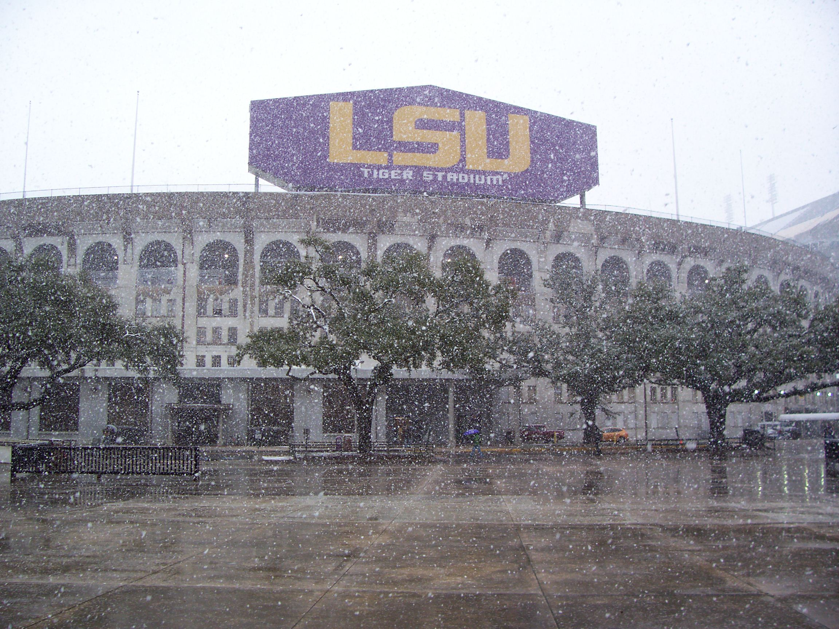

Slide 13
Re-Defining State Climatology
Assoc. of Levee Boards of Louisiana
83rd Annual Meeting
New Orleans
4 December 2024
Jay Grymes
State Climatologist
GOHSEP & LSU

Slide 14
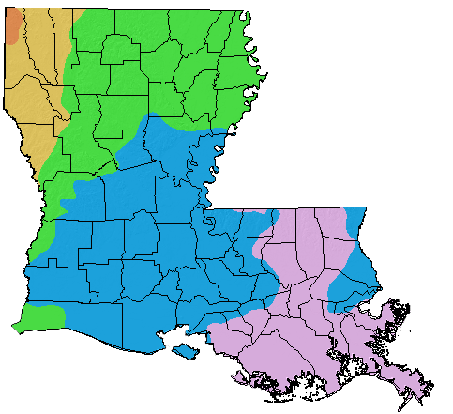
Louisiana Annual Average
Precipitation
under 50”
60” - 65”
50” - 55”
over 65”
55” - 60”
Adapted and Modified from:
PRISM Climate Group
www.prism.oregonstate.edu
A notable precipitation gradient …
nearly a 30% decrease (~20 inches)
in annual average rainfall over a
distance of less than 250 miles

Slide 15
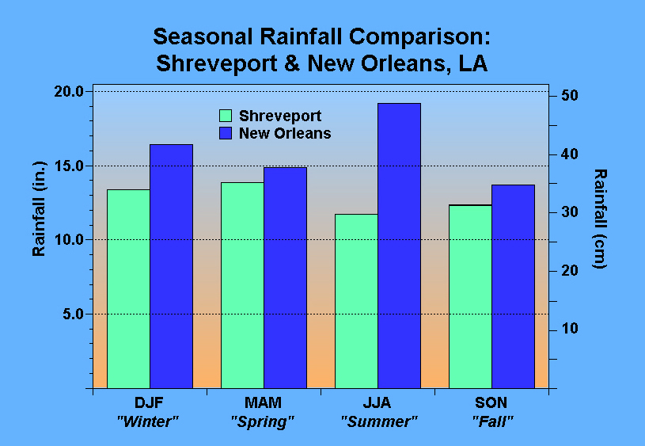

Slide 16
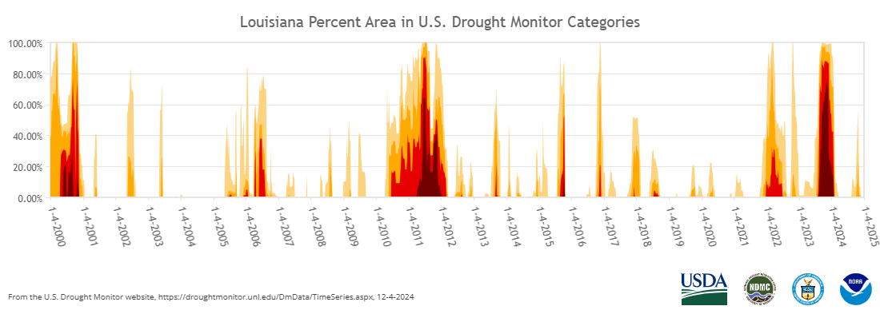
Back-to-back drought development during the summers of 2022 and 2023 reminded Louisiana that even the “wettest state in the lower 48” can suffer from significant moisture deficits. Impacts were especially critical for Ag & Forestry.

Slide 17
While the peak intensity of the 2023 drought exceeds anything in the USDM record (back to 2000), it was NOT the longest duration event in the last 25 years.

Slide 18
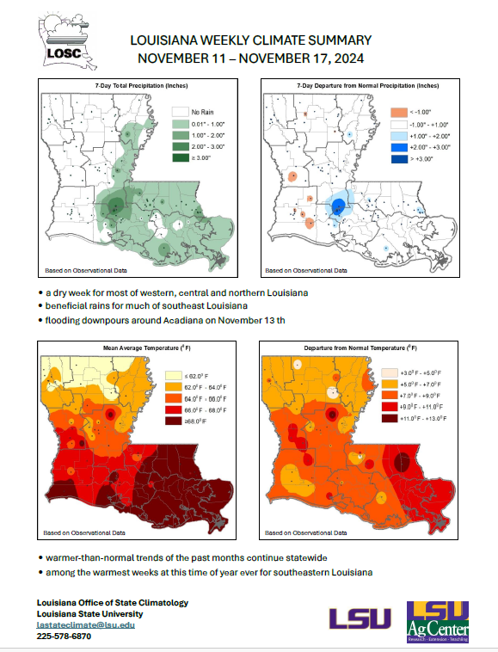
Addressing the Climate Info Needs
of the Bayou State
LSU & LDAF identify need for better
real-time climate monitoring with a
key focus on Ag & Forestry
(2) GOHSEP creates professional post for
in-house weather/climate expertise
State Climatologist assigned to GOHSEP
. . . Louisiana Office of State Climatology
housed at LSU . . . joint responsibilities

Slide 19
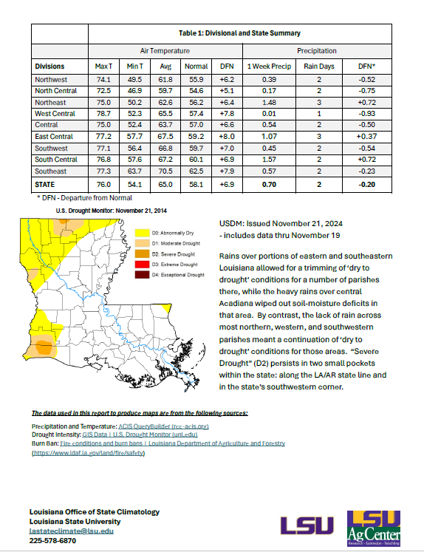
The ‘New’ Louisiana Office of State Climatology
GOHSEP State Climatologist serves as the
Director with a part-time appointment at LSU
LOSC staffed by 2 full-time professionals:
Dr. Nazla Bushra
Mr. Kyle Brehe
LOSC co-located in LSU’s College of The Coast and Environment . . . with the developing Coastal Meteorology Program
LOSC working collaboratively with LDAF’s Director of Meteorology (Lillie Adams Wiley) for drought monitoring

Slide 20
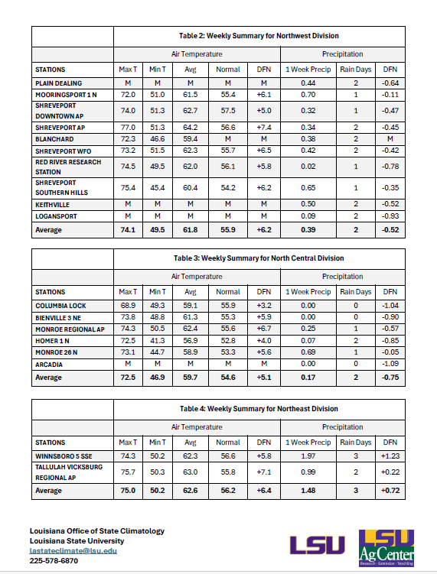
The ‘New’ Louisiana Office of State Climatology
GOHSEP State Climatologist is NOT a
replacement for the NWS & NHC . . .
but serves as a supplemental resource
LOSC focus: data services and support for any/all potential clients
LOSC looking for input/guidance as to the
development of climate assessment and tools that benefit users
jay.grymes@la.gov
225-505-6916

Slide 21
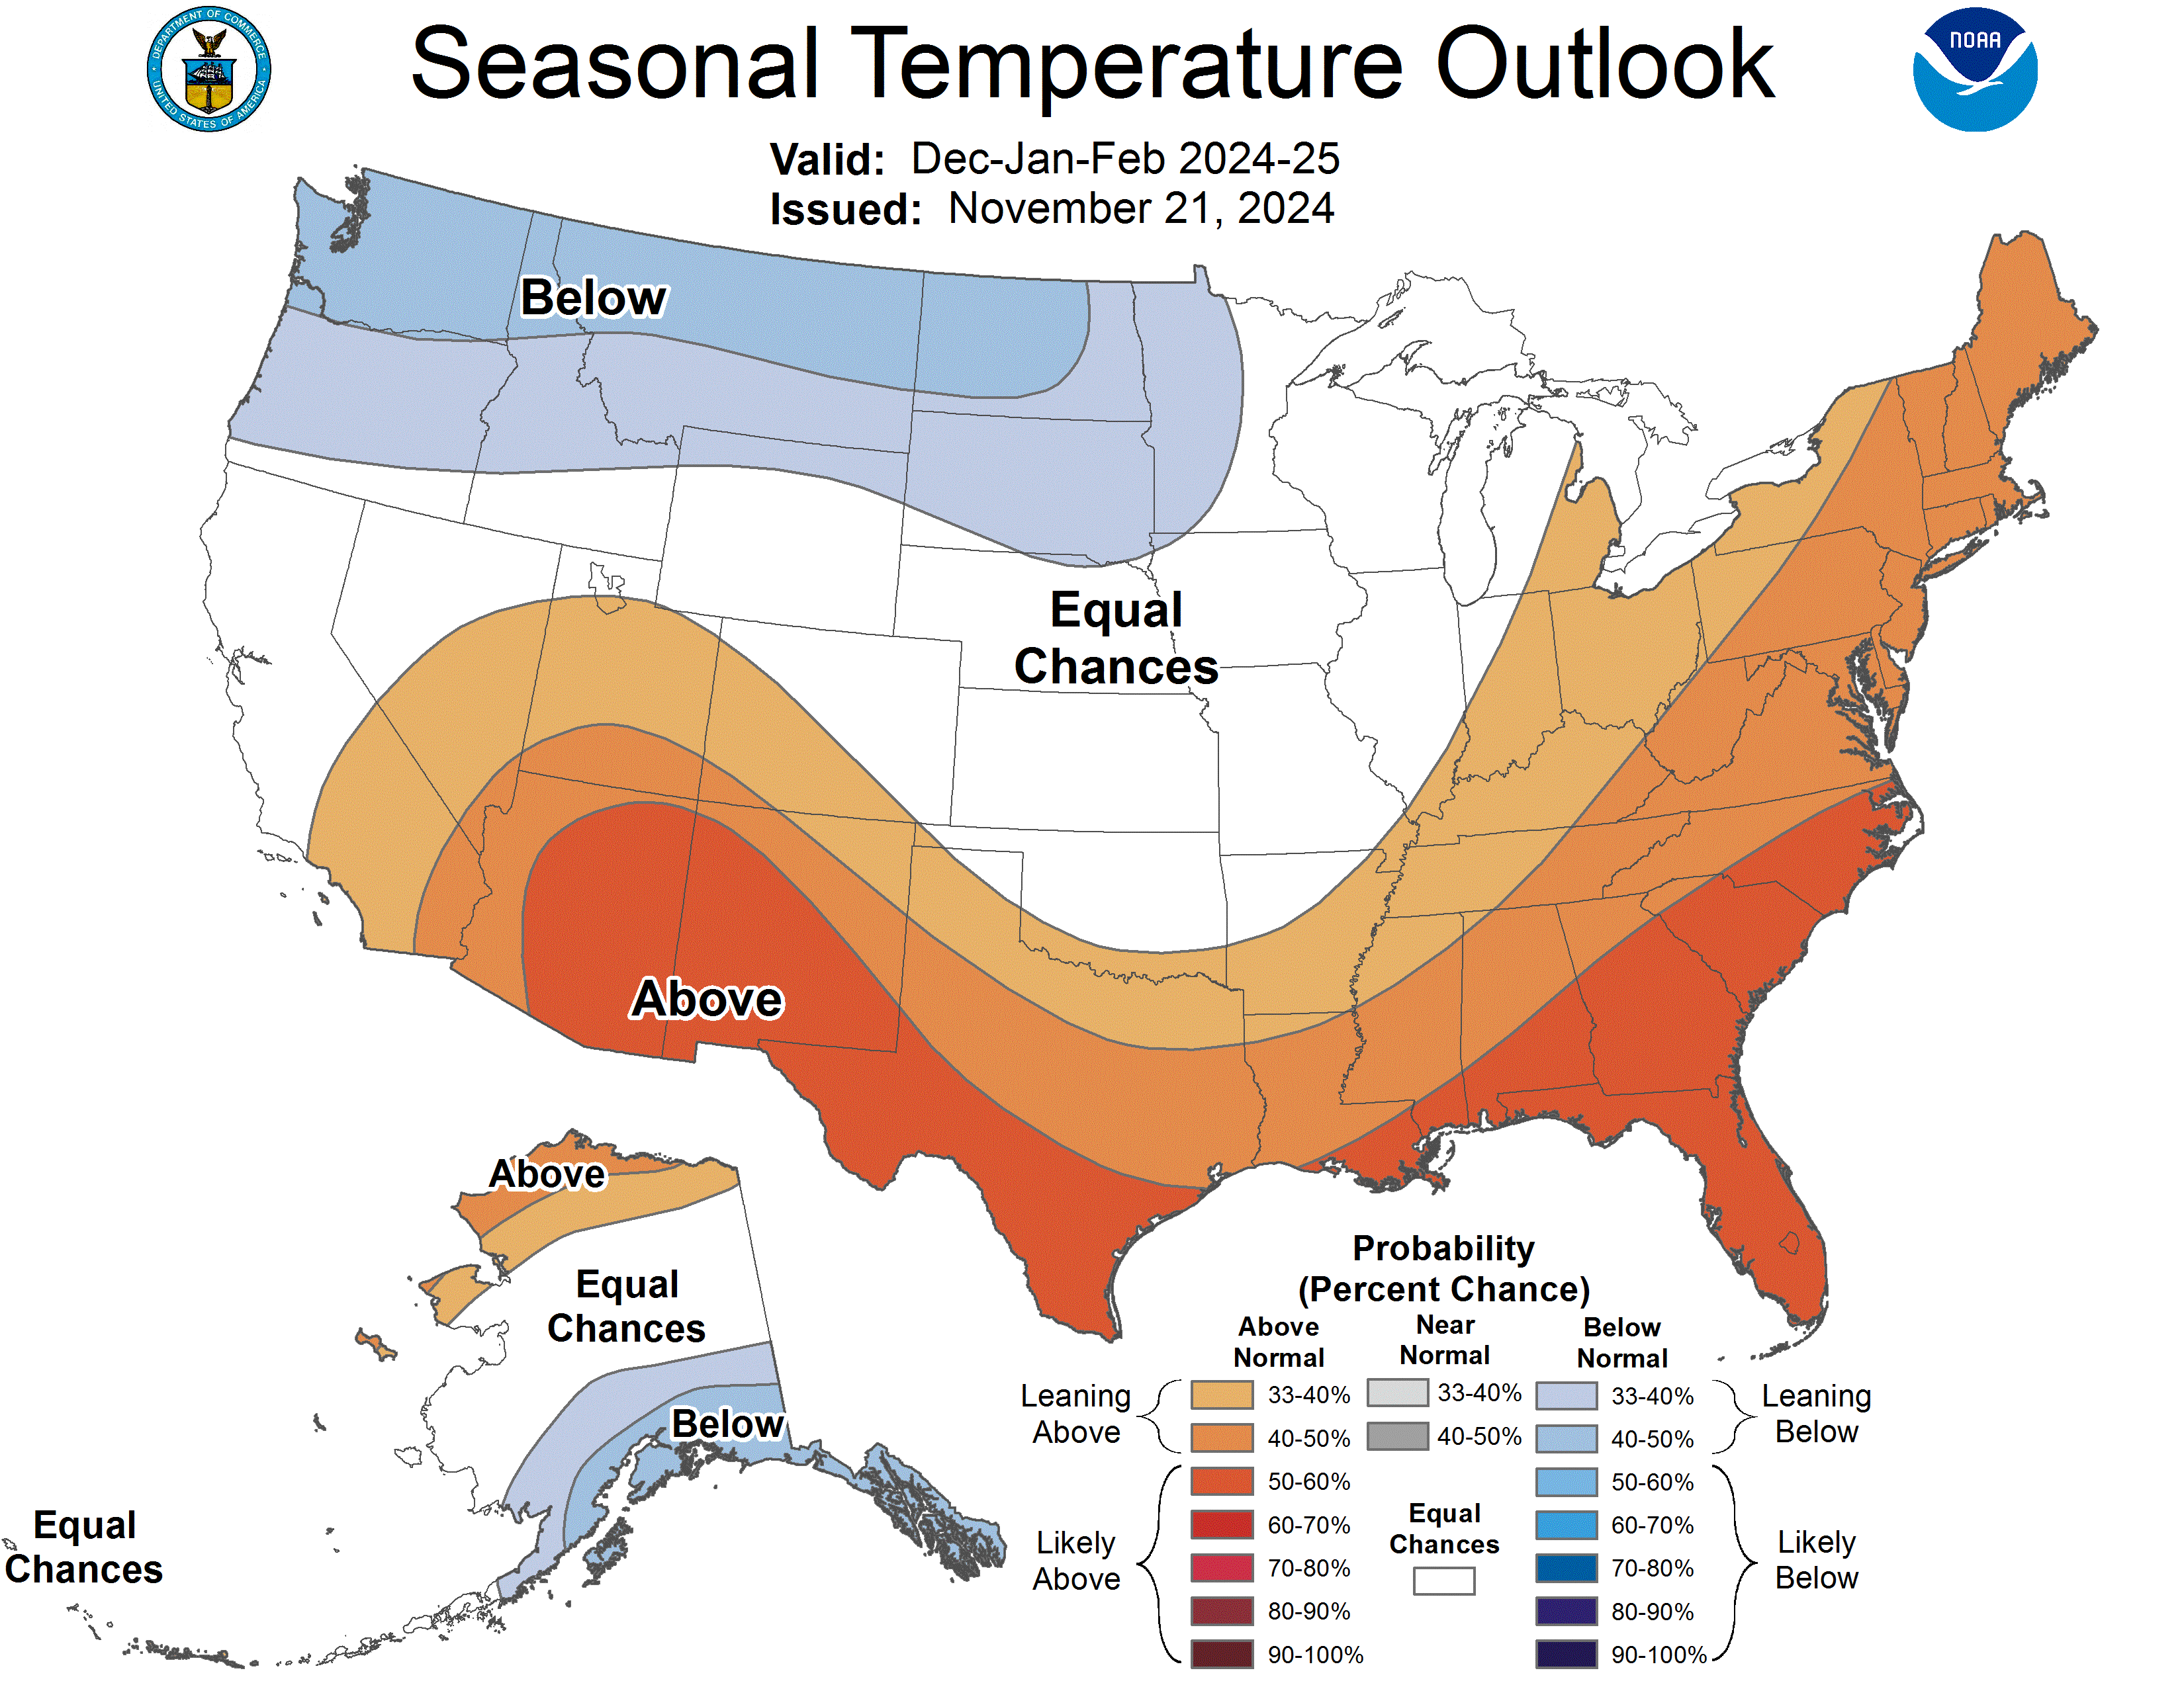
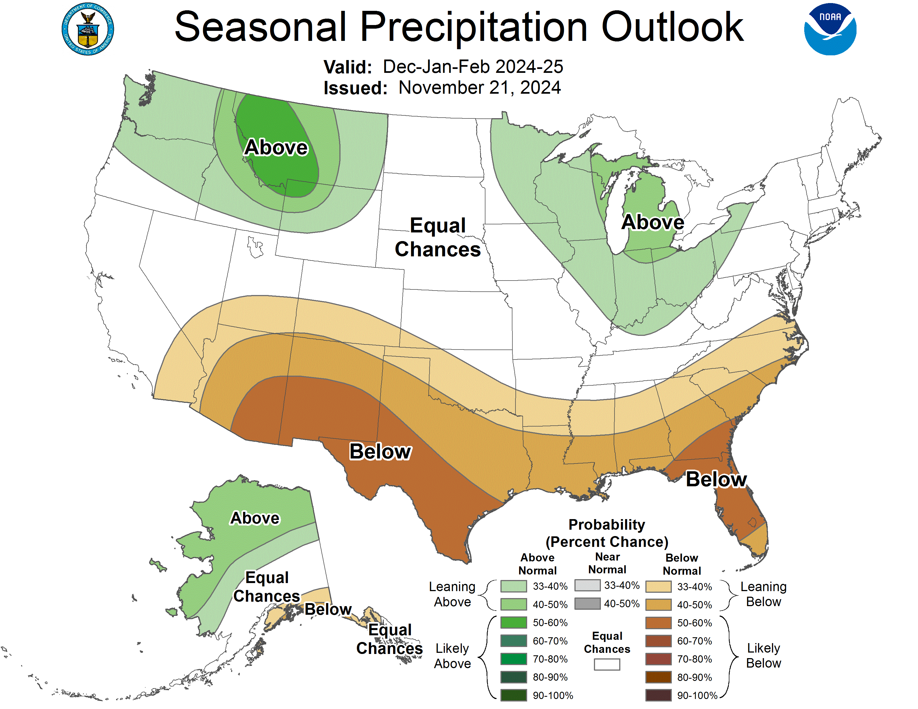
NWS/Climate Prediction Center
DJF Seasonal Average Temps Outlook for Louisiana
40% to 60% probability of averaging
“significantly” above the seasonal temp norm
NWS/Climate Prediction Center
DJF Seasonal Rainfall Outlook for Louisiana
40% to 50% probability that seasonal totals
will be “significantly” below the seasonal norm

Slide 22
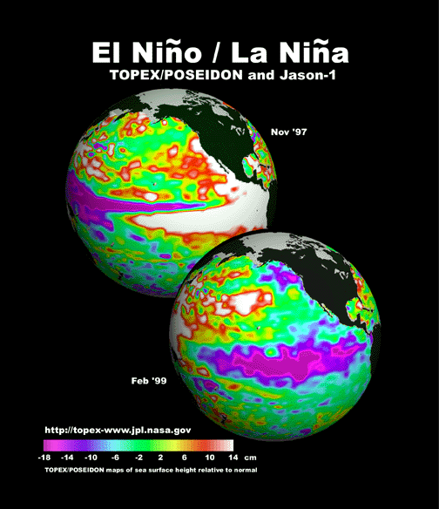
ENSO – El Niño / Southern Oscillation
-- Ocean-Atmosphere linkage that produces
“shifts” in regional / global weather and
climate patterns . . . teleconnections
El Niño / La Niña: ocean temperature (SST) ‘signature’
Southern Oscillation: atmosphere pressure-pattern ‘signature’

Slide 23
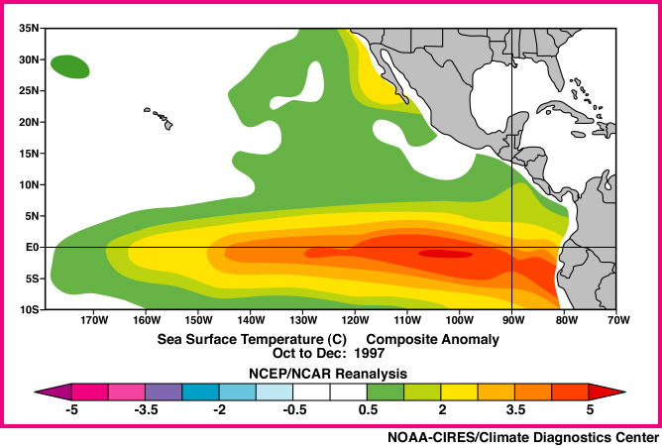
El Niño ‘cool months signature’ along Gulf Coast:
More Frequent Sub-Tropical Jet - ’Rainmaker’
More Frequent
Gulf Lows
Sub-Tropical Jet
“Warm” SSTs

Slide 24
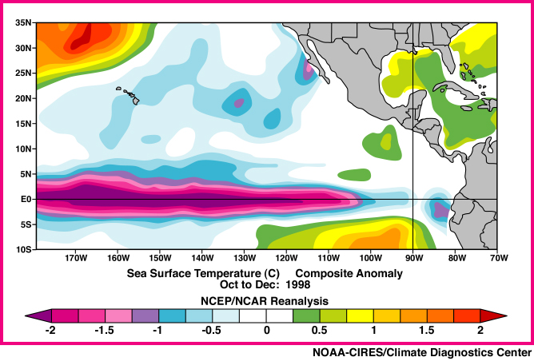
La Niña ‘cool months signature’ along Gulf Coast:
Reduced winter/spring Gulf Activity
Fewer
Gulf Lows
“Cool” SSTs

Slide 25
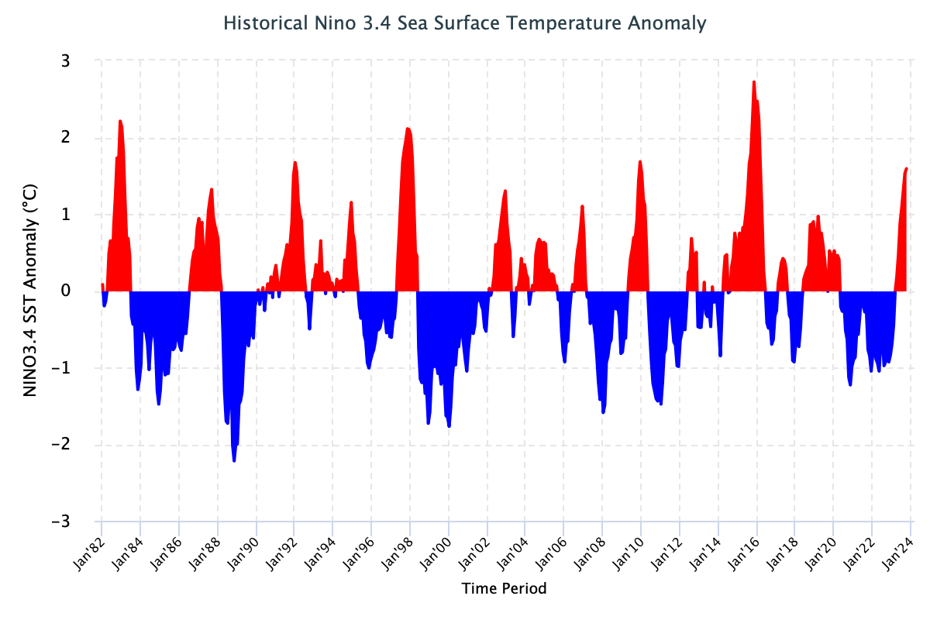
ENSO – El Niño / Southern Oscillation
El Niño – “warm” phase
La Niña – “cool” phase
La Nada – “near normal”
El Niño
La Niña

Slide 26
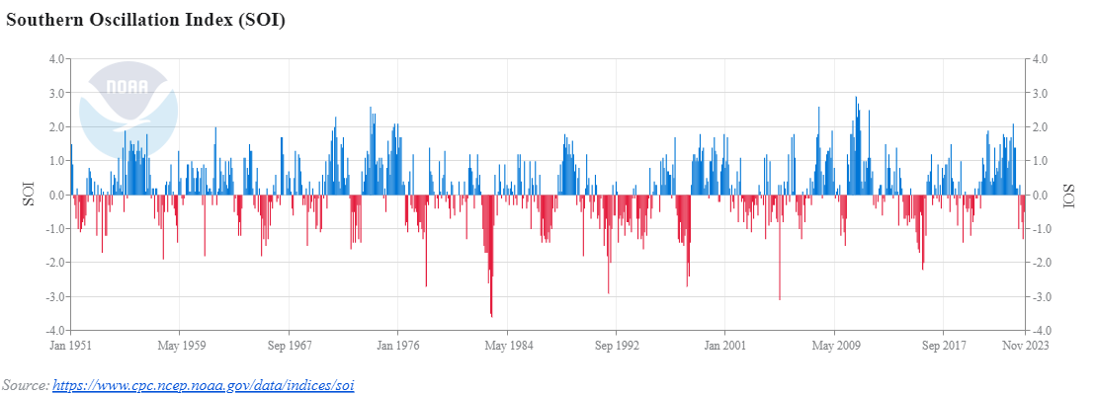
ENSO – El Niño / Southern Oscillation
La Niña
El Niño

Slide 27
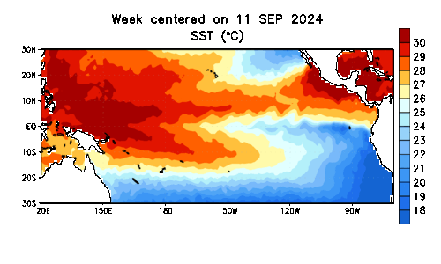
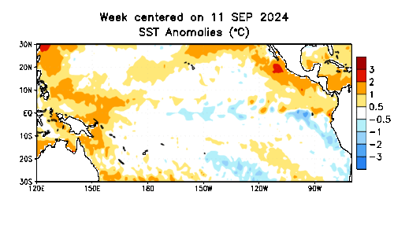
Pacific
Sea-Surface
Temps (SSTs)
Transitioning
to
La Niña?
Region of “warm” SSTs

Slide 28
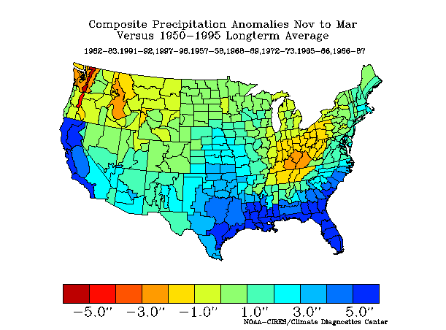
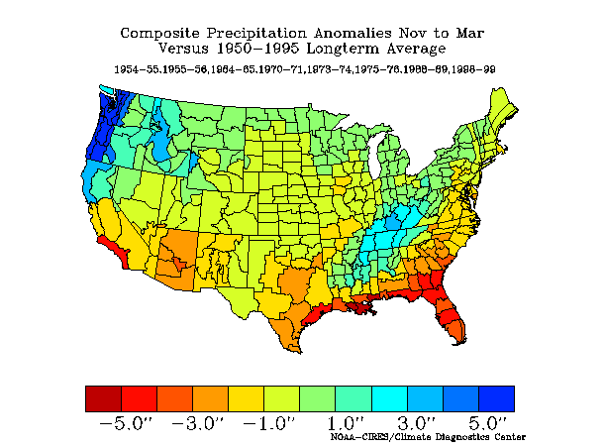
El Niño Median Rainfall:
November-thru-March
El Niño in Winter/Spring:
“wet” Gulf Coast
La Niña Median Rainfall:
November-thru-March
La Niña in Winter/Spring:
“dry” Gulf Coast

Slide 29
La Niña Median Rainfall:
November-thru-March
La Niña in Winter/Spring:
“dry” Gulf Coast

Slide 30
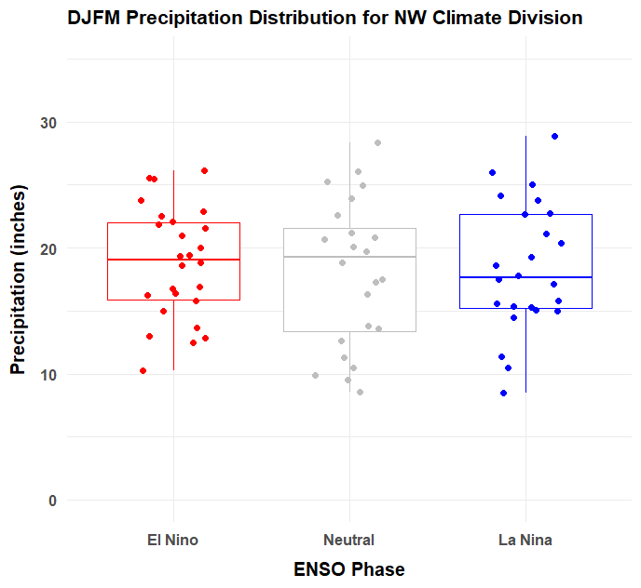
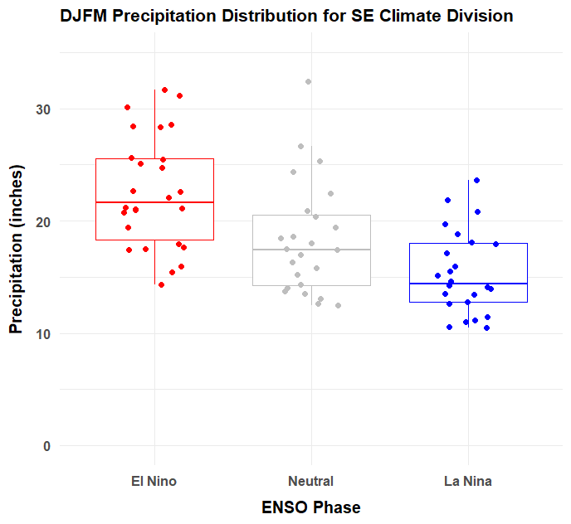
Does the ENSO Phase in Winter Provide Some Guidance for
Winter/Spring Rainfall in Louisiana?
NORTHWEST Louisiana
Dec-Mar Rainfall: 1950-51 thru 2022-23
SOUTHEAST Louisiana
Dec-Mar Rainfall: 1950-51 thru 2022-23
El Niño
‘Neutral’
La Niña
El Niño
‘Neutral’
La Niña

Slide 31
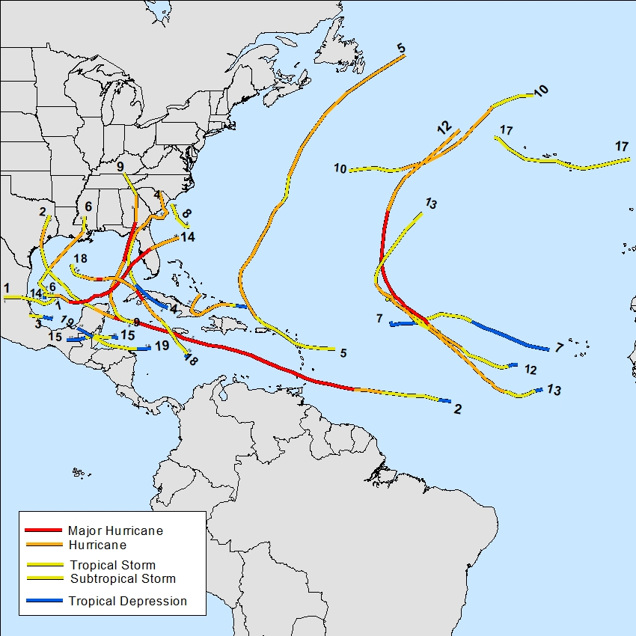
2024 Hurricane Season
NOAA Seasonal Forecast
17-25 ‘named’ storms
8-13 hurricanes
4-7 ‘majors’
End-of-Season Numbers
18 ‘named’ storms
11 hurricanes
5 ‘majors’
8 ‘named’ in the Gulf
5 Gulf Hurricane Landfalls

Slide 32
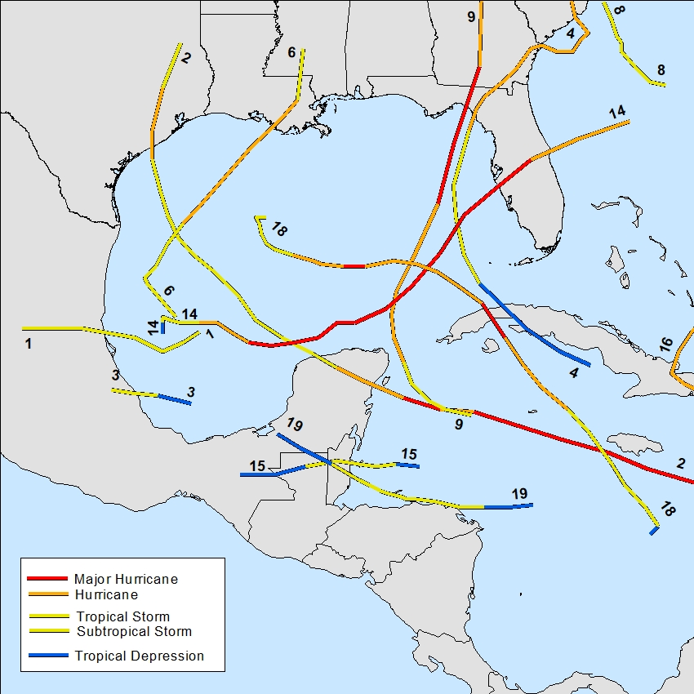
2024 Hurricane Season
TS Alberto
H5 Beryl
TS Chris
H1 Debby
H2 Francine
H4 Helene
H5 Milton
H3 Rafael

Slide 33
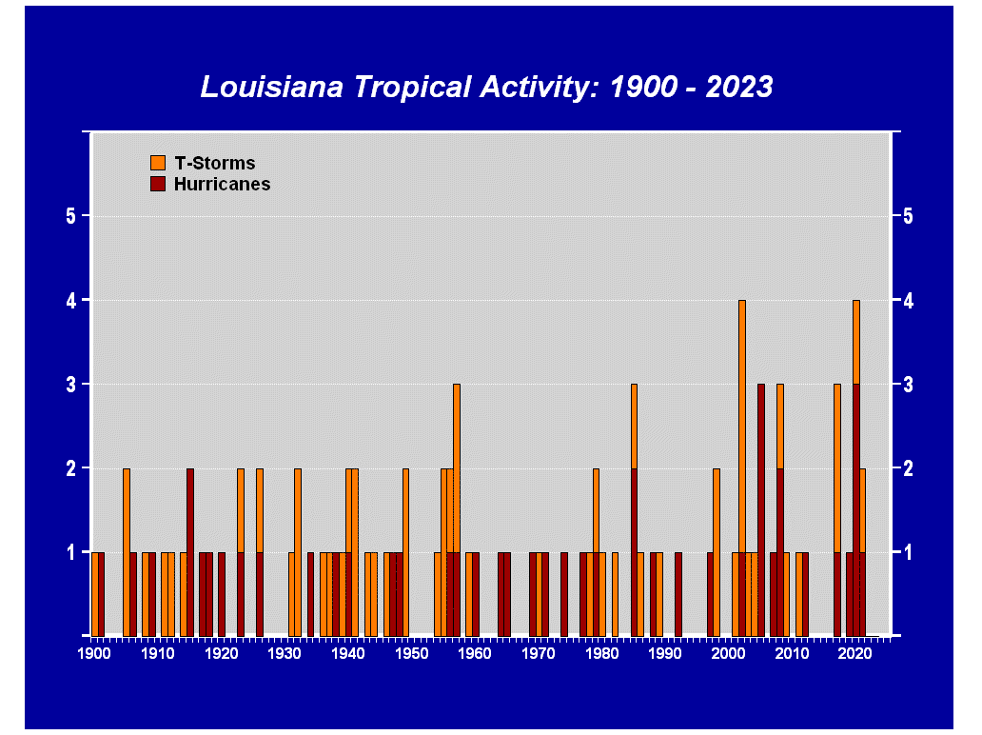
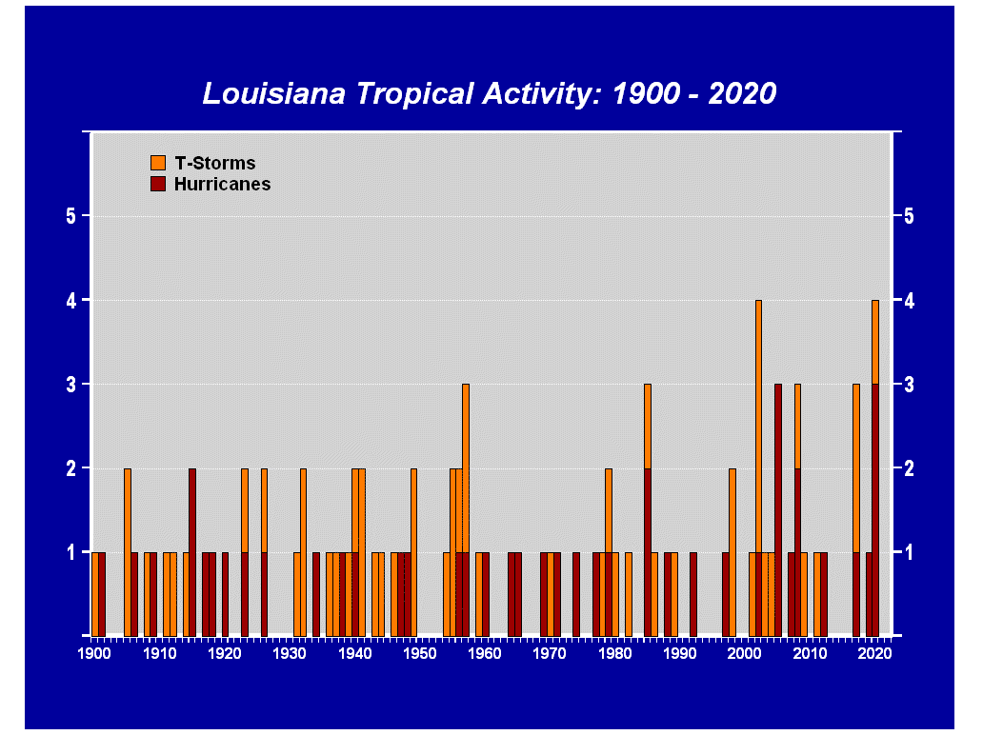
Louisiana Tropical Impacts: 1900 - 2024
2001 - 2024:
29 storms
in 24 seasons

Slide 34
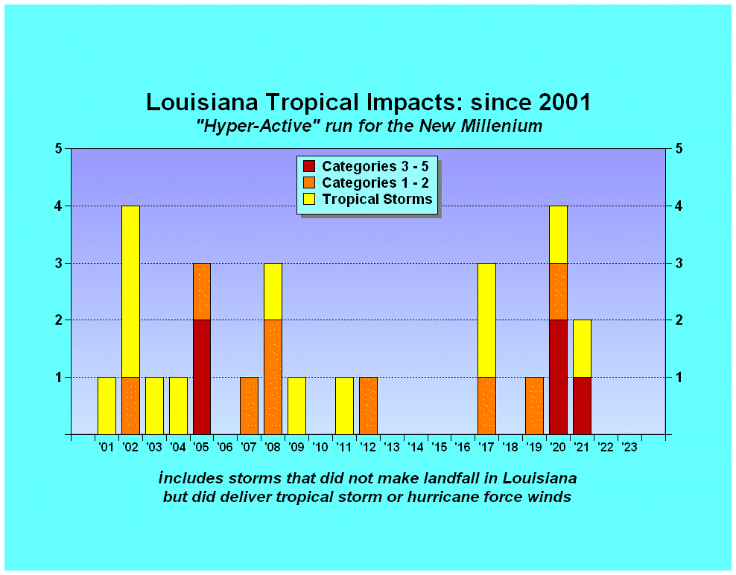
Louisiana Tropical Impacts: Since 2000
“Hyper-Active” Run for the New Millenium
Bertha
Cristobal
Hanna
CINDY
Edouard
Cindy
DELTA
Isidore
LAURA
KATRINA
IKE
Harvey
FRANCINE
Claudette
LILI
GUSTAV
ZETA
Beryl
Bill
RITA
ISAAC
NATE
IDA
Allison
Matthew
HUMBERTO
Ida
Lee
BARRY
‘00
‘24

Slide 35
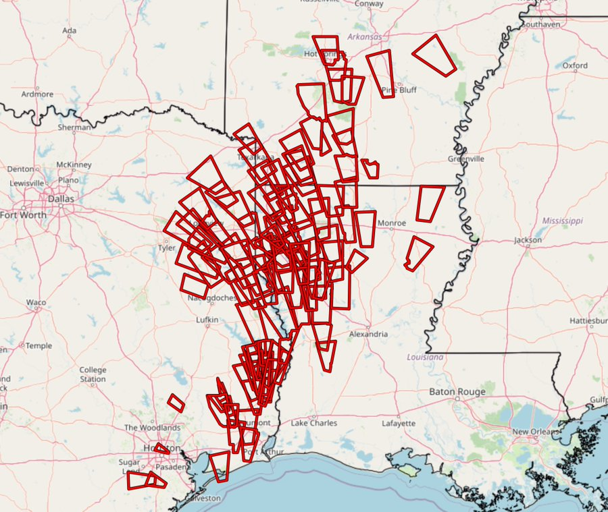
Beryl’s Footprint After Landfall
110 Tornado Warnings in a Day
- 43 more than previous July record

Slide 36
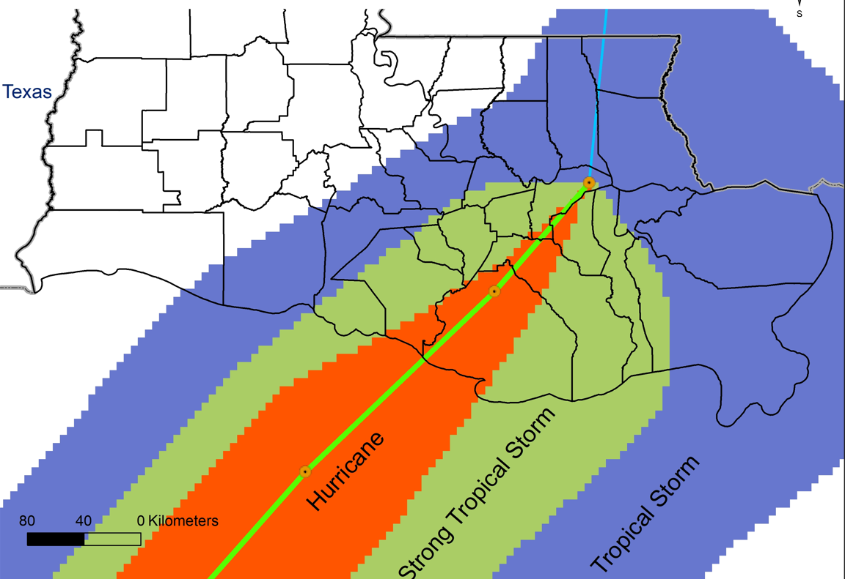
Hurricane Francine
Wind Assessment:
NHC Proposed Wind Field
11-12 September 2024
Preliminary Data
Data Provided by:
National Hurricane Center
Louisiana Office
of State Climatology
Louisiana State University
Contact: Jay Grymes
jgrymes@lsu.edu
225-505-6916

Slide 37
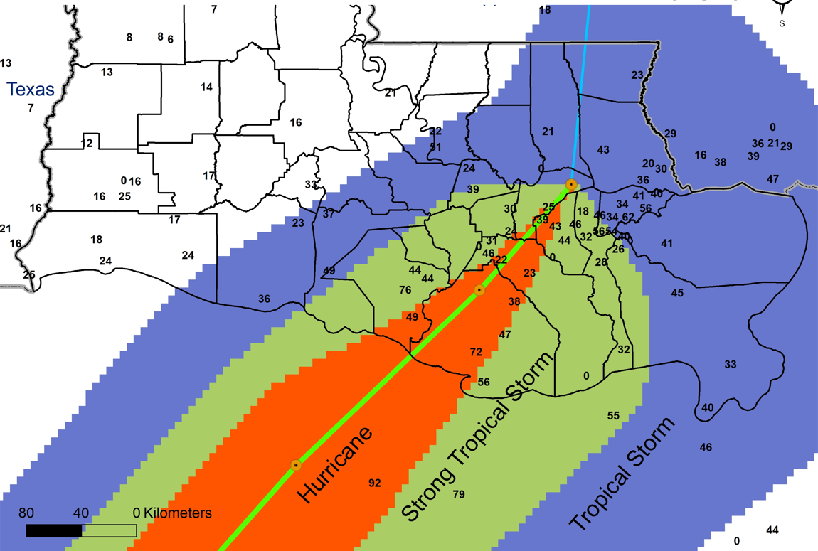
Hurricane Francine
Wind Assessment:
Sustained Winds (knots)
11-12 September 2024
Preliminary Data
(‘0’ indicates no data)
Data Provided by:
National Hurricane Center
NWS New Orleans (LIX)
NWS Lake Charles (LCH)
Louisiana Office
of State Climatology
Louisiana State University
Contact: Jay Grymes
jgrymes@lsu.edu
225-505-6916

Slide 38
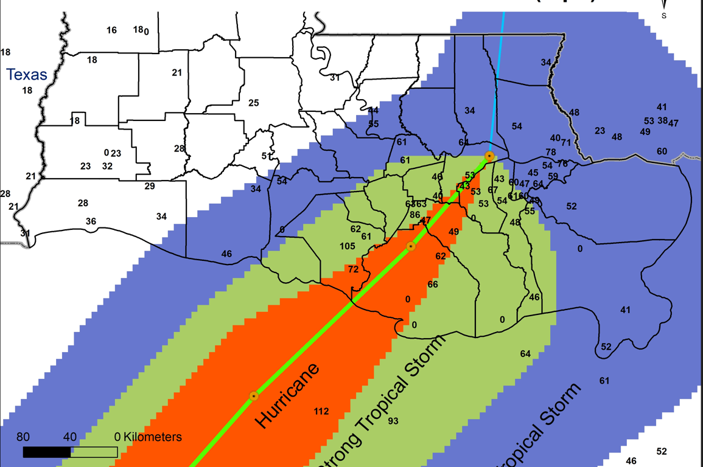
Hurricane Francine
Wind Assessment:
Peak Gusts (knots)
11-12 September 2024
Preliminary Data
(‘0’ indicates no data)
Data Provided by:
National Hurricane Center
NWS New Orleans (LIX)
NWS Lake Charles (LCH)
Louisiana Office
of State Climatology
Louisiana State University
Contact: Jay Grymes
jgrymes@lsu.edu
225-505-6916

Slide 39
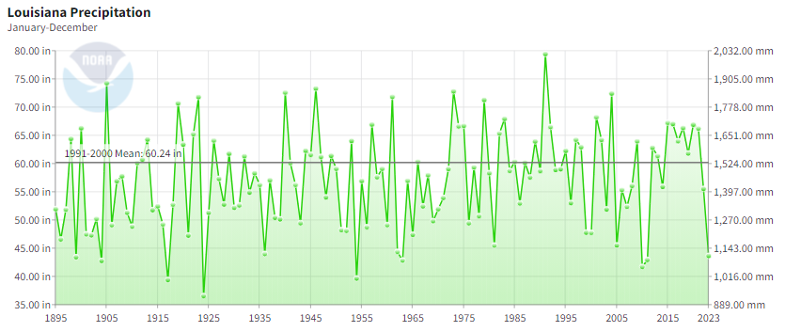
Louisiana Annual Average Rainfall: 1895-2023

Slide 40
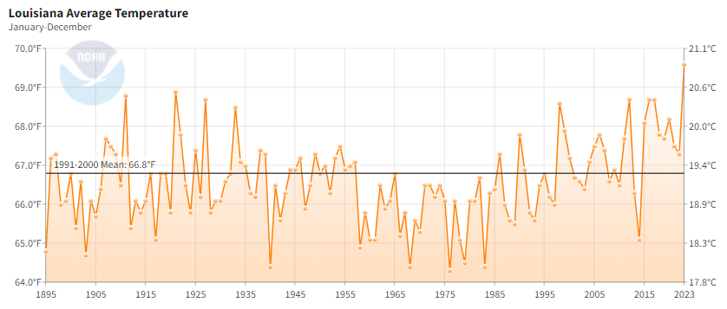
Louisiana Annual Average Temperature: 1895-2023

Slide 41
My Thoughts on Climate Change:
Is the planet “warmer” than it was
100-150 years ago?
Let’s assume “Yes” . . .
2. Are human activities contributing to
this “recent warming”?
A human influence is a near certainly!

Slide 42
3. Are human activities the primary
drivers behind this “warming”?
Humans responsible for “how much?”
I am not convinced that we can quantify.

Slide 43
4. Should we take actions to reduce the
human impact on the environment?
Of course!
This is not a point of debate!
5. Can “climate change” be stopped?
Mitigated . . . but not stopped . . .
at least not until the science and
processes are better understood.

Slide 44
“Even if the threats from climate change are being overstated, just ‘modest’ impacts could have dire effects on Louisiana . . .
Potentially, Louisiana may be among the most adversely impacted states in the nation.”

Slide 45
“Thank You!”
Jay Grymes
State Climatologist
jgrymes@agcenter.lsu.edu
225 / 505 - 6916

Slide 48
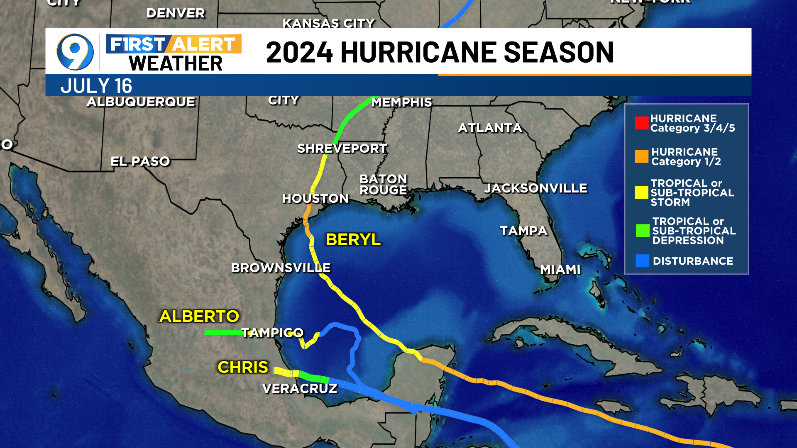

Slide 50
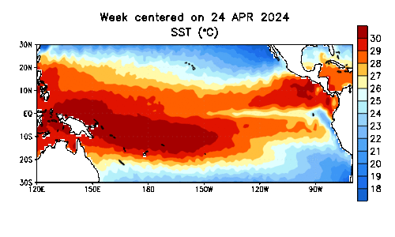
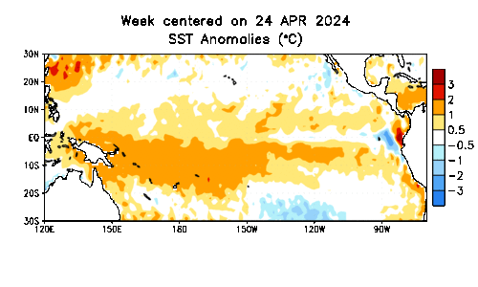
ENSO:
El Niño / Southern Oscillation
‘cooling’ trend for the
east-central Pacific:
- shift towards La Niña in the
coming months
- associated with increase in
Atlantic storm counts

Slide 51
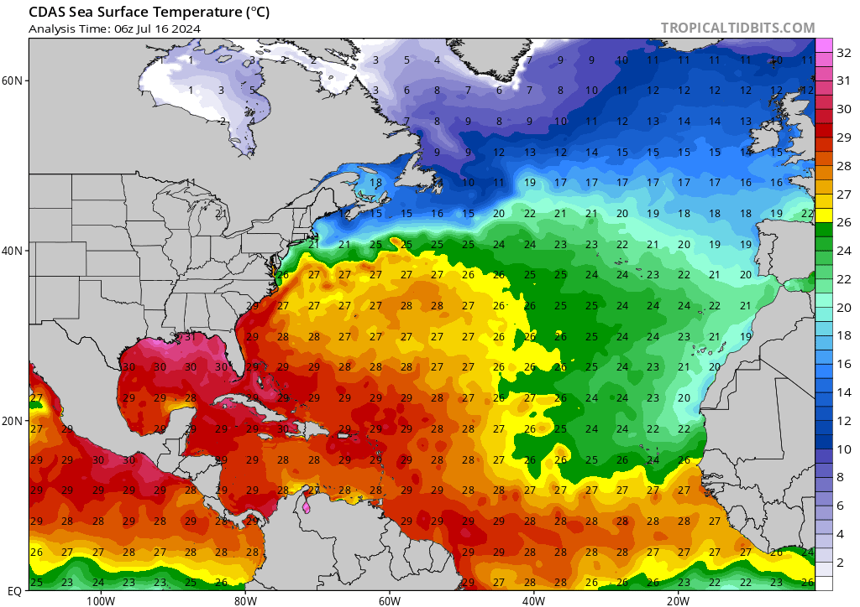

Slide 52
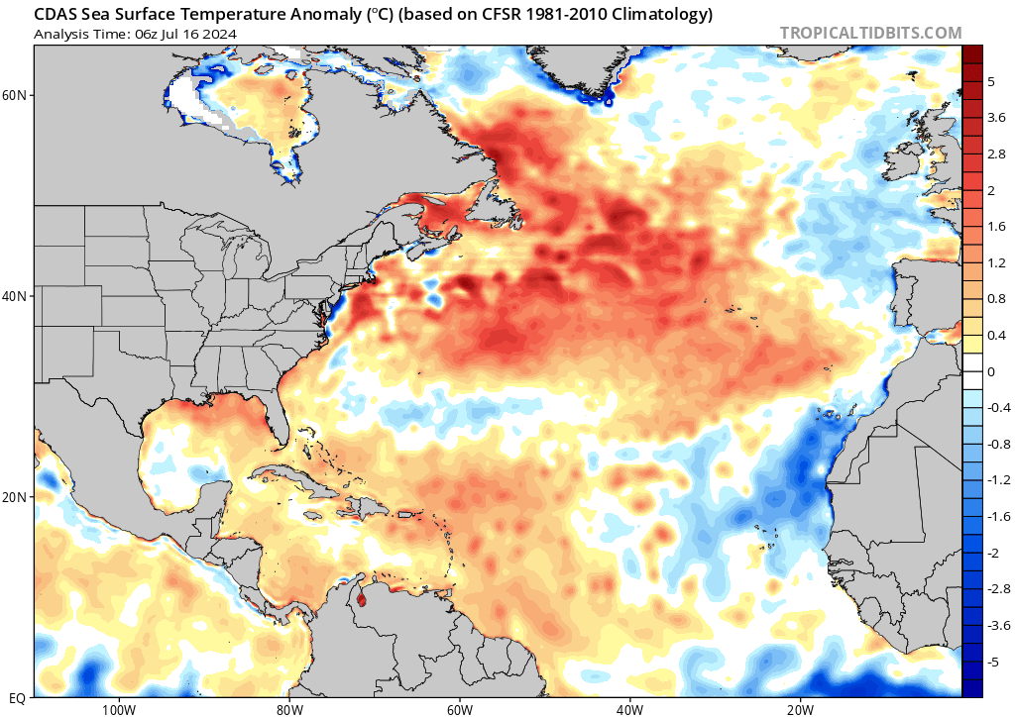
MDR – Main Development Region

Slide 53
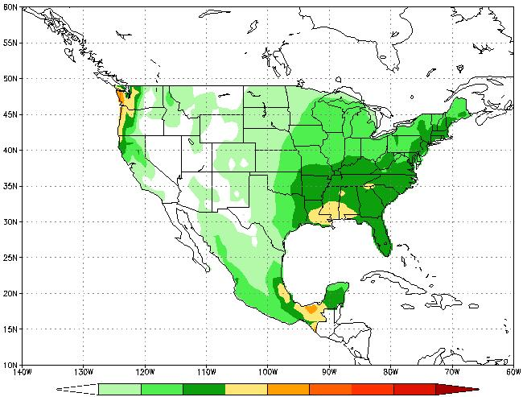
Louisiana:
The “Wettest” State
of the Lower 48
55”–70”

Slide 54
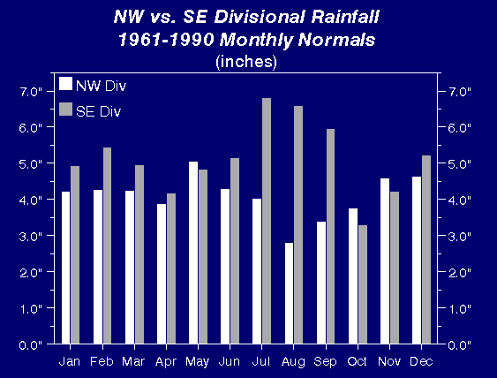
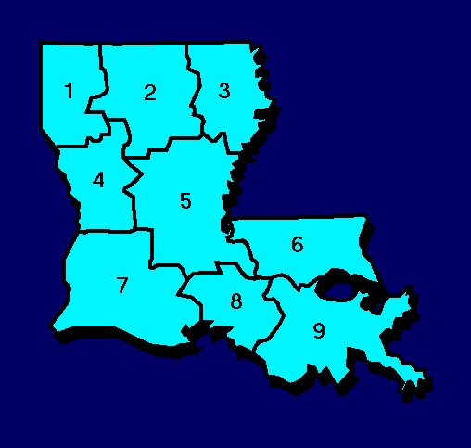
To understand the impacts and importance of changing weather patterns, we first must understand the state’s long-term climatic patterns.
NW vs. SE Comparative
Monthly Average Rainfall

Slide 55
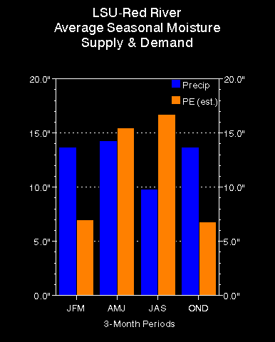
Moisture Demand (PE - Evapotranspiration)
vs.
Moisture Availability (Rainfall)

