Slide 1
Update on LOCD-DR Programs
Gina Campo | Executive Director

Slide 2
Overview

Slide 3
About LOCD-DR
Types of Programs ADMINISTERED
Buyouts and Resettlements
Immediate and Temporary Housing
Disaster Recovery Programs
Trainings and Workshops
Small Business Recovery Programs
Policy and Research
Homeowner Assistance
Provision of Public Services
Rental Assistance
Resilience and Mitigation
Long-Term Recovery Planning
Infrastructure Recovery Programs
The Louisiana Office of Community Development – Disaster Recovery is the grantee and administrator of disaster recovery funds in the state of Louisiana.
LOCD-DR helps communities provide a suitable living environment and expand economic opportunities for residents and businesses, particularly in low- to moderate-income areas.
Buyout and Incentive Programs

Slide 4
Disaster Recovery Cycle
Consistent and ongoing engagement with local elected officials and resource groups
Graphic source: FEMA, National Disaster Recovery Framework

Slide 5
CDBG Funding
Disaster Recovery
Mitigation
$13.4B
Hurricanes Katrina and Rita
$1.09B
Hurricanes Gustav and ike
$1.2B
Louisiana Watershed Initiative
$64.4M
Hurricane Isaac
$1.7B
Great Floods of 2016
$92.6M
National Disaster Resilience Competition (MIT)
$1.05B
Hurricanes Laura and delta
$2.1B
Hurricane Ida and May 2021 Flood

Slide 6
CDBG-DR
Disaster Recovery Programs for 2020-21 Disaster Events

Slide 7
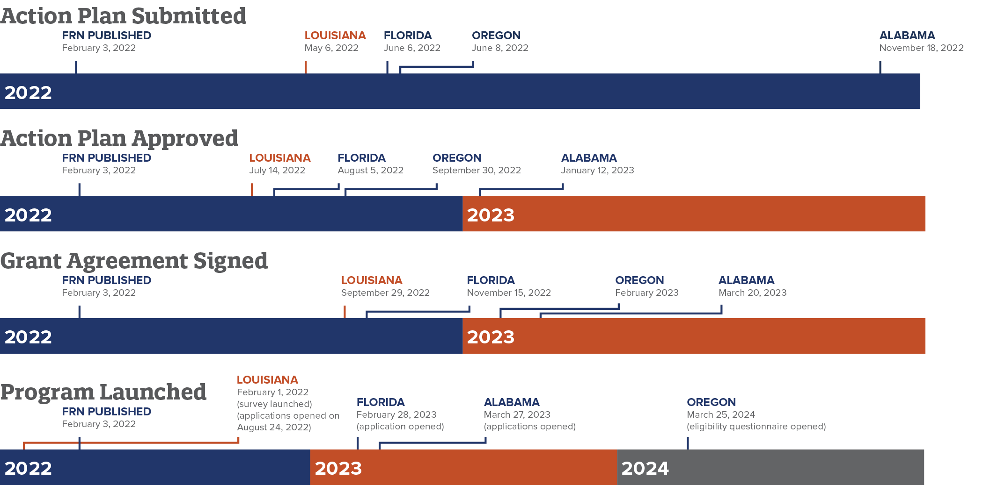
Comparison to Other States (2020-21)
Through its experience administering recovery programs throughout the state, LOCD-DR has been able to leverage lessons learned and implement best practices to more effectively and efficiently launch programs that provide Louisiana communities with critical recovery assistance.
Compared to other states who were included in the same Federal Register Notice issued on Feb. 3, 2022, across the board, Louisiana was the first state to reach each milestone, as seen in the timeline.

Slide 8
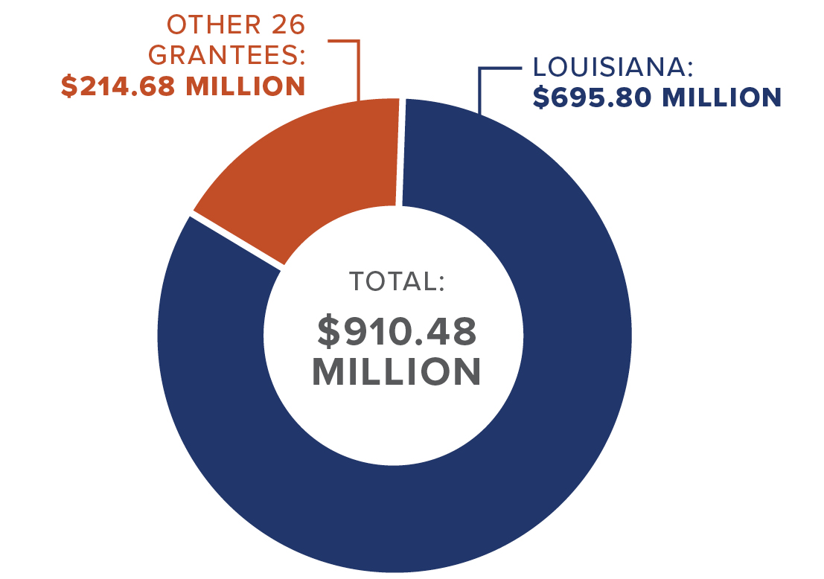
Comparison to Other States
Expenditure Comparison (as of Dec. 1, 2024)
For 2020-21 disaster events, Congress appropriated a total of $6.168 billion in CDBG-DR funding to 26 grantees
As of Dec. 1, 2024, grantees have drawn down $910.48 million, totaling only 15%.
Louisiana has drawn down 76% of the $910.48 million across all disasters totaling $695.80 million
2 of the 26 grantees have yet to expend any of their available funds

Slide 9
State of Louisiana’s Allocations for 2020 and 2021 Federally Declared Disasters
Louisiana has been allocated more than $3.1 billion for all eligible storms
Qualifying Event | Grant Agreement Signed By HUD | Funding Allocation
Hurricane Laura | First Allocation of $600M: September 28, 2022 Second Allocation of $450M: November 4, 2022 | $1 billion
Hurricane Delta | October 6, 2020 - October 10, 2020
May Severe Storms | First Allocation of $1.2B: November 4, 2022 Second Allocation of $831M: September 27, 2023 | $2.1 billion
Hurricane Ida | August 26, 2021 - September 3, 2021 | $1.27 billion

Slide 10
2020-2021 Program Allocations
ECONOMIC DEVELOPMENT PROGRAMS
Small Business Loan and Grant Program | $96.15M
HOUSING PROGRAMS
Soft Second Mortgage Assistance | $15M | Permanent Supportive Housing Program (PSHP) | $31M
Middle-Market Loan Program (MMLP) | $60M | FMA-SWIFT (Non-Federal Share Match) | $3M
PRIME (Piggyback) Program | $722.95M | Housing Buyouts | $100M
Rapid Rehousing Program | $25M | Restore Louisiana Homeowner Assistance Program | $1.07B
Rental Restoration and Development Program (RRDP) | $40M | Interim Housing Program | $20M
Flood Insurance Program | $1.5M | Homeless and Housing Stability Development Program | $26M
INFRASTRUCTURE PROGRAMS
Nonfederal Share Match Program | $240.79M
HMGP Global Match Program | $77.33M
Resilient Communities Infrastructure Program | $465M
Local and Regional Watershed Projects and Program | $20M
ADMIN + PLANNING: $136.47M

Slide 11
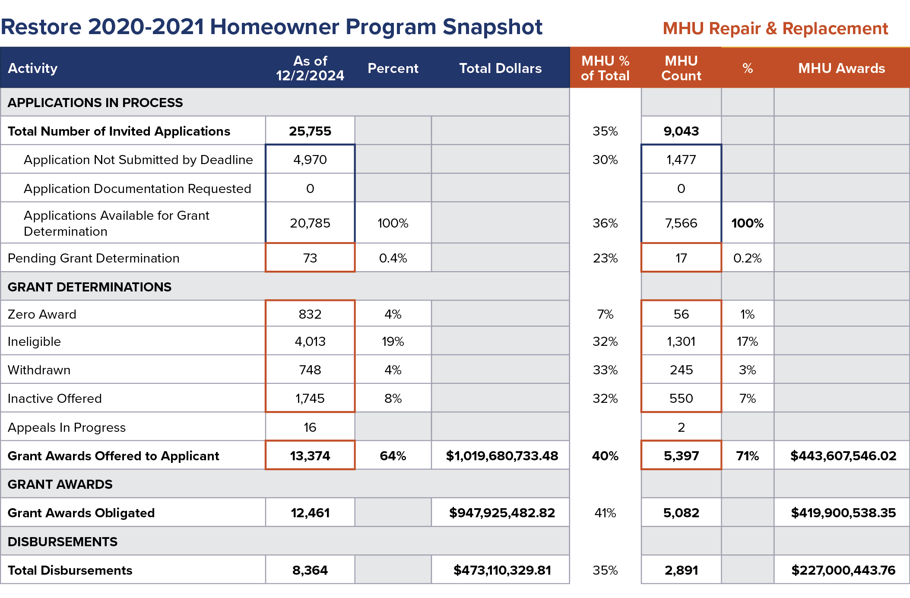
Restore Louisiana Update
Total funds DISBURSED
$473,110,329.81
Total awards offered
Total NUMBER OF DISBURSEMENTS
13,374
8,364
Award closing deadline
Occurred Fall 2024
Next steps Post-deadline
Construction of Sol. 1 continuing through 2025; close out of projects beginning 2026

Slide 12
Restore Louisiana Homeowner Assistance-Related Programs
Flood Insurance Program
This assistance covers the costs of flood insurance premiums for properties for one year for eligible LMI applicants participating in the Restore Louisiana Homeowner Assistance Program. This assistance is supplemental to a Homeowner Assistance Program award grant.
Interim Housing Assistance Program
Provides interim mortgage assistance for up to 20 months, or rental assistance for up to 20 months, for up to an estimated 90 days to eligible LMI homeowners who are participating in the Restore Louisiana Homeowner Assistance Program.
Buyout and Incentive Program (Solution 4)
Voluntary buyout program available for Restore Louisiana Homeowner Assistance Program applicants whose primary residences are located in floodways or designed high-risk areas.
Designed to move residents out of harm’s way and help facilitate the natural watershed as well as used as a means to help facilitate the natural watershed by improving local drainage and the resilience of impacted communities.
Homeowners may also be eligible for a Resilient Housing Incentive if they relocate to homes outside the Special Flood Hazard Area.
Contingent upon acceptance of disposition plan by parish where damaged property is located.

Slide 13
Resilient Communities Infrastructure Program Update
The Resilient Communities Infrastructure Program addresses unmet mitigation, business growth, economic and infrastructure recovery needs in impacted areas and improves resilient community planning. The goal of this program is to reduce overall risk to the population and structures from future hazard events while also reducing reliance on federal funding in future disasters.
*updates as of 9/3/24

Slide 14
Program Grantee Allocations and Phase Status
HURRICANES LAURA AND DELTA (2020)
HURRICANE IDA AND THE MAY 2021 SEVERE STORMS (2021)
HUD MID | Allocation | # of Proposed Projects | Status
City of Lake Charles | $46,568,506 | 14 | 2 Application Approved, 6 Applications Under Review, 1 Application Returned for Modifications, 5 Applications Withdrawn
Calcasieu Parish | $26,704,450 | 9 | 1 Application Approved, 8 Applications Under Review
Cameron Parish | $11,489,968 | 6 | 6 Applications in Progress
Vermilion Parish | $4,110,380 | 4 | 3 Applications Under Review, 1 Application in Progress
Rapides Parish | $2,974,974 | 1 | 1 Application Under Review
Beauregard Parish | $2,889,896 | 3 | 3 Applications Returned for Modifications
Allen Parish | $2,071,420 | 1 | 1 Application Returned for Modifications
Jefferson Davis Parish | $1,765,588 | 2 | 2 Applications Under Review
Lafayette Parish | $1,424,818 | 1 | Application Returned for Modifications
TOTAL: | $100,000,000 | 41
HUD MID | Allocation | # of Proposed Projects | Status
Terrebonne Parish | $117,627,676.87 | 29 | 7 Applications Approved, 17 Applications Under Review, 5 Applications in Process
Jefferson Parish | $85,595,593.88 | 29 | 11 Applications Approved, 17 Applications Under Review, 1 Withdrawn
Lafourche Parish | $43,385,290.25 | 6 | 1 Application Approved, 4 Applications Under Review, 1 Withdrawn
Orleans Parish | $33,280,853.85 | 13 | 8 Proposals in Progress, 4 Do Not Meet Project Requirements, 1 Withdrawn
St. John the Baptist Parish | $19,559,196.33 | 10 | 8 Applications Under Review, 2 Applications in Progress
Tangipahoa Parish | $15,724,537.28 | 8 | 3 Applications Approved, 5 Applications Under Review
St. Charles Parish | $11,066,576.98 | 2 | 2 Applications Approved
St. Tammany Parish | $7,068,752.90 | 5 | 5 Applications Returned for Modifications
Plaquemines Parish | $4,964,422.98 | 1 | Application Approved
Livingston Parish | $4,964,389.26 | 2 | 1 Application Under Review, 1 Withdrawn
East Baton Rouge Parish | $4,915,205.80 | 3 | 1 Proposal Returned for Modifications, 2 Withdrawn
St. James Parish | $4,545,295.40 | 10 | 4 Applications Approved, 1 Application Under Review, 5 Withdrawn
Ascension Parish | $3,777,481.64 | 1 | Application Approved
City of Lake Charles | $2,052,820.34 | See left for proposed projects and status
St. Bernard Parish | $1,958,708.34 | 2 | 2 Applications Approved
Washington Parish | $1,156,321.00 | 4 | 3 Applications in Progress, 1 Proposal Returned for Modifications
St. Helena Parish | $1,029,503.21 | 1 | 1 Proposal Pending
Assumption Parish | $885,014.85 | 1 | Proposal Returned for Modifications
Calcasieu Parish | $775,005.53 | See left for proposed projects and status
St. Mary Parish | $361,707.60 | 1 | 1 Proposal Pending
Iberville Parish | $305,645.71 | 1 | Proposal Returned for Modifications
TOTAL: | $365,000,000 | 129
*updated as of 12/1/24

Slide 15
Small Business Loan Program
The Small Business Loan Program provides partially forgivable, zero percent interest loans for non-construction expenses to eligible small businesses and non-profits affected by eligible 2020-21 disaster events.
Participating non-profit lender partners implement and administer the lending program to assist impacted businesses and non-profits.
Application deadline extended to Dec. 31, 2024, for businesses affected by Hurricanes Laura and Delta.
Lending Partners: South Central Planning and Development Commission
Regional Loan Corp
North Delta Regional Planning and Development District
NewCorp, Inc.
Restore Louisiana Small Business Loan Program Helps Local Business With Hurricane Recovery

Slide 16
Small Business Loan Program
To qualify for a loan, businesses must meet the following criteria:
1-50 full-time employees (35 hours or more per week)
Open at the time of the disaster event (meaning the business was in operation)
Minimum $25,000 in annual gross revenues before the disaster event
Located in an eligible parish
Experienced either a financial or physical loss as a result of one of 2020-2021 disaster events
Current Allocation: $96.2M
Funds Obligated: $86.2M
Funds Disbursed (Loan Assistance): $49.1M
Average Award Amount $150,657
Number of Loans Processed: 326
*updates as of 8/26/24

Slide 17
Non-Federal Match Program
The state will provide non-federal match funding for FEMA Public Assistance grants to offset the burden of local match requirements for infrastructure repair and rebuilding projects.
Eligible applicants may generally include parish and municipal governments, state agencies and authorities, schools (K-12) and universities, first responders, critical infrastructure facilities as defined by FEMA, and public housing authorities.
Debris Removal and Emergency Protective Measures (FEMA Cat A&B)
Disaster | Amount Projected | Number of Projects (Projected) | Current Awards | Number of Projects (Current)
Laura/Delta (2020) | $103,284,357 | 99 | $79,654,236 | 51
Ida/May Storms (2021) | $68,217,082 | 97 | $35,411,626 | 49
Total | $171,501,439 | 196 | $115,065,862 | 100

Slide 18
CDBG-MIT
Mitigation — Louisiana Watershed Initiative

Slide 19
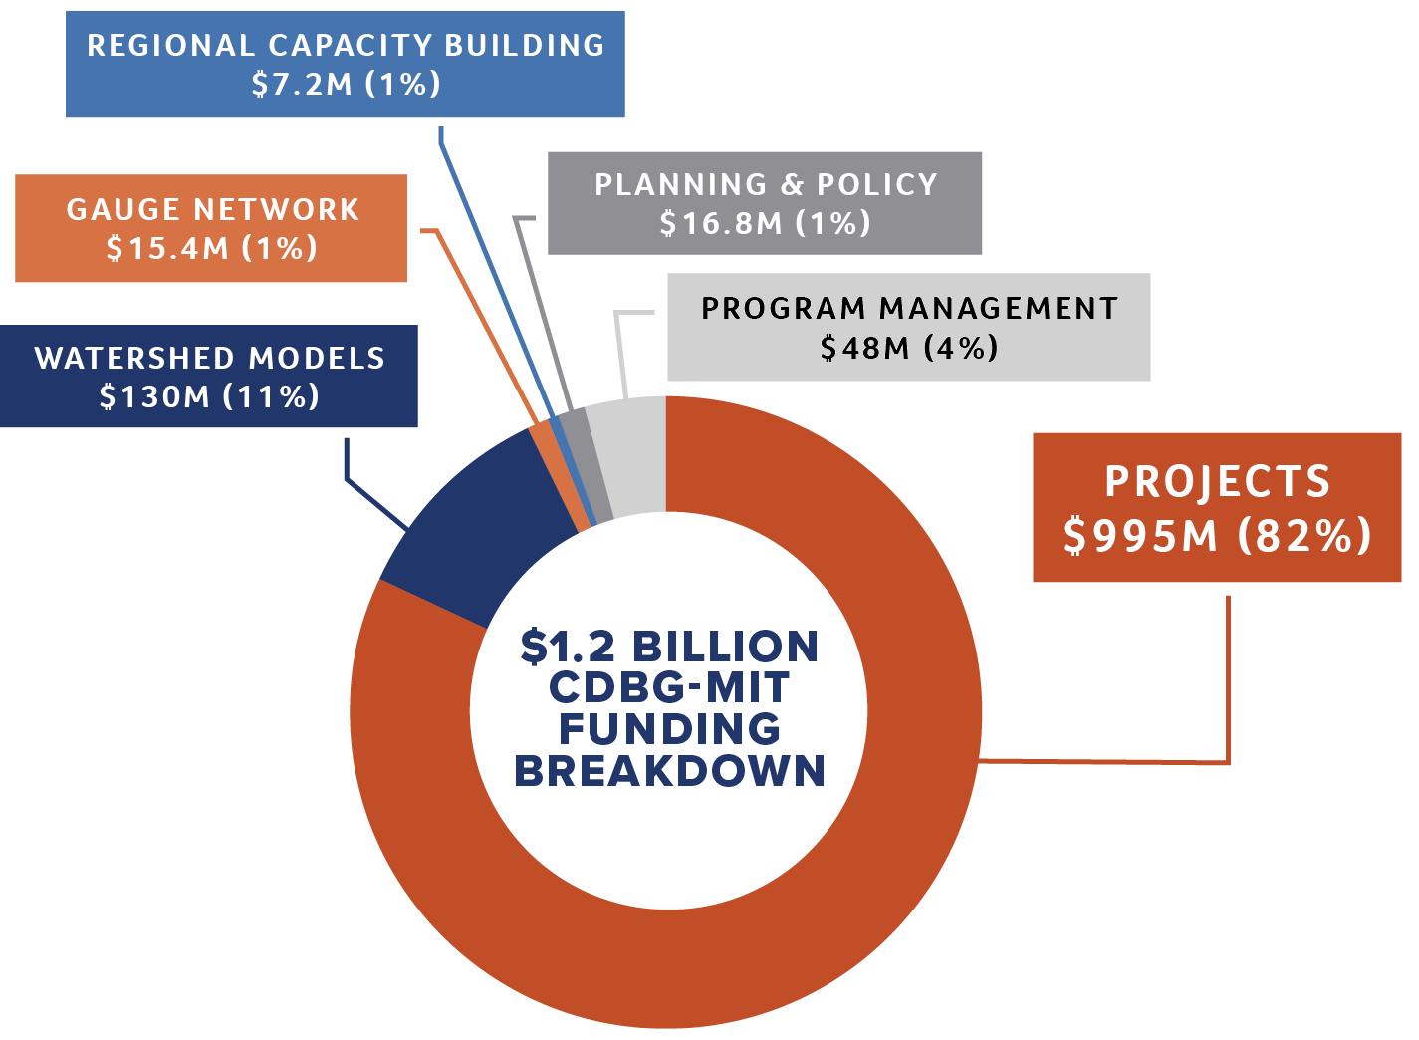
Louisiana Watershed Initiative Update
Budgeted Funding
In 2019, the federal government allocated a $1.2 billion flood mitigation grant to Louisiana—providing an unprecedented opportunity to expedite LWI efforts.
Guided by a federally approved Action Plan, the funds support planning, regional capacity building, data collection, modeling and projects focused on reducing flood risk statewide.

Slide 20
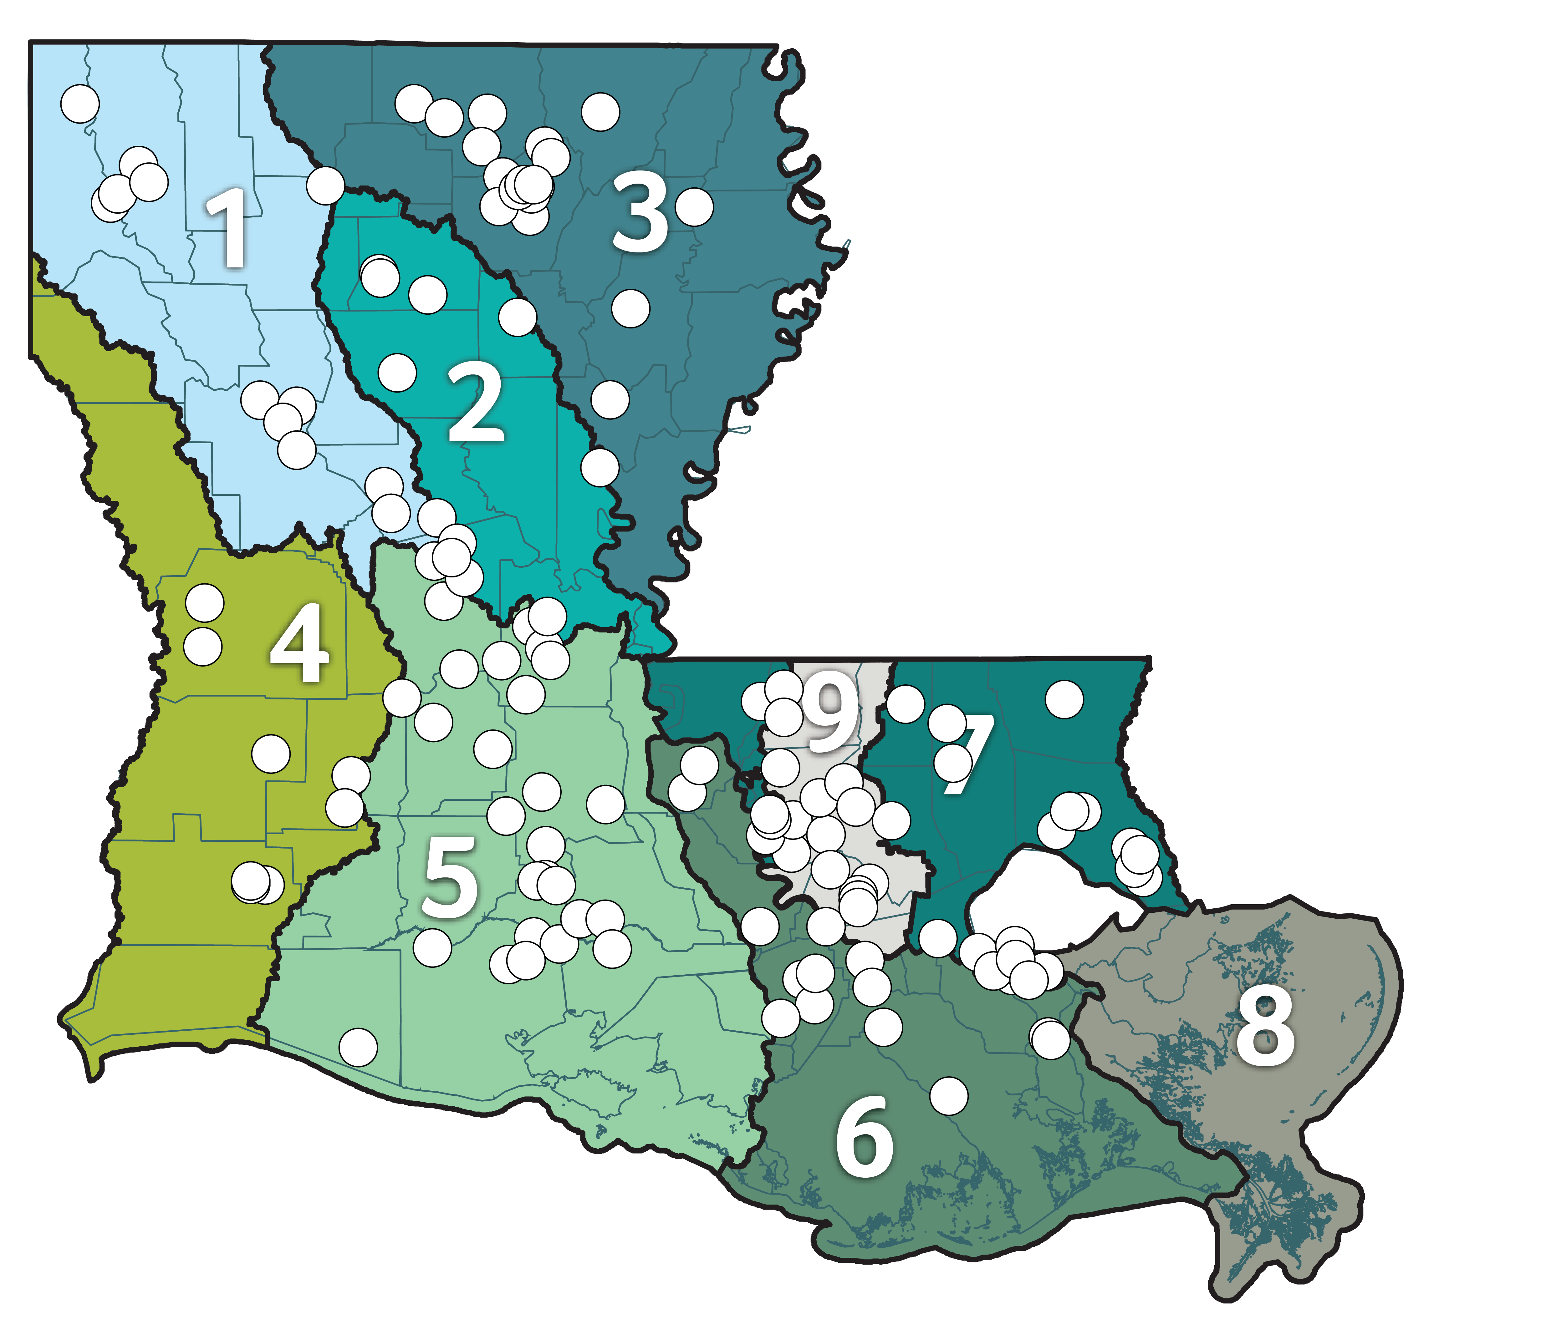
LWI Update
127 Projects Awarded Funding
The state dedicated funding to 127 projects through LWI programs including State Projects and Programs, Local and Regional Projects (Round 1, Round 2 and Design Support Program), and Non-Federal Cost Share Program (HMGP).

Slide 21
LWI Guiding Principles
The state launched LWI in 2018 guided by four key principles:
Using scientific tools and data
Maximizing the natural function of floodplains
Enabling transparent, objective decision-making
Establishing regional, watershed-based management of flood risk

Slide 22
Application
Using scientific tools and data
Enabling transparent, objective decision-making
Worked with technical experts, federal partners, academic institutions and local stakeholders to create seven regional models of Louisiana’s watershed
Allocated $15M to install a river and rain gauge network to provide enhanced statewide coverage in the real time and support the development of Louisiana’s watershed models
Utilized regional steering committees and stakeholder engagement to drive project prioritization
Required quantified project benefits and impacts for project selection for CDBG-MIT funding
Continued to develop tools, such as the LWI models, to support this goal

Slide 23
Application
Maximizing the natural function of floodplains
Establishing regional, watershed-based management of flood risk
Funded projects that harness natural features to reduce flood risk
Provided training and technical resources to advance understanding and adoption of nature-based solutions
Supported the development of the NBS Tool to quantify benefits and measure performance on our natural environment
Provided regional capacity building grants designed to help the state’s nine watershed regions build capacity for regional watershed management
Collected regional steering committees recommendations to guide long-term regional watershed management and create a statewide framework for flood risk reduction
Continuously examining and supporting strategies for funding watershed management and flood risk reduction

Slide 24
Future Focus
Integrate models into state operations
Create a data sharing and mitigation database to inform development and relocation decision making
Support floodplain management at the state and regional levels (leverage CRS crediting activities, support training and education of floodplain managers, work with FEMA to leverage model outputs as needed into mapping program)
Prioritize areas for non-structural programs with input from all stakeholders
Continued outreach and engagement (flood tools to evaluate risk, application of federal elevation requirements, integrate models into local planning efforts and regulations)

Slide 25
 | PROJECT NAME | AWARD | PARISH
REGION 1 | Black Bayou Structure Hardening and Runoff Retention Improvements | $6.6 million | Caddo Parish
 | Ockley Basin Storage Project | $5.36 million | Caddo Parish
 | Foxskin Bayou Drainage Improvements | $2.27 million | Bossier Parish
 | East Natchitoches Drainage Improvements | $3.43 million | Natchitoches Parish
 | Iatt Lake Drawdown Improvements | $1.1 million | Grant Parish
 | Sugarhouse Bayou Outfall | $1.48 million | Grant Parish
 | Clarence Drainage Improvements | $2.01 million | Natchitoches Parish
 | Natchez Drainage Improvements | $1.03 million | Natchitoches Parish
 | South Natchitoches Drainage Improvements | $3.16 million | Natchitoches Parish
 | Hazel Street Flood Mitigation | $4.76 million | Bienville Parish
 | Espanita Drainage Improvements | $1.72 million | Bossier Parish
 | Bardot Drainage Basin Improvements | $2.3 million | Bossier Parish
 | PROJECT NAME | AWARD | PARISH
REGION 3 | West Monroe Buyout Program | $10 million | Ouachita Parish
 | Portable Pumps Parishwide | $2.68 million | Ouachita Parish
 | Youngs Bayou Detention Pond | $2.68 million | Ouachita Parish
 | Georgia Street Pump Station | $500,000 | Ouachita Parish
 | Turkey Creek Retention Improvements and Critical Infrastructure Hardening | $10.32 million | Franklin Parish
 | Ash Slough Drainage Improvements | $3.87 million | Franklin Parish
 | Cypress Detention (South) | $1.08 million | Ouachita Parish
 | Gulley Street Drainage | $1.22 million | Union Parish
 | Highway 33 Ditch Hardening | $2.19 million | Union Parish
 | James Addition Drainage | $1.43 million | Union Parish
 | Salter Street Stormwater Retention | $2.9 million | Richland Parish
 | Staulkinghead Creek Rehabilitation | $4.86 million | Morehouse Parish
 | West Parkview Drainage Improvements | $3.25 million | Ouachita Parish
 | Monroe Regional Airport Offsite Drainage Improvements | $13.19 million | Ouachita Parish
 | New Black Bayou Stormwater Pumping Station | $10 million | Ouachita Parish
 | Black Bayou Canal Drainage Improvements | $2.9 million | Ouachita Parish
 | Georgia Street Pump Station | $2.7 million | Ouachita Parish
 | Oregon Trail Floodwall | $1.39 million | Ouachita Parish
 | River Styx Pump Station | $2.45 million | Ouachita Parish
 | PROJECT NAME | AWARD | PARISH
REGION 5 | Mermentau Basin Inundation Relief Project | $25.4 million | Cameron and Vermilion parishes
 | Cypress Bayou and Coulee LaSalle Drainage Improvements | $1 million | St. Martin Parish
 | Abbeville Area Vermilion River Bridge Debris Barrier System | $550,000 | Vermilion Parish
 | Victoria Acres Buyout Program | $10 million | Vermilion Parish
 | Scott Buyout Program | $7 million | Lafayette Parish
 | Coulee Mine East Detention Project | $4.73 million | Lafayette Parish
 | Church Point Detention and Flood Proofing | $2.94 million | Acadia Parish
 | Anslem Coulee Regional Detention Pond | $5.75 million | Lafayette Parish
 | East Side Drainage Improvements (Bunkie) | $3.79 million | Avoyelles Parish
 | East Side Drainage Improvements (Hessmer) | $2.24 million | Avoyelles Parish
 | Fullers Park Drainage Improvements | $6.07 million | Allen Parish
 | Oak Park Drainage Improvements | $8.5 million | Allen Parish
 | West Side Drainage Improvements | $2.79 million | Avoyelles Parish
 | Chatlin Lake Canal Backwater Overflow Relief Structure | $10 million | Rapides Parish
 | Horseshoe Canal Hardening | $1.91 million | Rapides Parish
 | LSU Alexandria Drainage Improvements | $3.45 million | Rapides Parish
 | Bayou Cocodrie Runoff Retention and Critical Infrastructure Improvements | $2.2 million | Rapides and Evangeline parishes
 | Bayou Lacombe Channel Improvements | $6.6 million | Avoyelles Parish
 | Three Mile Lake Backwater Flood Reduction | $3.03 million | St. Landry Parish
 | Gueydan Flood Protection | $1.17 million | Vermilion Parish
 | Brown Park Floodplain Restoration and Preservation Project | $4 million | Lafayette Parish
 | Youngs Coulee Flood Control Structure | $10 million | Vermilion Parish
 | St. Landry Parish Waterways Management | $5.5 million | St. Landry Parish
 | Ville Platte Detention Ponds | $4.6 million | Evangeline Parish
 | Rue de Belier Detention Pond | $2.81 million | Lafayette Parish
 | Cottonport Drainage Improvements | $5.75 million | Avoyelles Parish
 | St. Martinville Wastewater Floodproofing | $4.25 million | St. Martin Parish
 | Monterey Street Detention Pond | $3.1 million | Iberia Parish
 | PROJECT NAME | AWARD | PARISH
REGION 2 | Huffman Creek Pump Station and Outfall Improvements | $6.95 million | Rapides Parish
 | Drainage Crossing Replacements | $4.1 million | Rapides Parish
 | Bayou Lacombe Channel Improvements | $6.6 million | Avoyelles Parish
 | Caney Lake Flood Surcharge Management | $2.8 million | Jackson Parish
 | Glenn Ditch Pumping Station | $1.99 million | Catahoula Parish
 | Hodge Drainage Improvements | $1.46 million | Jackson Parish
 | Columbian Sherman Lake Flood Storage | $5.83 million | Caldwell Parish
 | Jonesboro Drainage Improvements | $1 million | Jackson Parish
 | Port de Luce Creek Project | $7.55 million | Winn Parish
 | Bayou Pierite Drainage Improvements | $5 million | Avoyelles Parish
 | Smithville Drainage Improvements | $1.42 million | Rapides Parish
 | PROJECT NAME | AWARD | PARISH
REGION 4 | Mermentau Basin Inundation Relief Project | $25.4 million | Cameron and Vermilion parishes
 | Greinwich Terrace Buyout Program | $30 million | Calcasieu Parish
 | Coushatta Casino Resort Wastewater Treatment Plant Floodwall | $1.2 million | Allen Parish
 | Bundick Lake Flood Surcharge Management | $12.96 million | Beauregard Parish
 | Anacoco Creek Watershed Improvements | $14.39 million | Vernon Parish
 | Replacement of Ball Park Lift Station | $630,900 | Vernon Parish
 | Nixon Addition Drainage Improvements | $3.5 million | Allen Parish
 | Greinwich Terrace Stormwater Management Project | $11.85 million | Calcasieu Parish
 | 6th Street Drainage Improvements | $3.15 million | Calcasieu Parish

Slide 26
 | PROJECT NAME | AWARD | PARISH
REGION 6 | Upper Terrebonne Basin Drainage | $9.5 million | Pointe Coupee Parish
 | Maringouin Drainage Improvements | $791,400 | Iberville Parish
 | White Castle Canal Drainage Improvement Project | $2.56 million | Iberville Parish
 | Bonadona-Cataldo Drainage Pump | $1.4 million | Ascension Parish
 | Bayou Lafourche Pump Project | $2.07 million | Ascension Parish
 | Cancienne Canal Floodplain Preservation | $3.7 million | Assumption Parish
 | Parishwide Drainage Improvements | $823,790 | St. James Parish
 | New Pump Station Construction | $1.5 million | Lafourche Parish
 | Emergency Backup Pumps for Pump Stations | $1.9 million | Lafourche Parish
 | Bayou St. Vincent Dredging Project | $9.08 million | Assumption Parish
 | Bayou Verret Drainage Improvements | $5 million | Ascension Parish
 | PROJECT NAME | AWARD | PARISH
REGION 8 | Ormond Area Flood Mitigation Project | $6.31 million | St. Charles Parish
 | Fairfield and Oakland Pump Station Upgrades | $5.77 million | St. Charles Parish
 | Turtle Pond Pump Station Upgrades | $9.23 million | St. Charles Parish
 | PROJECT NAME | AWARD | PARISH
REGION 9 | Ward Creek Floodplain Acquisition | $5.7 million | East Baton Rouge Parish
 | Bayou Duplantier Floodplain Acquisition | $8.5 million | East Baton Rouge Parish
 | Jones Creek Detention Improvements | $6 million | East Baton Rouge Parish
 | University Lakes Flood Risk Reduction Project | $10 million | East Baton Rouge Parish
 | Cypress Bayou Green Infrastructure | $4.69 million | East Baton Rouge Parish
 | Dawson Creek Drainage Improvements | $8.26 million | East Baton Rouge Parish
 | Spring Park Buyout Program | $10 million | Livingston Parish
 | Livingston Parish Drainage Improvements | $15 million | Livingston Parish
 | La. Hwy. 22 Bridge Construction and Drainage Improvements | $41.7 million | Ascension and Livingston parishes
 | Taylor Bayou Regional Improvements | $8.85 million | Livingston Parish
 | John Leblanc Detention Improvements | $536,232 | Ascension Parish
 | Lower Bayou Conway Drainage Improvements | $1.92 million | Ascension Parish
 | Clearing and Snagging in East Feliciana South of Highway 10 | $13.2 million | East Feliciana Parish
 | Clearing and Snagging in East Feliciana North of Highway 10 | $13.73 million | East Feliciana Parish
 | Conway Bayou Pump Station Upgrade | $6.39 million | Ascension Parish
 | Groom Road Storm System Improvements | $11.6 million | East Baton Rouge Parish
 | Airline Highway Park Recreation Center Safe Room -BREC | $12.9 million | East Baton Rouge Parish
 | Marvin Braud Pump Station Protection Levee Elevation and Upgrades | $13.98 million | Ascension Parish
 | Memorial Sports Complex Safe Room | $11.6 million | East Baton Rouge Parish
 | Ward Creek Detention Project | $30.8 million | East Baton Rouge Parish
 | Livingston Parish Drainage Improvements Project | $24.5 million | Livingston Parish
 | PROJECT NAME | AWARD | PARISH
REGION 7 | Washington Parish Buyout Program | $10 million | Washington Parish
 | St. Tammany Parish Buyout Program | $10 million | St. Tammany Parish
 | Livingston Parish Drainage Improvements | $15 million | Livingston Parish
 | Lee Street Drainage Pump Station Hardening | $2.36 million | St. Tammany Parish
 | Dellwood Drainage Pump Station Hardening | $4.01 million | St. Tammany Parish
 | Covington Lift Station Panel Elevations | $2.61 million | St. Tammany Parish
 | Jones Vaughn Creek Bridge | $3.28 million | West Feliciana Parish
 | Little Natalbany Drainage Improvements | $5.46 million | St. Helena Parish
 | Hano Road Area Retention Pond | $3.5 million | St. Helena Parish
 | Bayou Patassat Flood Mitigation Improvements | $10.57 million | St. Tammany Parish
 | Stormwater Detention Pond in W-14 Basin West Diversion East | $3.51 million | St. Tammany Parish
 | Alton Neighborhood Drainage Improvements | $500,000 | St. Tammany Parish
 | Greensburg Wastewater Treatment System | $3.81 million | St. Helena Parish
 | Spring Park Buyout Program | $10 million | Livingston Parish
 | Reserve Relief Homewood Pump Station Replacement and Drainage Improvement Project | $14 million | St. John the Baptist Parish
 | Drainage Improvements in Tickfaw and Maurepas Watersheds | $4 million | Tangipahoa Parish
 | Floodplain Restoration and Preservation | $21 million | Tangipahoa Parish
 | Livingston Parish Drainage Improvements Project | $24.5 million | Livingston Parish

Slide 27
LWI Funding by Parish
PARISH | AWARD TOTAL
ACADIA | $2.94M
ALLEN | $19.33M
ASCENSION & LIVINGSTON | $73.01M
ASCENSION
ASSUMPTION | $12.79M
AVOYELLES | $26.2M
BEAUREGARD | $12.96M
BIENVILLE | $4.77M
BOSSIER | $6.30M
CADDO | $12.04M
CALCASIEU | $45M
CALDWELL | $5.83M
CATAHOULA | $2M
EAST BATON ROUGE | $110.11M
EAST FELICIANA | $26.94M
PARISH | AWARD TOTAL
EVANGELINE | $4.60M
FRANKLIN | $14.20M
GRANT | $2.62M
IBERIA | $3.11M
IBERVILLE | $3.36M
JACKSON | $5.27M
LAFAYETTE | $24.29M
LAFOURCHE | $3.40M
LIVINGSTON | $58.34M
MOREHOUSE | $4.86M
NATCHITOCHES | $10.52M
OUACHITA | $52.90M
POINTE COUPEE | $9.50M
RAPIDES | $30.08M
REGION 9 | $100M
PARISH | AWARD TOTAL
RICHLAND | $2.90M
ST. CHARLES | $21.31M
ST. HELENA | $12.78M
ST. JAMES | $823,790
ST. JOHN THE BAPTIST | $14M
ST. LANDRY | $8.53M
ST. MARTIN | $5.26M
ST. TAMMANY | $33.58M
TANGIPAHOA | $25M
UNION | $4.84M
VERMILION | $21.72M
VERNON | $15.03M
WASHINGTON | $10M
WEST FELICIANA | $3.28M
WINN | $7.55M

Slide 28
LWI Funding by Region
REGION | AWARD TOTAL
1 | $36M
2 | $38M
3 | $80M
4 | $103M
5 | $124M
6 | $38M
7 | $99M
8 | $21M
9 | $363M

Slide 29
Discussion/Questions

Slide 30
Thank you!
Gina Campo | Executive Director

