Slide 1
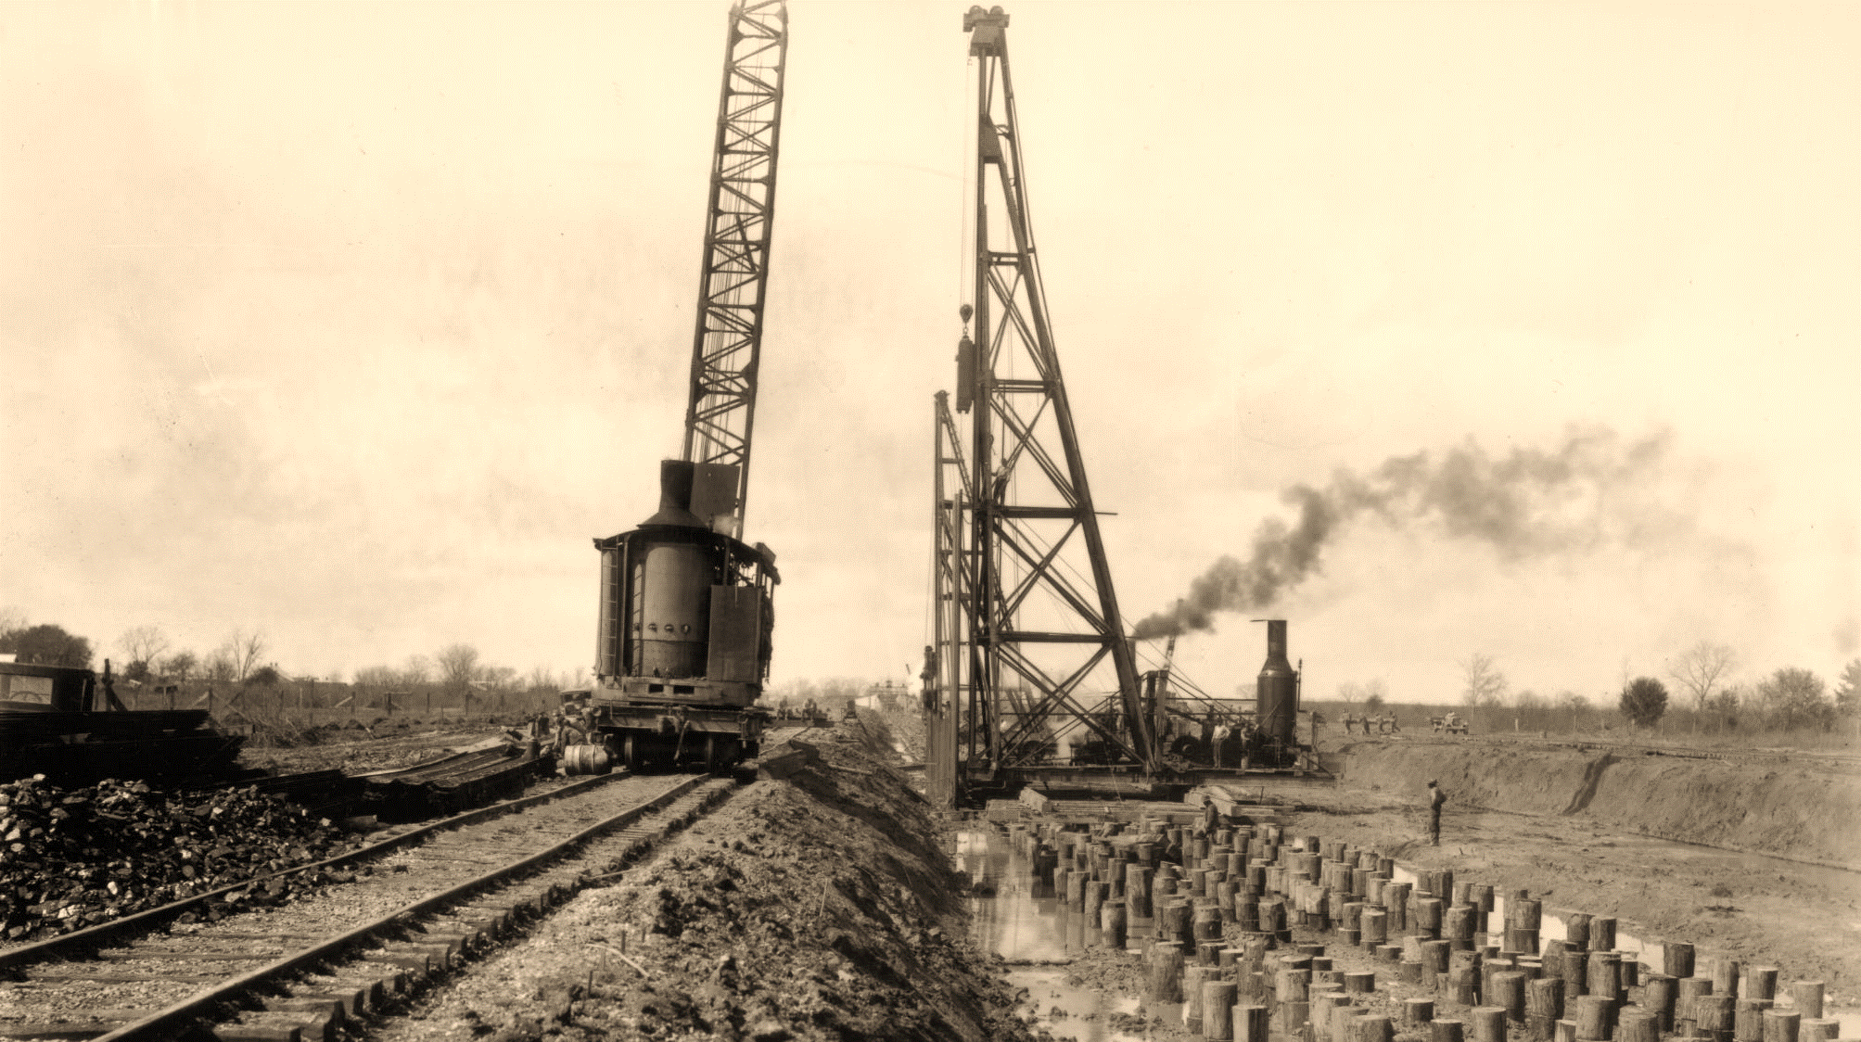
ASSOCIATION OF LEVEE BOARDS OF LOUISIANA
New Orleans District Update
COL Cullen Jones, P.E. PMP
1 MAY 2025

Slide 2
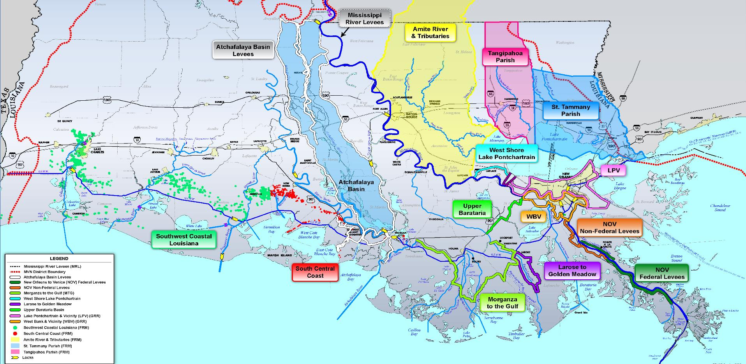
USACE NEW ORLEANS DISTRICT FLOOD RISK MANAGEMENT
REDUCING RISK THROUGHOUT SOUTH LOUISIANA
Eight FRM systems in active construction
Three undergoing feature design
Two active FRM studies
Two resiliency GRR studies underway
Notes:
Every day, we are working to improve or add this critical infrastructure in South Louisiana. I have used this map in the past because it not only shows the work we have in place and underway from heel to toe, but also underscores all of the areas that are subject to a source or multiple sources of flooding. When we look at flood risk management, we don’t recommend action if there is not a need for the action.
Today, we have 8 systems under construction, from the structural approach of Morganza to the Gulf to the non-structural efforts in Southwest Louisiana to the combination of both that will comprise the West Shore Lake Pontchartrain hurricane and storm damage risk reduction system. Three more systems, Upper Barataria, Lake Pontchartrain and Vicinity and the West Bank and Vicinity polders are either in or will soon be in design.
I will provide more detail on some of these shortly, but first I would like to share insight into the current response effort we are all currently engaged in, the region’s high rivers.

Slide 3
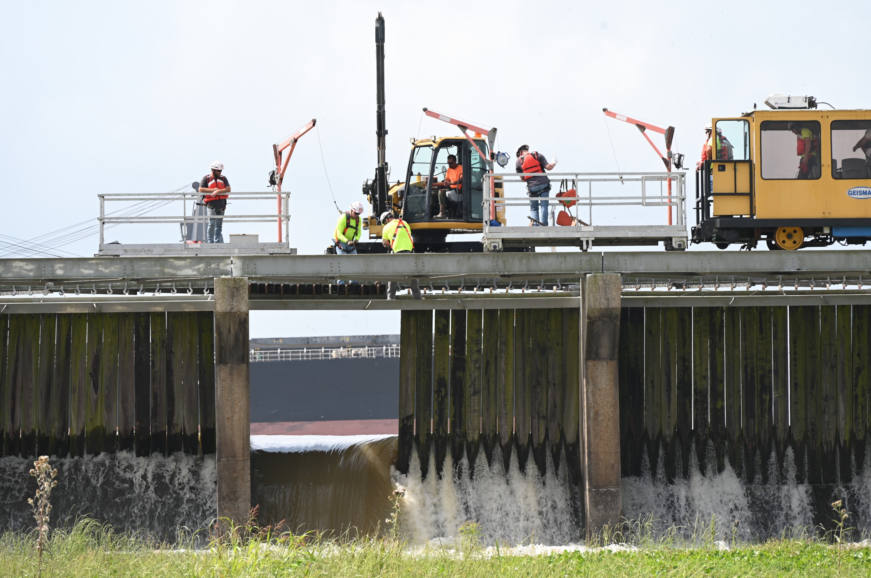
USACE NEW ORLEANS DISTRICT FLOOD RISK MANAGEMENT
2025 MISSISSIPPI RIVER HIGH WATER
IN PARTNERSHIP WITH RRABB, EBR, SLFPA-E & W, PLD, SMLD, ABLD, LBLD, & PPG
Phase I activated on FEB 24 and again on APR 14, 2025.
Phase II activated on APR 23, 2025.
Bonnet Carre’ Spillway is no longer forecasted
Anticipate passing just below the operational trigger
Highest mainstem flows since 2020
Notes:
The Carrollton Gage on the New Orleans District Campus is probably the most known of our trigger points for the Mississippi River. This year, we are seeing water levels not experienced since 2020. Since my assumption of command in late 2022, we have not had a year that reached 15 feet at the Carrollton Gage. Fortunately, we are no longer forecasted of reaching our operational trigger for the Bonnet Carre’ Spillway of 1.25 million cubic feet per second.
As I mentioned a few minutes ago, you must have a team of teams and infrastructure to successfully defend against flood event. Thanks to your work throughout the year, our system is in great shape. The daily levee inspections have not identified any areas of high or even medium concern. This is a testament to the year-round dedication of good aggressive maintenance of the levee system.
While it is good news that Bonnet Carre’ is not required for this event, we will remain in flood fight status through the first three weeks of May, with the possibility of more rain in the future. Once the river falls, we will shift to conducting damage assessments to ensure the system is ready to defend against the next crest.

Slide 4
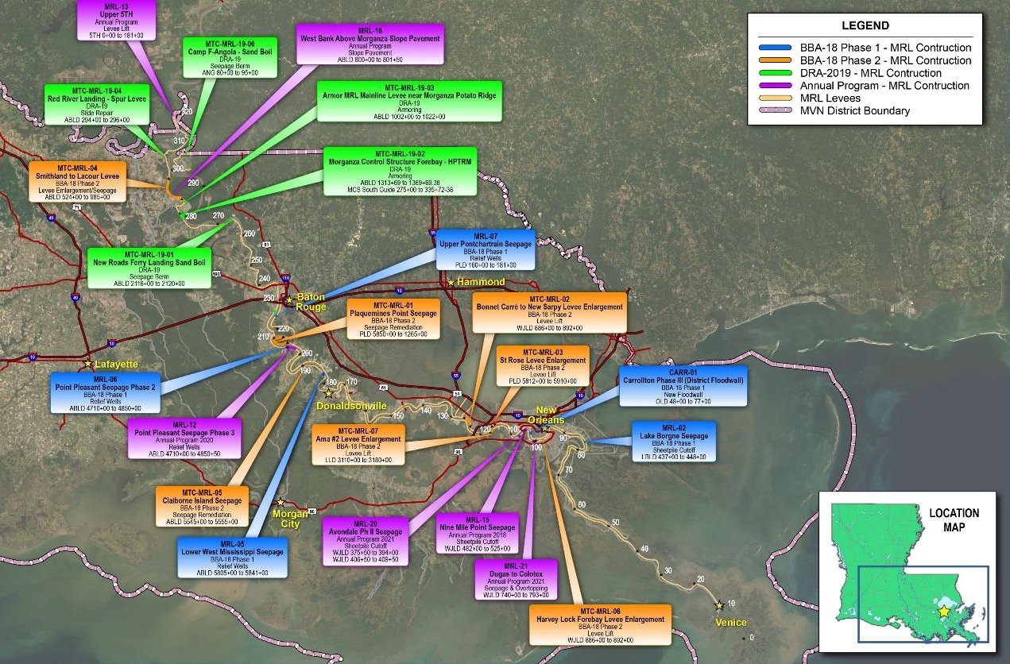
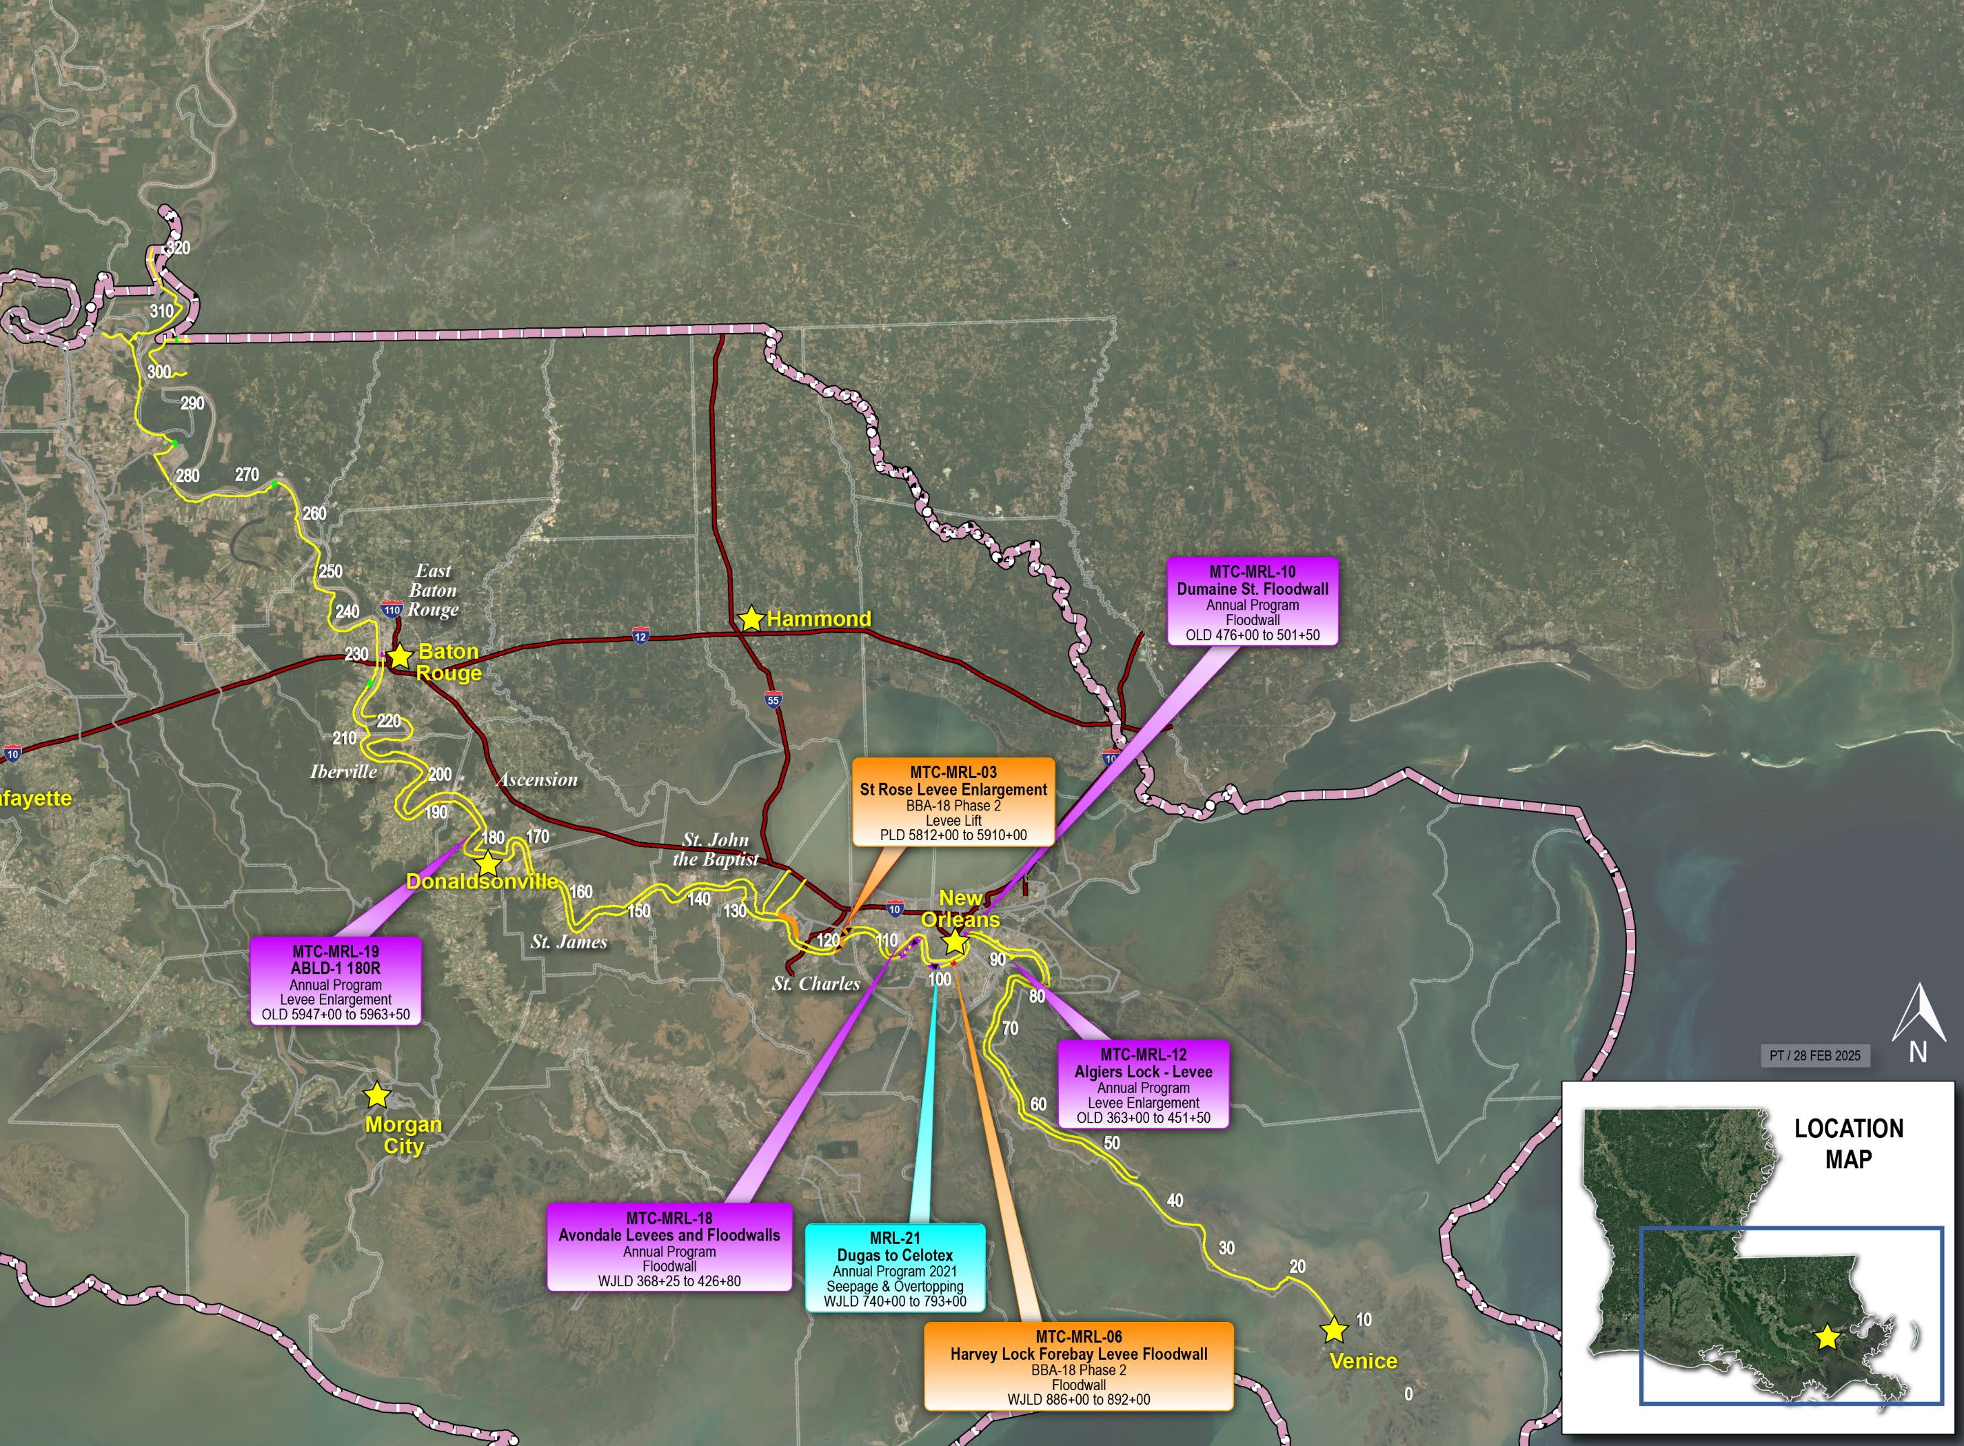
USACE NEW ORLEANS DISTRICT FLOOD RISK MANAGEMENT
MISSISSIPPI RIVER AND TRIBUTARIES LEVEE SYSTEM
IN PARTNERSHIP WITH RRABB, EBR, SLFPA-E & W, PLD, SMLD, ABLD, LBLD, & PPG
DECEMBER 2022
MAY 2025
$114 IN PREVENTED DAMAGE FOR EVERY FEDERAL $1 TOWARD CONSTRUCTION, OPERATION AND MAINTENANCE

Slide 5
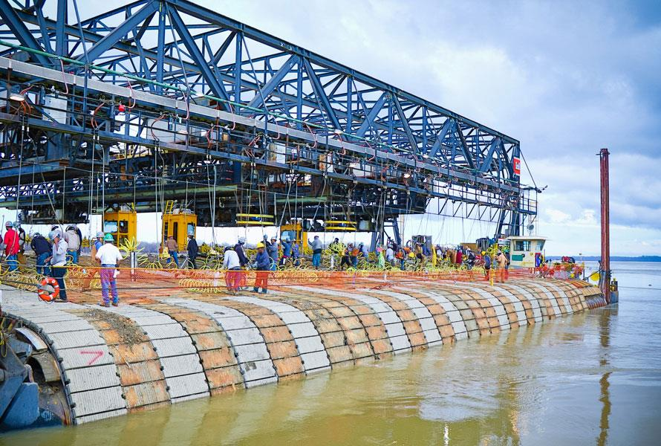
USACE NEW ORLEANS DISTRICT FLOOD RISK MANAGEMENT
RIVERBANK/CHANNEL STABILIZATION
Critical to both navigation and flood risk management because of proximity of levee to riverbank
417 miles of riverbank for Miss. and Atchafalaya rivers
Six locations planned for channel improvement during 2025 mat sinking season.

Slide 6
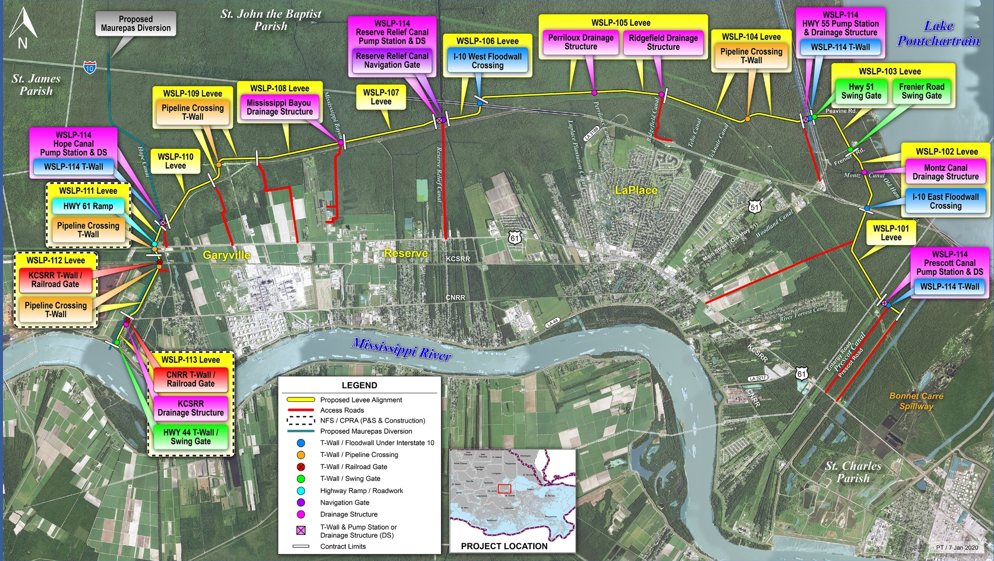
USACE NEW ORLEANS DISTRICT FLOOD RISK MANAGEMENT
WEST SHORE LAKE PONTCHARTRAIN
IN PARTNERSHIP WITH CPRA & PLD
DEC 2022
MAY 2025
Access roads under construction
Pile load test contract issued
Two sand placement contracts
First levee contract out for bid
Access roads complete
11 contracts in construction
First levee contract currently undergoing resilient turf establishment
Resiliency study underway
REDUCING RISK FOR 60,000 SOUTH LOUISIANA RESIDENTS

Slide 7
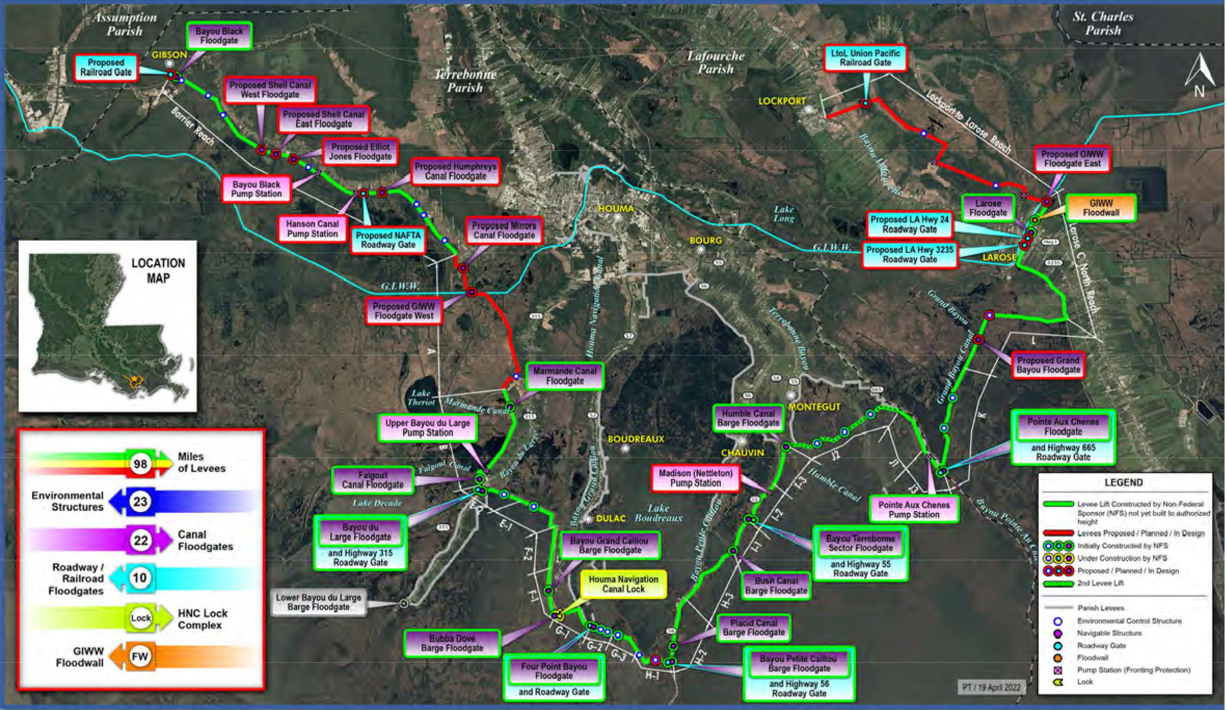
USACE NEW ORLEANS DISTRICT FLOOD RISK MANAGEMENT
MORGANZA TO THE GULF
IN PARTNERSHIP WITH CPRA, TCLD, NLLD & SLLD
DEC 2022
MAY 2025
Humble Canal Preload: First federal construction project broke ground
Humble Canal Preload completed in 2023
19 features in design
Reach A broke ground in OCT. 24 and on schedule
Reach F design to be completed this fiscal year.
SEIS scheduled completion in spring 2026
STATE OF LOUISIANA AND TCLD HAVE SPENT MORE THAN $1 BILLION TO ADVANCE SYSTEM

Slide 8
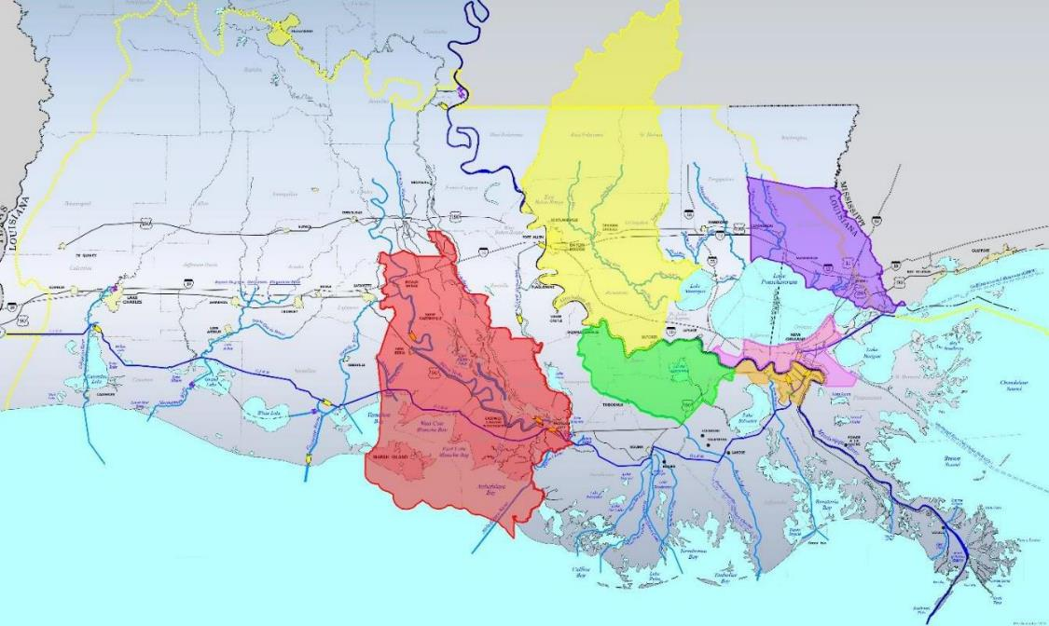
USACE NEW ORLEANS DISTRICT FLOOD RISK MANAGEMENT
FLOOD RISK MANAGEMENT STUDIES
IN PARTNERSHIP WITH CPRA & LADOTD
COMPLETED
South Central Coastal Louisiana
Upper Barataria Basin: Received funding for PED
St. Tammany Parish
LPV and WBV GRRs
NEAR COMPLETION
Amite River and Tributaries
Tangipahoa Parish

Slide 9
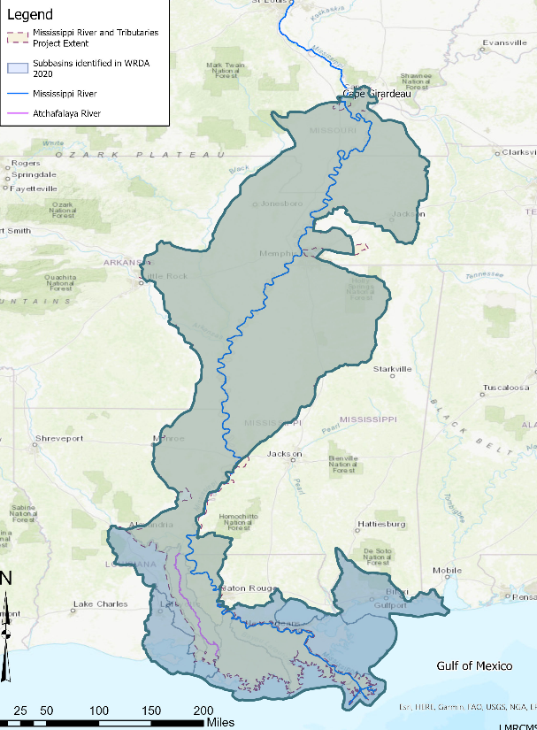
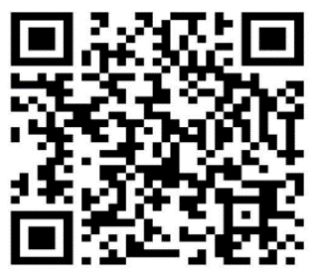
NEW ORLEANS DISTRICT UPDATE
LOWER MISSISSIPPI RIVER COMPREHENSIVE MANAGEMENT
Evaluate alternatives to identify Tentatively Selected Plan.
Prepare and release Draft Integrated Feasibility Report and Environmental document.
Collect and review comments to inform Agency decisions

Slide 10
NEW ORLEANS DISTRICT CHANNELS
FOLLOW FOR THE LATEST NEWS AND EVENTS
www.mvn.usace.army.mil
www.facebook.com/usacenola
www.instagram.com/usace_nola
twitter.com/usacenola
LinkedIn - New Orleans District

