Slide 1
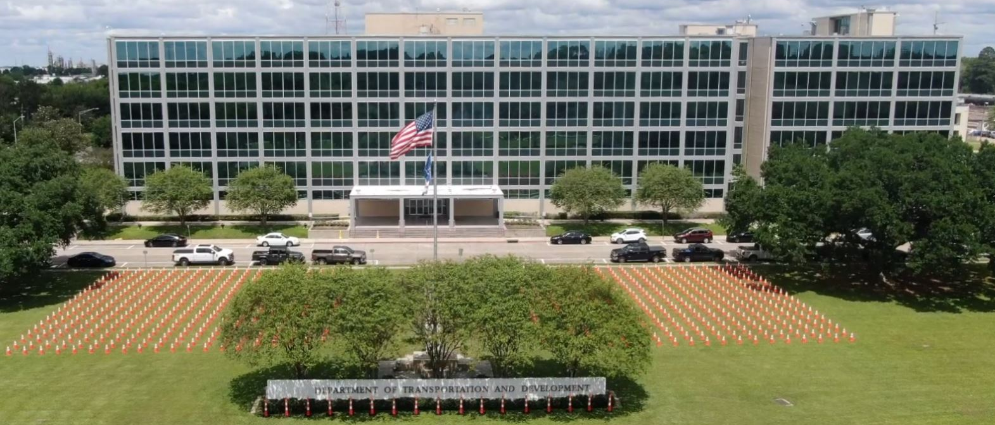
Association of Levee Boards of Louisiana
Billy Williamson
Director of Dams & Levees
May 1, 2024

Slide 2

Today’s Discussion
Levee Safety Program
Dam Safety Program
Louisiana Watershed Initiative
Statewide Flood Control Program
Floodplain Management
Ports & Waterways
Notes:
Hydraulics Section
Louisiana Watershed Initiative
Statewide Flood Control Program
Roadway Flooding Program
Floodplain Management Section
Levee & Dam Safety Section
NEXT SLIDE – Hydraulics

Slide 3
DOTD – Public Works and Water Resources
Mission:
  The mission of Public Works is to develop the potential of Louisiana's water related resources by administering programs and implementing infrastructure projects relating to controlling, developing, conserving and protecting all aspects of the resources.
Notes:
The second D is Public Works and Water Resources
Next Slide: Levee Safety Program

Slide 4
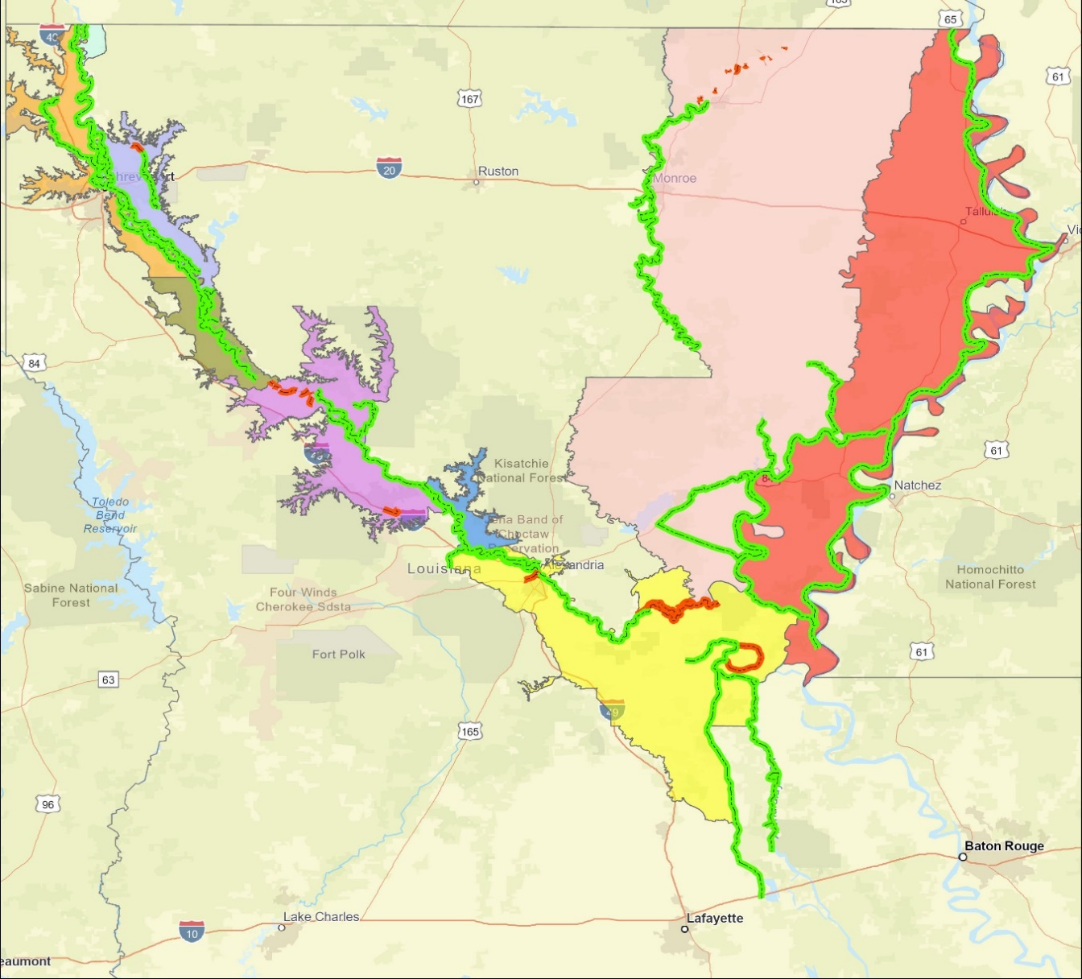
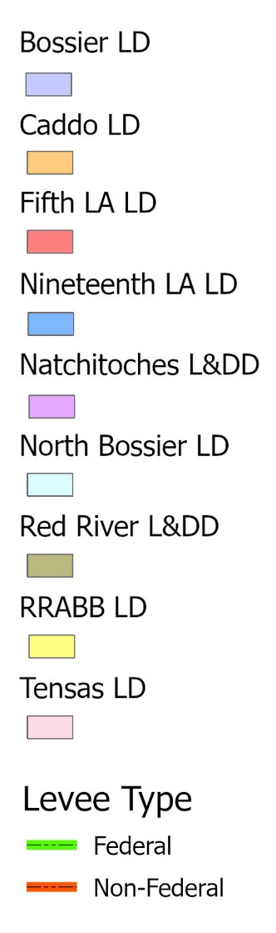
Levee Safety Program
Non-Coastal Levee Districts (9)
Federal 65.1
Non- Federal 4.3
Federal 116.7
Federal 306.3
Federal 26.2
Federal 69.3
Non- Federal 17.5
Federal 3.4
Federal 51.7
Federal 196.7
Non- Federal 55.2
Federal 249.9
Non- Federal 4.7
Notes:
Nine Non-Coastal levee districts
Program inspects about 1,000 miles of levees semi-annually
1085 miles of Federal Levees
81.7 miles of non-federal levees
Next Slide – Levee Safety Current Services

Slide 5
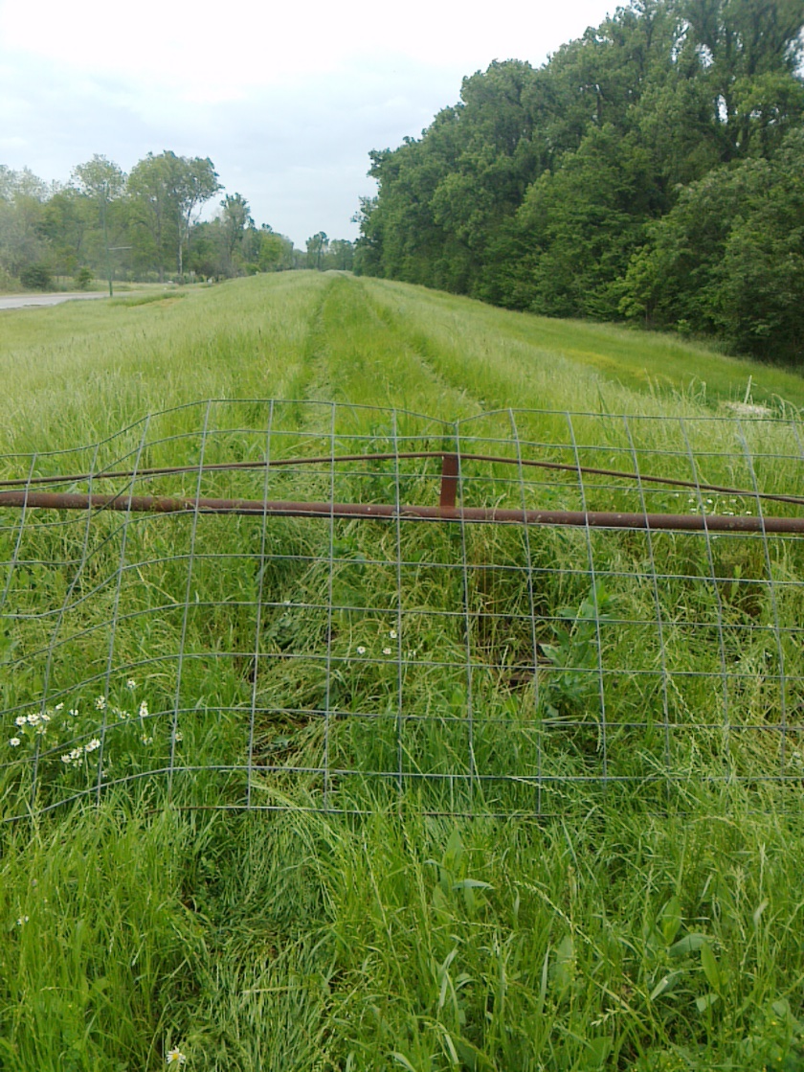
Levee Safety Program
Current Services
Inspections
  Assist Levee Districts with their Inspections
  Provide Semi-Annual Inspection Reports
  Provide Recommendations/Options for Corrective Actions
  Flood inspections / Monitoring
Inventory/Mapping
  Inventory Levee Assets
  Develop GIS Maps
Training Compliance
  Online training for levee inspectors
Notes:
Next Slide: Levee Safety Program Additional Services

Slide 6
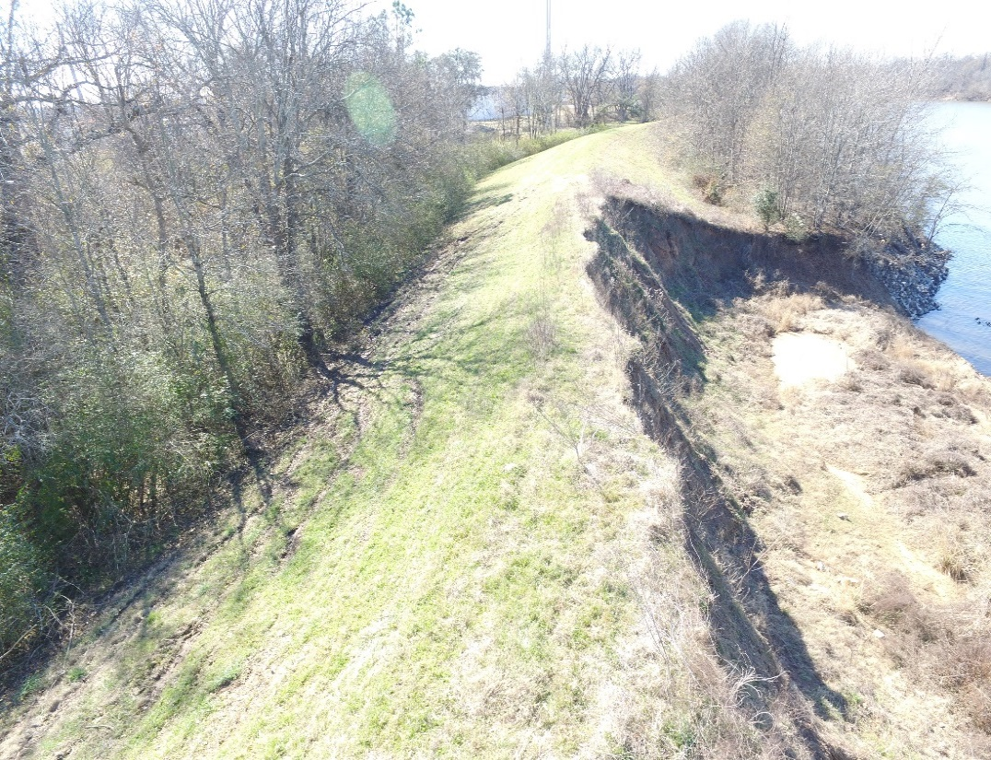
Levee Safety Program
Additional Services
Capital Outlay
  Assist levee districts with funding requests
  Project management
Regulatory Support
  Coordination for certifications
  Stakeholder meetings with USACE
Strategic Planning
  Review of USACE and FEMA guidance documents to identify upcoming requirements
  Interface with resources to determine if legislative activity should be considered
Notes:
NEXT SLIDE – 9 Non-coastal area levee districts

Slide 7
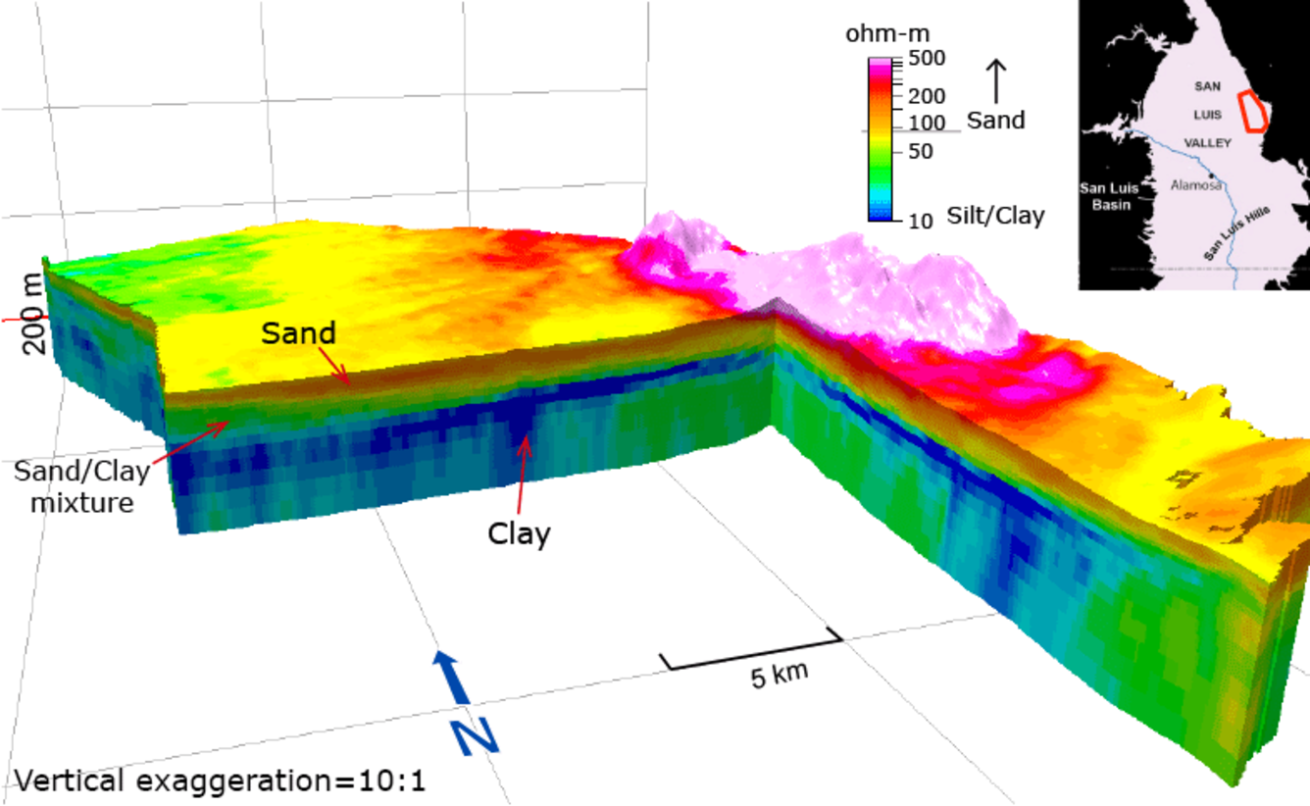
Levee Safety Program
Into the Future
Evaluation of Electromagnetic Geophysics
  Partnership with USGS for ongoing collection
  Identification of Potential Seepage Locations
Levee Centerline Surveys (RTK)
Integration of Drones, Crawlers, and USVs
Notes:
Next Slide: National Levee Safety Program

Slide 8
Levee Safety Program
National Levee Safety Program
Redesigned National Levee Database
New National Levee Safety Guidelines
Integrated Levee Management
  clarifying roles and responsibilities to improve coordination and implementation in order to be more complimentary, streamlined, and effective in managing all levees in the Nation; and
  promoting and encouraging formal levee safety programs at the state level to serve as key integrators with other entities that have levee responsibilities.
Implementation Support
Notes:
An integrated approach to levee safety requires each entity (federal, state, tribes, levee owner/operator, and communities "to understand and fulfill their responsibilities and to do so in coordination with each other". It is envisioned that the lynchpin to success is having states serve in a key integrator role. States have existing legal authorities to implement floodplain management regulations and have long-standing relationships with local governments in areas such as emergency planning and response. Even though federal agencies and tribes can have their own levee safety programs for management of levees within their authorities, their levees still influence watersheds that exist within states.
As part of the legislation for the National Levee Safety Program, Congress envisioned that state levee safety programs would adopt and implement consistent national levee safety practices; be able to receive federal assistance in support of levee safety; carry out public education activities to improve awareness of flood risk; and collect and share levee information using the National Levee Database. In addition, there is opportunity for state levee safety programs to:
Help build capacity in levee owners/operators to inspect, assess, repair, and rehabilitate levees;
Collaborate across programmatic and political jurisdictions to ensure that all levees have adequate oversight; and
Apply services in a fair and equitable way across the landscape with special attention to underserved communities, tribes, and individuals particularly vulnerable to flooding.
Next Slide: Dam Safety Program

Slide 9
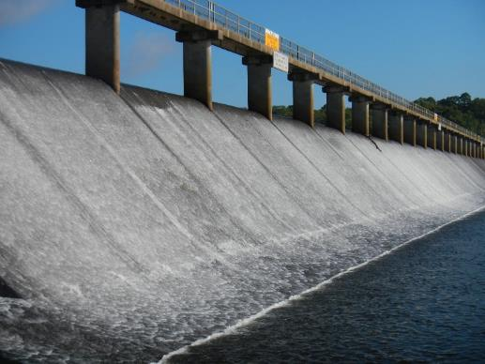
Dam Safety Program
767 Regulated Dams
(As of February 26, 2025)
43 High Hazard
69 Significant Hazard
641 Low Hazard
14 Under Investigation
Impact Classification | Potential Loss of Life | Potential Economic Loss | Inspection Frequency
High | Likely | Excessive | Annually
Significant | Possible | Appreciable | 3 years
Low | Not Likely | Minimal | 5 years
It is the responsibility of the owner/applicant to establish impact classification, and all dams will be considered to be of High Impact potential until demonstrated to be otherwise by a documented analysis provided by the applicant.
Spillway at Bayou D’Arbonne Dam
Union Parish
Notes:
State Dam Safety Program – number of dams has decreased in the last few years by about 30.
NEXT SLIDE – State-maintained dams

Slide 10
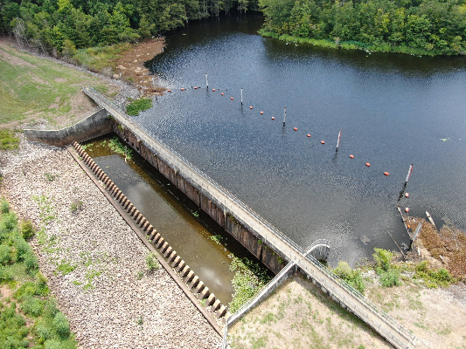
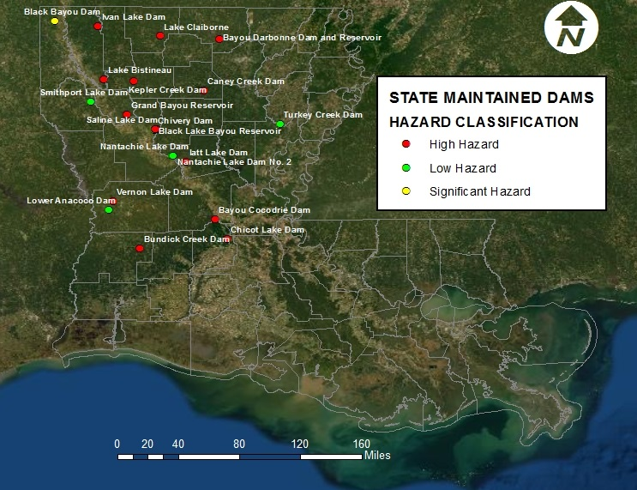
Dam Safety Program
R.S. 38:26: State-Maintained Dams
Spillway at Chicot Lake Dam
Evangeline Parish
21 DOTD Maintained Dams
  13 High Hazard
  2 Significant Hazard
  6 Low Hazard
(All DOTD Maintained dams are inspected annually)
Notes:
Location of 21 Dams that DOTD operates and maintains per statute LA RS 38:26
These dams are inspected annually
NEXT SLIDE – Dams – Mobile Inspection App

Slide 11
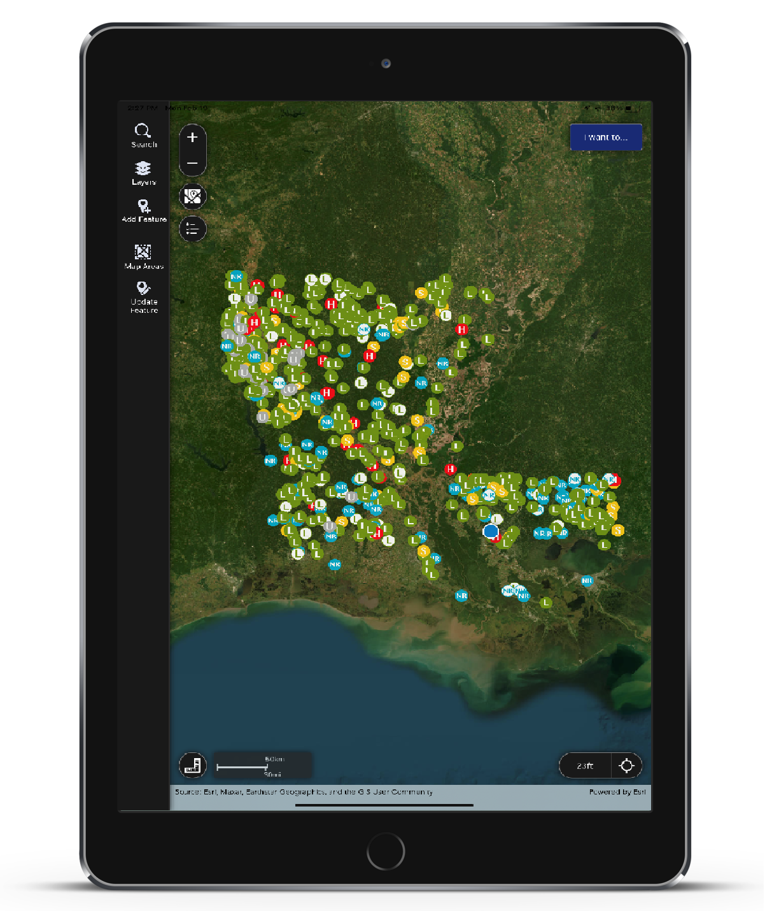
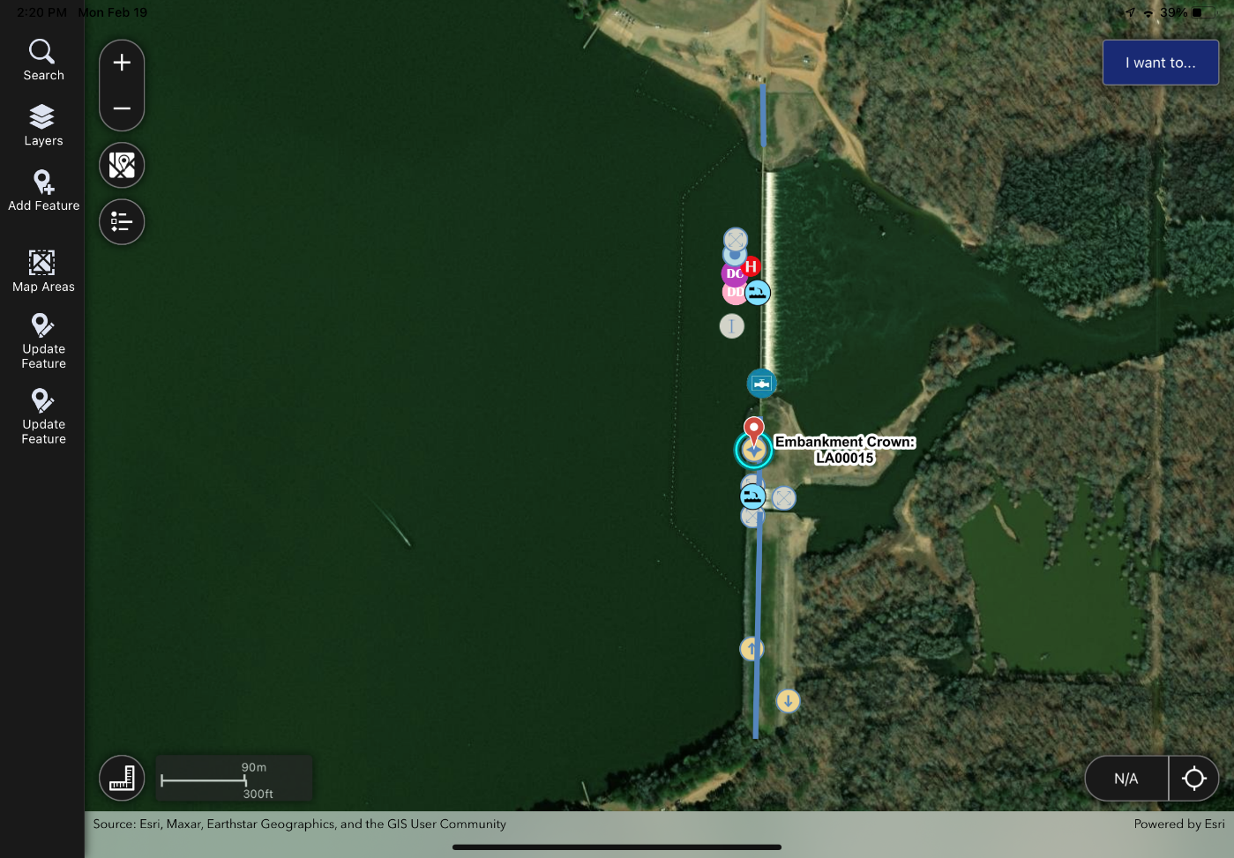
Mobile Dam Inspection App
Notes:
Allows DOTD staff and consultants to seamlessly perform inspections and consolidate inspection data
NEXT SLIDE – State Maintained Dams – Capital Outlay Projects

Slide 12
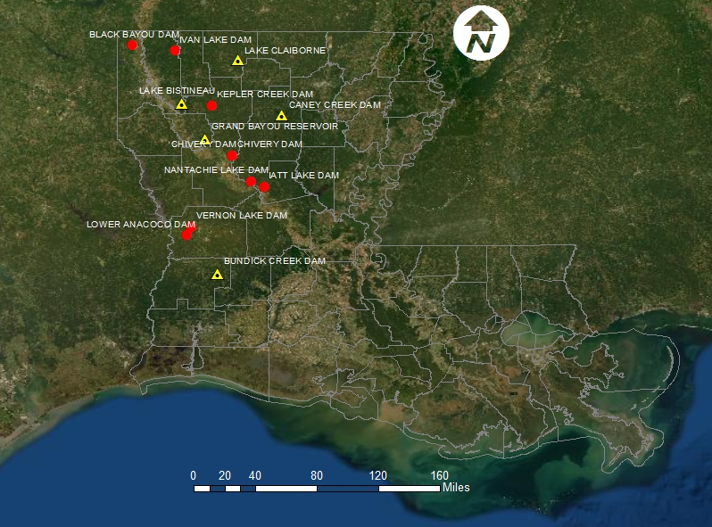
Dam Safety Program
State Maintained Dams – Capital Outlay Projects (13)
Safety Measures Only (8) (signs, boat barriers, fences)
Gate Rehab/Maintenance & Safety Measures (5 Projects)
Total Projects = $2.5 Million
Notes:
Total Capital Outlay $2.5 Million
Safety Measures – warning signs, boater barriers, fences
Bundick Creek Dam repairs and safety improvements is under contract and is scheduled to be completed this spring
Three projects (Lower Annacoco Dam, Vernon Lake Dam & Lake Bistineau) are being designed but safety improvements are planned for all of our state maintained dams
NEXT SLIDE – Drone Program

Slide 13
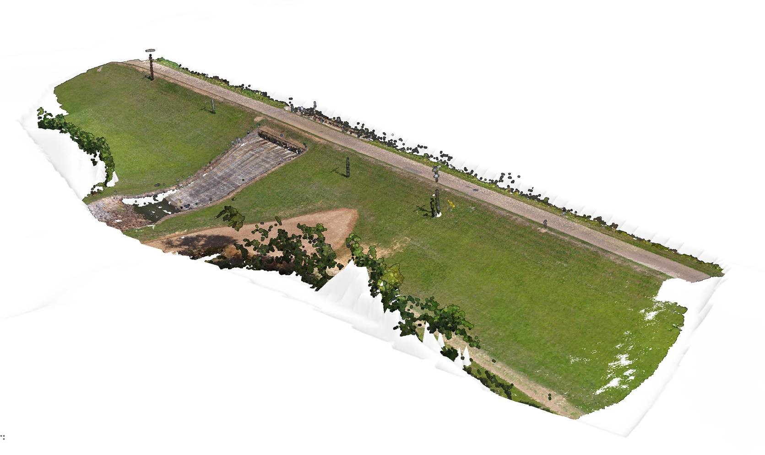
Dam Safety Program
Drone Program
Since January 2023
Skydio X2E
  Photogrammetry
  Thermal Imaging
Limitations:
  1 Drone
  2 Pilots
  LiDAR
  Data Volumes
Notes:
Developing Program
Next Slide: Drone Program – Thermal Evaluation

Slide 14
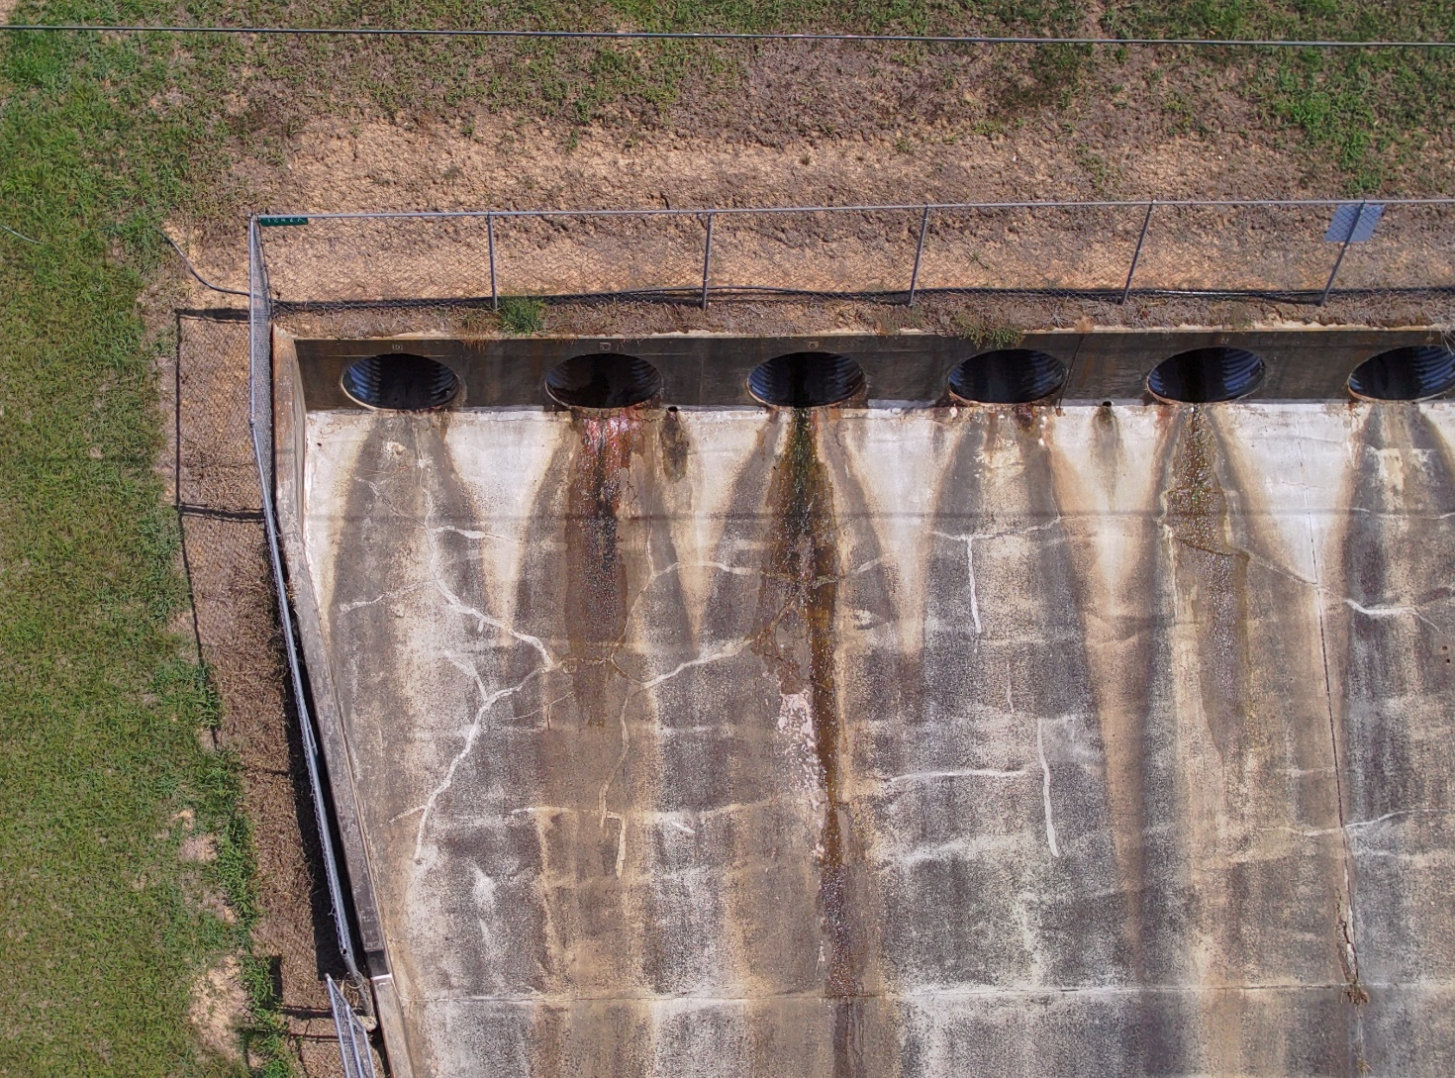
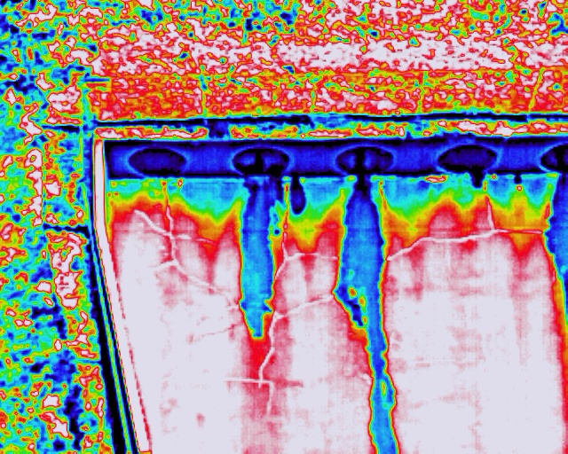
Dam Safety Program
Thermal Evaluation
  Seepage
  Voids
Drone Program
Notes:
Next Slide: Thermal Evaluation continued

Slide 15
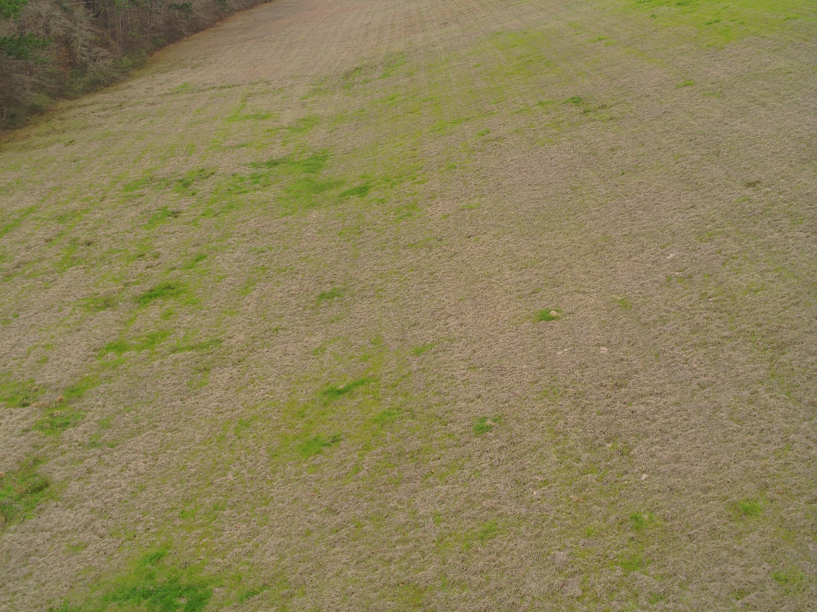

Dam Safety Program
Thermal Evaluation
  Seepage
  Voids
Drone Program
Notes:
Next Slide: Remote Monitoring, Data Collection and Controls

Slide 16
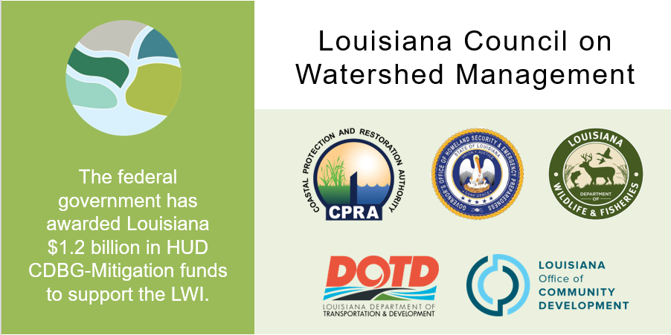
Louisiana Watershed Initiative
The federal government has awarded Louisiana $1.2 billion in HUD CDBG-Mitigation funds to support the LWI.
Notes:
Council on Watershed Management was formed in 2018.
NEXT SLIDE – Watershed Modeling

Slide 17
Louisiana Watershed Initiative
Statewide Watershed Modeling
$94M (Modeling Budget)
HUC8 Models (48 total)
Coupled 1D/2D or Full 2D
Tiered Approach Factors
  Population
  Complexity
  Known Risk
Notes:
All 48 models have been Calibrated and Validated as of 3rd quarter 2024. Probabilistic design storms and consequence modeling is to be delivered by the end of June.
NEXT SLIDE – Statewid Flood Control Program

Slide 18
Statewide Flood Control Program
Background
Created by Act 351 of the 1982 Regular Session
Primary goal is to reduce existing flood damages through an active, innovative approach that considers both structural and non-structural solutions
Funded by Louisiana Transportation Trust Fund
  $20M in total annual program funding
Project applications and funding amounts are approved by the Joint Transportation Committee
Notes:
NEXT SLIDE – Statewide Flood Control Program cont’d
NEXT SLIDE – Flood Control contined

Slide 19
Statewide Flood Control Program
Project Requirements
Must reduce existing flood damages of structures
Does not encourage additional development in flood prone areas
Does not adversely affect upstream or downstream flooding
Must have a construction cost of $100,000 or more
Must be a stand-alone project
Cannot serve the primary purpose of protection against coastal storm surge
Maximum SWFC Participation: $5M per project (New requirement)
Notes:
NEXT SLIDE – Statewide Flood Control Program cont’d
NEXT SLIDE – Flood Control contined

Slide 20
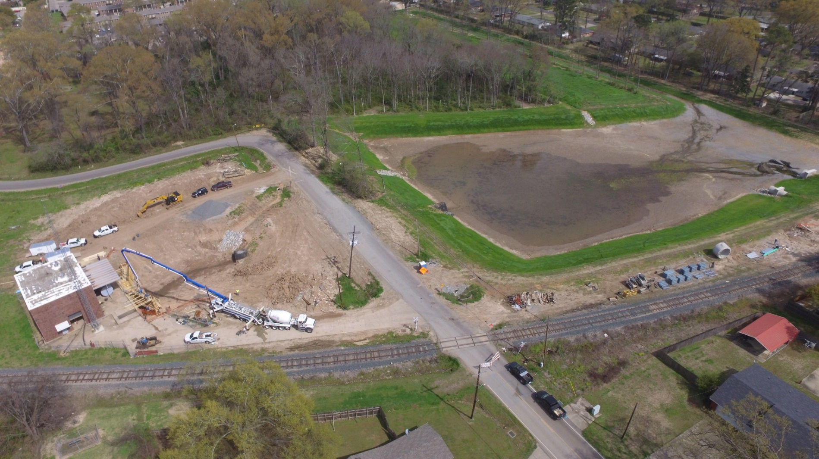
Statewide Flood Control Program
Competitive & Cost-Shared
  Projects are evaluated based on potential damage reduction versus State investment
  Provides up to 90% of the construction cost for non-federal projects
  Provides up to 70% of non-federal participants’ share of federal projects
  Rural Grant Opportunity may eliminate 10% match requirement for parishes with less than 50,000 residents and municipalities less than 5,000 residents
Uniquely structured to ensure:
  Equitable distribution of funds statewide
  All levels of local government can compete successfully
Notes:
NEXT SLIDE – Funding Distribution
NEXT SLIDE – Flood Control continued

Slide 21
Statewide Flood Control Program
Funding Distribution
Funds are distributed between the Urban Program and Rural Program:
  Urban Areas (45%)
    Shreveport, Monroe, Alexandria, Lake Charles, Lafayette, Baton Rouge, New Orleans, Hammond, Mandeville-Covington, Slidell, and Houma Urban Areas
  Rural Funding Districts (55%)
Rural Funding District | Percentage of Rural Funding
Northwest | 28.589
Northeast | 19.644
Southwest | 18.199
South Central | 16.907
Southeast | 16.661
Notes:
NEXT SLIDE – Statewide Flood Control Program - 2022-2023 Application Cycle
NEXT SLIDE – Flood Control contined

Slide 22
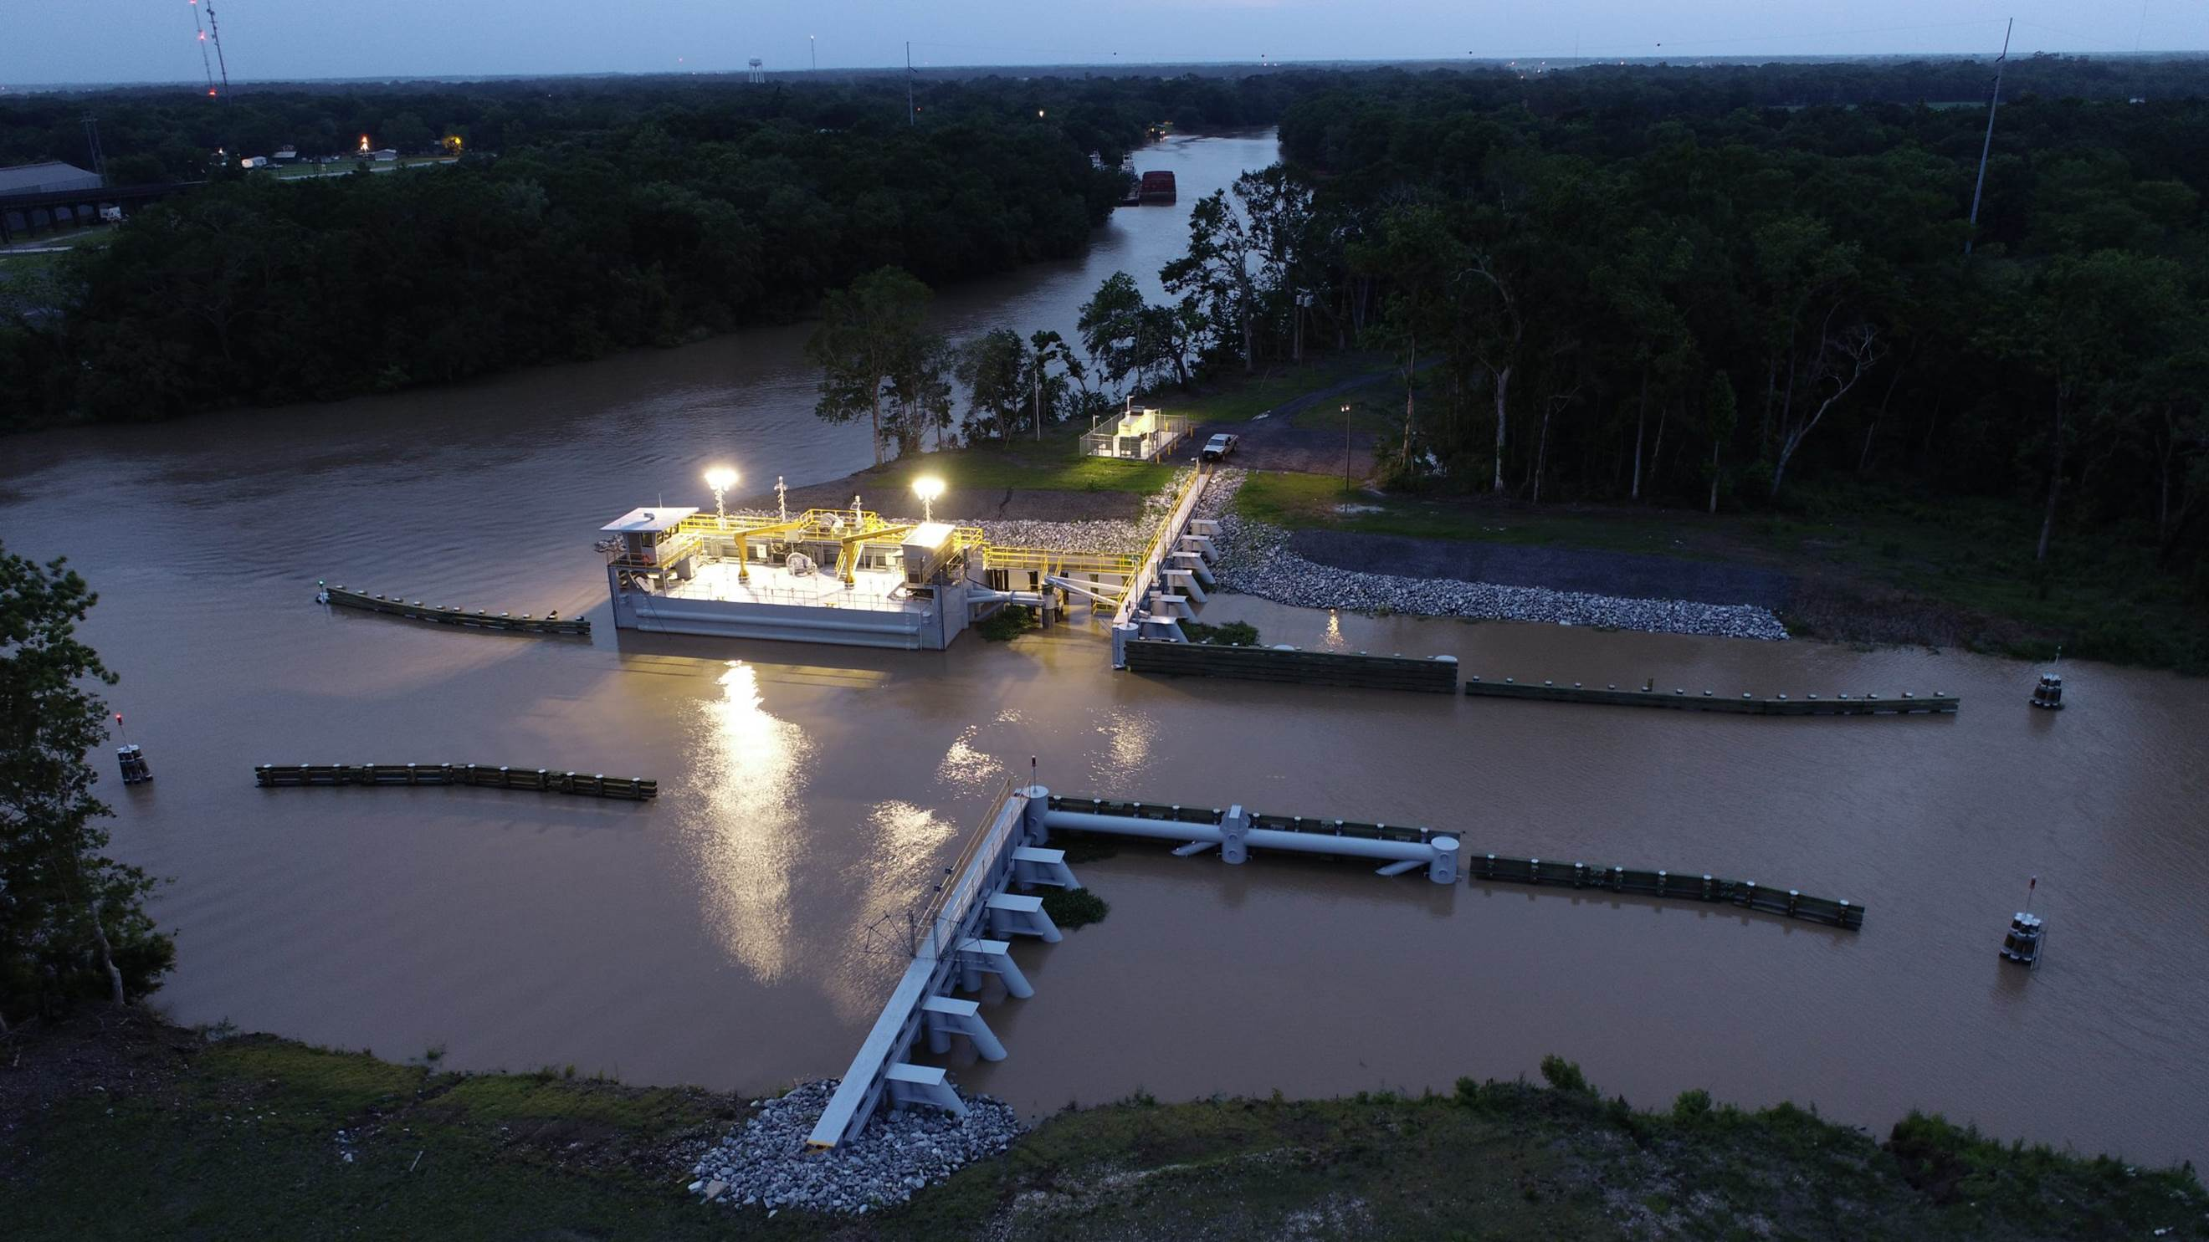
Statewide Flood Control Program
Accomplishments to Date
Approved projects in 43 of 64 parishes
129 projects completed
$305.5M Expended
$2.876B in Flood Reduction Benefits
10.76 Benefits/Cost Ratio
Notes:
NEXT SLIDE – Floodplain Management

Slide 23
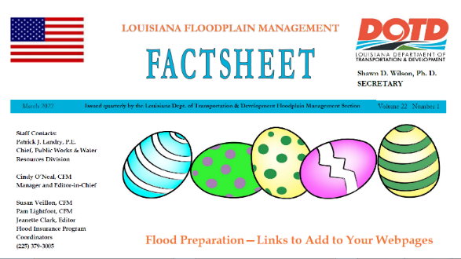
Floodplain Management
Training and Outreach
Training & Workshops:
  Assists multiple agencies with various workshops and classes
Outreach:
  Publish a quarterly newsletter – the Floodplain Management Factsheet distributed to all 318 NFIP communities, lending institutions, insurance agents, realtors, engineers, etc.
Notes:
NEXT SLIDE – Community Rating System

Slide 24
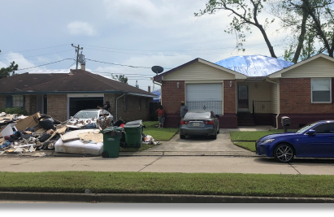
Floodplain Management
Community Assistance Visits:
  Assess floodplain activities of 318 NFIP communities
  Inspect SFHA (over 50% of state) (#1)
  Review permits & elevation certificates
  Meet with community officials to determine any assistance they need
Disasters:
  Respond to Presidentially declared disasters
  Assist FEMA helping communities comply with post disaster regulations
Notes:
NEXT SLIDE – Training and Outreach

Slide 25
Floodplain Management
Community Rating System (CRS)
Voluntary program that credits community efforts to go above minimum requirements by reducing flood insurance premiums from 5% to 45%
39 communities currently receive a discount
Notes:
Community Rating System Class Ratings are similar to Fire Ratings for your Homeowners’ Policy. Each lower class receives a 5% decrease in flood insurance premiums.
Class 1 is the “best” rating and results in the highest premium reductions available through the program.
Louisiana achieved its first Class 5 rating in May of 2019. Jefferson Parish flood insurance policyholders now receive a 25% discount.
Next Slide – CRS

Slide 26
Floodplain Management
Community Rating System (CRS)
Over 291,000 (77%) of Louisiana’s Flood Insurance Policies are in CRS Communities
Over $29M in premium savings annual
Notes:
Rating System saves Louisiana flood insurance policyholders more than $29 million annually.
Worth noting: Louisiana is ranked in the Top 5 nationwide with 77% of the state’s flood insurance polices located in CRS communities.
NEXT SLIDE – Cooperating Technical Partner (CTP)

Slide 27
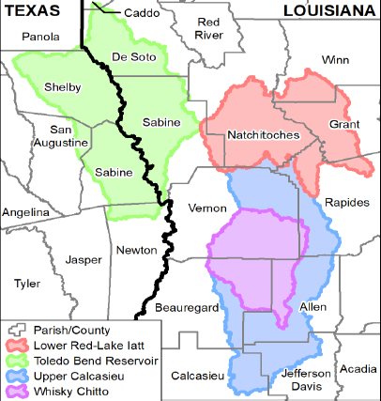
Floodplain Management
Cooperating Technical Partners (CTP)
Works with FEMA to release updated flood risk information to communities
  Could lead to updated Insurance Rate Maps
Currently under contract with two consulting firms to assist with CTP/NFIP task orders
  Total CTP/NFIP contract amount: $10M for 5 years
  Discoveries in 15 watersheds recently completed
  Phase 2: Risk Analysis and Mapping in Rapides Parish
  Pilot: Roadmap to Leveraging LWI data with BLE process
Notes:
7 Discoveries closed in the last 6 months
Discoveries have been initiated in 8 additional watersheds
Efforts in Rapides Parish have advanced to Phase 2: Risk Analysis and Mapping
NEXT SLIDE – Policy Information

Slide 28
Floodplain Management
Policy Information as of 2/28/2025
Policies in Force: 338,498
Premiums Paid: $282,234,147
Total Coverage: $98,120,334,000
Notes:
39% of the flood insurance policies are for properties located in the Special Flood Hazard Area.
61% of the flood insurance policies are for properties located in a No Special Flood Hazard Area or X Zone.
-15.8% policies
-0.7% premiums/policy
+6.7% coverage/policy
+7.4% coverage/premium
NEXT SLIDE – Questions?

Slide 29
Questions ?

