Slide 1
U.S. Army Corps of Engineers: 250th Anniversary Plan
Lower Mississippi River Comprehensive Management Study
Jeff Varisco, PMP
Chief, Projects and Restoration Branch
New Orleans District
U.S. Army Corps of Engineers
May 1, 2025

Slide 2
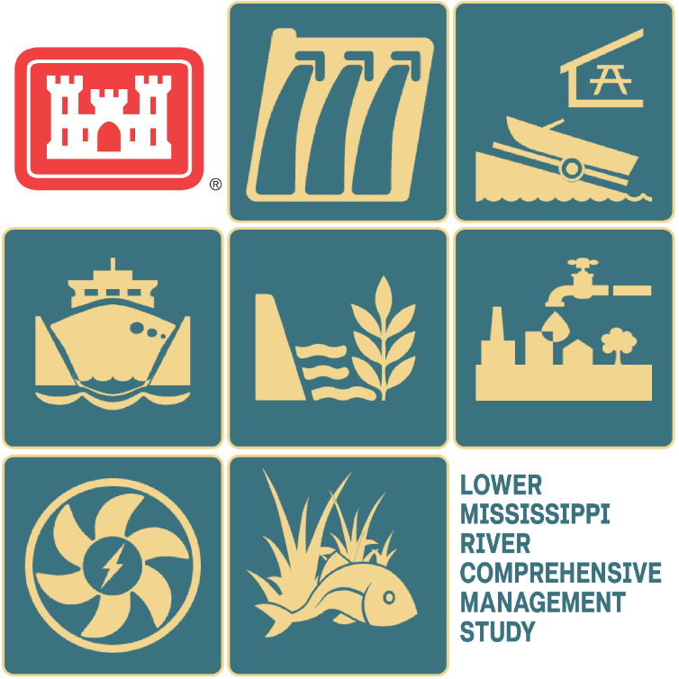
Study overview
Generational opportunity to determine the best approach for long-term management of the Mississippi River from Cape Girardeau, Missouri, to the Gulf.
Leveraging foundational studies and ongoing work in the Mississippi River Basin
Identifying management opportunities across multiple USACE mission areas
Public and stakeholder engagement
Actionable recommendations and tiered feasibility studies

Slide 3
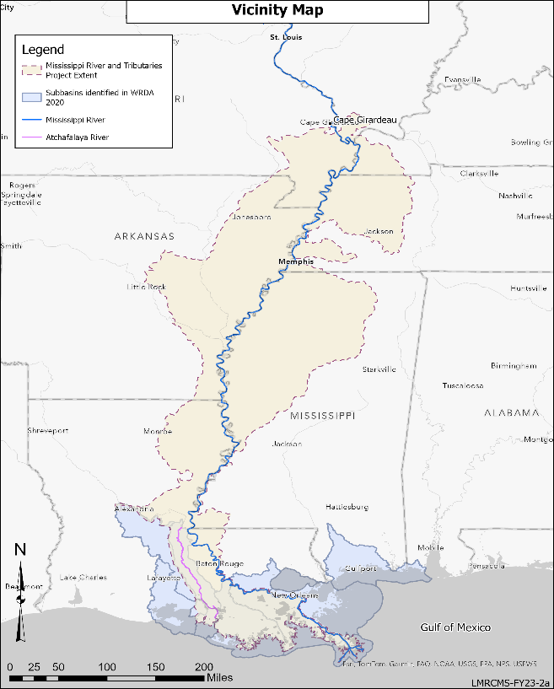
Study authority
WRDA 2020, Sec 213, WRDA 2022, Sec 8343:
5 Years, $25M (100% Federally Funded)
PURPOSE – The Secretary, in collaboration with the heads of other Federal agencies and pursuant to subsection (d)(1)(A), shall conduct a comprehensive study of the Lower Mississippi River basin from Cape Girardeau, Missouri, to the Gulf of Mexico*. The study will identify recommendations of actions to be undertaken by the Secretary, under existing authorities or after congressional authorization, for the comprehensive management of the basin for multiple purposes:
Hurricane and storm damage reduction, flood risk management, structural and nonstructural flood control, and floodplain management strategies; (Priority Missions)
Navigation (Priority Mission)
Ecosystem and environmental restoration (Priority Mission)
Water supply (Explore when Compatible)
Hydropower production (Explore when Compatible)
Recreation (Explore when Compatible)
Other purposes as determined by the Secretary
Mississippi River and Tributaries Project Boundary (MR&T)
Coastal Subbasins
Lake Pontchartrain
Mississippi Sound
Teche-Vermilion
Breton Sound
Barataria
*Officially known as Gulf of America per “Restoring Names that Honor American Greatness” Executive Order by President Trump (1/20/2025)
Atchafalaya
Terrebonne

Slide 4
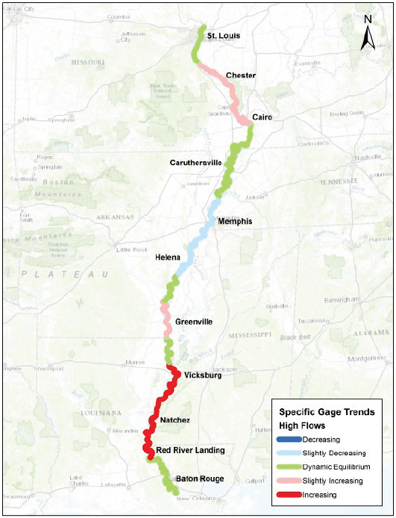
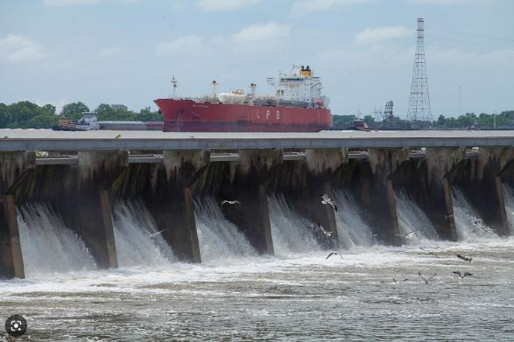
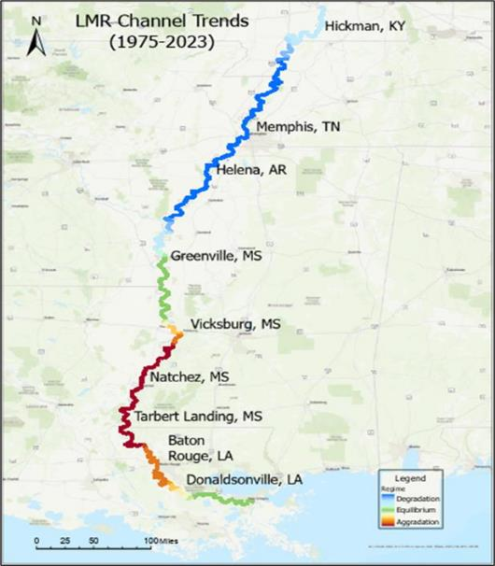
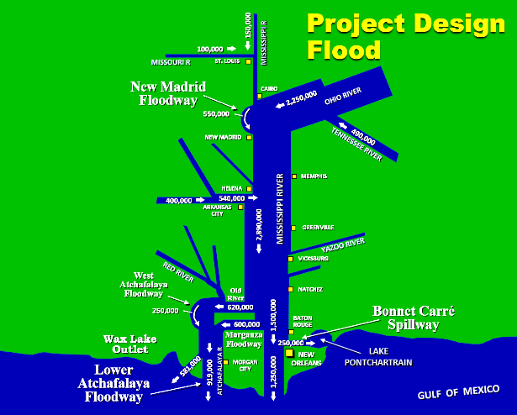
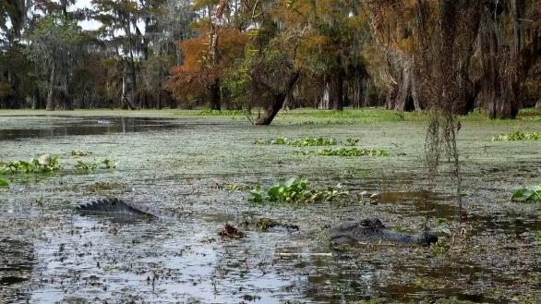
Problems & opportunities
Increased rainfall and extreme storm events have attributed to more frequent openings of the Bonnet Carré Spillway.
Ongoing assessments indicate long-term changes in the Mississippi and Atchafalaya rivers may occur over the next 50 years.
70%-30% flow split between the Mississippi and Atchafalaya/Red Rivers may no longer be the optimal distribution of flow for Flood Risk Management, Navigation, and Ecosystem priorities.
Degradation
(deepening)
Bonnet Carré Spillway in May 2019 (Source: Frank McCormack)
Equilibrium
Aggradation
(infilling)
Gulf of America
Stakeholder concerns include stagnant water quality, impaired hydrology affecting forested wetlands, and siltation affecting navigational channels, commercial ports, and habitats.
Preliminary model results from the Lower Mississippi River Comprehensive Management Study
Alligator in Atchafalaya Basin(Source: Basinkeeper.org)

Slide 5
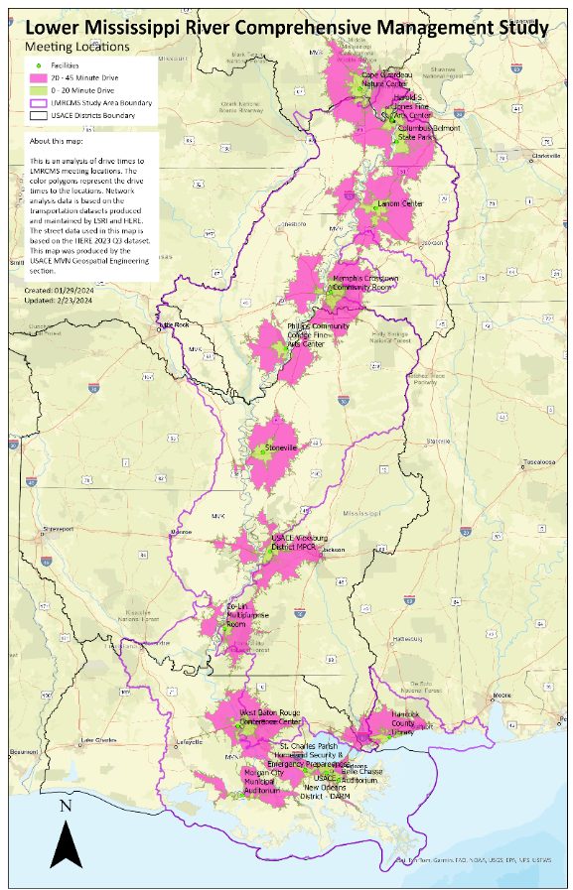
What we’ve accomplished to date
Scoping
Alternatives Formulation
Feasibility Level Analysis
Chief’s Report
Initiated Regional USACE collaboration, across 6 Districts, Mississippi Valley Division, and Headquarters
Conducted Planning Charrettes with State and Federal Partners to develop Problems, Opportunities, Objectives, and Constraints
Engaged and Collaborated with Agencies, Public, and Stakeholders:
State and Federal Interagency Meetings
Tribal Nations Coordination and Consultation
State Partnering Group, appointed by 7 State Governors
Public Scoping Meetings, across 7-state Study area
Quarterly Public Updates, next meeting to be held in early summer 2025
Stakeholders, as requested
Published Scoping Report, available at https://www.mvn.usace.army.mil/About/LMRComp/
Locations of 32 Public Meetings

Slide 6
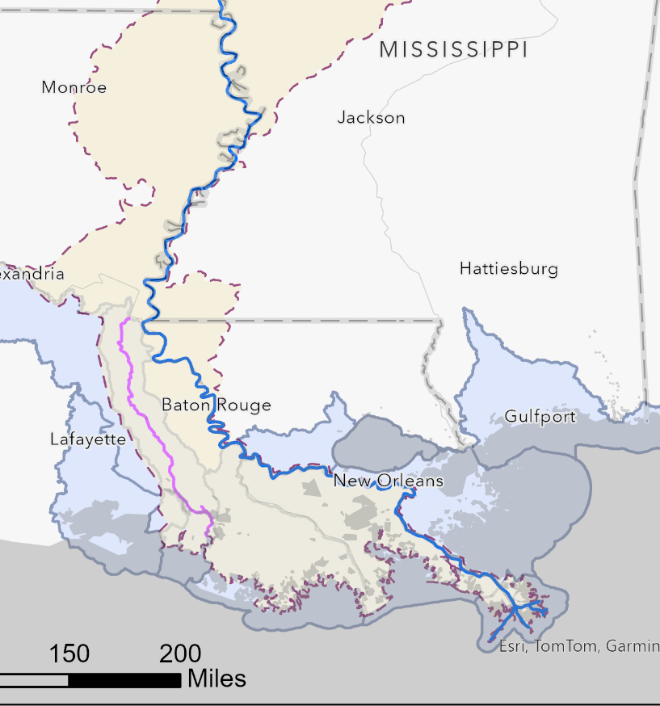
Measures being considered
Scoping
Alternatives Formulation
Feasibility Level Analysis
Chief’s Report
Key:
N = navigation
E = ecosystem restoration
WS = water supply
F = flood risk management
R = recreation
We are here
Native Rivercane ^{E}
Reviewing Measures (i.e., solutions) to develop actionable alternatives.
Developing flexible operations of Old River Control Complex to benefit the Mississippi and Atchafalaya Rivers.
Investigate opportunities for integrated ORCC, Morganza and Bonnet Carré operations to possibly reduce the frequency and duration of Bonnet Carré openings.
Dedicated dredging in the lower river for ecosystem restoration
Temporary low water sand closures in crevasses which will be dispersed into receiving basin during high water.
Recommending Tiered Studies
Old River Control Complex operations ^{F, N, E, WS}
Bonnet Carré/
MS Sound ^{F, E}
Manage flows in Atchafalaya Basin ^{E, R}
Dedicated dredging ^{E}
Atchafalaya River Dredging ^{N, E, WS, R}
Mound sand to bolster east bank ^{N, E, WS}

Slide 7
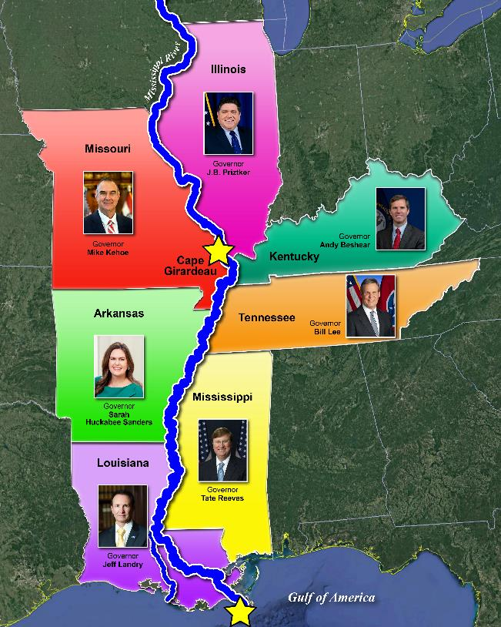
Way ahead
Scoping
Alternatives Formulation
Feasibility Level Analysis
Chief’s Report
Short-Term Outlook
Complete screening of measures to develop alternatives and Tiered Studies as part of the tentatively selected plan
Evaluate benefits and impacts of proposed alternatives in the Study Area
Continue engagements with agencies, tribes, public, and stakeholders
Long-Term Outlook
Summer 2026: Release of Draft Integrated Feasibility Report for Public Review
Fall 2027: Release Final Integrated Feasibility Report for State and Agency Review
Winter 2027: Complete Chief’s Report

Slide 8
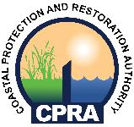
engagements in Louisiana
Engaged Louisiana State Agencies
The Project Delivery Team continues to engage with the State of Louisiana on synergistic efforts:
Atchafalaya Basin Master Plan
Lower Mississippi River Management Program
Upper Basin Diversion Program Study
Coastal Master Plan
The Project Delivery Team also regularly engages with stakeholders in Louisiana through Quarterly Public Updates and directly with stakeholders, at their request.

Slide 9
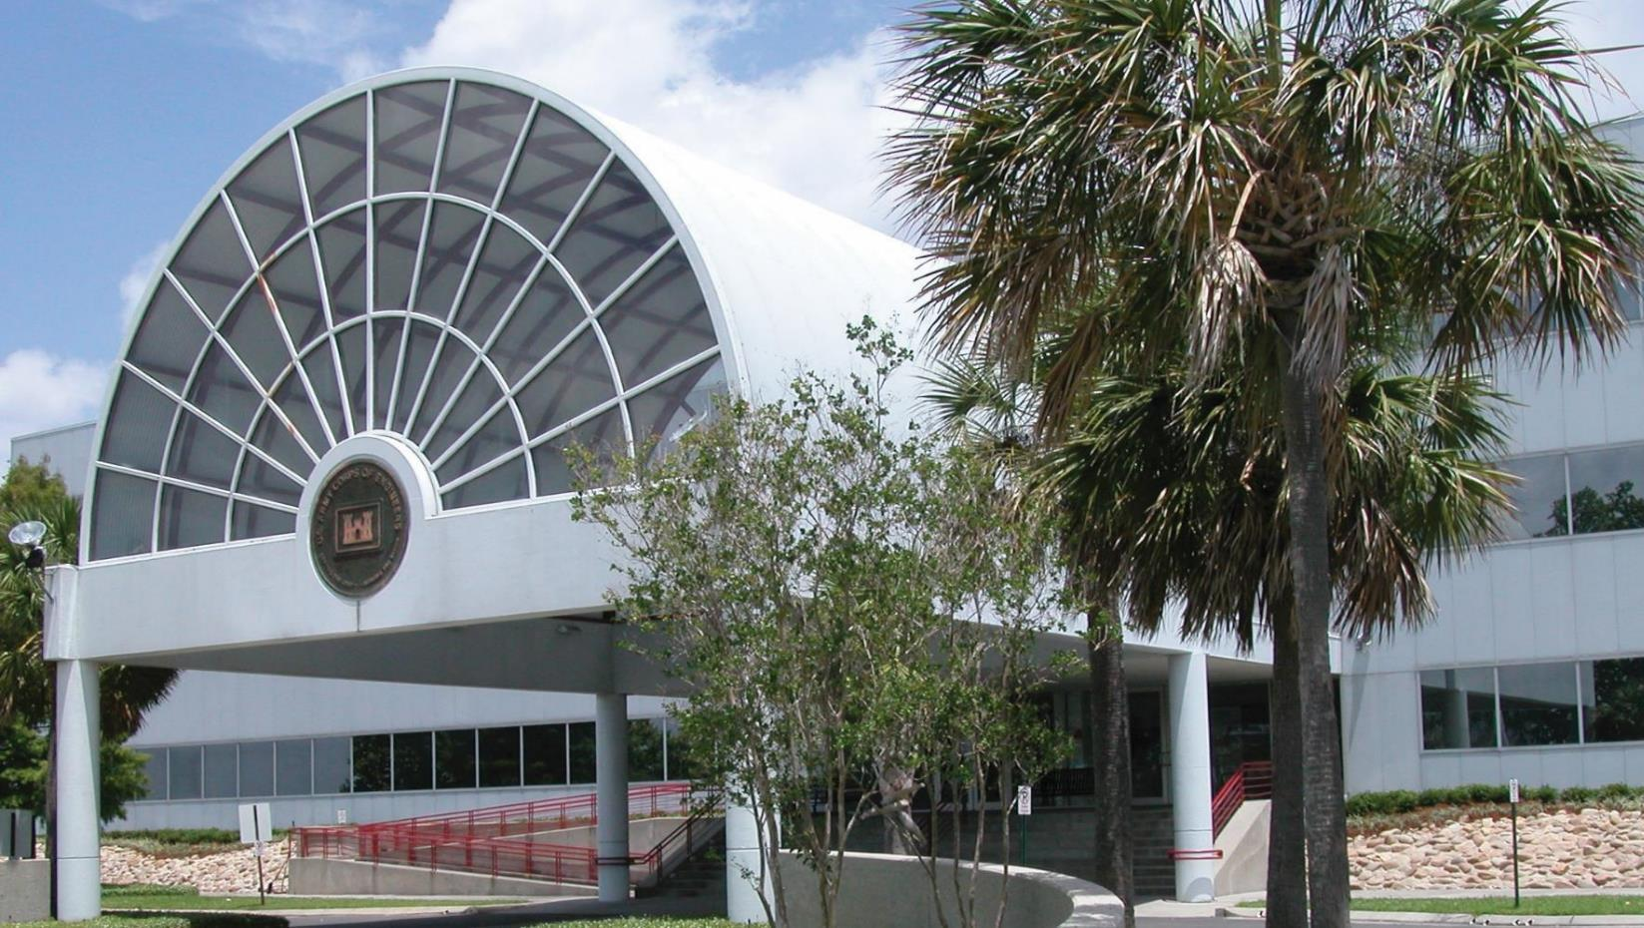
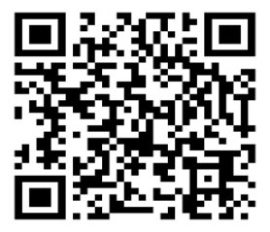
FOLLOW US FOR THE LATEST ANNOUNCEMENTS
District website
www.mvn.usace.army.mil
Facebook
www.facebook.com/usacenola
Instagram
www.instagram.com/usace_nola
Study Website
Email:
LMRComp@usace.army.mil
Website: www.mvn.usace.army.mil/About/LMRComp/
X (Twitter)
twitter.com/usacenola

