Slide 1

Association of Levee Boards of Louisiana
Billy Williamson, P.E.
Director of Dams, Levees, and Reservoir Development
December 3, 2025

Slide 2

Today’s Discussion
Levee Safety Program
Dam Safety Program
Changes
Notes:
Hydraulics Section
Louisiana Watershed Initiative
Statewide Flood Control Program
Roadway Flooding Program
Floodplain Management Section
Levee & Dam Safety Section
NEXT SLIDE – Hydraulics

Slide 3
Public Works and Water Resources Division
Mission:
The mission of Public Works is to develop the potential of Louisiana's water related resources by administering programs and implementing infrastructure projects relating to controlling, developing, conserving and protecting all aspects of the resources.
Notes:
The second D is Public Works and Water Resources
Public Works and Water Resources
Next Slide: Levee Safety Program

Slide 4
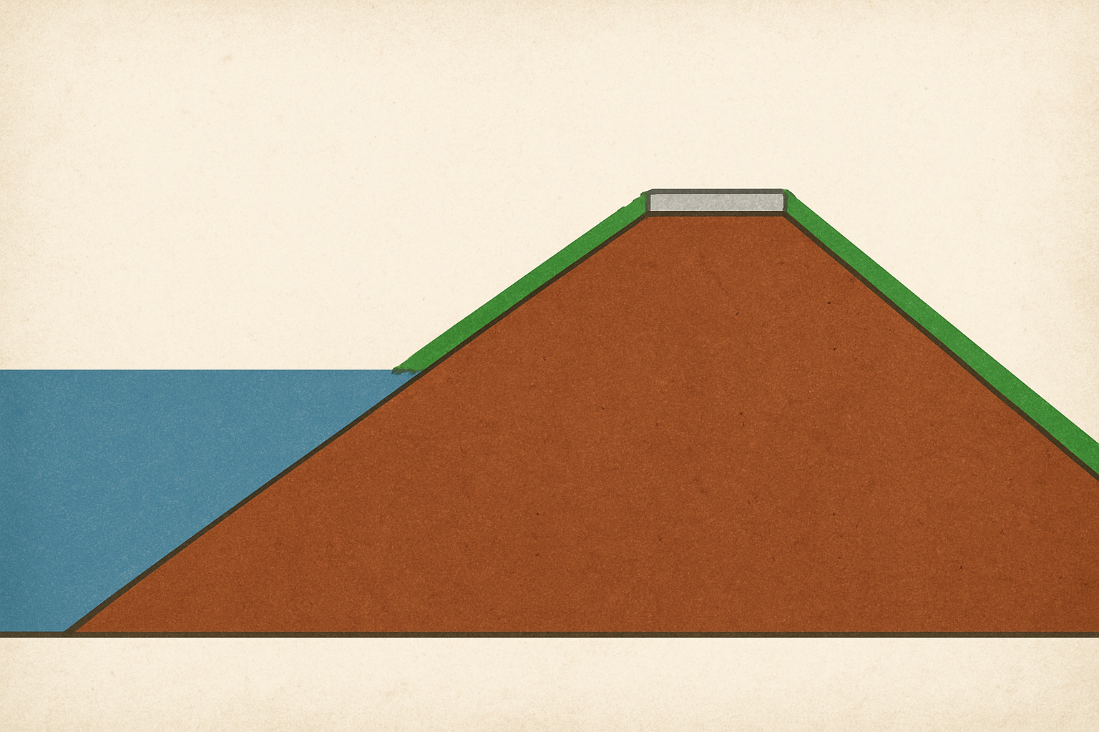
Dams, Levees, and Reservoir Development
Dam
Holds water in
Built across bodies of water
Levee
Holds water out
Built along bodies of water
Notes:
Next Slide: Levee Safety Program Current Services

Slide 5
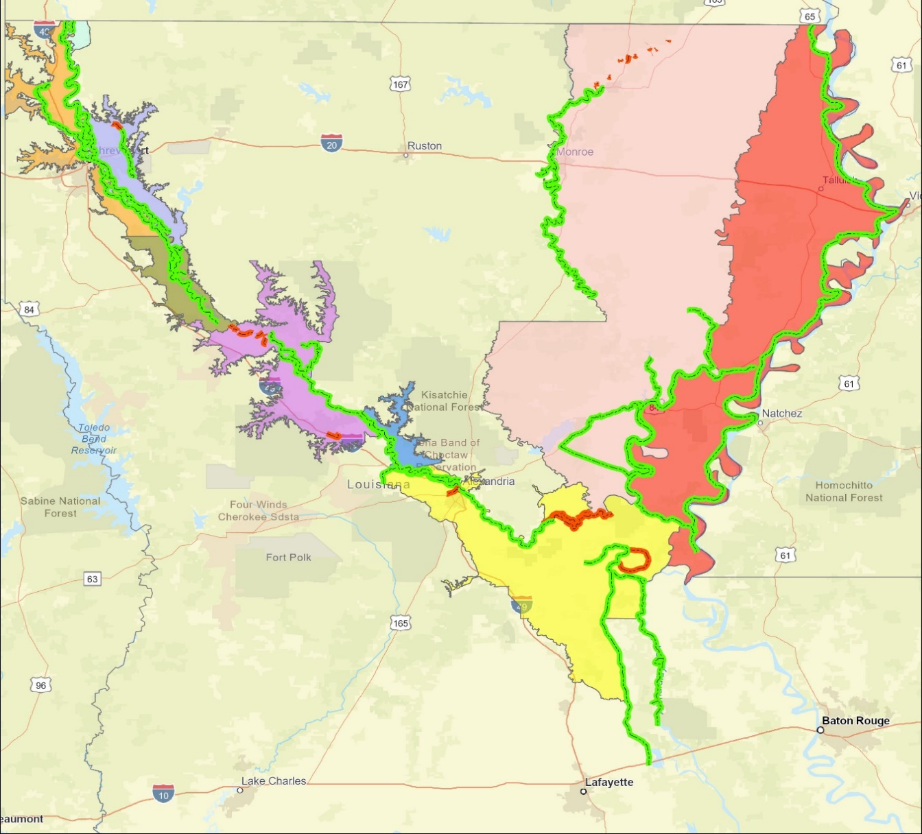
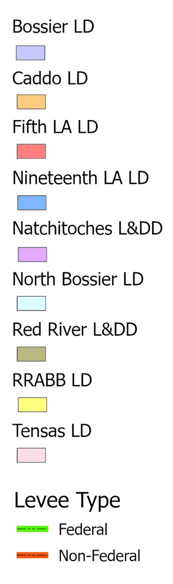
Levee Safety
Non-Coastal Levee Districts (9)
Federal 65.1
Non- Federal 4.3
Federal 116.7
Federal 306.3
Federal 26.2
Federal 69.3
Non- Federal 17.5
Federal 3.4
Federal 51.7
Federal 196.7
Non- Federal 55.2
Federal 249.9
Non- Federal 4.7
Notes:
Nine Non-Coastal levee districts
Program inspects about 1,000 miles of levees semi-annually
1085 miles of Federal Levees
81.7 miles of non-federal levees
Next Slide – Riverine vs. Coastal

Slide 6
Levee Safety
Riverine
Loaded for weeks or months
Parallel flows
Coastal
Typically loaded for days
Perpendicular flows
Notes:
Next Slide: Levee Safety Program Current Services

Slide 7
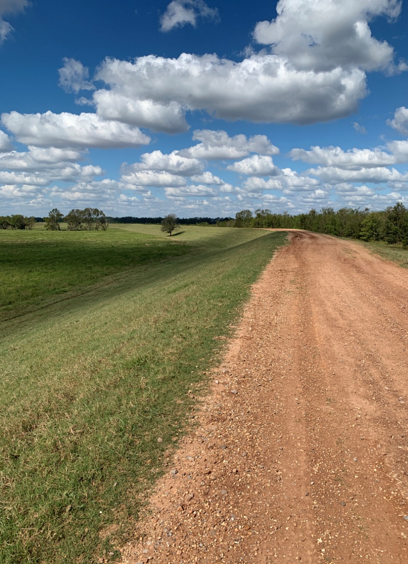
Levee Safety
Inspections
Assist Levee Districts with their Inspections
Provide Semi-Annual Inspection Reports
Provide Recommendations/Options for Corrective Actions
Flood inspections / Monitoring
Inventory/Mapping
Inventory Levee Assets
Develop GIS Maps
Training Compliance
Online training for levee inspectors
Notes:
Next Slide: Levee Safety Program Additional Services

Slide 8
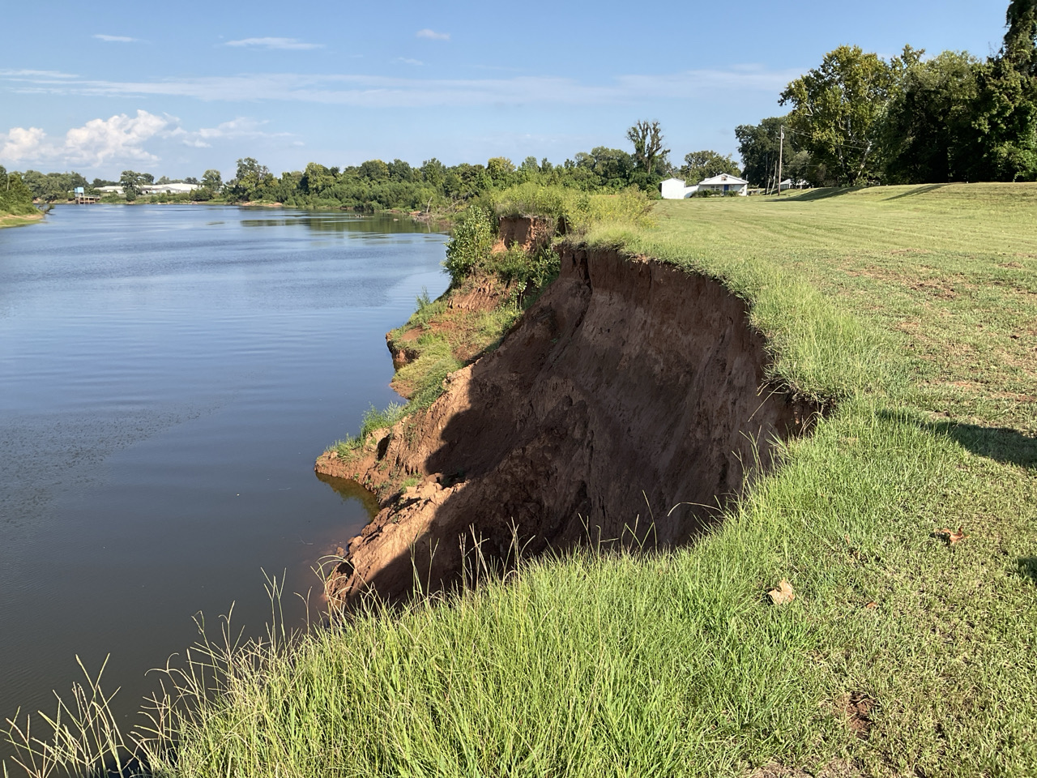
Levee Safety
Regulatory Support
Coordination for certifications
Stakeholder meetings with USACE
Strategic Planning
Review of USACE and FEMA guidance documents to identify upcoming requirements
Interface with resources to determine if legislative activity should be considered
Capital Outlay
Assist levee districts with funding requests
Project management
Notes:
Additional Services that can be provided
NEXT SLIDE – 9 Non-coastal area levee districts

Slide 9
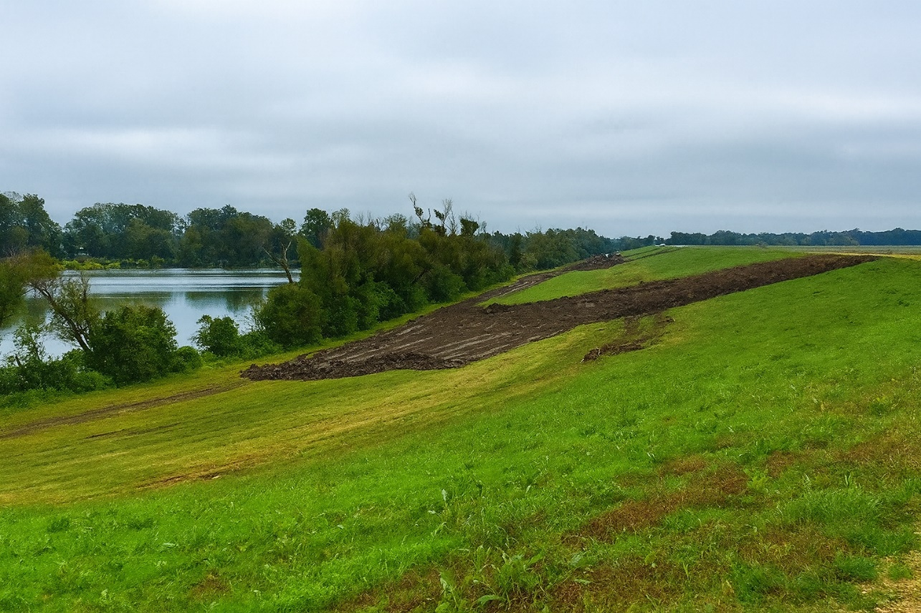
USACE Levee Safety Program
Redesigned National Levee Database
New National Levee Safety Guidelines
Integrated Levee Management
clarifying roles and responsibilities to improve coordination and implementation
promoting and encouraging formal levee safety programs at the state level
Implementation Support
Notes:
An integrated approach to levee safety requires each entity (federal, state, tribes, levee owner/operator, and communities "to understand and fulfill their responsibilities and to do so in coordination with each other". It is envisioned that the lynchpin to success is having states serve in a key integrator role. States have existing legal authorities to implement floodplain management regulations and have long-standing relationships with local governments in areas such as emergency planning and response. Even though federal agencies and tribes can have their own levee safety programs for management of levees within their authorities, their levees still influence watersheds that exist within states. As part of the legislation for the National Levee Safety Program, Congress envisioned that state levee safety programs would adopt and implement consistent national levee safety practices; be able to receive federal assistance in support of levee safety; carry out public education activities to improve awareness of flood risk; and collect and share levee information using the National Levee Database. In addition, there is opportunity for state levee safety programs to:
Help build capacity in levee owners/operators to inspect, assess, repair, and rehabilitate levees;
Collaborate across programmatic and political jurisdictions to ensure that all levees have adequate oversight; and
Apply services in a fair and equitable way across the landscape with special attention to underserved communities, tribes, and individuals particularly vulnerable to flooding.
Next Slide: Dam Safety Program

Slide 10
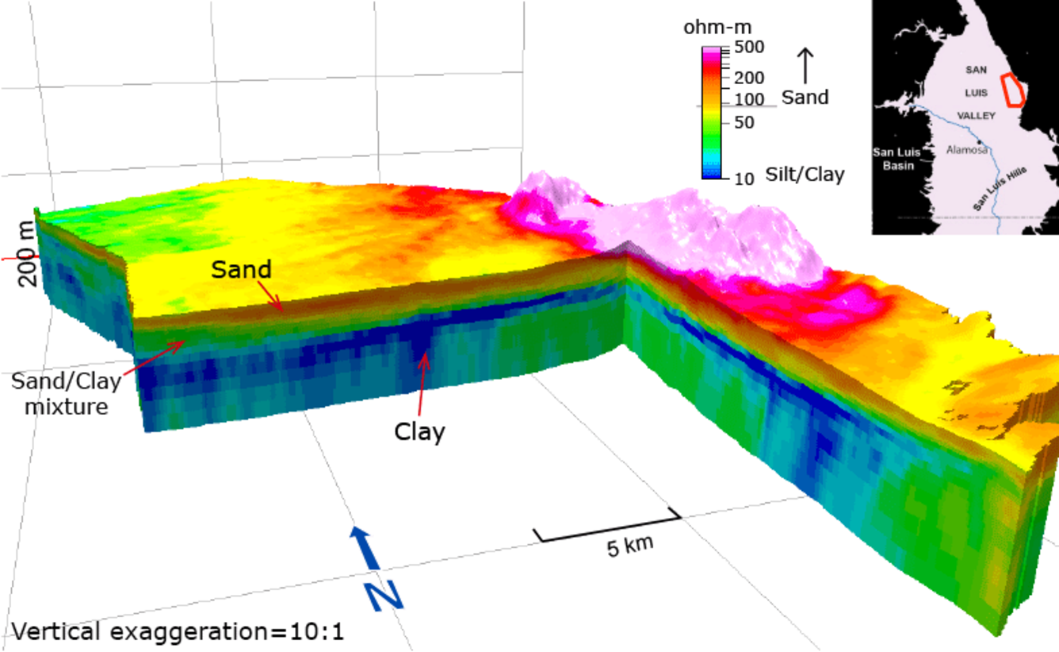
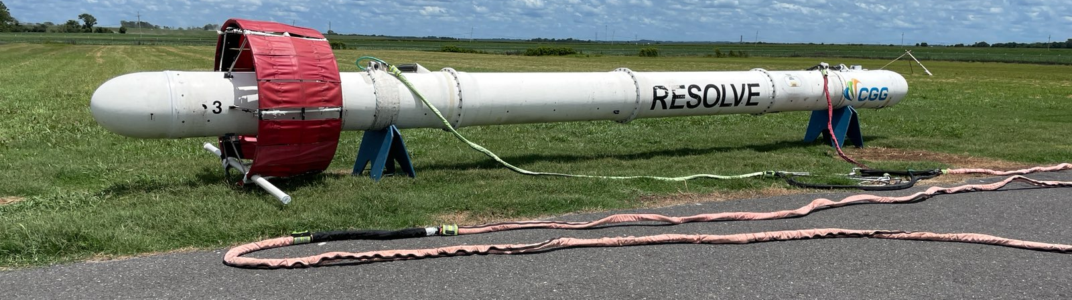
Levee Safety Program
Into the Future
Evaluation of Electromagnetic Geophysics
Entire State Collected
Data processing ongoing at USGS
Screening Potential Seepage Locations
Photo by Eugene Wall (USACE)
Notes:
Next Slide: DSS-Wise Simulations

Slide 11
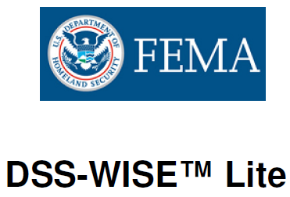
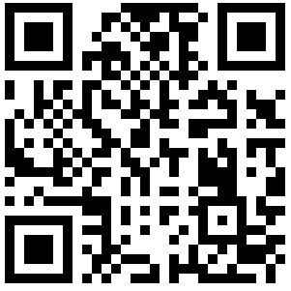
Levee Safety Program
Into the Future
Notes:
DSS-WISE is developed by the National Center for Computational Hydroscience and Engineering at the University of Mississippi
Next Slide: National Levee Safety Program

Slide 12
Levee Safety Program
Request Form
Select Requesting Entity (Dropdown)
Select Request Type (Dropdown)
Emergency
Routine
Select Services Needed (Dropdown)
Inspection
Survey Services
Plan Review
What else?
Upload Supporting Files
DOTD Receives Request
Review and Submit
Notes:
As part of an initiative to better track our performance, a system is being developed to accept and track requests for assistance from the Levee Districts.
Next Slide: Dam Safety Program

Slide 13
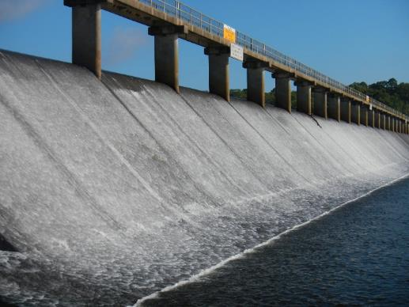
Dam Safety Program
767 Regulated Dams
(As of February 26, 2025)
43 High Hazard
69 Significant Hazard
641 Low Hazard
14 Under Investigation
Impact Classification | Potential Loss of Life | Potential Economic Loss | Inspection Frequency
High | Likely | Excessive | Annually
Significant | Possible | Appreciable | 3 years
Low | Not Likely | Minimal | 5 years
It is the responsibility of the owner/applicant to establish impact classification, and all dams will be considered to be of High Impact potential until demonstrated to be otherwise by a documented analysis provided by the applicant.
Spillway at Bayou D’Arbonne Dam
Union Parish
Notes:
State Dam Safety Program – number of dams has decreased in the last few years by about 30.
NEXT SLIDE – State-maintained dams

Slide 14
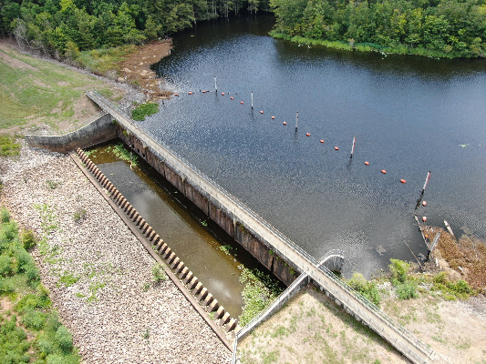
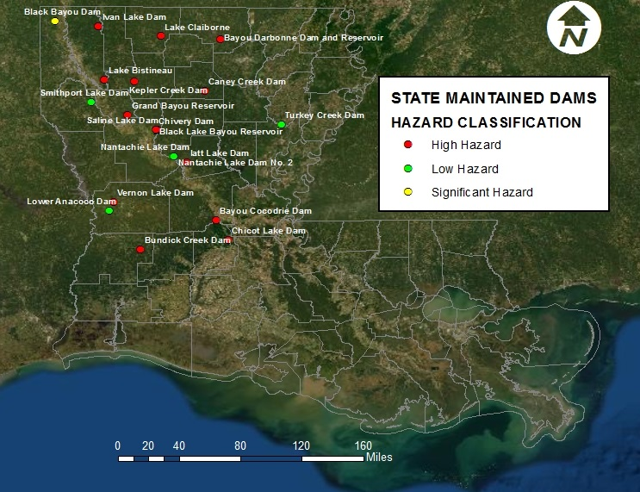
Dam Safety Program
R.S. 38:26: State-Maintained Dams
Spillway at Chicot Lake Dam
Evangeline Parish
21 DOTD Maintained Dams
13 High Hazard
2 Significant Hazard
6 Low Hazard
(All DOTD Maintained dams are inspected annually)
Notes:
Location of 21 Dams that DOTD operates and maintains per statute LA RS 38:26
These dams are inspected annually
NEXT SLIDE – Dams – Mobile Inspection App

Slide 15
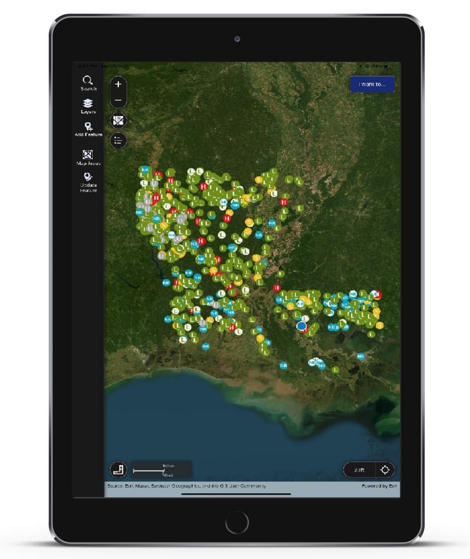
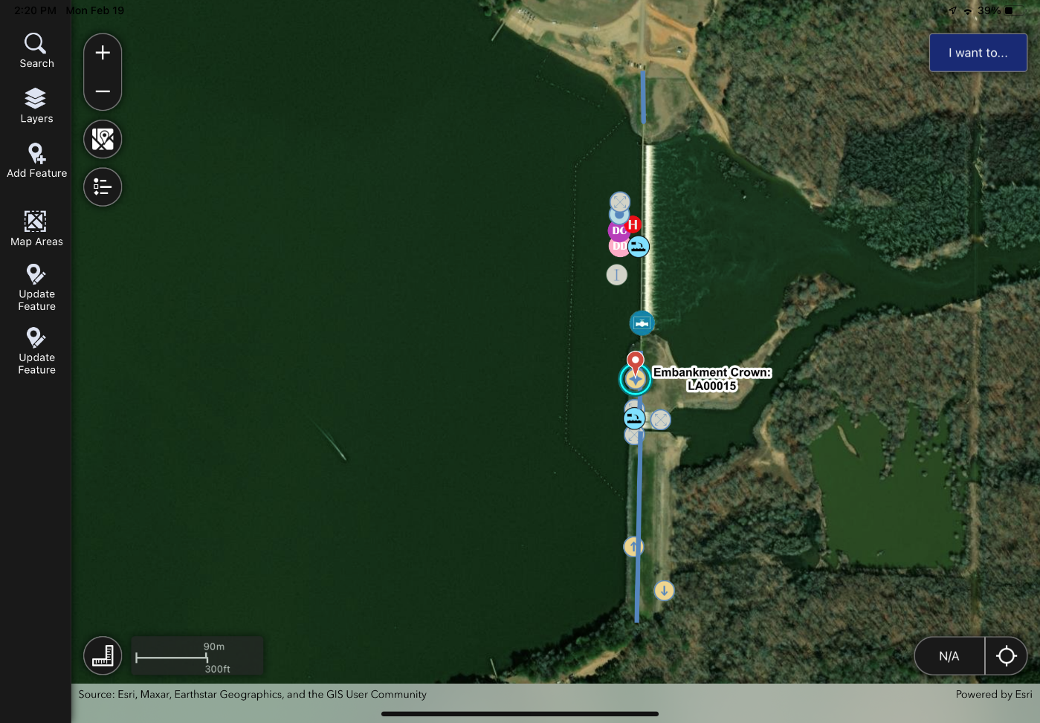
Mobile Dam Inspection App
Notes:
Allows DOTD staff and consultants to seamlessly perform inspections and consolidate inspection data
NEXT SLIDE – State Maintained Dams – Capital Outlay Projects

Slide 16
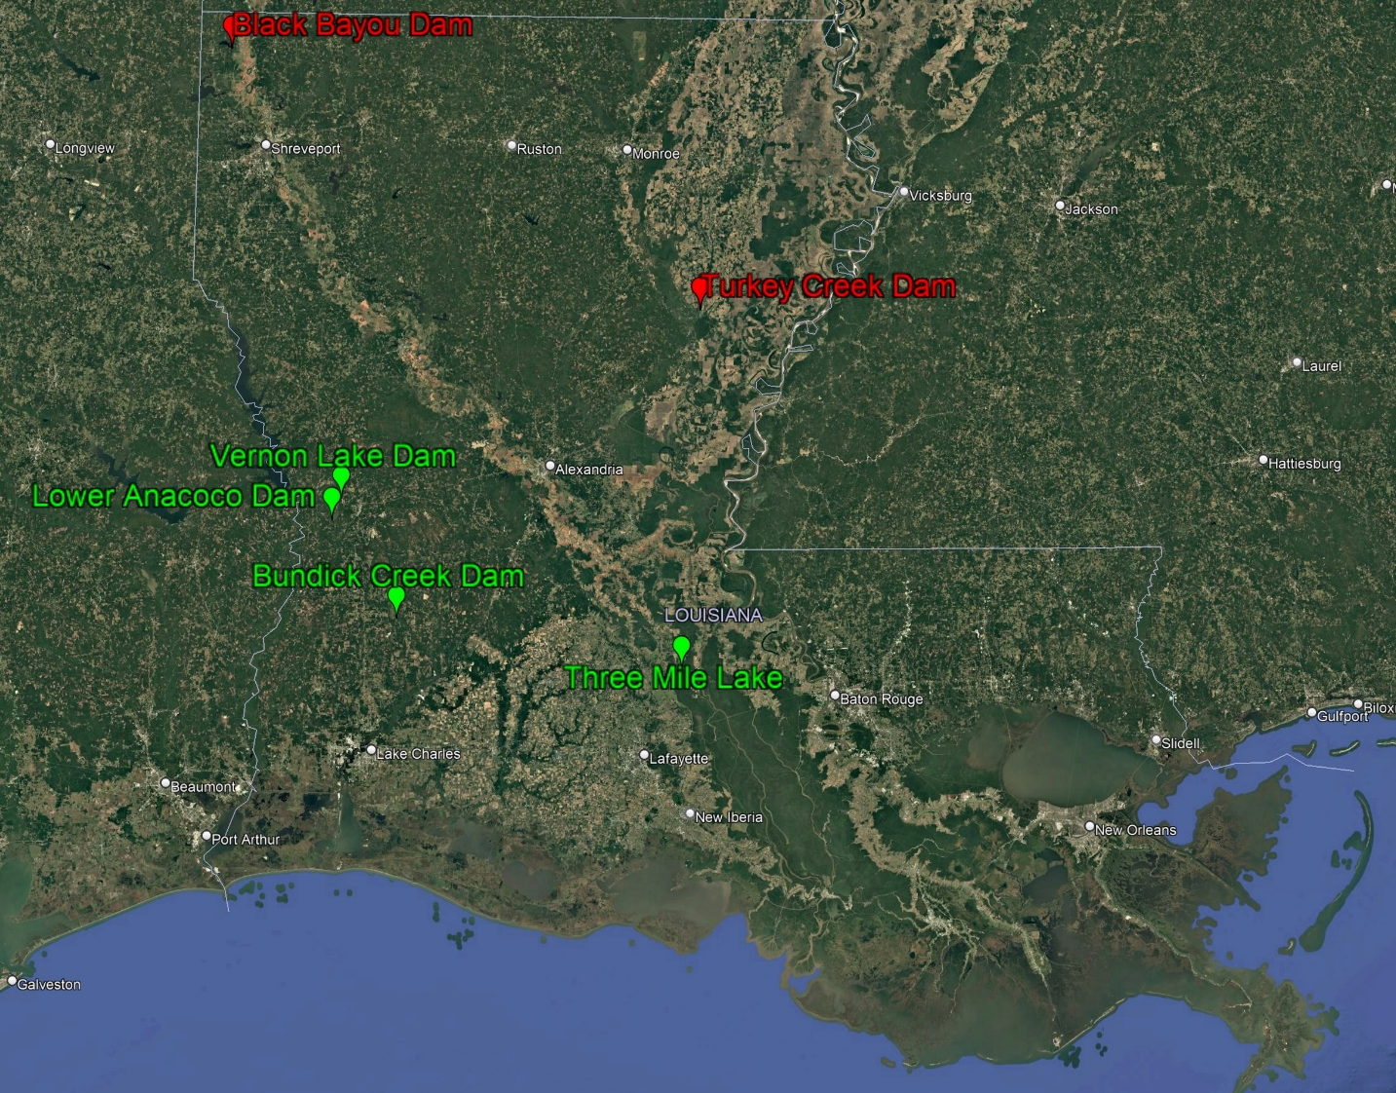
Dam Safety Program
State Maintained Dams – LWI Projects (5)
5 Projects @ 6 Dams
$63.7M
Group 1 Projects
Michael Baker International
Group 2 Projects
Freese and Nichols, Inc
Notes:
Total Capital Outlay $2.5 Million
Safety Measures – warning signs, boater barriers, fences
Bundick Creek Dam repairs and safety improvements is under contract and is scheduled to be completed this spring
Three projects (Lower Annacoco Dam, Vernon Lake Dam & Lake Bistineau) are being designed but safety improvements are planned for all of our state maintained dams
NEXT SLIDE – Drone Program

Slide 17
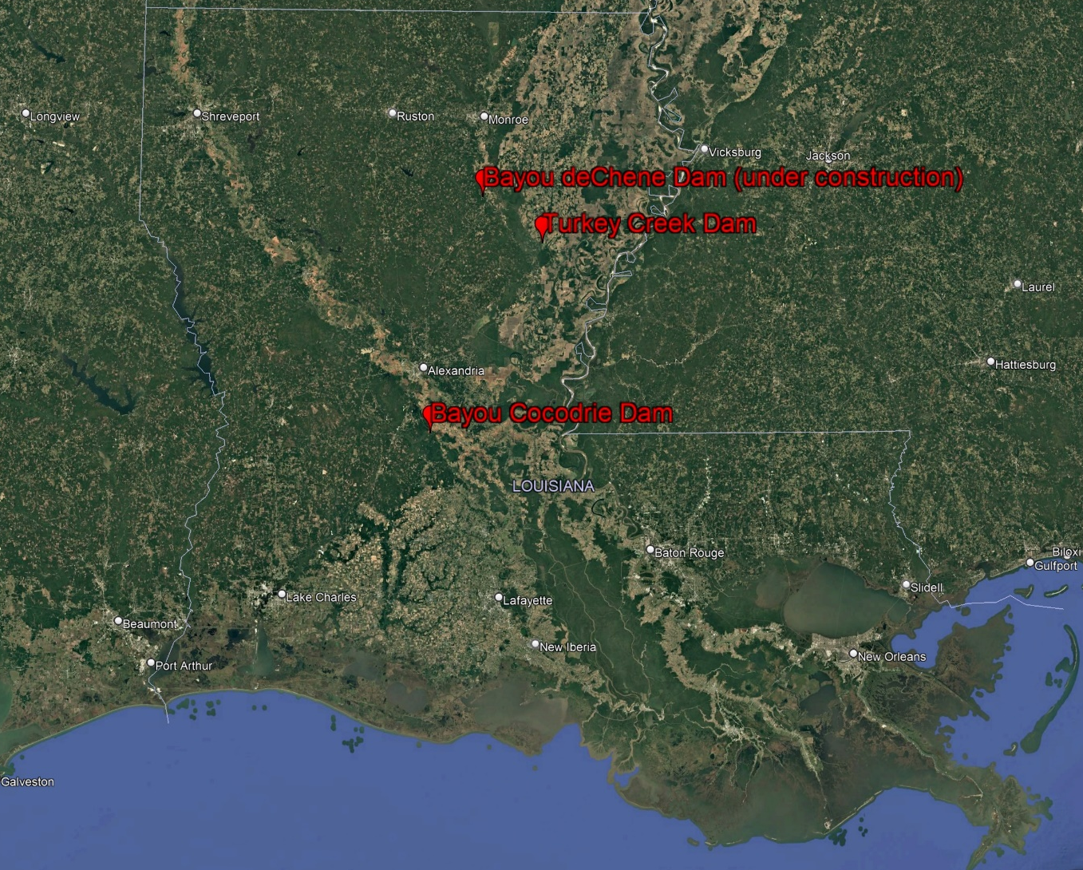
Dam Safety Program
State Maintained Dams – Capital Outlay Projects (3)
Bayou deChene Dam Construction
$72M
Turkey Creek Rehabilitation
$3.8M
Bayou Cocodrie Dam Hardening
$4M
Notes:
Total Capital Outlay $2.5 Million
Safety Measures – warning signs, boater barriers, fences
Bundick Creek Dam repairs and safety improvements is under contract and is scheduled to be completed this spring
Three projects (Lower Annacoco Dam, Vernon Lake Dam & Lake Bistineau) are being designed but safety improvements are planned for all of our state maintained dams
NEXT SLIDE – Drone Program

Slide 18
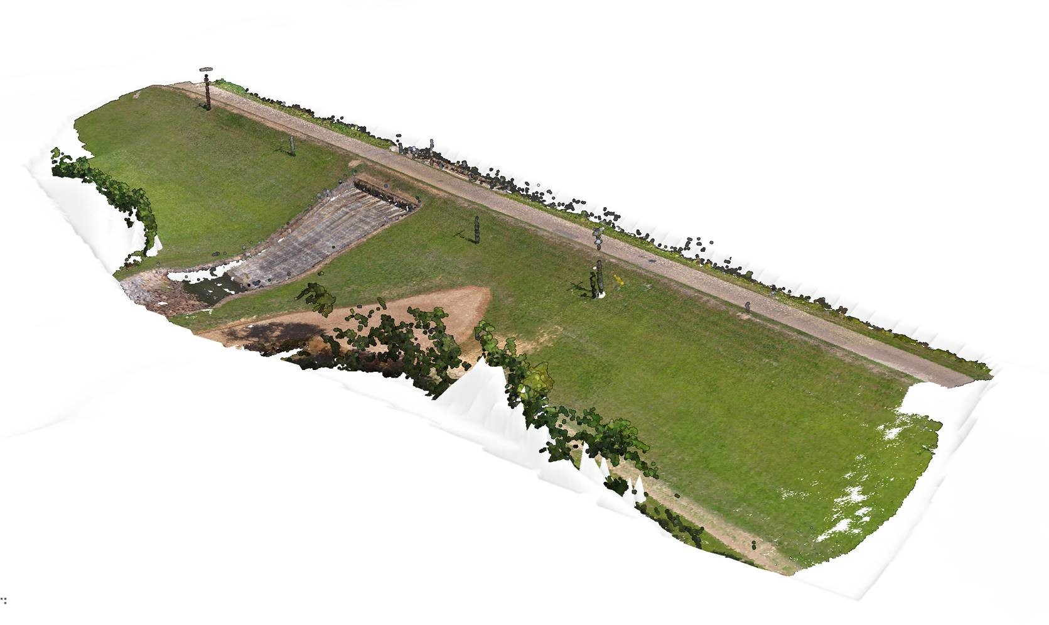
Dam Safety Program
Drone Program
Since January 2023
Skydio X2E
Photogrammetry
Thermal Imaging
Limitations:
1 Drone
2 Pilots
LiDAR
Data Volumes
Notes:
Developing Program
Next Slide: Drone Program – Thermal Evaluation

Slide 19
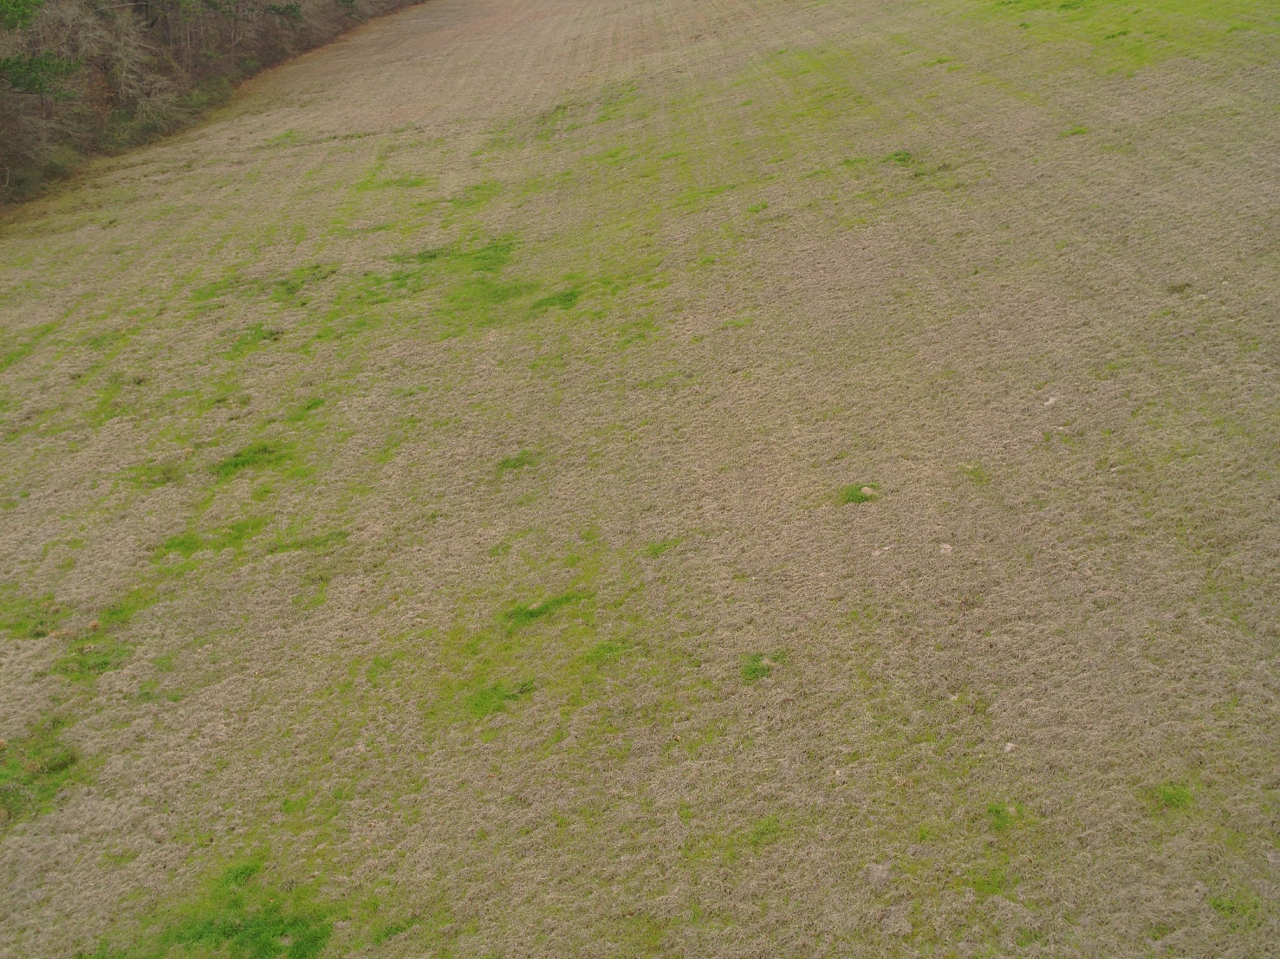
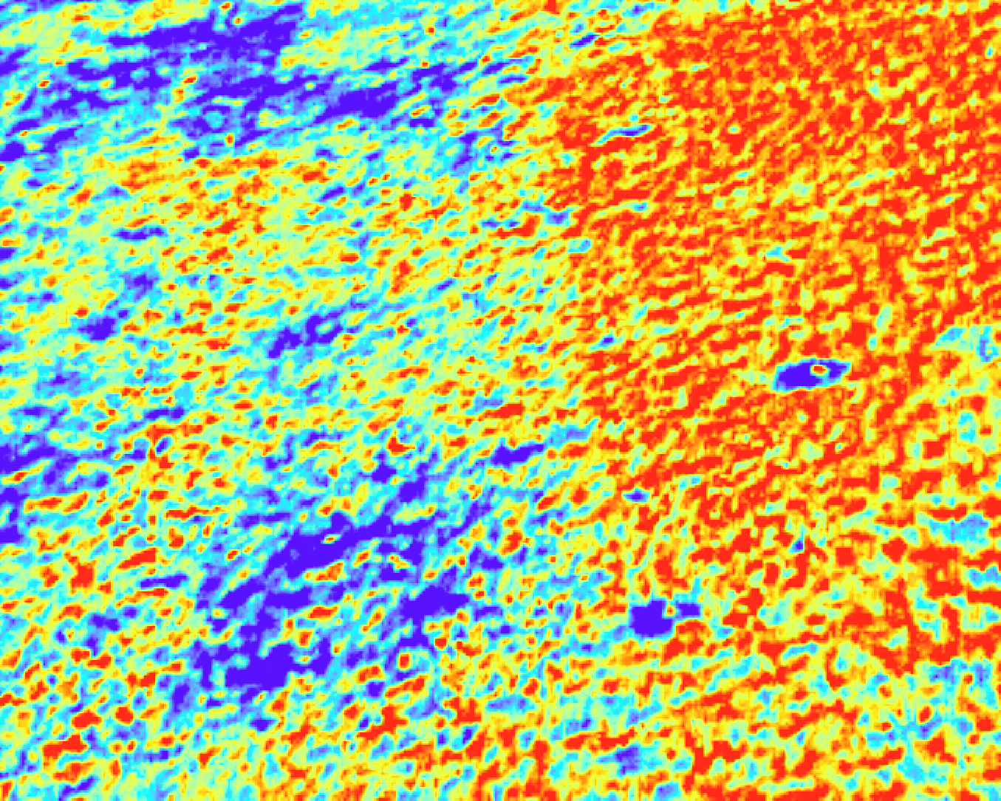
Dam Safety Program
Thermal Evaluation
Seepage
Voids
Drone Program
Notes:
Next Slide: Remote Monitoring, Data Collection and Controls

Slide 20
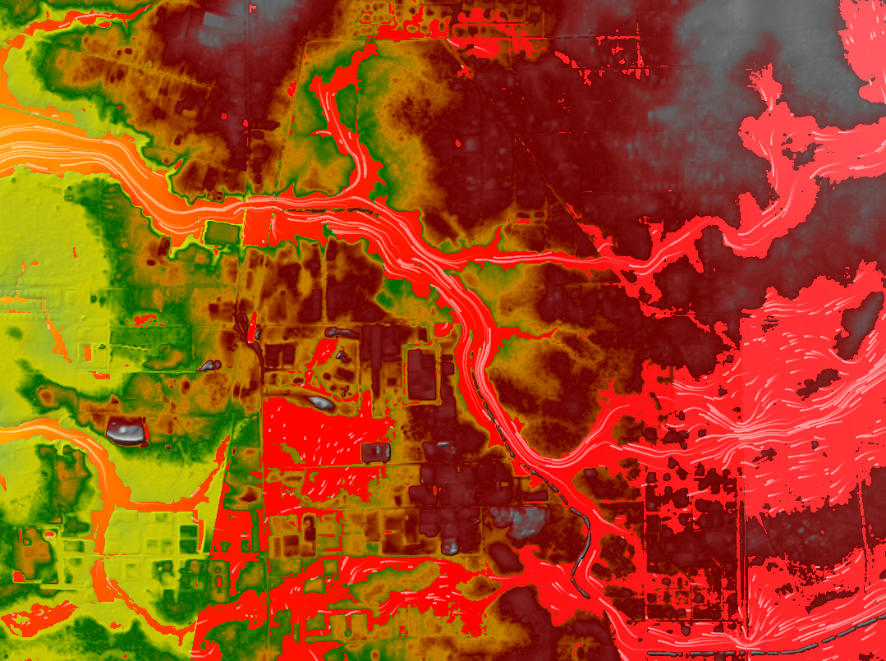
Louisiana Watershed Initiative
Statewide Watershed Modeling
$94M (Modeling Budget)
HUC8 Models (48 total)
Coupled 1D/2D or Full 2D
Tiered Approach Factors
Population
Complexity
Known Risk
Notes:
All 48 models have been Calibrated and Validated as of 3rd quarter 2024. Probabilistic design storms and consequence modeling is to be delivered by the end of June.
NEXT SLIDE – Statewid Flood Control Program

Slide 21
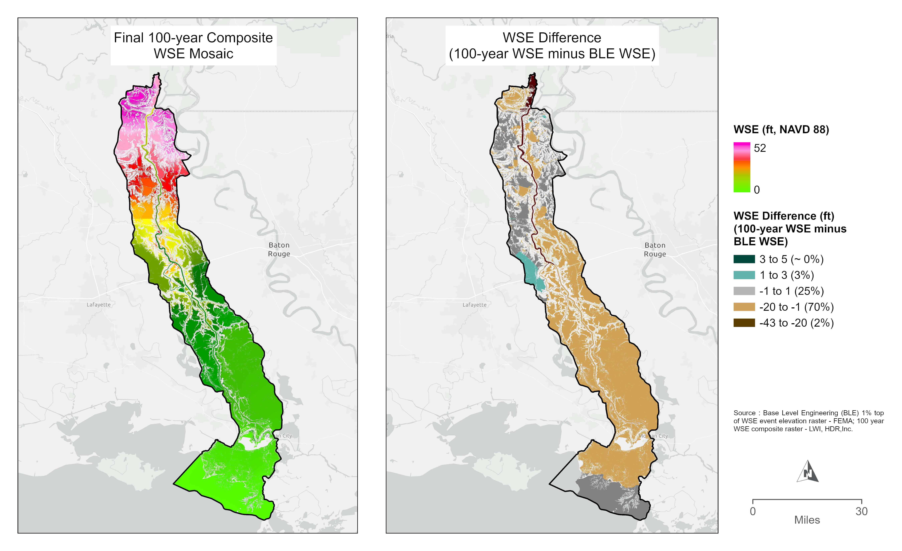
LWI H&H Models
Future Use Cases
BLE Comparison
Breakout Models
Project Evaluation
Floodplain Mapping
Notes:
All 48 models have been Calibrated and Validated as of 3rd quarter 2024. Probabilistic design storms and consequence modeling is to be delivered by the end of June.
NEXT SLIDE – Statewide Flood Control Program

Slide 22
Billy.Williamson@la.gov

