Slide 1
Louisiana Governor’s Office Homeland Security and Emergency Preparedness
BG Jason Mahfouz
Director
Association of Levee Boards of Louisiana
December 2025

Slide 2
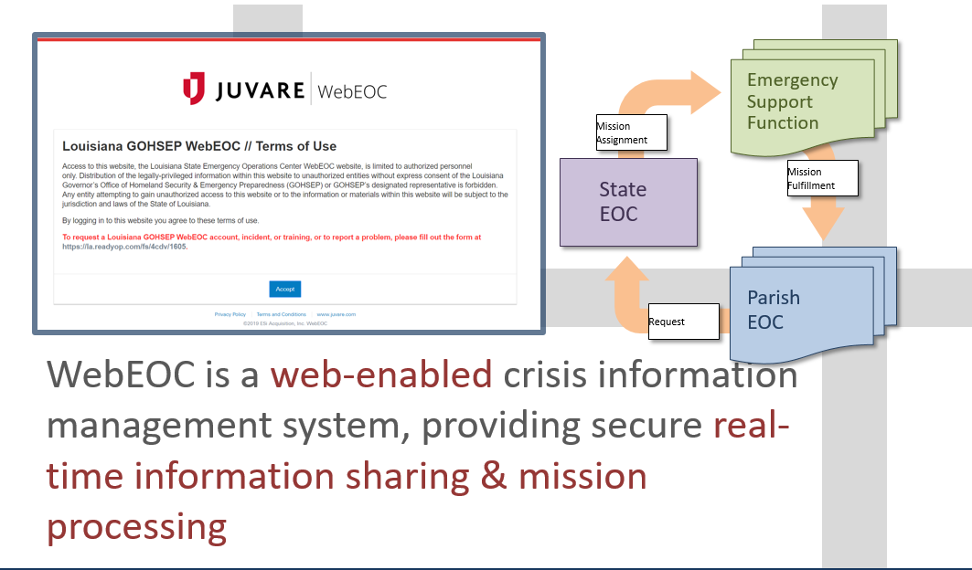
WebEOC
Notes:
ESF Executive Overview

Slide 3
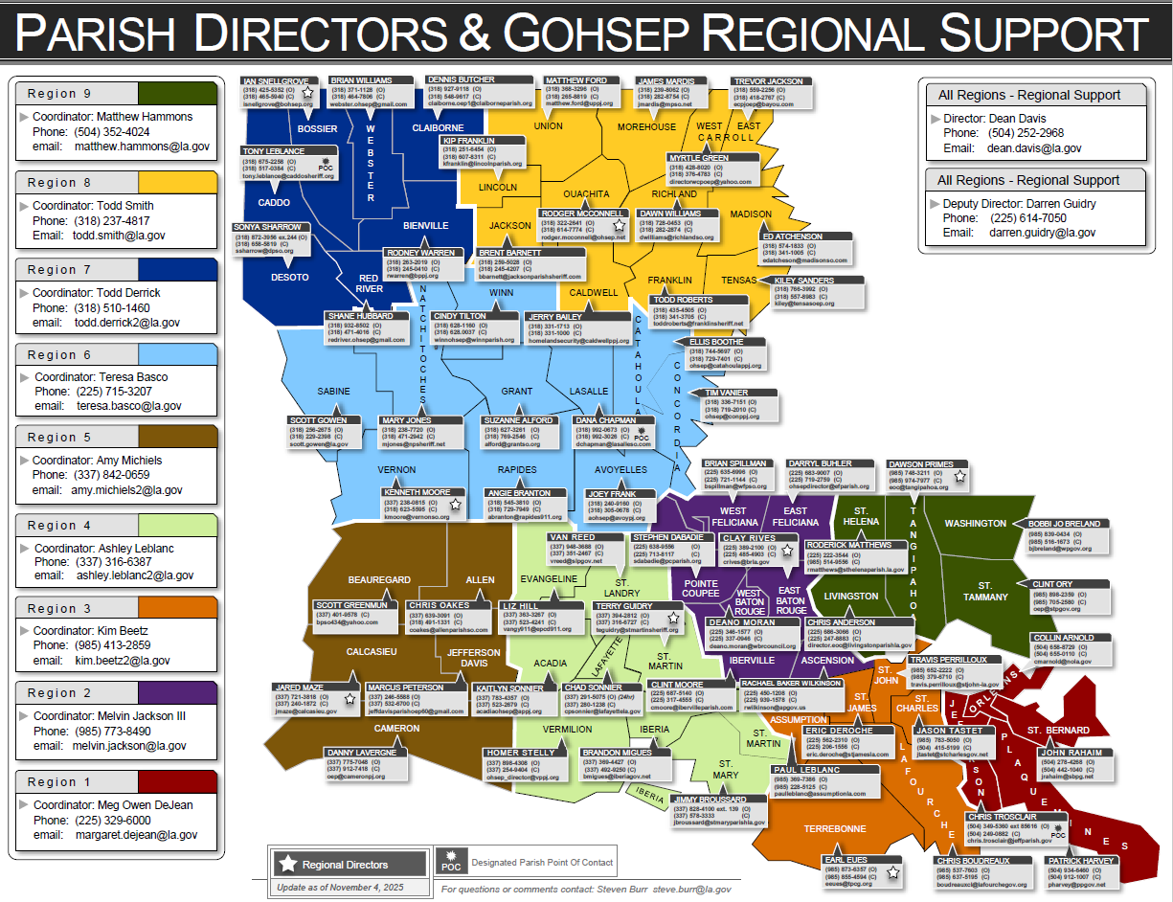
Parish OEP Directors

Slide 4
Resource Request Process
LLevee Board contacts local Parish OEP
Municipal
Assets
State
Agency
Assets
ESF
Contracts
Rentals
etc.
Contracts
Rentals
etc.
Business
EOC
Municipal
Incident
Command
Parish
EOC
State
Operations
GOHSEP
Federal
Assistance
Parish
Assets
Intrastate
Mutual
Aid
EMAC
State
To State
Assets
LEGEND
Contracts
Rentals
etc.
Status Feedback
Request Support
Notes:
ESF Executive Overview

Slide 5

Resource Request (Mission) Flow
PARISH EOC
1. A need/gap is identified
2. Local resources unavailable
3. Enters Resource Request in WebEOC
GOHSEP LOGGER
Reviews requests for completeness
If complete Tasker
Parish If more info needed
GOHSEP TASKER
Reviews resource requests
Operations/Taskers vet requests
Gets approval from Ops Chief for critical request
Assigns to appropriate branch
BRANCH MANAGER
1. Ensure ESF Leads updating WebEOC
2. Update comments in WebEOC
3. Close Mission in WebEOC OR
ESF LEAD
1. Identify best way to complete task
2. Complete task in WebEOC
3. Update comments in WebEOC
BRANCH MANAGER
1. Validate Request
2. Identify the ESF Lead agency
3. Task the ESF Lead
BRANCH MANAGER
1. If ESF cannot fill
OPERATIONS SECTION
1. Identify best way to fulfill request
2. Initiates RRF with FEMA OR
3. Seeks EMAC to fill resource shortfall
EMAC BRANCH/FEMA
1. Works to address resource gap
2. Fulfills task/mission in WebEOC
3. Updates notes in WebEOC
PARISH EOC
1. Resource gap has been filled/need has been met
2. Mission Closed

Slide 6
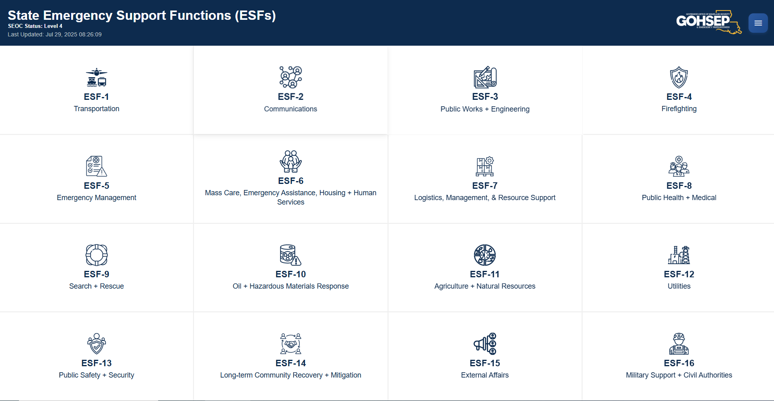
Common Operating Picture
Notes:
Cop can be accessed @ https://gohsepcop.lsu.edu/.
Some layers require login through ArcGIS online.

Slide 7
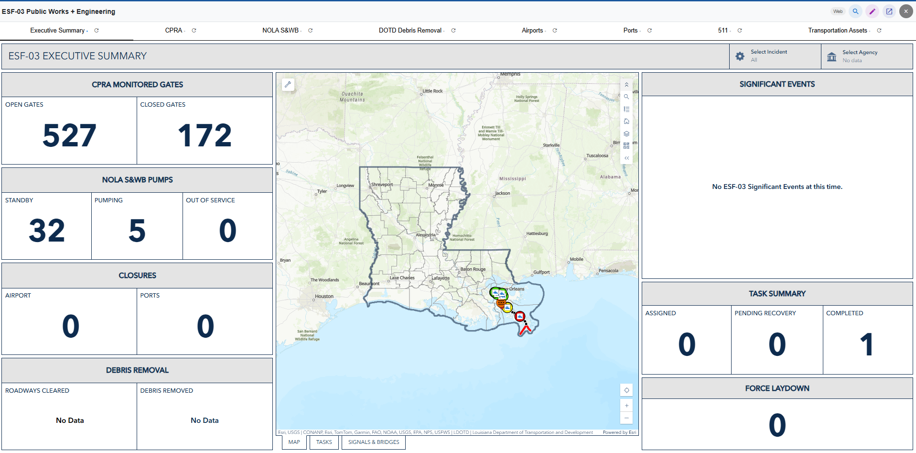
Emergency Support Function 3
4
12
7
5
1
14
9
Notes:
Executive Summary

Slide 8
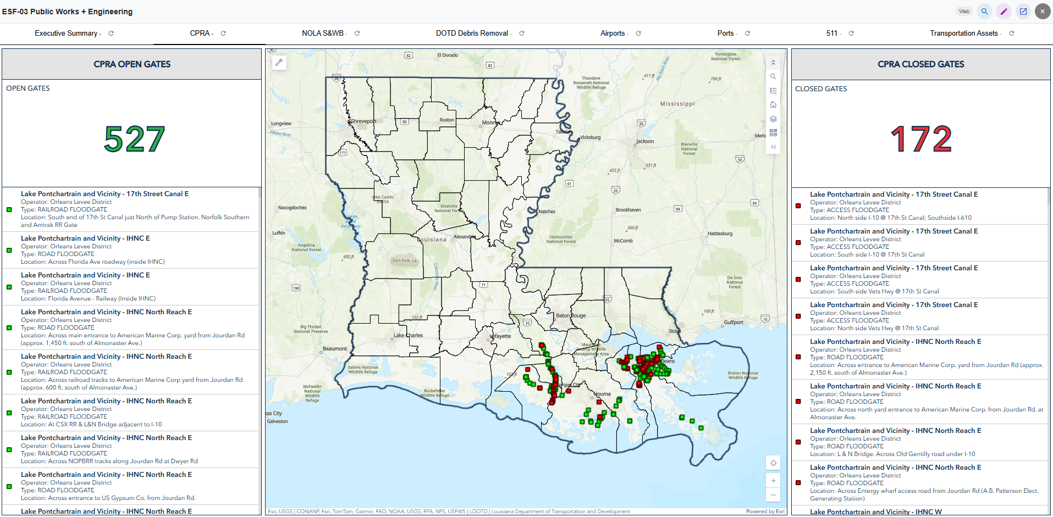
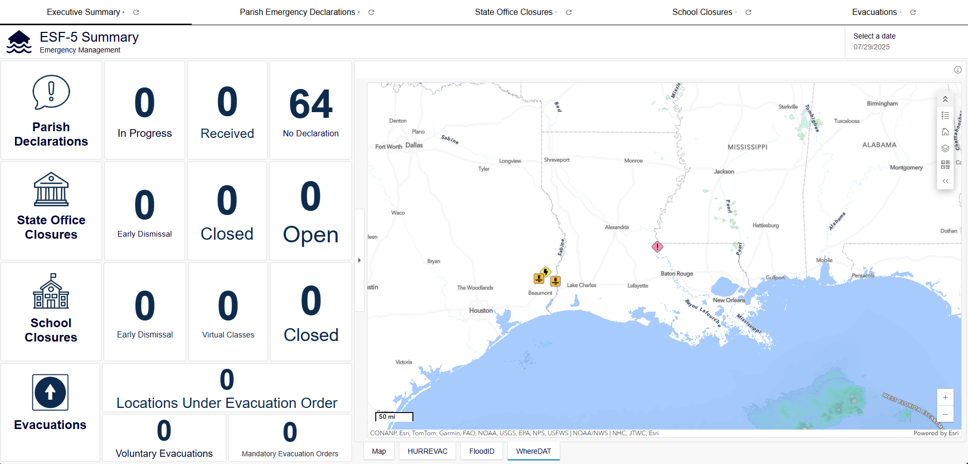
Emergency Support Function 3
4
16
44
20
44
2
18
4
Notes:
ESF Executive Overview

Slide 9
CONTACT INFORMATION
BG Jason Mahfouz
Director
jason.mahfouz@la.gov

