Slide 1

Association of Levee Boards of Louisiana
Glenn Ledet
Secretary
May 7, 2026

Slide 2
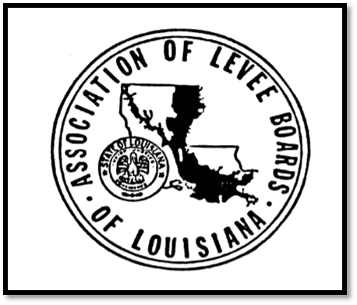
Today’s Discussion
DOTD Transformation & Water Resources Program
Levee Safety Program & Statewide Watershed Modeling
Flood Control in Louisiana
CURRENT
Notes:
Hydraulics Section
Louisiana Watershed Initiative
Statewide Flood Control Program
Roadway Flooding Program
Floodplain Management Section
Levee & Dam Safety Section
NEXT SLIDE – Hydraulics

Slide 3
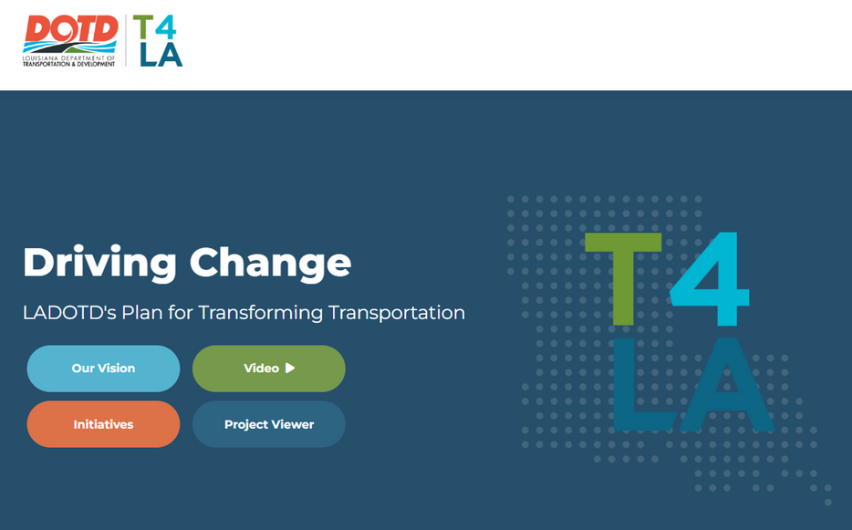
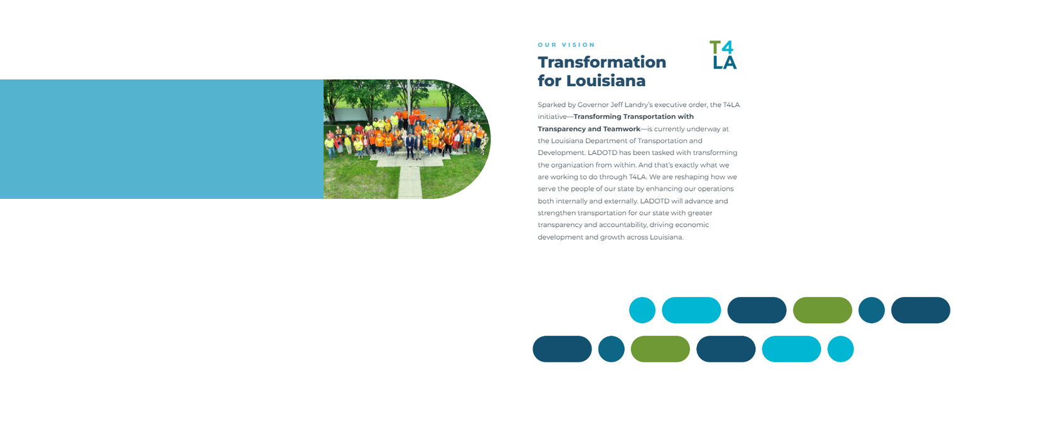
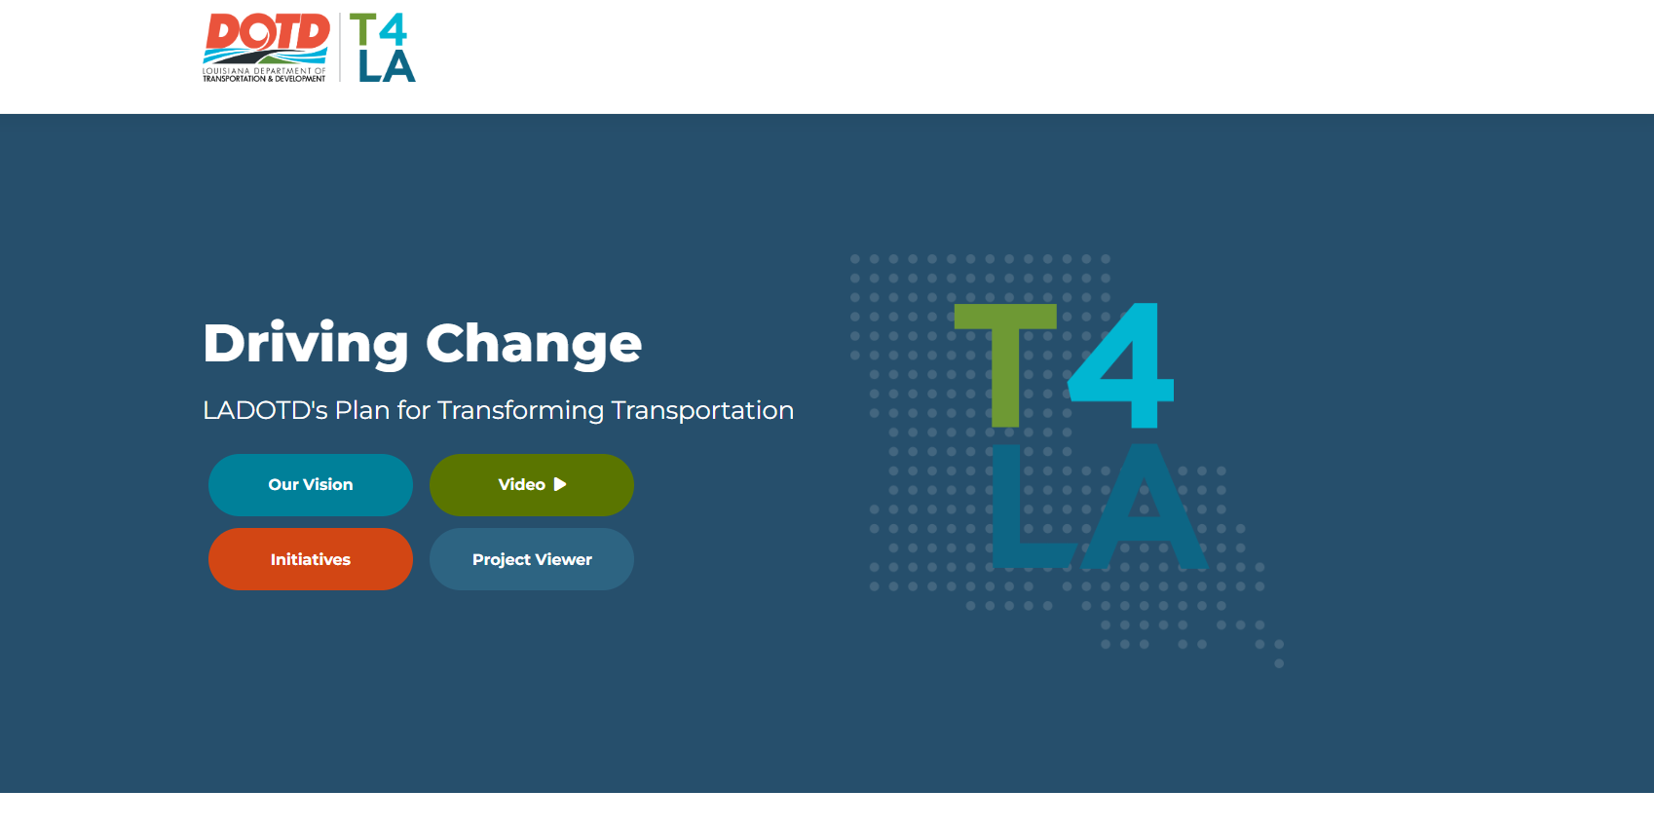
T4LA Initiative Focus Areas
  Program & Project Delivery
    Streamline processes for planning and project delivery
    Development of Office of Project Delivery
  Technology & Innovative Tools
    Advanced tools, AI, Automation
    Development of Office of Transformation
  Economic Development
    Build DOTD for the economic growth of the State
    Support LED for Economic Development Across the State
  Communication & Customer Service
    Proactive clear communications with clear expectations
    Permit Reform
  Common Sense Organizational Structure
    Reorganization, improve efficiency, effectiveness, sustainable funding, & workforce development

Slide 4
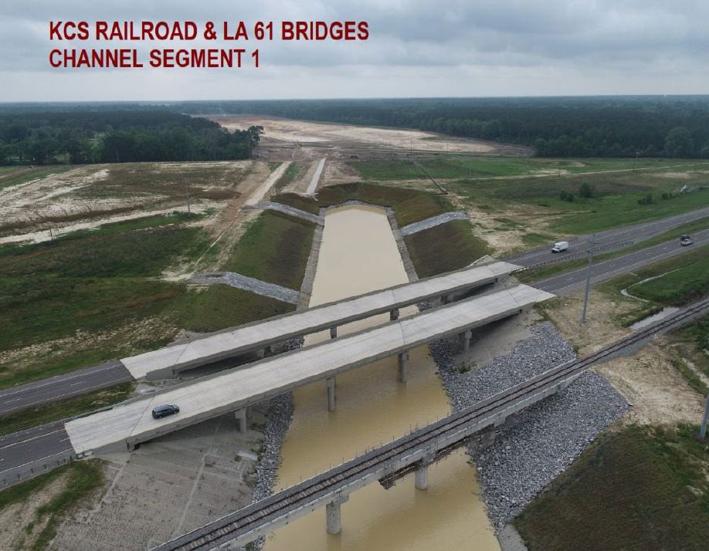
DOTD Water Resources
  Levee Safety
  Dam Safety
  National Flood Insurance Program
  CURRENT
  Hydraulics
  Programs and Projects
    Dams
    Levees Statewide Flood Control
    Water Resources

Slide 5
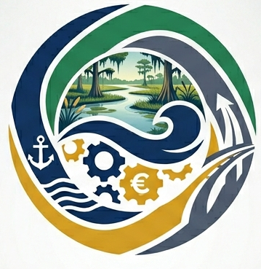
CURRENT Authority
Act 418 (2025)
Act 418 (2025) created the Coordinated Use of Resources for Recreation, Economy, Navigation, and Transportation (CURRENT) Authority
Purpose & Intent
“Development and implementation of an integrated plan for the upland area (non-coastal) area”
Status
Full Board appointed
Senate Bill 171 was introduced in 2026 to provide clarification for administration and scope. Also adds a CPRA seat to the board.
Bylaws drafted
Notes:
The CURRENT Authority was created during the 2025 legislative session. Act 418 established the Authority as the single coordinating entity responsible for prioritization, planning, and funding of integrated projects in non-coastal Louisiana.
While we are working to develop the initial bylaws and framework for the board, Senate Bill 171 was passed out of the Senate and received by the House this week. This bill offers clarifying language to both the Authority’s focus and the membership of the board.
Next Slide: CURRENT Activities

Slide 6
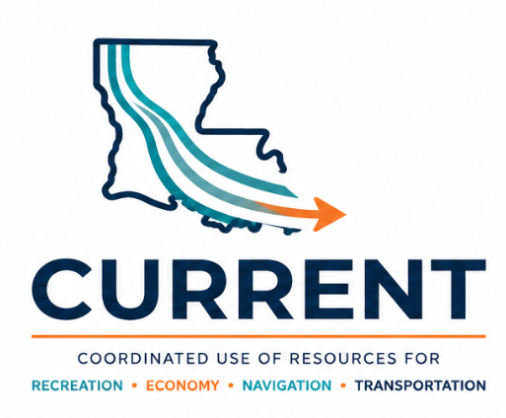
CURRENT Authority
First Meeting
Today, May 7th 2:00 P.M.
Planning
Fiscal Plan and Master Plan Framework draft delivery
Public and Stakeholder Engagement
Branding and websites
Governor’s Press Room – Louisiana State Capitol
Program Administrative Support Contract – Summer 2026
Meeting schedule and location
Master Plan Development IDIQ advertised by June 2026
Stakeholder Lists
Notes:
The main focus of the authority is to develop a master plan and an annual plan for protecting, conserving, enhancing, and developing the area outside the coastal area through the construction and management of integrated projects and programs, including privately funded projects or plans, and addressing those activities that significantly affect such projects, all consistent with the legislative intent (LA R.S. 38 2354 and other related).
We clearly have some work to do on branding. At this point, our staff have tested a couple of simple logo concepts, but engineers are not he most artistically inclined bunch, so we will be working on refining the branding as we move forward
Next Slide: Flood Control in Louisiana Digitization

Slide 7
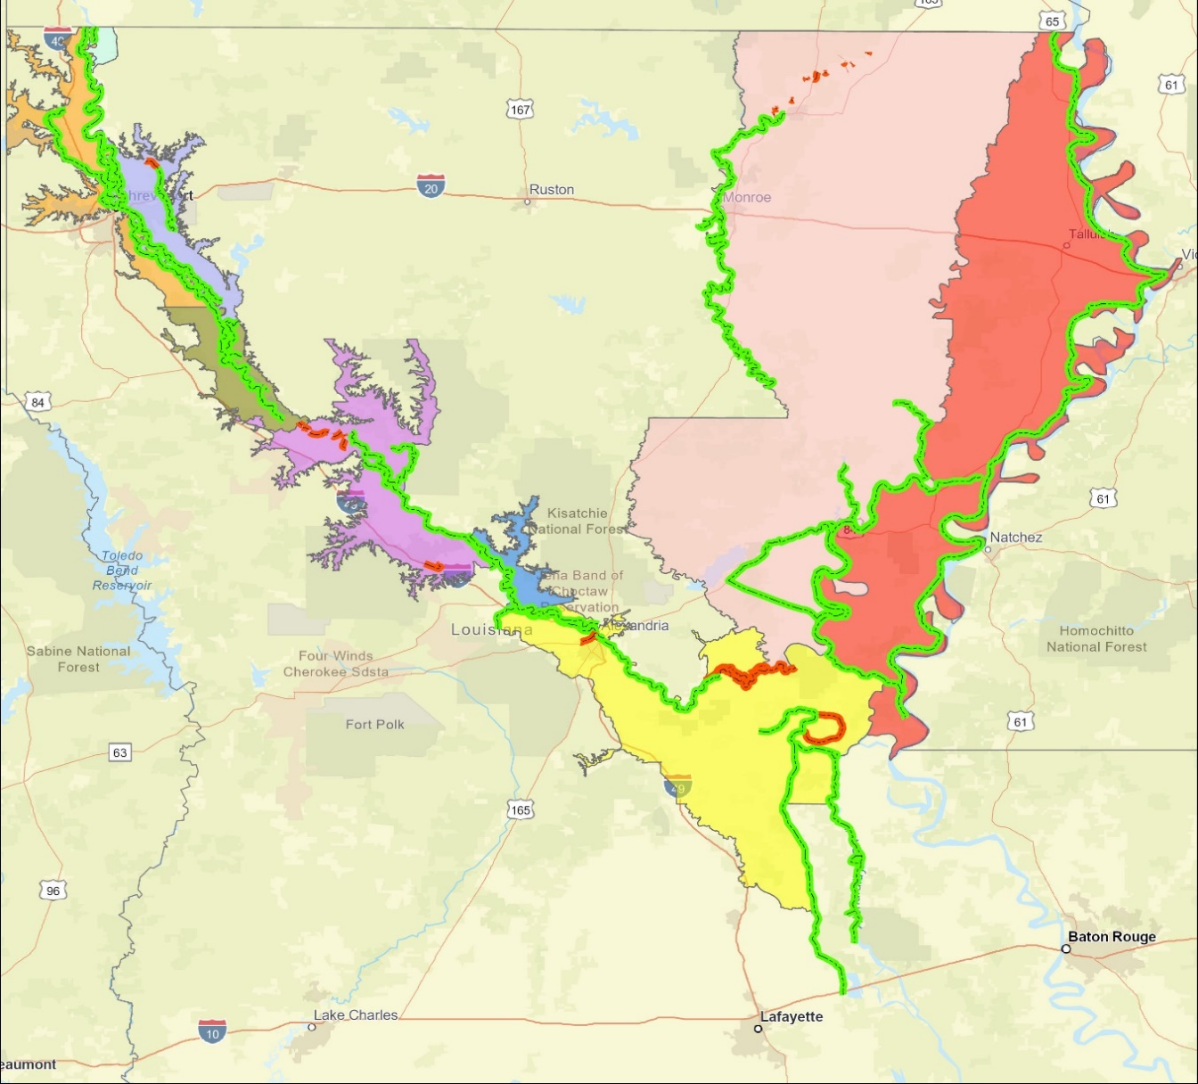
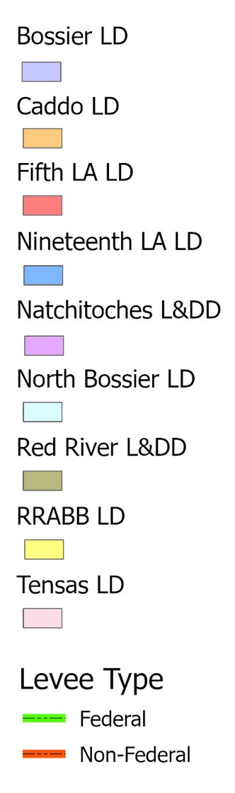
Levee Safety
Non-Coastal Levee Districts (9)
Federal 65.1
Non- Federal 4.3
Federal 116.7
Federal 306.3
Federal 26.2
Federal 69.3
Non- Federal 17.5
Federal 3.4
Federal 51.7
Federal 196.7
Non- Federal 55.2
Federal 249.9
Non- Federal 4.7
Notes:
DOTD is tasked with assisting the nine Non-Coastal levee districts in Louisiana. This includes providing assistance to systems consisting of 1,085 miles of Federal Levees and 81.7 miles of non-federal levees
Next Slide – Existing Services of Levee Safety Program

Slide 8
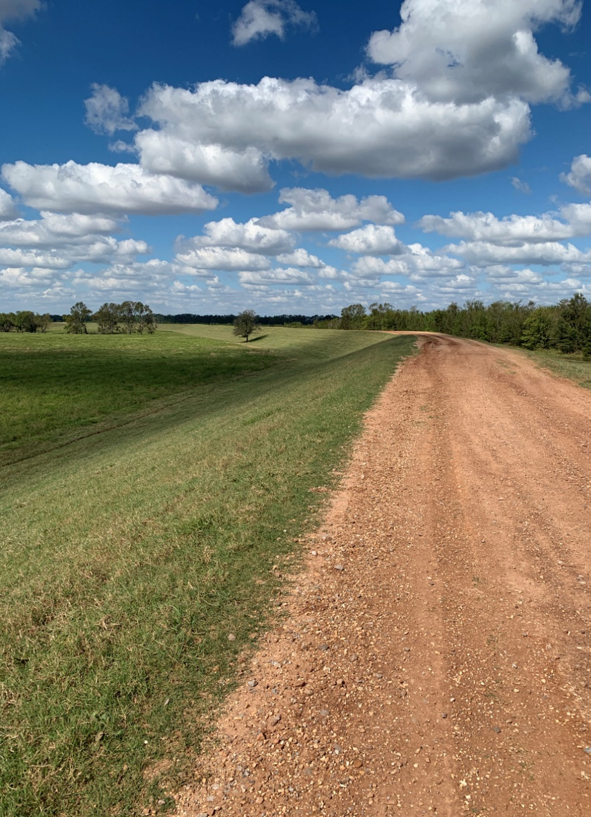
Levee Safety
Inspections
Assist Levee Districts with their Inspections
Provide Semi-Annual Inspection Reports
Provide Recommendations/Options for Corrective Actions
Flood Inspections / Monitoring
Inventory/Mapping
Inventory Levee Assets
Develop GIS Maps
Training Compliance
Online training for levee inspectors
Centerline Surveys
Notes:
DOTD Public Works and Water Resources Division provides inspection services, including inspection reports, to participating levee districts.
The program also develops asset inventories on behalf of the levee districts, GIS mapping systems and layers, and centerline survey support
Next Slide: Levee Safety Program Additional Services

Slide 9
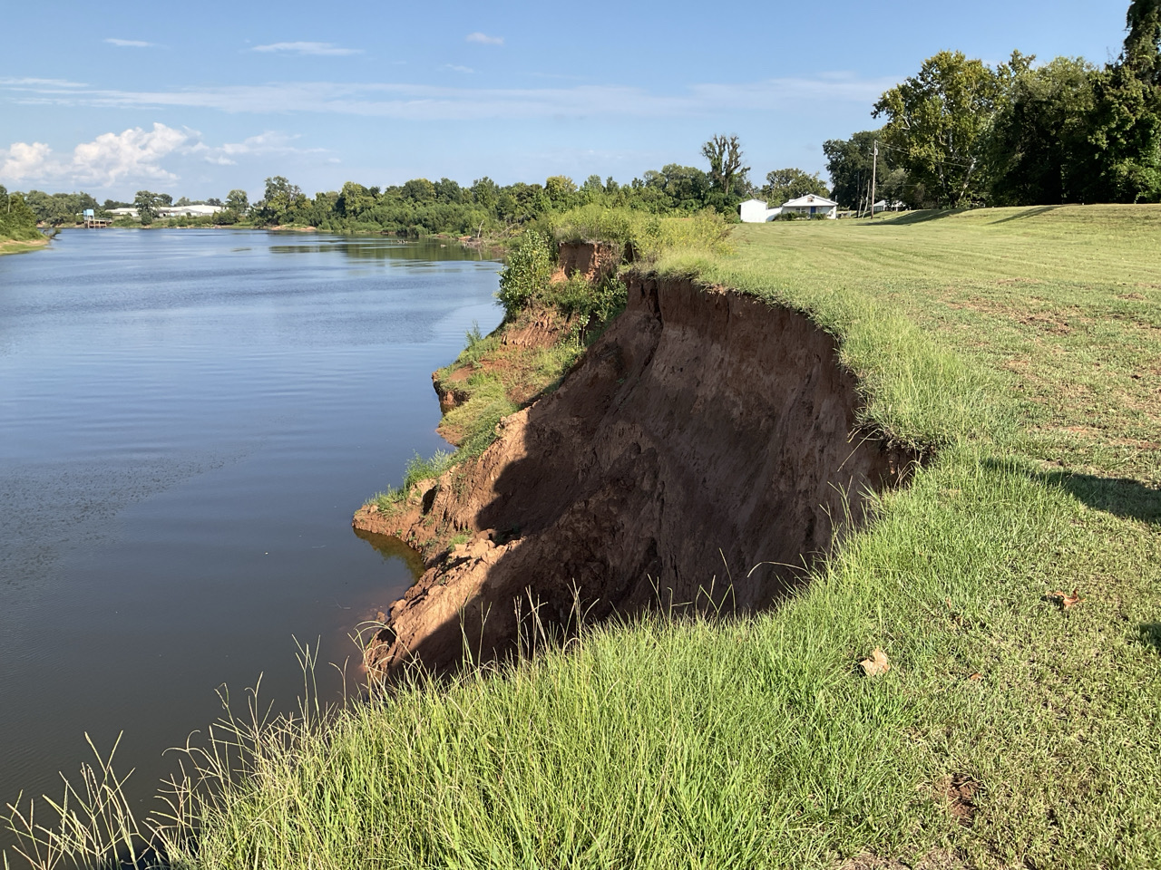
Levee Safety
Regulatory Support
Coordination for certifications
Stakeholder meetings with USACE
Strategic Planning
Review of USACE and FEMA guidance documents to identify upcoming requirements
Interface with resources to determine if legislative activity should be considered
Capital Outlay
Assist levee districts with funding requests
Project management and Technical Support
Notes:
Regulatory support is provided through the Levee Permit Database, including permit review assistance. The Department also coordinates with FEMA and USACE to identify resources and determine if any legislative or administrative actions need to be taken.
Regarding Capital Outlay funding, the legislature is currently moving forward with a new plan for managing the funds that would place all Public Works-supported projects under a single budget line. This is intended to provide more flexibility in funding projects. Previously, capital outlay was siloed between projects, where each pot was too small to construct the respective project. This new plan will consolidate funds so that projects can be let sooner.
NEXT SLIDE – USACE National Levee Safety Program

Slide 10
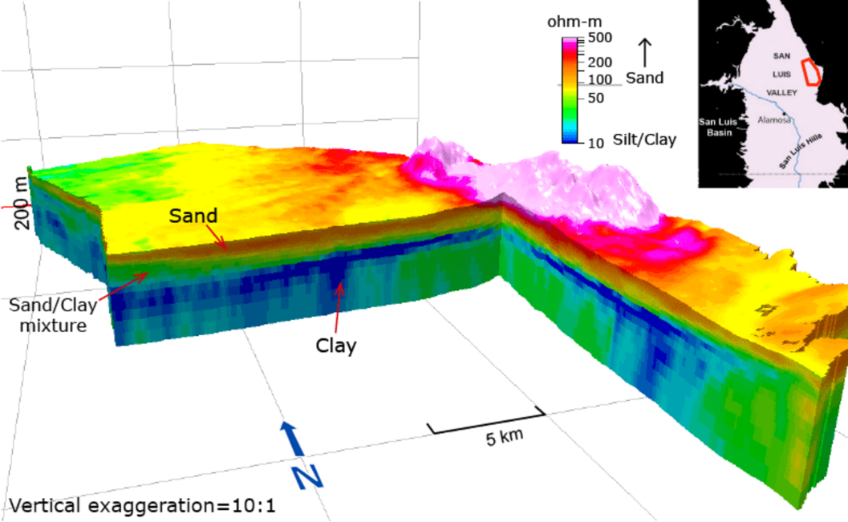
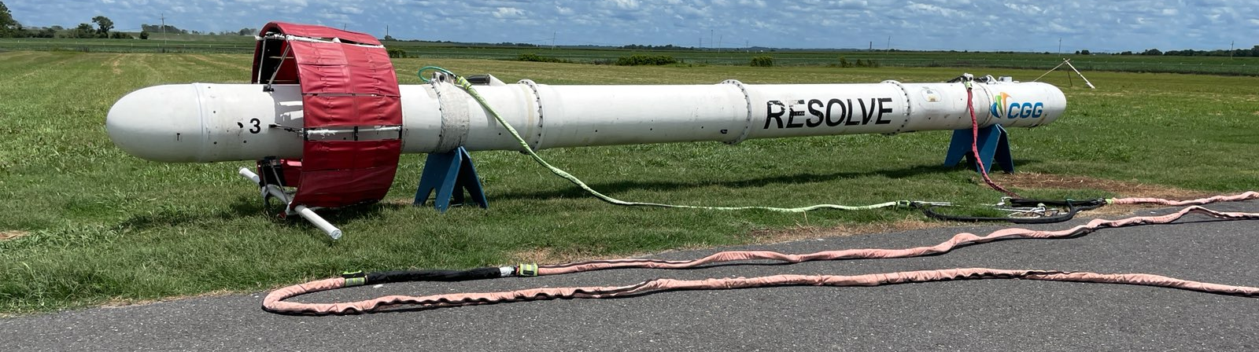
Levee Safety Program
Into the Future
Evaluation of Electromagnetic Geophysics
  Entire State Collected
  Data processing ongoing at USGS
  Screening Potential Seepage Locations
Photo by Eugene Wall (USACE)
Notes:
We are taking advantage of the USGS collections to attempt to parse out levee foundation information. This could potentially provide data to understand potential seepage and breach locations for further analysis.
Next Slide: DSS-Wise Simulations

Slide 11
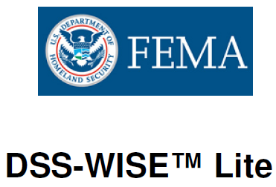
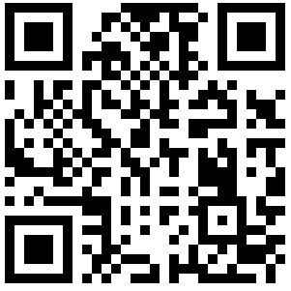
Levee Safety Program
Into the Future
Notes:
DOTD staff is working to beta test the latest version of DSS-WISE, which allows cloud-based simulations of levee breach scenarios. This tool, developed by the National Center for Computational Hydroscience and Engineering at the University of Mississippi, will allow engineers and levee officials to analyze potential breach scenarios to better understand levee risk profiles.
Our staff will run breach scenarios on the potential breach locations identified through the USGS Electromagnetic data
Next Slide: Request Form Status

Slide 12
Levee Safety Program
Request Form
Select Requesting Entity (Dropdown)
Select Request Type (Dropdown)
Emergency
Routine
Select Services Needed (Dropdown)
Inspection
Survey Services
Plan Review
What else?
Upload Supporting Files
DOTD Receives Request
Review and Submit
Notes:
Our staff is still working on a digital form to accept and track requests for assistance from the Levee Districts. The initial form has been created, but staff are working through some software security issues prior to publications. We were forced to swap software providers recently, which caused delays, but we expect the form to be published by July 1st.
Next Slide: Louisiana Watershed Initiative Statewide H&H Models

Slide 13
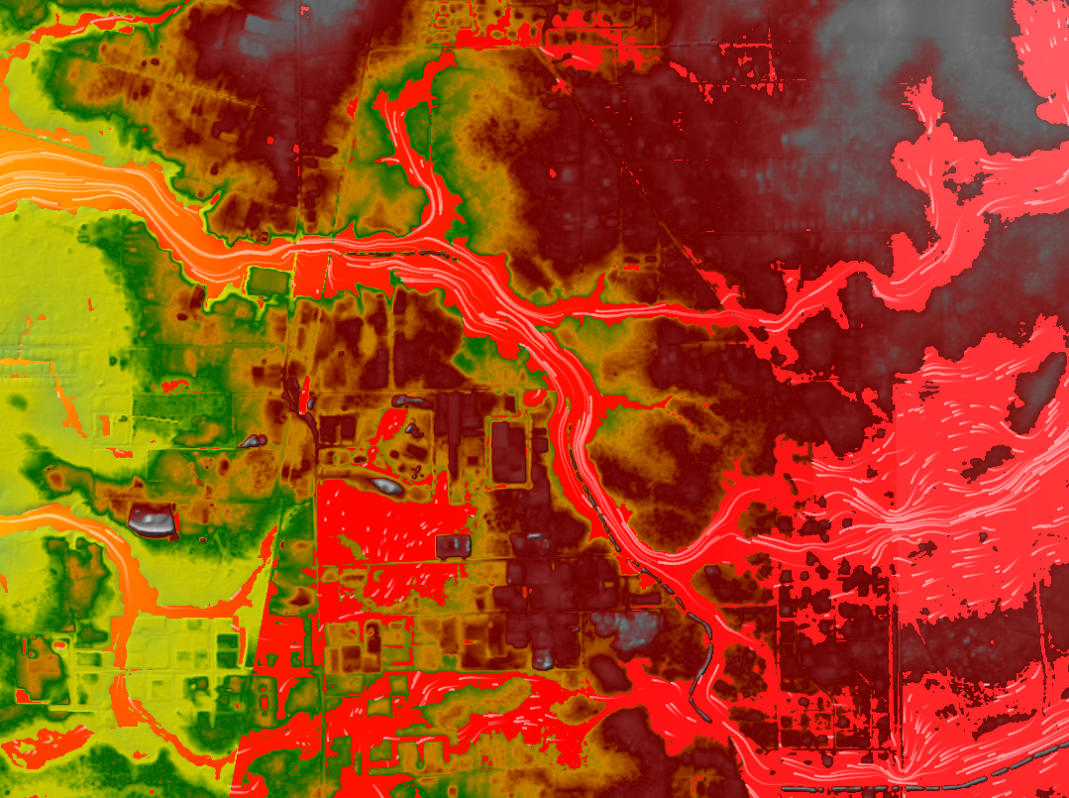
Louisiana Watershed Initiative
Statewide Watershed Modeling
Over $84M Investment
HUC8 Models (48 total)
Coupled 1D/2D or Full 2D
  Tiered approach
35+ Probabilistic Design Storms
Consequence Modeling
Proof of Concept Project Analyses
Notes:
DOTD’s seven (7) modeling consultants have delivered been Calibrated and Validated models with Probabilistic design storms and consequence modeling for 48 HUC8 watersheds across the state. These are among the most advanced model sets in the entire world and provide the state with a strong backbone to all of our future flood risk reduction efforts.
NEXT SLIDE – Future Model Use Cases

Slide 14
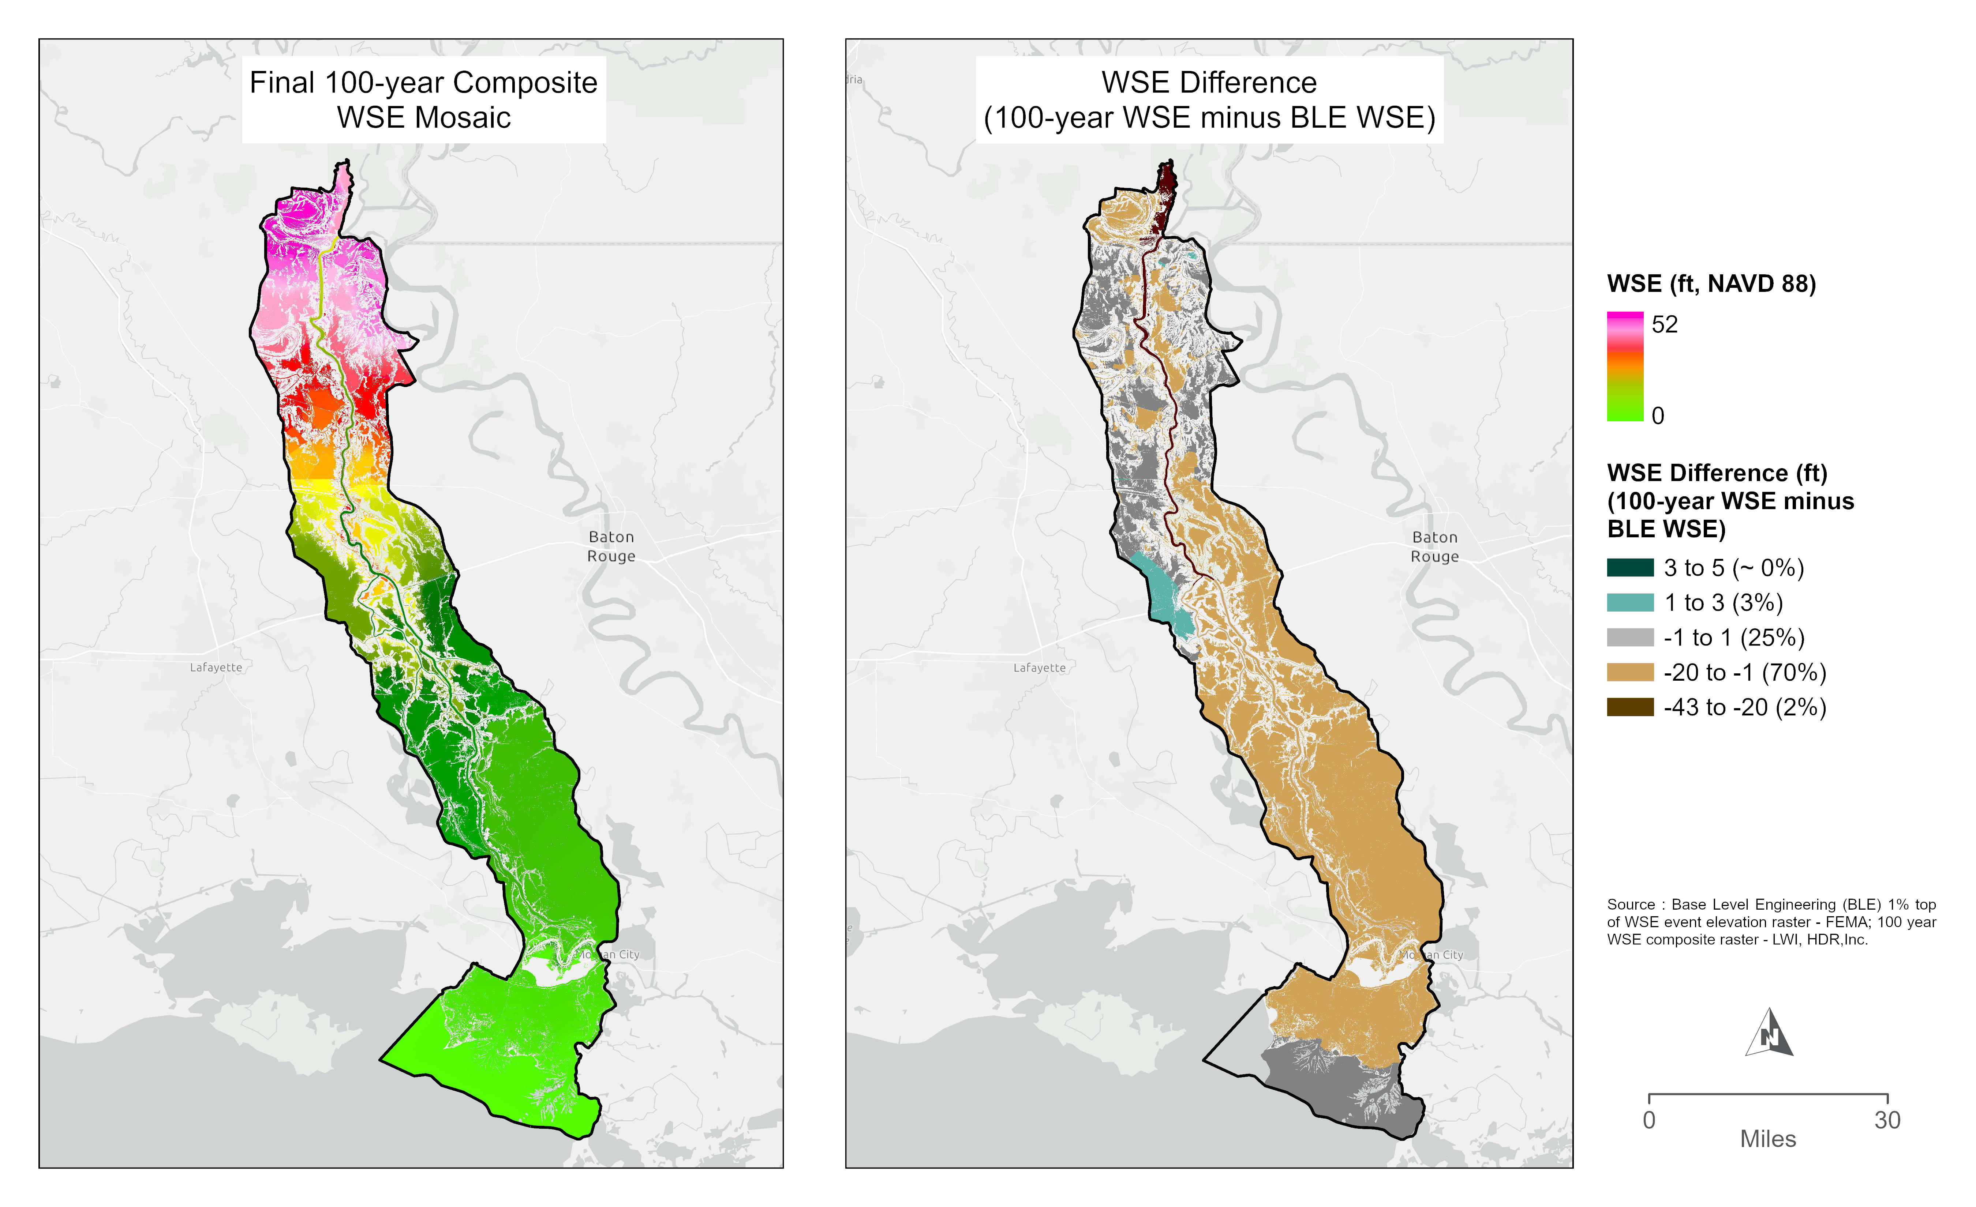
LWI H&H Models
Future Use Cases
Base Level Engineering (BLE) Comparison
Floodplain Mapping
Breakout Models
  Project Evaluation
Notes:
DOTD staff and consulting teams have workshopped several potential uses of these models.
BLE - High-resolution ground elevation data and semi-automated hydrologic/hydraulic modeling to produce watershed-wide flood hazard information, including estimated Base Flood Elevations (BFEs),
Several efforts were made to compare our modeled outputs to existing datasets, specifically the FEMA Base Level Engineering rasters. This could help prioritize statewide efforts toward developing new floodplain maps.
DOTD engineers have been training to develop breakout models from existing LWI models, using the operation of state-maintained dams to develop further skills.
NEXT SLIDE – CURRENT Authority

Slide 15
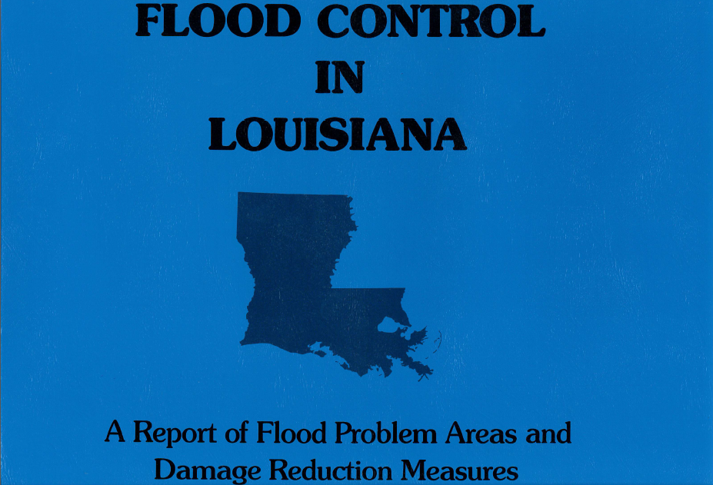
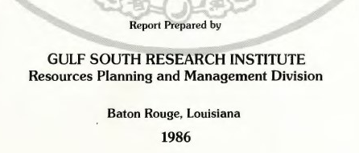
Notes:
In preparation of the work expected to come from the CURRENT Board, DOTD staff has begun the process of digitizing old sources of flood information into a single location. Flood Control in Louisiana was a comprehensive document developed in 1985 and published in 1986. This document forms the basis of the initial mapping platform that is being developed.

Slide 16
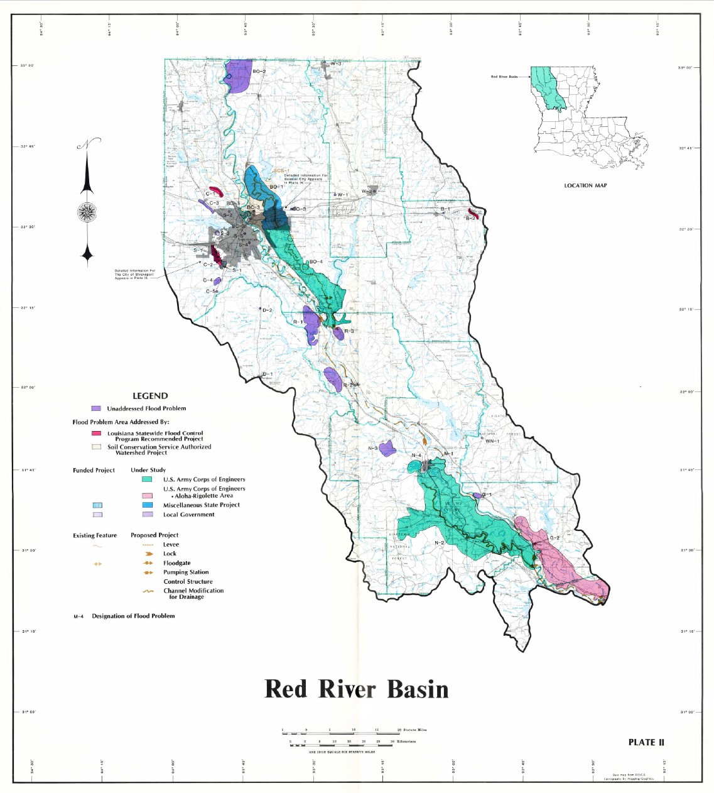
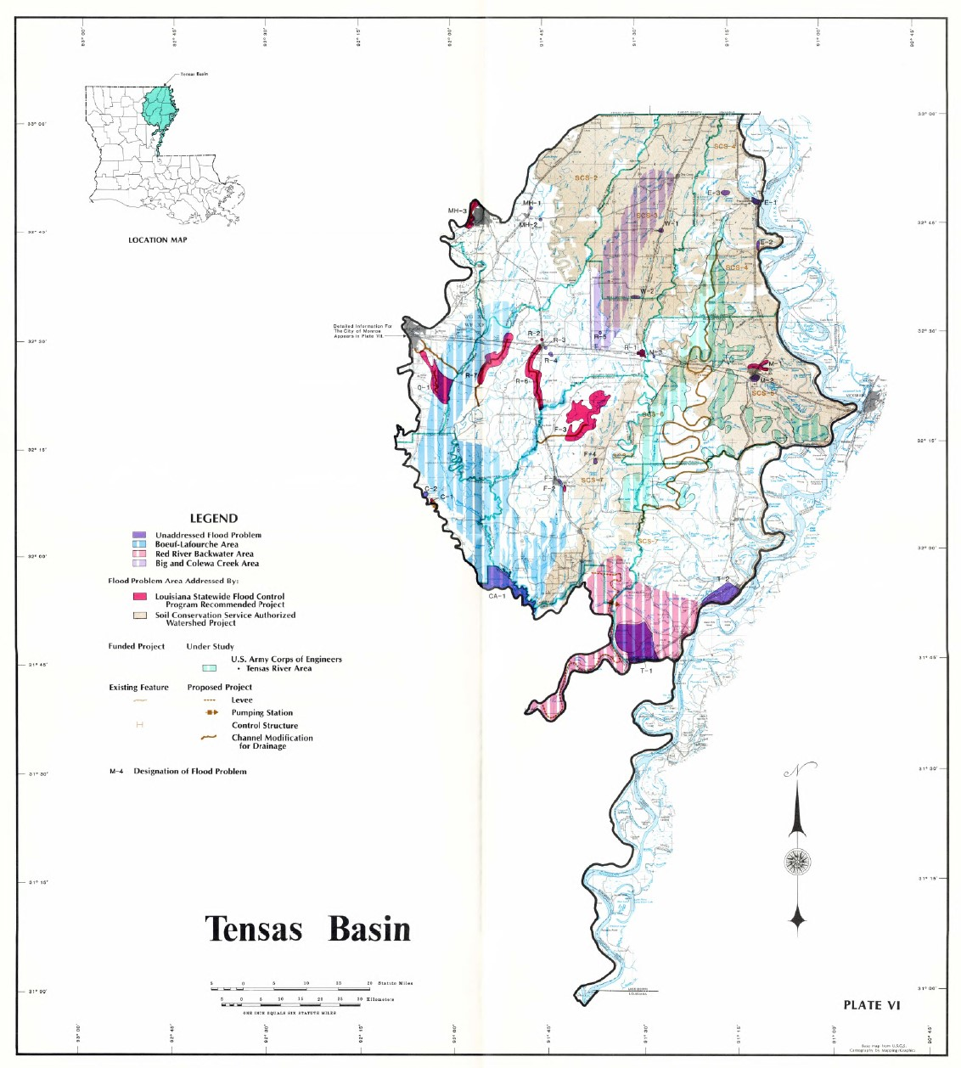
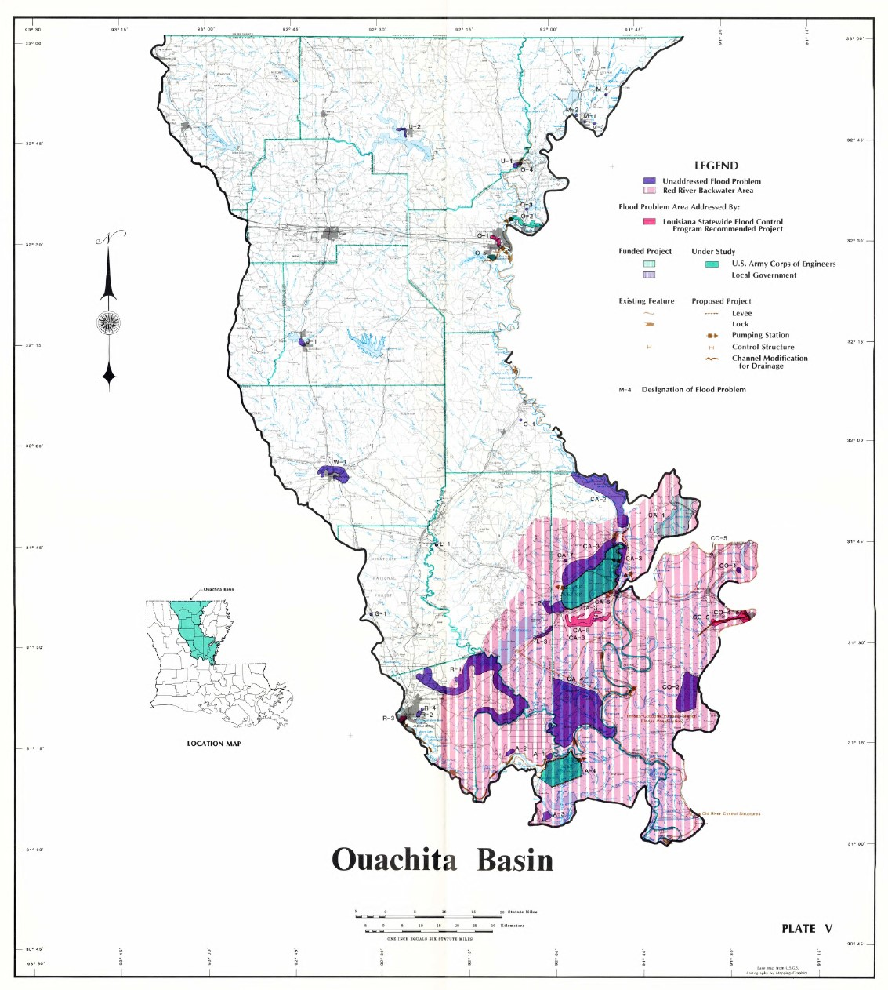
Flood Control in Louisiana
Digitization Process
Notes:
Flood Control in Louisiana was a very well-developed document, but it was developed 40 years ago.
DOTD scanned the individual drainage basin maps from the physical documents. However, these are simple PDF files with way to interact with the data.
The maps were then brought into a GIS environment where they were rectified over a basemap of the state, which allows for simplified statewide analysis.
Next Page: Data processing

Slide 17
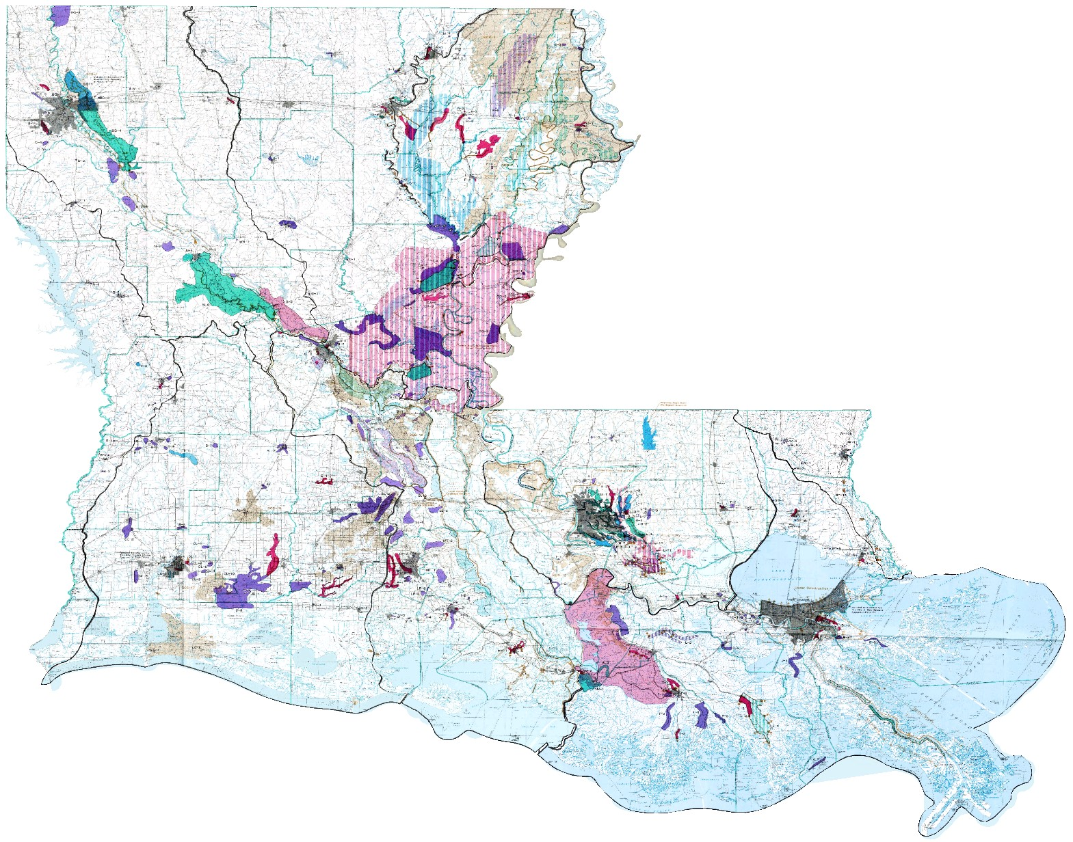
Flood Control in Louisiana
Digitization Process
Notes:
The individual map plates were rectified over by correlating specific points in the images to that location on the base map. The individual basin and city maps could then be turned on and off individually in the mapping product.
Our staff was then able to extract the specific problem areas for inclusion into a statewide flood hazard layer.
Next Slide: Statewide Flood Hazard Layer

Slide 18
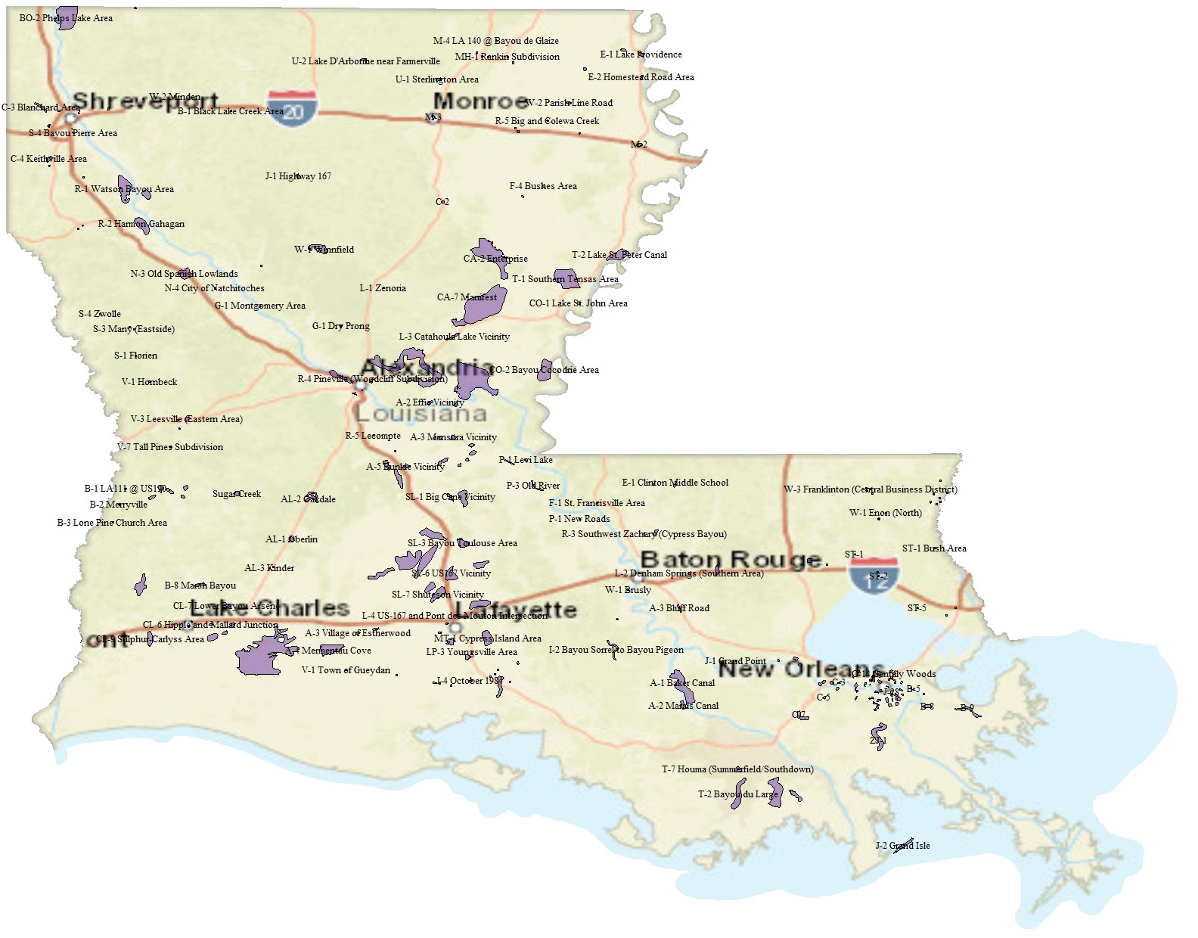
Flood Control in Louisiana
Statewide Flood Hazard Layer
Notes:
The displayed is just the initial draft dataset. We will work with our statewide mapping specialists to optimize the
This effort will continue with mapping problem areas identified through the Statewide Flood Control Program and LWI application processes.
This layer will then be compared to the probabilistic design storms produces by the LWI modeling consultants to identify primary flooding sources and potential improvements to the problem areas.
We see this layer as a basis for the long-term management of these watersheds. However, this dataset will require continuous improvement as projects are completed and the built environment evolves.

Slide 19
Questions?

